Slide 1
MWA ASVO & Data access
Aug 2024 MWA Project meeting, Lausanne
-Mouriyan Rajendran, Curtin University/ICRAR/MWA
Notes:
Today, I will be presenting an overview of the MWA ASVO (All Sky Virtual Observatory) and data access.
In this presentation, I will take you through
Our data portal and the type of data we provide
What is ASVO and VO services and standards supported by MWA ASVO
A tour of MWA data portal and how to Search the data
Submitting / managing / downloading your jobs Using Web portal and Command line clients
Finally, some tips and tricks.
I have prepared this with a focus on new MWA members, so many of you might already be familiar with most of the information I’m going to share. However, I hope you’ll enjoy it, much like watching your Favorite movie again!

Slide 2
MWA Public Data Access
All-Sky Virtual Observatory (ASVO) https://asvo.org.au
5 data portals (including MWA)
https://asvo.mwatelescope.org
Notes:
The All-Sky Virtual Observatory (ASVO) is enabling researchers to access astronomical data from all types of astronomical facilities in Australia
MWA is one of five data portals under ASVO, the other portals are TAO, SkyMapper, data central and CASDA
All these portals follows the VO standards to provide interoperability
One of the VO services provided by MWA ASVO is TAP Service. The table access protocol (TAP) defines a service protocol for accessing astronomical catalogs like metadata of the observations.
You can either use TOPCAT application or pyvo package in your python code.

Slide 3
VO TAP service – TOPCAT
The Murchison Widefield Array
3
Notes:
Open the TOPCAT application, and go to VO -> Table access protocol
To get the URL, open the ASVO portal go to services and get the URL
Paste it here and click use service. This will pull all the metadata tables. We have created a new table under mwa schema called observation. Pass you ADQL query to get the metadata.
Usually, people use obscore table to list their metadata But to provide more radio astronomy related information that are not part of the standards yet. IVOA radio interest group is still working on it.
If you love coding and always use python for your astronomy you can use pyvo package.

Slide 4
VO TAP service – pyvo
Data Access(pyvo.dal) - This subpackage provides access to the various data services in the VO
TAPService – to search by passing a ADQL query.
The Murchison Widefield Array
4
Notes:
Pyvo has a subpackage called dal(data access layer) which provides access to the various data services. TAPService is one of that and you can use TAP services to search the metadata by passing URL of the observatory and the ADQL query.
Now you have the metadata, we don’t provide direct download link like other observatories because of the size of the data we provide.

Slide 5
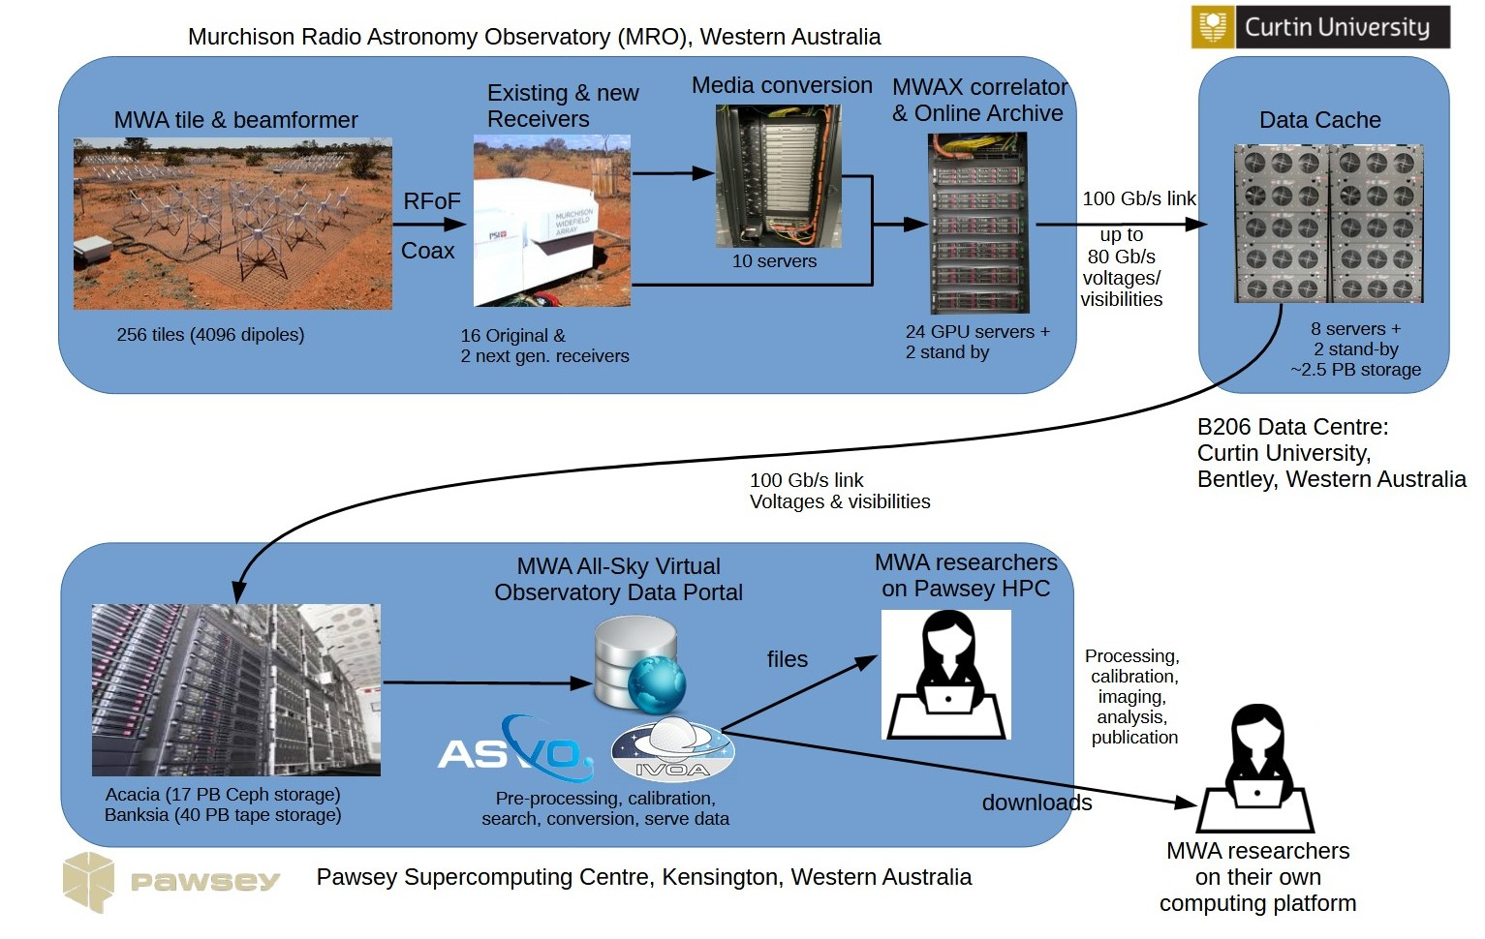
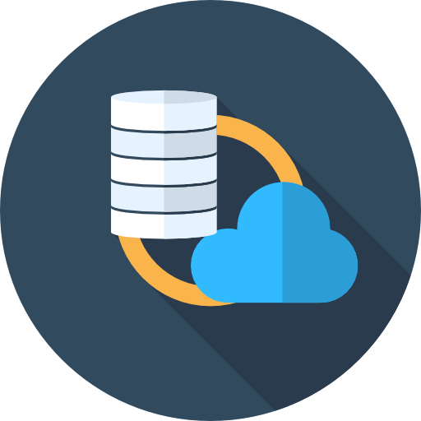
MWA Data Flow
Responsibility of science groups
E.g. GLEAM
Notes:
A quick glimpse of our Data flow. I am not going to get into this in detail.
But you can see , The data captured by telescope on site is sent through a 100Gig link down to Pawsey.
Where it is archived in two different storages; Acacia with 17 PB of Ceph storage and 40 PB of tape storage
Currently we have 53 PB worth of Raw data. For a compression you can store approximately 12M Hollywood movies
Our data portal just sits in between the researches and our archive.
Our data portal not just move data from archive to you , It can tailor the data according to the user's requirement and It can also apply calibration and correction on the fly.

Slide 6
MWA: Types of Raw Data
RAW Voltages
0.781 μs time resolution (~85 TB per hour)
Raw uncorrected, uncalibrated visibilities
Bespoke MWA FITS format
On-the-fly corrected, uncalibrated visibilities
CASA MS or UVFITS
On–the-fly corrected and calibrated visibilities
CASA MS or UVFITS
Expert MWA research groups
Raw data from our receivers
Pre-processed by Birli
Intermediate users do calibration themselves
Expert MWA research groups
For “non-MWA radio astronomers”
Calibration is very basic, but enough for simple/quick look imaging
Requires special permission
Notes:
We provide 4 types of data to researchers. Actually, two and two are generated on-the-fly
Row voltages: this is the raw data captured from the receivers.
Birli does file format conversion and applies data corrections
No images – only raw data – researches

Slide 7
MWA ASVO
Notes:
Let's move on to our data portal. This is the front page of our data portal
Outage notice
About
Data collection
Services provided
Support - documentation

Slide 8
MWA ASVO Workflow
Register
Login
Search
Submit jobs
Monitor
Download / use Pawsey file system
Notes:
Registration
We accept two logins.
We authenticate datacentral account – data central is also one of the ASVO nodes that provides auth service. Or
You can create local MWA ASVO account. Enter your details and submit

Slide 9
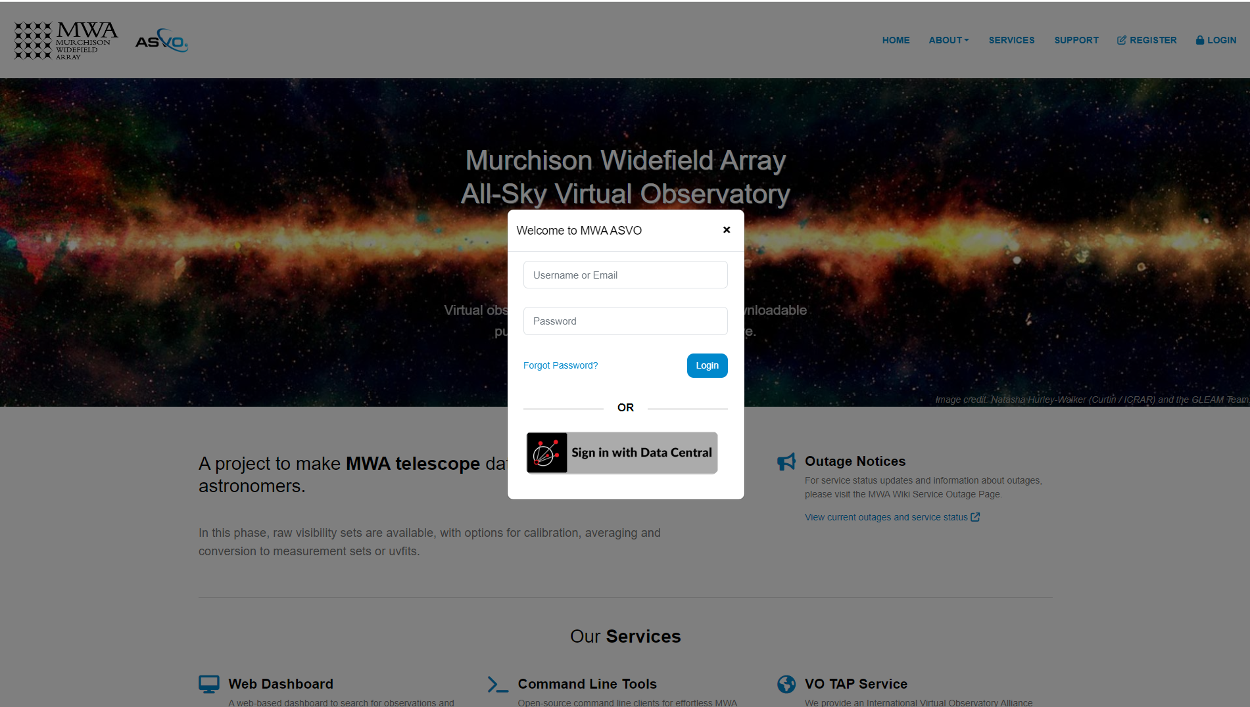
MWA ASVO Workflow
Register
Login
Search
Submit jobs
Monitor
Download / use Pawsey file system
Notes:
Either use your email or username to login

Slide 10
MWA ASVO Workflow
44 Fields can be searched
Register
Login
Search
Submit jobs
Monitor
Download / use Pawsey file system
Notes:
Search for observations
We have 44 fields that you can search with.
Cone search, Date, GPS time, observation mode, data size, or ADQL query itself.
It used the same TAP service inside.

Slide 11
MWA ASVO Workflow
Register
Login
Search
Submit jobs
Monitor
Download / use Pawsey file system
Notes:
Information page, with list of channels, quality of tiles and so many other information.

Slide 12
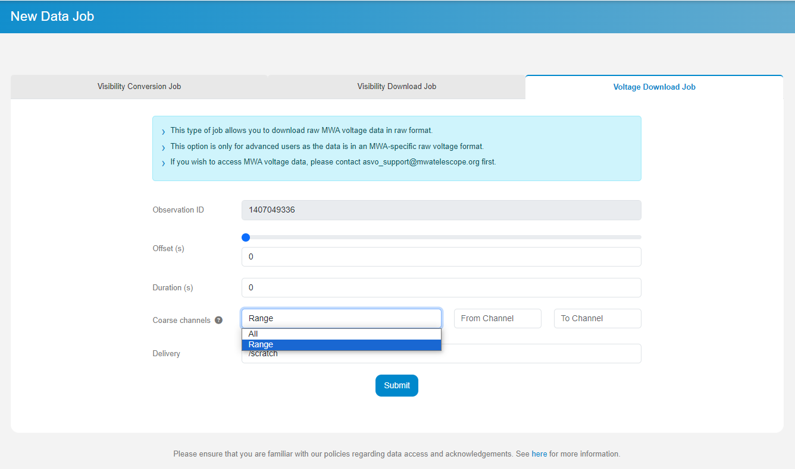
MWA ASVO Workflow
Register
Login
Search
Submit jobs
Monitor
Download / use Pawsey file system
Notes:
Select one observation to get this page
This is Voltage job. Voltage jobs are huge, and we have given more flexibility to selecting a subset of the data
By selecting offset, duration and coarse channels(freq range).
Freq = channel no * 1.28 MHz – 30.72 MHz
SO, if you are interested in only a small bandwidth of 70 – 80 MHz you can select channel 1 to 8.

Slide 13
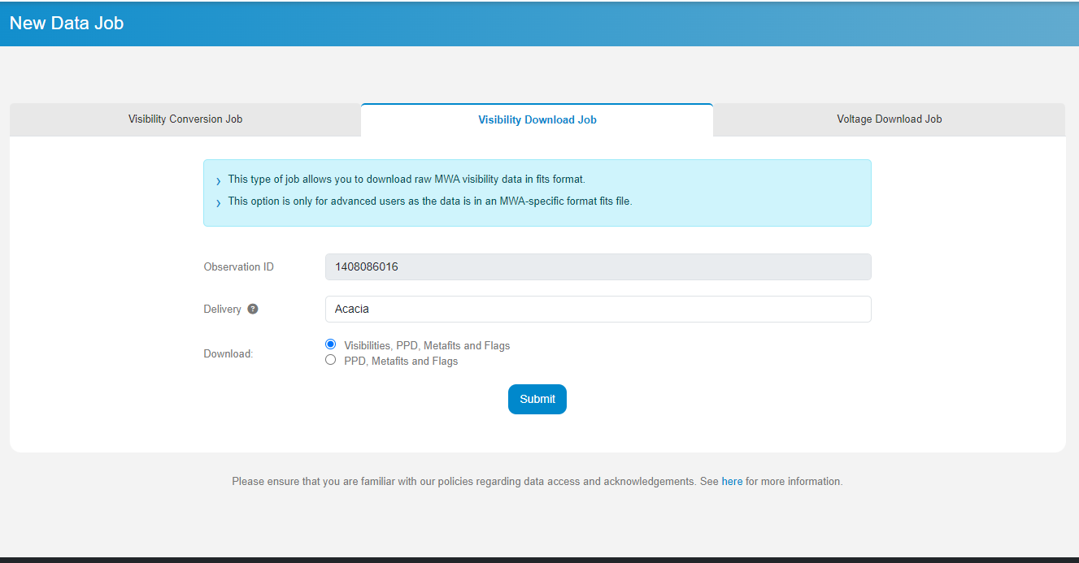
MWA ASVO Workflow
Register
Login
Search
Submit jobs
Monitor
Download / use Pawsey file system
Notes:
Visibility downloads Bespoke MWA FITS format
Can be delivered to either acacia or scratch.

Slide 14
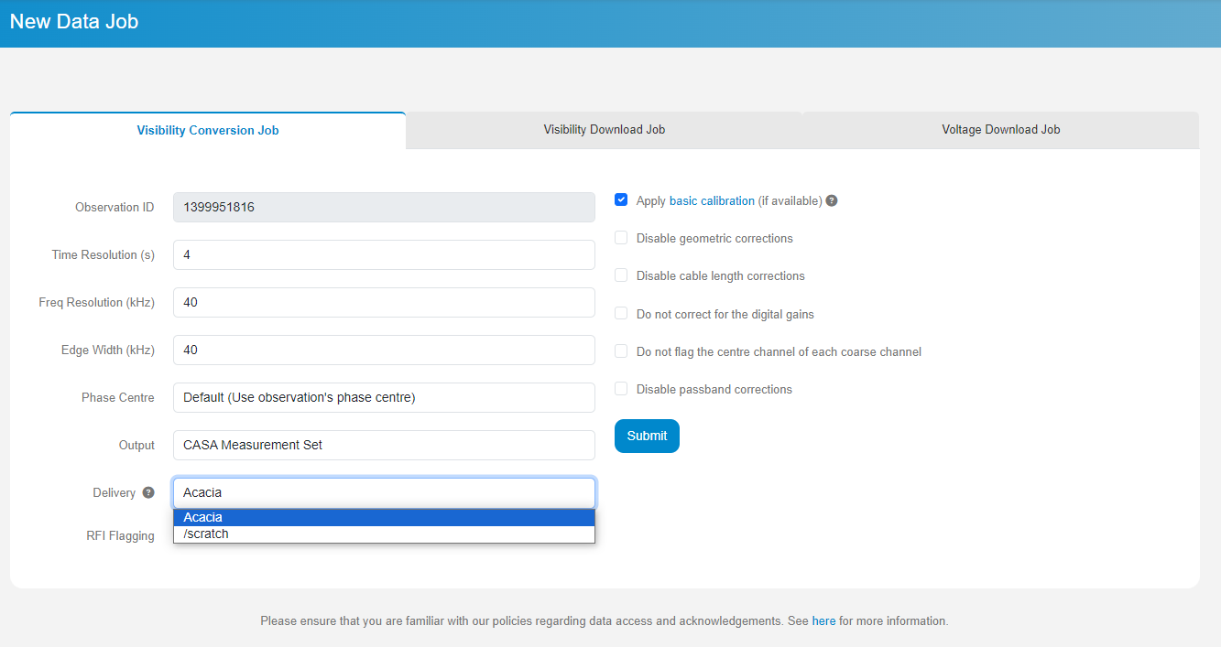
MWA ASVO Workflow
Register
Login
Search
Submit jobs
Monitor
Download / use Pawsey file system
Notes:
This is the Conversion job.
Intermediate users can use this to get corrected and calibrated MS.
Here if you check this apply basic calibration – applies the calibration to the data
Its basic but it still can help in bettering the imaging.

Slide 15
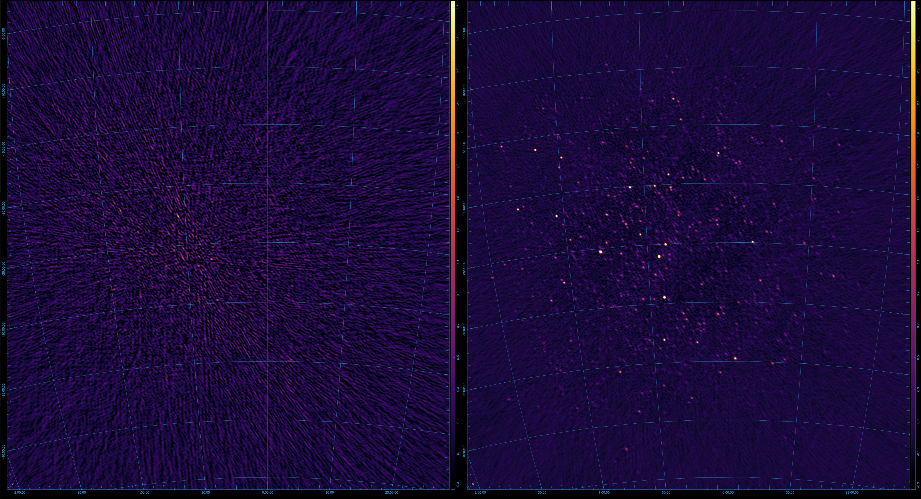
MWA ASVO Workflow

Slide 16
MWA ASVO Workflow
Register
Login
Search
Submit jobs
Monitor
Download / use Pawsey file system
Notes:
There is another way to submit jobs when you want to submit multiple observation in a single go.
Export CSV to use it with with the CLI clients we provide.

Slide 17
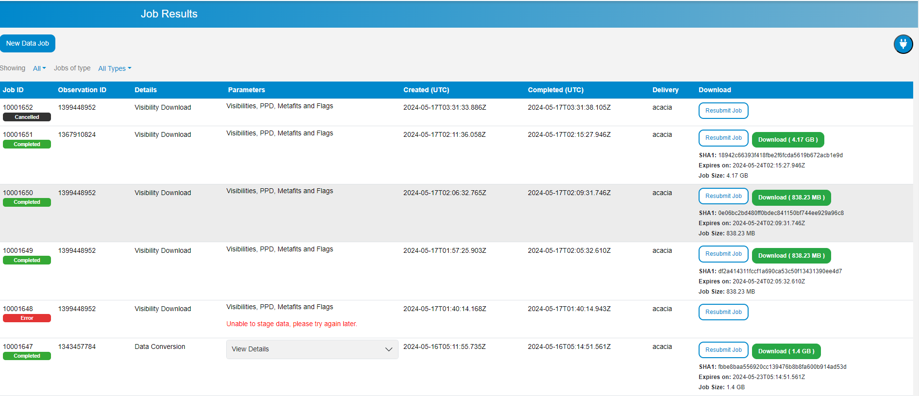
MWA ASVO Workflow
Register
Login
Search
Submit jobs
Monitor
Download / use Pawsey file system
Notes:
Monitor your jobs to find the status
Download / resubmit or retry the jobs from here.

Slide 18
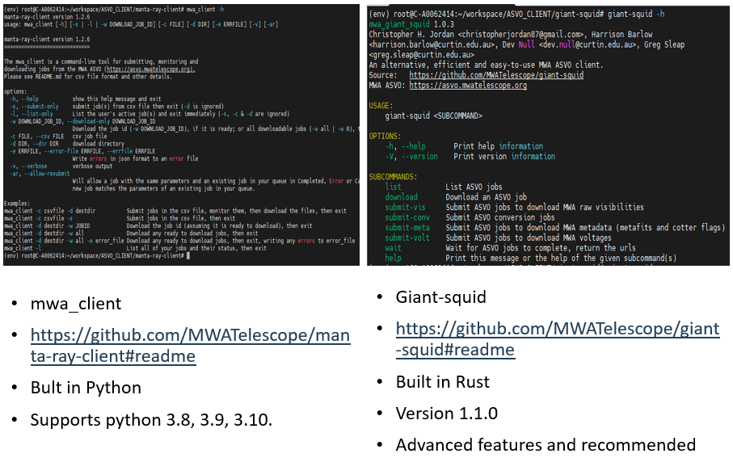
MWA ASVO Workflow – CLI client
Get a CLI client
Get API Key
Search and get csv of obs
Submit jobs
Monitor
Download / use Pawsey file system
Notes:
We provide two CLI clients
Mwa client and giant-squid

Slide 19
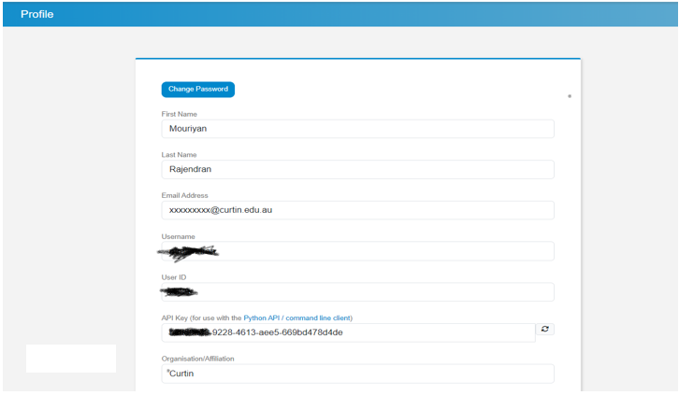
MWA ASVO Workflow – CLI client
Set up your API key in your environment
export MWA_ASVO_API_KEY=your_api_key
Get a CLI client
Get API Key
Search and get csv of obs
Submit jobs
Monitor
Download / use Pawsey file system
Notes:
First thing to use the CLI client is to update your environment with your API key of your ASVO account.

Slide 20
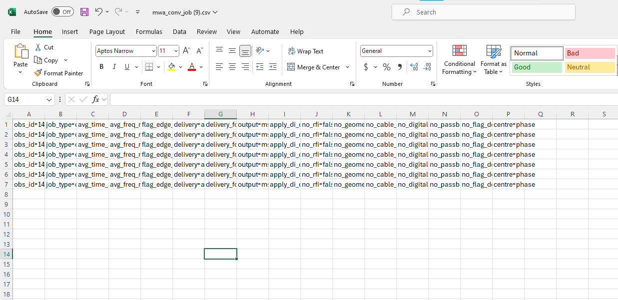
MWA ASVO Workflow – CLI client
Get a CLI client
Get API Key
Get csv of obs
Submit jobs
Monitor
Download / use Pawsey file system
Notes:
And get the csv file of obs ids.

Slide 21
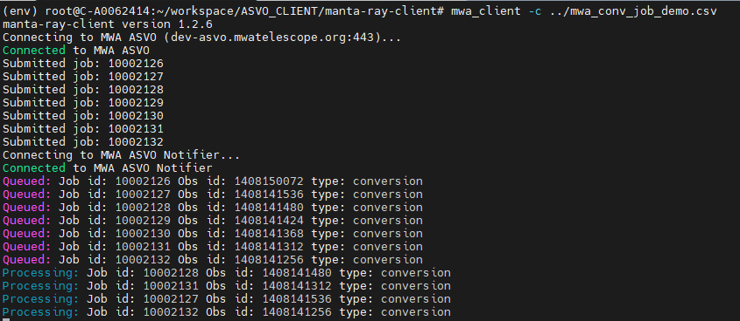
CLI client : mwa_client
mwa_client -c csvfile -d destdir Submit jobs in the csv file, monitor them, then download the files, then exit
mwa_client -c csvfile -s Submit jobs in the csv file, then exit
mwa_client -c csvfile -s -ar Re Submits the jobs in the csv file if they were already submitted.
Get a CLI client
Get API Key
Get csv of obs
Submit jobs
Monitor
Download / use Pawsey file system

Slide 22
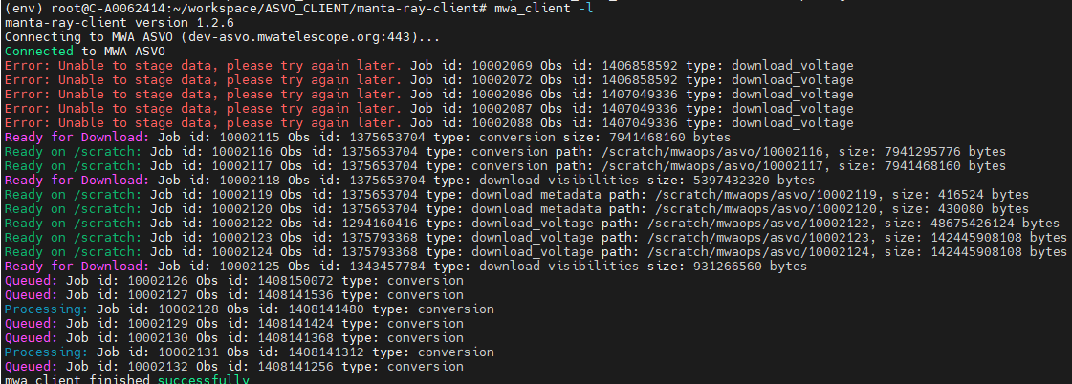
CLI client : mwa_client
mwa_client -l List all your jobs and their status, then exit
mwa_client -d destdir -w JOBID Download the job id (assuming it is ready to download), then exit
mwa_client -d destdir -w all Download any ready to download jobs, then exit
Get a CLI client
Get API Key
Get csv of obs
Submit jobs
Monitor
Download / use Pawsey file system

Slide 23
CLI client : giant-squid
No csv file is needed, observation id and params can be passed as giant-squid arguments
Multiple obs ids and be passed in CLI or a text file with list of obs ids.
Examples:
giant-squid submit-conv -p avg_freq_res=40 –d ‘acacia’ 1403939704
giant-squid submit-conv -p avg_freq_res=40 –d ‘acacia’ observation_ids.txt
Get a CLI client
Get API Key
Get csv of obs
Submit jobs
Monitor
Download / use Pawsey file system

Slide 24
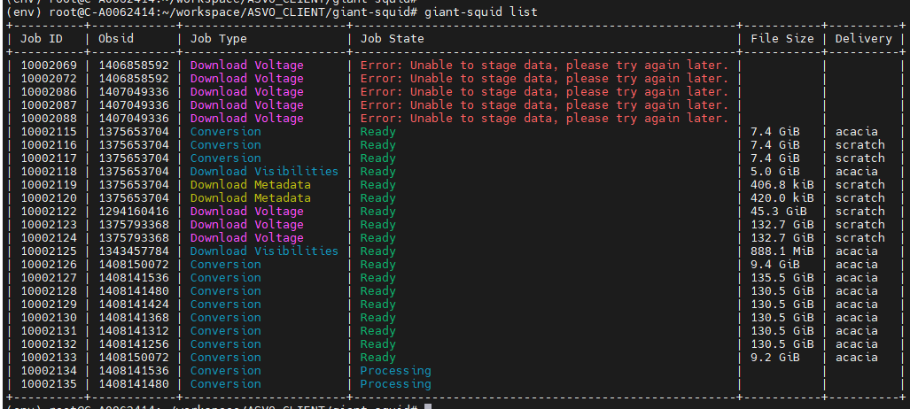
CLI client : giant-squid
giant-squid list List all your jobs and their status
giant-squid download -d directory obs_id Download the job id (assuming it is ready to download), then exit
Get a CLI client
Get API Key
Get csv of obs
Submit jobs
Monitor
Download / use Pawsey file system

Slide 25
MWA ASVO Job priorities
Jobs are assigned with priority index to balance the queue and reduce wait times.
Priority index ∝ number of jobs.
Voltage jobs are given relatively lower priority due to its long processing time.
Notes:
Now that you have an account and have submitted many jobs, you might be wondering why it sometimes takes longer and other times it's quicker.

Slide 26
MWA ASVO – Tips and Tricks
Permissions
MWA members get full permission
Embargo – 18 months for non MWA members
Special project permission from the PI
Mwavcs Pawsey group to access VCS data.
Email asvo_support@mwatelescope.org
Expect longer wait time if the no. of submitted jobs are high
Split your voltage jobs to avoid hitting wall time.

Slide 27
MWA ASVO – Future plans
Custom delivery option
Astroquery
Migration to Setonix
VO registry
Choose coarse channels for conversion and visibility download jobs
Transition to Open API

Slide 28
Thank you
Mouriyan Rajendran
Developer
Mouriyan.rajendran@curtin.edu.au
http://www.mwatelescope.org
https://asvo.mwatelescope.org
@mwatelescope
Murchison Widefield Array
We acknowledge the Wajarri people as the traditional owners of the MRO site.

