Slide 1
Using beam simulations to model mutual coupling coefficients in the MWA Phase II compact array
Katherine Elder, PhD Student
Dr. Daniel C. Jacobs

Slide 2
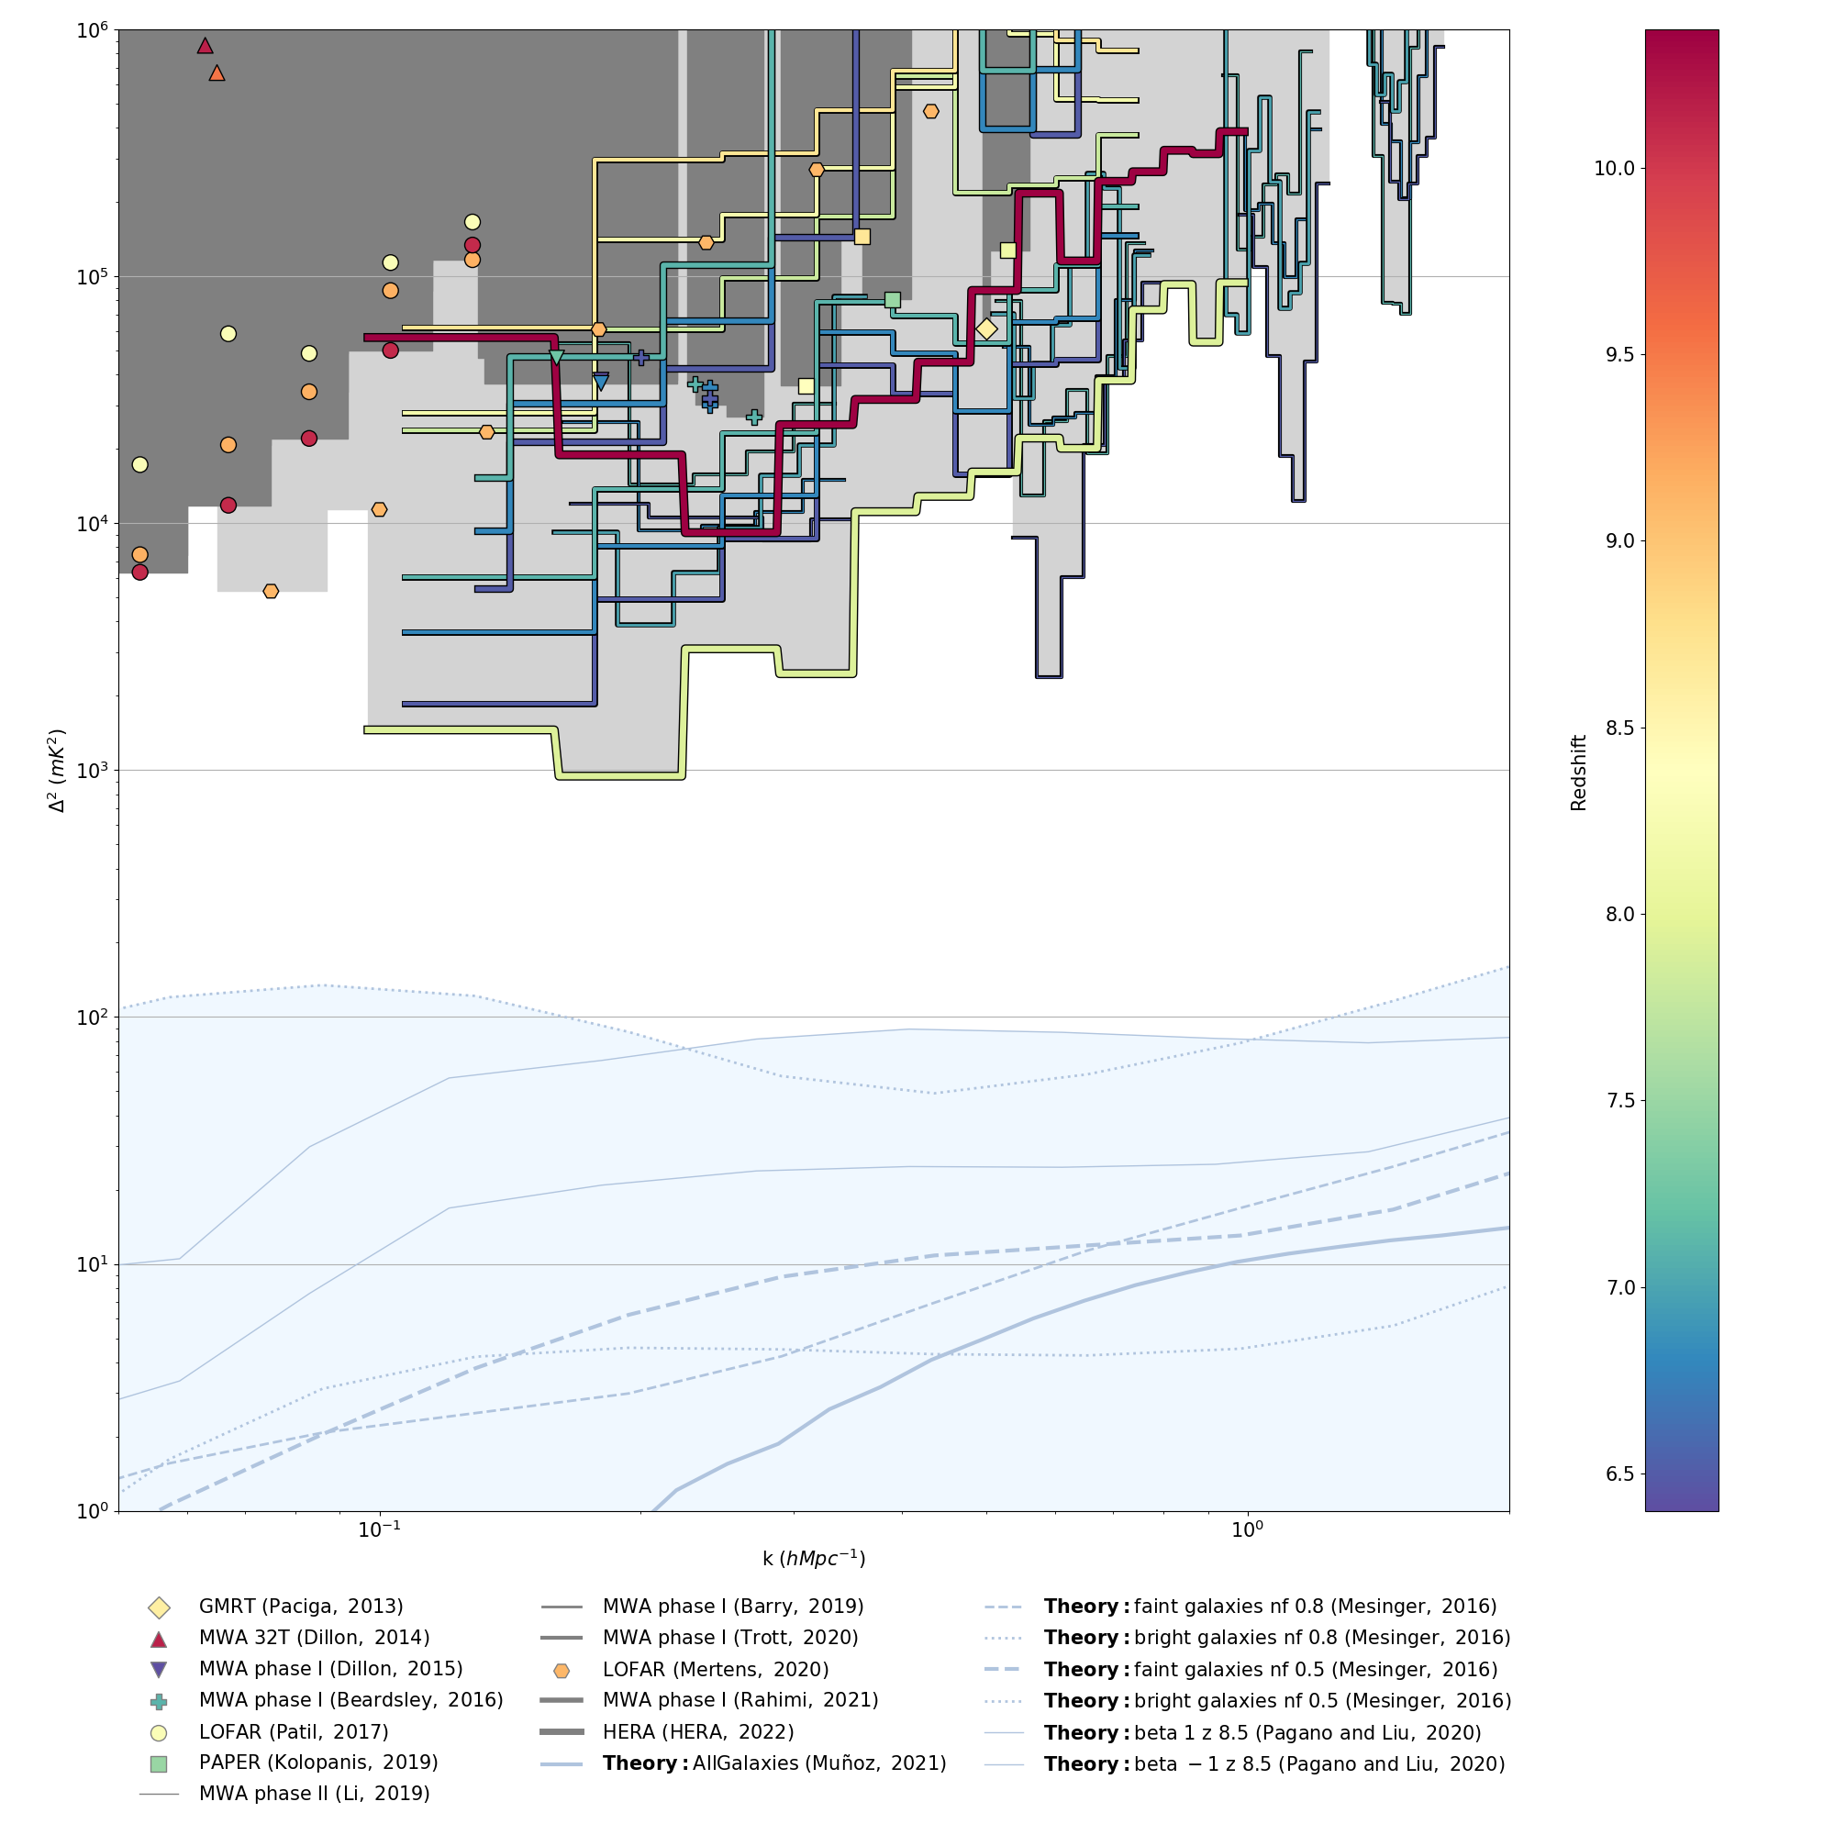
Why haven’t we detected the EoR yet?
21 cm signal very faint
Limited by instrumentation uncertainty
Beam pattern is a main uncertainty
We need to understand our instruments extremely well
https://github.com/EoRImaging/eor_limits

Slide 3
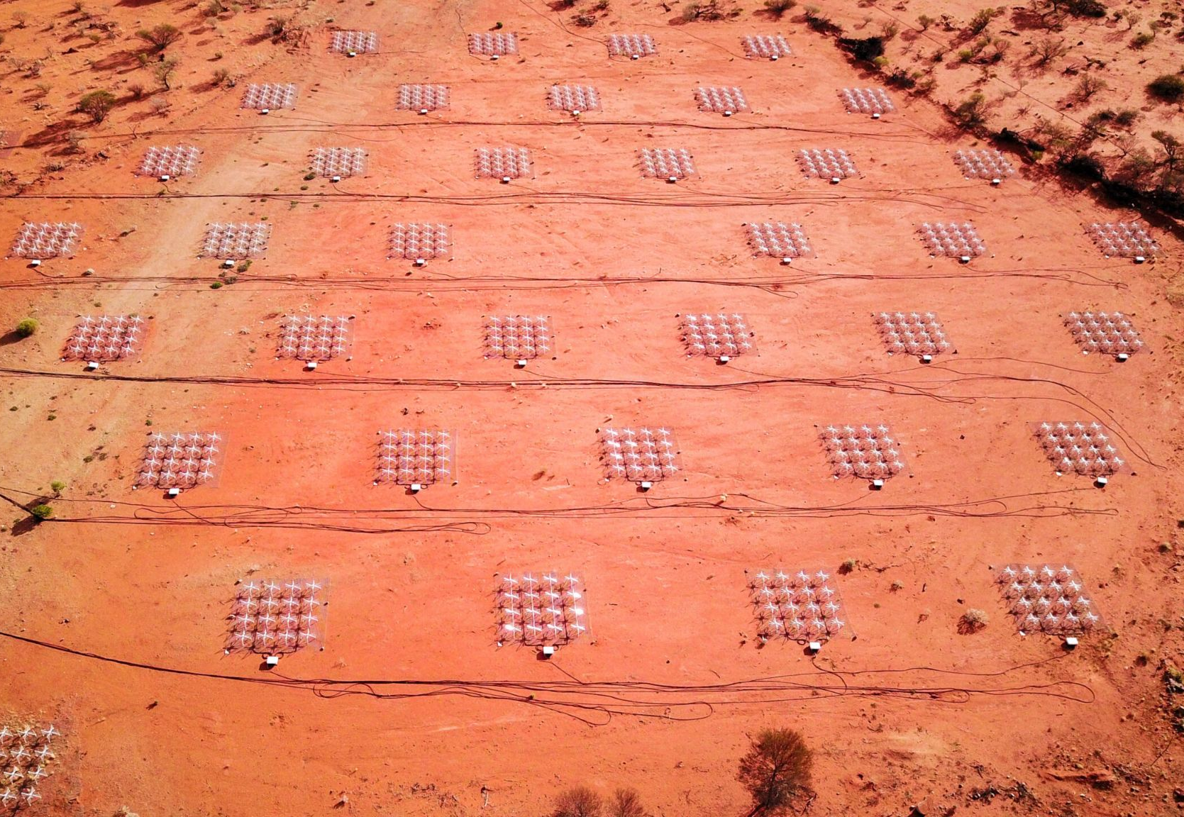
Murchison Widefield Array (MWA)
Phase II
Two Hexagonal sub-arrays
36 tiles each
More sensitive to 21 cm signal
Short, redundant baselines
https://www.mwatelescope.org/

Slide 4
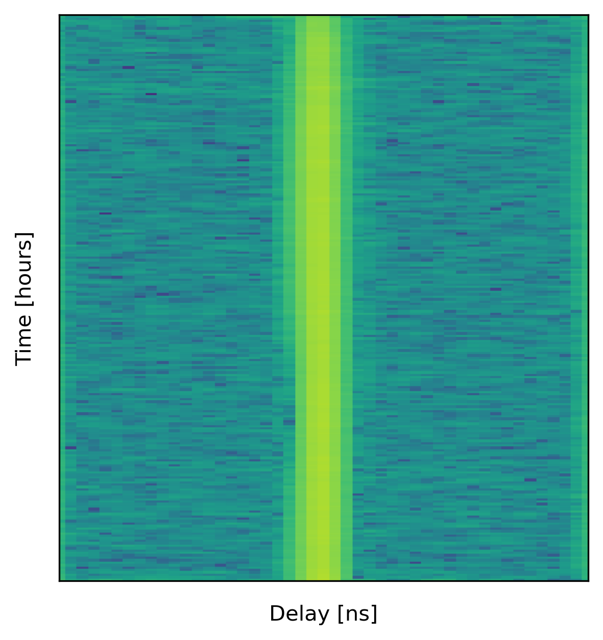
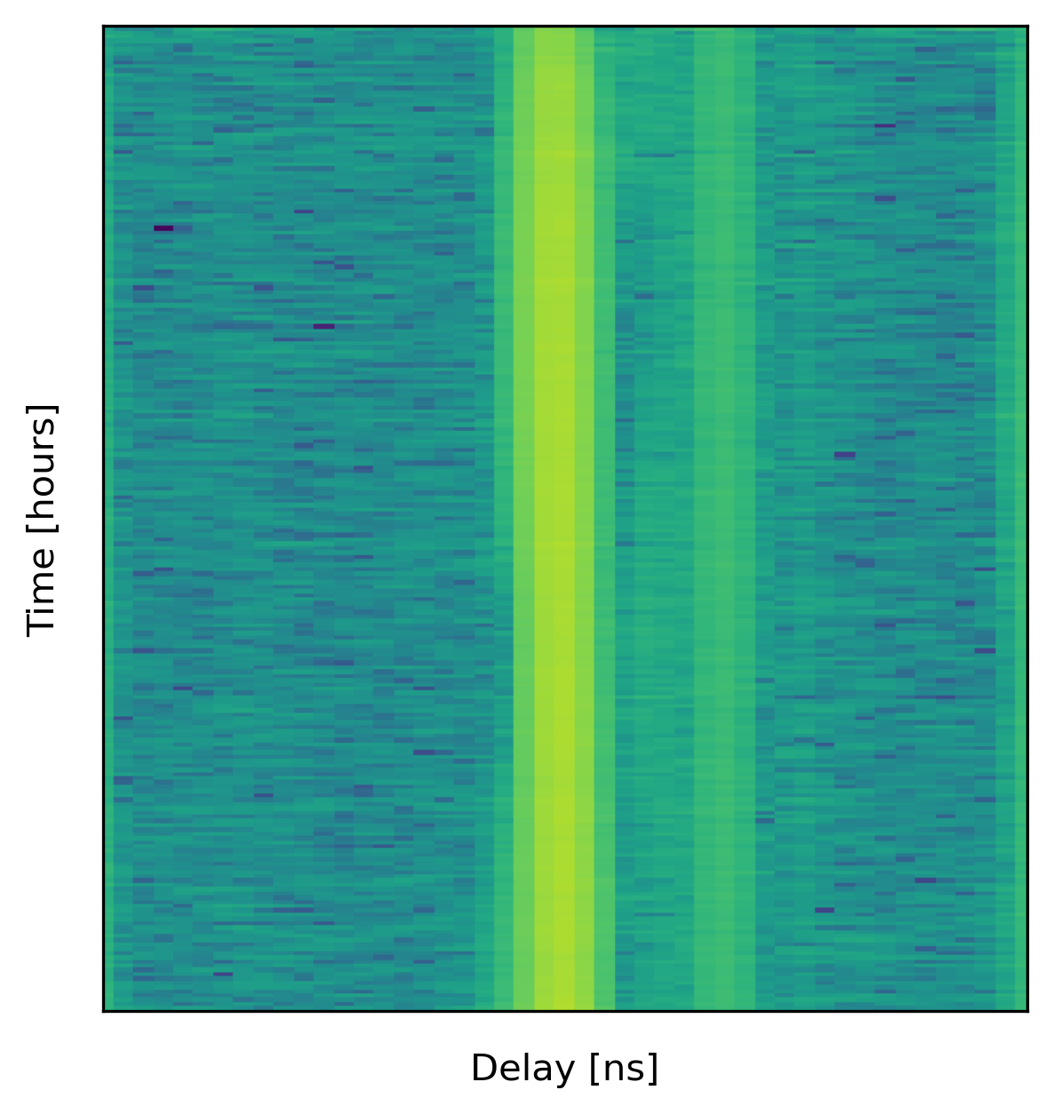
Common Mode Signal
Kolopanis et al (2023) found a strong common mode signal in Phase II data
This introduces a statistically significant bias
Short baselines are the most sensitive to EoR
Previously all short baselines were flagged
~50% of short baselines still flagged
Time [LST]
0
Delay [ns]

Slide 5
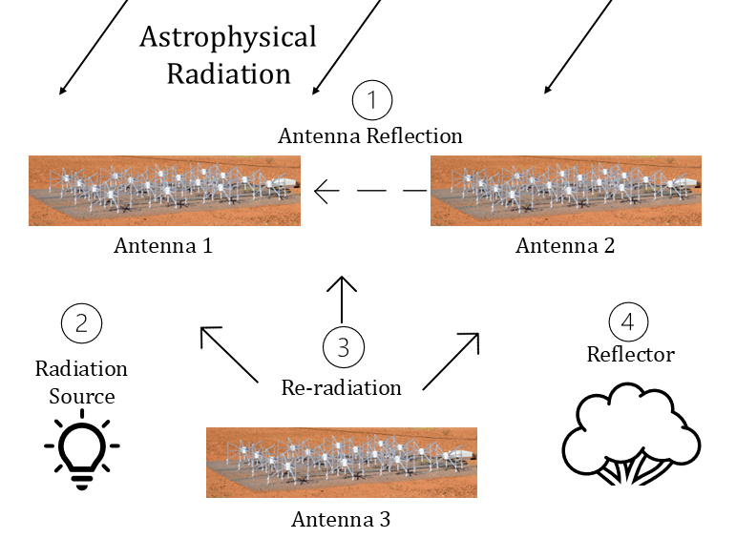
Sources of excess correlation
Re-radiation is one part of mutual coupling
How much does mutual coupling affect the visibilities?

Slide 6
Mutual Coupling Models
Numerical EM simulator (FEKO)
Detailed model of antenna
Models multiple paths for excess correlation
Direct Re-radiation
Re-radiation Reflection
Time consuming
Computationally expensive
Re-radiation model
Simplified model
Only need simulation of one antenna
Fast and easy
Easy to scale up
Only models single path for excess correlation
Direct Re-radiation

Slide 7
Re-radiation model:
Direct path
Numerical EM model:
Direct path
Reflections

Slide 8
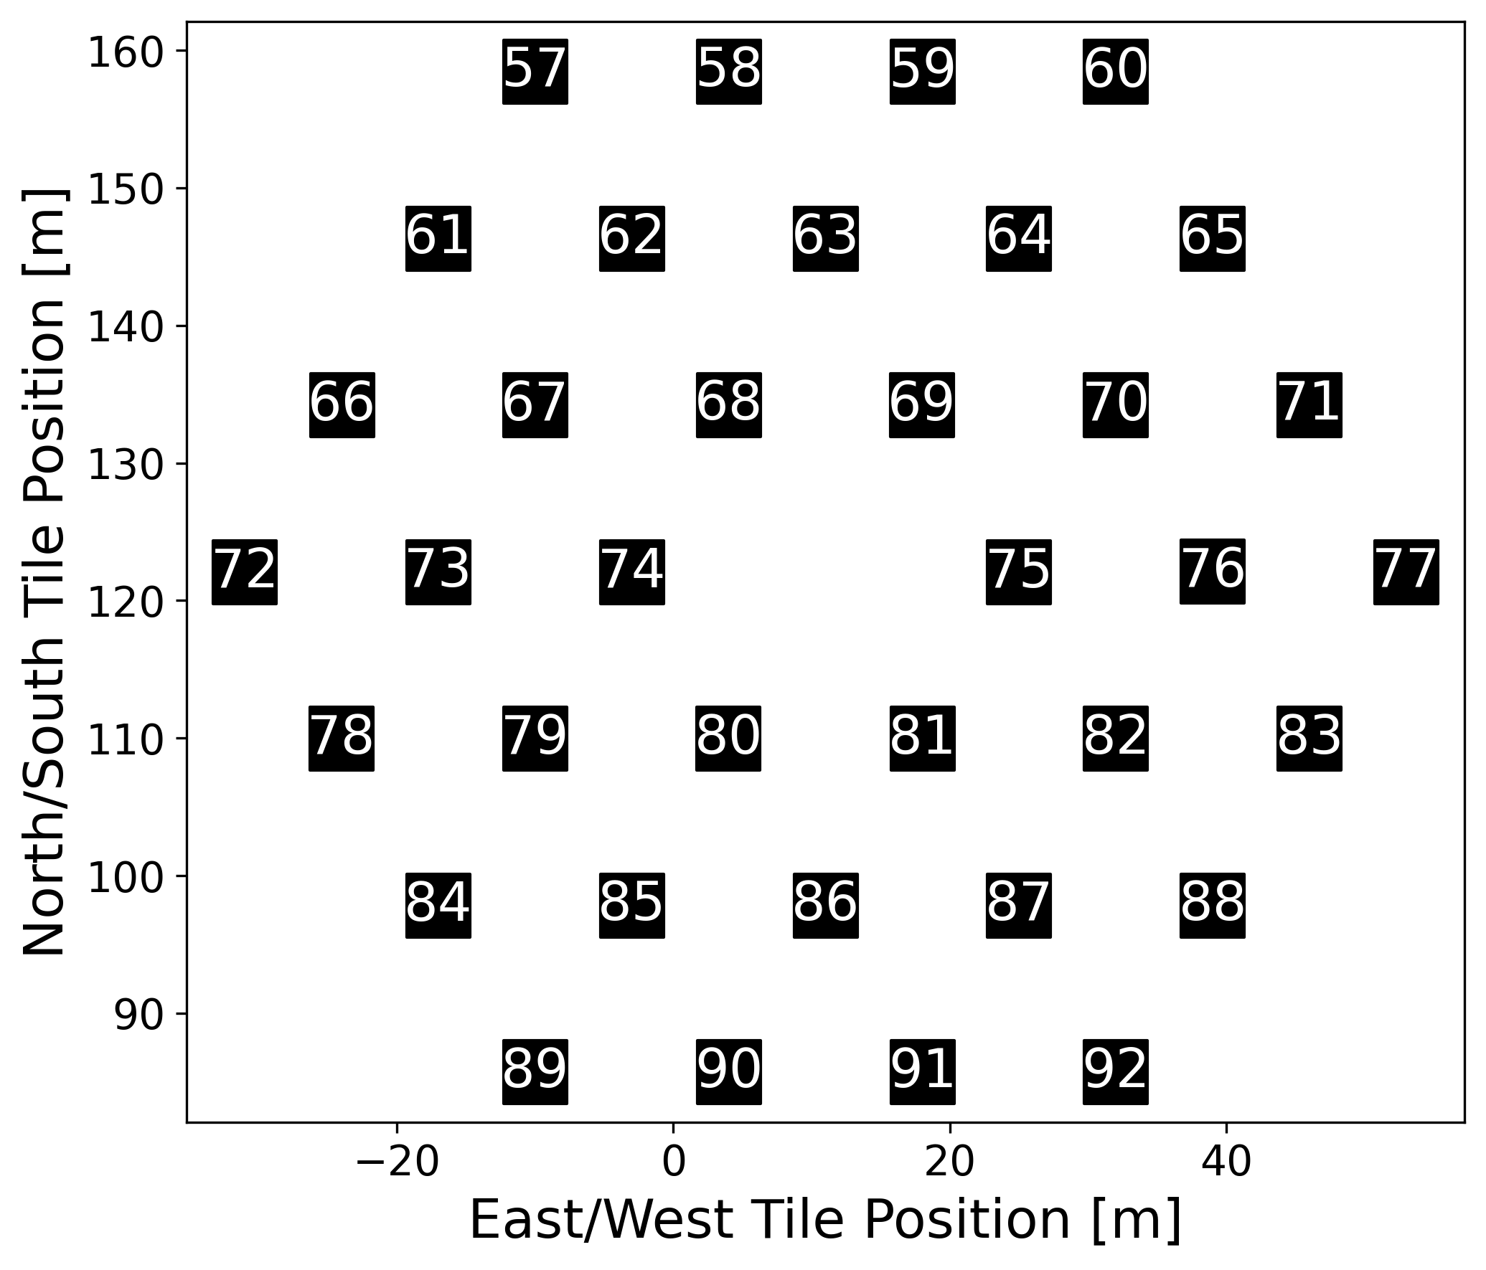
Choosing the baselines
Kolopanis et al. (2023) looked at three baselines
14m, 24m, 28m
Shortest
Most redundant
Most sensitive to 21 cm signal

Slide 9
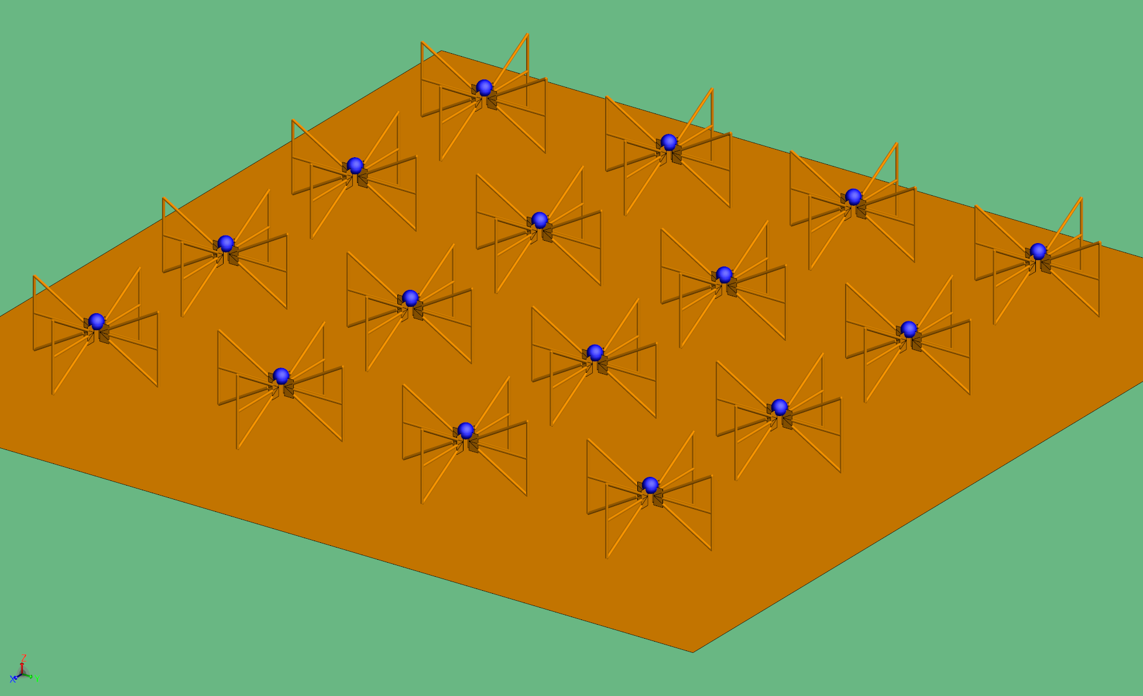
Multipath Re-radiation model
FEKO modeling software
Model details same as the 2016 FEE beam model
Model has an LNA and a voltage source
Array is N-S polarized
Sokolowski et al. (2017)

Slide 10
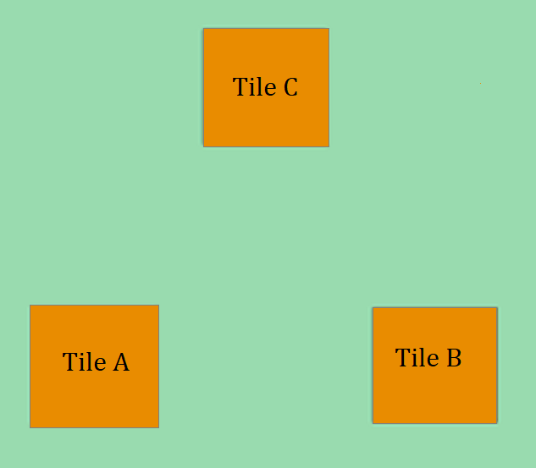
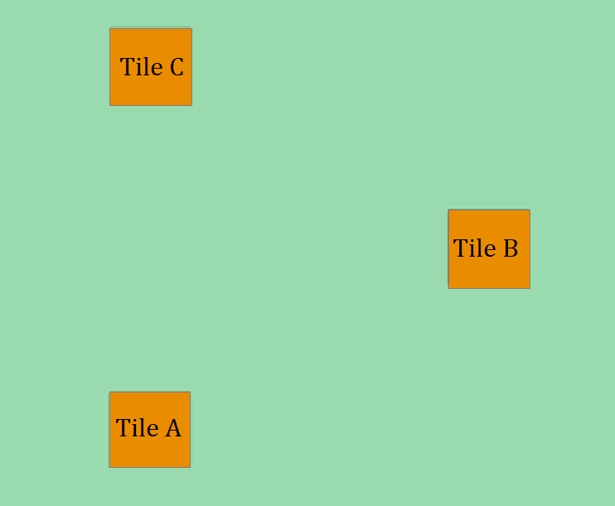
Multipath Re-radiation model
$$S_{BC}$$
$$S_{CA}$$
$$S_{BC}$$
$$S_{CA}$$
$$S_{AB}$$
$$S_{AB}$$
14 m baselines
24 m baselines

Slide 11
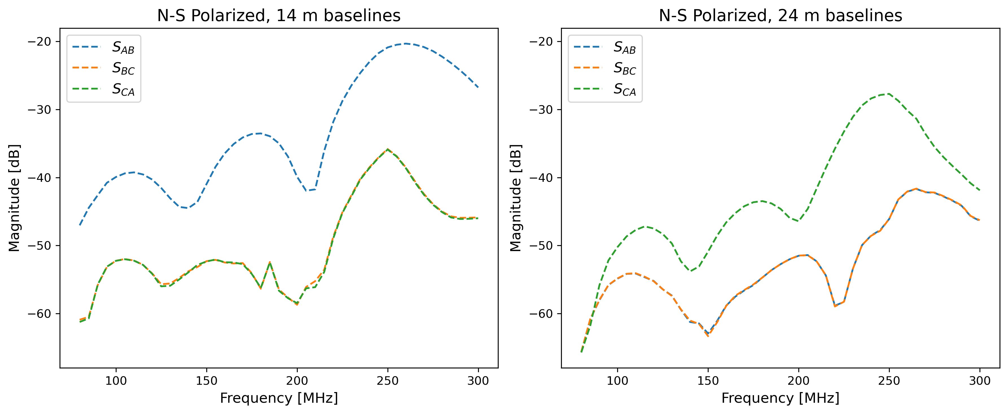
$$S_{BC}$$
$$S_{CA}$$
$$S_{BC}$$
$$S_{CA}$$
$$S_{AB}$$
$$S_{AB}$$

Slide 12
Single path Re-radiation model
Rath et al. (2024) (arXiv:2406.08549) define the visibility equation with mutual coupling as:
Where $V_{ij}^{(0)}$ is the original visibility, $X_{ik}$ is the mutual coupling coefficient, and $V_{ij}^{(1)}$ is the adjusted visibility

Slide 13
Coupling coefficient
$λ$ is the wavelength, $Γ$ is the reflection coefficient, $Ω_{p}$ is the beam area, $υ$ is the frequency, $b_{ik}$ is the baseline length, and J(${\hat{b}}_{ik}$) is the far field radiation pattern
$Γ$, $Ω_{p}$, and J(${\hat{b}}_{ik}$) are calculated in FEKO for a single tile

Slide 14
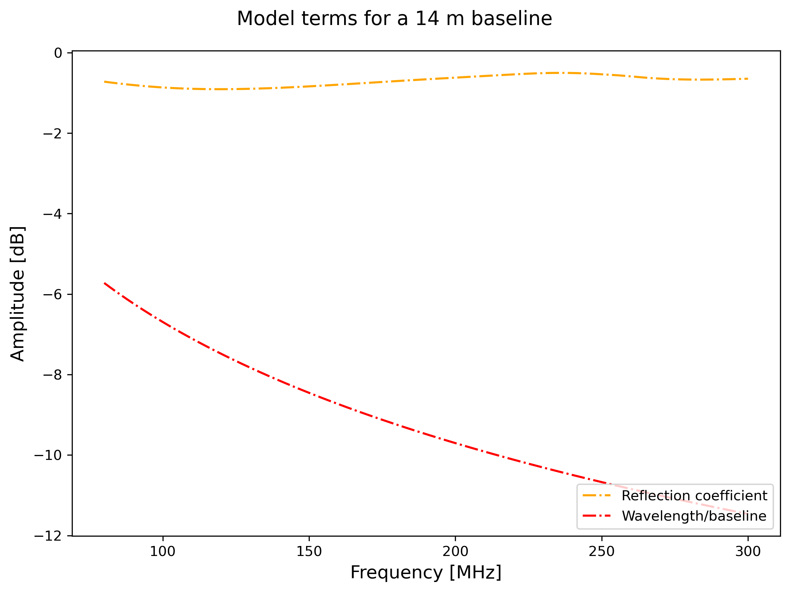
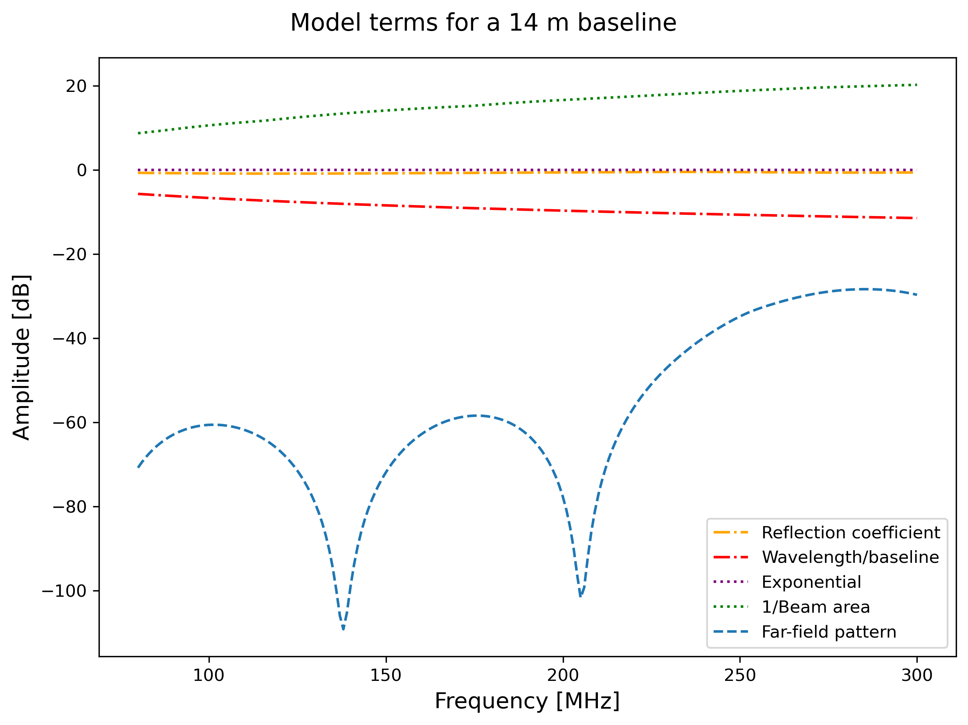
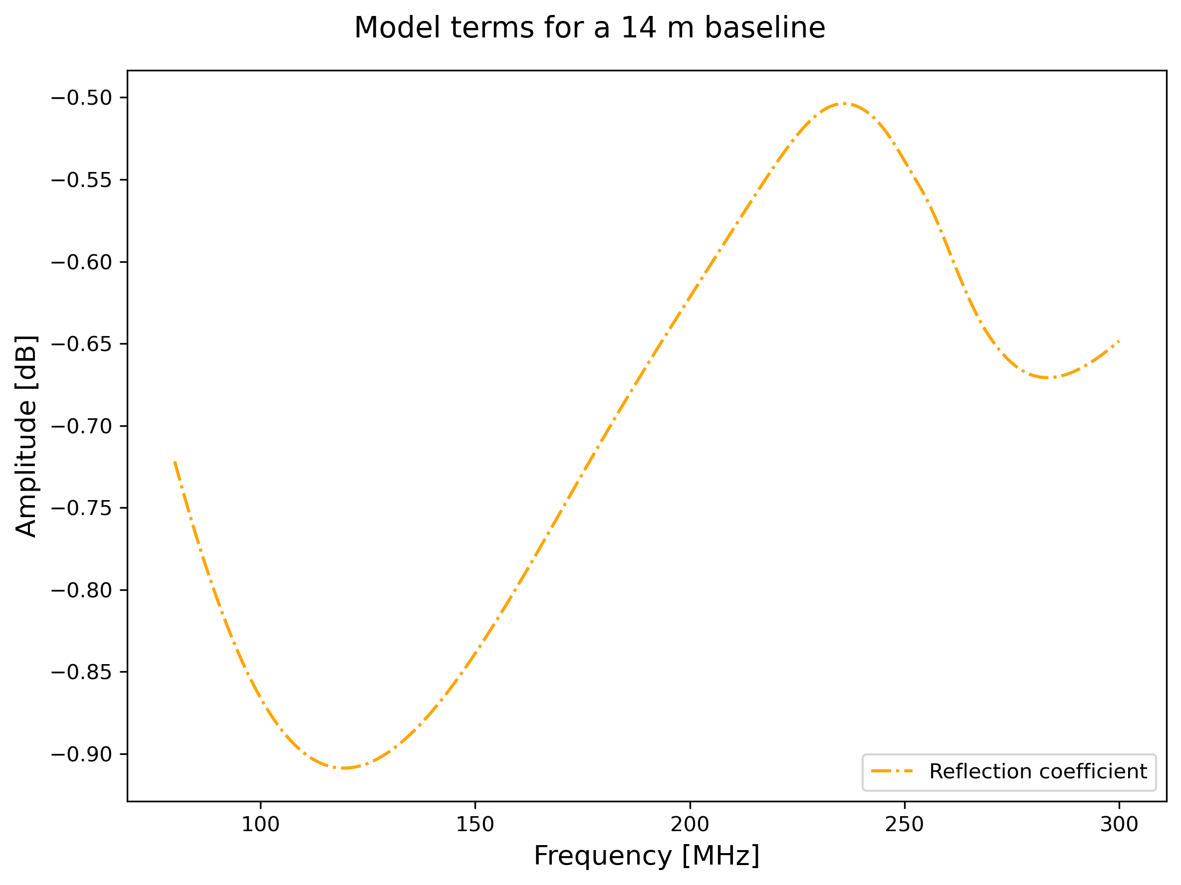
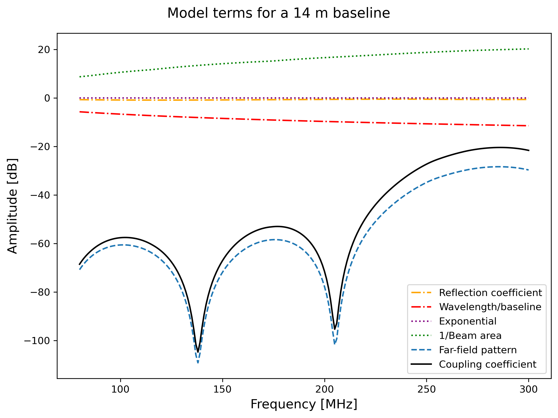
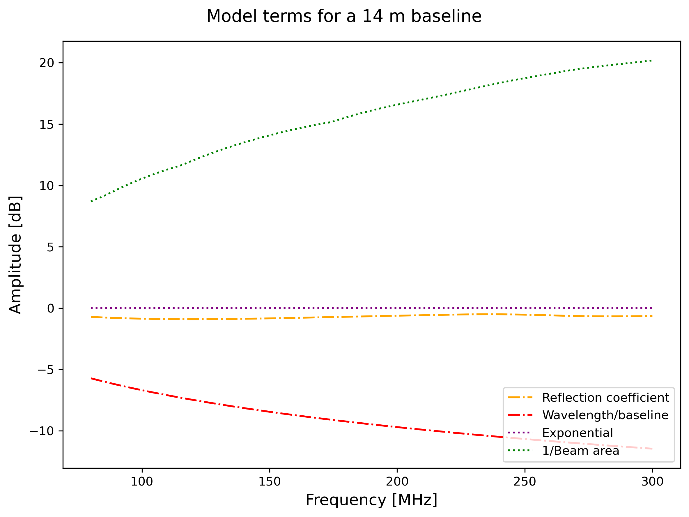
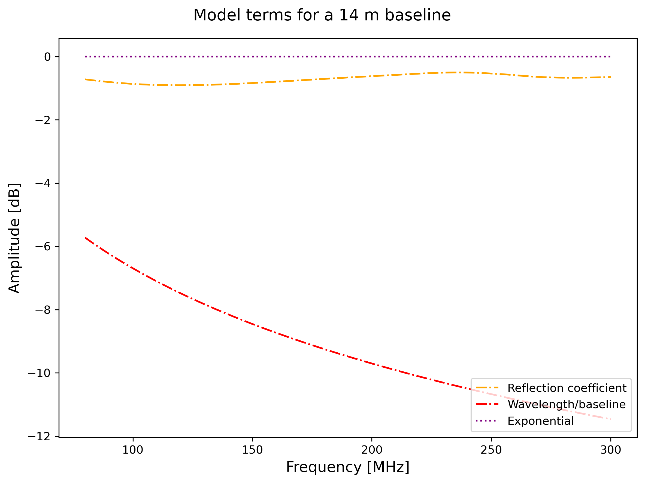
Single path Re-radiation model
$$X_{ik}=\frac{iλΓ}{b_{ik}}\frac{e^{\frac{i2πνb_{ik}}{c}}}{Ω_{p}}J\left({\hat{b}}_{ik}\right)J{\left({\hat{b}}_{ik}\right)}^{†}$$

Slide 15
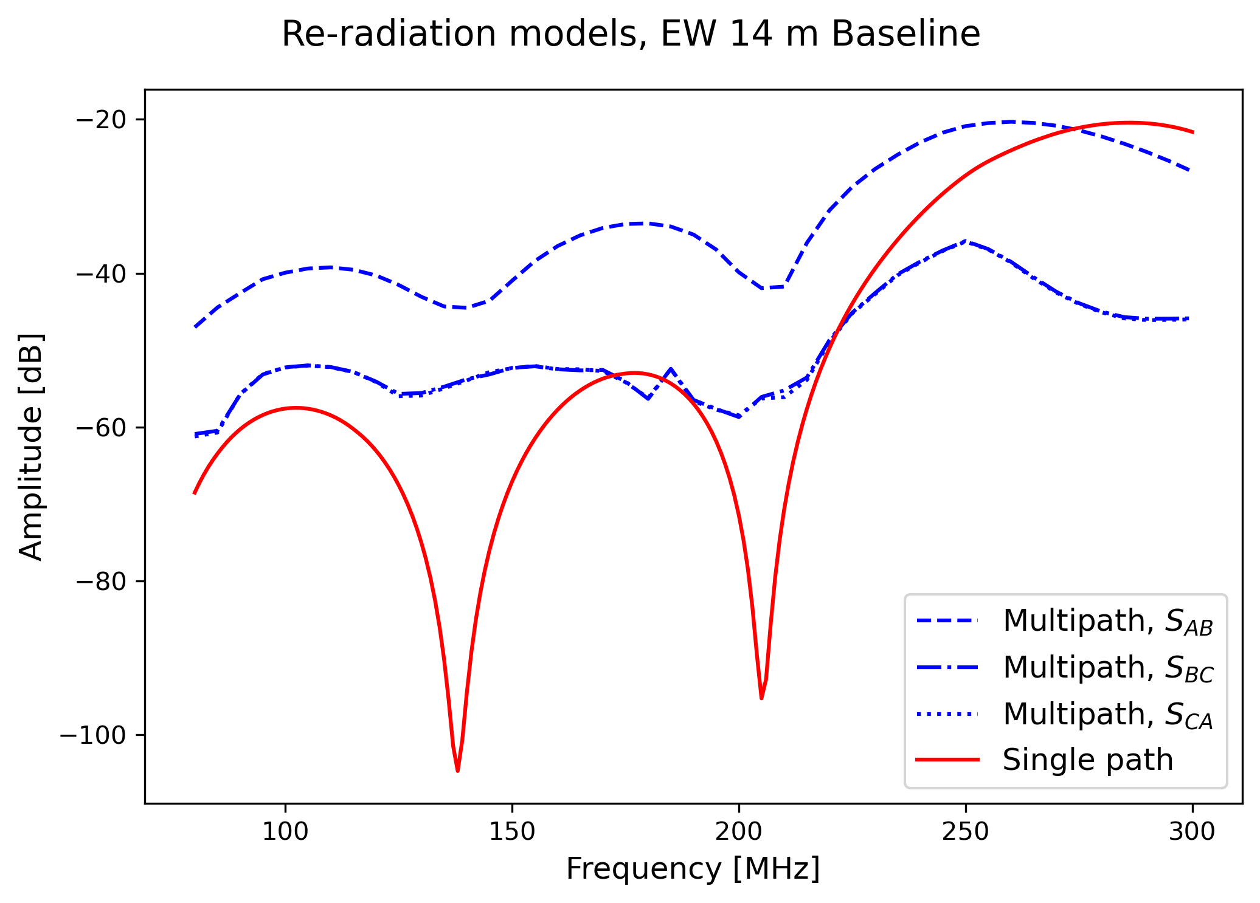
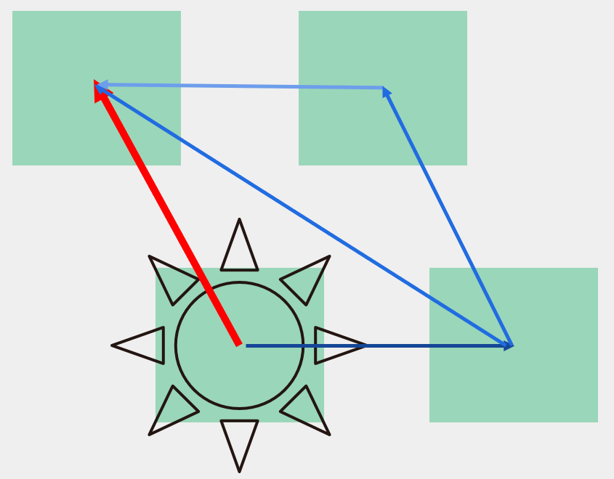
$$S_{CA}$$
$$S_{BC}$$
$$S_{AB}$$

Slide 16
Why does any of this matter???

Slide 17
How much does mutual coupling affect the visibilities?

Slide 18
DO WE NEED TO BE WORRIED ABOUT IT??

Slide 19
Total mutual coupling approximation
We approximate${\text{V}}^{(0)}$ to be identical for all baselines and ij as interchangeable, we can sum over ${\text{X}}_{ik}$ for every baseline

Slide 20
Worst Case Scenario
Using the limits reported by Trott et al. (2020), we approximate a limit of ~ -20 dB for the visibilities
The sum must be lower than -20 dB

Slide 21
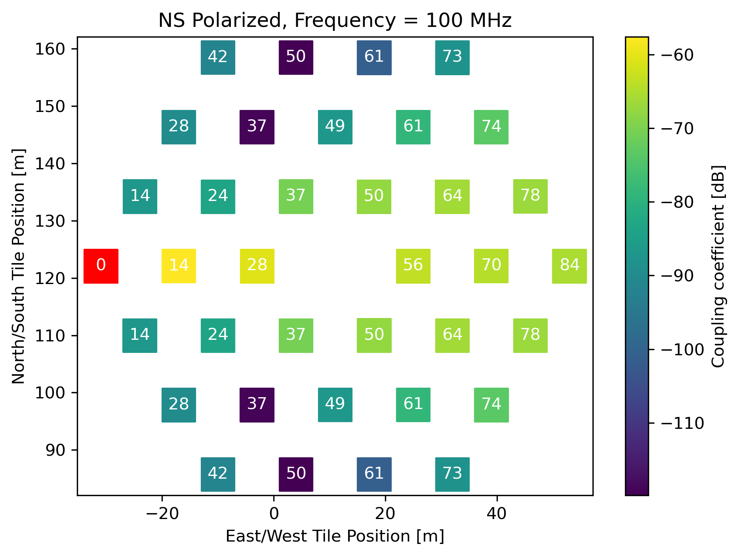
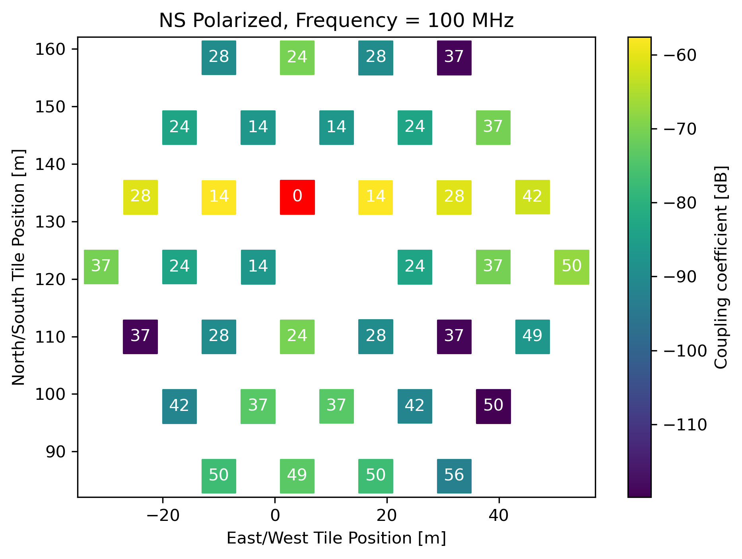
Single Path Re-radiation model for all baselines

Slide 22
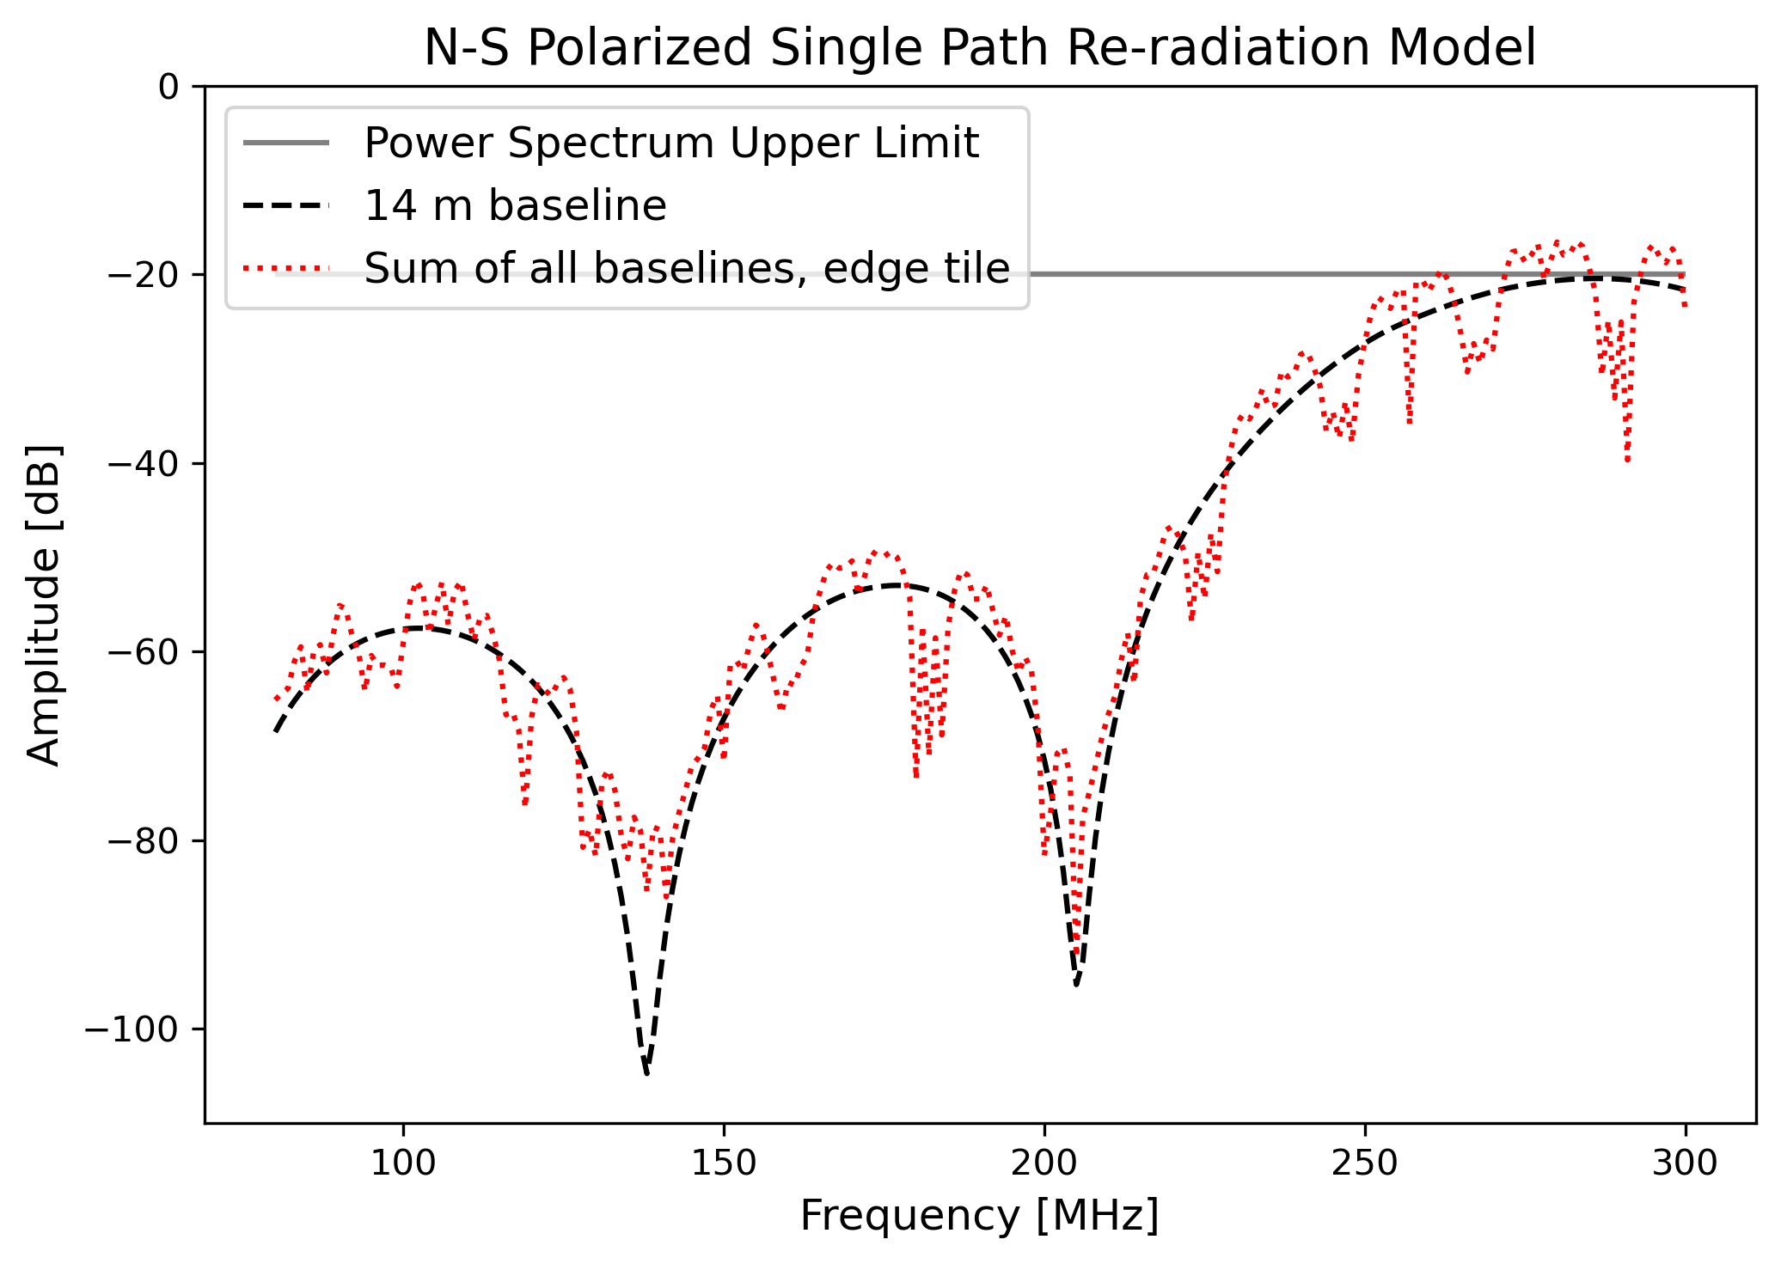

Slide 23
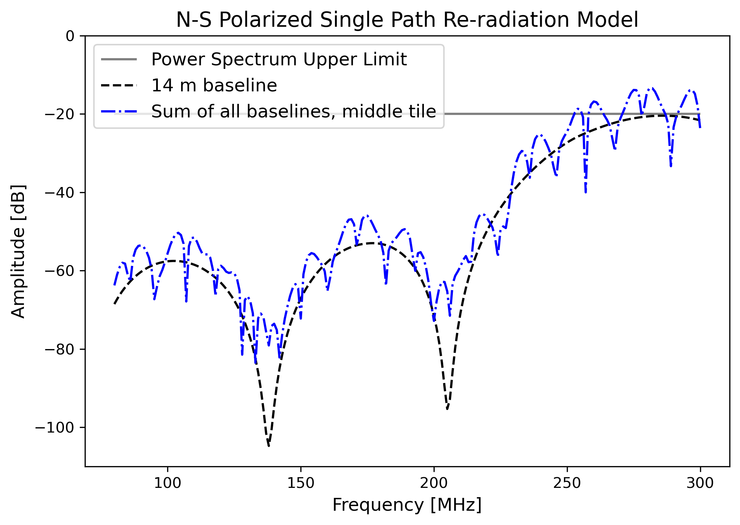

Slide 24
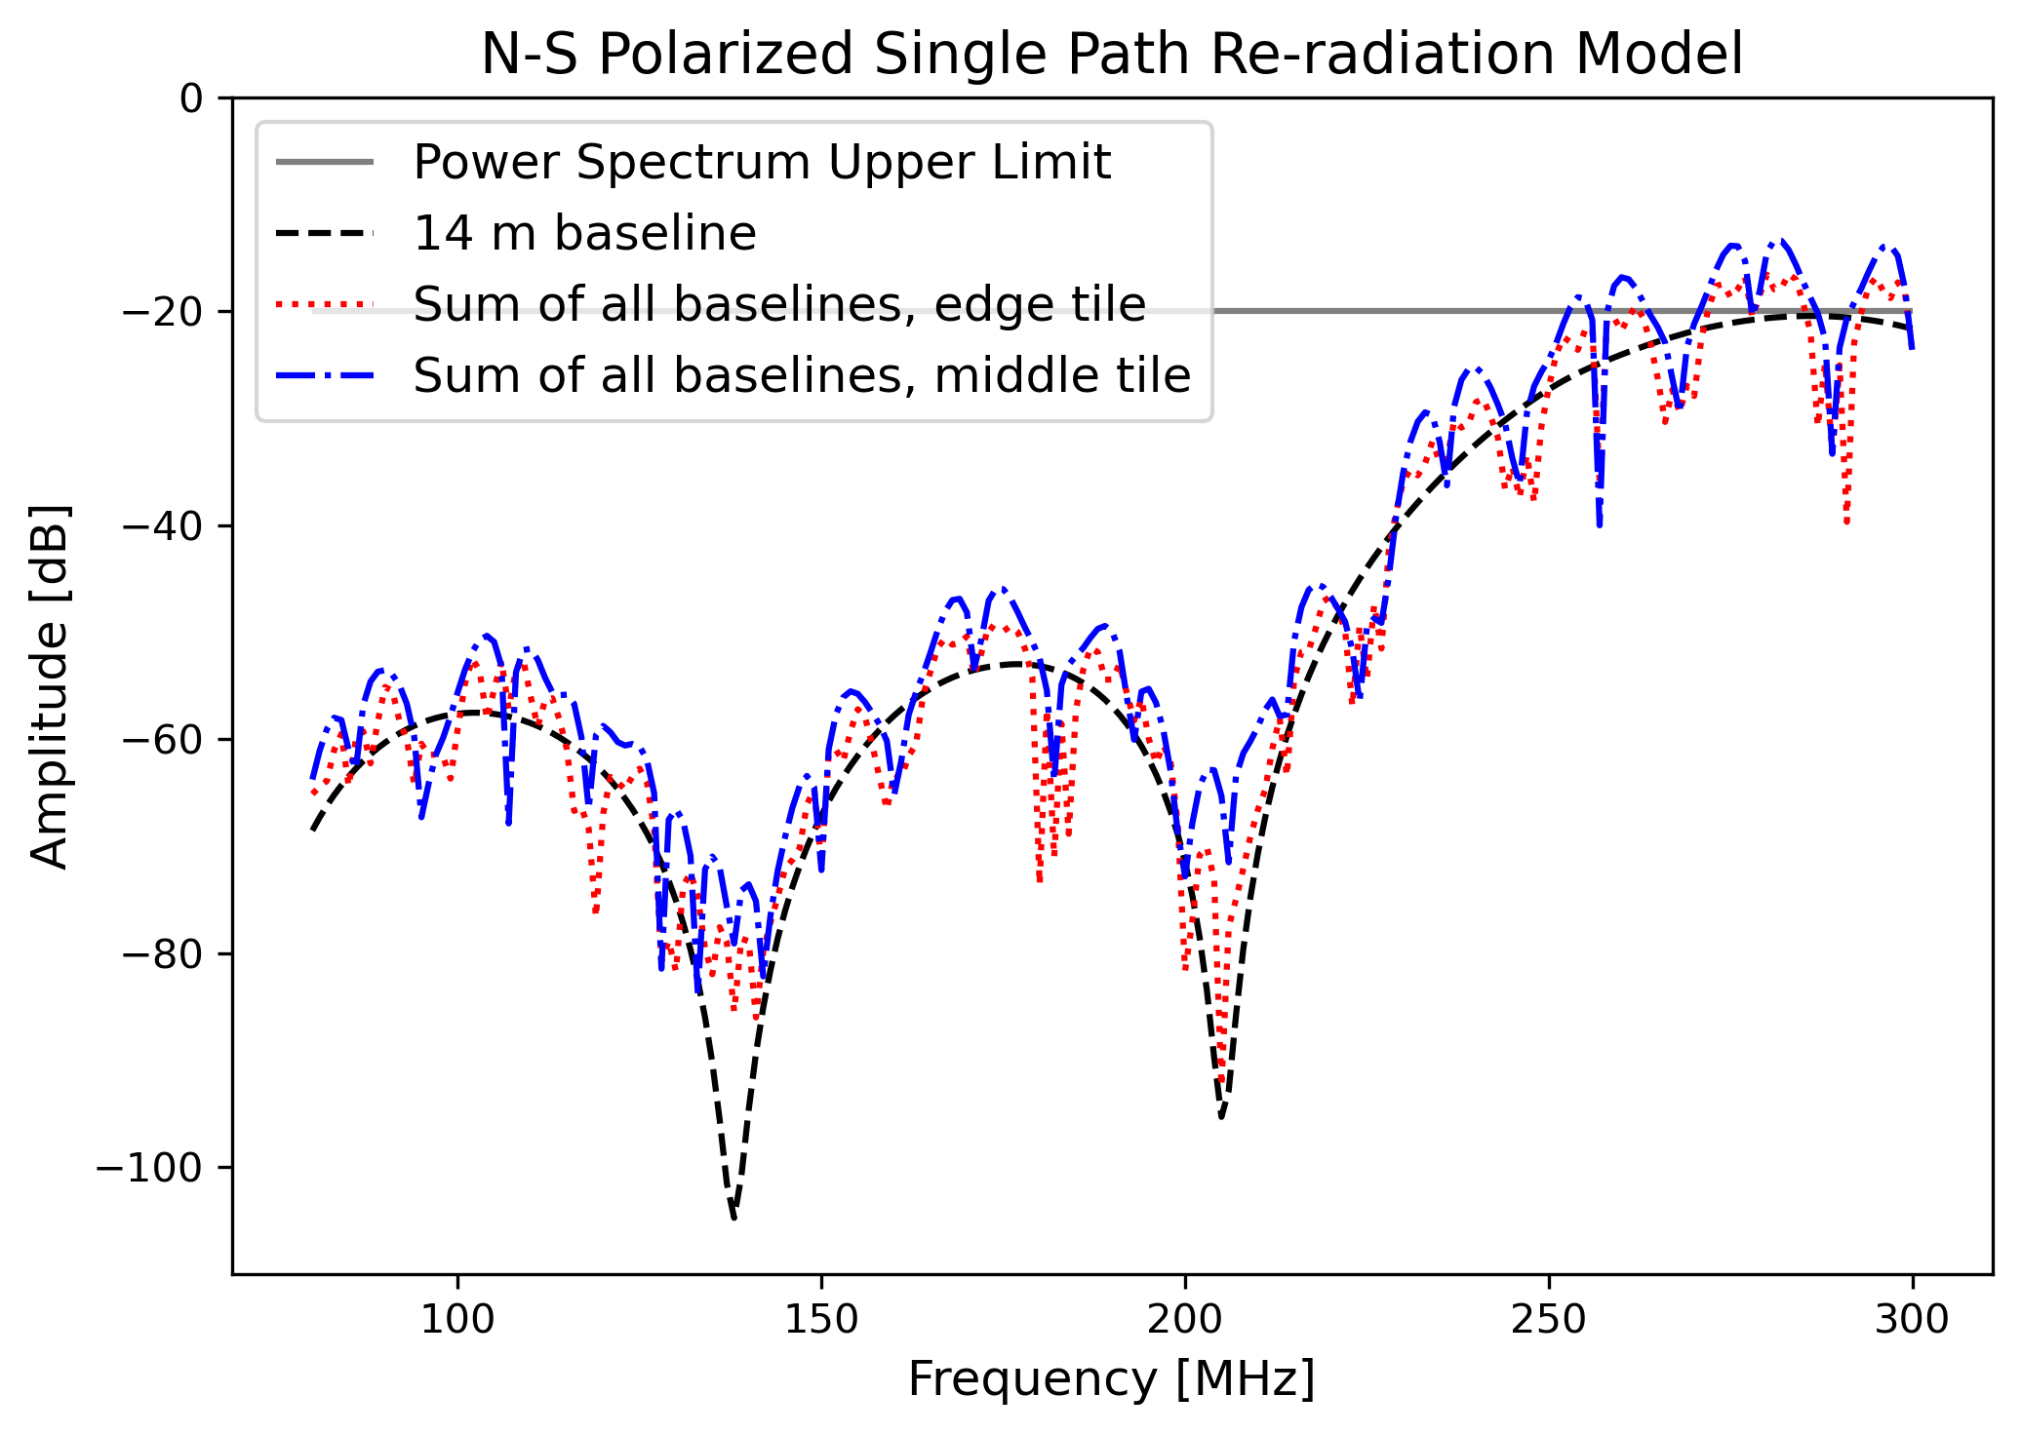

Slide 25
Summary and Conclusions
Name: Katherine Elder
Email: kat.elder@asu.edu
We need to know how much mutual coupling affects the visibilities
The models show:
Adding more tiles increases mutual coupling
A rough approximation shows mutual coupling is near EoR power spectrum limits only at high frequencies
Open questions:
Why is there a >20 dB difference between models?
Is -20 dB the actual EoR power spectrum limit?

Slide 26
Extra Slides

Slide 27
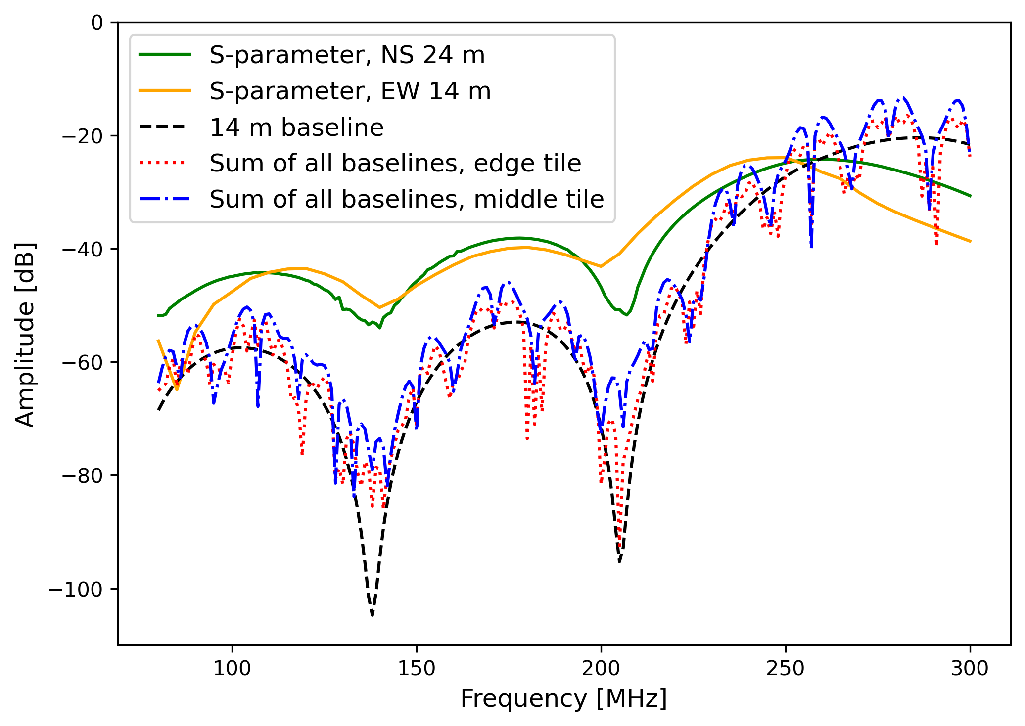

Slide 28
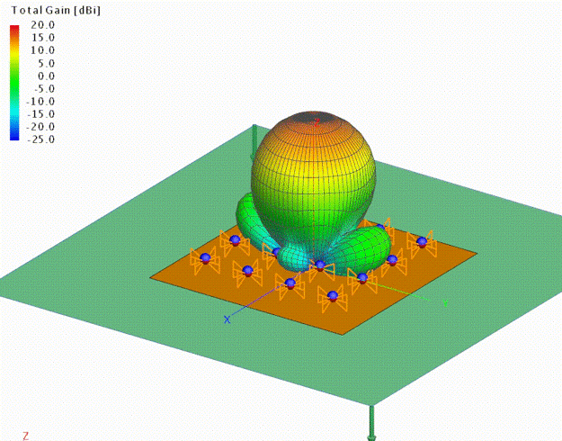
Single Tile
3D Beam Pattern

Slide 29
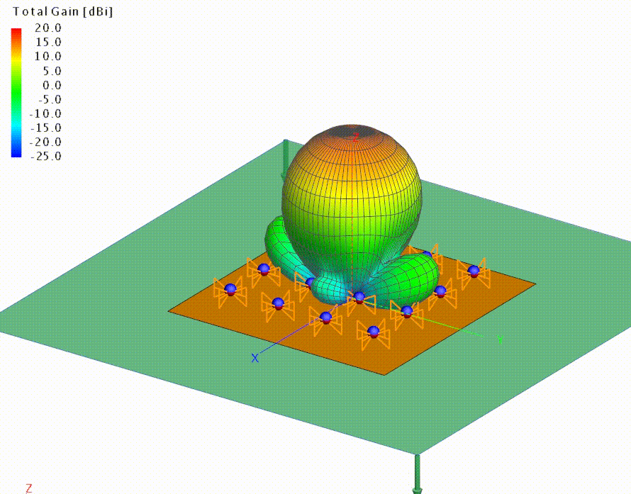
Single Tile
3D Beam Pattern

