Slide 1
U.S.-Based Research on Mitigating
Radio Frequency Interference
for MWA Data
Jade Ducharme
on behalf of the U.S. MWA SWIFT Team
MWA Project Meeting 2024

Slide 2
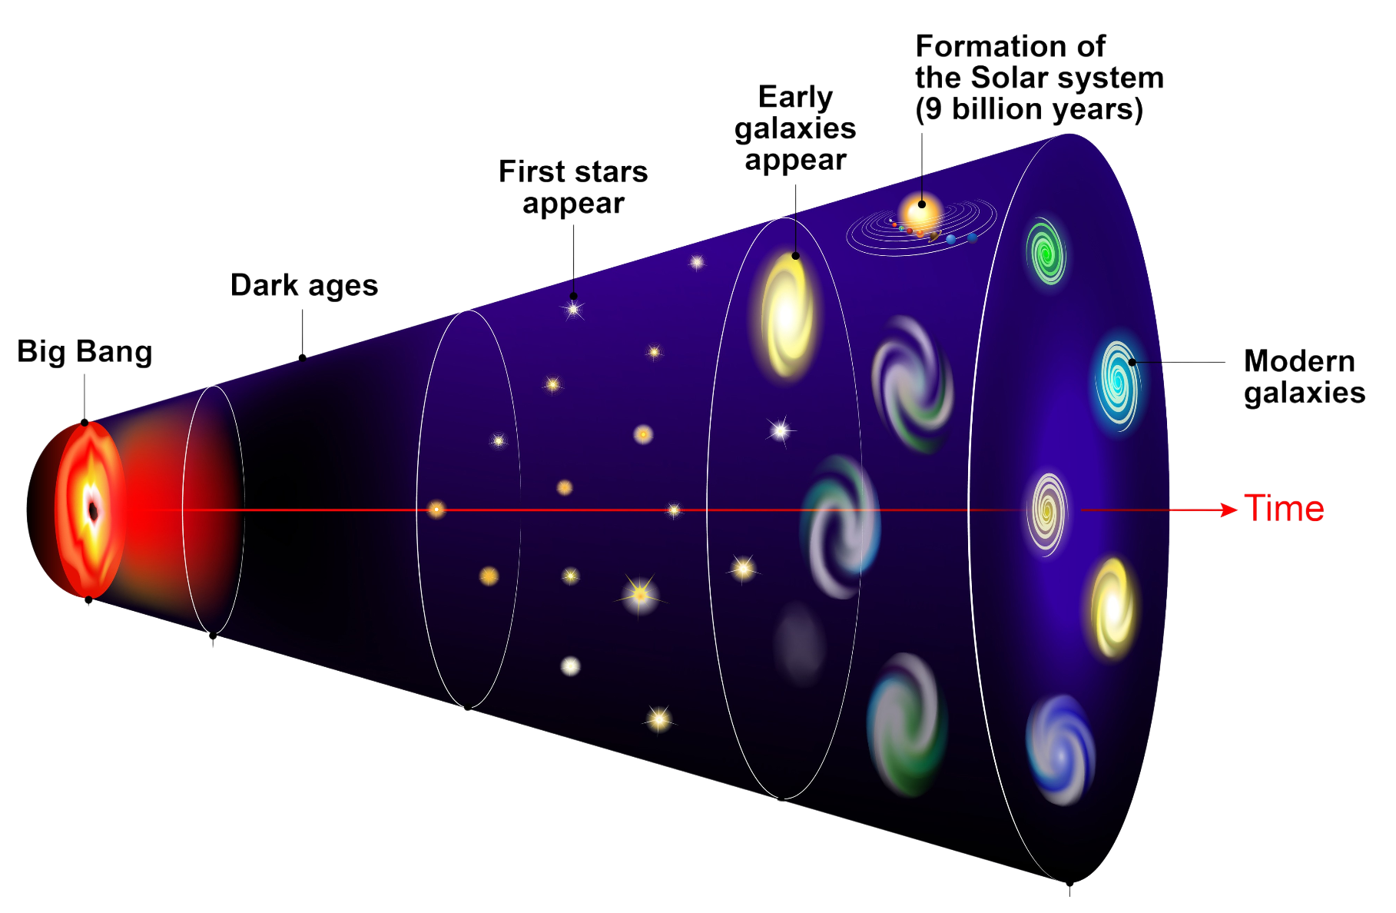
U.S. MWA SWIFT Team
SWIFT: Spectrum and Wireless Innovation enabled by Future Technologies
RFI-focused research funded by the National Science Foundation
Brings together physicists from Brown University and the University of Washington
Scientific focus: Epoch of Reionization (EoR) → 21 cm cosmology
Instrument: MWA
EoR

Slide 3
Roadmap
Introduction
RFI detection/flagging algorithms
1.
RFI overview
2.
𝜒2-based algorithm
3.
HERA watershed algorithm
4.
EAVILS
5.
U-Net
Conclusion
Near-field Interferometry
9.
Future Directions
8.
Altitude Estimation
7.
Beamforming
6.
Near-field corrections

Slide 4
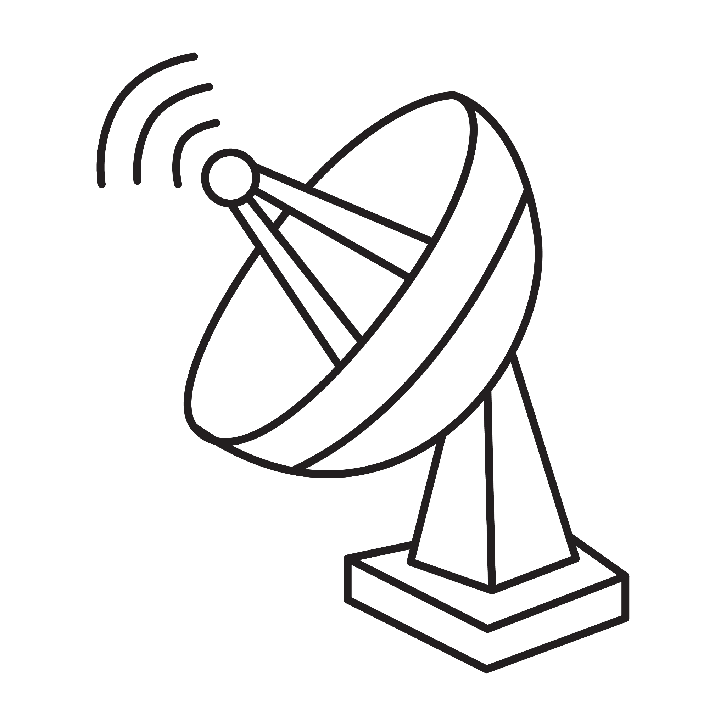
Radio Frequency Interference
1
2
3
4
5
6
7
8
9
RFI contaminates MWA data, further obscuring the 21cm signal
Difficult to predict and avoid due to the multitude of different sources

Slide 5
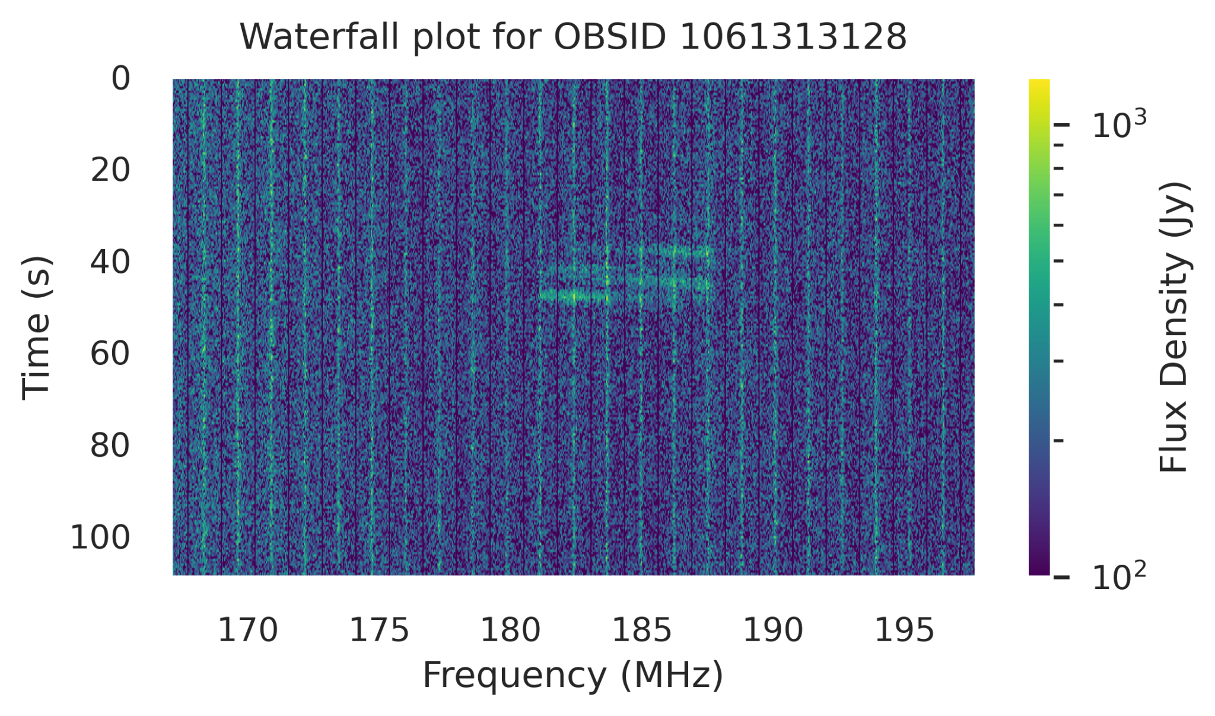
Radio Frequency Interference – Flagging
1
2
3
4
5
6
7
8
9
Can be identified via “waterfall plots”
Several flagging algorithms acting on waterfall plots already developed for use with the MWA:
AOFlagger (Offringa+ 2010)
SSINS (Wilensky+ 2019)
…
Single-baseline waterfall plot for the MWA observation with OBSID 1061313128

Slide 6
Radio Frequency Interference – Flagging
1
2
3
4
5
6
7
8
9
Flagging consists in producing a boolean array to mask the contaminated regions of data
The affected data is then removed from further analysis

Slide 7
Radio Frequency Interference – Flagging
1
2
3
4
5
6
7
8
9
The problem is… This is a really difficult task!
How bright should a pixel be to count as RFI? What about its neighbors? How to fill in the gaps?
Current flagging algorithms struggle with these questions, leading to often unreliable flags
?
?

Slide 8
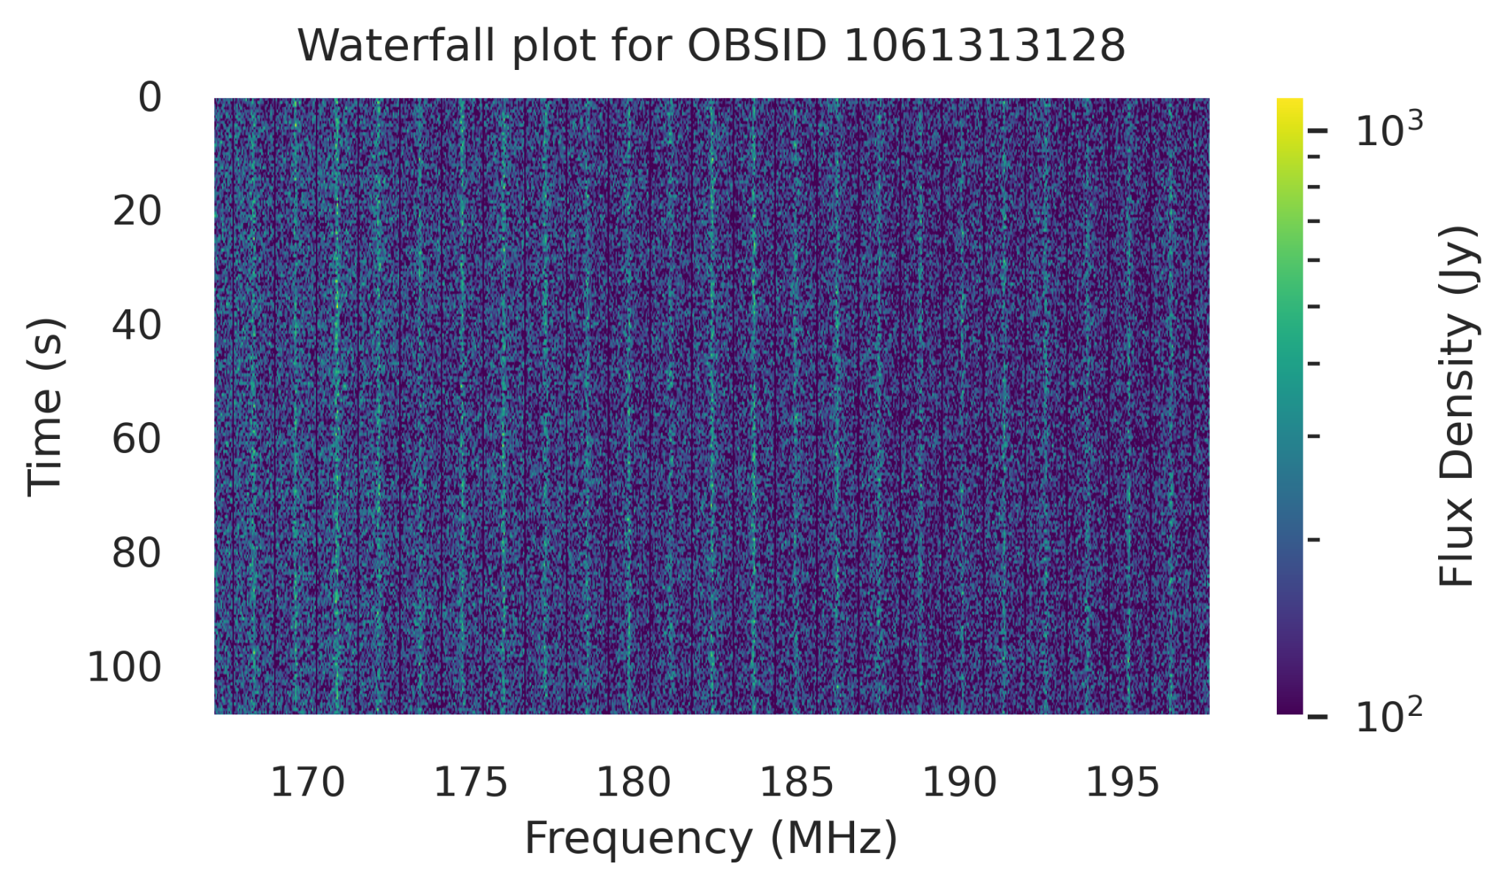
Radio Frequency Interference – Complications
1
2
3
4
5
6
7
8
9
Within the same observation, some baselines see RFI while others seemingly don’t!
Need to flag data on observation-polarization level (as opposed to waterfall level)
Single-baseline waterfall plot for a given baseline; i.e. pair of antennas
Same observation seen by a different baseline

Slide 9
Radio Frequency Interference – Complications
1
2
3
4
5
6
7
8
9
Within the same observation, some baselines see RFI while others seemingly don’t!
Wilensky+ 2023 show that ultrafaint RFI in MWA data still contaminates the power spectrum within the EoR window
This contamination deteriorates constraints on the 21 cm signal
Highlights the need for improved RFI mitigation strategies
Seemingly “clean” waterfall plot, but RFI could be present below the noise…

Slide 10
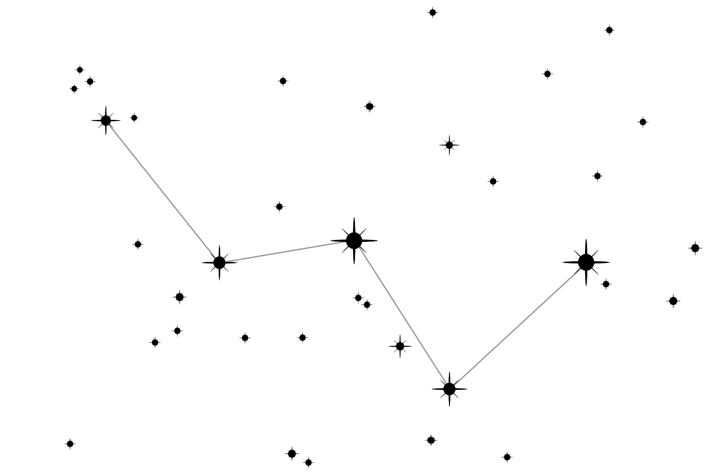
Radio Frequency Interference
1
2
3
4
5
6
7
8
9
In order to obtain more reliable flags, we are continuing
to develop more sophisticated algorithms:
𝜒2 from redundant calibration (Kunicki & Pober 2024)
HERA watershed algorithm (HERA Collaboration, adapted for MWA by Xiaorui Lu)
EAVILS (SWIFT team at the University of Washington)
U-Net based machine learning algorithm (SWIFT team at Brown University)
Near-field interferometry techniques can also help localizing RFI, with the ultimate goal being its subtraction or excision

Slide 11
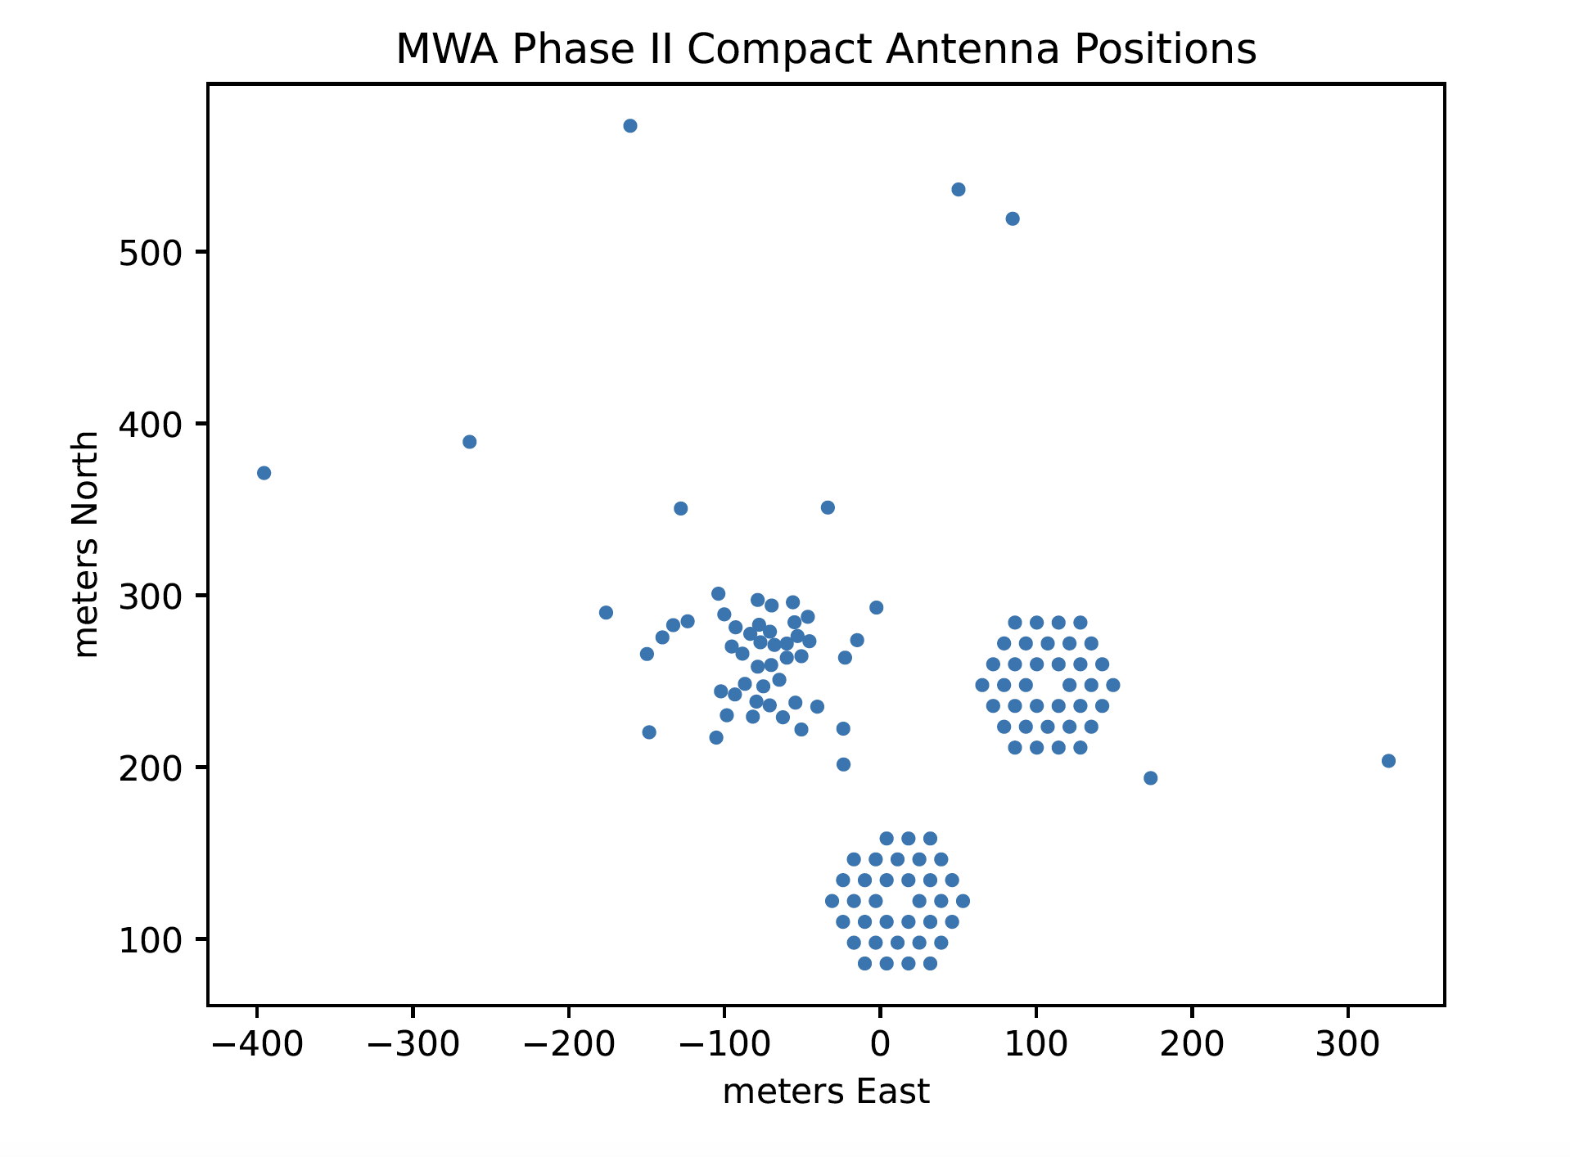
𝜒² RFI Detection Algorithm
1
2
3
4
5
6
7
8
9
Based on the 𝜒2 metric from redundant calibration
Using pyuvdata (Hazelton+ 2017), select down to the redundant antennas within the hexagons
The time resolution is averaged to 18 seconds (from an initial 2 seconds) to reduce noise
(Kunicki & Pober 2024)

Slide 12
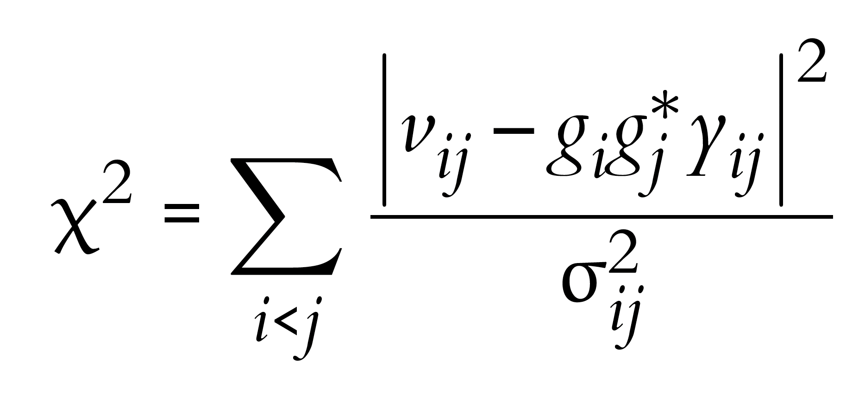
𝜒² RFI Detection Algorithm
1
2
3
4
5
6
7
8
9
For a perfectly redundant, successfully calibrated array, we expect the 𝜒2 to be very similar for each time and frequency
RFI biases the 𝜒2 → can use that to help identify RFI
Important: this RFI detection algorithm runs hera_cal only in order to obtain the 𝜒2! (Calibration solutions are not used or looked at)
Run redundant calibration using hera_cal (Dillon+ 2020)
This algorithm’s goal is to solve for the complex gains g_{i} , g_{j} by minimizing the 𝜒2:

Slide 13
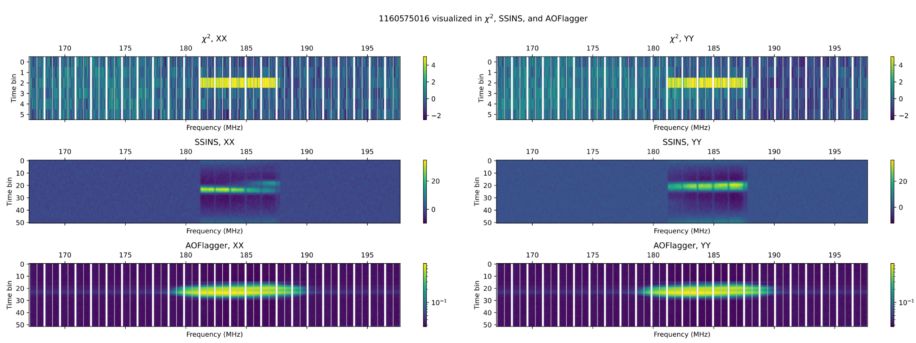
𝜒² RFI Detection Algorithm
1
2
3
4
5
6
7
8
9
Result: 𝜒2 metric (top row) can identify RFI…
(Kunicki & Pober 2024)

Slide 14
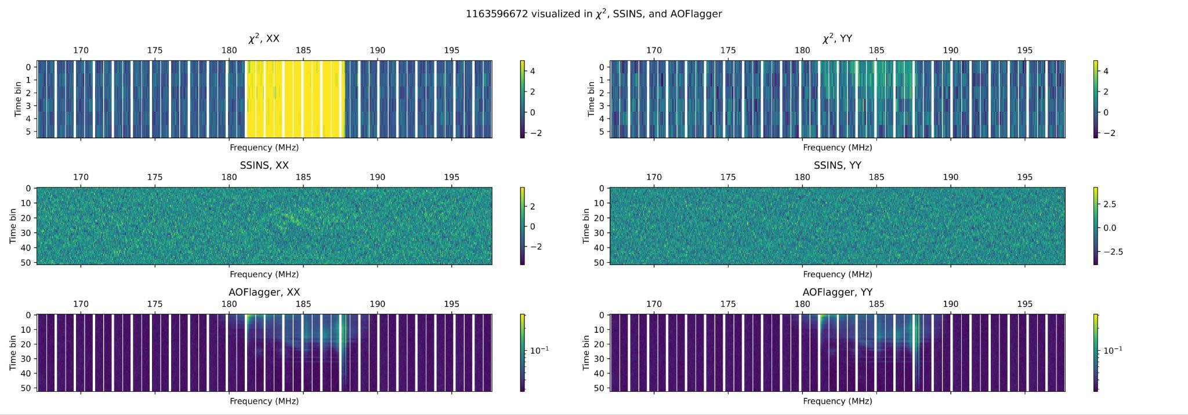
𝜒² RFI Detection Algorithm
1
2
3
4
5
6
7
8
9
Result: 𝜒2 metric (top row) can identify RFI… even when other flaggers don’t
(Kunicki & Pober 2024)

Slide 15
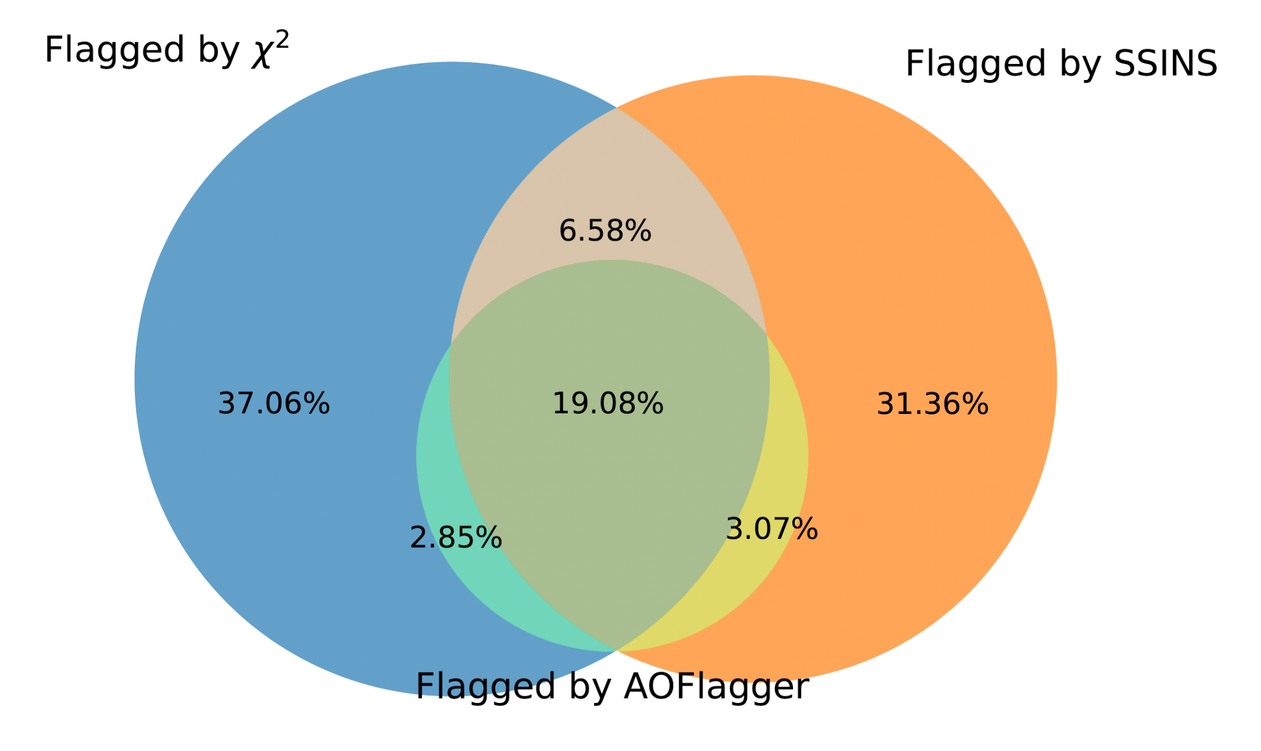
𝜒² RFI Detection Algorithm
1
2
3
4
5
6
7
8
9
𝜒2 is a metric computed at the observation-polarization level
This allows it to find RFI fainter than at the individual waterfall level
In summary, here is how it compares to SSINS and AOFlagger
Percentage of observations with RFI in the DTV Channel 7 band flagged by each method, classified by detection or non-detection (Kunicki & Pober 2024). Computed across the entire MWA Fall 2016 season data.

Slide 16
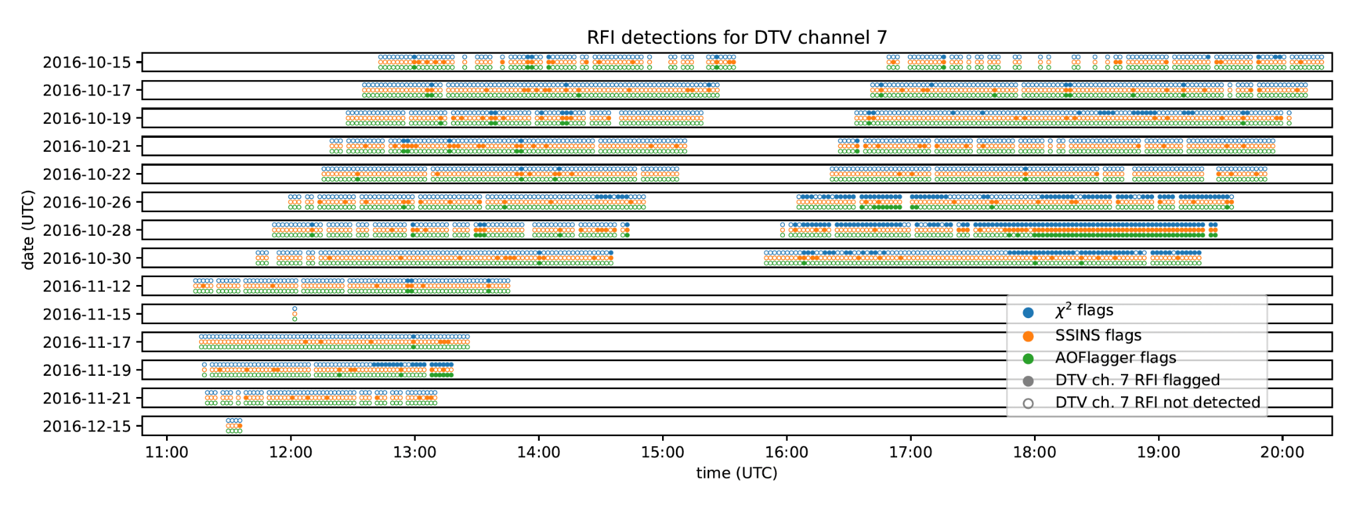
𝜒² RFI Detection Algorithm
1
2
3
4
5
6
7
8
9
(Kunicki & Pober 2024)

Slide 17
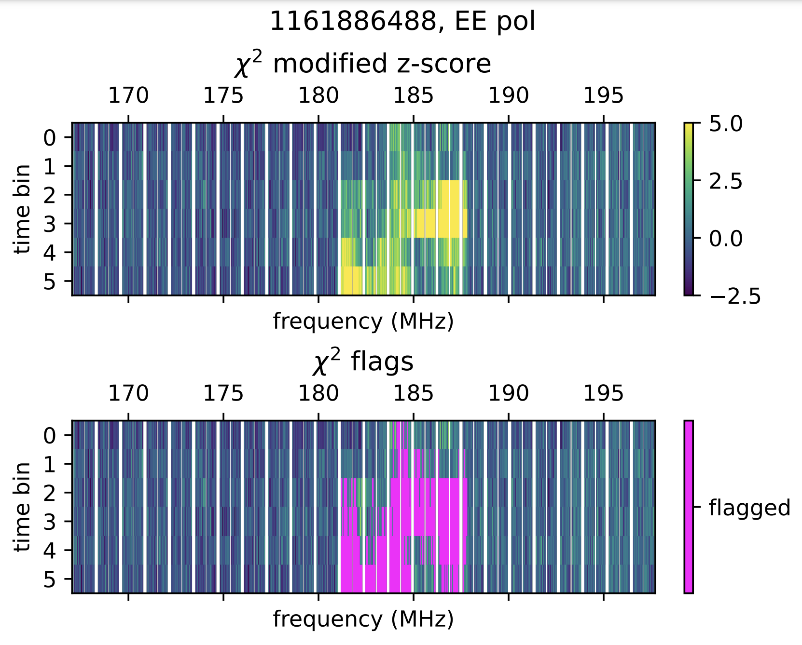
𝜒² RFI Flagger?
1
2
3
4
5
6
7
8
9
The 𝜒2 metric is clearly able to identify RFI
Work is still needed in order to turn it into a functional flagger
In this example, RFI is detected in the Australian DTV Channel 7 band, but a simple iterative flagging process fails to flag the whole band
desired
(Kunicki & Pober 2024)

Slide 18
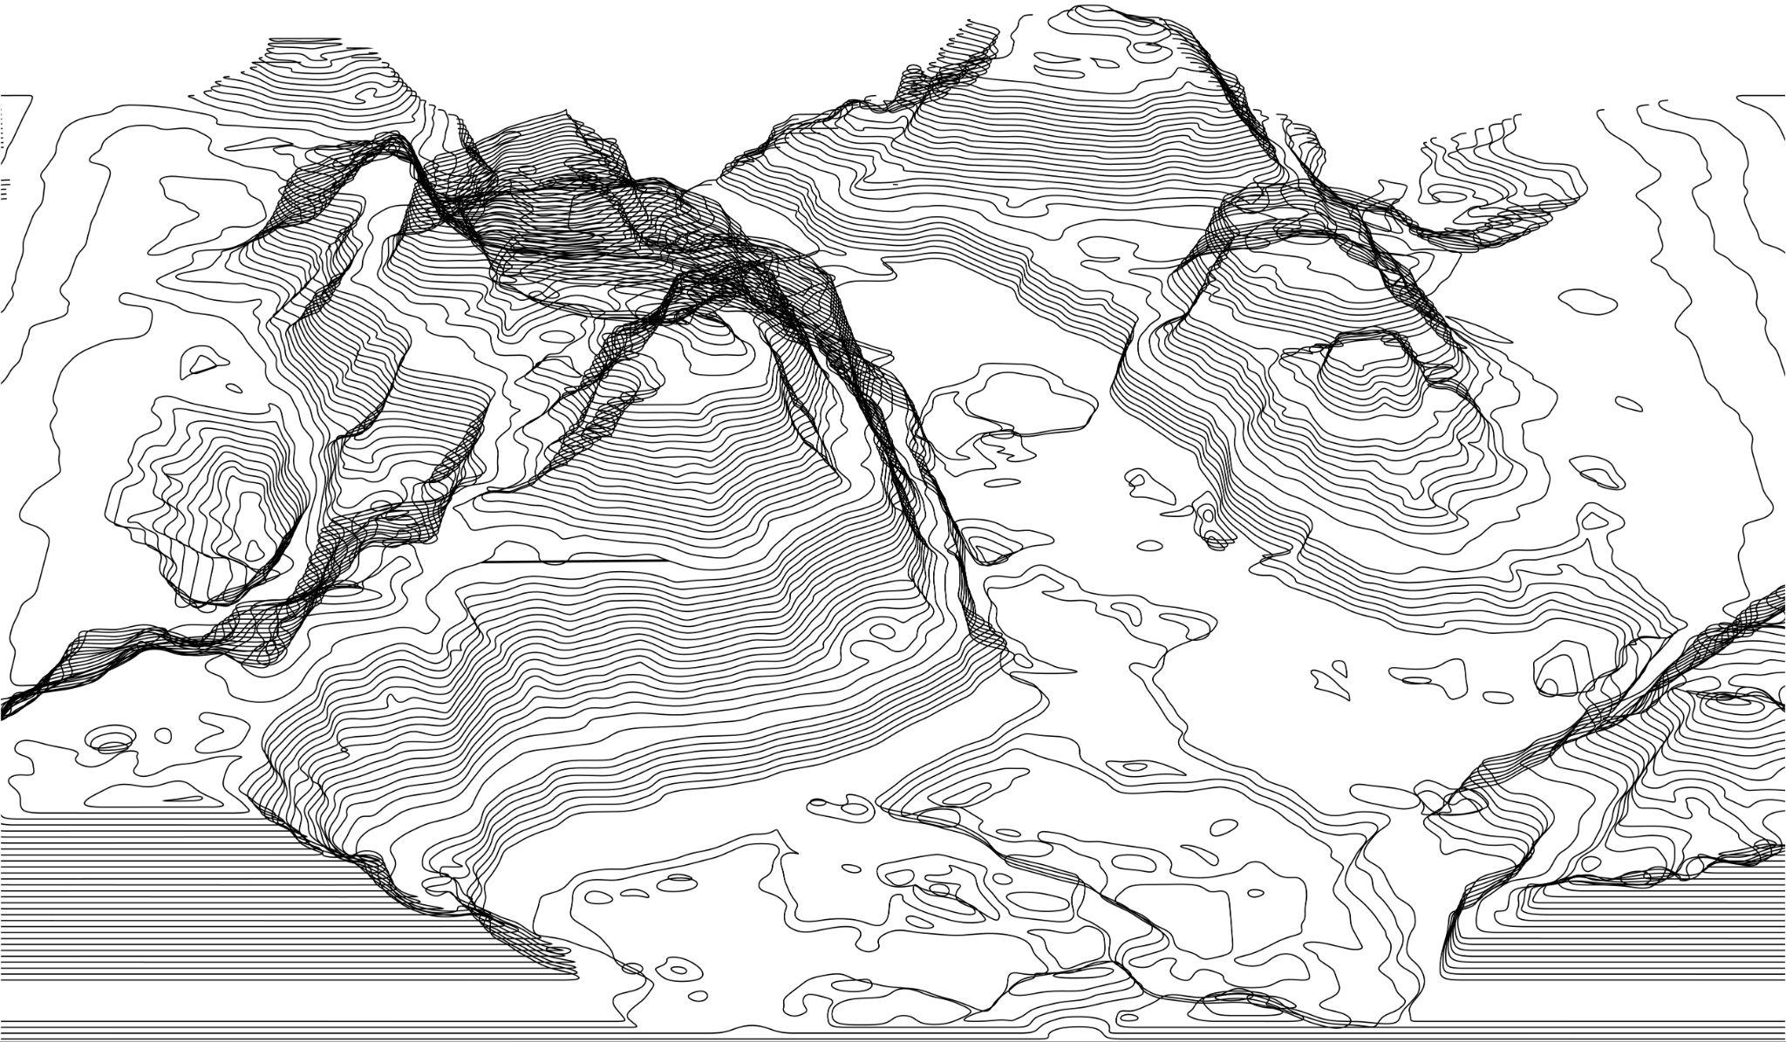
HERA Watershed Algorithm
1
2
3
4
5
6
7
8
9
Currently, a watershed algorithm is used to flag RFI in the HERA analysis pipeline
This is done via the xrfi module in hera_qm (https://github.com/HERA-Team/hera_qm)
Approach involves treating waterfall plots like topographical maps and flagging (“flooding”) the neighborhood of a bright pixel signaling RFI, up to a user-defined threshold (“watershed line”)

Slide 19
HERA Watershed Algorithm – Adaptation for MWA
1
2
3
4
5
6
7
8
9
Problem: MWA coarse band lines confuse the algorithm
Solution:
Remove the coarse band lines and flatten the data
Run xrfi
Stitch the data back together

Slide 20
HERA Watershed Algorithm – Results
1
2
3
4
5
6
7
8
9
(Xiaorui Lu, Master’s Thesis 2024)

Slide 21
EAVILS: Expected Absolute Visibility Incoherent resoLved Spectra
1
2
3
4
5
6
7
8
9
Similar to SSINS, but skips the subtraction step
For a given frequency channel and polarization, take the average of the magnitudes of visibilities across all baselines
Subtract the average of that in time
Finally, compute the z-score
z-score:

Slide 22
EAVILS: Expected Absolute Visibility Incoherent resoLved Spectra
1
2
3
4
5
6
7
8
9
(Credits: Elias Lilleskov, University of Washington)

Slide 23
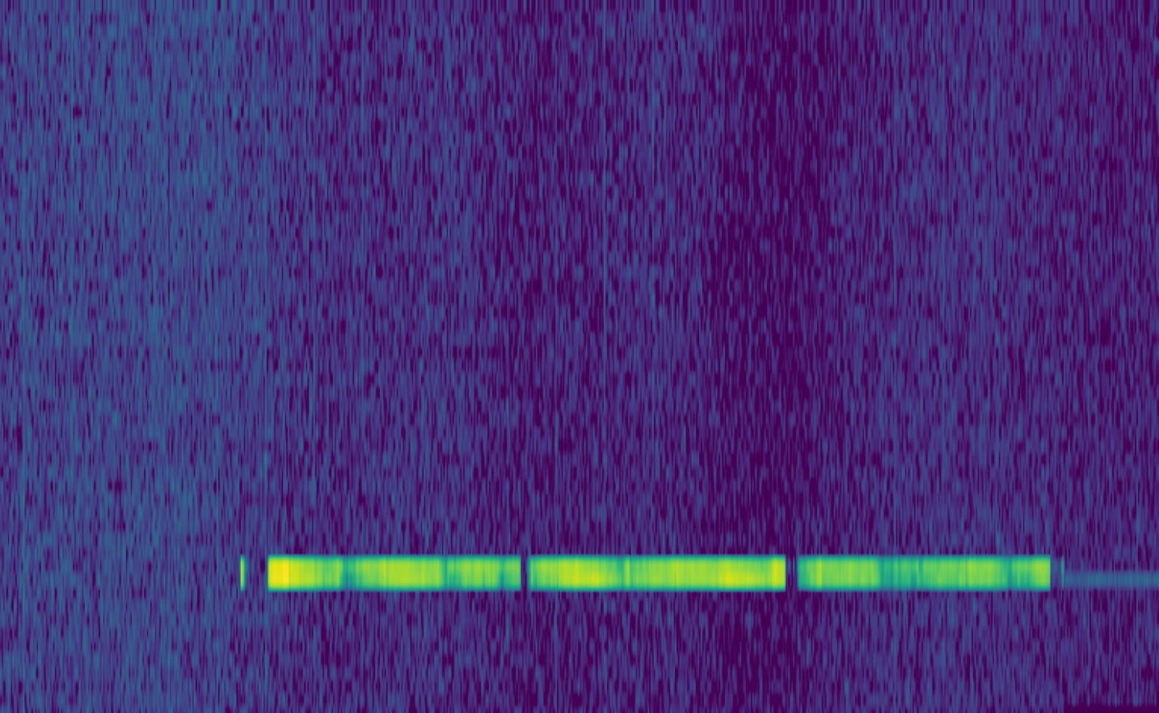
U-Net
1
2
3
4
5
6
7
8
9
Machine learning based approach
Goal: feed in several waterfall plots, obtain the corresponding flag array
U-Net

Slide 24
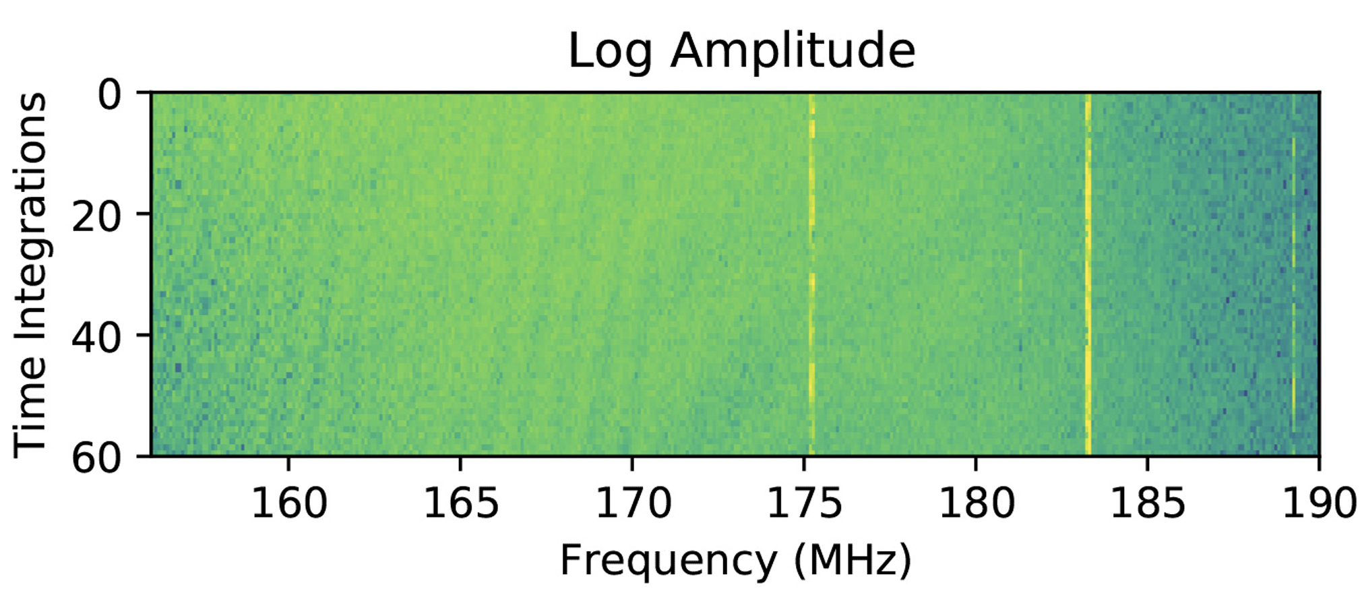
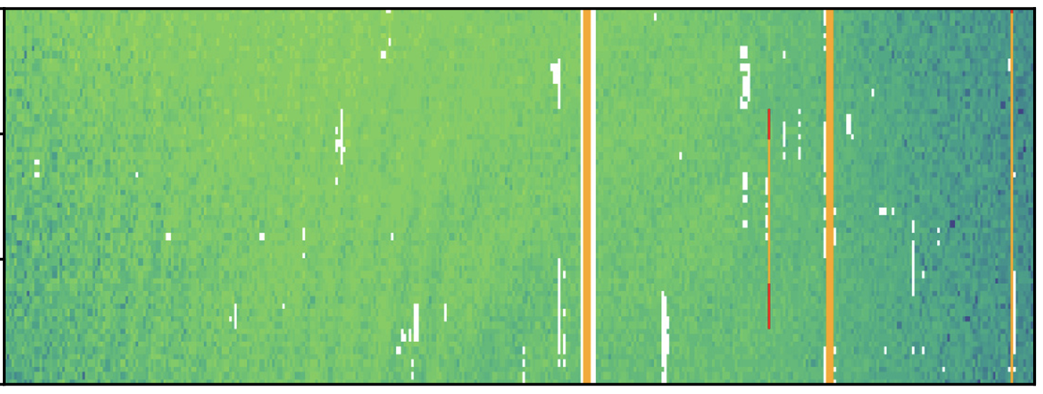
U-Net: Previous Work
1
2
3
4
5
6
7
8
9
Previous research has shown that U-Nets can successfully produce flags from one waterfall plot (cf. Akeret+ 2017, Kerrigan+ 2019)
No previous research on U-Nets with MWA data
U-Net
Using HERA data (one waterfall plot)
(Kerrigan+ 2019)
Orange = true positive

Slide 25
Simplified
Diagram
1
2
3
4
5
6
7
8
9
Input array
(n_channels, 54, 768)
Output array
(54, 768)
Treats waterfall plots like images
2D CNN
(downsamples)
2D CNN
(upsamples)
Each layer applies a two-dimensional convolutional neural network
2D CNN
(downsamples)
2D CNN
(upsamples)
Latent space representation

Slide 26
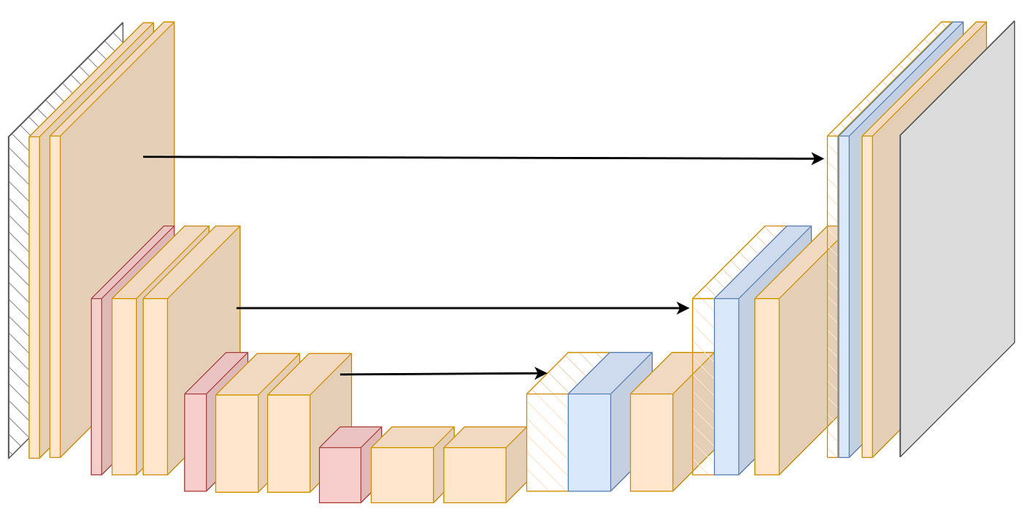
U-Net: Challenges
1
2
3
4
5
6
7
8
9
The greatest challenges is the need for reliable “ground-truth” flags, necessary to accurately train the model
All traditional flaggers have their pros and cons → none can be used as ground truth
Addressing this challenge requires the need for hand-labelled data → labour-intensive!

Slide 27
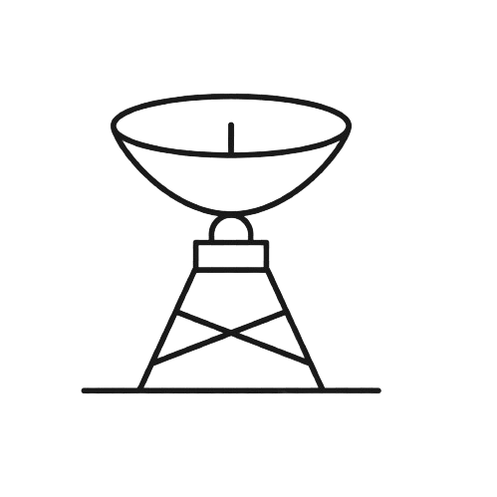
Near-Field Interferometry
1
2
3
4
5
6
7
8
9
Standard interferometry assumes light sources are located in the far field
Under this assumption, light hits the antennas as plane waves
Since astronomical sources are indeed very far, this assumption usually holds

Slide 28
Near-Field Interferometry
1
2
3
4
5
6
7
8
9
Sources of RFI are usually located much closer, in the “near field”
They emit curved wavefronts
Curvature induces additional phase differences
These extra differences can be corrected for

Slide 29
Near-Field Corrections
1
2
3
4
5
6
7
8
9
phase center
w_{near-field}
Δw
Near-field curved wavefront
w_{far-field}
far-field planar wavefront
antenna 1
antenna 2

Slide 30
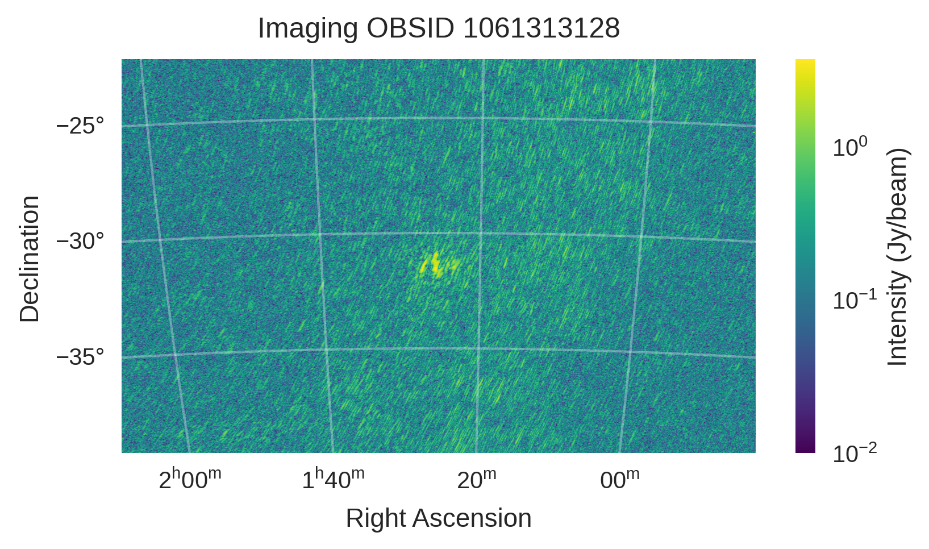
Near-Field Interferometry
1
2
3
4
5
6
7
8
9
Precision: Single-timestep image, selected down to a narrow frequency range
The different near-field delays experienced by different baselines effectively lead them to placing the same object in different locations
When imaged, this object appears blurry or out of focus
Attempting to image an airplane using WSClean (Offringa+ 2014) produces blurry output…

Slide 31
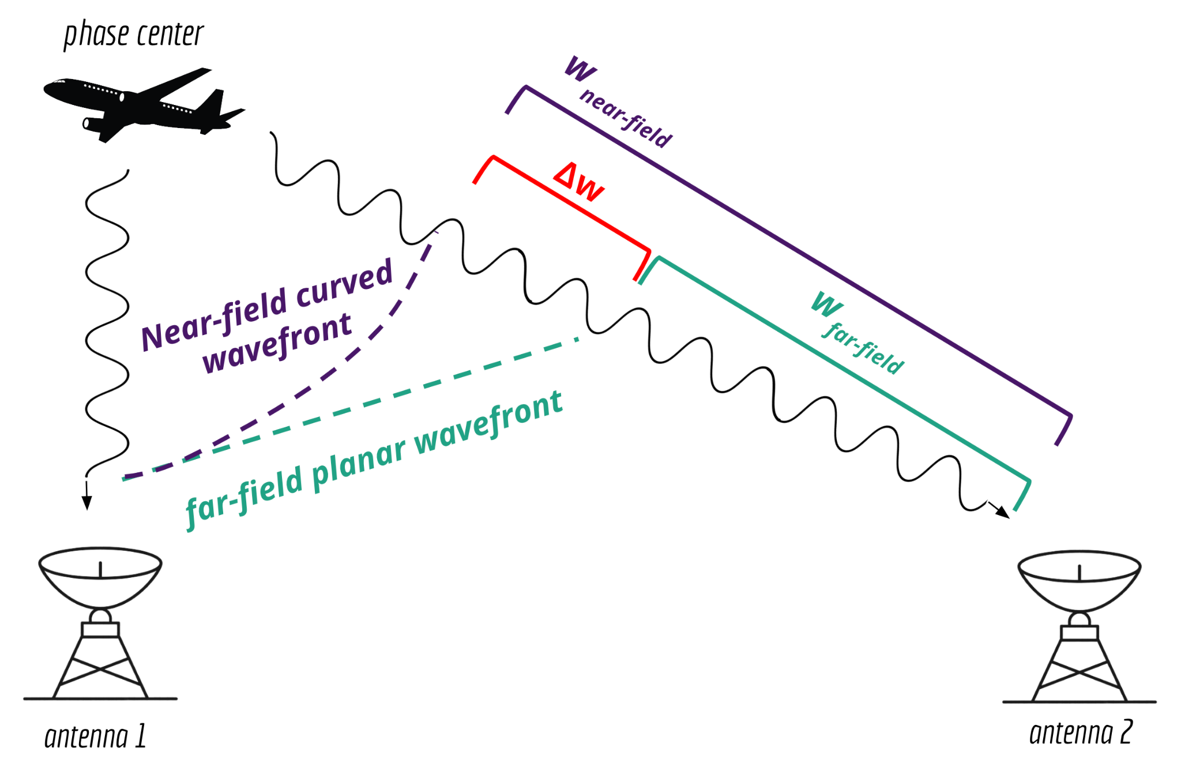
Near-Field Corrections
1
2
3
4
5
6
7
8
9
Applying this frequency-, time-, and baseline-dependent Δw to each visibility can bring a near-field object into focus
This technique has been demonstrated most recently in Prabu+ 2023, where the International Space Station was successfully resolved in an observation using near-field corrections

Slide 32
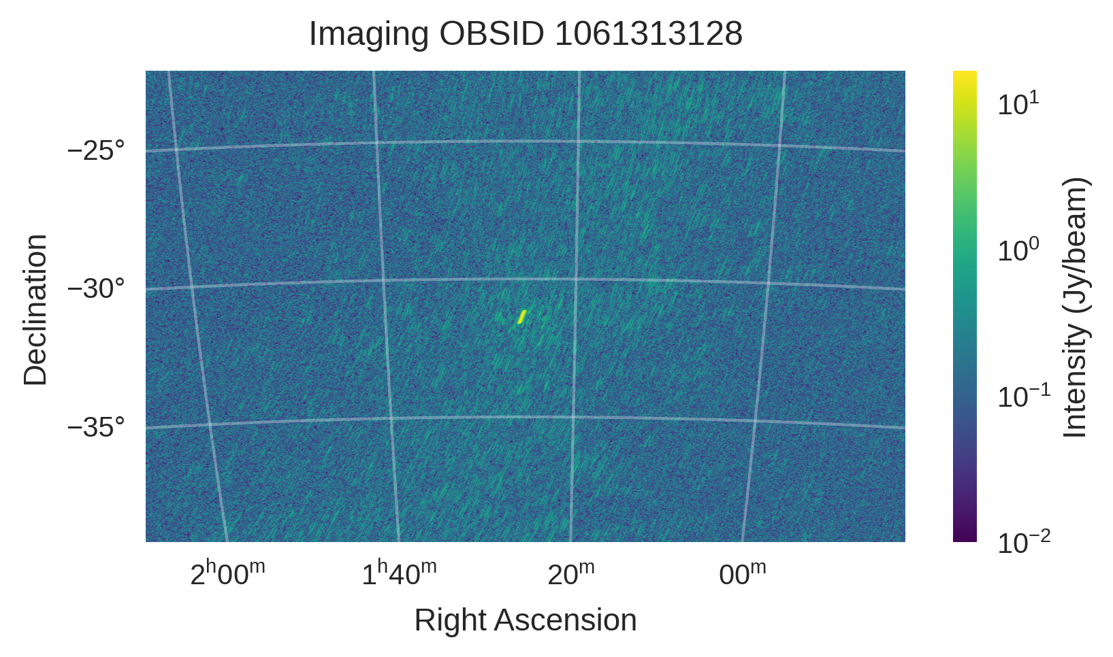
Near-Field Corrections
1
2
3
4
5
6
7
8
9
Applying the near-field corrections brings the airplane into sharp focus!
Before applying Δw
After applying Δw

Slide 33
Near-Field Corrections
1
2
3
4
5
6
7
8
9
Applying this frequency-, time-, and baseline-dependent Δw to each visibility can bring a near-field object into focus!
Important note: the Δw also depends on the distance to the source…
How do we get this?

Slide 34
Beamforming
1
2
3
4
5
6
7
8
9
In this context: the process of averaging all visibilities together
Effectively concentrates the beam into one pixel at the phase center and returns the intensity of that pixel
Real
Real
“Cloud” of visibilities in the IR plane
Averaging them returns the intensity of the source at the phase center
Imag
Imag

Slide 35
Beamforming
1
2
3
4
5
6
7
8
9
Idea:
Iterate through several values of the focal distance
Beamform at each iteration
The maximum beamformed intensity corresponds to the optimal focal distance
This assumes we already know the object’s spatial coordinates (right ascension, declination); without these, we cannot calculate Δw
For a bright enough object, can obtain these via an imager; e.g. WSClean

Slide 36
(Ducharme & Pober, in review)

Slide 37
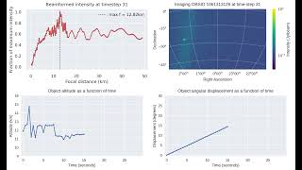
(Ducharme & Pober, in review)

Slide 38
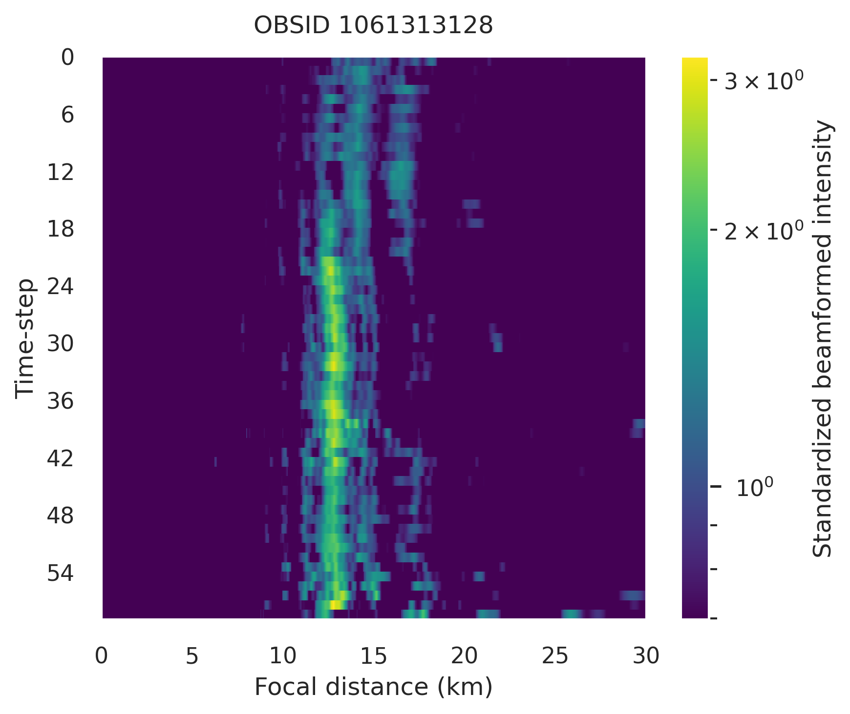
Summary Plot
1
2
3
4
5
6
7
8
9
Plot shows high confidence in the focal distance predicted using beamforming
Converting this to an altitude above sea level allows to cross-reference with various sources of RFI…
(Ducharme & Pober, in review)

Slide 39
Final Result
1
2
3
4
5
6
7
8
9
For OBSID 1061313128, the altitude consistently hovers around 11.5 km
That’s an airplane!
Combining the altitude with the radial displacement, we calculate a speed of approximately 790 km/h
Also consistent with an airplane’s cruising speed
First conclusive airplane detection in MWA data

Slide 40
More observations
1
2
3
4
5
6
7
8
9
Mixed results for other airplane-containing observations…
Phase I
0.5-second resolution
Phase I
2-second resolution
Phase II (compact)
2-second resolution

Slide 41
Limitations
1
2
3
4
5
6
7
8
9
Higher time resolution leads to less confident results
The airplane moves a lot in 2 seconds, making its spatial coordinates harder to express as a single pair of Ra/Dec coordinates
Phase II (compact) data also leads to less confident results
The Phase II (compact) configuration features much shorter baselines
Shorter baselines see the near-field closer than longer baselines
The airplane is already in the far field for such baselines!
The object needs to be bright enough to image in order to obtain its spatial coordinates
Faint RFI would image poorly, and this technique would be difficult to apply

Slide 42
Future Directions
1
2
3
4
5
6
7
8
9
Pictured:
Persistent narrowband emission from Starlink. If it also reflects RFI in other bands, we may be in trouble…
Credits:
Dev Null, Curtin University
Knowing where the airplane is may allow its subtraction or excision
This would allow to retain a higher fraction of usable data
Applying this technique to data containing RFI from a known origin may help ascertain whether the object is also reflecting faint or ultrafaint RFI in different band

Slide 43
Concluding Remarks
1
2
3
4
5
6
7
8
9
Particularly excited about prospects for the U-Net
Ultimate goal: establish a weak supervision framework where flags from all traditional methods are intelligently combined → use these combined flags to build a ground truth for training
xrfi
Weak supervision framework
𝜒2
Optimal flags for training
EAVILS
SSINS

Slide 44
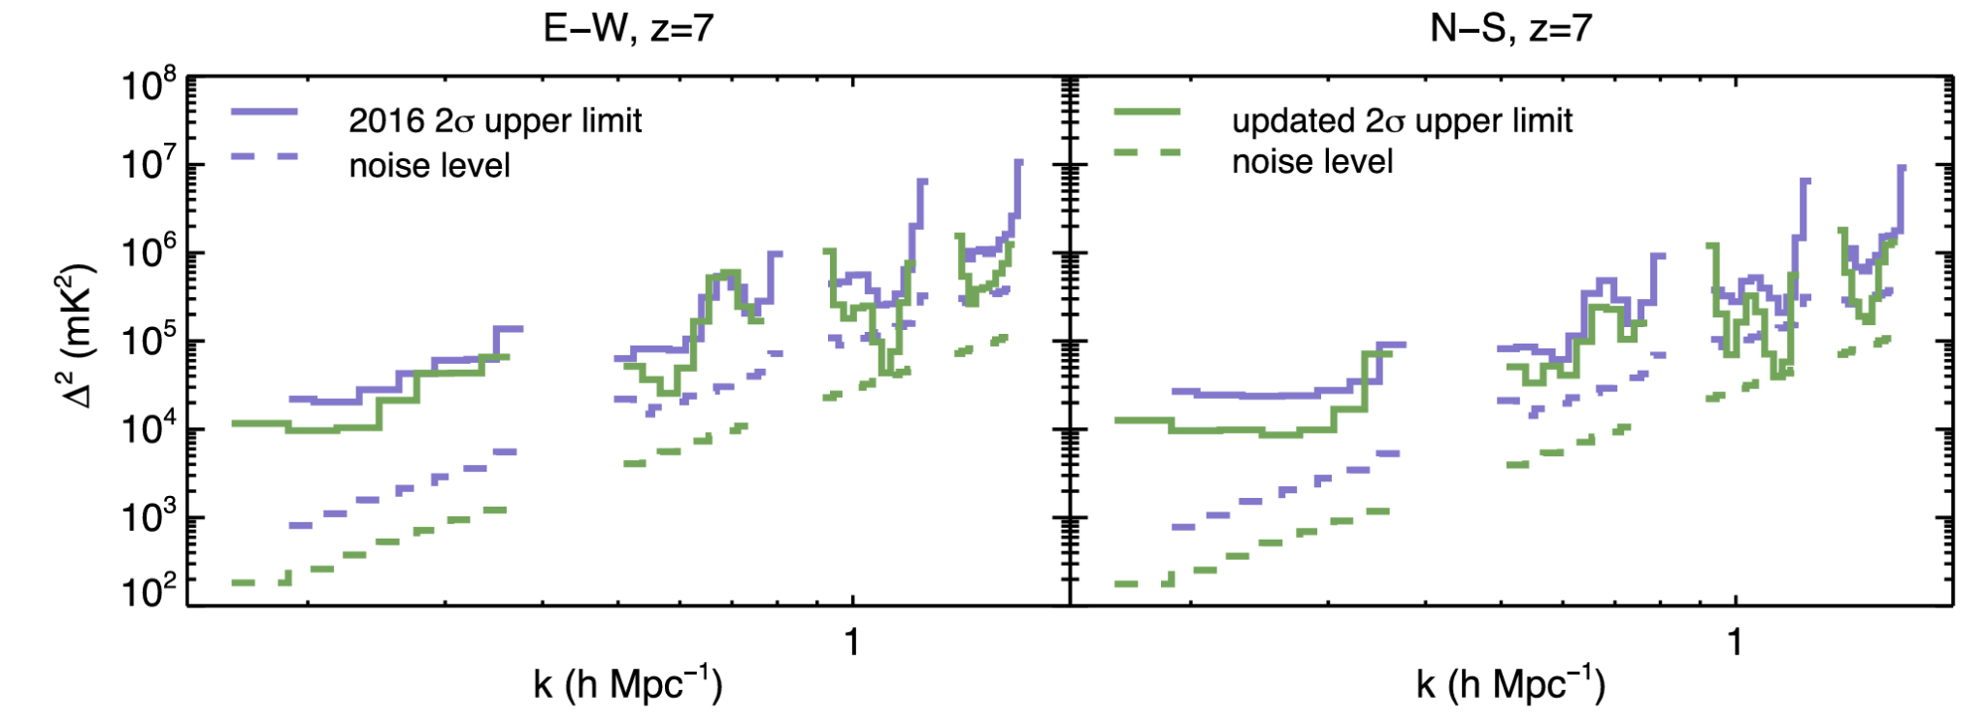
Concluding Remarks
1
2
3
4
5
6
7
8
9
RFI mitigation has been shown to improve EoR power spectrum limits for the 21 cm signal
In Barry+ 2019, SSINS was used in addition to AOFlagger for RFI flagging
1D EoR upper limit comparison between the Beardsley+ 2016 (purple) and Barry+ 2019 (green) analyses
(Barry+ 2019)

Slide 45
References I
Akeret, J., C. Chang, A. Lucchi, et al. 2017. "Radio Frequency Interference Mitigation Using Deep Convolutional Neural Networks." Astronomy and Computing 18: 35-39. https://doi.org/10.1016/j.ascom.2017.01.002.
Barry, N., M. Wilensky, C. M. Trott, et al. 2019. "Improving the Epoch of Reionization Power Spectrum Results from Murchison Widefield Array Season 1 Observations." The Astrophysical Journal 884, no. 1: 1. https://doi.org/10.3847/1538-4357/ab40a8.
Beardsley, A. P., B. J. Hazelton, I. S. Sullivan, et al. 2016. "First Season MWA EoR Power Spectrum Results at Redshift 7." The Astrophysical Journal 833, no. 1: 102. https://doi.org/10.3847/1538-4357/833/1/102.
Dillon, J. S., M. Lee, Z. S. Ali, et al. 2020. "Redundant-baseline Calibration of the Hydrogen Epoch of Reionization Array." Monthly Notices of the Royal Astronomical Society 499, no. 4: 5840–5861. https://doi.org/10.1093/mnras/staa3001.
Ducharme, J. M., and J. C. Pober. "Altitude Estimation of Radio Frequency Interference Sources via Interferometric Near Field Corrections." Publications of the Astronomical Society of Australia (in review).
Hazelton, B. J., D. C. Jacobs, J. C. Pober, et al. 2017. "pyuvdata: An Interface for Astronomical Interferometric Datasets in Python." Journal of Open Source Software 2, no. 10: 140. https://doi.org/10.21105/joss.00140.
Kerrigan, J., P. La Plante, S. Kohn, et al. 2019. "Optimizing Sparse RFI Prediction Using Deep Learning." Monthly Notices of the Royal Astronomical Society 488, no. 2: 2605-2615. https://doi.org/10.1093/mnras/stz1865.

Slide 46
References II
Kunicki, T., and J. C. Pober. 2024. "χ² from Redundant Calibration as a Tool in the Detection of Faint Radio-frequency Interference." Publications of the Astronomical Society of Australia (forthcoming).
Offringa, A. R. 2010. AOFlagger: RFI Software. Astrophysics Source Code Library, record ascl:1010.017. https://ui.adsabs.harvard.edu/abs/2010ascl.soft10017O.
Offringa, A. R., B. McKinley, and N. Hurley-Walker, et al. "WSClean: An Implementation of a Fast, Generic Wide-Field Imager for Radio Astronomy." Monthly Notices of the Royal Astronomical Society 444, no. 1 (August 2014): 606–619. https://doi.org/10.1093/mnras/stu1368.
Prabu, S., S. J. Tingay, and A. Williams. 2023. “A Near-Field Treatment of Aperture Synthesis Techniques Using the Murchison Widefield Array.” Publications of the Astronomical Society of Australia 40: e056. https://doi.org/10.1017/pasa.2023.56.
Wilensky, M. J., M. F. Morales, B. J. Hazelton, et al. 2019. "Absolving the SSINS of Precision Interferometric Radio Data: A New Technique for Mitigating Faint Radio Frequency Interference." Publications of the Astronomical Society of the Pacific 131, no. 1005: 114507. https://doi.org/10.1088/1538-3873/ab3cad.
Wilensky, M. J., M. F. Morales, B. J. Hazelton, et al. 2023. "Evidence of Ultrafaint Radio Frequency Interference in Deep 21 cm Epoch of Reionization Power Spectra with the Murchison Wide-field Array." The Astrophysical Journal 957, no. 2: 78. https://doi.org/10.3847/1538-4357/acffbd.

