Slide 1
A Candidate Field for Deep Imaging of CD/EoR with MWA
Cathie Zheng
Xueying Zhang, Linhui Wu, Quan Guo, Mengfan He, Huanyuan Shan, Feiyu Zhao, Tianyang Liu
Shanghai Astronomical Observatory, China

Slide 2
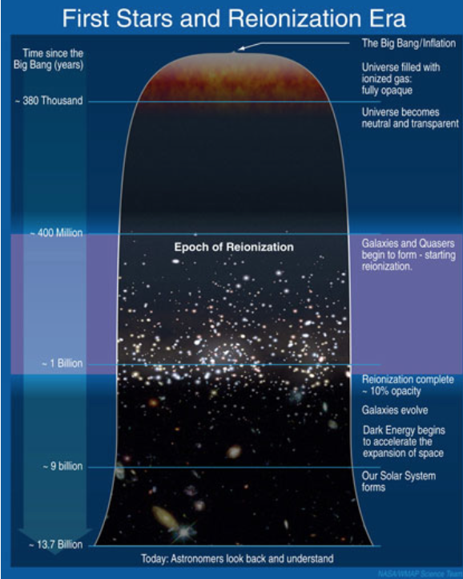
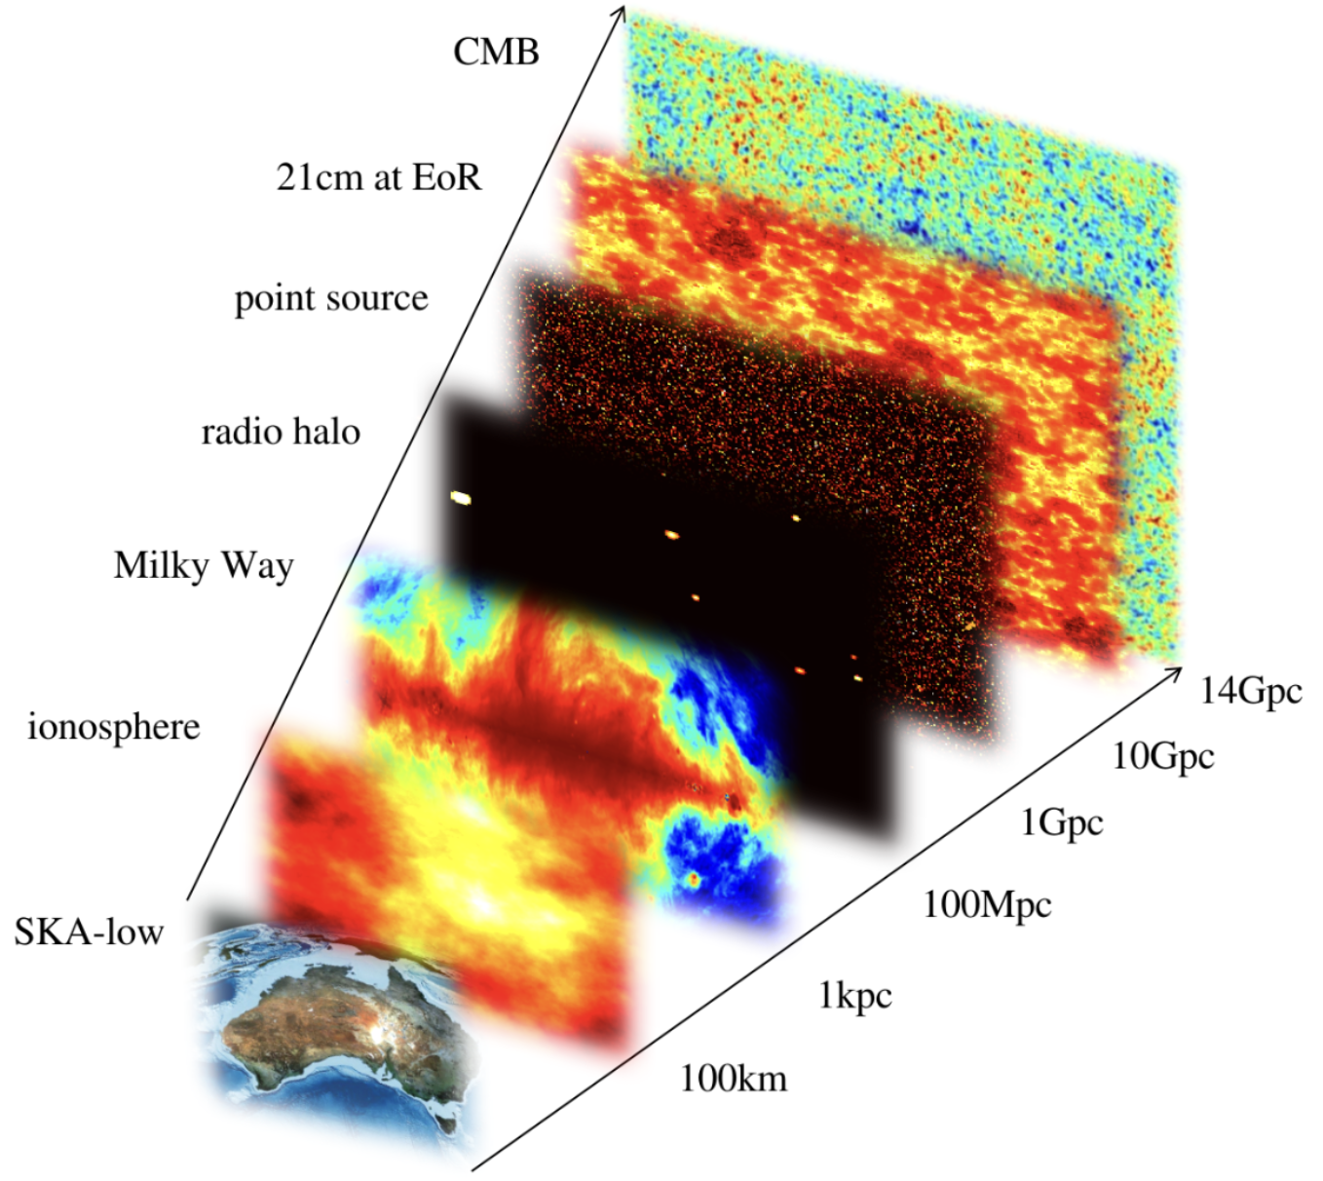
(SKAO)
(Philosophy-of-cosmology.ox.au.uk)
(Zhu, 2024)

Slide 3
Pre-selection of the Candidate Fields for Deep Imaging of the EoR with SKA1-low
SKA1-low will have a sky coverage similar to MWA, which can observe the entire sky south of Dec. +30 degrees. (Hurley-Walker et al. 2017)
The candidate fields should be large enough to capture the largest ionized structures during the late stage of EoR at z~6. (100 h^-1Mpc -> 1 h degree)
Multi-frequency observations：MWA，TGSS, etc.
Zheng et al. (2020), MNRAS

Slide 4
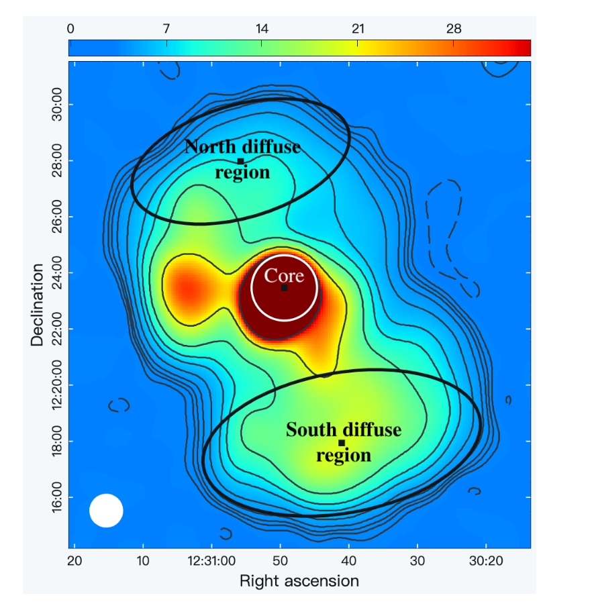
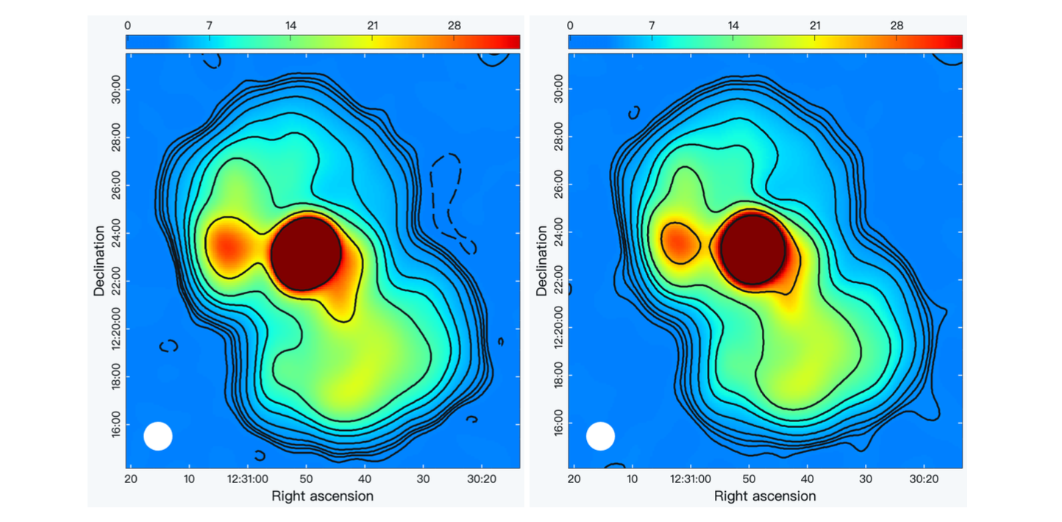
Observations with MWA
Extended Configuration: D0013, G0044, D0018
Compact Configuration: G0091

Slide 5
G0044 - a Candidate EoR Field
Observation Time 2018-04-08 - 2018-04-30
Configuration Extended
Central Frequency 87.675MHz (z~ 15.20)
215.675MHz (z~5.58)
Bandwidth 30.72MHz
Spectral Resolution 40kHz
Max Number of Used Snapshots 169 @87MHz
133 @ 215MHz
Integration Time per Snapshot 2 minutes
Images centred at
RA (J2000) 120 degrees, Dec (J2000) 0degree

Slide 6
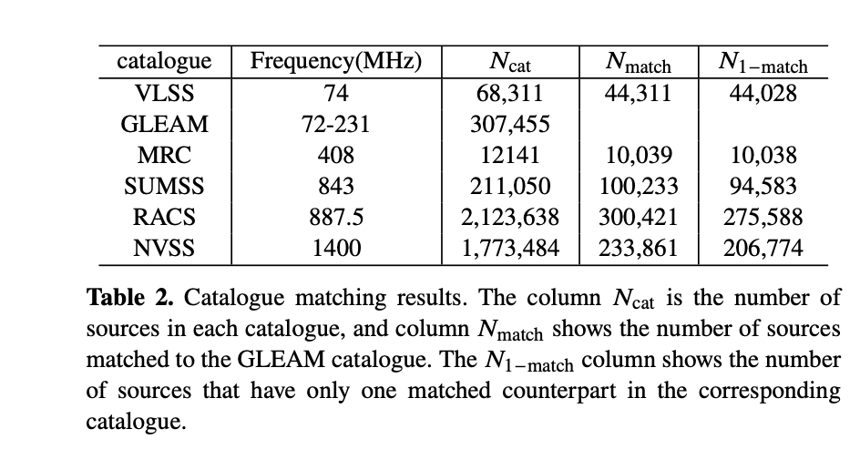
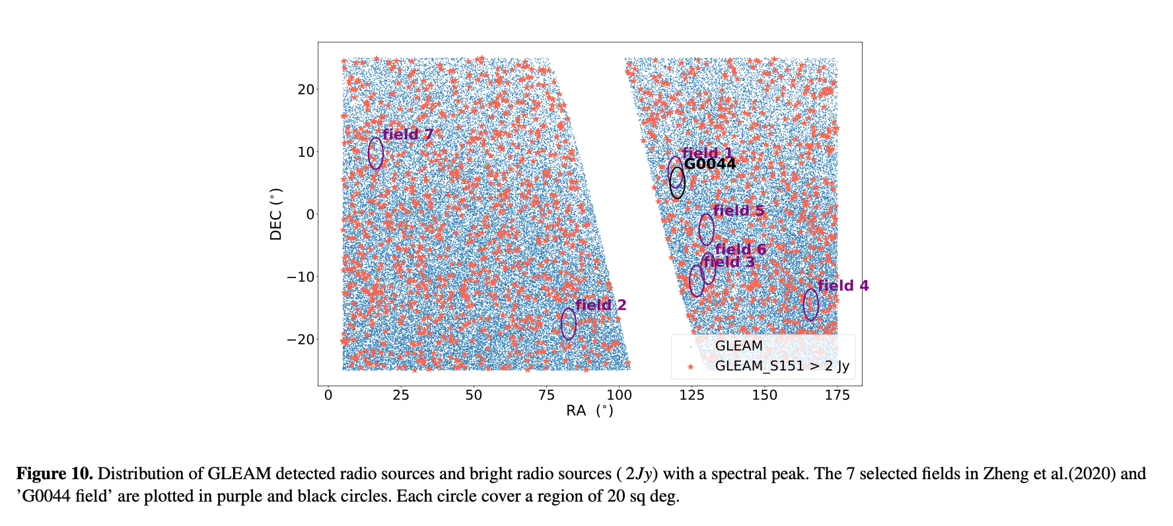

Slide 7
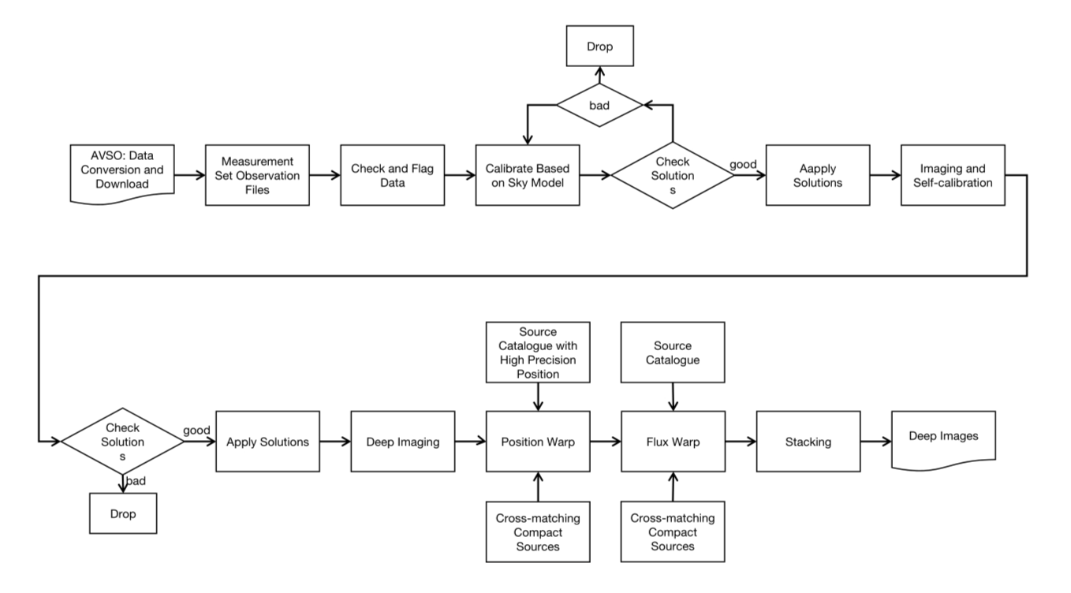
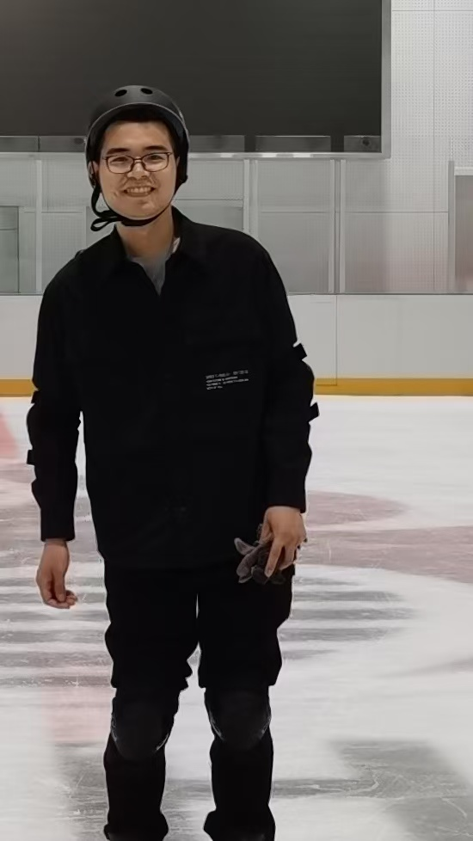
Pipeline
Linhui Wu (SHAO)
Duchesne et al. (2020)

Slide 8
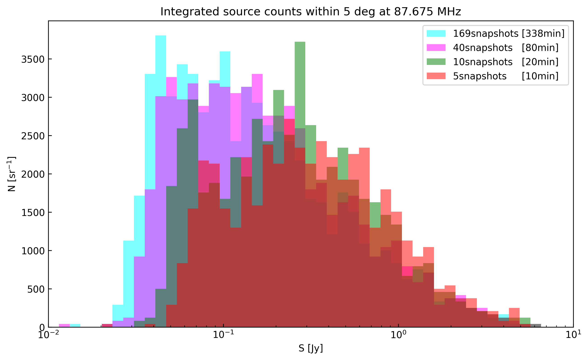
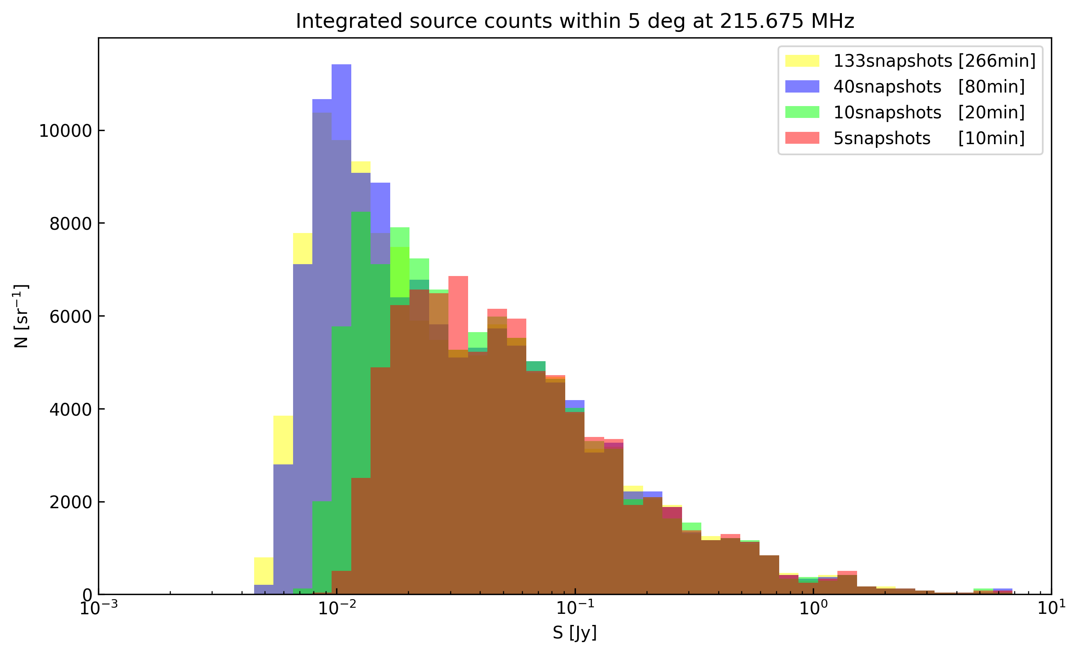
Source Detection
Xueying Zhang (SHAO)
133 snapshots, 2972 sources

Slide 9
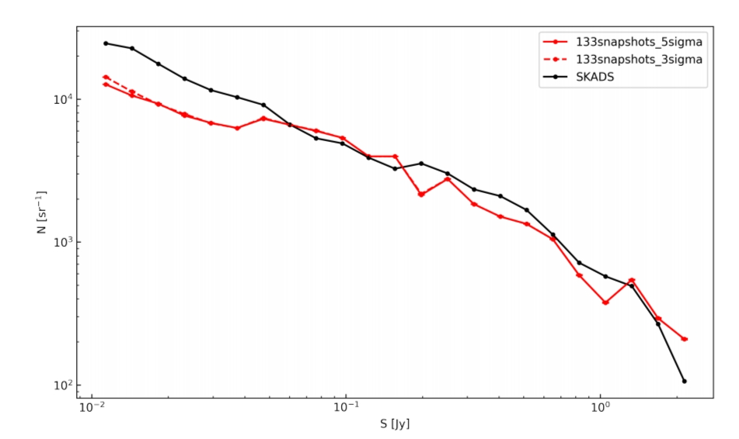
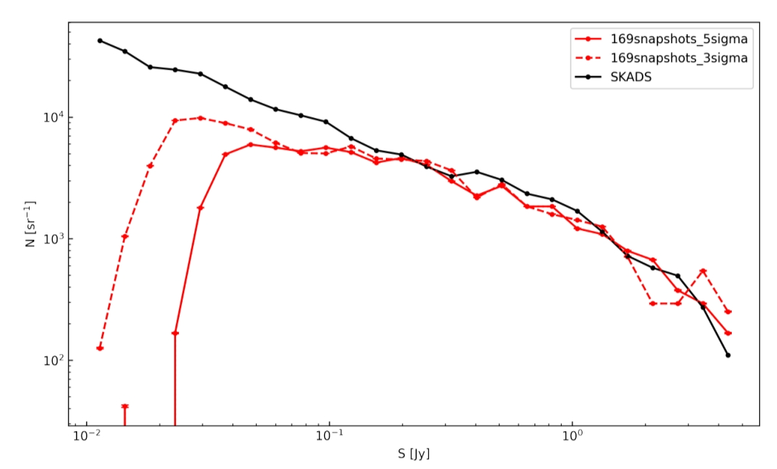
Completeness
87.675MHz _ 5deg
215.675MHz _ 5deg
SKADS :（Wilman, et al. 2008）

Slide 10
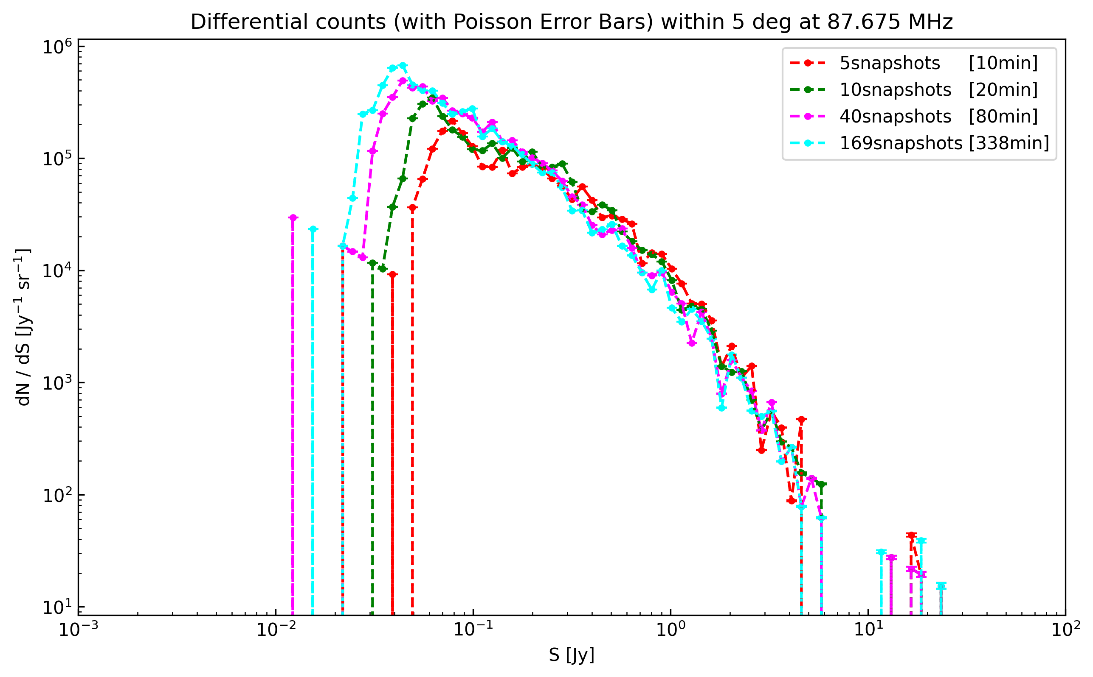
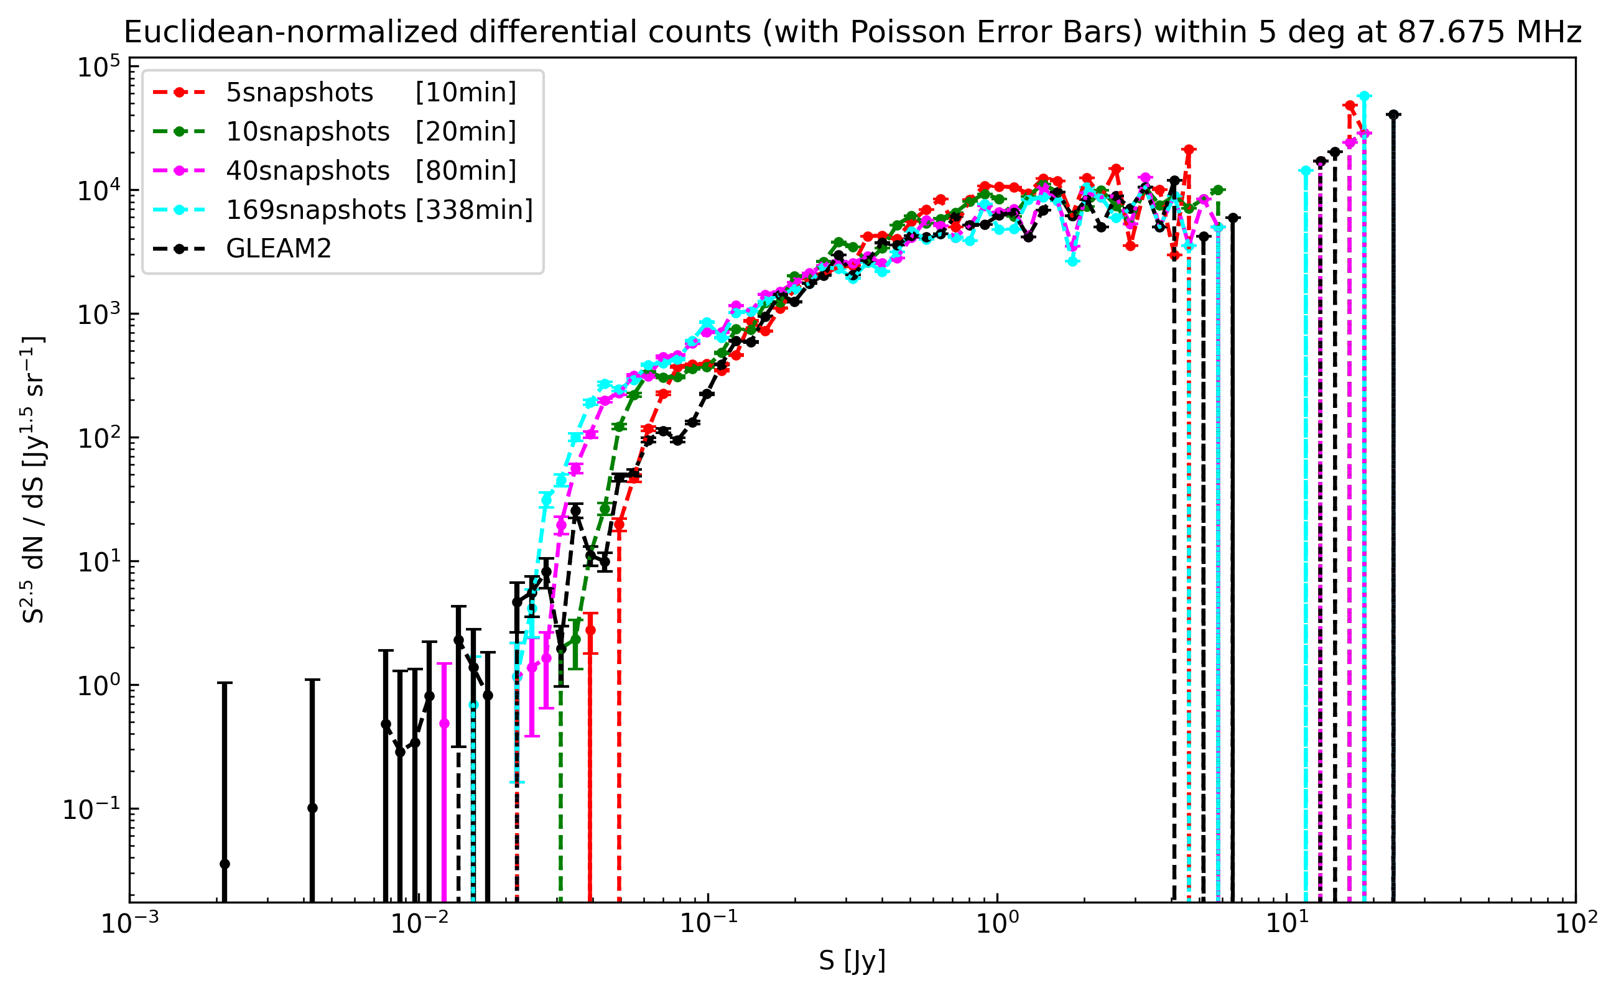
@87.675MHz _ 5deg

Slide 11
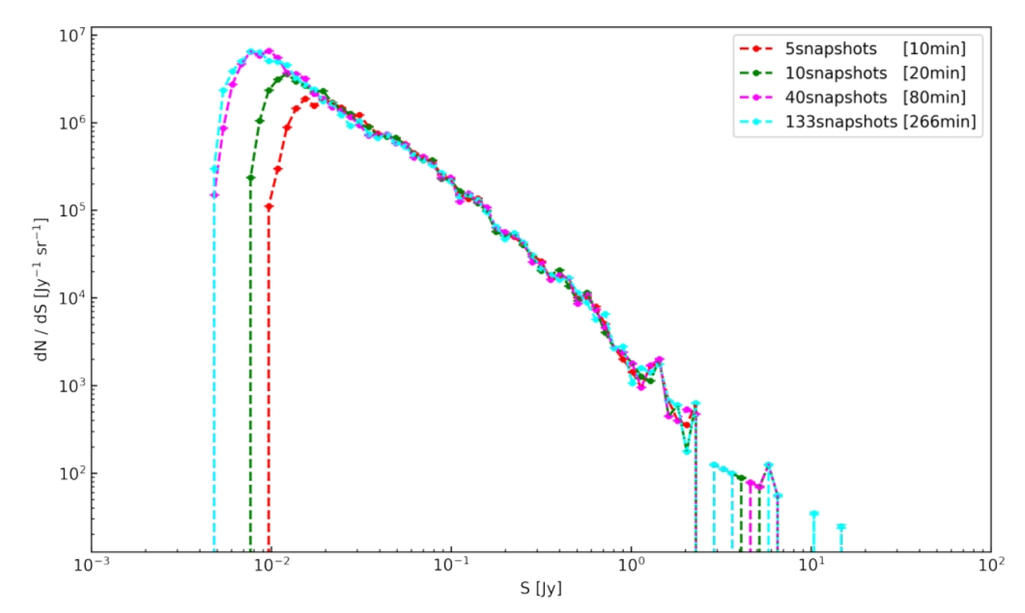
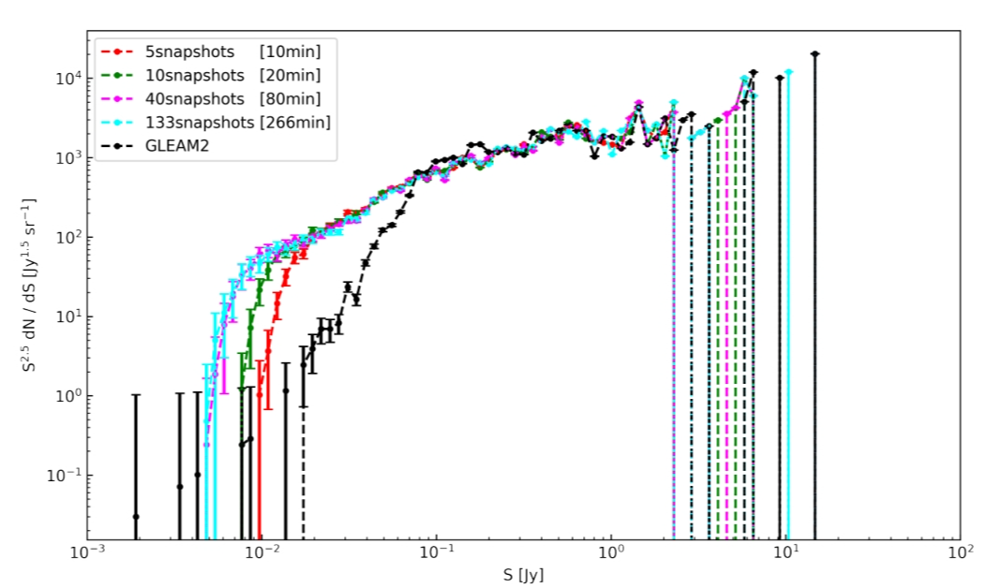
@215.675MHz _ 5deg

Slide 12
Foreground Removal
Number of sources in 30.72MHz combined image: 461
Sources subtracted by PCA in 4 subband images:
100.00%, 100.00%, 99.38% and 98.11%
Principal Component Analysis
Data: 87.675 MHz Observation
169 snapshots (2min/snapshot)
4 channels (WSCLEAN)

Slide 13
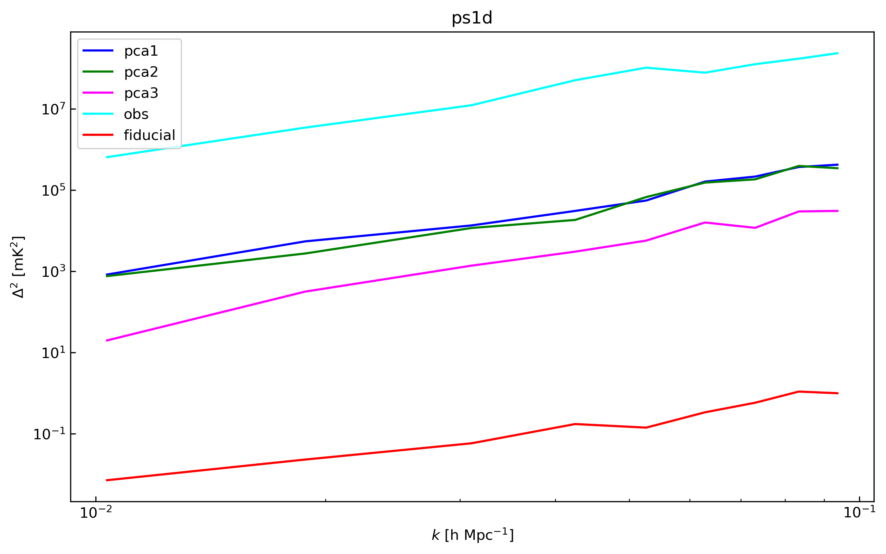
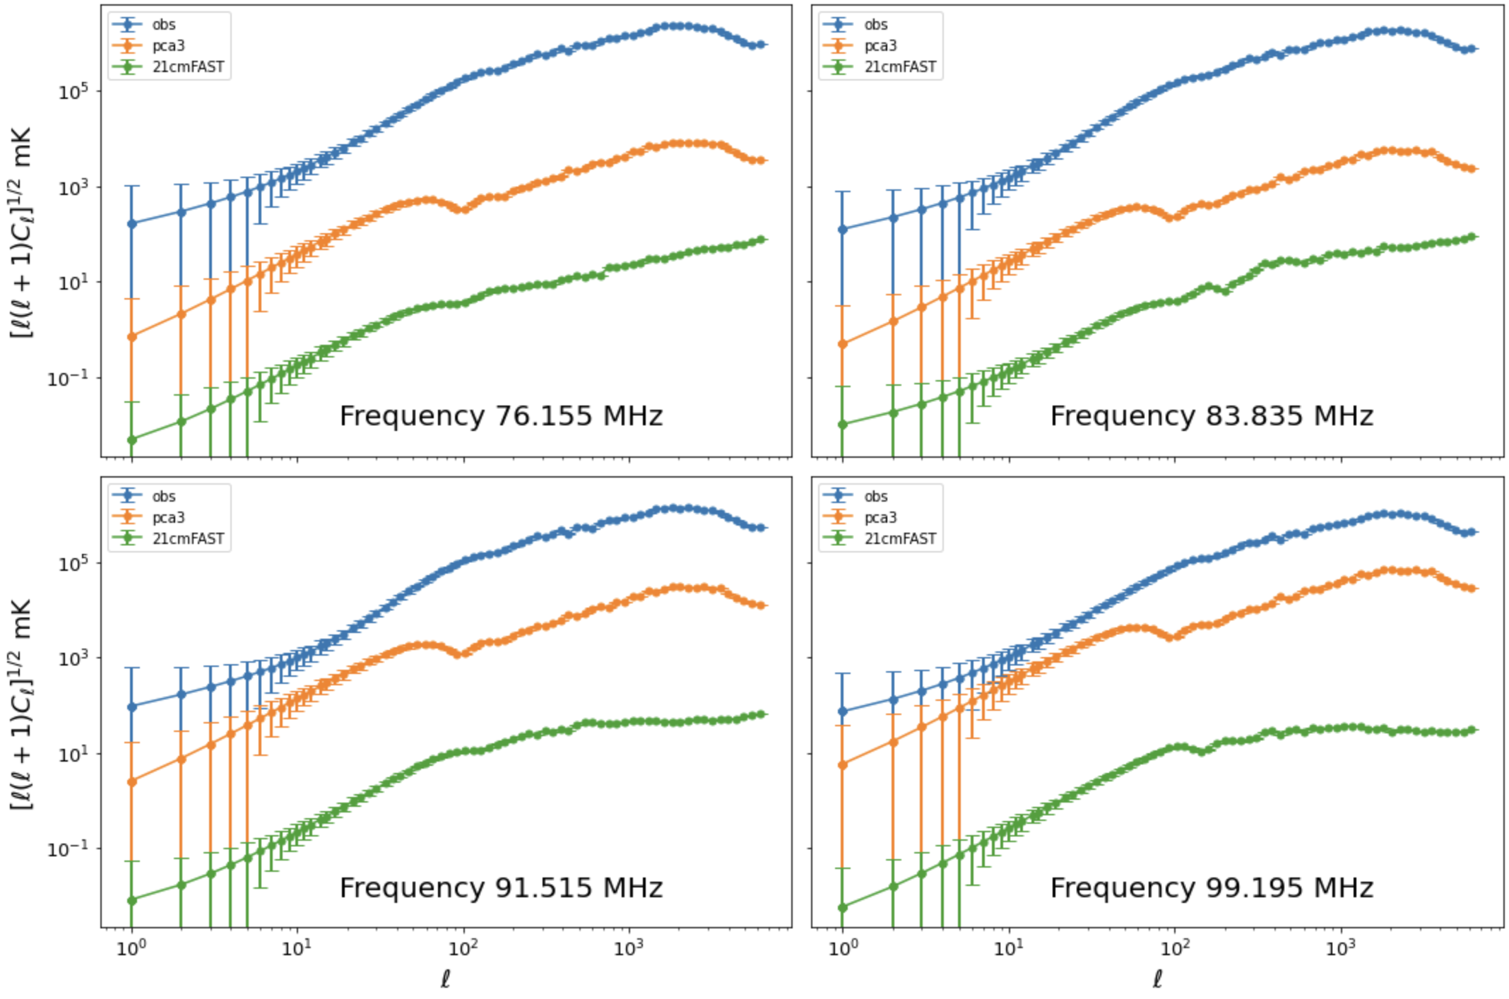
Power spectrum
Fiducial cosmo signal
21cmFAST

Slide 14
Noise_MWA
Thermal Noise
Δν = 0.75 × 7.68MHz
Aeff = 21.5 m²
Nant = 128
Tsky = 228K(ν/150MHz)^{−2.53}, Trec = 50K except at ν>200MHz, where we set Trec = 80K
2.75, 0.29 mJy @ 87.675 MHz, Tsys = 937 K, with integration time of 338 min (169 snapshots), 500h,
201.47 min (when σN = σc).
0.57, 0.053 mJy @ 215.675 MHz, Tsys = 170K, with integration time of 266 min (133 snapshots), 500h,
523.56 min (when σN = σc).
Confusion Noise
87.675 MHz
θs = 4.77 arcmin for MWA
Slim = 3σ RMS noise = 39.36 mJy
σc = 3.563 mJy
215.675 MHz
θs = 2.16 arcmin for MWA
Slim = 3σ RMS noise = 7.39 mJy
σc = 0.401 mJy
Notes:
1812.00666

Slide 15
Noise_SKA1-Low Array
Thermal Noise
Δν = 125 kHz
Nant = 512
0.27, 0.028 μJy @ 87.675 MHz, Aeff / Tsys = 399.7 m²/K, with integration time of 338 min (169 snapshots), 500h,
0.032s (when σN = σc).
0.19, 0.018 μJy @ 215.675 MHz, Aeff / Tsys = 646.5 m²/K, with integration time of 266 min (133 snapshots), 500h,
1.39s (when σN = σc).
Confusion Noise
87.675 MHz
θs = 17 arcsec for SKA1-Low
Slim = 3σ RMS noise = 39.36 mJy
σc = 0.212 mJy
215.675 MHz
θs = 6.4 arcsec for SKA1-Low
Slim = 3σ RMS noise = 7.39 mJy
σc = 0.020 mJy
Notes:
2407.17573

Slide 16
Conclusions
G0044 field – a candidate field for deep EoR imaging, (338 min @ 87 MHz, 266 min @ 216 MHz)
2972 sources within 5 degrees radius around the field center can be detected
PCA is used for source subtraction
Currently, we are working on the D0018 (extended configuration) and G0091(compact configuration) datasets using Hyperdrive, …
Thank you !

