Slide 1
The Implications of quasiperiodic nulling on the pulsar death mechanism
Garvit Grover

Slide 2
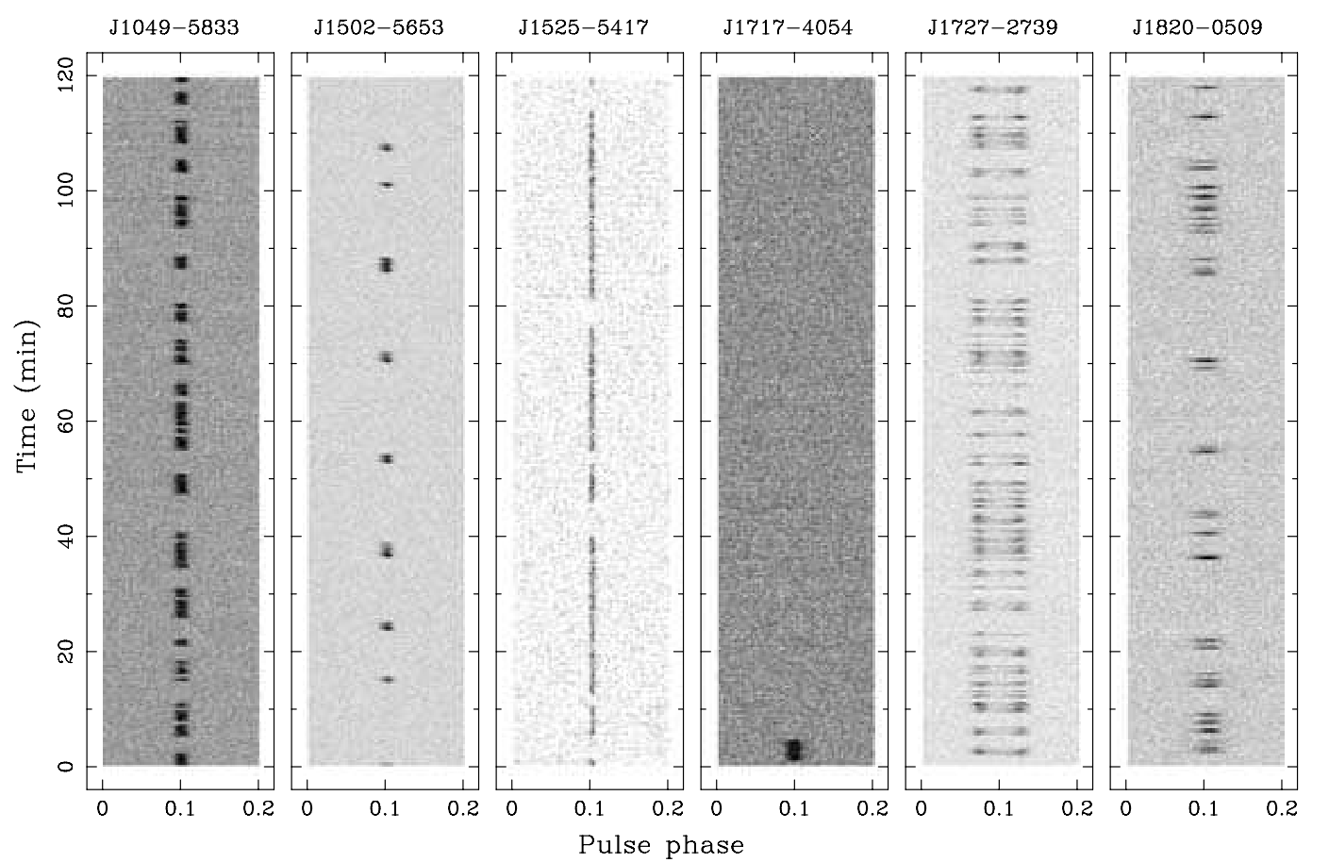
Nulling
Temporary cessation of emission
Stochastic
Typically parameters:
Nulling fraction
Nulling Duration
Wang+2007
Notes:
Describe nulling -

Slide 3
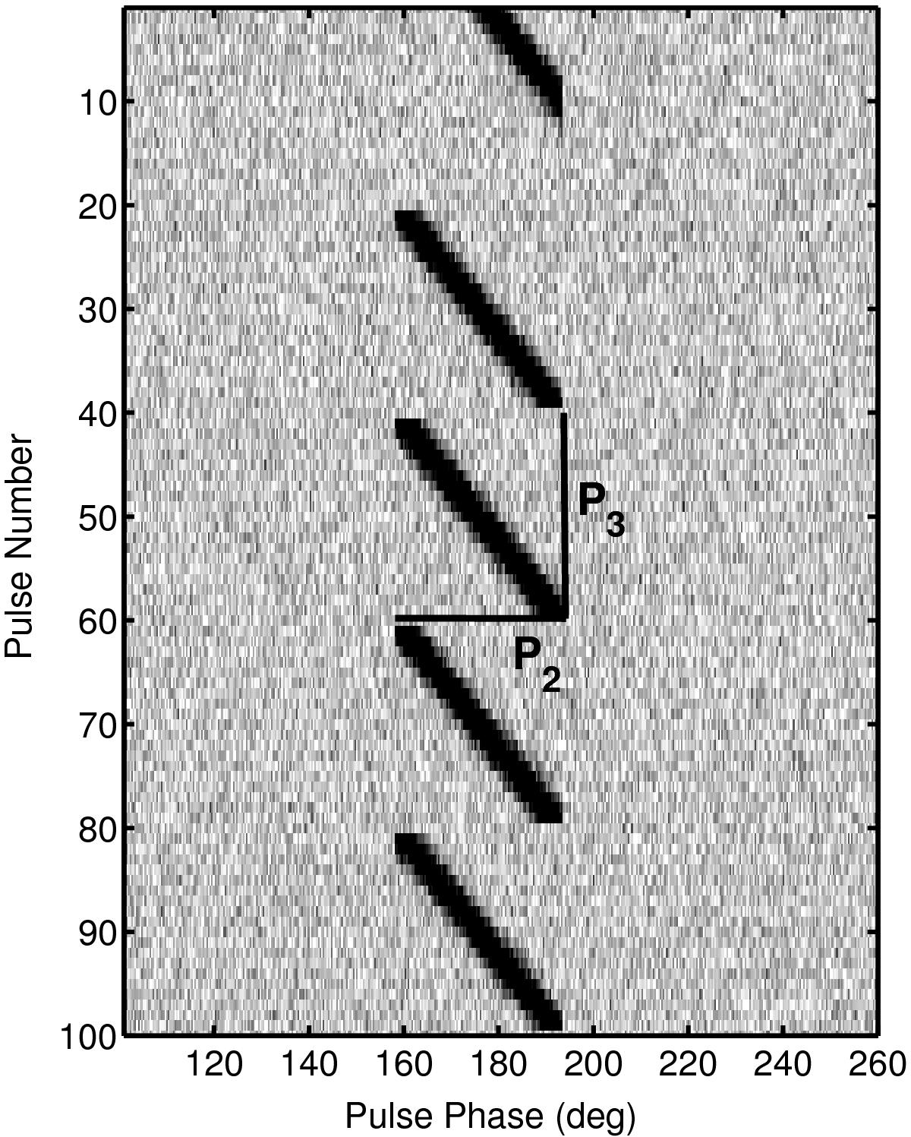
Subpulse drifting - quick definition
Wen+2016
Modulation of pulse phase over time
Can be well behaved
Notes:
-pulse position shifts overtime in phase -

Slide 4
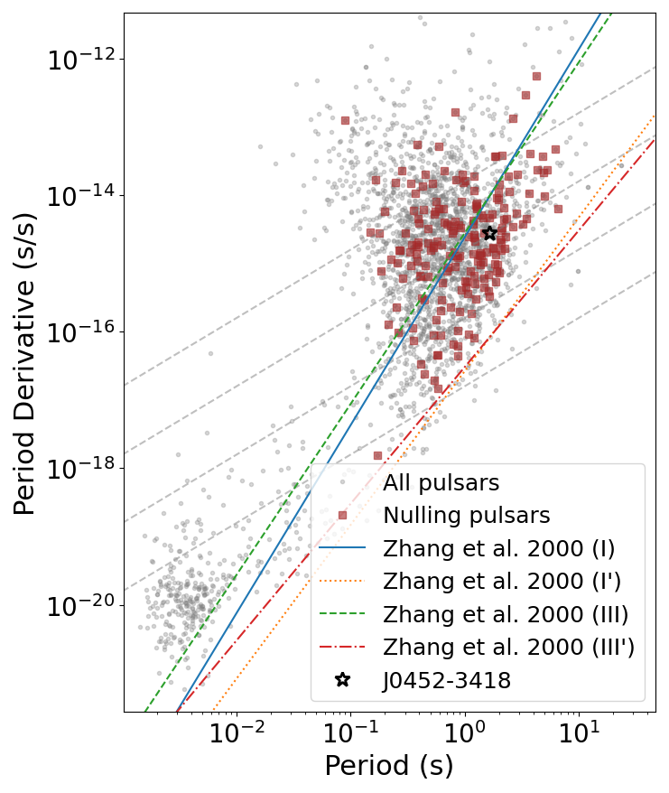
Nulling and death lines
Death = no emission
Death lines are theoretical limits
Nature of nulling linked to pulsar death
No conclusive evidence
Notes:
Pulsar death and death lines - temporary cessation -> permanent cessation - some correlations in the past

Slide 5
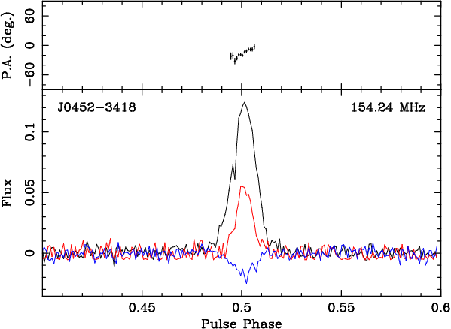
Pulsar J0452-3418
Period ~ 1.66s
Pdot ~ 2.77 e-15 s/s
DM ~ 19.78 pc/cc
RA/Dec 04:52.00.7 / -34:18:42.4
Notes:
Fifth pulsar discovered with MWA - Basic parameters - slowish pulsars - boring polarisation and profile

Slide 6
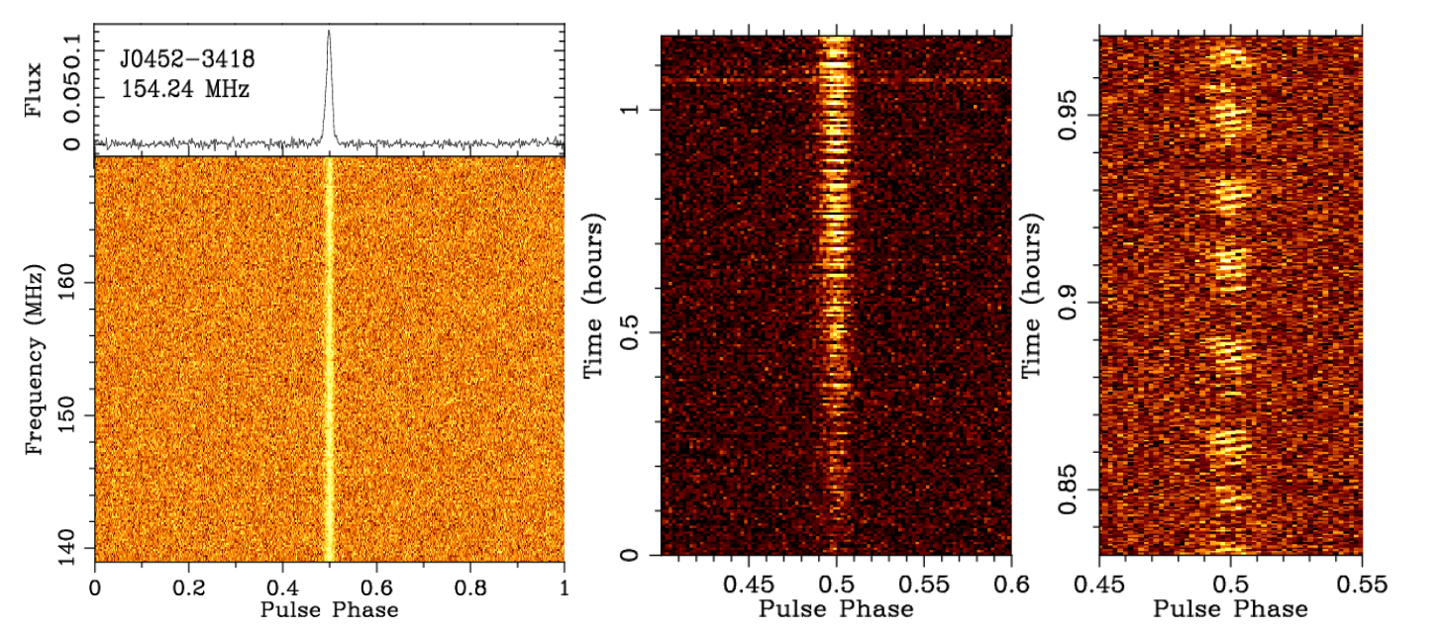
Pulsar J0452-3418
Basic parameters
Notes:
Nulling -Profile - Subpulse drifting - quasiperiodicity

Slide 7
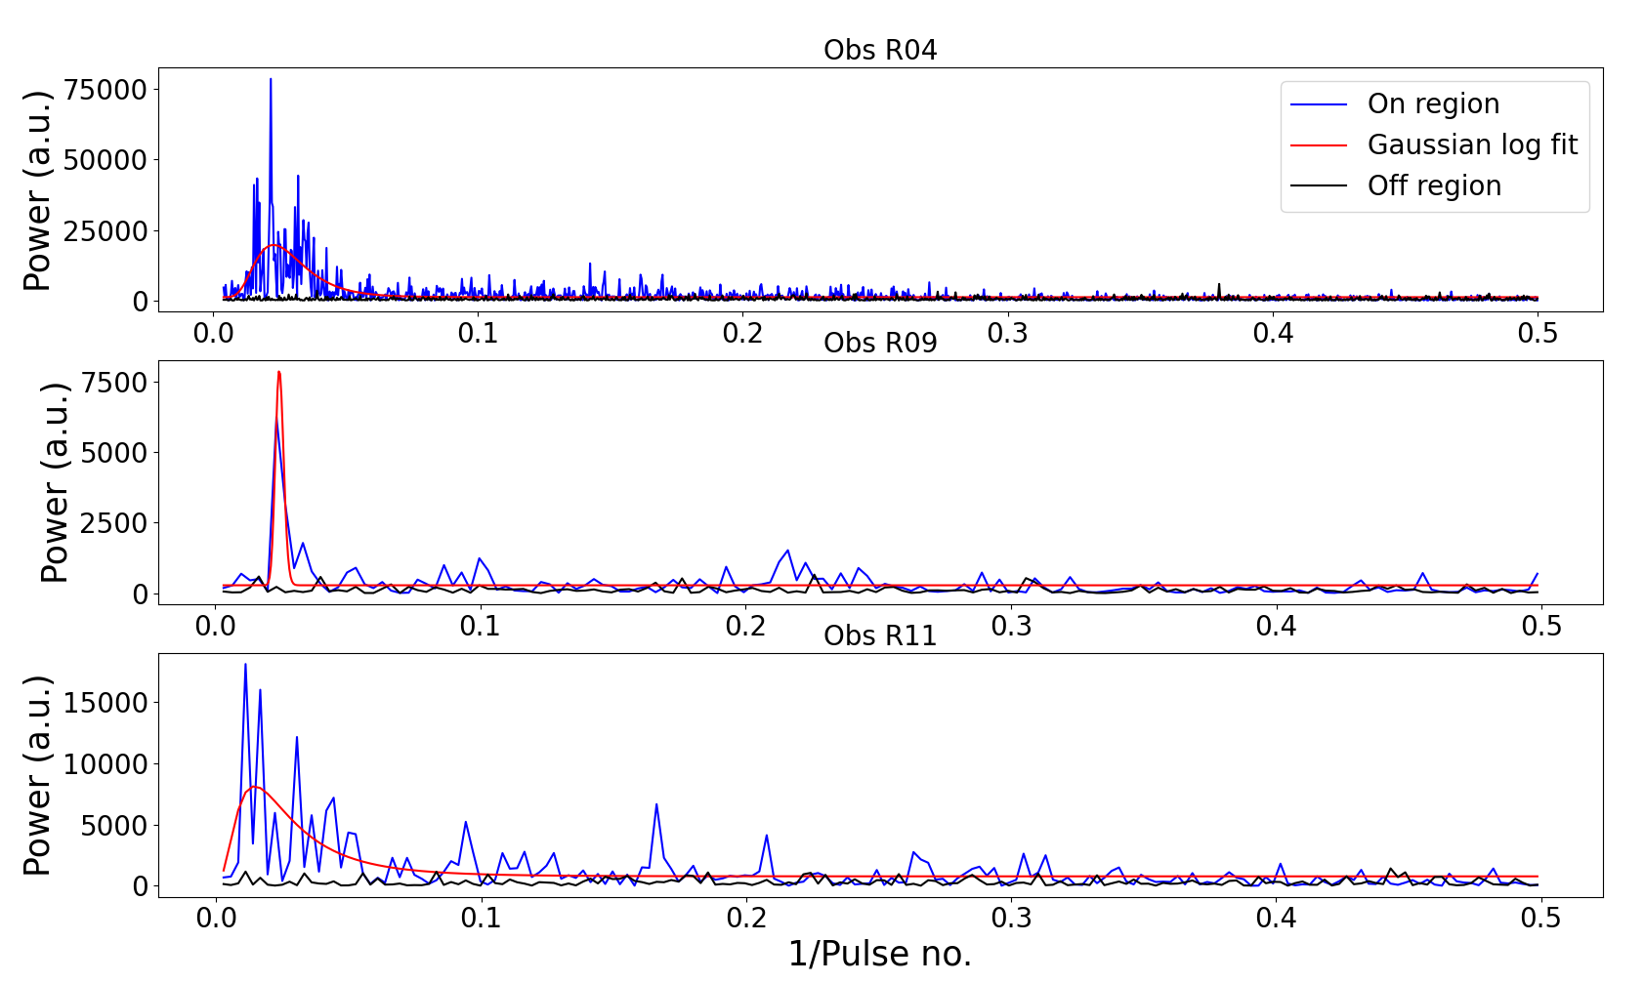
Nulling
Periodicity ~ 42 pulses
Notes:
Studied quasiperiodicity - FFT of each observation- SMART survey observations overlap - published paper

Slide 8
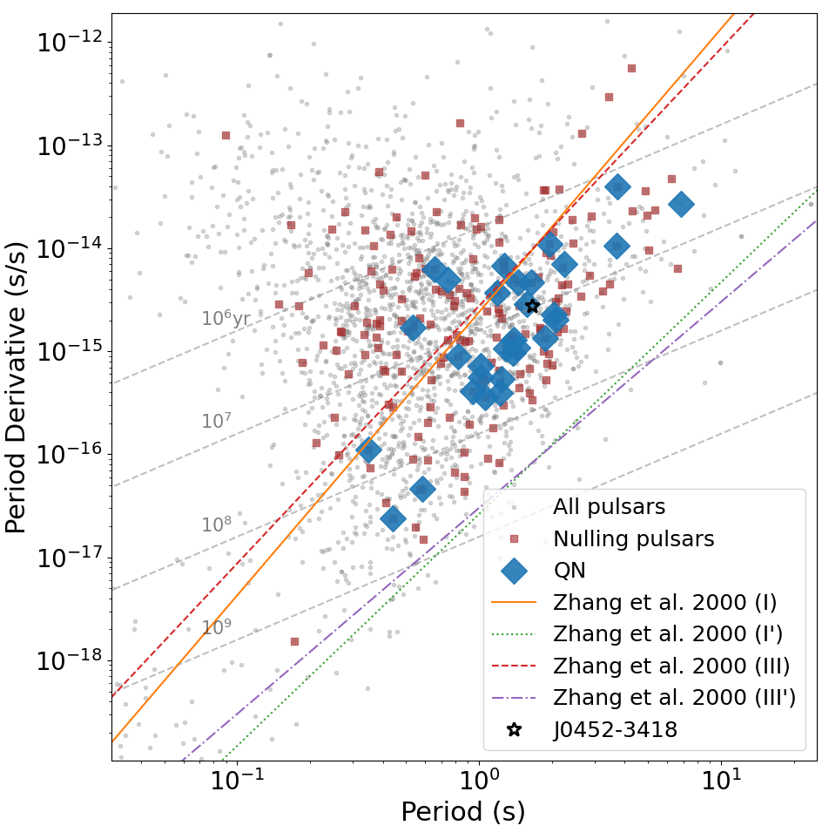
Grover+2024a
Notes:
Looked at other quasiperiodic nulling pulsars - 1% of the pulsar population

Slide 9
Quasiperiodicity
Grover+2024a
Past models
Carousel model
New models
Axion
RLC circuit
Connection to death mechanism
Notes:
Carousel models says possible but also has subpulse drifting - nulling becomes more periodic with age - measure come from a collection of papers

Slide 10
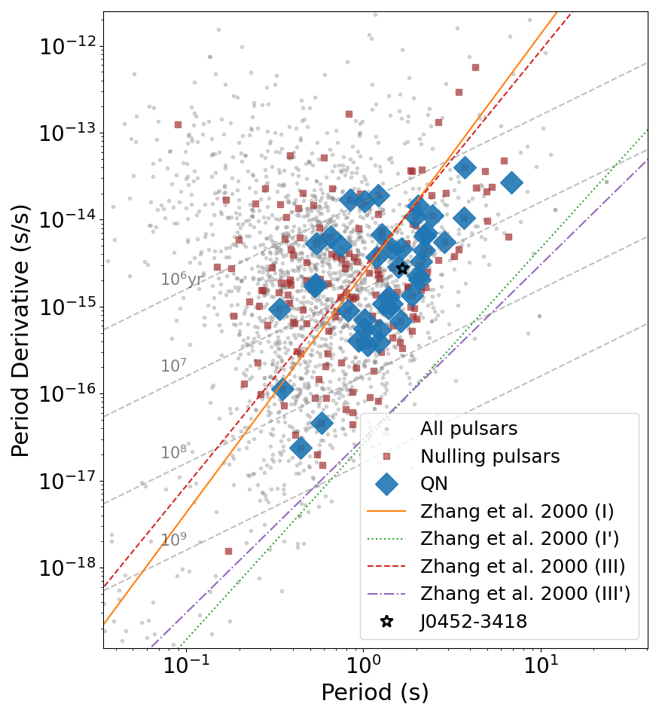
With Wang+2007 data
Grover+2024a
Notes:
10-60s integrations - significance classified as - in wang+ they found no correlation with periodicity

Slide 11
Detecting long-period and nulling pulsars
Red noise
Short survey observations
FFT based algorithms are less sensitive
Long duration surveys (e.g. SMART survey)
Using alternate algorithms
Fast folding algorithm
Single pulse search
Notes:
Simulated ~1.7 million signals - recent long period discoveries all show nulling

Slide 12
Summary of simulated results
FFT is fastest and overall pretty good
FFA is slowest but performs consistently and best overall
SPS performs best at sign S/N but can outperform FFA is some cases
Grover+2024b

Slide 13
Current work
Nulling population analysis with MWA
Classify nulling using:
Pulse energy
Pulse width
S/N
Analysis on distribution of nulling durations
Measure and examine nulling quasiperiodicity

Slide 14
Summary
Discovered J0452-3418 that shows nulling quasiperiodicity
This has rarely been reported in nulling pulsars
Could be related to pulsars death mechanism
Populations study using MWA
Report key parameters often overlooked

