Slide 2
submitted to GRL

Slide 6
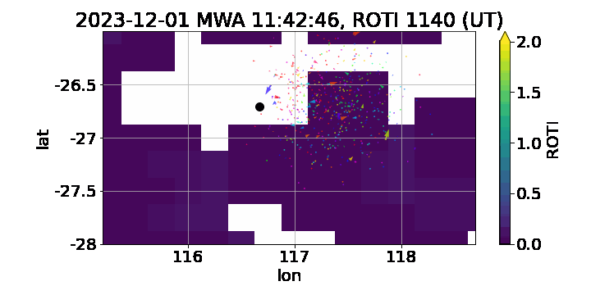

Slide 7
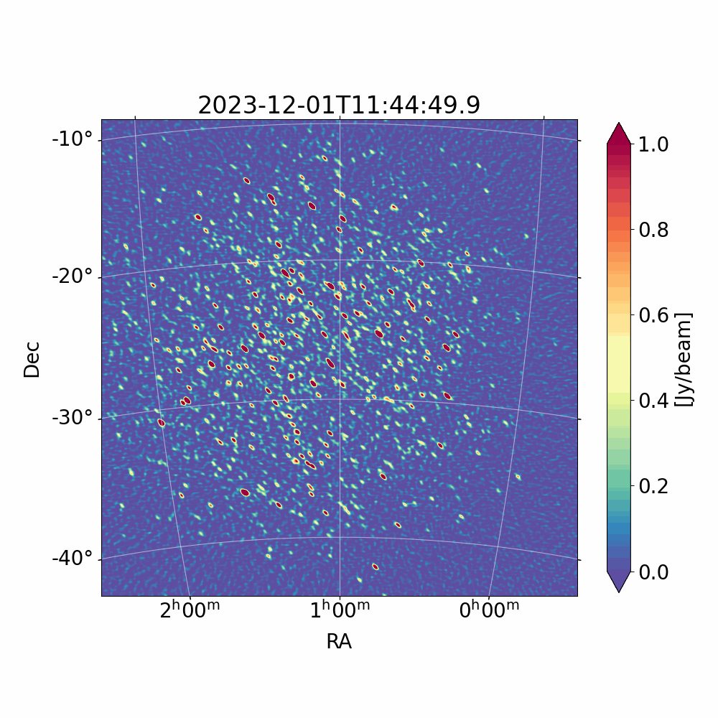

Slide 10
