Slide 1
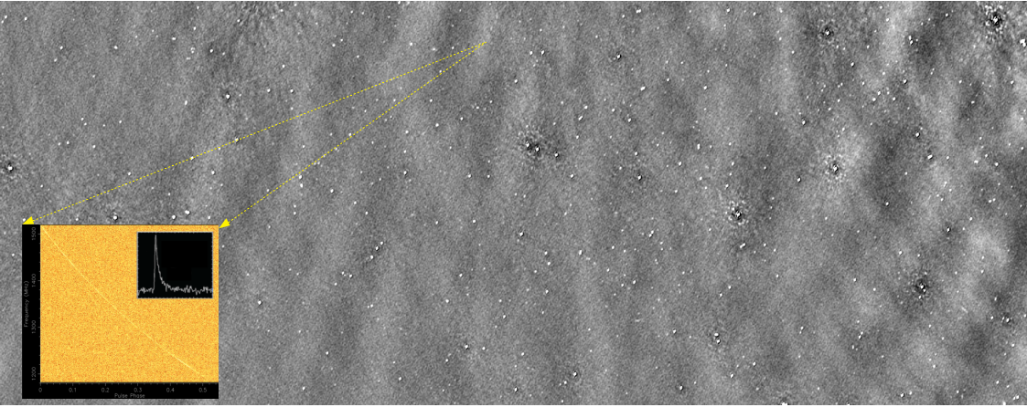
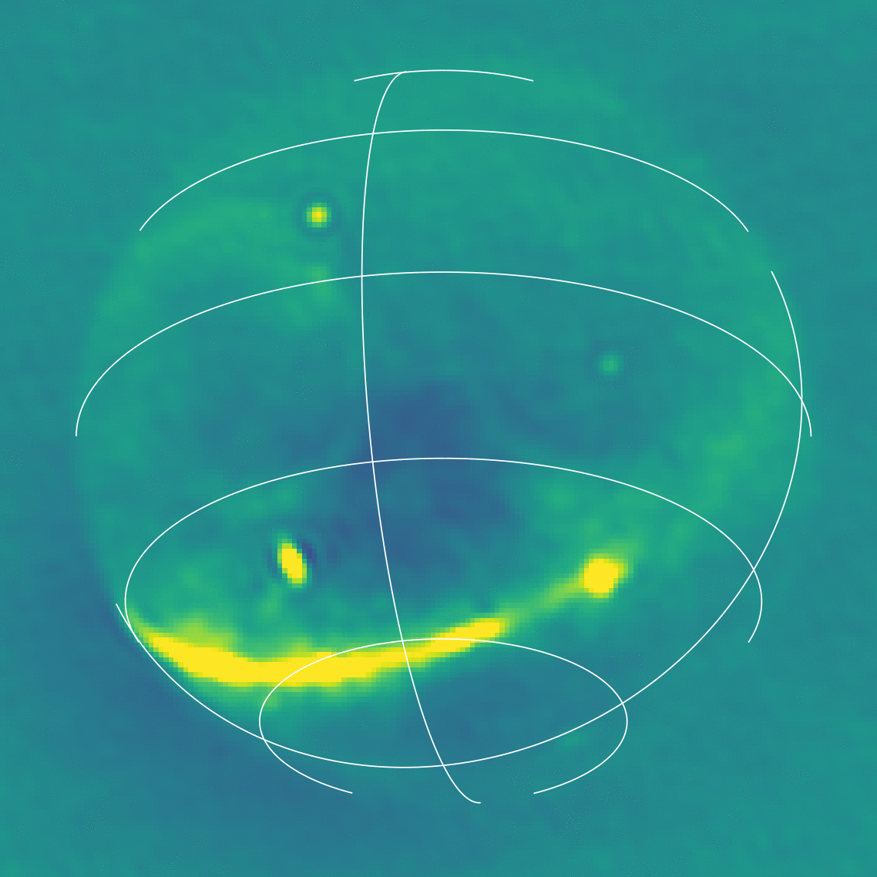
High-Time Resolution GPU Imager for FRB searches at low radio frequencies
Marcin Sokołowski (ICRAR/Curtin), Cristian Di Pietrantonio, Chris Harris (Curtin/Pawsey), Danny Price, Randall Wayth (SKAO), Gayatri Aniruddha (Curtin University)

Slide 2
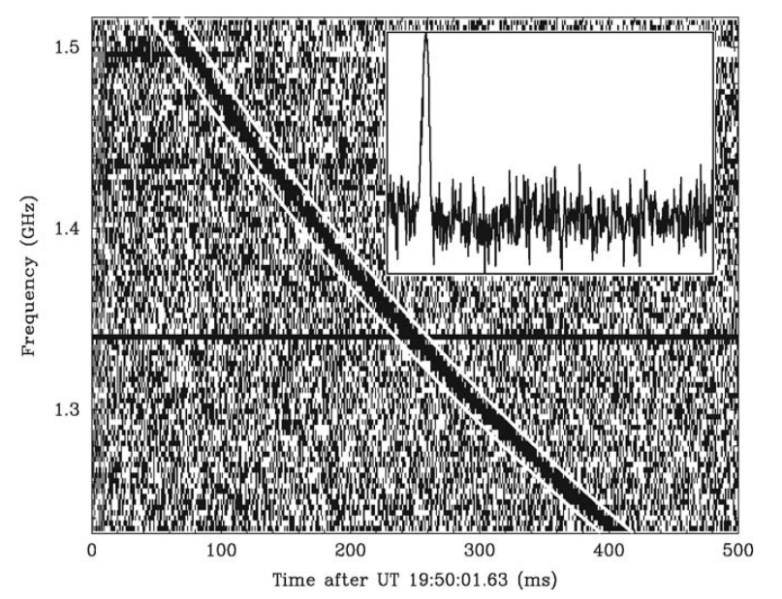
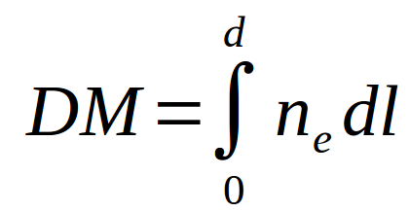
Fast Radio Bursts (FRBs)
FRBs are short (~millisecond) dispersed radio pulses
Discovered 15 years ago and still awaiting full physical explanation
Dispersed pulses at higher frequencies arrive earlier than at low frequencies
Extragalactic origin confirmed by redshifts measurements of several host galaxies
Extreme energies of the order of 10³⁹ erg
Require coherent emission mechanism
By several radio-telescopes: Parkes, ASKAP, Arecibo, UTMOST, CHIME, GBT etc.
~5% FRBs repeat
At 100 MHz ≤ ν ≤ 8 GHz , but only very few were detected ≤ 350 MHz)
The first FRB detected in archive data from Murriyang (Parkes) radio telescope by Lorimer et al (2007)
High-frequency
de-dispersed
Low-frequency
, where
MWA Project meeting, Lausanne, 29-08-2024
Notes:
Left : South Africa Right : Australia
Facts - not just use the ready slide !
Use images of both telescopes from these pages (or the one Chris Lee sent)
https://www.skatelescope.org/quickimages/ Use SKA page from Australia too ! SKA images :
https://www.auska-multimedia.org/
Multimedia :
- https://www.auska-multimedia.org/

Slide 3
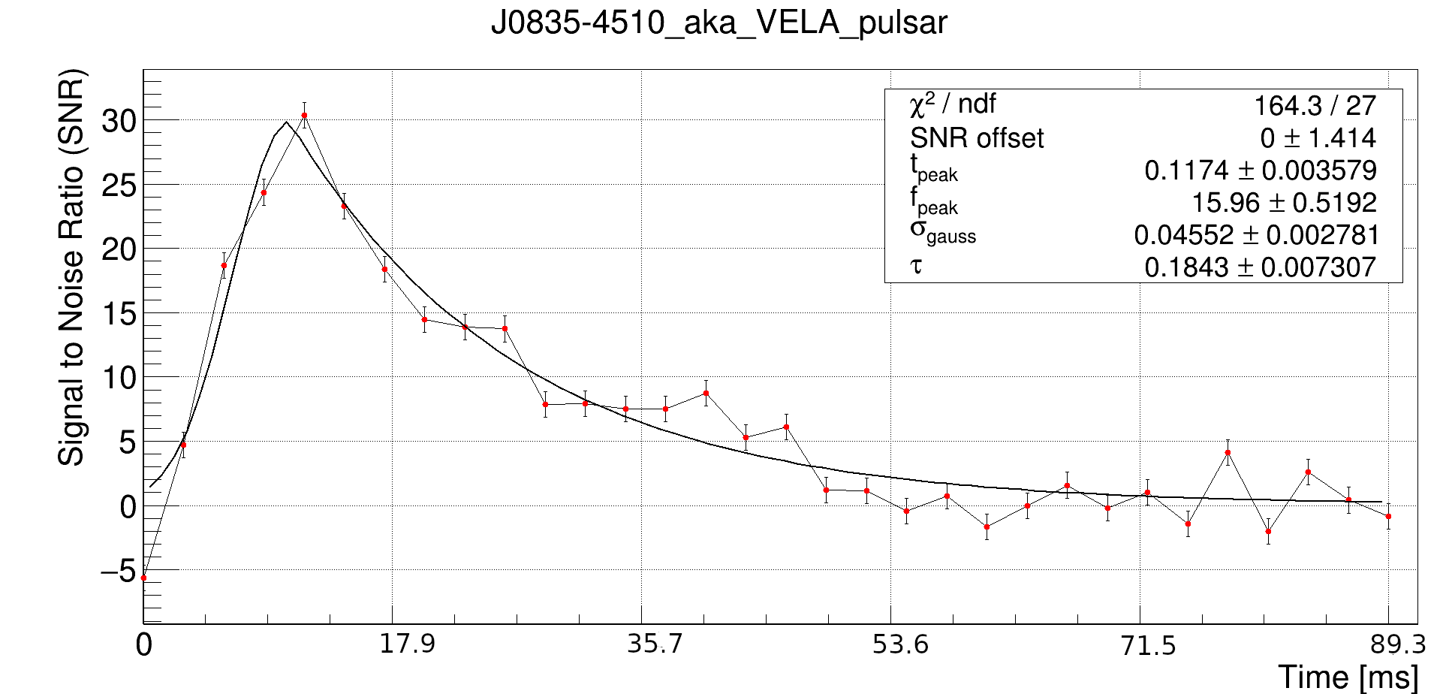
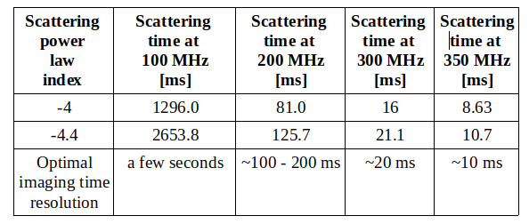
Why we cannot detect more low-frequency FRBs?
Physical reasons, like absorption or propagation effects, like temporal broadening due to scattering
~60% of CHIME FRBs with measured scattering (~293 of out 536 have scattering time <1ms
This translates to scattering times between 10 - 130 ms at 350 and 200 MHz respectively
Hence ~10 - 100ms time resolution is reasonable
MWA Project meeting, Lausanne, 29-08-2024
Notes:
Left : South Africa Right : Australia
Facts - not just use the ready slide !
Use images of both telescopes from these pages (or the one Chris Lee sent)
https://www.skatelescope.org/quickimages/ Use SKA page from Australia too ! SKA images :
https://www.auska-multimedia.org/
Multimedia :
- https://www.auska-multimedia.org/

Slide 4
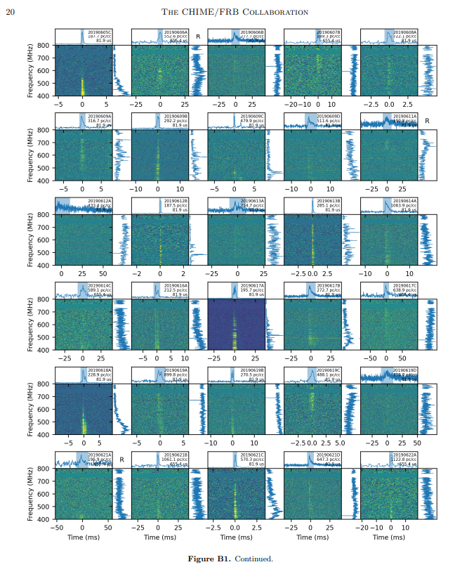
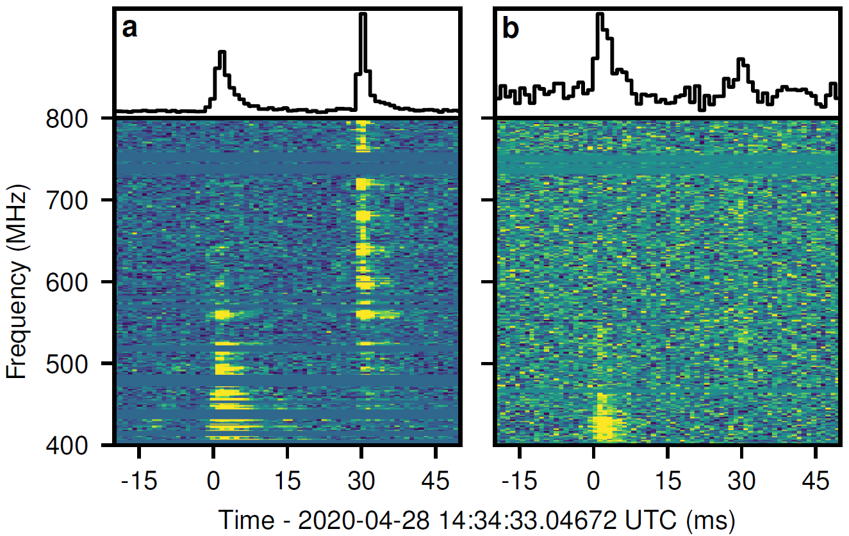
Detections of FRBs and alikes at low radio-frequencies (≤ 350 MHz)
CHIME detections of Galactic magnetar SGR 1935+2154 at 400 - 800 MHz
Peak flux density 110 - 150 kJy ( fluence 220 - 480 kJy ms) and even MJys ms at higher frequencies (STARE2)
Burst energy ~3 x 10³⁴ erg
Amiri et al., AJ, 2024
CHIME/FRB Collaboration, Nature, 2020
MWA Project meeting, Lausanne, 29-08-2024
Notes:
Left : South Africa Right : Australia
Facts - not just use the ready slide !
Use images of both telescopes from these pages (or the one Chris Lee sent)
https://www.skatelescope.org/quickimages/ Use SKA page from Australia too ! SKA images :
https://www.auska-multimedia.org/
Multimedia :
- https://www.auska-multimedia.org/

Slide 5
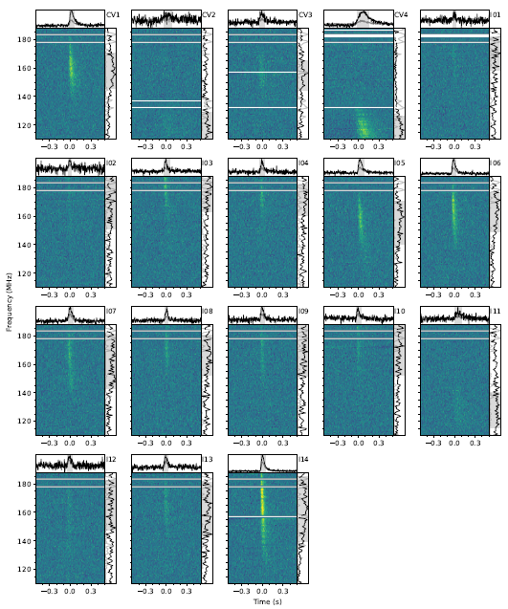
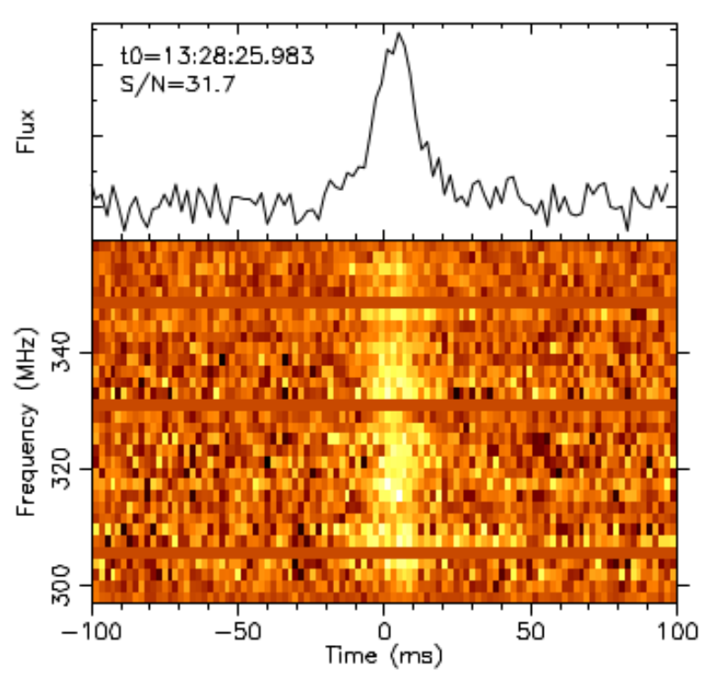
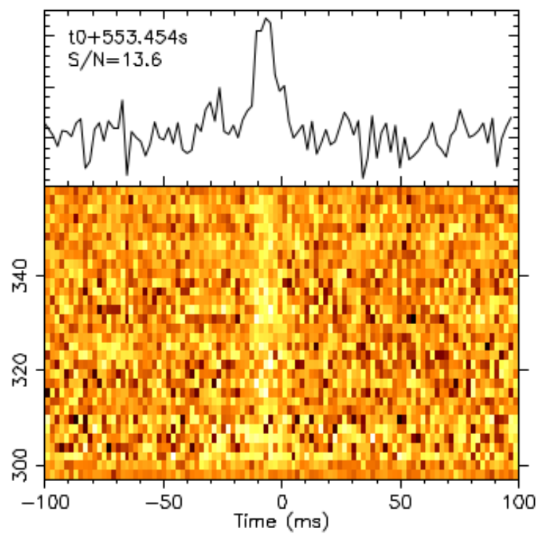
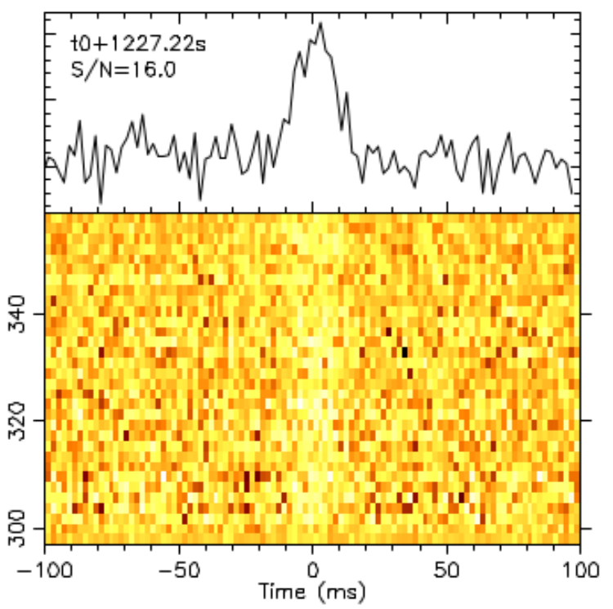
Detections of FRBs and alikes at low radio-frequencies (≤ 350 MHz)
LOFAR detections of the repeating FRB 20180916B
Detections by Sardinia Radio Telescope
Detections by Sardinia Radio Telescope (Pilia et al. ApJL, 2020)
Pleunis et al. ApJL, 2021
MWA Project meeting, Lausanne, 29-08-2024
Notes:
Left : South Africa Right : Australia
Facts - not just use the ready slide !
Use images of both telescopes from these pages (or the one Chris Lee sent)
https://www.skatelescope.org/quickimages/ Use SKA page from Australia too ! SKA images :
https://www.auska-multimedia.org/
Multimedia :
- https://www.auska-multimedia.org/

Slide 6
Why we cannot detect more low-frequency FRBs?
Frequency [MHz]
MOCK FRB WITH DM=1000 pc/cm³
Time [sec]
Computationally challenging due to long dispersive delays (e.g. more memory required and more additions in de-dispersion)
Assuming FRB DM=1000 pc/cm3, over 30 MHz frequency band, de-dispersion requires:
10ms time resolution ~ 1.2 TB memory to keep ~25seconds of data from 200x200 images in 3000 10 kHz frequency channels (200*200 pixels * 2500*3000*4 bytes)
100ms time resolution ~ 12 GB memory - manageable but may be lower sensitivity
to keep ~25seconds of data from 200x200 images in 300 100 kHz frequency channels (200*200 pixels * 250*300*4 bytes )
Real time searches require very high memory bandwidth of at least 120 GB/s
Pushing gaming requirements ~10 GB/s for 100 fps , 5000x5000 images
MWA Project meeting, Lausanne, 29-08-2024
Notes:
Left : South Africa Right : Australia
Facts - not just use the ready slide !
Use images of both telescopes from these pages (or the one Chris Lee sent)
https://www.skatelescope.org/quickimages/ Use SKA page from Australia too ! SKA images :
https://www.auska-multimedia.org/
Multimedia :
- https://www.auska-multimedia.org/

Slide 7
Searches for low-frequency FRBs
Survey | FoV [deg²] | Observing Time (T) in [days] | Sensitivity (S) in [Jy ms] | Figure of merit (M) N_{FRB} / year
Parent et al. (2020) - reference survey with GBT, detected one FRB at 350 MHz | FoV₀ = 0.27 | T₀ = 173.6 | S₀ = 1.26 | M₀ = 2.1
Coenen et al. (2014) | 75 | 9.7 | 71 | 1.09
Karastergiou et al. (2015) | 24 | 60.25 | 310 | 1.6
Rajwade et al. (2020) | 0.61 | 58 | 46 | 0.62
Rowlinson et al. (2016) | 452 | 3.3 | 223 500 | 2.4 x 10⁻⁷
Tingay et al. (2015) | 610 | 0.44 | 700 | 3.6
Kemp et al. (2024) | 1600 | 3.65 | 840 | 31.1
An all-sky FRB detector | 12000 | At least ~180 per year (planned ) | 200 | 142
$${N_{FRB}}/{year}=\frac{FoV}{{FoV}_{0}}{\left(\frac{S}{S_{0}}\right)}^{{−3}/2}\frac{365}{T_{0}\left[days\right]}\frac{δt_{0}}{δt}$$
where FoV is Field-of-View, S sensitivity (fluence threshold), T total observing time and δt₀ is time resolution of the survey in the table above. Subscript “0” stands for the parameters of the reference survey at 350 MHz Parent et al. (1st row in the table), which detected 1 FRB in 173.6 days of data.
MWA Project meeting, Lausanne, 29-08-2024
Notes:
Left : South Africa Right : Australia
Facts - not just use the ready slide !
Use images of both telescopes from these pages (or the one Chris Lee sent)
https://www.skatelescope.org/quickimages/ Use SKA page from Australia too ! SKA images :
https://www.auska-multimedia.org/
Multimedia :
- https://www.auska-multimedia.org/

Slide 8
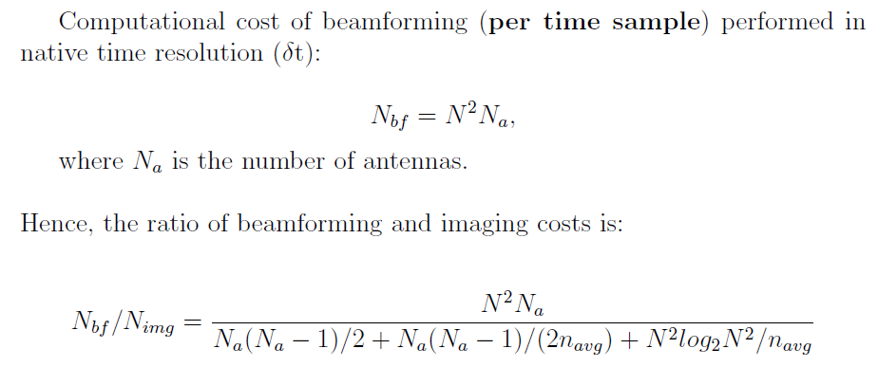
Multiple tied-array imaging vs. beamforming
This ratio depends on number of antennas (N_{a}) and number of image pixels (N), for example
for large images (N >> N_{a}) it can be approximated by:
MWA Project meeting, Lausanne, 29-08-2024
Notes:
Left : South Africa Right : Australia
Facts - not just use the ready slide !
Use images of both telescopes from these pages (or the one Chris Lee sent)
https://www.skatelescope.org/quickimages/ Use SKA page from Australia too ! SKA images :
https://www.auska-multimedia.org/
Multimedia :
- https://www.auska-multimedia.org/

Slide 9
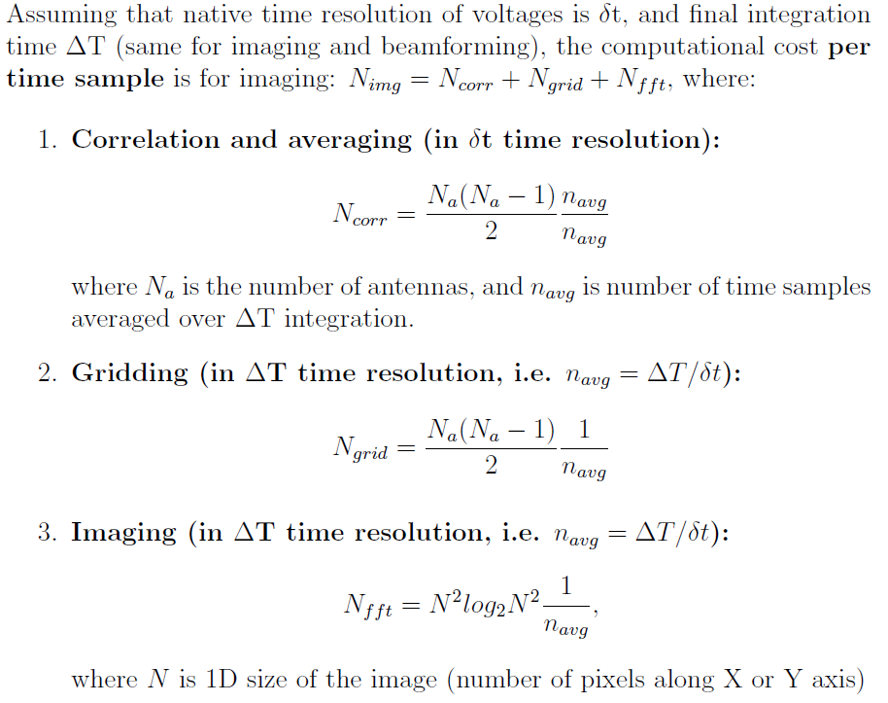
Multiple tied-array imaging vs. beamforming
Notes:
Left : South Africa Right : Australia
Facts - not just use the ready slide !
Use images of both telescopes from these pages (or the one Chris Lee sent)
https://www.skatelescope.org/quickimages/ Use SKA page from Australia too ! SKA images :
https://www.auska-multimedia.org/
Multimedia :
- https://www.auska-multimedia.org/

Slide 10
Multiple tied-array imaging vs. beamforming
This ratio depends on number of antennas (N_{a}) and number of image pixels (N), for example
for large images (N >> N_{a}) it can be approximated by:
MWA Project meeting, Lausanne, 29-08-2024
Notes:
Left : South Africa Right : Australia
Facts - not just use the ready slide !
Use images of both telescopes from these pages (or the one Chris Lee sent)
https://www.skatelescope.org/quickimages/ Use SKA page from Australia too ! SKA images :
https://www.auska-multimedia.org/
Multimedia :
- https://www.auska-multimedia.org/

Slide 11
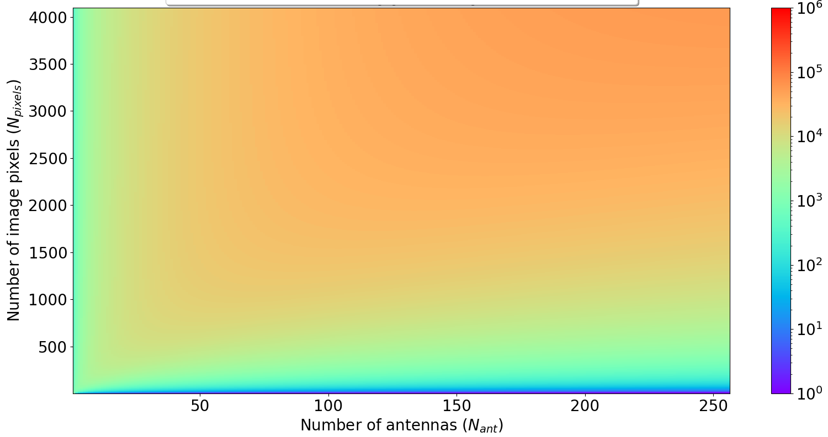
Ratio of computational costs N_{bf} / N_{img}
Ratio of computational cost of beamforming to imaging for EDA2 in native resolution 1.08 usec correlated and imaged in 10ms
MWA Project meeting, Lausanne, 29-08-2024
Notes:
python ./dispersion2.py 1000 230 200 23 : 200.56000 MHz -> delta = 24721.526 [ms] = 24.7215 [sec] (at UTC 19700101 000024) , 1.28 MHz sweep time = 1.30 [sec]
python ./dispersion2.py 1000 350 320 23 : 320.56000 MHz -> delta = 6508.319 [ms] = 6.5083 [sec] (at UTC 19700101 000006) , 1.28 MHz sweep time = 0.32 [sec]
cd ~/github/frb_rate/
python ./memory_requirements.py --dispersion_delay=24.7 --pixels=200
Required memory size = 15808000000 bytes = 15808.000 MB = 15.808000 GB Required memory bandwidth = 1580.800 GB/s
~0.64GB/sec * 24.7 ~= 16 GB

Slide 12
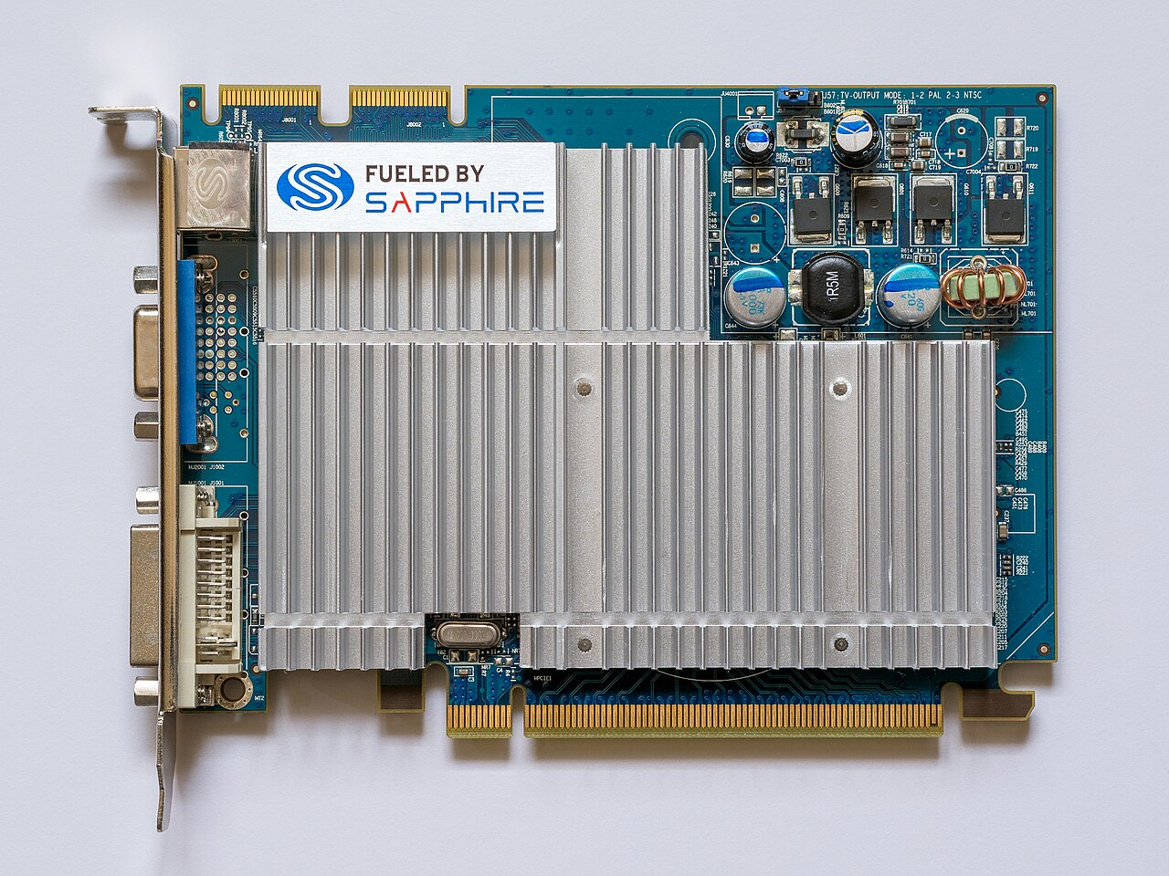
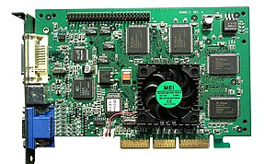
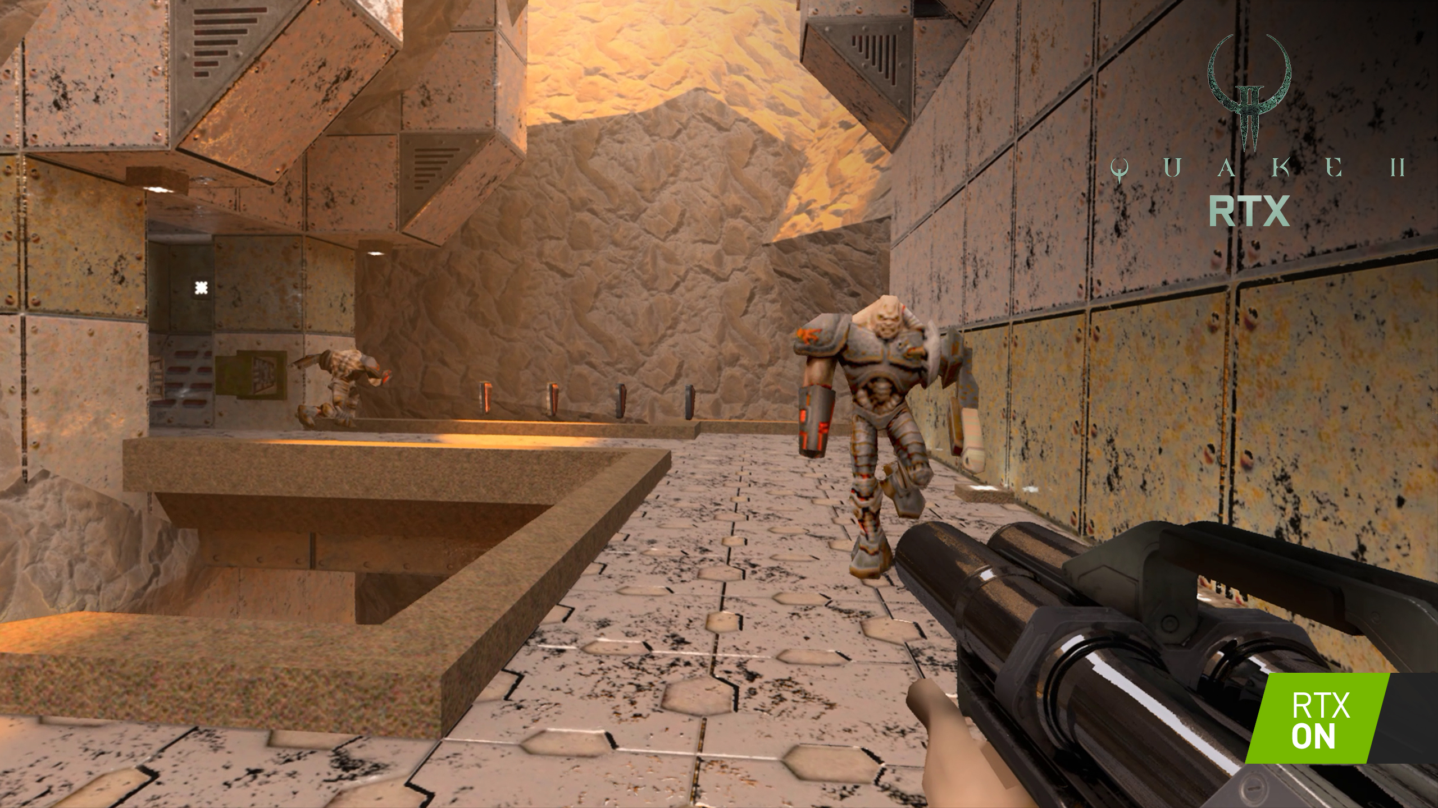
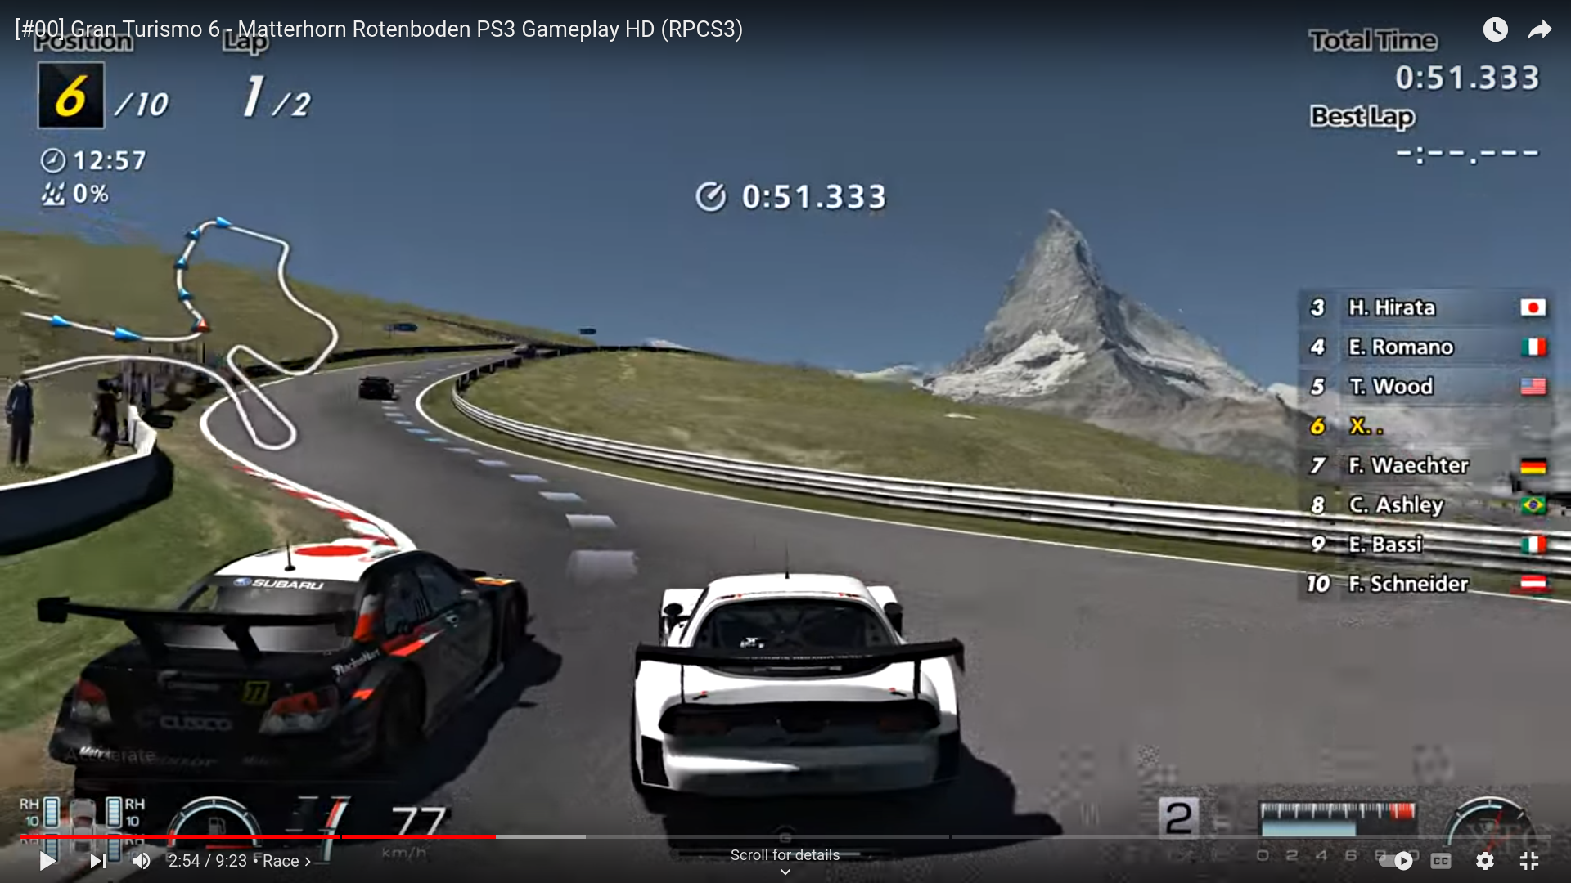
Graphical Processing Units (GPUs) first GPUs
NVIDIA GPUs / CUDA Framework ( since late 1990s )
AMD GPUs
( since 2006 acquisition of ATI)
The 1st GPU NVIDIA GeForce 256
Radeon HD 2000
MWA Project meeting, Lausanne, 29-08-2024
Notes:
https://www.youtube.com/watch?app=desktop&v=nFg_rVga7-0

Slide 13
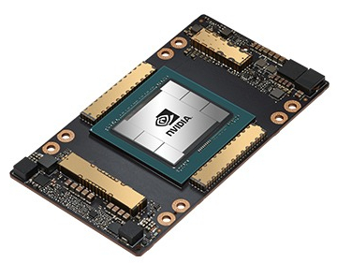
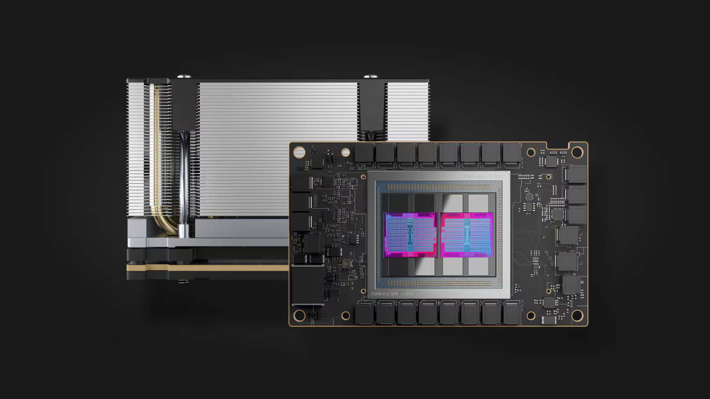
Graphical Processing Units (GPUs) modern GPUs
Modern NVIDIA GPUs
Modern AMD GPUs
A100 (Ampere architecture)
AMD MI250X
~20 TFlops in TF32 (8192 CUDA cores)
~156 TFlops in TF32 (512 tensor cores)
up to 80 GB memory
memory bandwidth up to 2TB/s
~45.3 TFlops TF32 (13312 cores)
90.5 TFlops TF32 from matrix cores
128 GB memory
memory bandwidth up to 3.2TB/s
MWA Project meeting, Lausanne, 29-08-2024
Notes:
Left : South Africa Right : Australia
Facts - not just use the ready slide !
Use images of both telescopes from these pages (or the one Chris Lee sent)
https://www.skatelescope.org/quickimages/ Use SKA page from Australia too ! SKA images :
https://www.auska-multimedia.org/
Multimedia :
- https://www.auska-multimedia.org/

Slide 14
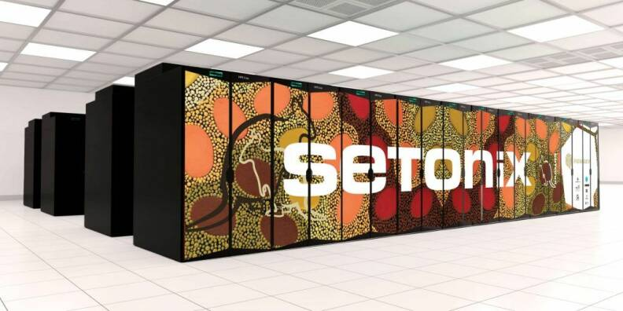
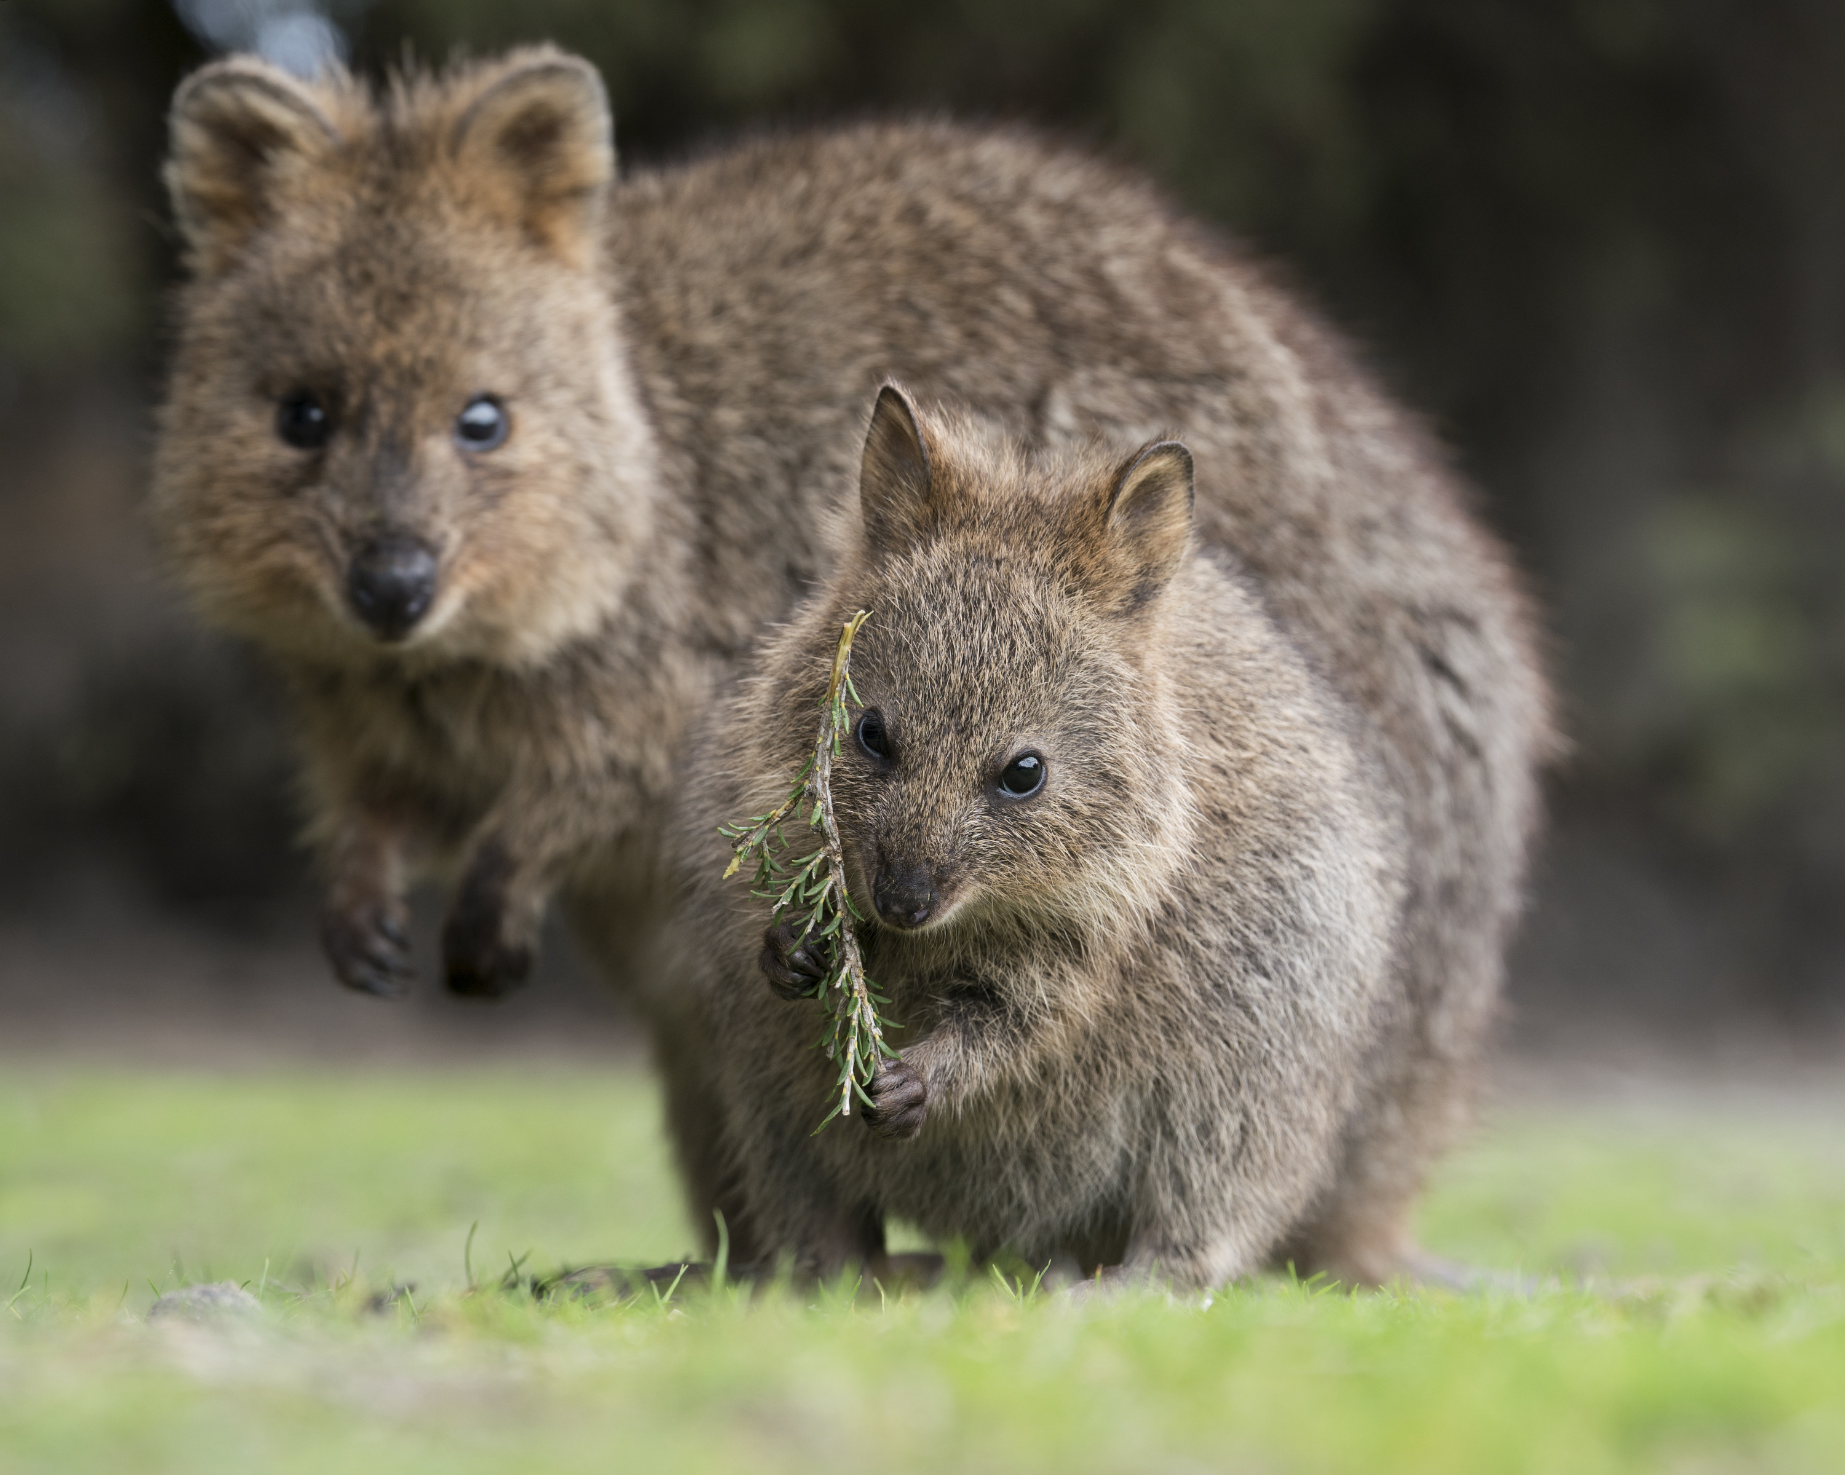
SETONIX Supercomputer at Pawsey 15th HPC in the world, 4th HPC greenest
https://pawsey.org.au/systems/setonix/
• Manufacturer: HPE Cray
• Model: EX Supercomputer
• Computing power (R_{peak}): 43 petaFlops
• Memory: 463 TB of RAM
• Power consumption: 56.98 GFlops/Watts or 17.5 kW / PF (GPU partition)
1600 AMD EPYC “Milan” CPU nodes
192 GPU nodes have with single AMD EPYC “Trento” CPU and four Instinct MI250X GPUs)
16 data mover nodes
32 visualisation nodes
217,088 CPU Cores
168,960 GPU cores
Changes in GPU codes required -> PaCER projects to help with the transition
MWA Project meeting, Lausanne, 29-08-2024
Notes:
Left : South Africa Right : Australia
Facts - not just use the ready slide !
Use images of both telescopes from these pages (or the one Chris Lee sent)
https://www.skatelescope.org/quickimages/ Use SKA page from Australia too ! SKA images :
https://www.auska-multimedia.org/
Multimedia :
- https://www.auska-multimedia.org/

Slide 15
Graphical Processing Units (GPUs)
// NVIDIA GPUs / CUDA Framework
// AMD GPUs / HIP Framework
MWA Project meeting, Lausanne, 29-08-2024
Notes:
Left : South Africa Right : Australia
Facts - not just use the ready slide !
Use images of both telescopes from these pages (or the one Chris Lee sent)
https://www.skatelescope.org/quickimages/ Use SKA page from Australia too ! SKA images :
https://www.auska-multimedia.org/
Multimedia :
- https://www.auska-multimedia.org/

Slide 16
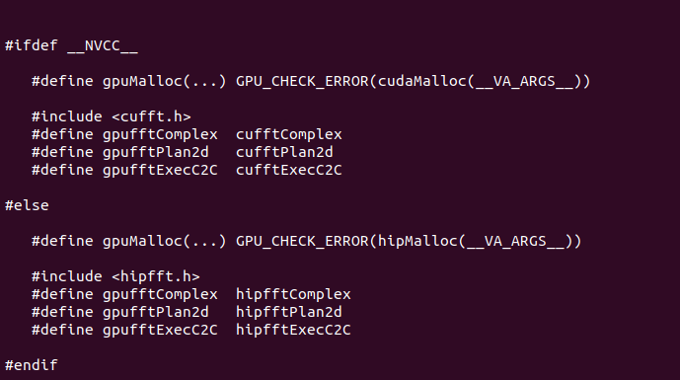
Graphical Processing Units (GPUs)
// GPU MACROS TO CREATE CODE FOR BOTH FRAMEWORKS CUDA AND HIP :
// The same code for NVIDIA CUDA and AMD HIP frameworks
MWA Project meeting, Lausanne, 29-08-2024
Code Available at: https://github.com/PaCER-BLINK-Project
Notes:
Left : South Africa Right : Australia
Facts - not just use the ready slide !
Use images of both telescopes from these pages (or the one Chris Lee sent)
https://www.skatelescope.org/quickimages/ Use SKA page from Australia too ! SKA images :
https://www.auska-multimedia.org/
Multimedia :
- https://www.auska-multimedia.org/

Slide 17
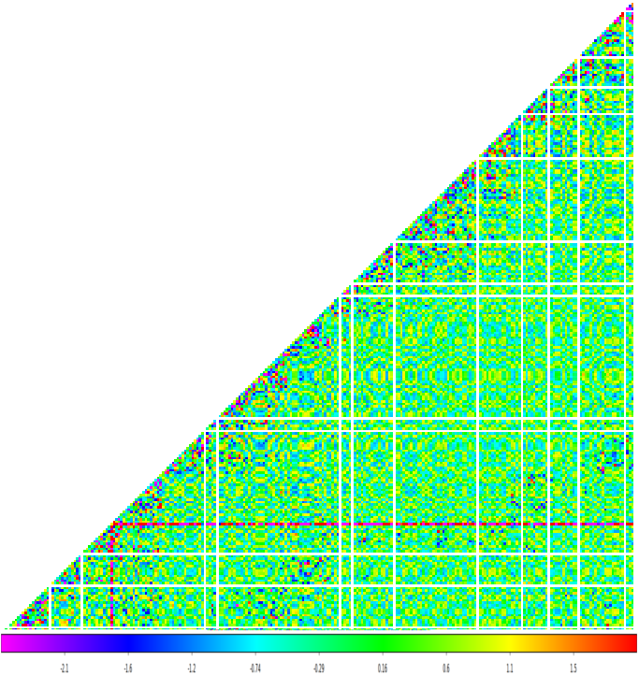
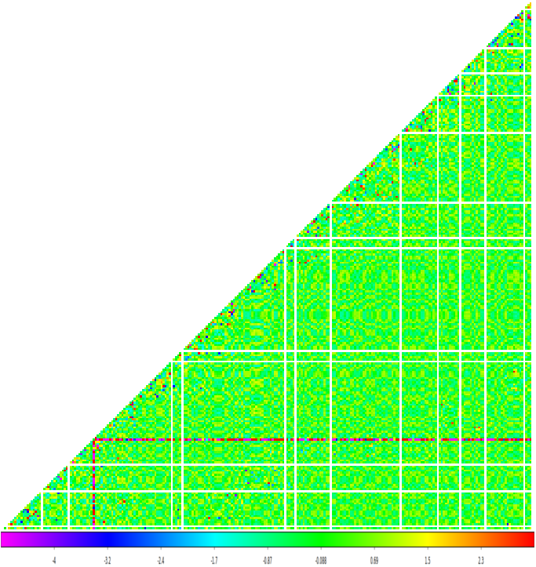
Main steps of interferometric imaging: correlation
REAL PART OF VISIBILITIES
IMAGINARY PART OF VISIBILITIES
V_{ij} = v_{i} * v_{j}*
Number of operations ~N(N+1)/2 ~ O(N²) * (1/dt) per second, dt voltage resolution
Very good for GPUs (example xGPU correlator)
MWA Project meeting, Lausanne, 29-08-2024
Notes:
Left : South Africa Right : Australia
Facts - not just use the ready slide !
Use images of both telescopes from these pages (or the one Chris Lee sent)
https://www.skatelescope.org/quickimages/ Use SKA page from Australia too ! SKA images :
https://www.auska-multimedia.org/
Multimedia :
- https://www.auska-multimedia.org/

Slide 18
Main steps of interferometric imaging: apply phase corrections and calibration
REAL PART OF VISIBILITIES
IMAGINARY PART OF VISIBILITIES
Multiply all visibilities by various complex factors
Number of operations ~N(N+1)/2 ~ O(N²) * (1/ΔT) per second, ΔT - visibility resolution
Good for GPUs
MWA Project meeting, Lausanne, 29-08-2024
Notes:
Left : South Africa Right : Australia
Facts - not just use the ready slide !
Use images of both telescopes from these pages (or the one Chris Lee sent)
https://www.skatelescope.org/quickimages/ Use SKA page from Australia too ! SKA images :
https://www.auska-multimedia.org/
Multimedia :
- https://www.auska-multimedia.org/

Slide 19
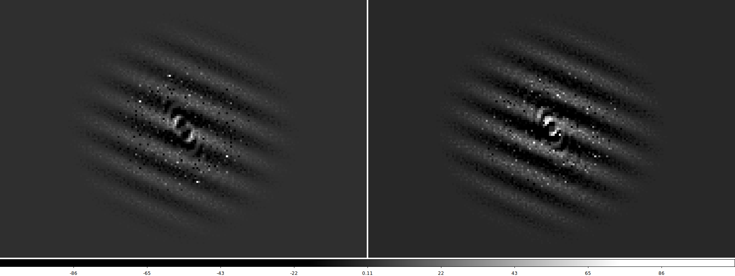
Main steps of interferometric imaging: gridding visibilities on (u,v) plane
REAL PART OF VISIBILITIES ON (U,V) GRID
IMAG PART OF VISIBILITIES ON (U,V) GRID
Number of visibilities to put on (u,v) grid ~N(N+1)/2 ~ O(N²) * (1/ΔT) per second
Good for GPUs ( different visibilities processed by different GPU cores)
MWA Project meeting, Lausanne, 29-08-2024
Notes:
Left : South Africa Right : Australia
Facts - not just use the ready slide !
Use images of both telescopes from these pages (or the one Chris Lee sent)
https://www.skatelescope.org/quickimages/ Use SKA page from Australia too ! SKA images :
https://www.auska-multimedia.org/
Multimedia :
- https://www.auska-multimedia.org/

Slide 20
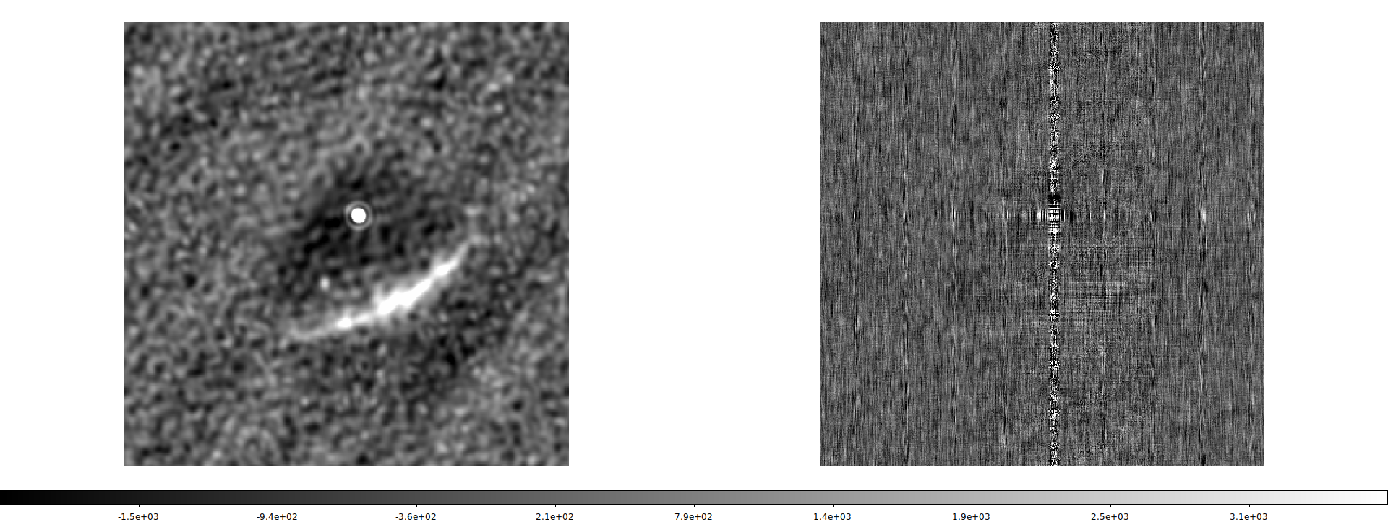
Main steps of interferometric imaging: 2D Fast Fourier Transform -> Dirty Image
All-sky image obtained from SKA-Low prototype station EDA2
IMAGINARY part of the 2D FFT must
be ~0 otherwise something is wrong
REAL part of the 2D FFT -> sky image
N
N
Computational cost of 2D FFT ~ N_{px}log₂(N_{px}), where N_{px} = N x N
Very good for GPUs - implemented in NVIDIA/CUDA cuFFT and AMD/HIP hipFFT
MWA Project meeting, Lausanne, 29-08-2024
Notes:
Left : South Africa Right : Australia
Facts - not just use the ready slide !
Use images of both telescopes from these pages (or the one Chris Lee sent)
https://www.skatelescope.org/quickimages/ Use SKA page from Australia too ! SKA images :
https://www.auska-multimedia.org/
Multimedia :
- https://www.auska-multimedia.org/

Slide 21
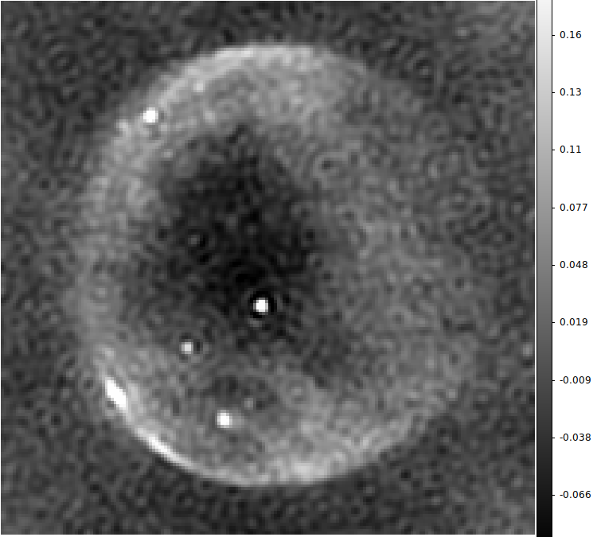
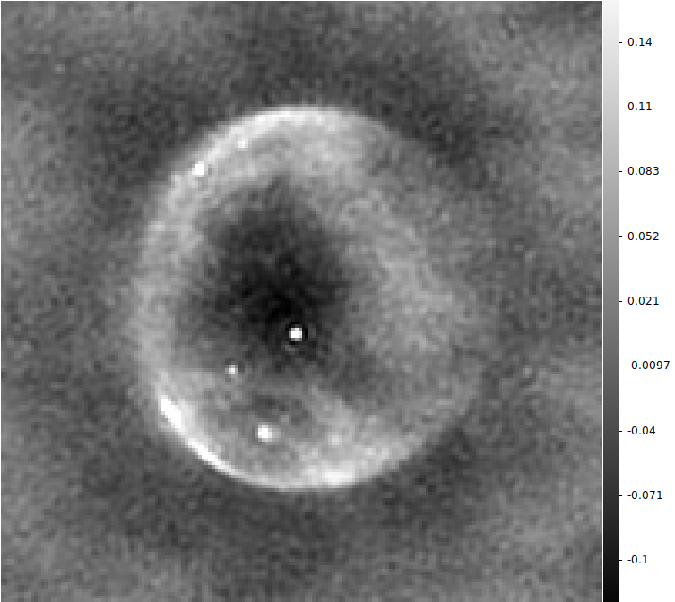
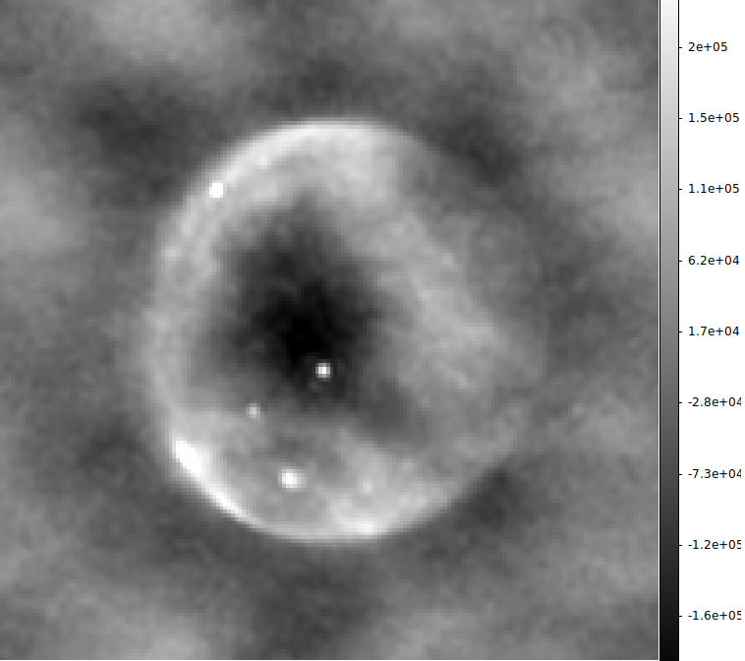
GPU-based high-time resolution imaging software (PaCER BLINK project)
Image of the entire visible hemisphere at 160 MHz obtained with MIRIAD package
Image of the entire visible hemisphere at 160 MHz obtained with CASA package
Image of the entire visible hemisphere at 160 MHz obtained with BLINK (our!) imager
Flux scale is incorrect in this particular case
Validation of the code against standard radio astronomy packages on sample EDA2 data (2022_01_18_ch204_station_beam) at 160 MHz , 180x180 images
Right : BLINK_pipeline program (correlation + imaging in 1-go)
Production version of imaging pipeline under development
Sokolowski et al., PASA, 2024
MWA Project meeting, Lausanne, 29-08-2024
Notes:
python ./dispersion2.py 1000 230 200 23 : 200.56000 MHz -> delta = 24721.526 [ms] = 24.7215 [sec] (at UTC 19700101 000024) , 1.28 MHz sweep time = 1.30 [sec]
python ./dispersion2.py 1000 350 320 23 : 320.56000 MHz -> delta = 6508.319 [ms] = 6.5083 [sec] (at UTC 19700101 000006) , 1.28 MHz sweep time = 0.32 [sec]
cd ~/github/frb_rate/
python ./memory_requirements.py --dispersion_delay=24.7 --pixels=200
Required memory size = 15808000000 bytes = 15808.000 MB = 15.808000 GB Required memory bandwidth = 1580.800 GB/s
~0.64GB/sec * 24.7 ~= 16 GB

Slide 22
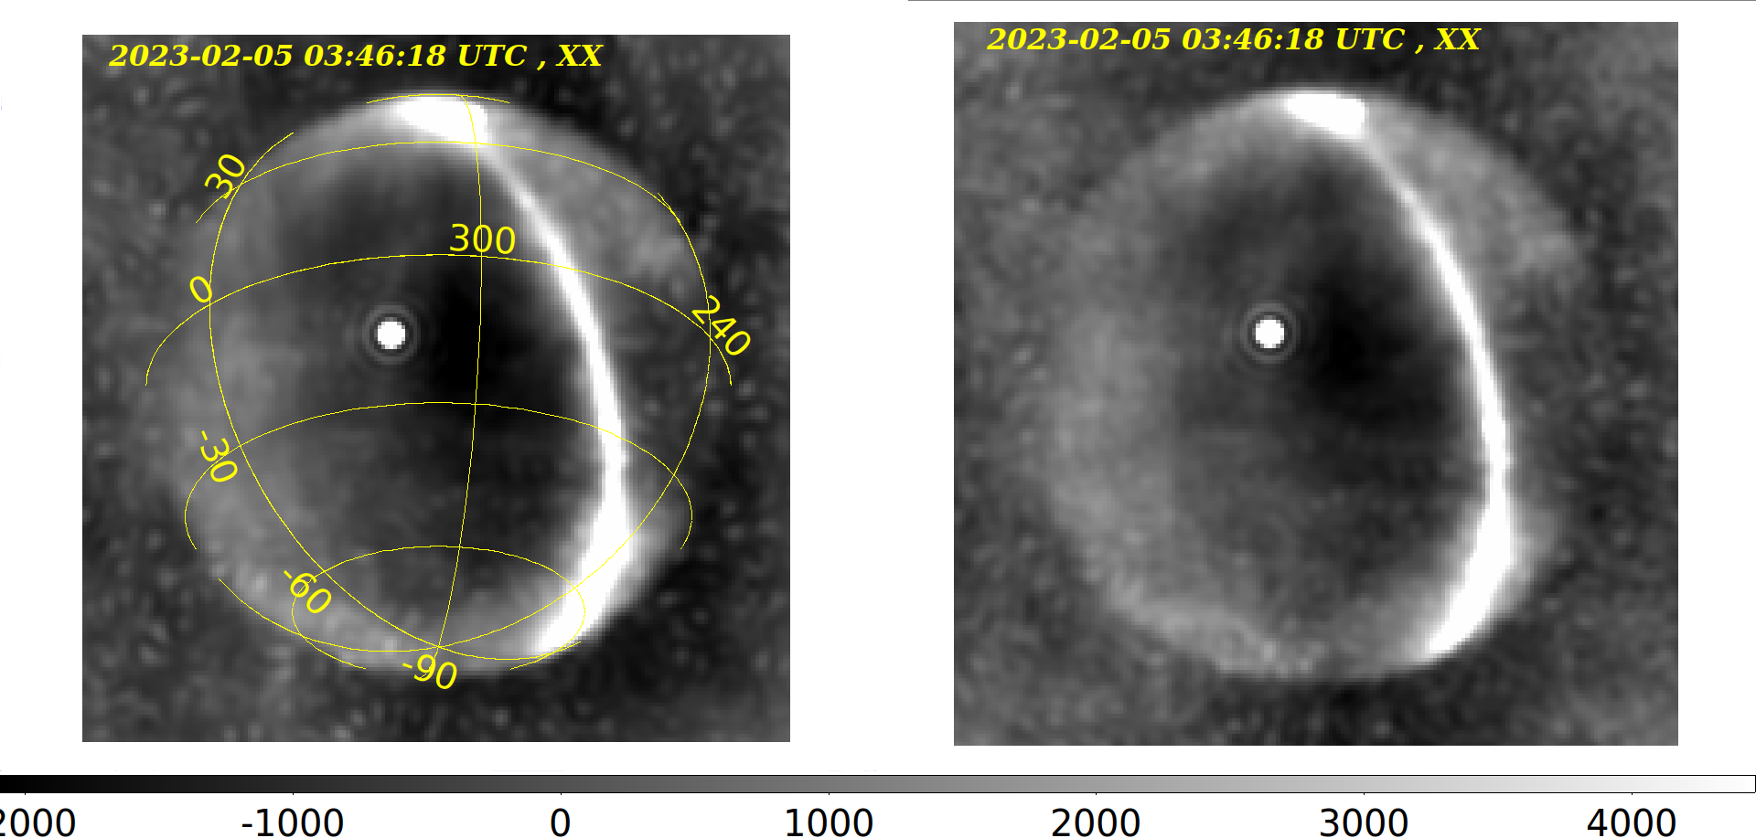
GPU-based high-time resolution imager validation : EDA2 simulated data
MIRIAD image of visitilities
simulated for EDA2 at 160 MHz
BLINK image of visitilities
simulated for EDA2 at 160 MHz
Both images in natural weighting
Sokolowski et al., PASA, 2024
MWA Project meeting, Lausanne, 29-08-2024
Notes:
/home/msok/Desktop/Conferences/2023/MWA_project_meeting/TALK/images/BLINK_imager/eda2

Slide 23
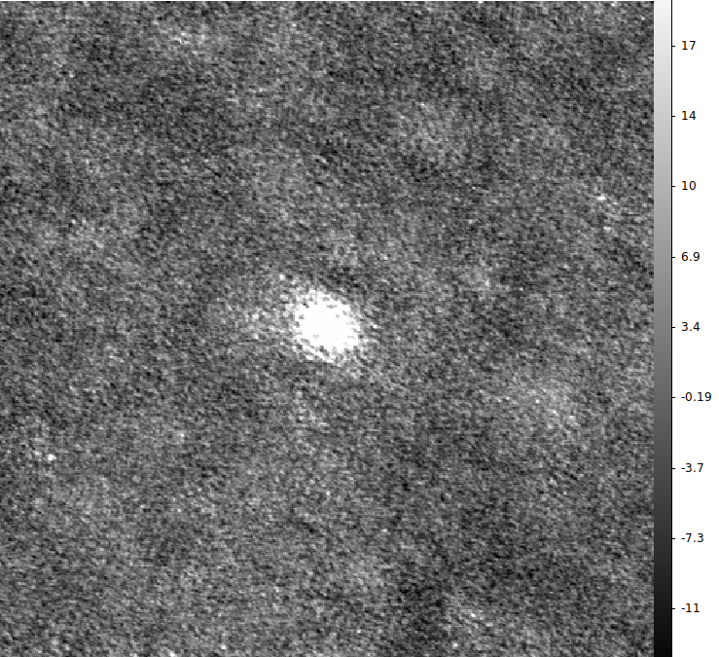
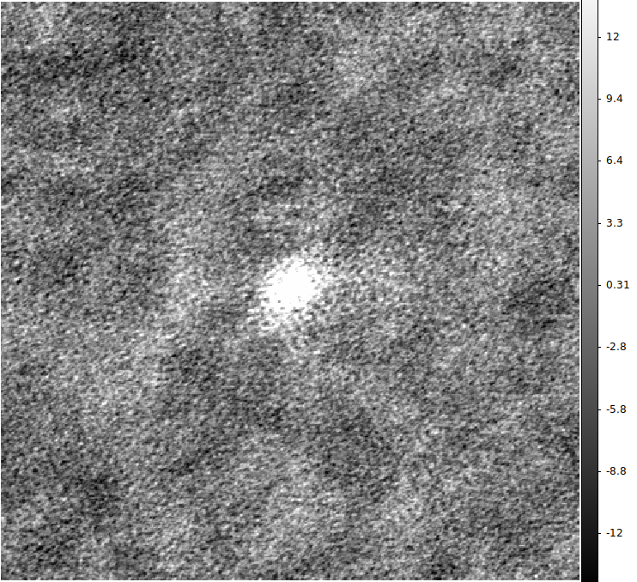
GPU-based high-time resolution imager validation : MWA Hydra-A observation
CASA image of MWA data from Hydra-A observation took ~2.2sec (including I/O)
BLINK image of MWA data from Hydra-A observation took ~0.17 sec (including I/O)
Validation of the code against standard radio astronomy packages on sample MWA Hydra-A observation (obsID = 1419609943) Both dirty images in natural weighting, same image size etc.
Sokolowski et al., PASA, 2024
MWA Project meeting, Lausanne, 29-08-2024
Notes:
python ./dispersion2.py 1000 230 200 23 : 200.56000 MHz -> delta = 24721.526 [ms] = 24.7215 [sec] (at UTC 19700101 000024) , 1.28 MHz sweep time = 1.30 [sec]
python ./dispersion2.py 1000 350 320 23 : 320.56000 MHz -> delta = 6508.319 [ms] = 6.5083 [sec] (at UTC 19700101 000006) , 1.28 MHz sweep time = 0.32 [sec]
cd ~/github/frb_rate/
python ./memory_requirements.py --dispersion_delay=24.7 --pixels=200
Required memory size = 15808000000 bytes = 15808.000 MB = 15.808000 GB Required memory bandwidth = 1580.800 GB/s
~0.64GB/sec * 24.7 ~= 16 GB

Slide 24
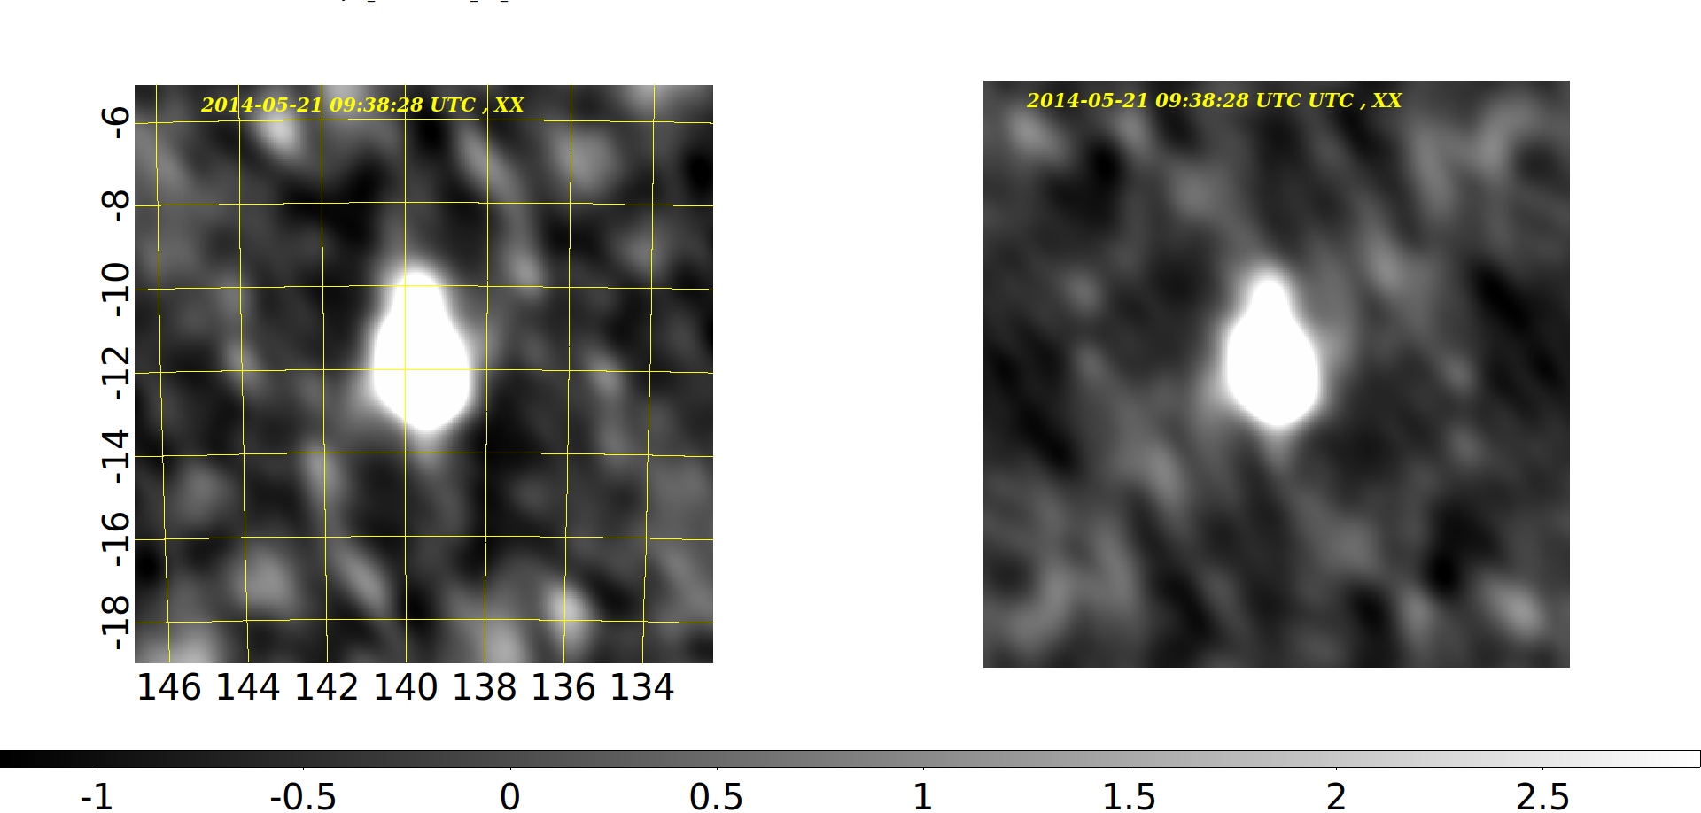
GPU-based high-time resolution imager validation : MWA Hydra-A simulated data
WSCLEAN image of MWA data of Hydra-A simulated visitilities
BLINK image of MWA data of Hydra-A simulated visitilities
Sokolowski et al., PASA, 2024
MWA Project meeting, Lausanne, 29-08-2024
Notes:
python ./dispersion2.py 1000 230 200 23 : 200.56000 MHz -> delta = 24721.526 [ms] = 24.7215 [sec] (at UTC 19700101 000024) , 1.28 MHz sweep time = 1.30 [sec]
python ./dispersion2.py 1000 350 320 23 : 320.56000 MHz -> delta = 6508.319 [ms] = 6.5083 [sec] (at UTC 19700101 000006) , 1.28 MHz sweep time = 0.32 [sec]
cd ~/github/frb_rate/
python ./memory_requirements.py --dispersion_delay=24.7 --pixels=200
Required memory size = 15808000000 bytes = 15808.000 MB = 15.808000 GB Required memory bandwidth = 1580.800 GB/s
~0.64GB/sec * 24.7 ~= 16 GB

Slide 25
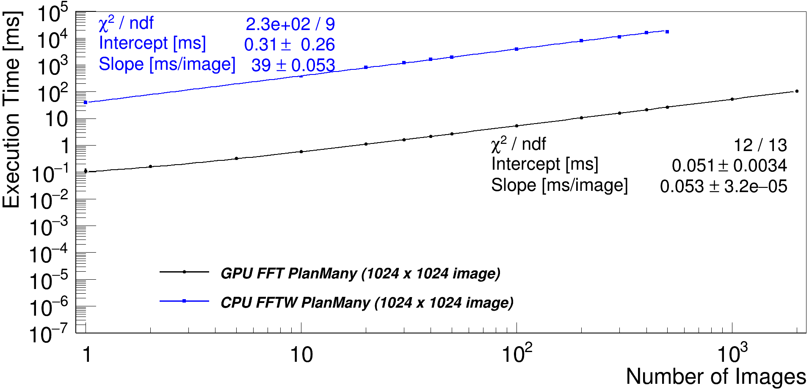
GPU imager banchmarking on Pawsey HPC Setonix (AMD GPUs) and Topaz (NVIDIA GPUs)
GPU vs. CPU FFT Plan Many
Sokolowski et al., PASA, 2024
MWA Project meeting, Lausanne, 29-08-2024
Notes:
180x180 43.6 ms/5000 images ≈ 8.7 usec / image
1024x1024: 6.1 ms/500 images ≈ 12 usec / image
Source:
/home/msok/Desktop/PAWSEY/PaCER/doc/PhD_project/APPLICATION/Applicants/Domestic/Gayatri/doc/Milestones/M1_Candidacy/CONDITIONAL/NEW/MASTERS/doc/travel/Poster/versions/20230706

Slide 26
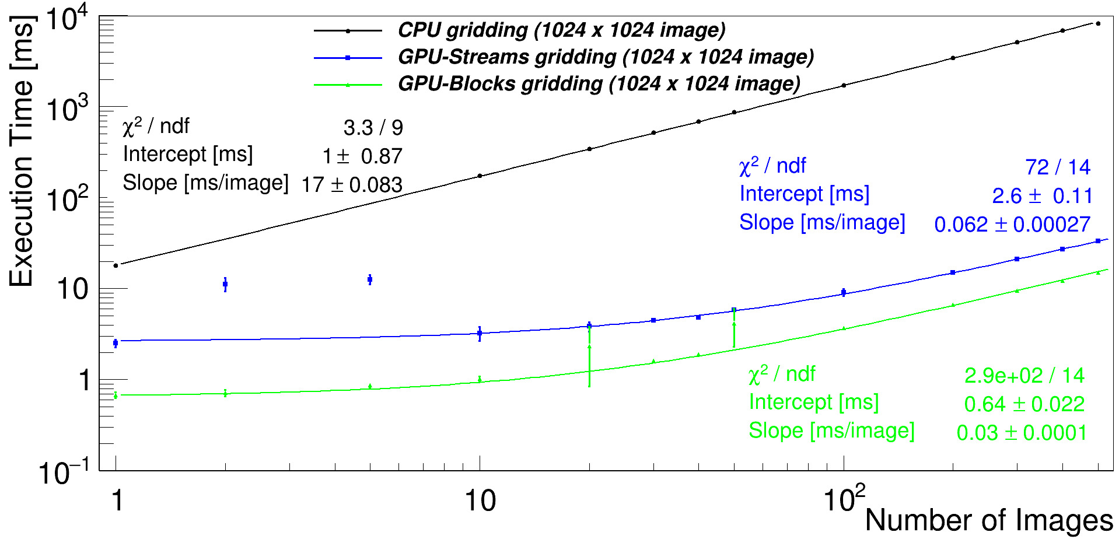
GPU imager banchmarking on Pawsey HPC Setonix (AMD GPUs) and Topaz (NVIDIA GPUs)
GPU vs. CPU Gridding
Sokolowski et al., PASA, 2024
MWA Project meeting, Lausanne, 29-08-2024
Notes:
180x180 43.6 ms/5000 images ≈ 8.7 usec / image
1024x1024: 6.1 ms/500 images ≈ 12 usec / image
Source:
/home/msok/Desktop/PAWSEY/PaCER/doc/PhD_project/APPLICATION/Applicants/Domestic/Gayatri/doc/Milestones/M1_Candidacy/CONDITIONAL/NEW/MASTERS/doc/travel/Poster/versions/20230706

Slide 27
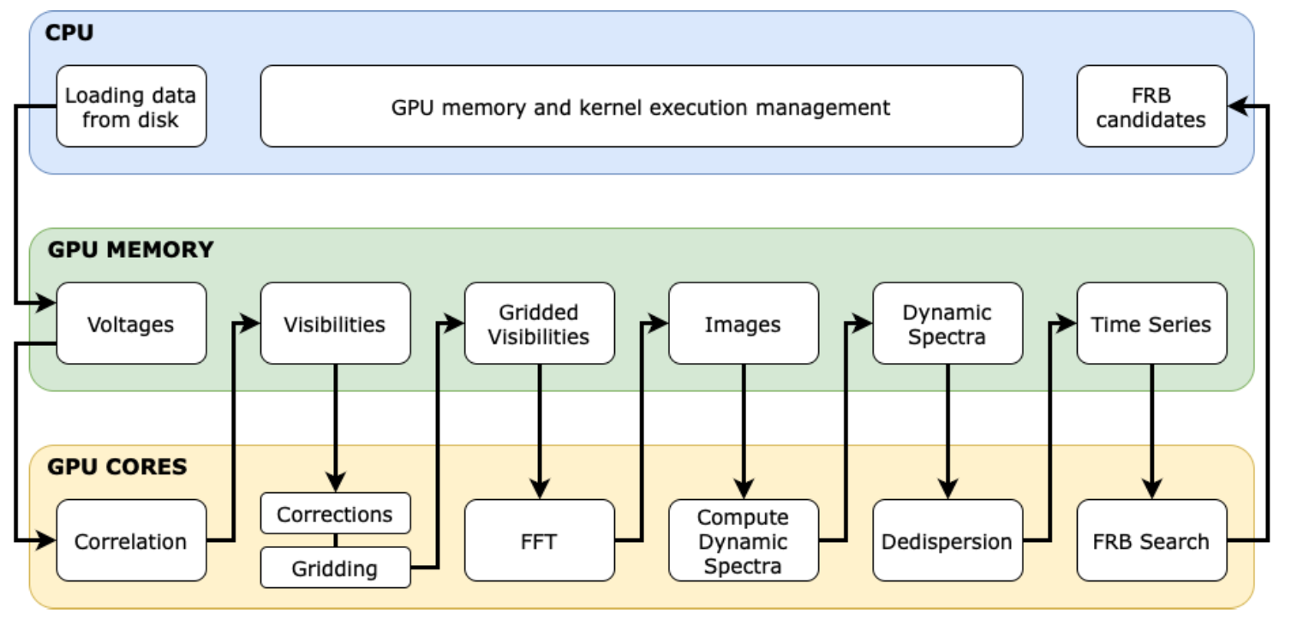
Diagram of the entire BLINK pipeline for image-based FRB searched - work in progress ...
Di Pietrantonio et al., in preparation
MWA Project meeting, Lausanne, 29-08-2024
Notes:
Show 32 channel panel movie
Chose some example from:
/home/msok/Desktop/Conferences/2023/MWA_project_meeting/TALK/images/movies/20230709_120921_100ms_ch294_movies
Event 0102_0050 on page 3 of 20230709_EDA2_Nx10min_for_pilot_FRB_search_CANDIDATES.odt 0102_0050
/home/msok/Desktop/PAWSEY/PaCER/logbook
20230709_EDA2_Nx10min_for_pilot_FRB_search_CANDIDATES.odt

Slide 28
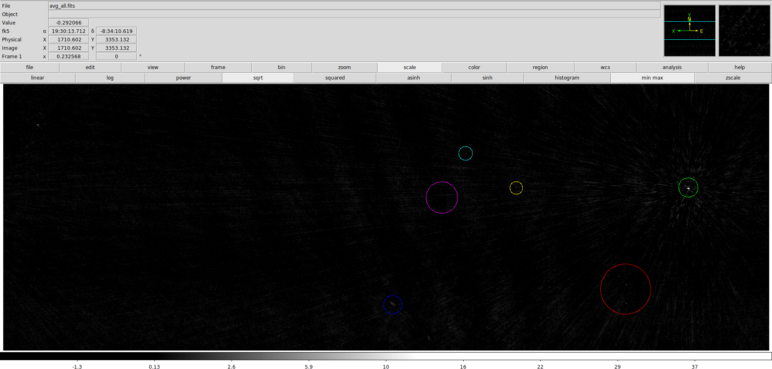
1st second MWA image from off-line correlated MWA Voltage Capture System (VCS). BLINK vs. WSCLEAN
BLINK DIRTY IMAGE - 1st second
MWA Project meeting, Lausanne, 29-08-2024
Notes:
20240821_BLINK_vs_WSCLEAN_1second_1276619416.odt

Slide 29
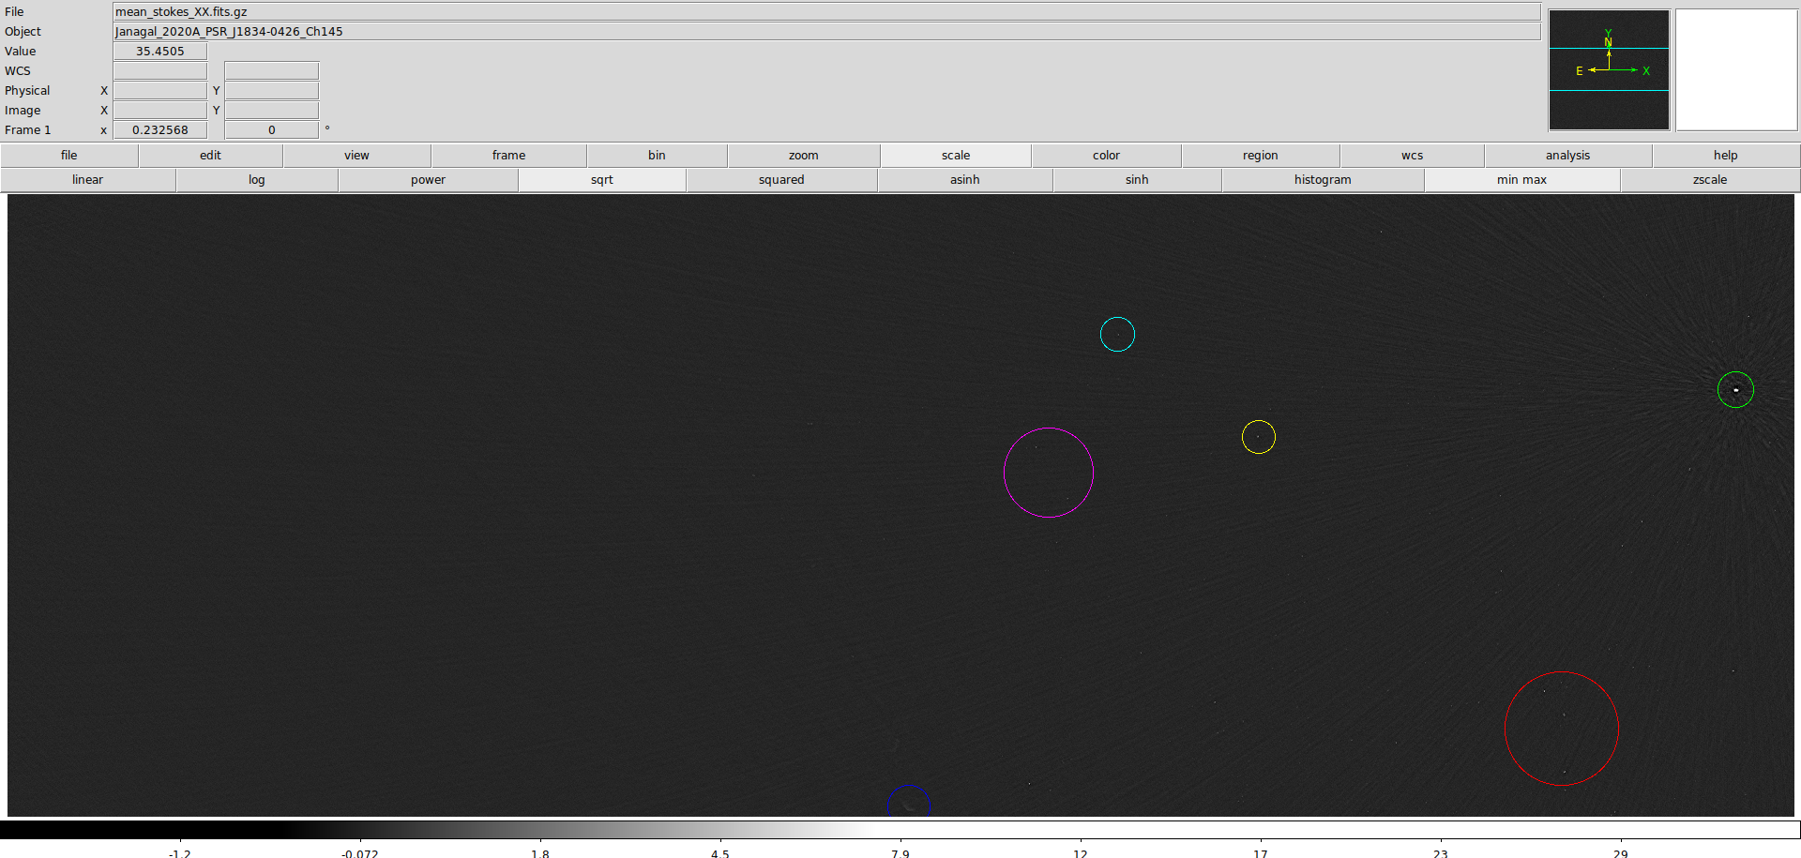
1st second MWA image from off-line correlated MWA Voltage Capture System (VCS). BLINK vs. WSCLEAN
WSCLEAN DIRTY IMAGE
MWA Project meeting, Lausanne, 29-08-2024
Notes:
20240821_BLINK_vs_WSCLEAN_1second_1276619416.odt

Slide 30
1st second MWA image from off-line correlated MWA Voltage Capture System (VCS). BLINK vs. WSCLEAN
BLINK DIRTY IMAGE - 1st second
Ghost source due to lack of convolution kernel in the BLINK gridding procedure : work in progress !
MWA Project meeting, Lausanne, 29-08-2024
Notes:
20240821_BLINK_vs_WSCLEAN_1second_1276619416.odt

Slide 31
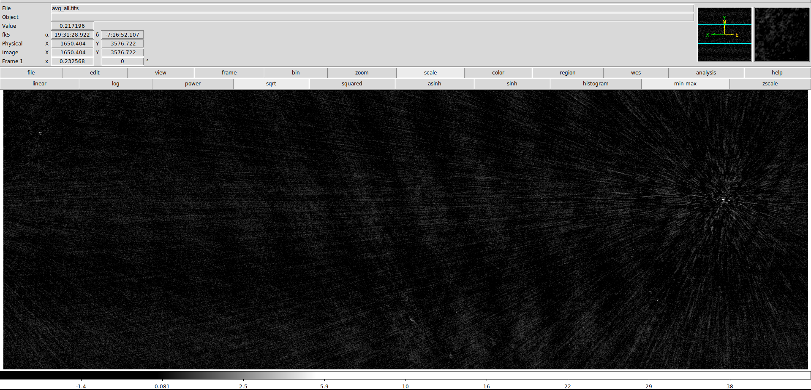
2nd second MWA image from off-line correlated MWA Voltage Capture System (VCS). BLINK vs. WSCLEAN
BLINK DIRTY IMAGE - 2nd second
MWA Project meeting, Lausanne, 29-08-2024
Notes:
20240821_BLINK_vs_WSCLEAN_1second_1276619416.odt

Slide 32
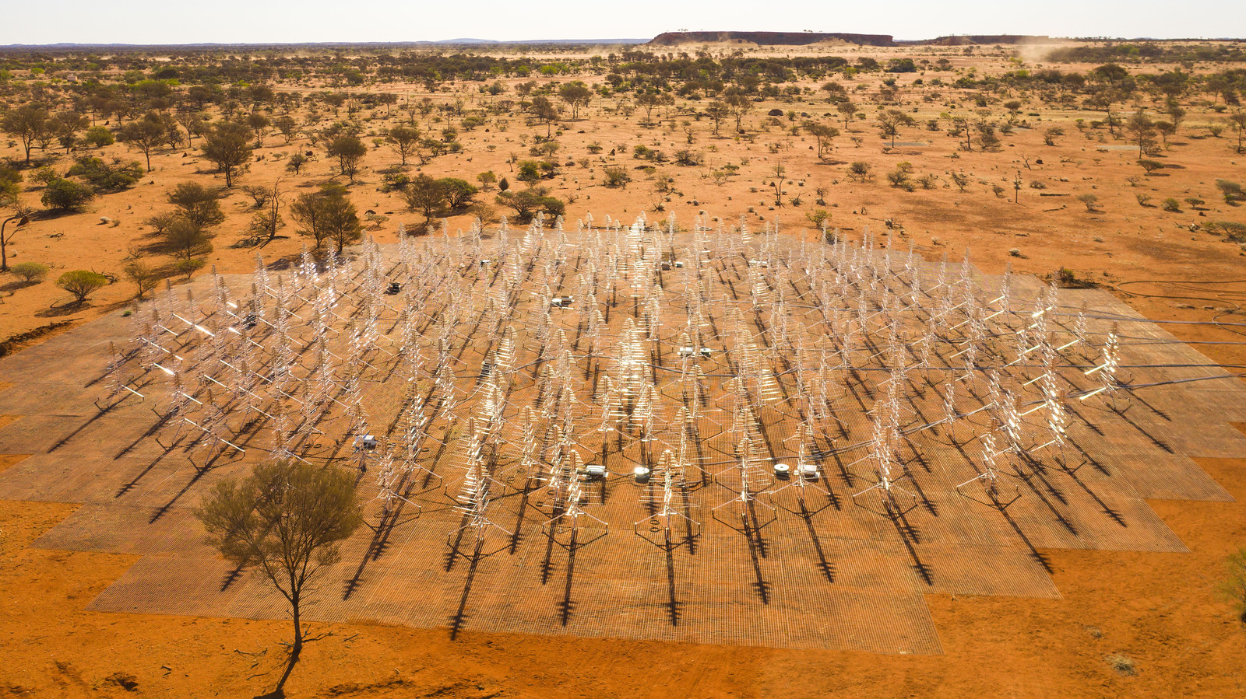
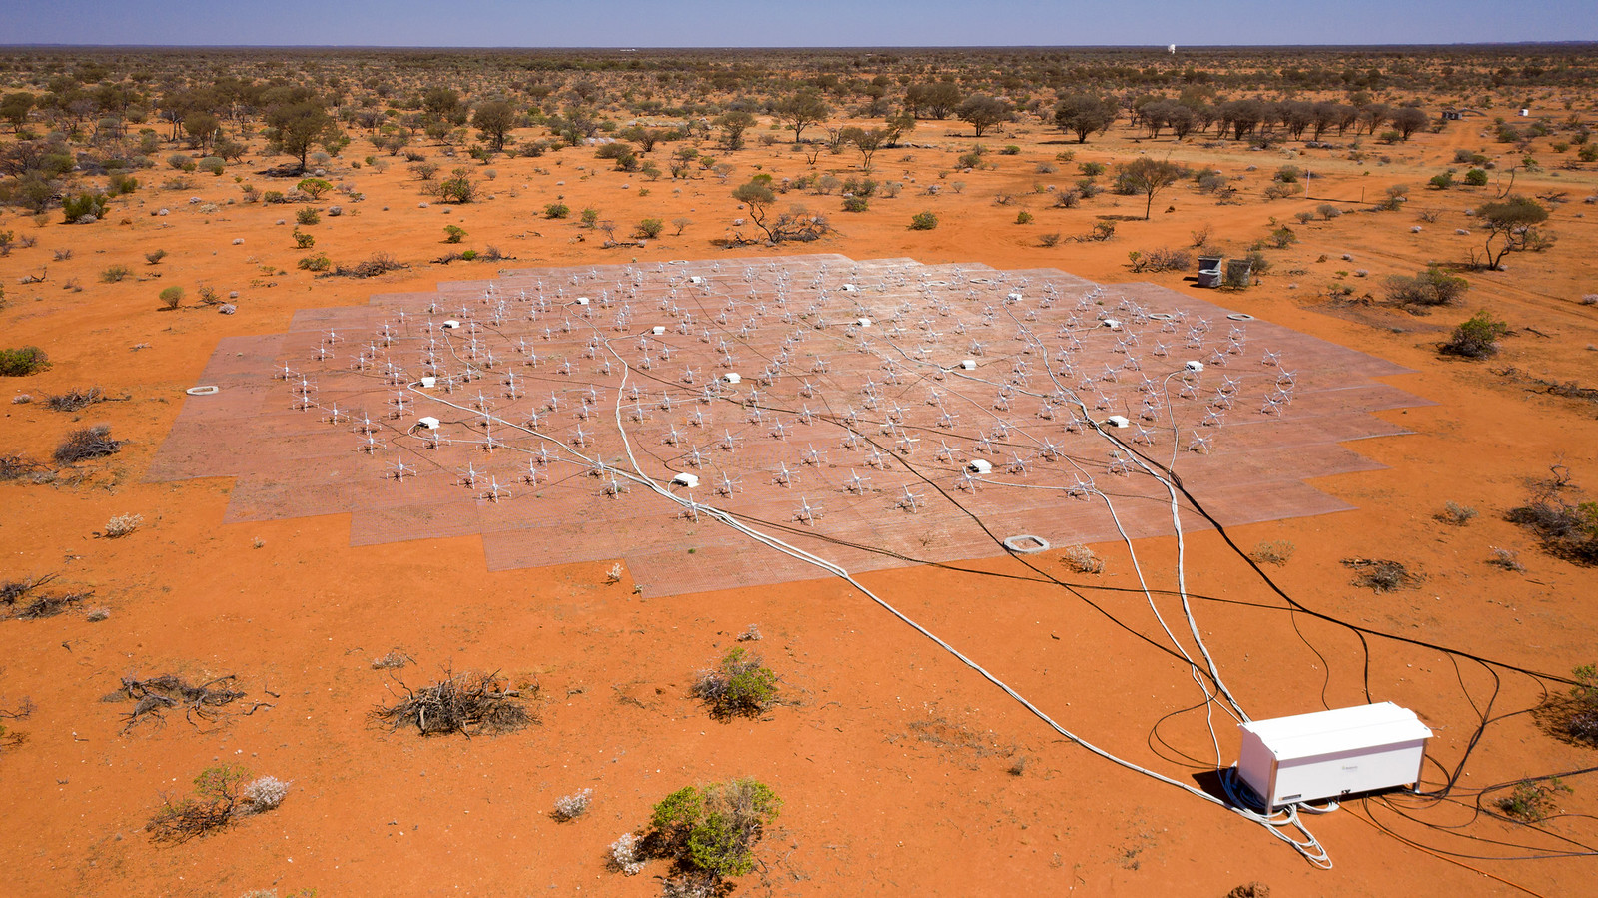
SKA-Low stations (50 - 350 MHz)
Aperture Array Verification System 2 (AAVS2) 256 SKALA-4.1 antennas
( Macario et al, SPIE JATIS ,2022 )
Engineering Development Array 2 (EDA2)
256 MWA Dipoles
( Wayth et al., SPIE JATIS, 2022 )
Antennas individually digitised → can be used as standalone interferometers → all-sky imaging
Currently can capture only 1 coarse channel (~0.93 MHz) worth of bandwidth
All-sky transient searches demonstrated in 2-second time resolution
Larger observing BW requires software/firmware work in DAQ and real-time processing
More stations on a few months time scale → all-sky FRB/pulsar/transient searches!
MWA Project meeting, Lausanne, 29-08-2024
Notes:
Left : South Africa Right : Australia
Facts - not just use the ready slide !
Use images of both telescopes from these pages (or the one Chris Lee sent)
https://www.skatelescope.org/quickimages/ Use SKA page from Australia too ! SKA images :
https://www.auska-multimedia.org/
Multimedia :
- https://www.auska-multimedia.org/

Slide 33
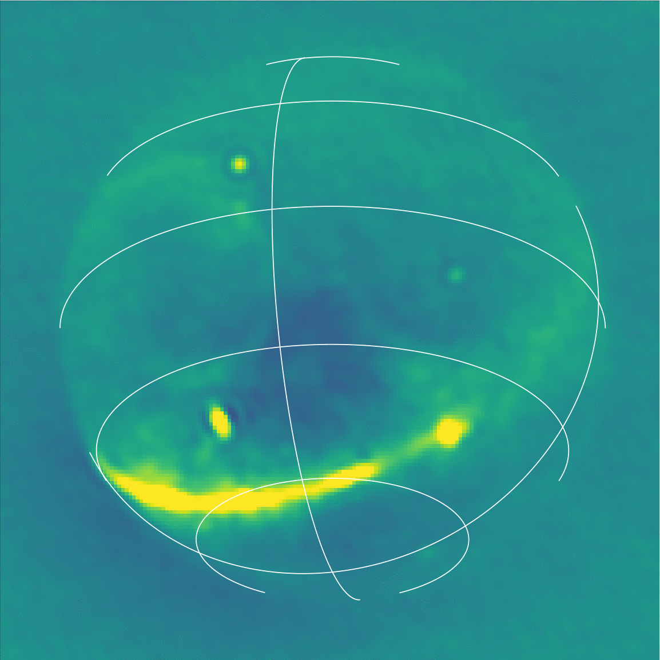
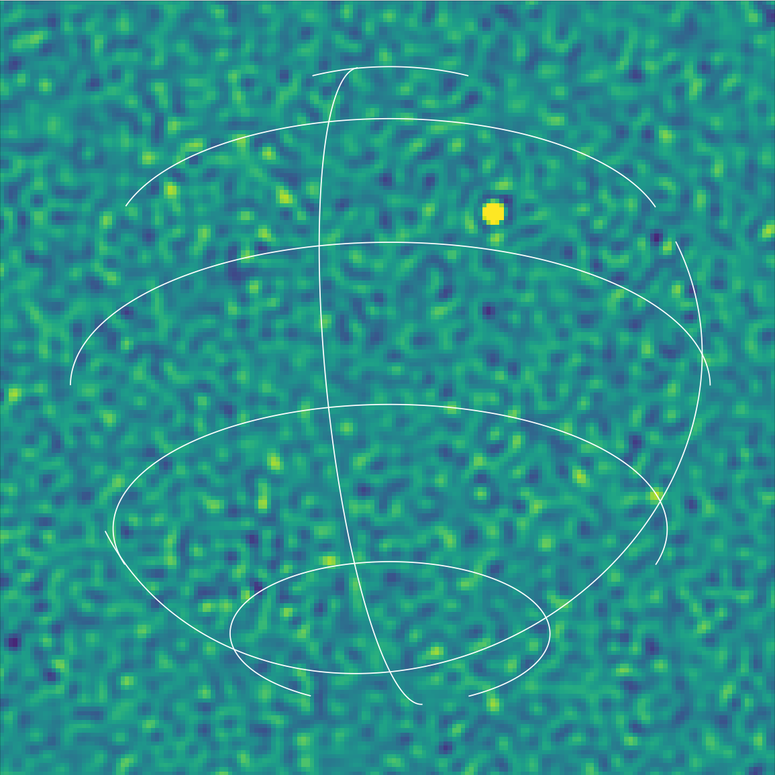
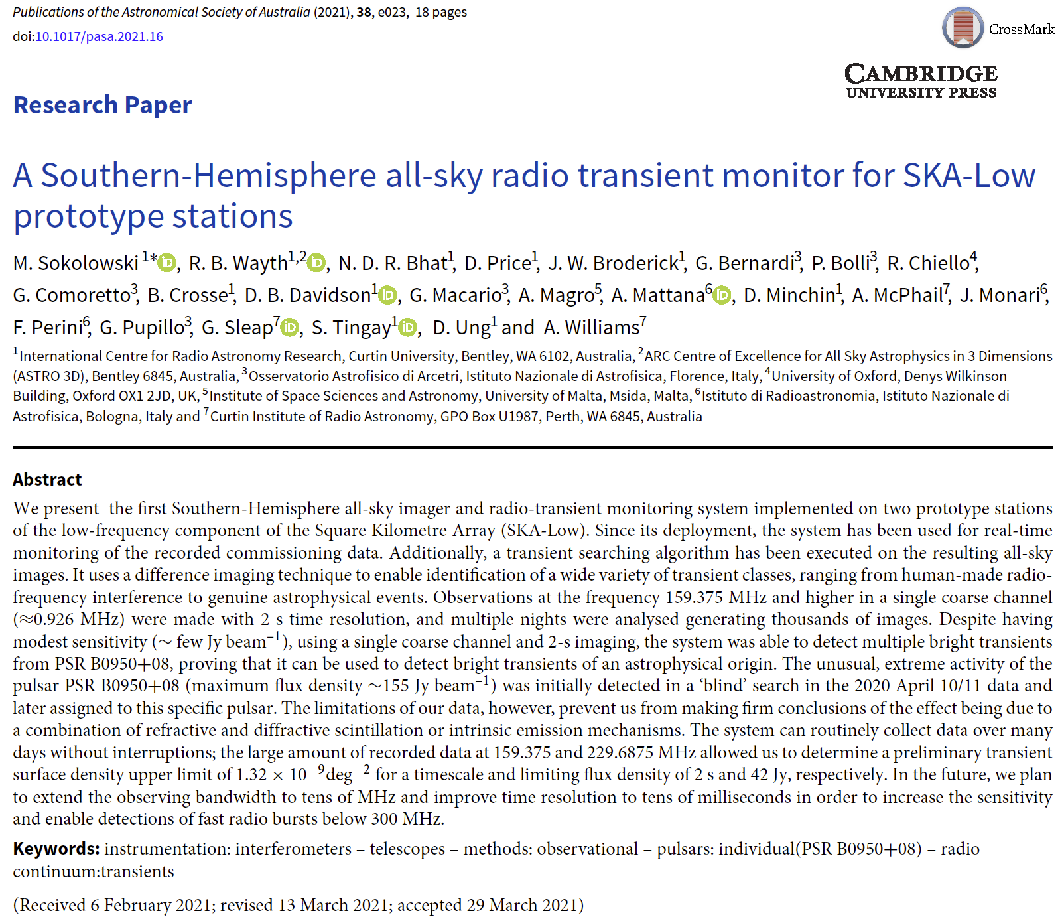
All-sky imaging with SKA-Low stations
2020-04-10 14:04:44 UTC
2020-04-10 14:04:46 UTC
DIFFERENCE OF THE TWO
EDA2 at 159.375 MHz
Demonstration on 2-sec
all-sky imaging
Difference imaging used to identified transients
Example, bright known pulsars like B0950+08
MWA Project meeting, Lausanne, 29-08-2024
Notes:
Left : South Africa Right : Australia
Facts - not just use the ready slide !
Use images of both telescopes from these pages (or the one Chris Lee sent)
https://www.skatelescope.org/quickimages/ Use SKA page from Australia too ! SKA images :
https://www.auska-multimedia.org/
Multimedia :
- https://www.auska-multimedia.org/

Slide 34
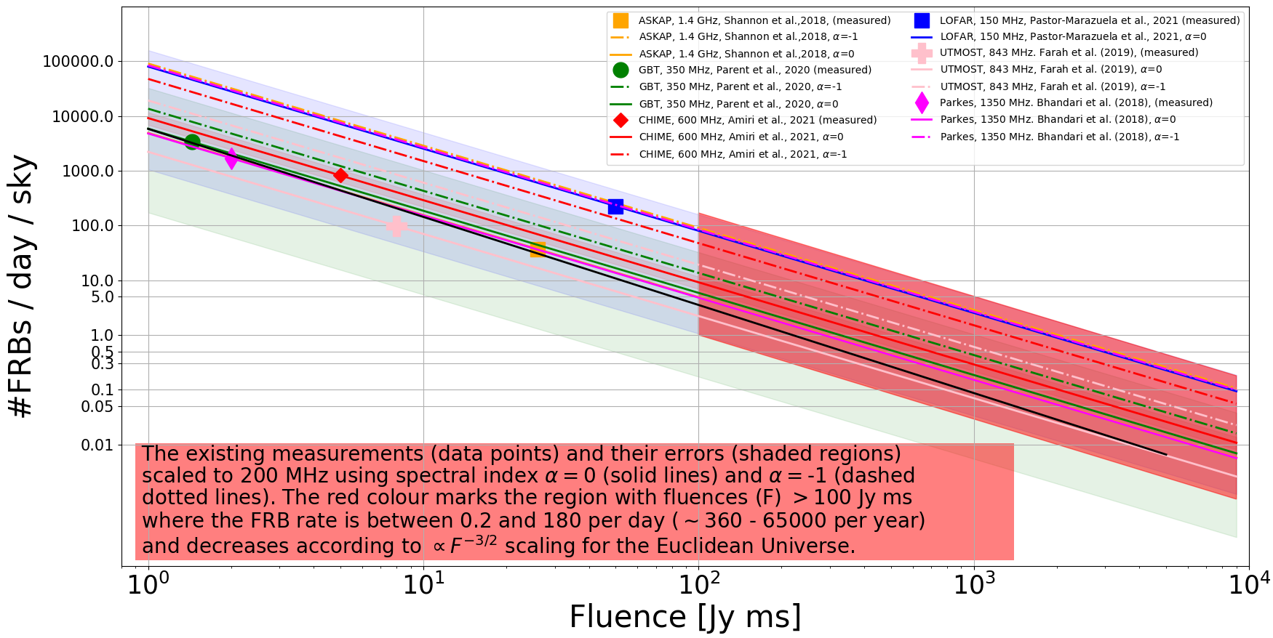
FRB rates at 200 MHz derived from higher frequency measurements assuming flat rate or rate ~ ν⁰
MWA Project meeting, Lausanne, 29-08-2024
Notes:
Left : South Africa Right : Australia
Facts - not just use the ready slide !
Use images of both telescopes from these pages (or the one Chris Lee sent)
https://www.skatelescope.org/quickimages/ Use SKA page from Australia too ! SKA images :
https://www.auska-multimedia.org/
Multimedia :
- https://www.auska-multimedia.org/

Slide 35
FRB rates at 200 MHz derived from higher frequency measurements assuming flat rate or rate ~ ν⁰
BW ~ 30 MHz, 10ms, 10σ ~ 300 Jy ms
~1 ± 0.4 FRBs/day/sky
Expected number of 10σ (≥ 300 Jy ms) detections ~ 10s - 100s FRBs / year mainly in the local Universe (redshift < 1)
MWA Project meeting, Lausanne, 29-08-2024
Notes:
Left : South Africa Right : Australia
Facts - not just use the ready slide !
Use images of both telescopes from these pages (or the one Chris Lee sent)
https://www.skatelescope.org/quickimages/ Use SKA page from Australia too ! SKA images :
https://www.auska-multimedia.org/
Multimedia :
- https://www.auska-multimedia.org/

Slide 36
FRB rates at 200 MHz derived from higher frequency measurements assuming flat rate or rate ~ ν⁰
BW ~ 0.93 MHz, 100ms, 10σ ~ 6000 Jy ms
~0.01 ± 0.005 FRBs/day/sky
With current system 10σ (≥ 6 kJy ms) detections ~ 4 ± 2 FRBs / year
MWA Project meeting, Lausanne, 29-08-2024
Notes:
Left : South Africa Right : Australia
Facts - not just use the ready slide !
Use images of both telescopes from these pages (or the one Chris Lee sent)
https://www.skatelescope.org/quickimages/ Use SKA page from Australia too ! SKA images :
https://www.auska-multimedia.org/
Multimedia :
- https://www.auska-multimedia.org/

Slide 37
Real-time and off-line GPU-imaging on EDA2 data acquisition server or Setonix
Recorded ~2.5 hours of data for testing in 1 minute blocks
Bandwidth ~1 MHz of data (32 channels) at 230 MHz, 100ms, start 20230709 12:09:21 UTC
MWA Project meeting, Lausanne, 29-08-2024
Notes:
~/Desktop/Conferences/2024/SETI/talk/images/movies
Show 32 channel panel movie
Chose some example from:
/home/msok/Desktop/Conferences/2023/MWA_project_meeting/TALK/images/movies/20230709_120921_100ms_ch294_movies
Event 0102_0050 on page 3 of 20230709_EDA2_Nx10min_for_pilot_FRB_search_CANDIDATES.odt 0102_0050
/home/msok/Desktop/EDA2/data/2023_07_09_eda2_10min_ch294/processing/all/external_hdd/20230709_105510_100ms_ch294/fits_images/images/movie
/home/msok/Desktop/Conferences/2023/MWA_project_meeting/images/eda2_1channel_examples/20230709_105510_100ms_ch294
+ dynamic spectrum and DTS

Slide 38
Pilot off-line “FRB search” on Setonix
For every pixel above horizon - create dynamic spectrum and look for dispersed pulses ...
Dynamic spectrum at pixel (102,50)
Form de-dispersed time series as in
Anderson et al., PASA, 2021
Trial DM
6 DM ranges between 0 - 900 due to small BW ~ 1 MHz
Pulse arrival time
MWA Project meeting, Lausanne, 29-08-2024
Notes:
python ./dispersion2.py 1000 230 200 23 : 200.56000 MHz -> delta = 24721.526 [ms] = 24.7215 [sec] (at UTC 19700101 000024) , 1.28 MHz sweep time = 1.30 [sec]
python ./dispersion2.py 1000 350 320 23 : 320.56000 MHz -> delta = 6508.319 [ms] = 6.5083 [sec] (at UTC 19700101 000006) , 1.28 MHz sweep time = 0.32 [sec]
cd ~/github/frb_rate/
python ./memory_requirements.py --dispersion_delay=24.7 --pixels=200
Required memory size = 15808000000 bytes = 15808.000 MB = 15.808000 GB Required memory bandwidth = 1580.800 GB/s
~0.64GB/sec * 24.7 ~= 16 GB

Slide 39
Example of candidates (~9 in ~2 hours) : mostly similar RFI transients most likely from satellites or planes
For every pixel above horizon - create dynamic spectrum and look for dispersed pulses ...
Pixel (102,50) : 20230709_105510
(0125_0114) 20230709_105410_100ms_ch294
(0050_0076) 20230709_105410_100ms_ch294
MWA Project meeting, Lausanne, 29-08-2024
Notes:
Show 32 channel panel movie
Chose some example from:
/home/msok/Desktop/Conferences/2023/MWA_project_meeting/TALK/images/movies/20230709_120921_100ms_ch294_movies
Event 0102_0050 on page 3 of 20230709_EDA2_Nx10min_for_pilot_FRB_search_CANDIDATES.odt 0102_0050
/home/msok/Desktop/PAWSEY/PaCER/logbook
20230709_EDA2_Nx10min_for_pilot_FRB_search_CANDIDATES.odt

Slide 40
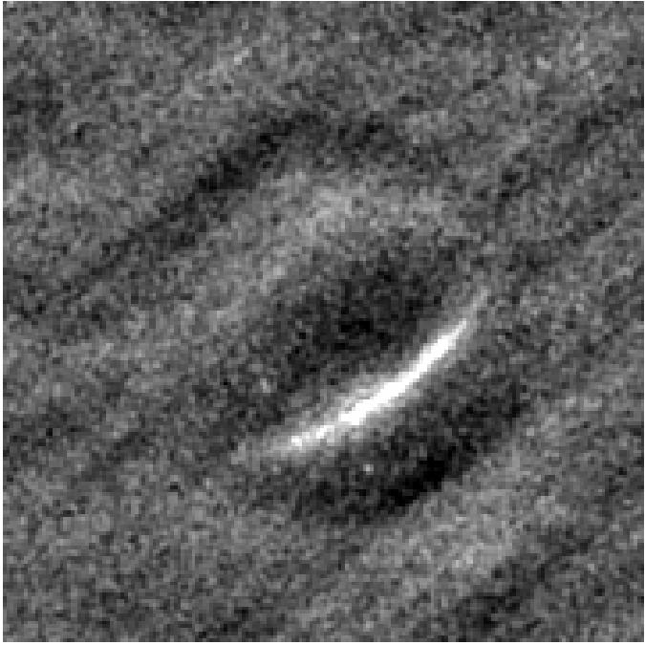
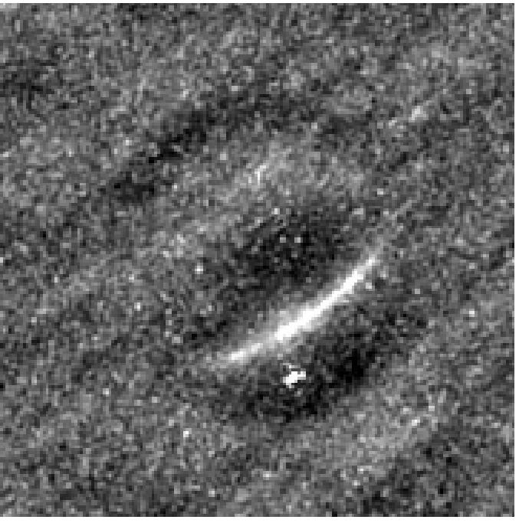
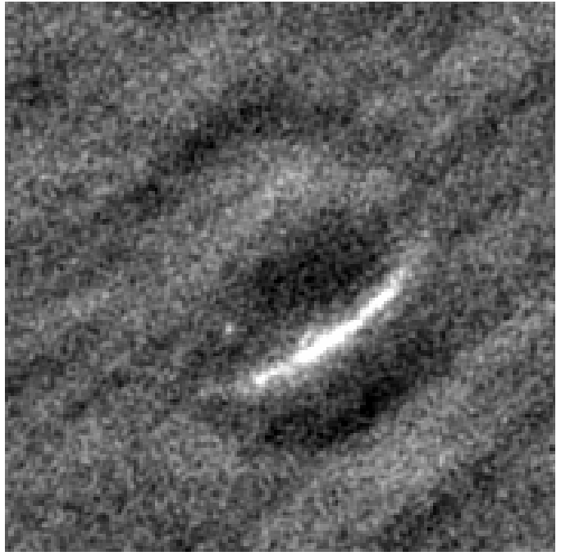
Pilot off-line “FRB search” on Setonix
Back to images to check what it is ?
20230709T121006.099 UTC
20230709T121006.200 UTC
Fine Channel
0
20230709T121006.299 UTC
20230709T121006.400 UTC
MWA Project meeting, Lausanne, 29-08-2024
Notes:
python ./dispersion2.py 1000 230 200 23 : 200.56000 MHz -> delta = 24721.526 [ms] = 24.7215 [sec] (at UTC 19700101 000024) , 1.28 MHz sweep time = 1.30 [sec]
python ./dispersion2.py 1000 350 320 23 : 320.56000 MHz -> delta = 6508.319 [ms] = 6.5083 [sec] (at UTC 19700101 000006) , 1.28 MHz sweep time = 0.32 [sec]
cd ~/github/frb_rate/
python ./memory_requirements.py --dispersion_delay=24.7 --pixels=200
Required memory size = 15808000000 bytes = 15808.000 MB = 15.808000 GB Required memory bandwidth = 1580.800 GB/s
~0.64GB/sec * 24.7 ~= 16 GB

Slide 41
Pilot off-line “FRB search” on Setonix
Back to images to check what it is ?
20230709T121006.099 UTC
20230709T121006.200 UTC
Fine Channel
31
20230709T121006.299 UTC
20230709T121006.400 UTC
MWA Project meeting, Lausanne, 29-08-2024
Notes:
python ./dispersion2.py 1000 230 200 23 : 200.56000 MHz -> delta = 24721.526 [ms] = 24.7215 [sec] (at UTC 19700101 000024) , 1.28 MHz sweep time = 1.30 [sec]
python ./dispersion2.py 1000 350 320 23 : 320.56000 MHz -> delta = 6508.319 [ms] = 6.5083 [sec] (at UTC 19700101 000006) , 1.28 MHz sweep time = 0.32 [sec]
cd ~/github/frb_rate/
python ./memory_requirements.py --dispersion_delay=24.7 --pixels=200
Required memory size = 15808000000 bytes = 15808.000 MB = 15.808000 GB Required memory bandwidth = 1580.800 GB/s
~0.64GB/sec * 24.7 ~= 16 GB

Slide 42
Summary
Low-frequency FRB searches are computationally very challenging
Imaging can be orders of magnitude more faster than tessellation of FoV with thousands or more of tied-array beams
Parallelisation on GPUs make it even faster and more energy efficient
We developed a new GPU imager which can be compiled for NVIDIA and AMD GPUs
(Sokolowski et al., PASA, 2024; https://github.com/PaCER-BLINK-Project/imager)
The full FRB search pipeline using this imager is being developed (Di Pietrantonio et al. in preparation), and will be applied to MWA VCS data.
The GPU imager and FRB search pipeline will also be applied to produce high-time resolution (~10 or 100ms) all-sky images from SKA-Low stations and FRB searches
Can be used for imaging of non-VCS MWA visibilities
Future : use different (more modern) imaging technique in the pipeline ?
MWA Project meeting, Lausanne, 29-08-2024
Notes:
Left : South Africa Right : Australia
Facts - not just use the ready slide !
Use images of both telescopes from these pages (or the one Chris Lee sent)
https://www.skatelescope.org/quickimages/ Use SKA page from Australia too ! SKA images :
https://www.auska-multimedia.org/
Multimedia :
- https://www.auska-multimedia.org/

