Slide 1
Solar and Heliospheric Physics with SKA
Rohit Sharma¹, Andre Csillaghy², Divya Oberoi³, Simon Felix²
¹Space Planetary Astronomical Sciences & Engineering (SPASE), Indian Institute of Technology, Kanpur, India
²Fachhochschule Nordwestschweiz (FHNW), Windisch, Switzerland
³National Centre for Radio Astrophysics, Tata Institute of Fundamental Research, Pune, India
MWA Project Meeting 2024
EPFL École Polytechnique Fédérale de Lausanne (EPFL) , Lausanne, Switzerland
29th August 2024

Slide 2
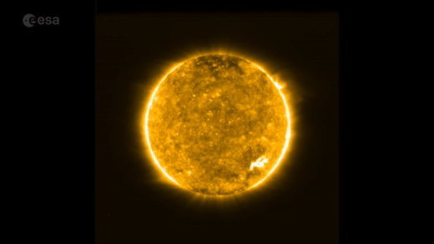
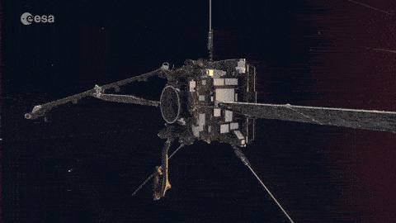
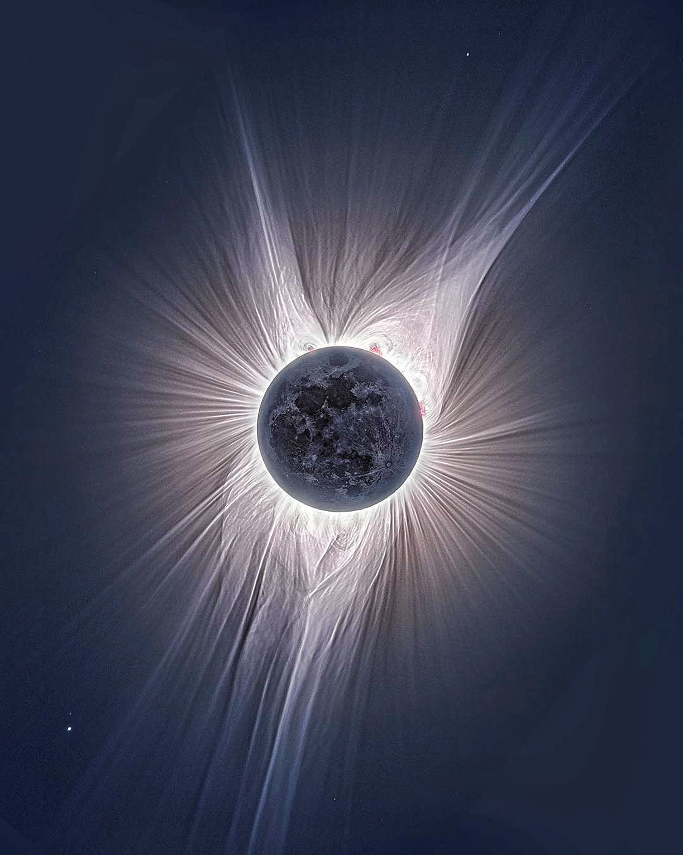
Dynamic ball of Plasma
Enormous length scales
Lot of structure
Wide range of timescales
High resolution Probes: Space-based observatories solar orbiter and parker solar probe
MWA Project Meeting 2024, EPFL, Lausanne

Slide 3
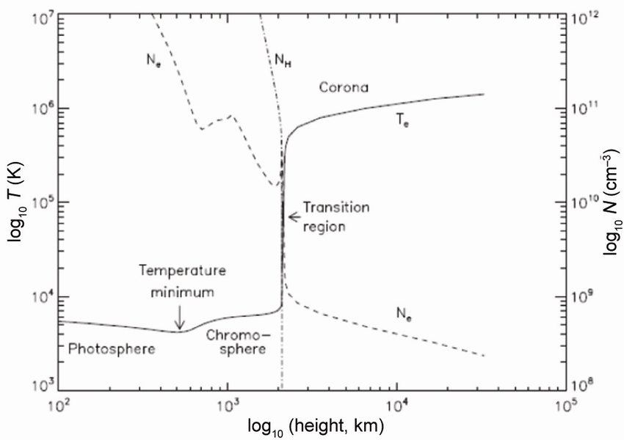
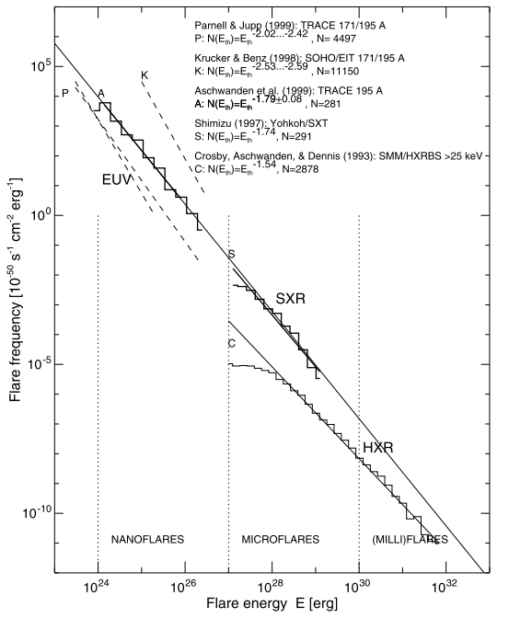
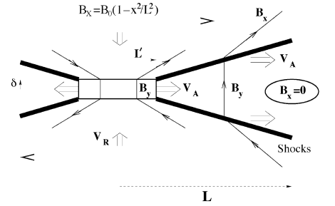
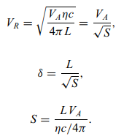
Energetics in the Corona - Coronal Heating
The Sun is dynamic plasma laboratory
Coronal heating and acceleration of solar wind
Flares/Microflares
Magnetic Reconnection and nonthermal particle acceleration
Radio Waves are direct Signature of nonthermal particles
MWA Project Meeting 2024, EPFL, Lausanne

Slide 4
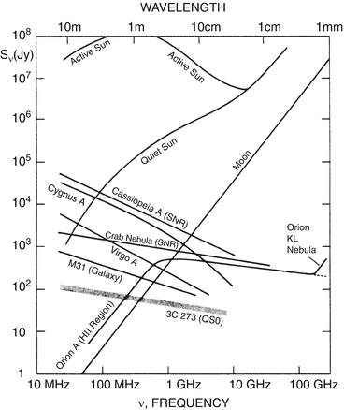
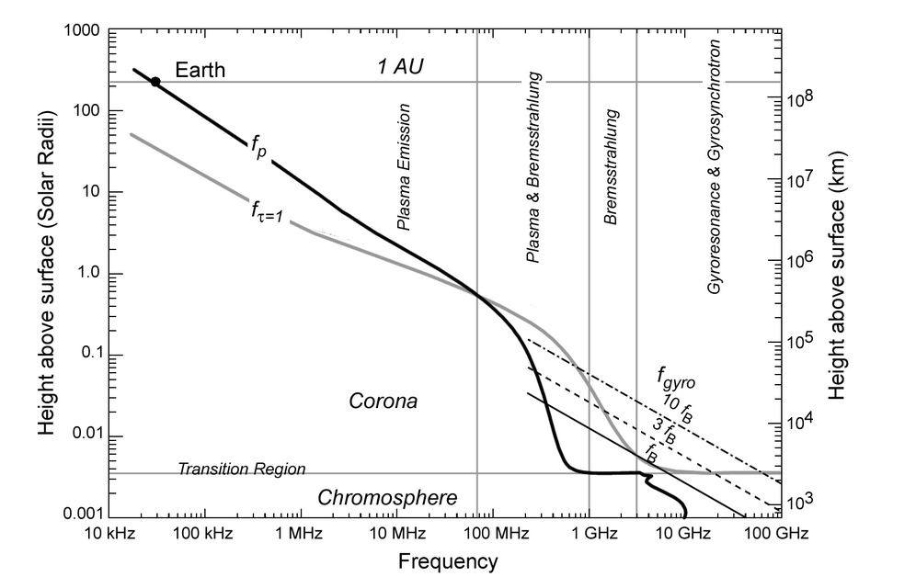
Diverse Scales of Emission
SKA Frequency Range
MWA Project Meeting 2024, EPFL, Lausanne

Slide 5
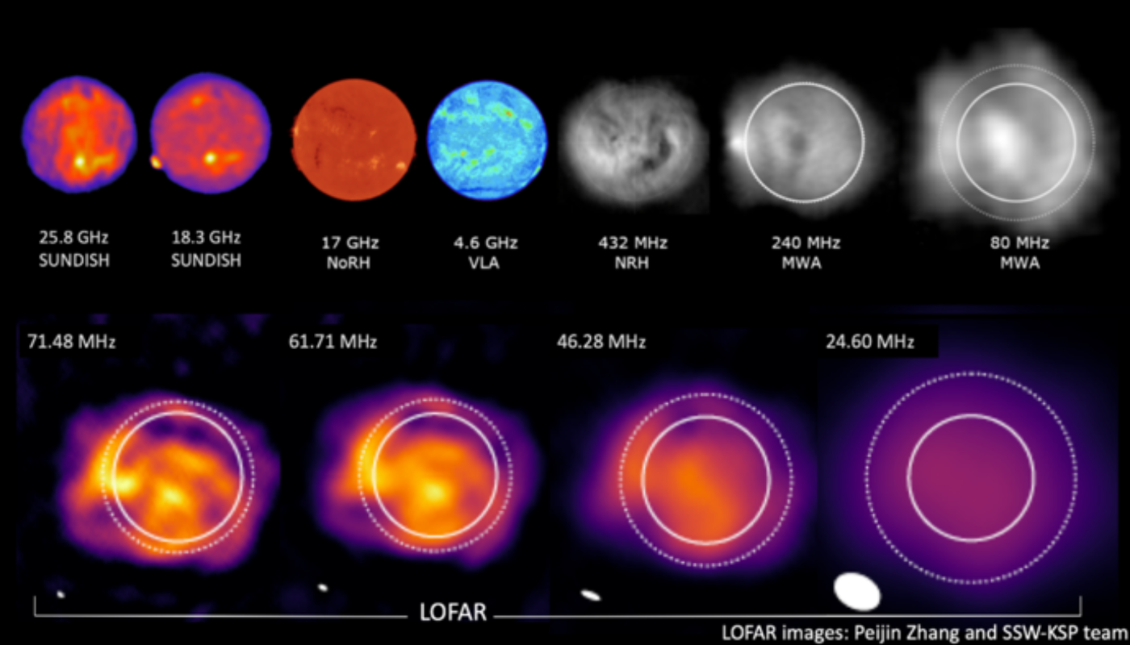
Morphology of the Sun
MWA Project Meeting 2024, EPFL, Lausanne

Slide 6
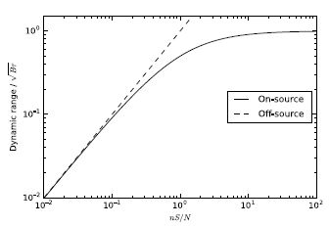
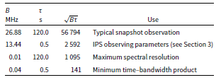
Heliophysics-related challenges
Dynamic nature of the Sun
Flux Calibration / Polarisation
Capturing of big solar events – Flares & CMEs
Complex emission mechanism in low frequency range
Self-noise limited
Morgan, J. S. & Ekers, R., 2021
MWA Project Meeting 2024, EPFL, Lausanne

Slide 7
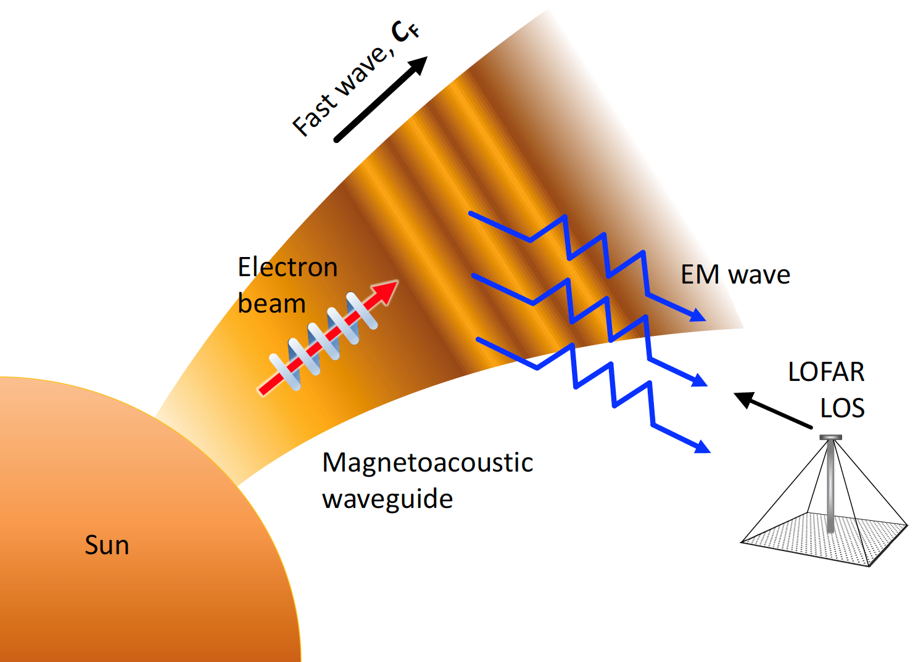
Science Cases
MHD waves
Periodic Radio Emission
Zebra Patterns
Solar Science
Cases
With SKA
Waves in corona
Shock waves
Propagation
Type-II bursts
CMEs
Small-scale bursts
Coronal Mass Ejections
(CMEs)
Fine density/magnetic
field Structures
Coronal Heating
Space Weather
Faraday Rotation
Propagation in the interplanetary medium / In-Situ
IPS (sub-arrays)
Weak brightness variations
Small-scale bursts
Fine structures in Type-I/II/III radio bursts
Scattering Studies
MWA Project Meeting 2024, EPFL, Lausanne

Slide 8
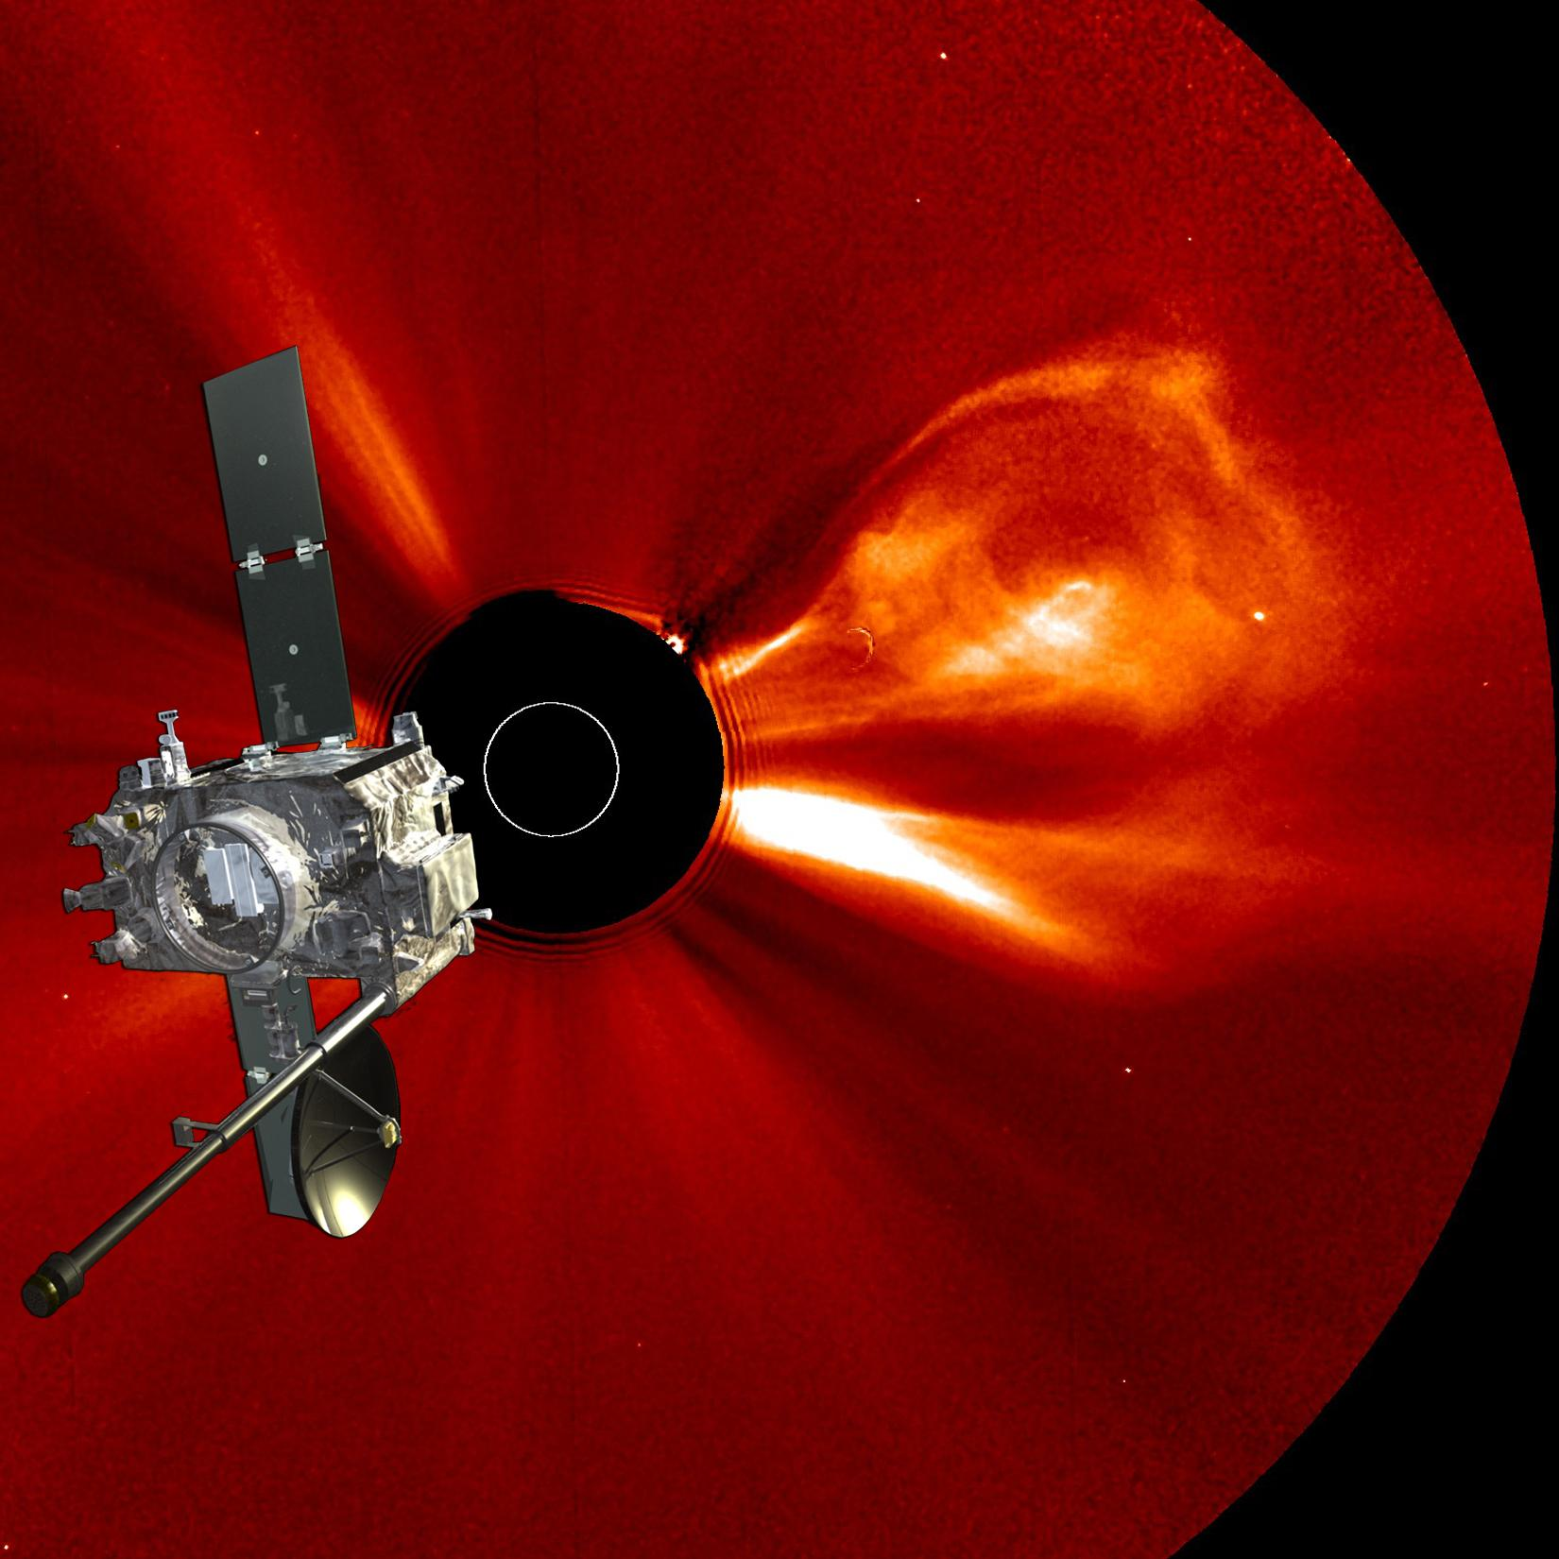
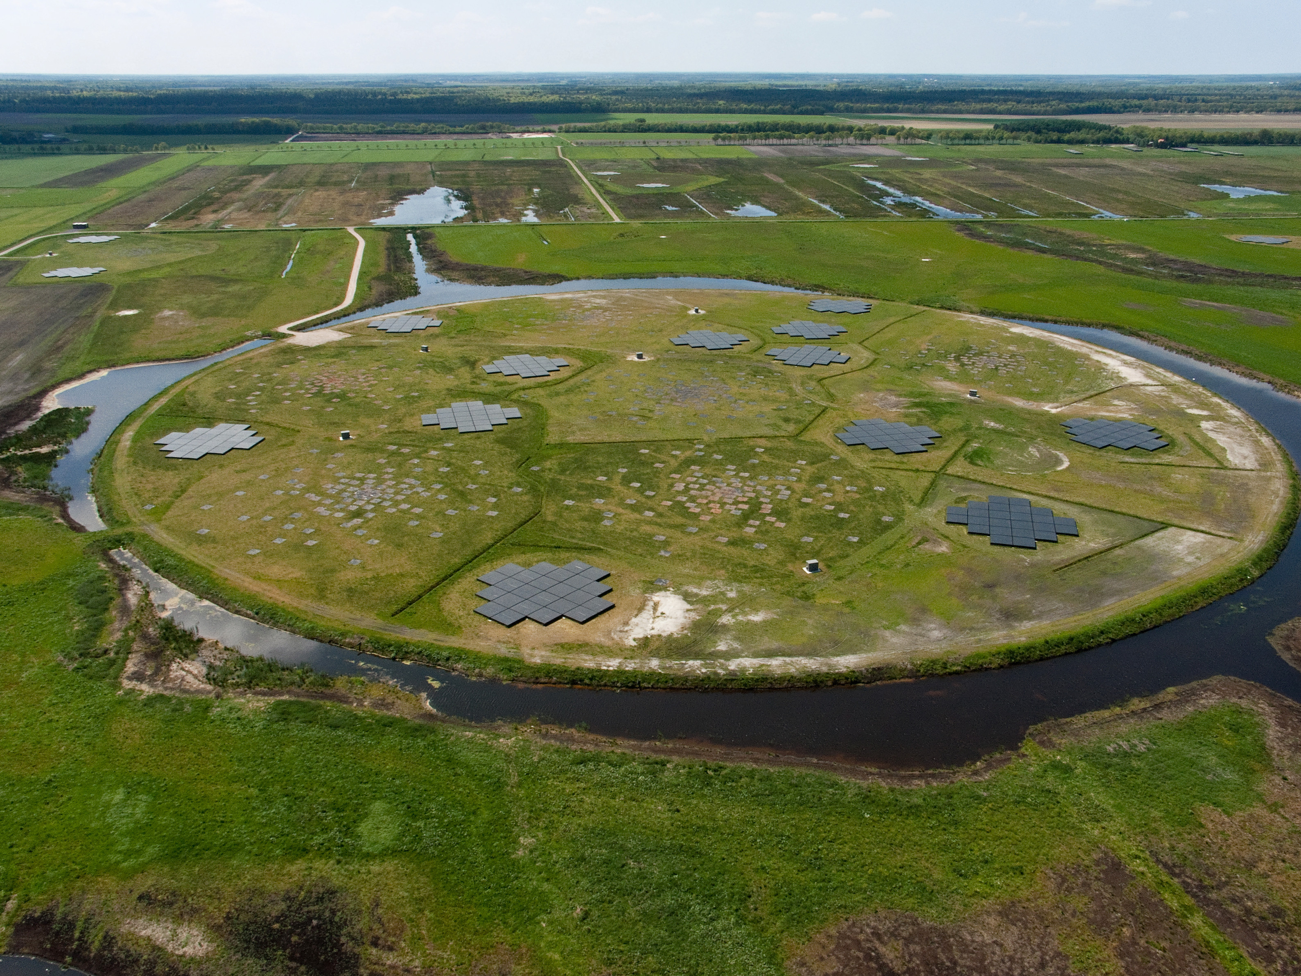
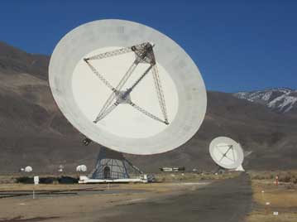
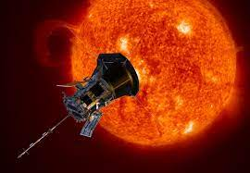
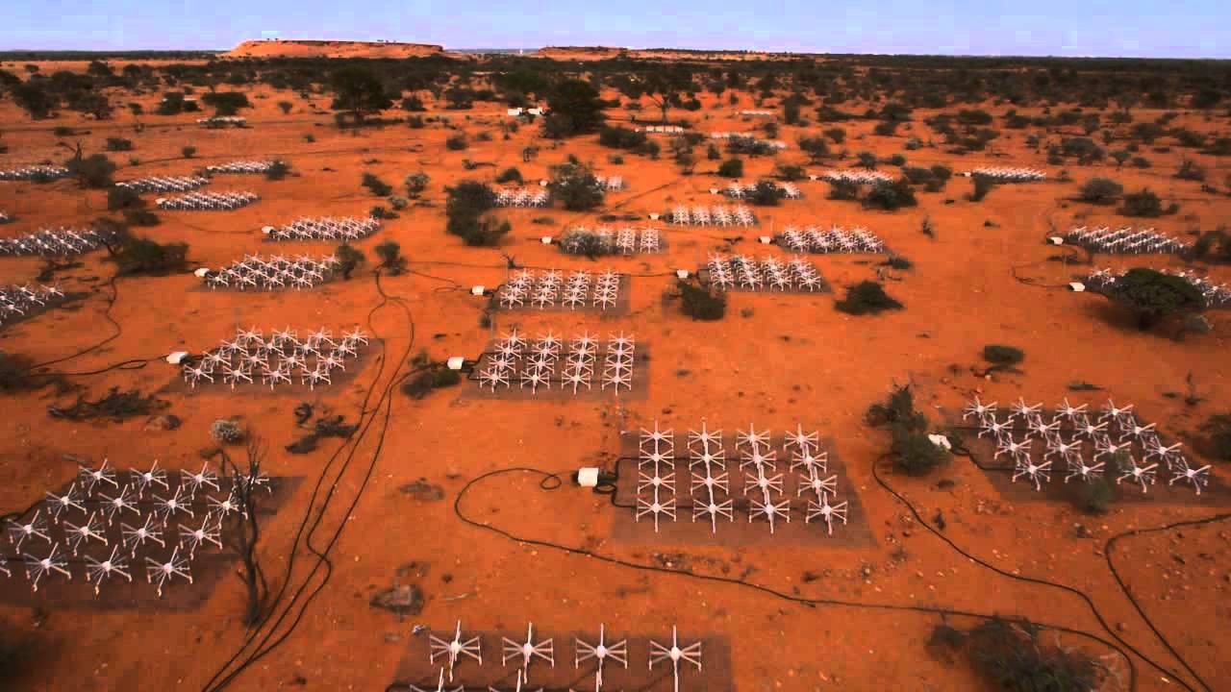
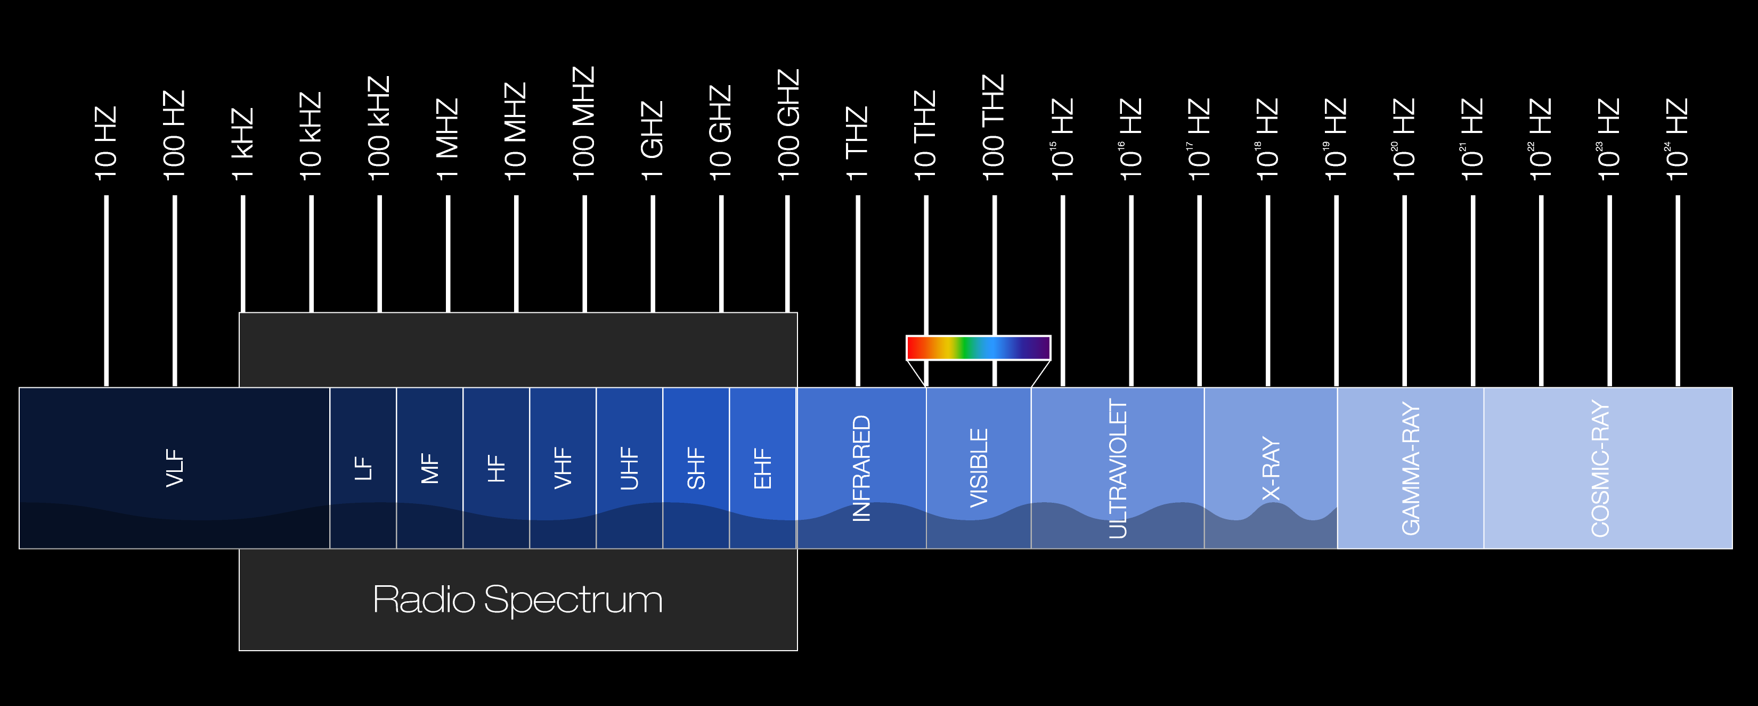
Current Best Radio Telescopes for Solar Observations
STEREO (Solar Terrestrial Relations Observatory)
10 kHz – 10 MHz
LOFAR
10–240 MHz
Parker Solar Probe
Radio Frequency Spectrometer (RFS)
10 kHz – 2 MHz
EOVSA (1-18 GHz)
Murchison Widefield Array
80-300 MHz
VLA (1-50 GHz)
MWA Project Meeting 2024, EPFL, Lausanne

Slide 9
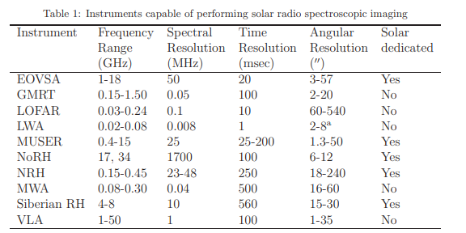
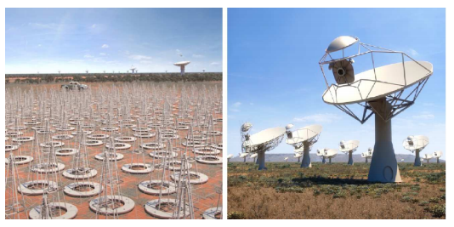
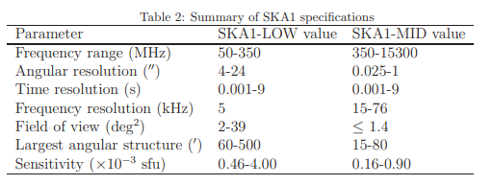
Improvements from Square Kilometer Array
Improvement of spatial resolution upto 10 times
Time resolution improvement upto 5 times
Sensitivities / Fidelity improvements by 10 times at low frequencies
Nindos A., Kontar E. P., Oberoi D., 2019, Advances in Space Research, 63, 1404

Slide 10
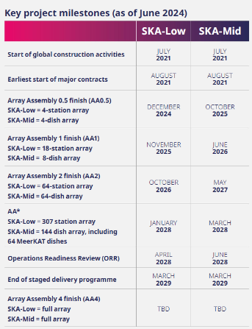
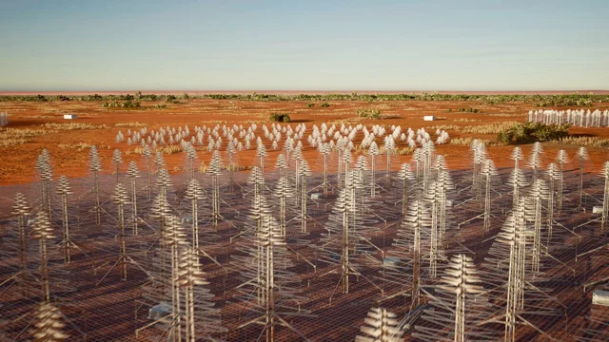
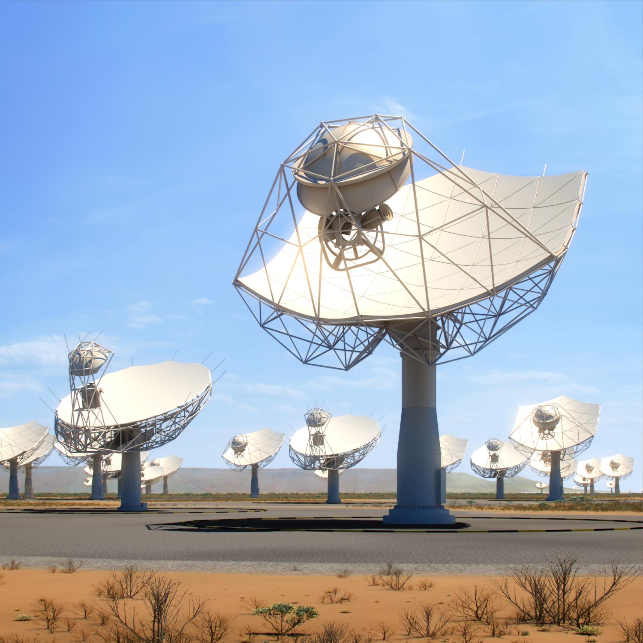
SKA-low & SKA-mid timelines
MWA Project Meeting 2024, EPFL, Lausanne

Slide 11
Eye-opening moment – 1 station / 511 to go
MWA Project Meeting 2024, EPFL, Lausanne
Notes:
This is the first image and video from observations using one complete SKA-Low station, known as S-8, produced only 18 months after the start of construction activities on site, and five months after the first antenna was installed. The completion of a station means not only assembling and installing the 256 antennas, but also integrating them with all the computing systems behind them. The video shows a 24-hour observation, with the Milky Way rising and passing overhead during the night time hours. Some other bright radio sources are marked, including the galaxies Centaurus A and M87, and the Sun is also visible during the day. It demonstrates the high sensitivity of a single station, the stability of the current system, and the ease of producing an image, which required relatively little processing.

Slide 12
First Spectroscopic Solar Image using MeerKAT
Observations were done in MeerKAT L-band on September 26 and 27, 2020 during perihelion of the Parker Solar Probe.
Images are made for every 15 minute temporal and 20 MHz spectral chunks.
Special care has been taken to account for spectral variability of the solar emission as well as chromatic primary beam.
This band averaged image is made by stacking all 20 MHz spectral chunks.
Kansabanik et al., 2024, ApJ 961 96
MWA Project Meeting 2024, EPFL, Lausanne

Slide 13
Importance of Simulations
Design better science optimised array and observing strategies
Simulate artifacts and manifestation in the image plane
Test new algorithms
Debugging Pipelines
https://github.com/i4Ds/Karabo-Pipeline (SKACH effort)
MWA Project Meeting 2024, EPFL, Lausanne

Slide 14
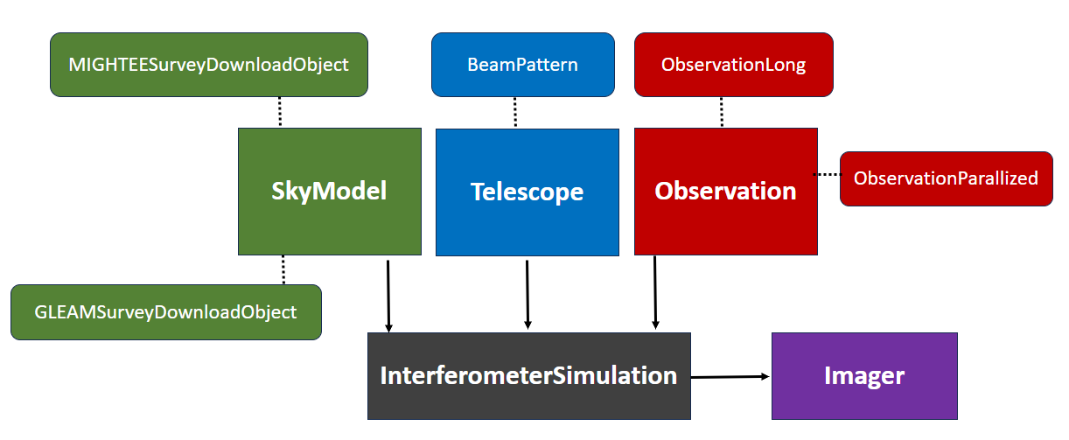
KARABO Workflow
MWA Project Meeting 2024, EPFL, Lausanne

Slide 15
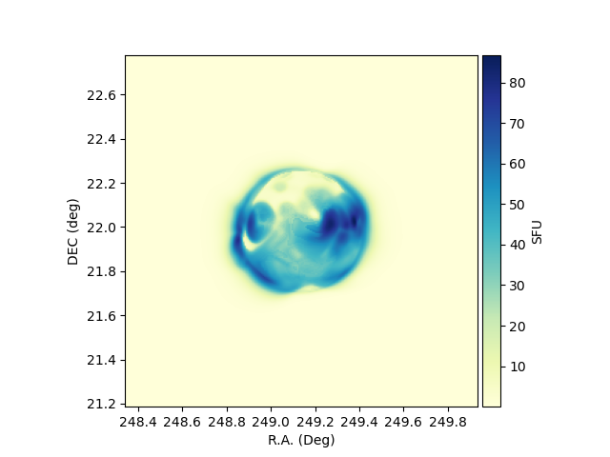
Skymodel
Sky Model – 15th Dec 2015 – FORWARD model
Skymodel – Solar disk
Free-free emission
Brightness Temperature T = T_{e}(1-e^{-t})
1 SFU ~ 10⁴ Jy
Assuming zero position angle
Source Contrast = Image max / RMS_{off}
240 MHz
$$T\left(ν\right)=T\left(240 MHz\right)×{(ν(MHz)/240)}^{2}$$
https://www2.hao.ucar.edu/modeling/FORWARD

Slide 16
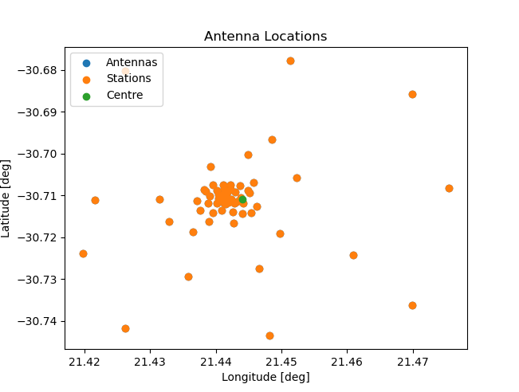
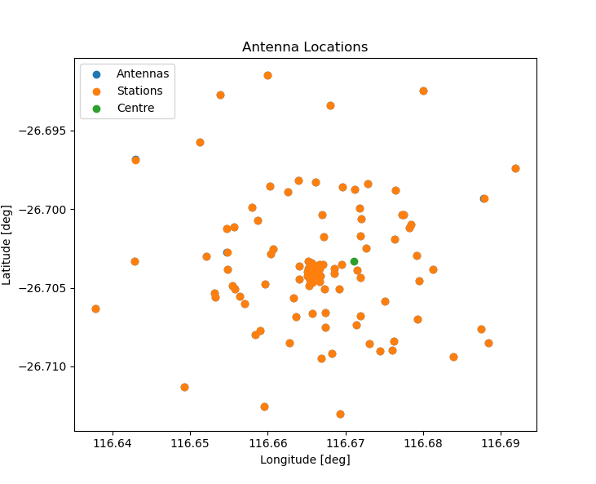
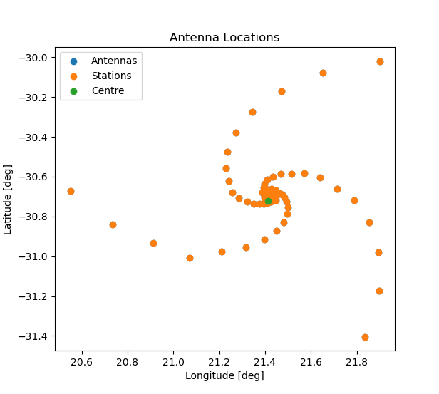
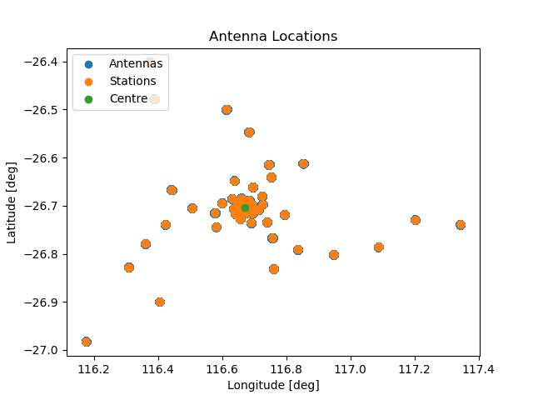
Telescopes
Telescope | # Elements | Max Baseline
MWA | 128 | 5 km
SKA-low | 512 | 74 km
Meerkat | 64 | 7.7 km
SKA-mid | 133 | 150 km
Meerkat
MWA
SKA-low
SKA-mid
MWA Project Meeting 2024, EPFL, Lausanne

Slide 17
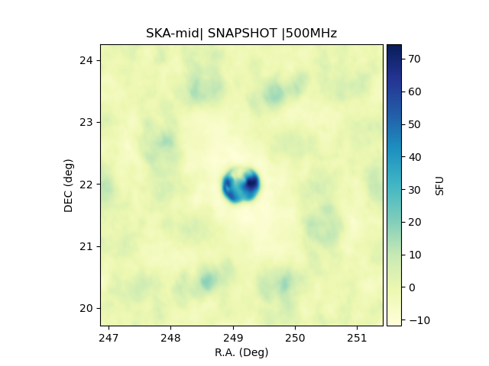
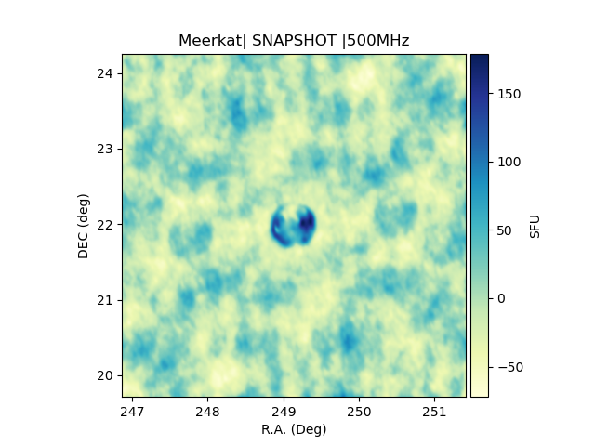
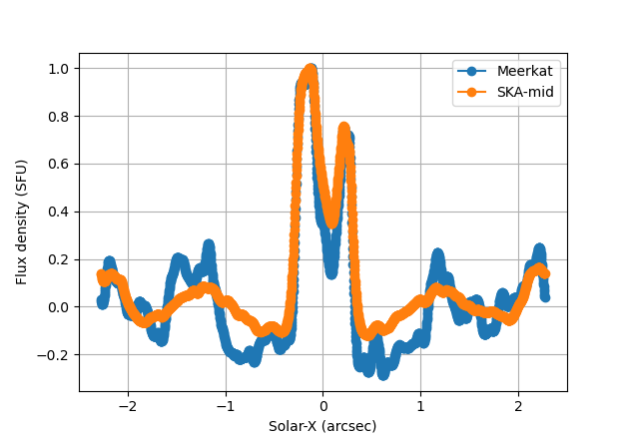
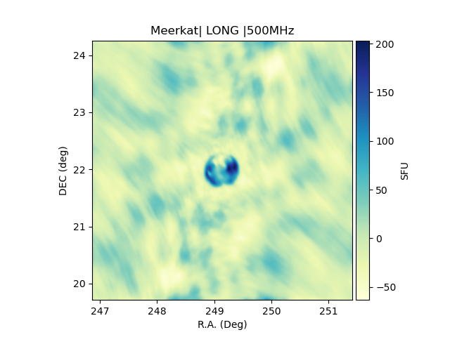
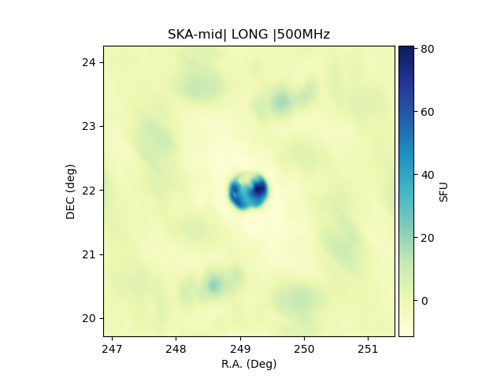
Example: Simulated Images – SKA-mid and Meerkat
Amplitude Imperfections
Sky Model
Meerkat Snapshot
SKA-mid Snapshot
Smoothening
Meerkat long
SKA-mid long
MWA Project Meeting 2024, EPFL, Lausanne

Slide 18
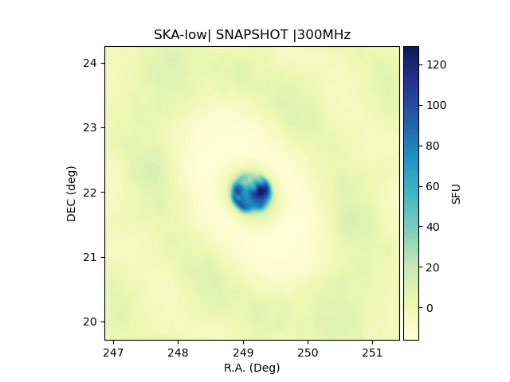
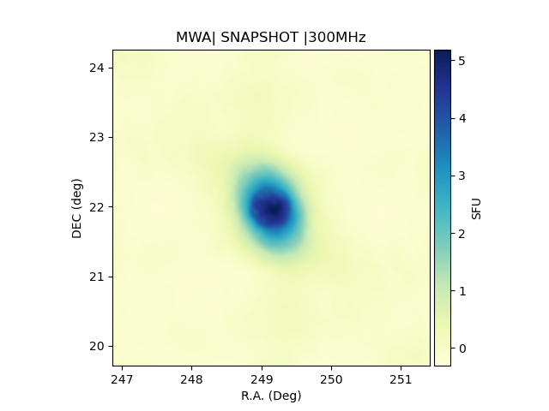
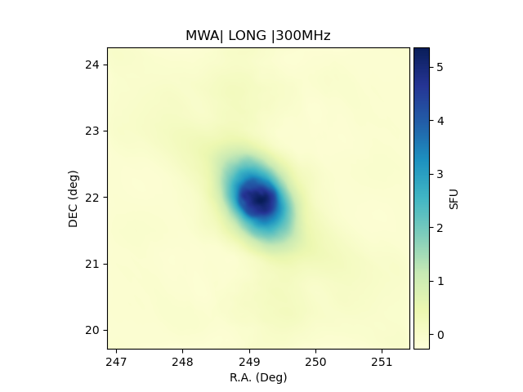
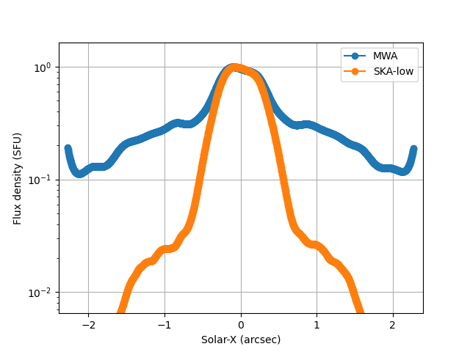
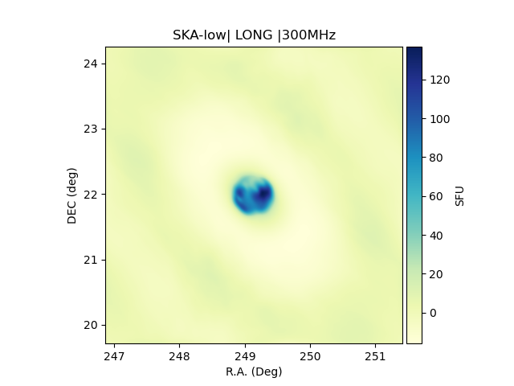
Example: Simulated Images – SKA-low and MWA
Sky Model
Extended Aura
SKA-low Snapshot
MWA Snapshot
MWA long
SKA-low long
MWA Project Meeting 2024, EPFL, Lausanne

Slide 19
High-resolution for SHI - Smaller Source Confusion
Location of particle acceleration sites within the standard model
Accurate B calculations during solar flares
Scales of turbulence in the loops
Scattering Sizes
CME fine Structures
Telescope |  | Maximum Baseline | Max. Resolution | Physical Distance
SKA-low | 50 MHz | 65 km | 18” | ~ 13 Mm
 | 150 MHz |  | 6” | ~ 4.3 Mm
 | 300 MHz |  | 3” | ~ 2000 km
SKA-mid | 600 MHz | 150 km | 0.7” | ~ 500 km
 | 3 GHz |  | 0.14” | ~ 100 km
 | 9 GHz |  | 0.05” | ~ 34 km
MWA Project Meeting 2024, EPFL, Lausanne

Slide 20
Summary
SKA will enable wide range of SHI science cases
With 512 SKA-low stations spread over 65 km, will provide finer resolution
- CME evolution: Flank & Core emission / Particle Acceleration
- Solar Flares: Position of Acceleration Sites
- Better correlation with Jets / Spicules
- Solar Wind Origin
With SKA-mid with 150 km baseline with 197 dishes will be unprecedented in details
- Particle acceleration sites within the solar flares
- Detecting faint solar burst are crucial for coronal heating
Sub-array modes and beamforming modes for IPS
Simulations are vital to understand instrument characteristics
Experience of MWA observing will be vital to design the SKA-low SHI observations
MWA Project Meeting 2024, EPFL, Lausanne

