Slide 1
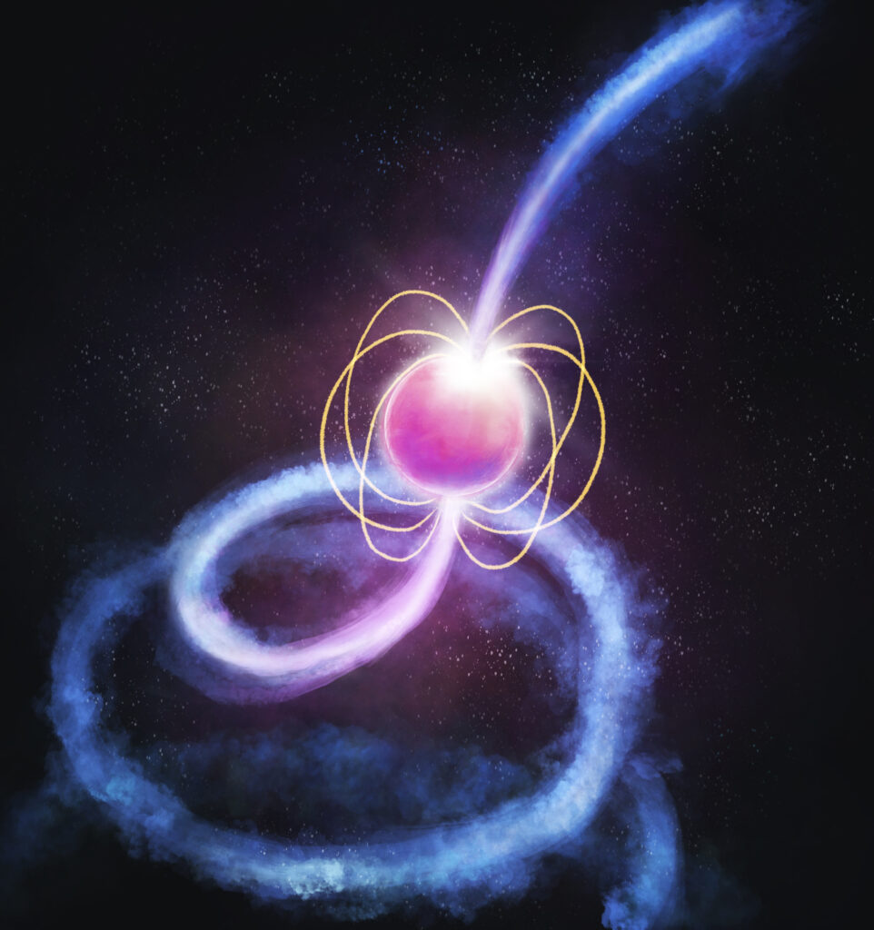



Pulsars and Fast Transients: Overview & Updates
Ramesh Bhat
The Pulsars & Fast Transients SWG
The MWA 2024 Project Meeting, 28-30 August, Lausanne

Slide 2
PFT science with the MWA: Timeline, Technology & Data milestones
2013/14
2015
2021
2023
First voltage capture tests
Voltage Capture System commissioned
MWAX VCS commissioning
SMART survey data collection completed
Technology demo. for a new observing mode
To provide sub-ms timeseries data
Software development to enable pulsar science accelerates (offline beamformer)
First pulsar publication in 2014 (PSR J0437-4715)
The “dawn” of high time resolution science with the MWA
A way to access the Nyquist sampled tile voltage data in an “easy” and schedulable way
Coherent beamforming on the horizon
Upgrades to the MWA correlator, necessitate a new generation of VCS
More flexible, but even higher data rate!
Now record the 1.28 MHz baseband data rather than PFB output
The flagship MWA pulsar survey project completes its large data acquisition step
A voltage record of the sky at 154 MHz
Preserved* via the ARDC as a Data Collection of National Significance
  PFT science
    Science using the VCS + software and processing pipelines
    Pulsars, FRBs, cosmic ray detection, passive radar, etc.

Slide 3
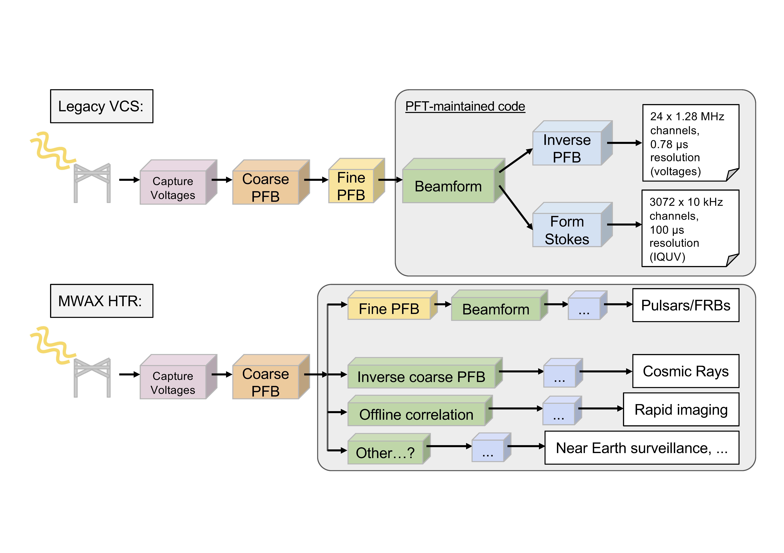
MWAX VCS (New HTR) Development
Slide from Sam McSweeney
3
Notes:
8/23/24
3
3

Slide 4
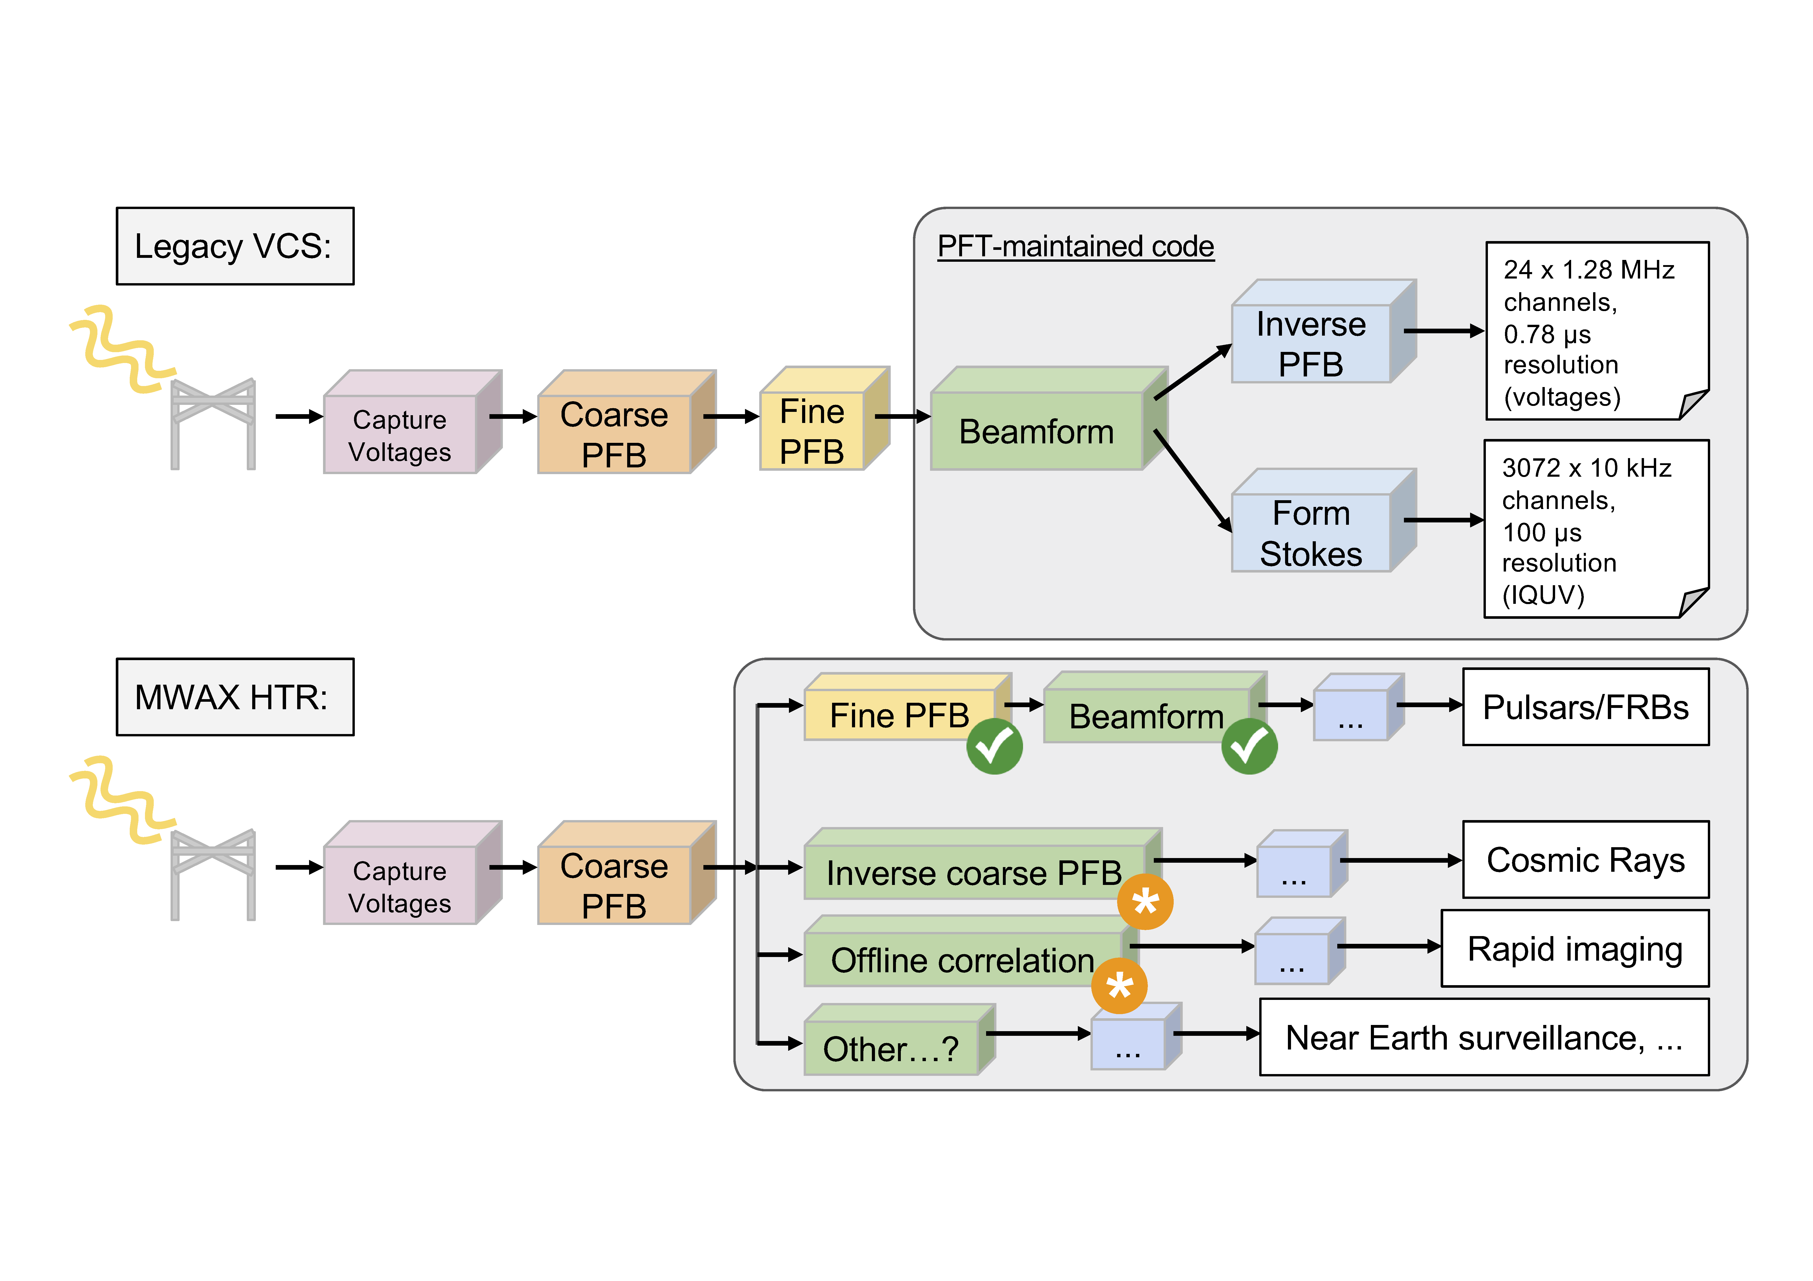
MWAX VCS (New HTR) Development
Slide from Sam McSweeney
4
Notes:
8/23/24
4
4

Slide 5
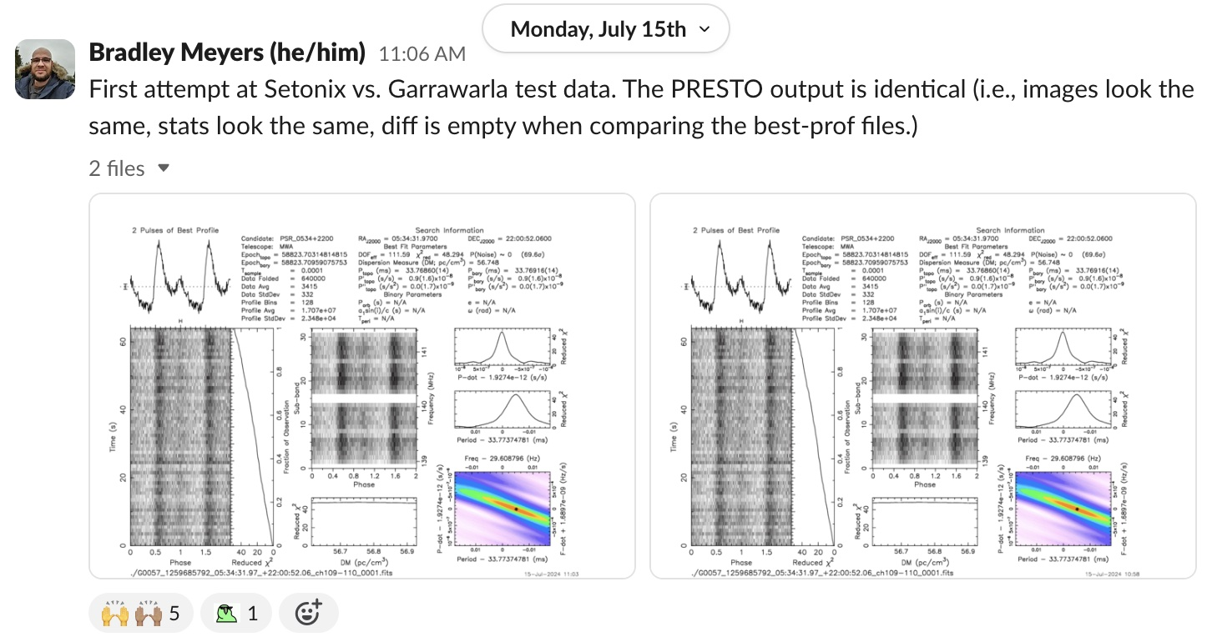
Setonix migration – VCSBeam first light
Supported by Pawsey “uptake” project (Team: Meyers, Di Pietrantonio, Sokolowski, Lee, Tan)
Next steps: Profiling, more in-depth comparison (e.g. VDIF output)
5
Notes:
8/23/24
5
5

Slide 6
Science Updates & Highlights: SMART survey and Pulsar Science

Slide 7
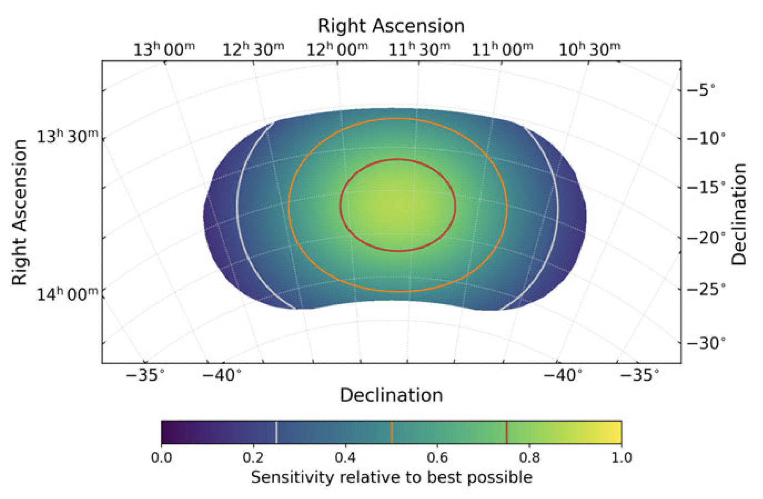
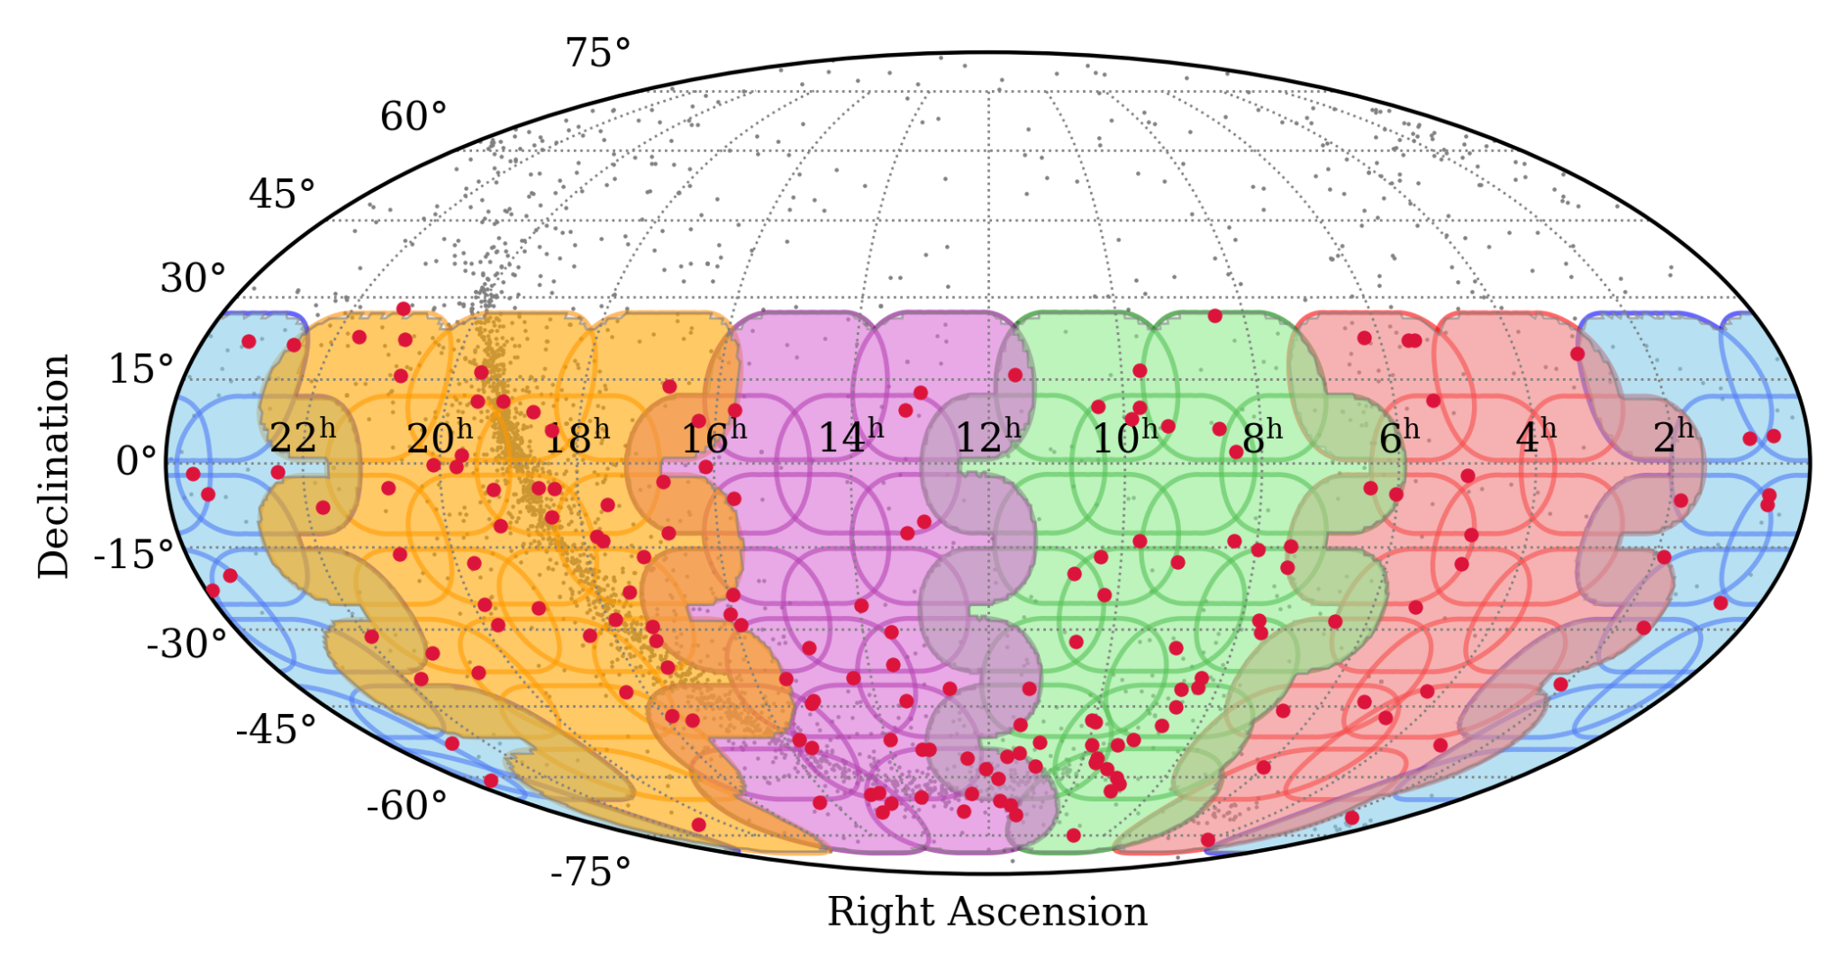
SMART Survey Update
Southern-sky MWA Rapid Two-metre (SMART) pulsar survey
Covers declinations < +30°
71 observations at frequencies 140-170 MHz
~10° overlap of fields; i.e. 1-3 obs. per pulsar
80 min dwell time; i.e. <100 hr of telescope time
Data collection complete!
200+ known pulsar redetections
5 pulsar discoveries after processing <10% of the data
(Bhat et al. 2023a/b, PASA, 40, e020/e021)

Slide 8
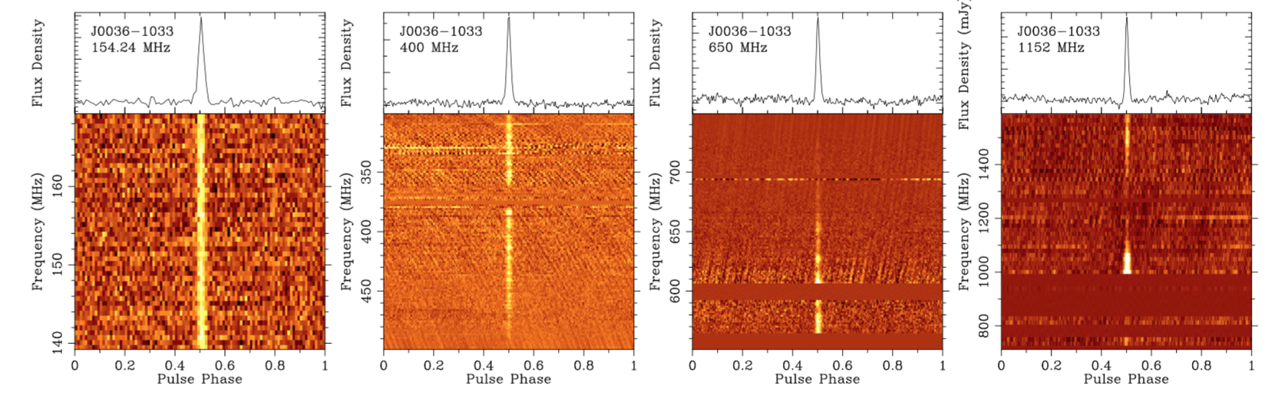
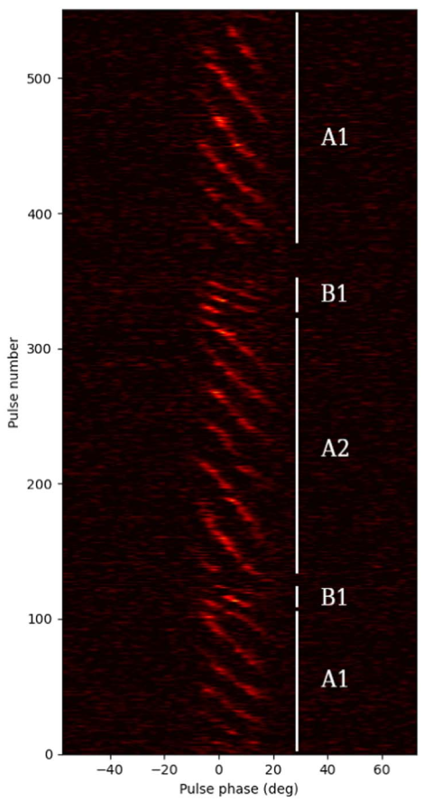
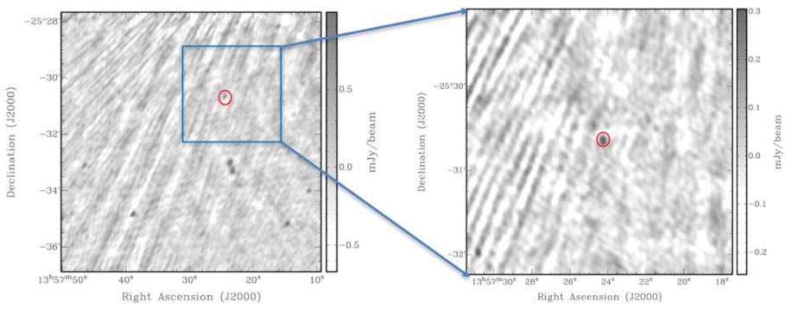
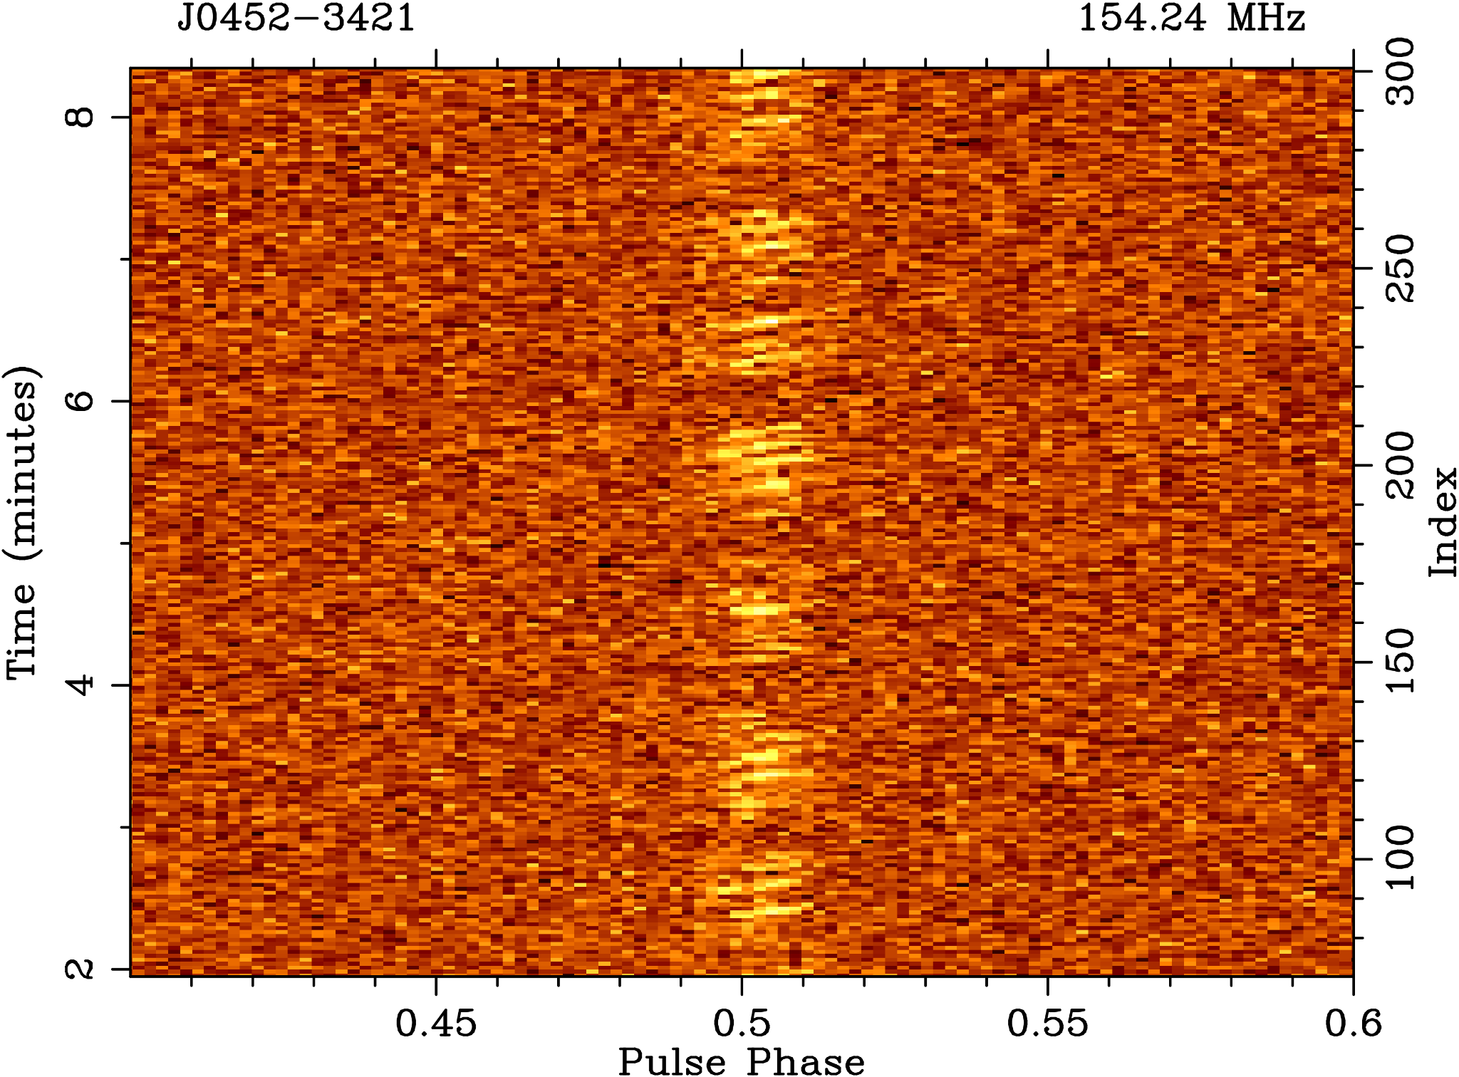
New Pulsars from the First pass
J0036-1033: steep spectrum, low-luminosity, and highly variable
by a factor of ~few, high-|b| = interesting scintillation possibilities
(Swainston et al. 2021, ApJL, 911, L26)
J0026-1955: sub-pulse drifting, nulling, high-|b|
(McSweeney et al. 2022, ApJ, 933, 210)
J1357-2530: uGMRT imaging localisation based on initial MWA position (Bhat et al. 2023b, PASA, 40, e020)
J0452-3418: subpulse drifting, nulling (Grover et al. 2024a, accepted in ApJ)

Slide 9
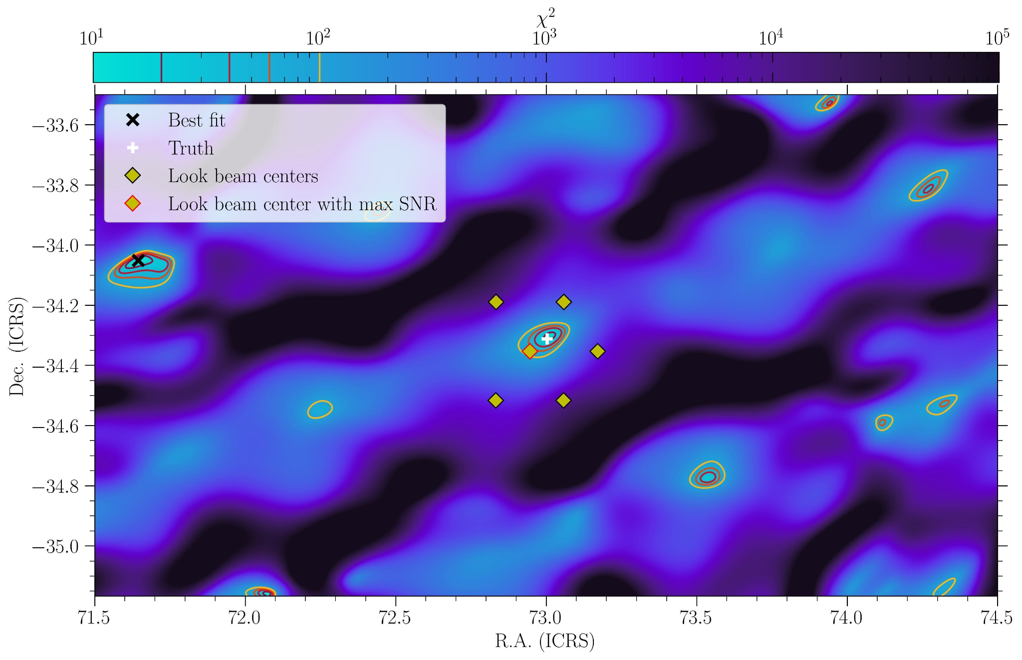
Localisation improvements for Tied-array Beam detections
Leverage knowledge of the tied-array beam power pattern on the sky
Detections in multiple beams of the same pulsar can be used to improve localisation
Much better precision than the beam width
  For SMART the beam FWHM ~ 24’
The true position is within a reasonable best-fit statistic interval. Missing: beam covariances…

Slide 10
SMART calibration Observations
This processing can be done independently of any actual beamforming or searching procedure.
Systematically produced calibration solutions using the new generation MWA pre-processing tools (i.e. birli and hyperdrive) for each calibration observation associated with every SMART VCS observation.
These can then be stored (e.g. on NT/OzSTAR, or Data Central) and called upon for testing, or for full-scale search beamforming operations.
Almost completed – improved efficiency with the work leading up to MSP census and SMART data release papers in prep. (see paper proposals).
The solutions are also very handily available for non-SMART science that will make use of SMART observations.

Slide 11
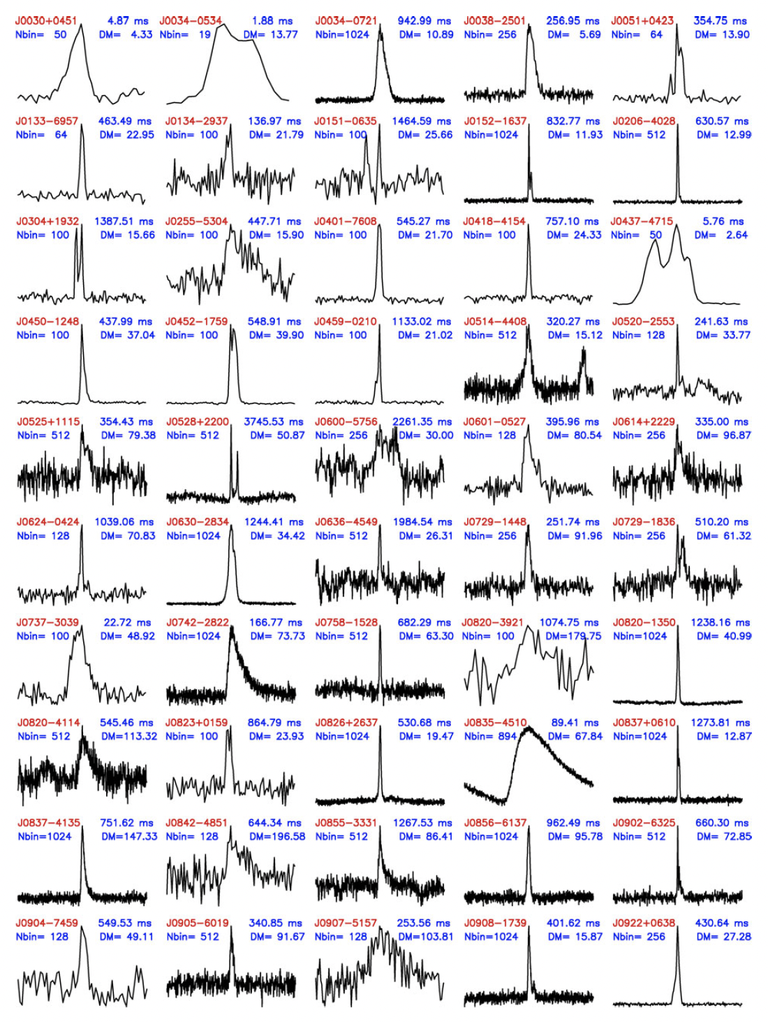
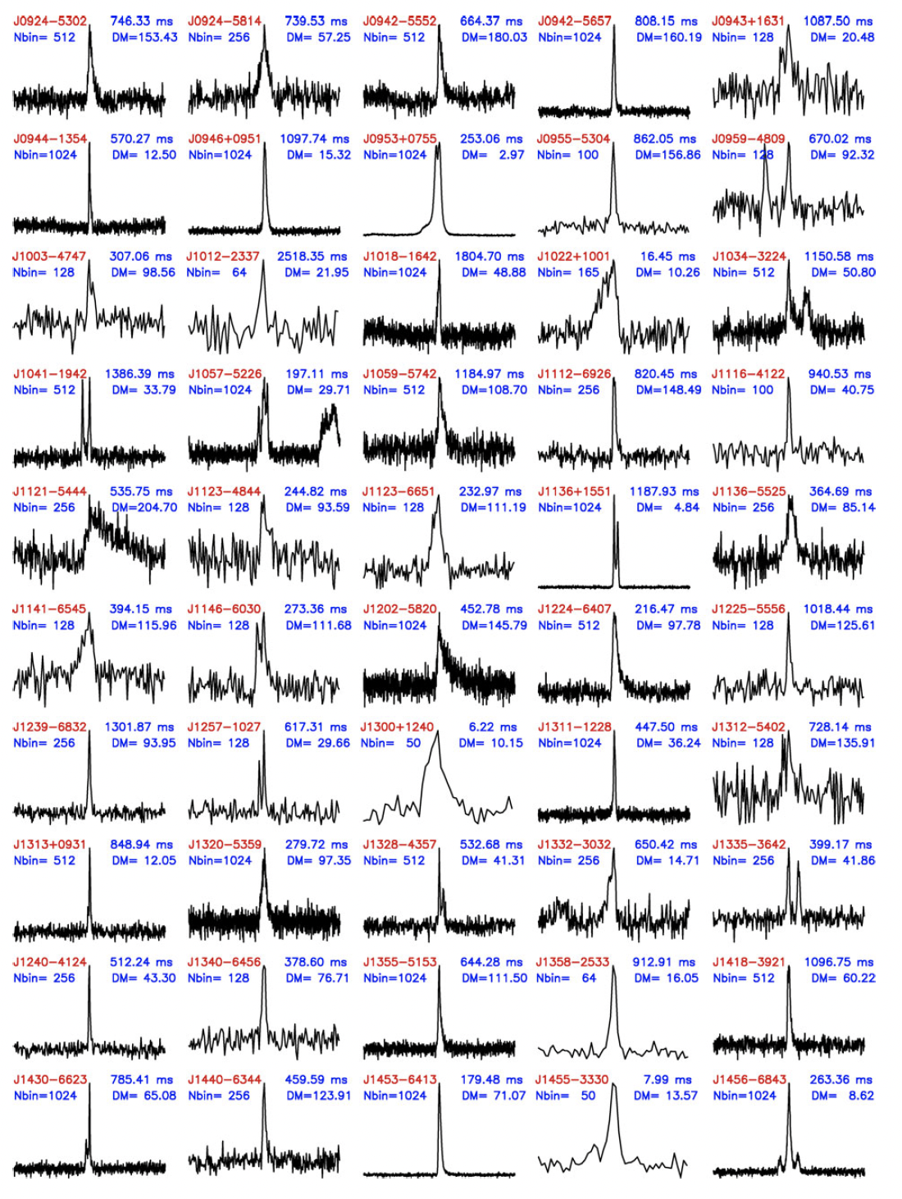
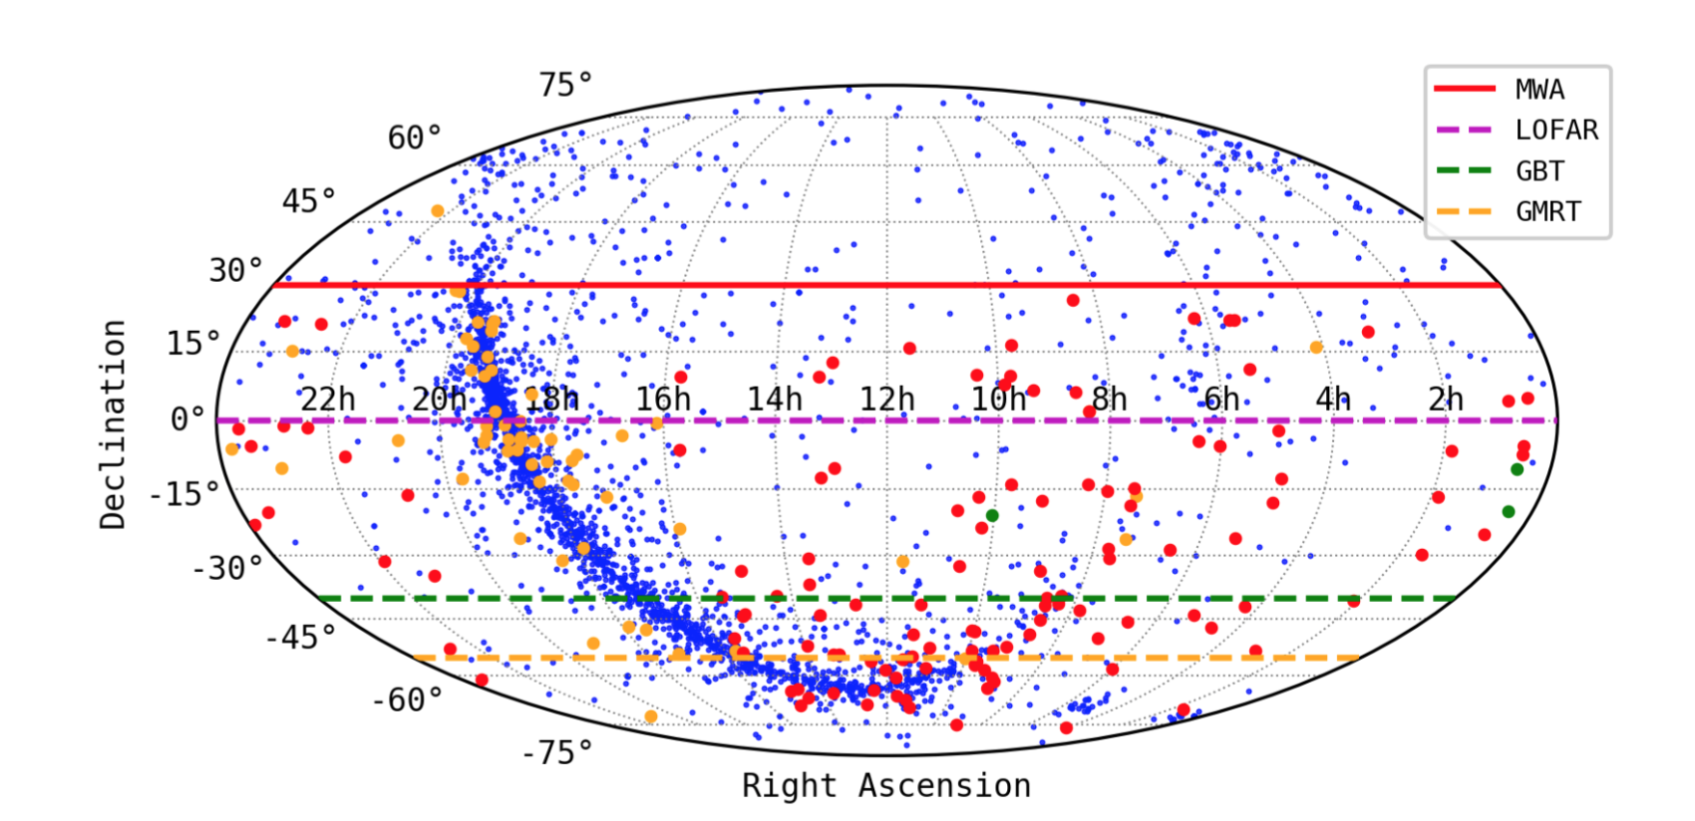
MWA Pulsar Census

Slide 12
MWA Pulsar Census
A voltage legacy data set of the metre-wavelength radio sky
with flexible reprocessing options for future algorithms or phenomena, and
an important reference for SKA-Low pulsar survey planning and verification

Slide 13
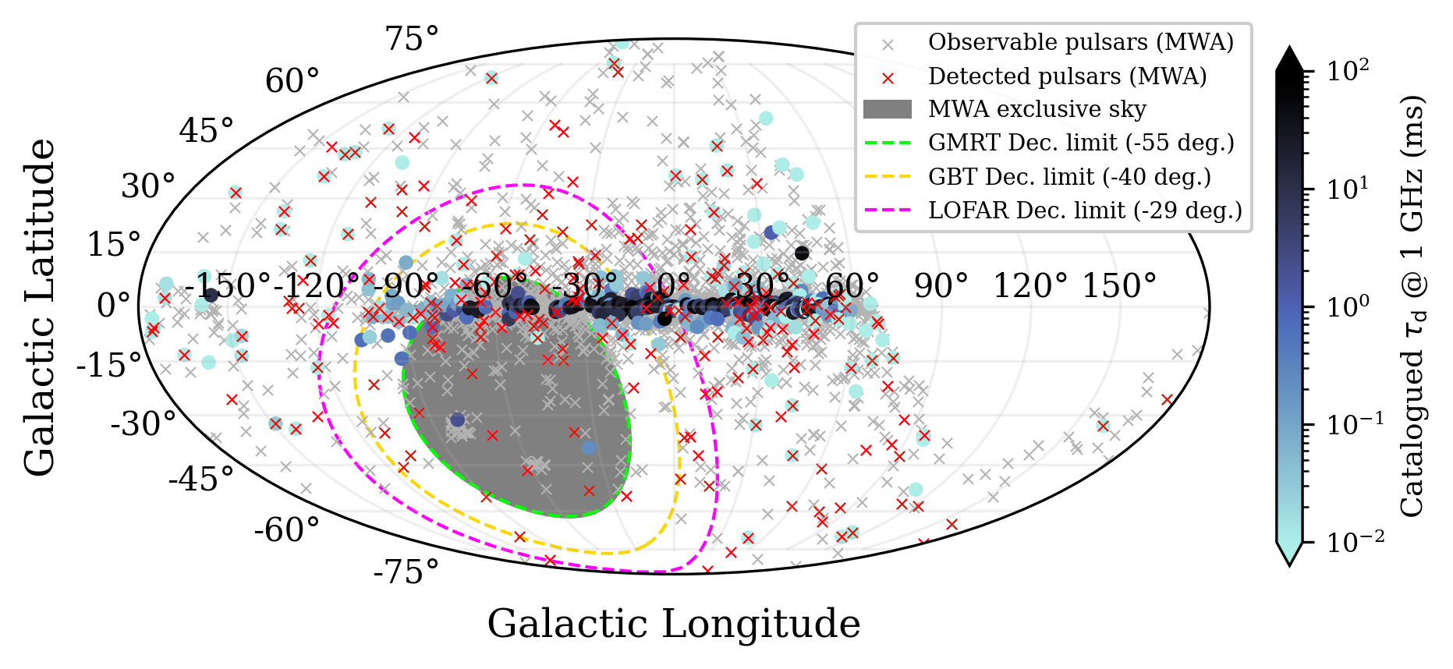
Pulse Broadening (Scattering) timescales from SMART data
Using the SMART data and detections of known pulsars across the observable sky
Interstellar scattering
measurements
non-existent for many
high-|b| pulsars
MWA presents unique
contribution to the
next-generation of
electron density models

Slide 14

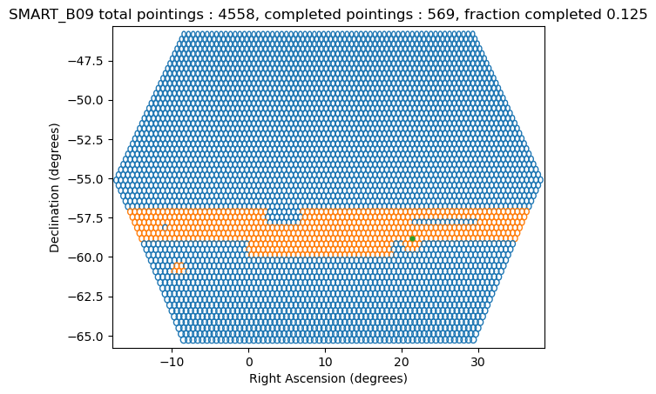
Gearing up for the second pass
More optimal (and efficient) ways of tessellating the sky
Layers of hexagonal rings around the start and end times of SMART drift scans
Working with the FWHM of the MWA tied-array beam (more realistic beam size)
Slide from Chia Min Tan

Slide 15
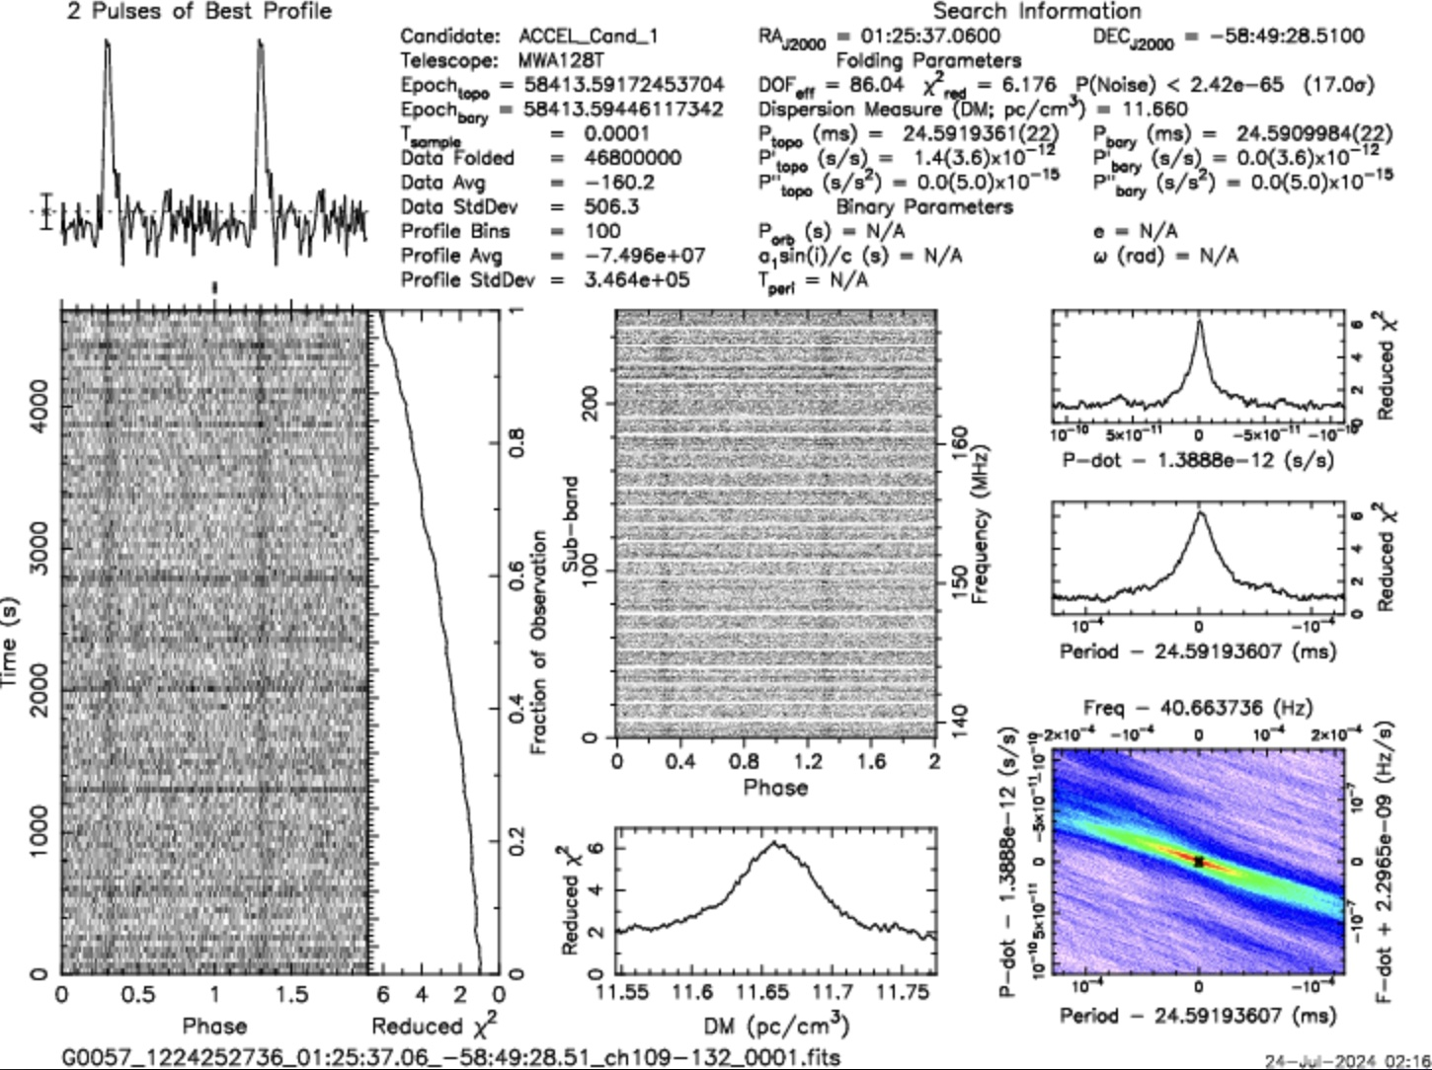
New pulsar candidate J0125

Slide 16
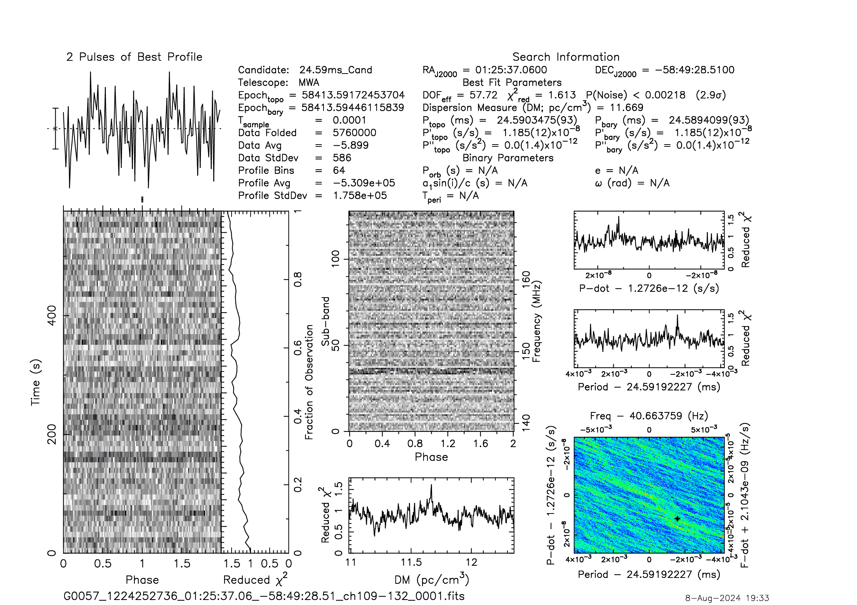
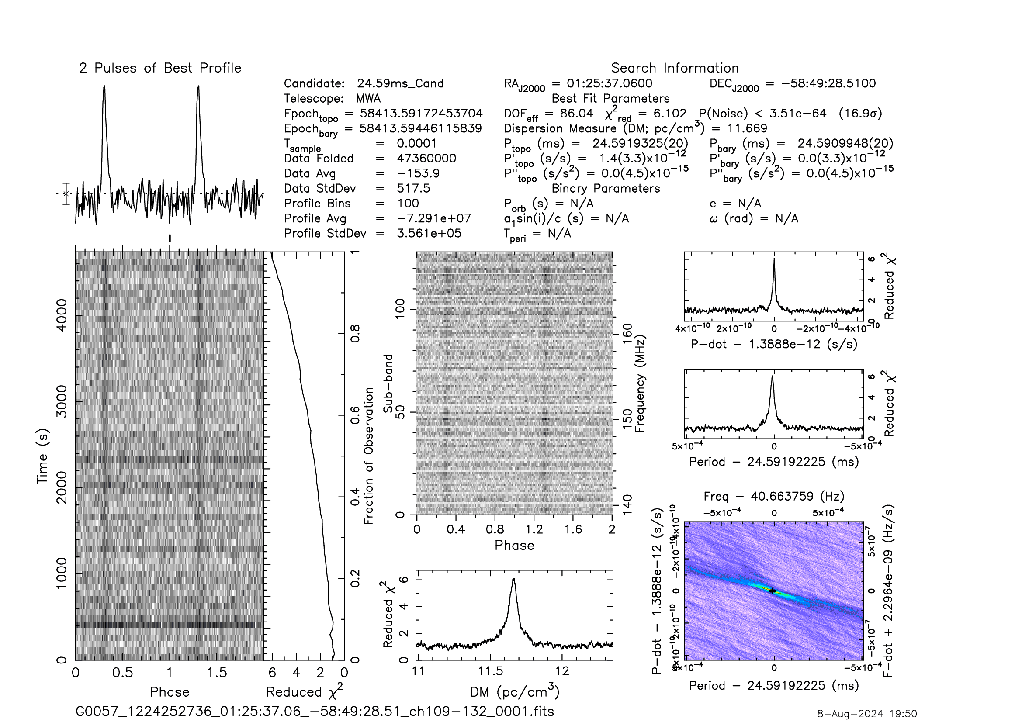
But why we didn’t find it earlier?

Slide 17
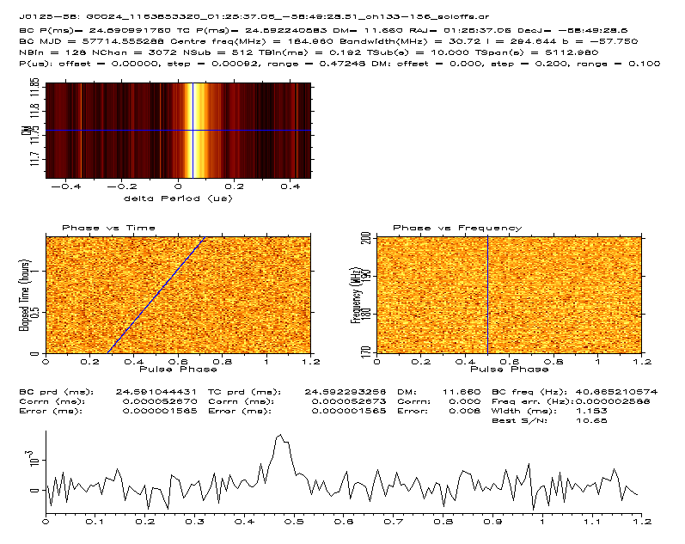
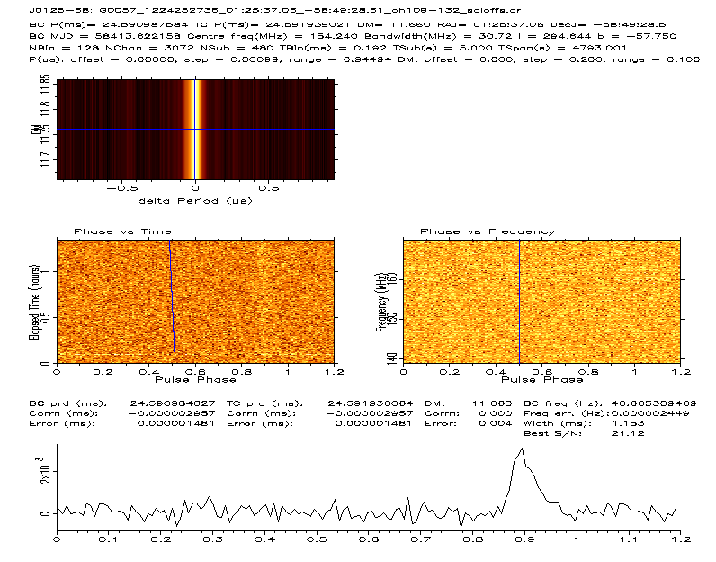
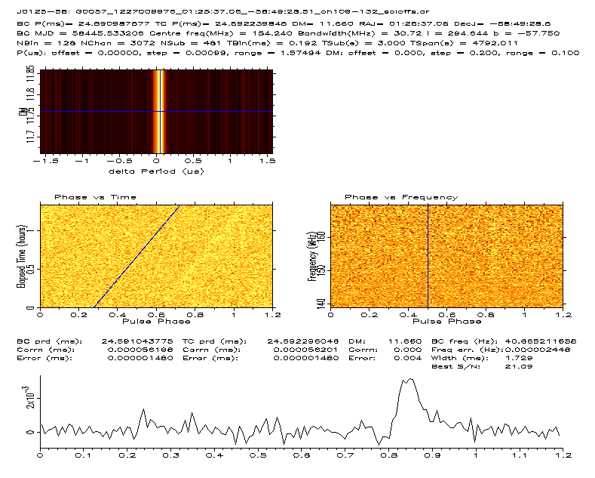
Seen in two other observations

Slide 18
SMART data processing: HPC Challenges and Opportunities
Dedispersion at low frequencies
  Exploring GPU accelerated options, like:
    AstroAccelerate (tuned for SKA-mid, loses ~most of its efficiency at low-freq.)
    dedisp (time-domain and Fourier domain options)
I/O for beamforming/reduction tasks
  Large (many-TB) raw data sets, potentially many medium (many-GB) outputs
  Lustre filesystems have performance issues, SSD storage tends to not be large enough
Performance extensions to community pulsar search software
  Popular, well-tested and trusted software is showing its age
  Some parallelism, but still much to exploit (even on CPU front)
  GPU Fourier-domain acceleration/jerk searches? GPU fast folding algorithms?
  Key point: Needs to be easy to use!!

Slide 19
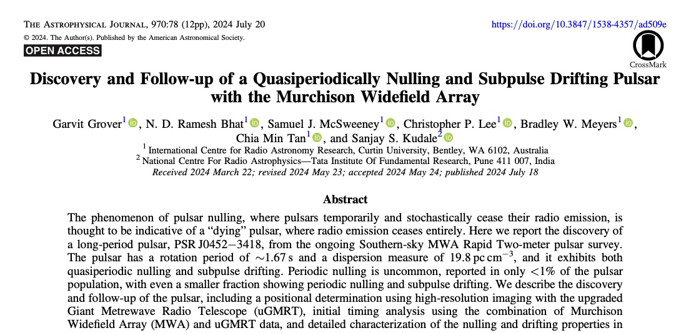
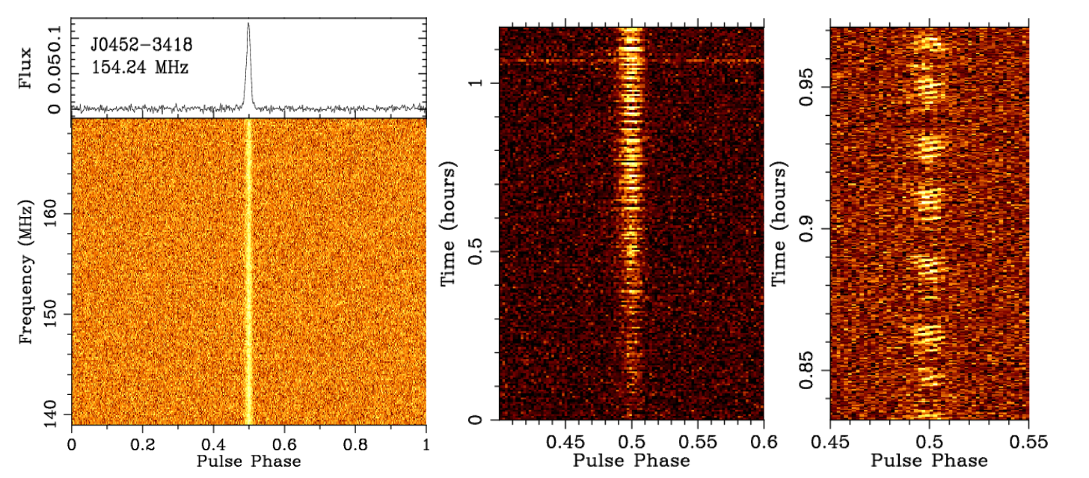

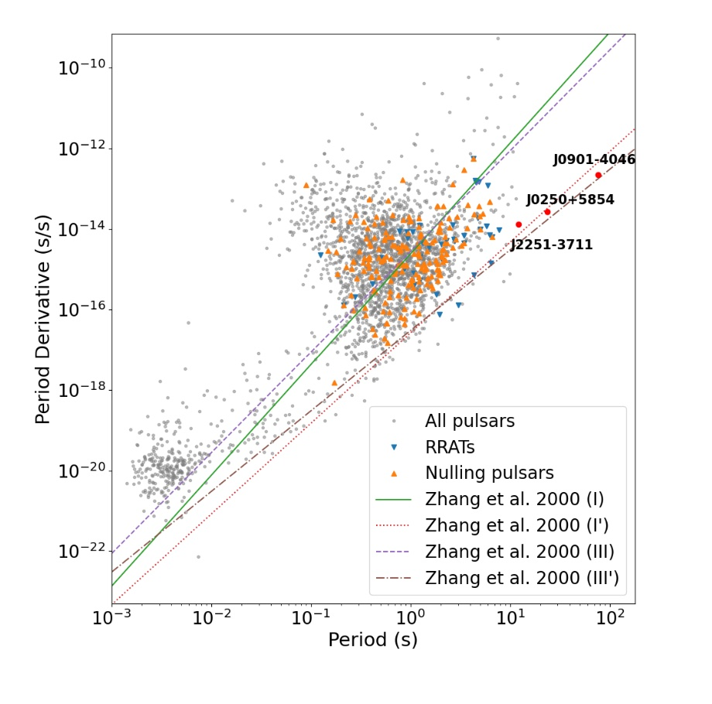
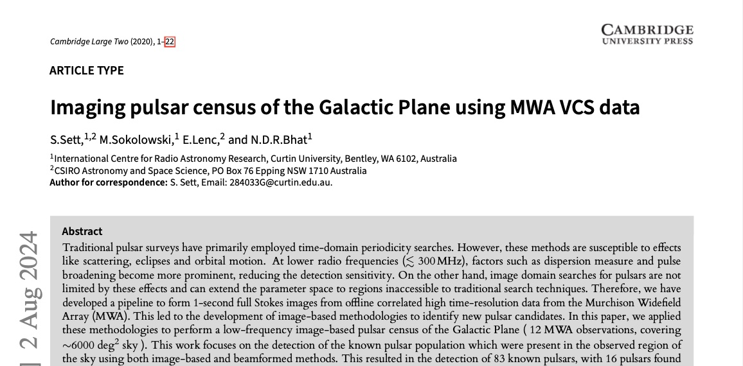
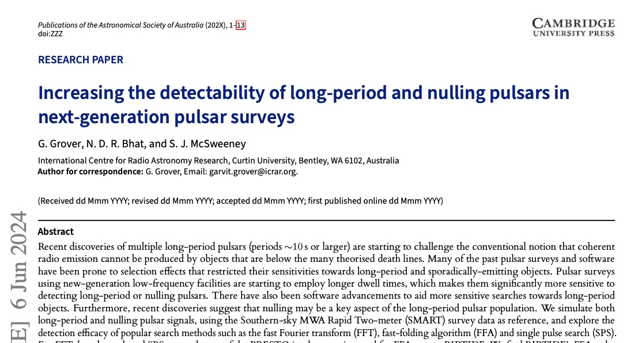
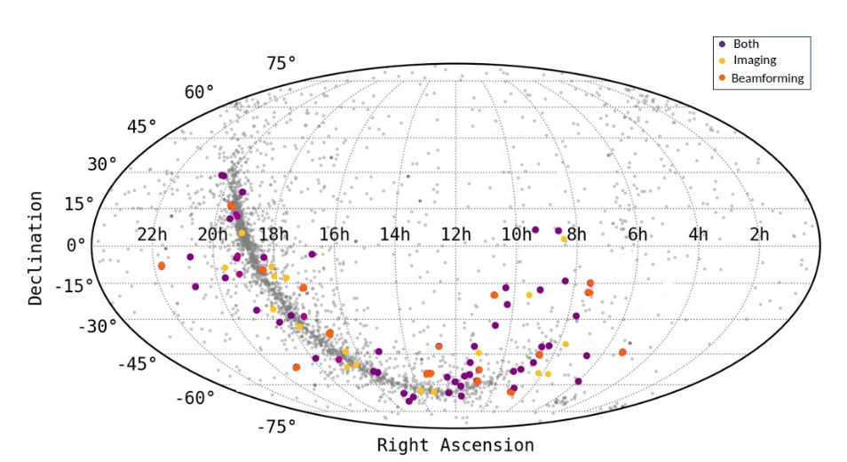

Recent Pulsar Publications
Grover et al. (2024a), ApJ, 970, 78
Grover et al. (2024b), accepted in PASA
See Garvit’s talk
Sett et al. (2024), accepted in PASA

Slide 20

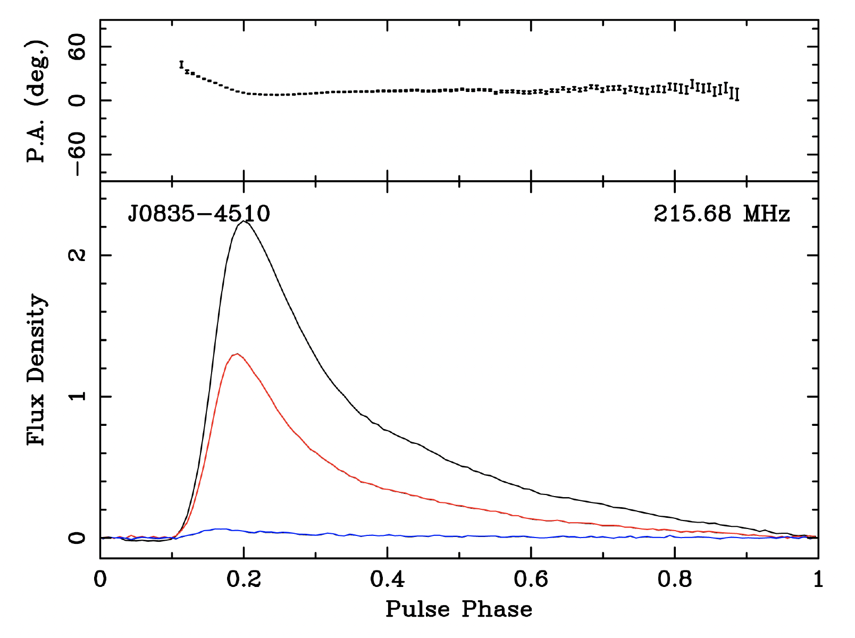
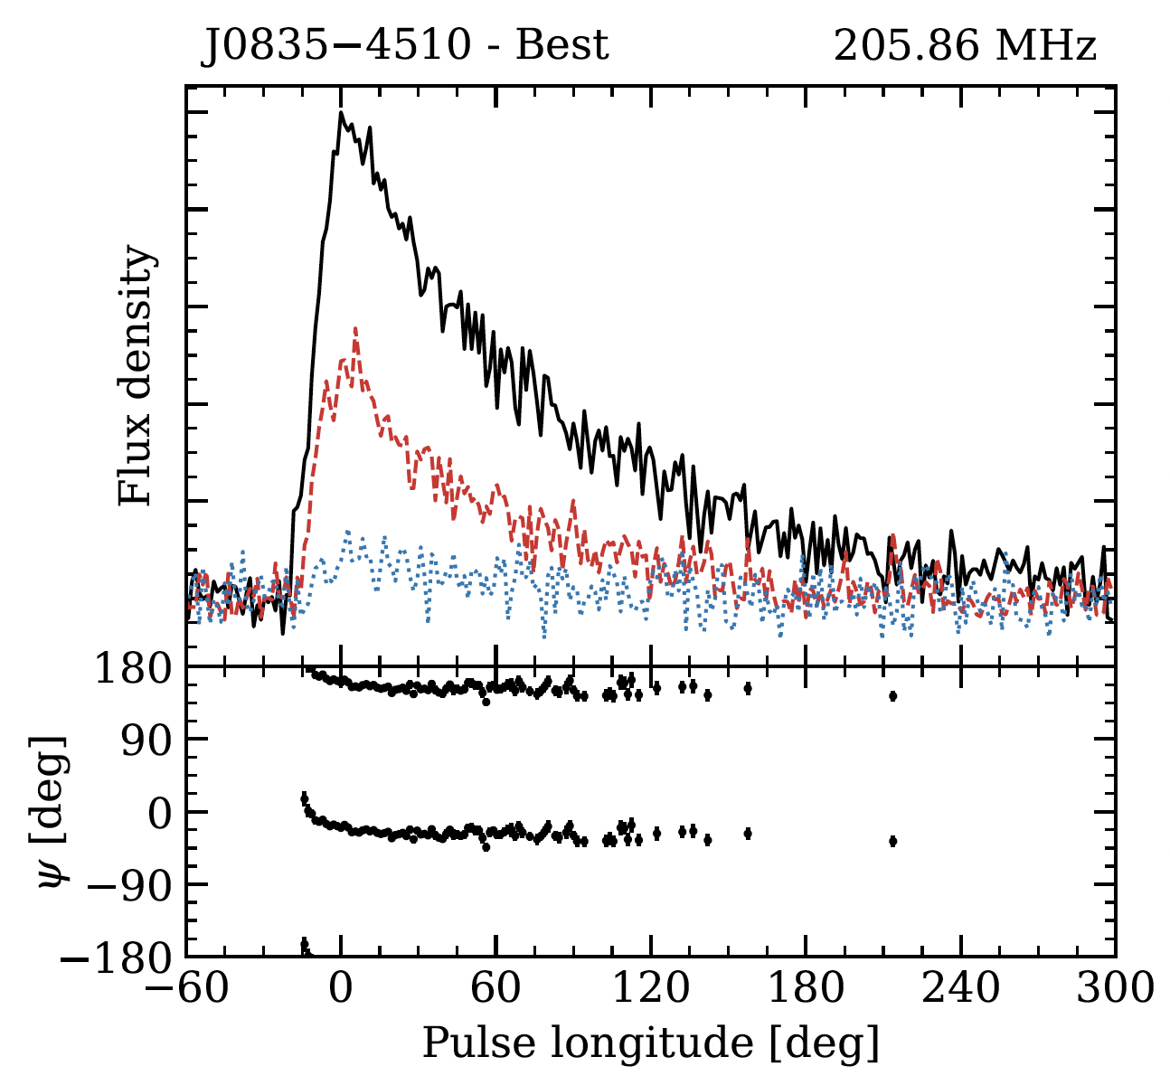
AAVS2 System Verification & Polarimetry
The AAVS2 bandwidth upgrade (32 x) has enabled sensitive pulsar observations with full polarisation information
Validation of AAVS2 polarimetry is important for gaining confidence in SKA-Low station data, and as a useful cross-check of MWA polarimetry
MWA pulsar detections provide a reference point to validate this exercise
Vela pulsar profiles near ~ 200 MHz are consistent between AAVS2 and MWA
Evidence for micro-structure (~AU scales) in the interstellar B field toward the Vela pulsar (Lee et al. 2024)
MWA
AAVS2
Lee et al. (2024), accepted in PASA

Slide 21


MWA Pulse broadening study of J1935+1616
Multipath due to electron density microturbulence
    A unique tracer of the wavenumber spectrum
    Deleterious for precision pulsar timing (PTAs etc.)
Wavenumber spectrum
  Inner scale → upper cutoff on wavenumber q
J1935+1616
  Claims in literature that 𝛽 > Kolmogorov
  Based on model fitting pulse broadening function to pulse shapes vs. frequency
  Results depend on shape of PBF
  Exponential PBFs (the most used) yield biased results based on simulations
  PBFs for Kolmogorov media with a finite inner scale are ‘heavy tailed’ and yield different results
MWA
  Valuable for providing highly scattered pulses → better discrimination between PBF models

Slide 22

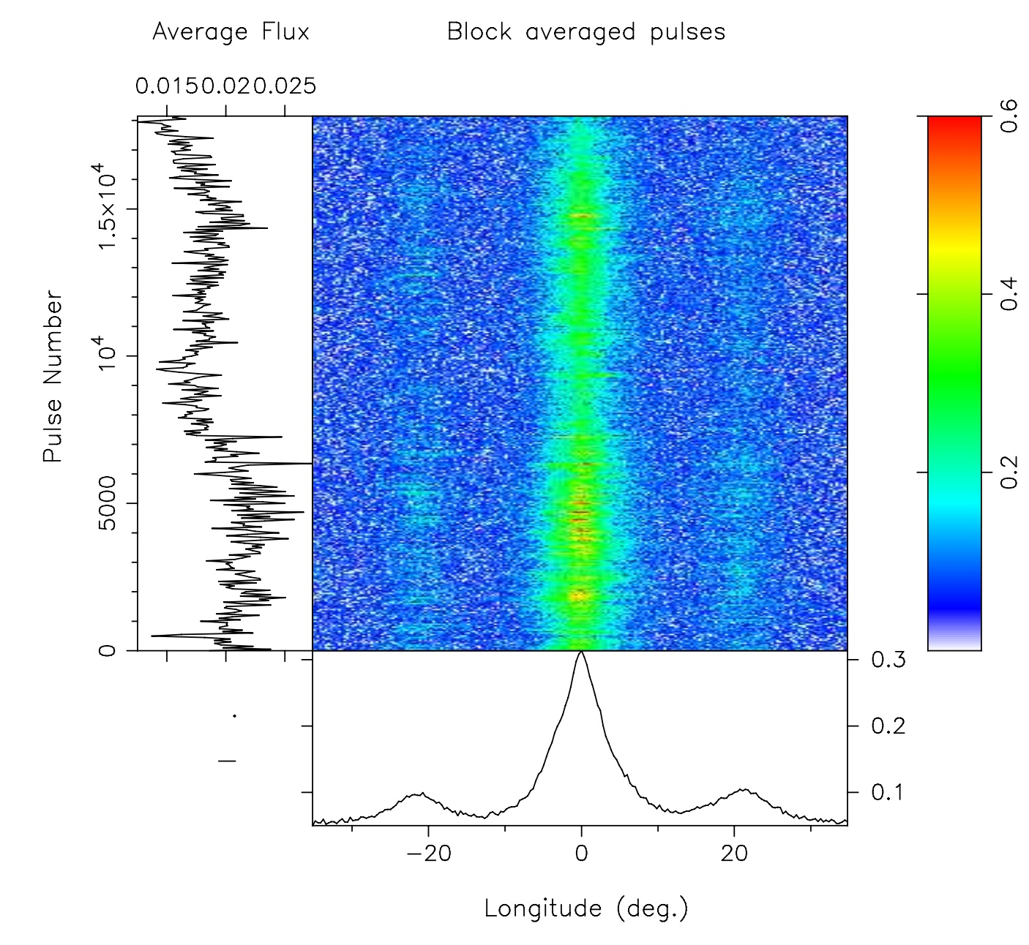
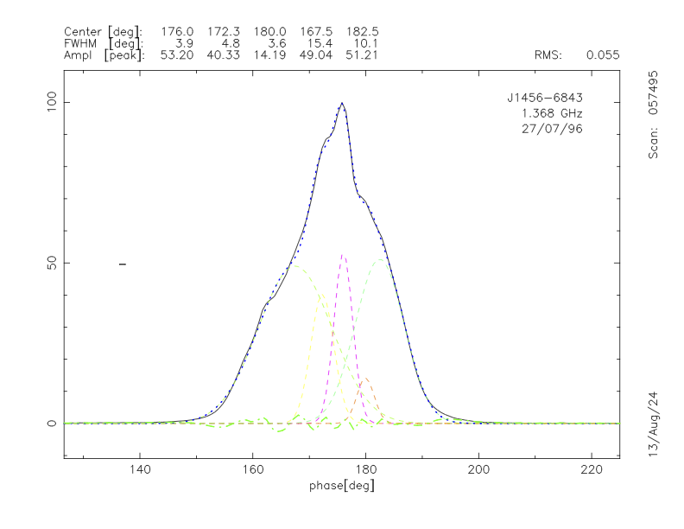
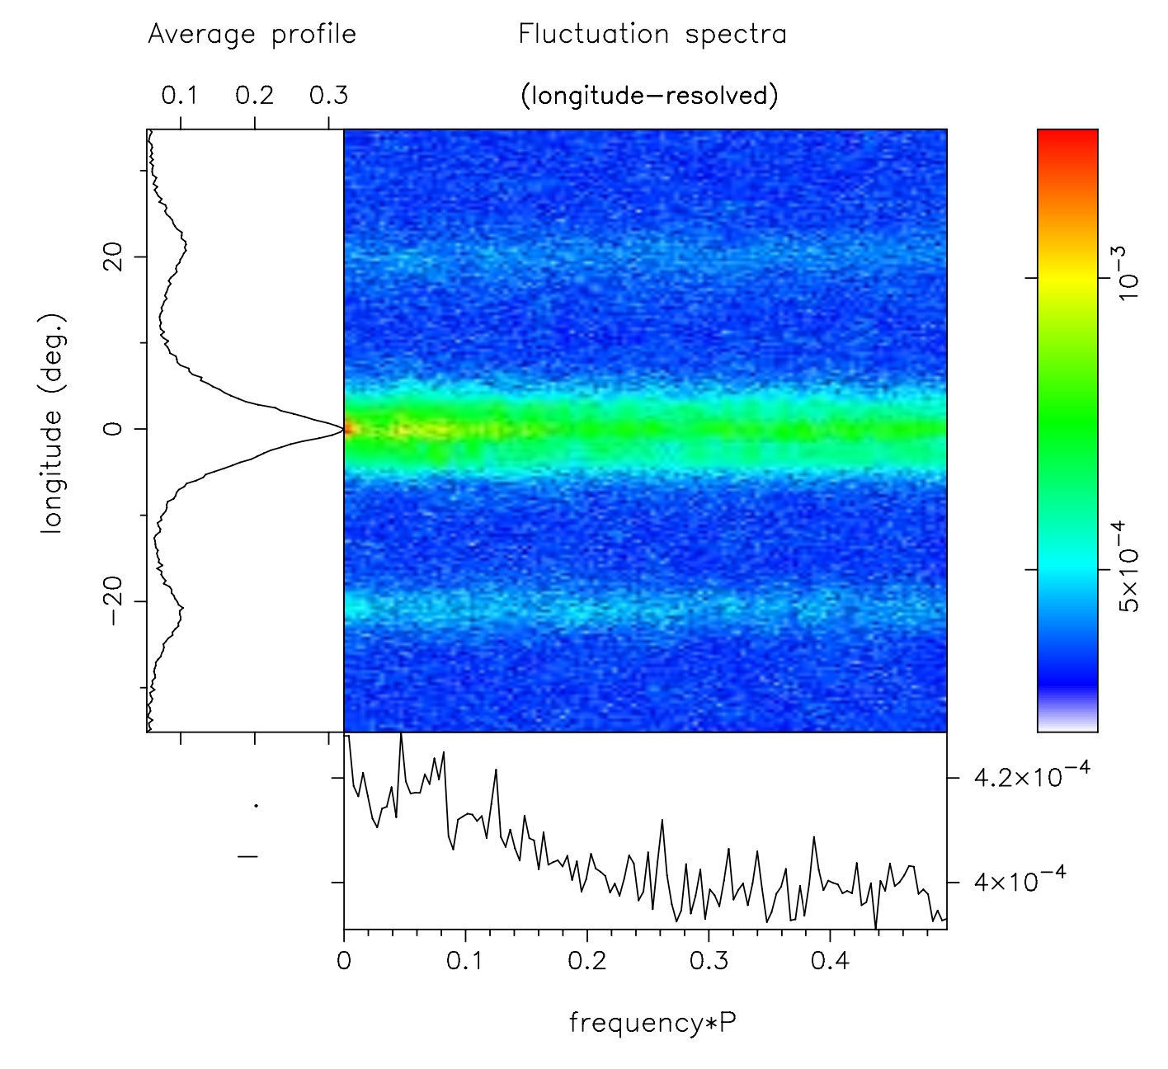
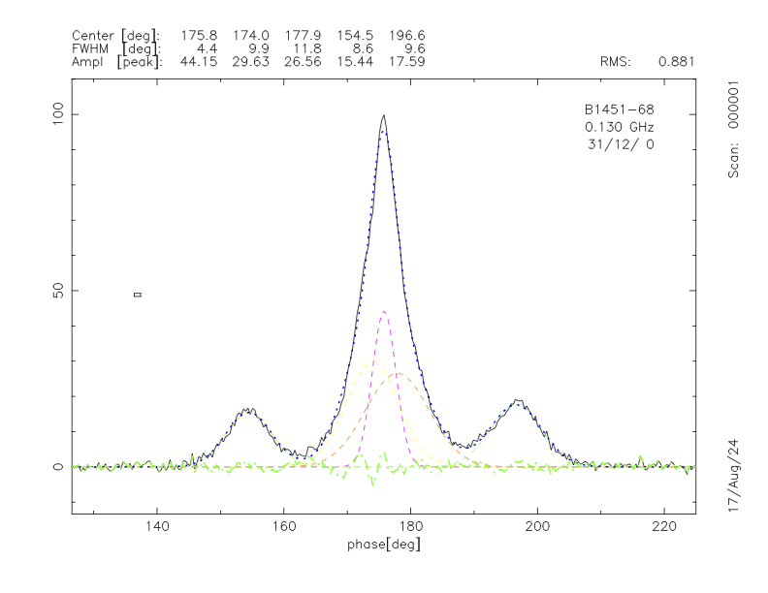
Low-frequency emission from B1451-68
Rankin, et al. (in prep.)
Notes:
Joanna Rankin, another pulsar expert, who has been in the field since the day 1 of pulsar astronomy, thinks this particular is super interesting,….
Pulsar does nothing (and absolutely nothing unusual ) if you look at single pulse perspective e.g…. See the pulse stack and LRFS on right 2 panels (we can’t get someone like Sammy excited with this…. ) no drifting no nulling…. (and Bradley looked for arcs there is nothing…)
But look at the profiles – top one some ancient data from Parkes (90s) and bottom panel MWA data (from SMART) G0104 to complement SMART and archival obs to cover ~70 MHz to 300 MHz. A paper is in prep….

Slide 23
Science Updates & Highlights: Fast Transients

Slide 24
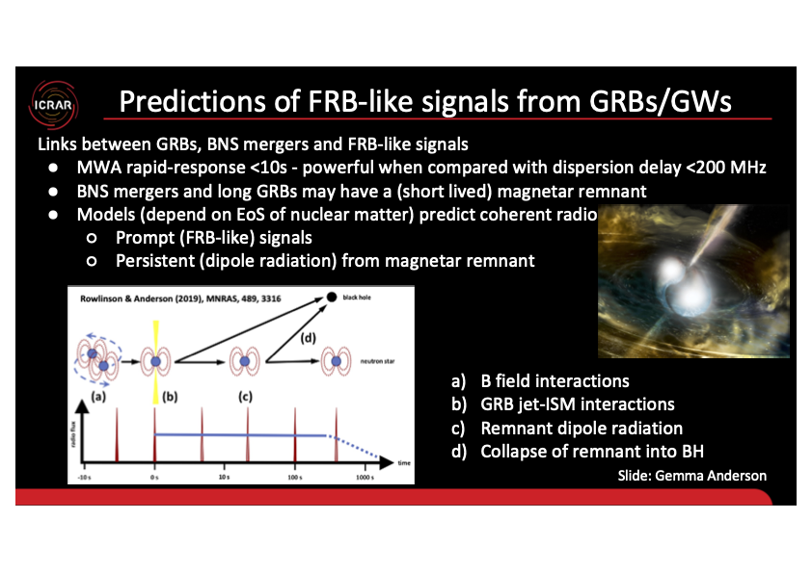
VCS Triggering for GRBs

Slide 25
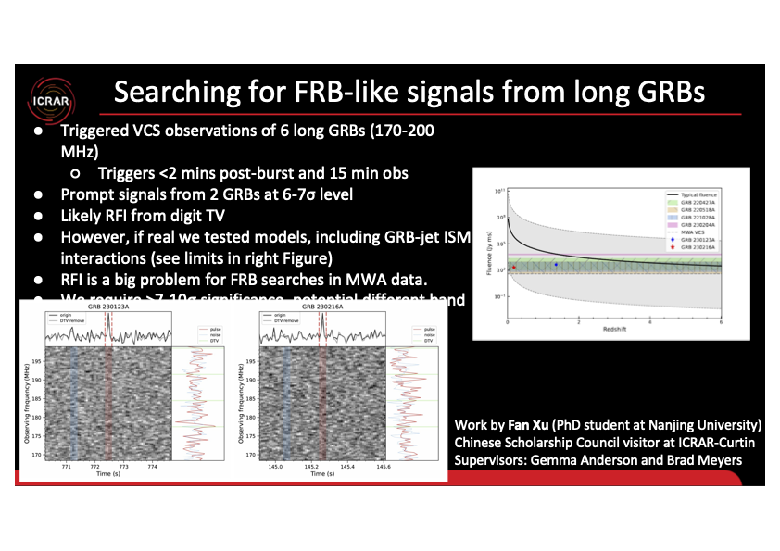
VCS Triggering for GRBs

Slide 26
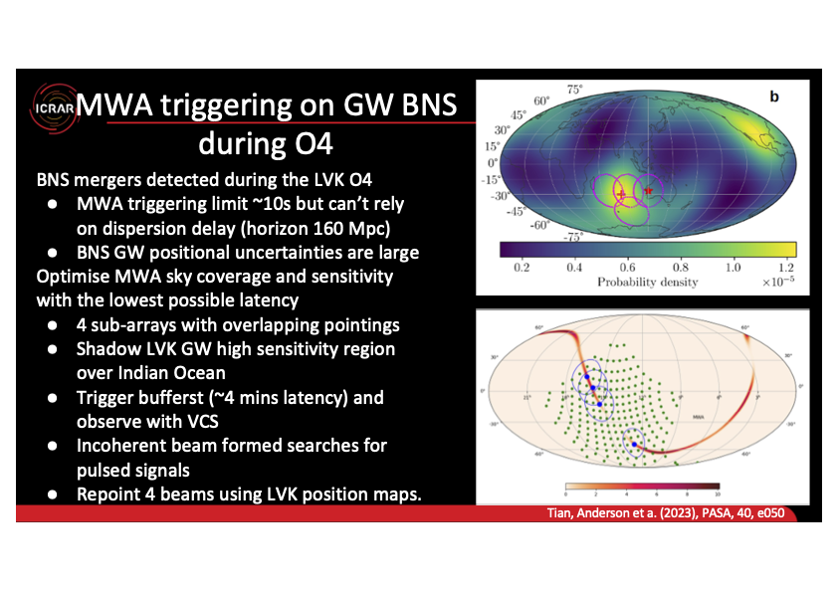
VCS Triggering for GW BNS

Slide 27


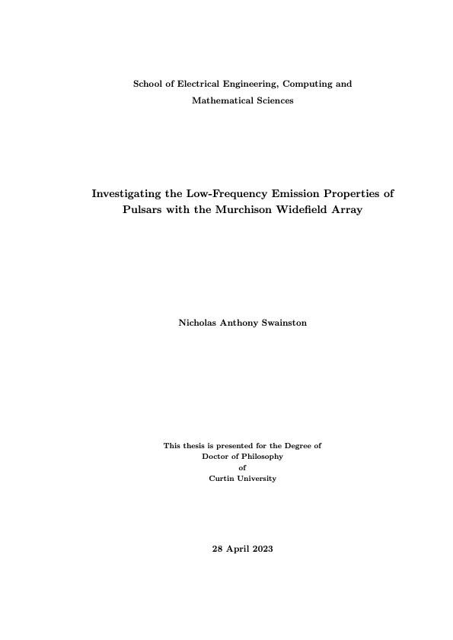
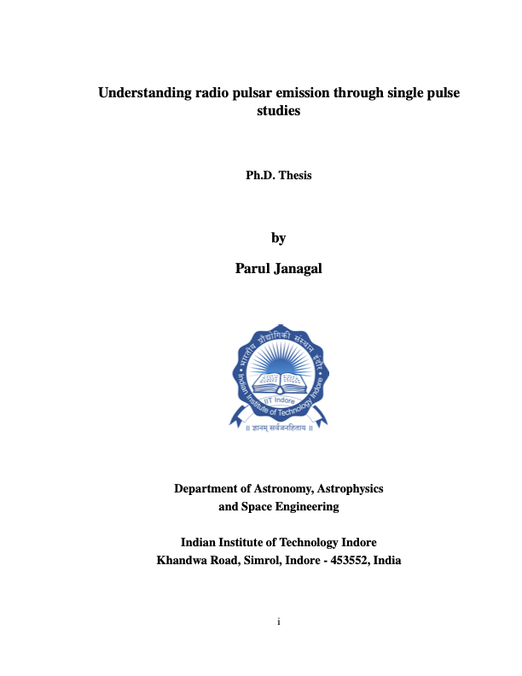
PhD completions
Congratulations on Graduation!
Congratulations on Graduation!
27
Notes:
8/23/24
27
27

Slide 28

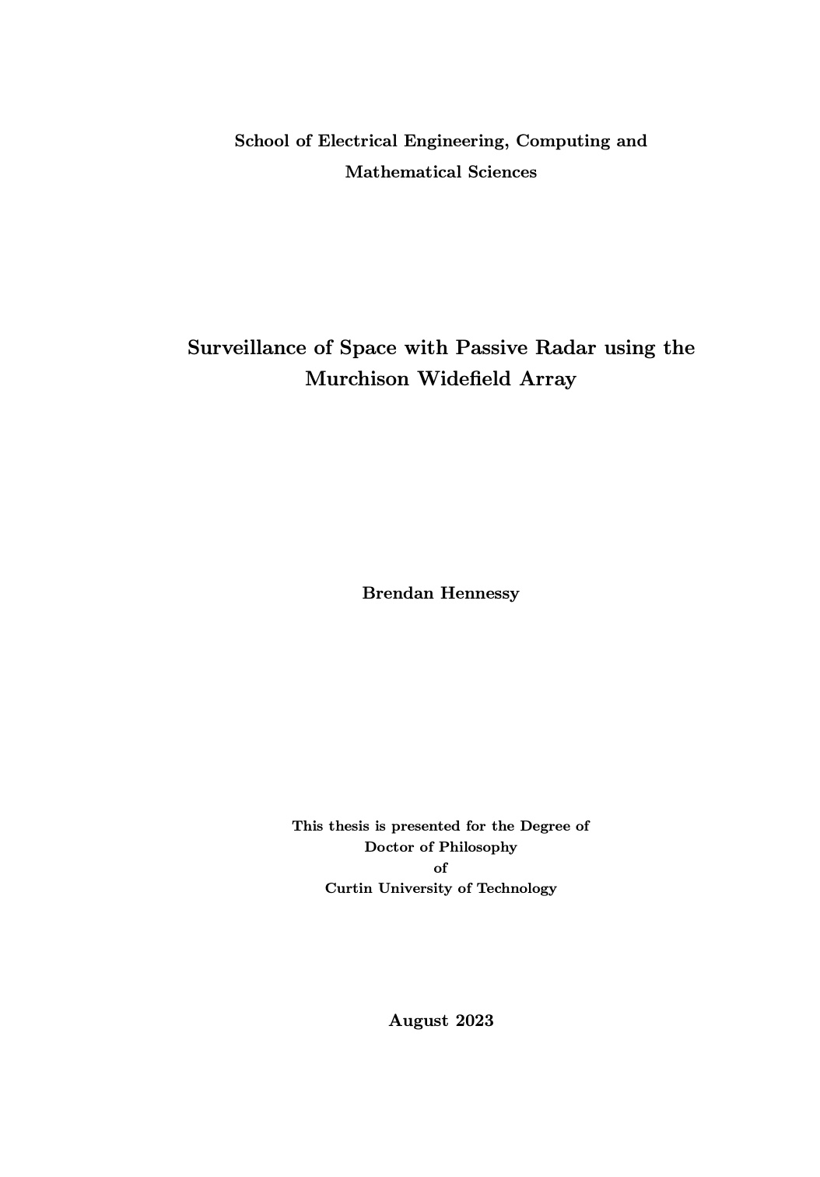
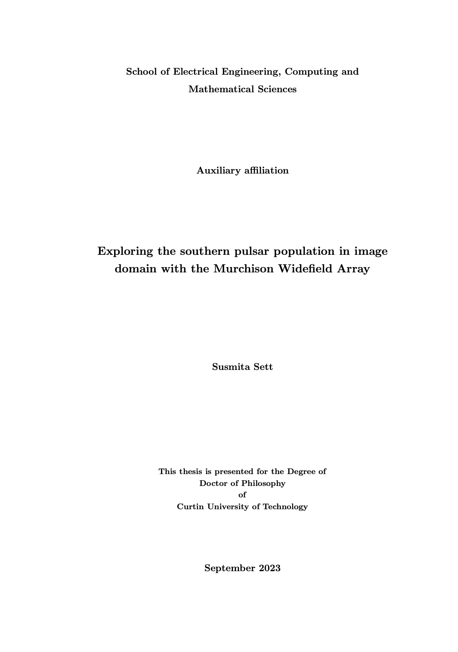
PhD completions
Congratulations on Approval to graduate!
Congratulations on Approval to graduate!
Congratulations on Submission!
Congratulations on Submission!
28
Notes:
8/23/24
28
28

Slide 29
Looking Ahead – MWAX Beamformer
  A decade of productive science; but VCS recording + processing is a major limitation in scientific opportunities (64 TB/hour with MWAX VCS!)
  Real-time processing + beamforming capability will open up a multitude of science opportunities
  MWA as a low-frequency monitoring telescope:
    Monitoring pulsar timing array (PTA) targets, and contribute toward PTA science goals (e.g., DM variations, ISM characterisation, etc.)
    Rich ISM science (e.g., scintillation arcs, flux variability, etc.)
    Targeted searches (Globular clusters, Fermi-LAT targets, etc)
    FRB monitoring (e.g., repeaters)
    Low-frequency VLBI (e.g. LAMBDA) in prep for SKA-Low VLBI
    Rapid follow-up of transients (GRBs, GW events) and fast turnaround
  Developing “self-reliance” for regular timing of SMART discoveries
    More demanding constraints expected as we transition to the second phase of SMART processing (e.g. J0125 may need daily observations)
29
Notes:
8/23/24
29
29

Slide 30
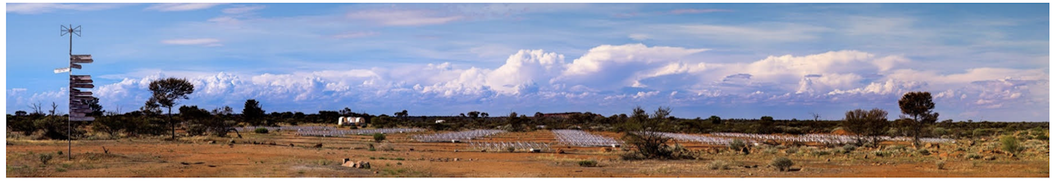
Summary
  The MWA presents a fantastic opportunity for an amazing range of Pulsars and Fast Transient science
  Opportunities for skill developments (HPC, software), and student and ECR training
  A productive decade of scientific and technical accomplishments: 40+ VCS publications, 10 PhD completions
  Low frequency detections of 230+ pulsars, 5 discoveries (from the first pass)
  Beyond pulsars: GRBs, FRBs, GW events, cosmic ray detection, passive radar applications (and potentially SETI)
  Bright and promising future ahead (PBs of VCS archives + SMART data)
  The planned (MWAX) beamformer will open up the untapped potential to emerge as a powerful low-frequency monitoring telescope

