Slide 1
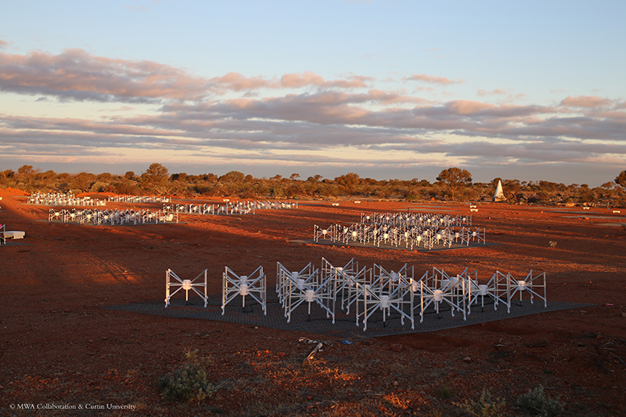
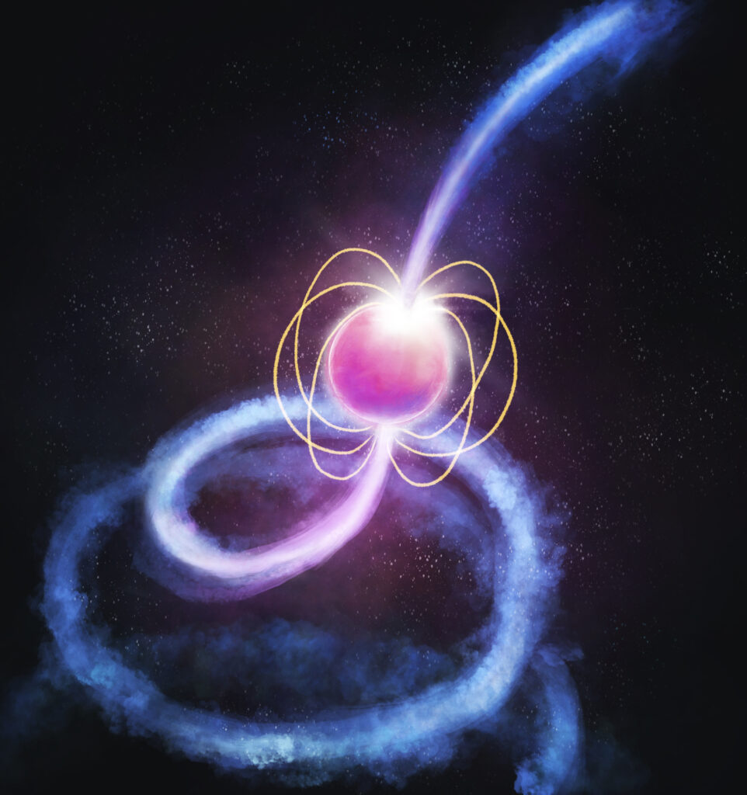



Pulsars and Fast Transients: Overview & Updates
Ramesh Bhat
The Pulsars & Fast Transients SWG
The MWA 2024 Project Meeting, 28-30 August, Lausanne

Slide 2
Pulsars and Fast Transients
Timeline, Technology & Data milestones
2013/14
2015
2021
2023
First voltage capture tests
Voltage Capture System commissioned
MWAX VCS commissioning
SMART survey data collection completed
Technology demo. for a new observing mode
To provide sub-ms timeseries data
Software development to enable pulsar science accelerates (offline beamformer)
First pulsar publication in 2014 (PSR J0437-4715)
The “dawn” of high time resolution science with the MWA
A way to access the Nyquist sampled tile voltage data in an “easy” and schedulable way
Coherent beamforming on the horizon
Upgrades to the MWA correlator, necessitate a new generation of VCS
More flexible, but even higher data rate!
Now record the 1.28 MHz baseband data rather than PFB output
The flagship MWA pulsar survey project completes its large data acquisition step
A voltage record of the sky at 154 MHz
Preserved* via the ARDC as a Data Collection of National Significance
  Pulsars and Fast Transients (PFT) science
    Science using the Voltage Capture System (VCS) + software, HPC/processing pipelines
    Pulsars, FRBs, GRBs, GW events, cosmic ray detection, passive radar applications, etc.
Slide from Bradley Meyers

Slide 3
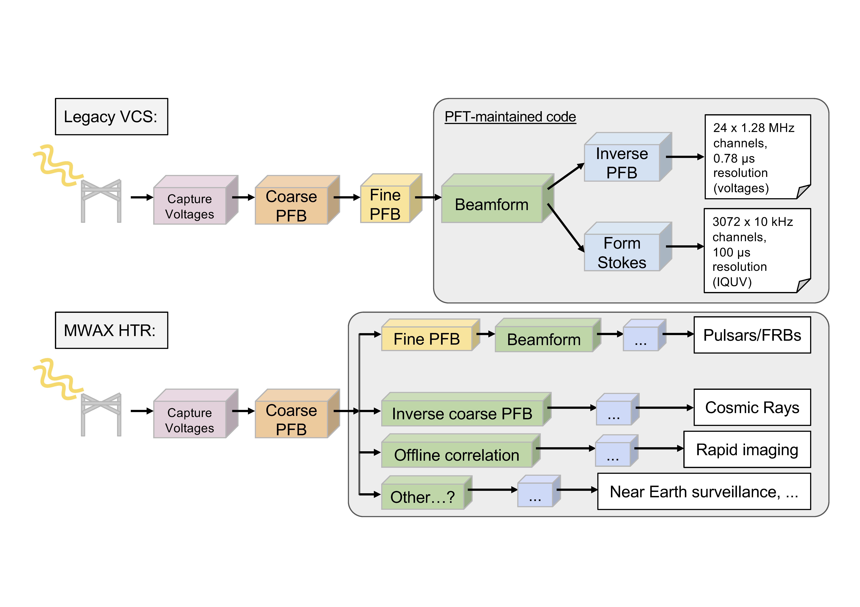

MWAX Voltage Capture System (VCS)
VCSBeam
Code: https://github.com/CIRA-Pulsars-and-Transients-Group/vcsbeam
Documentation: https://cira-pulsars-and-transients-group.github.io/vcsbeam/
Slide from Sam McSweeney
3
Notes:
8/29/24
3
3

Slide 4
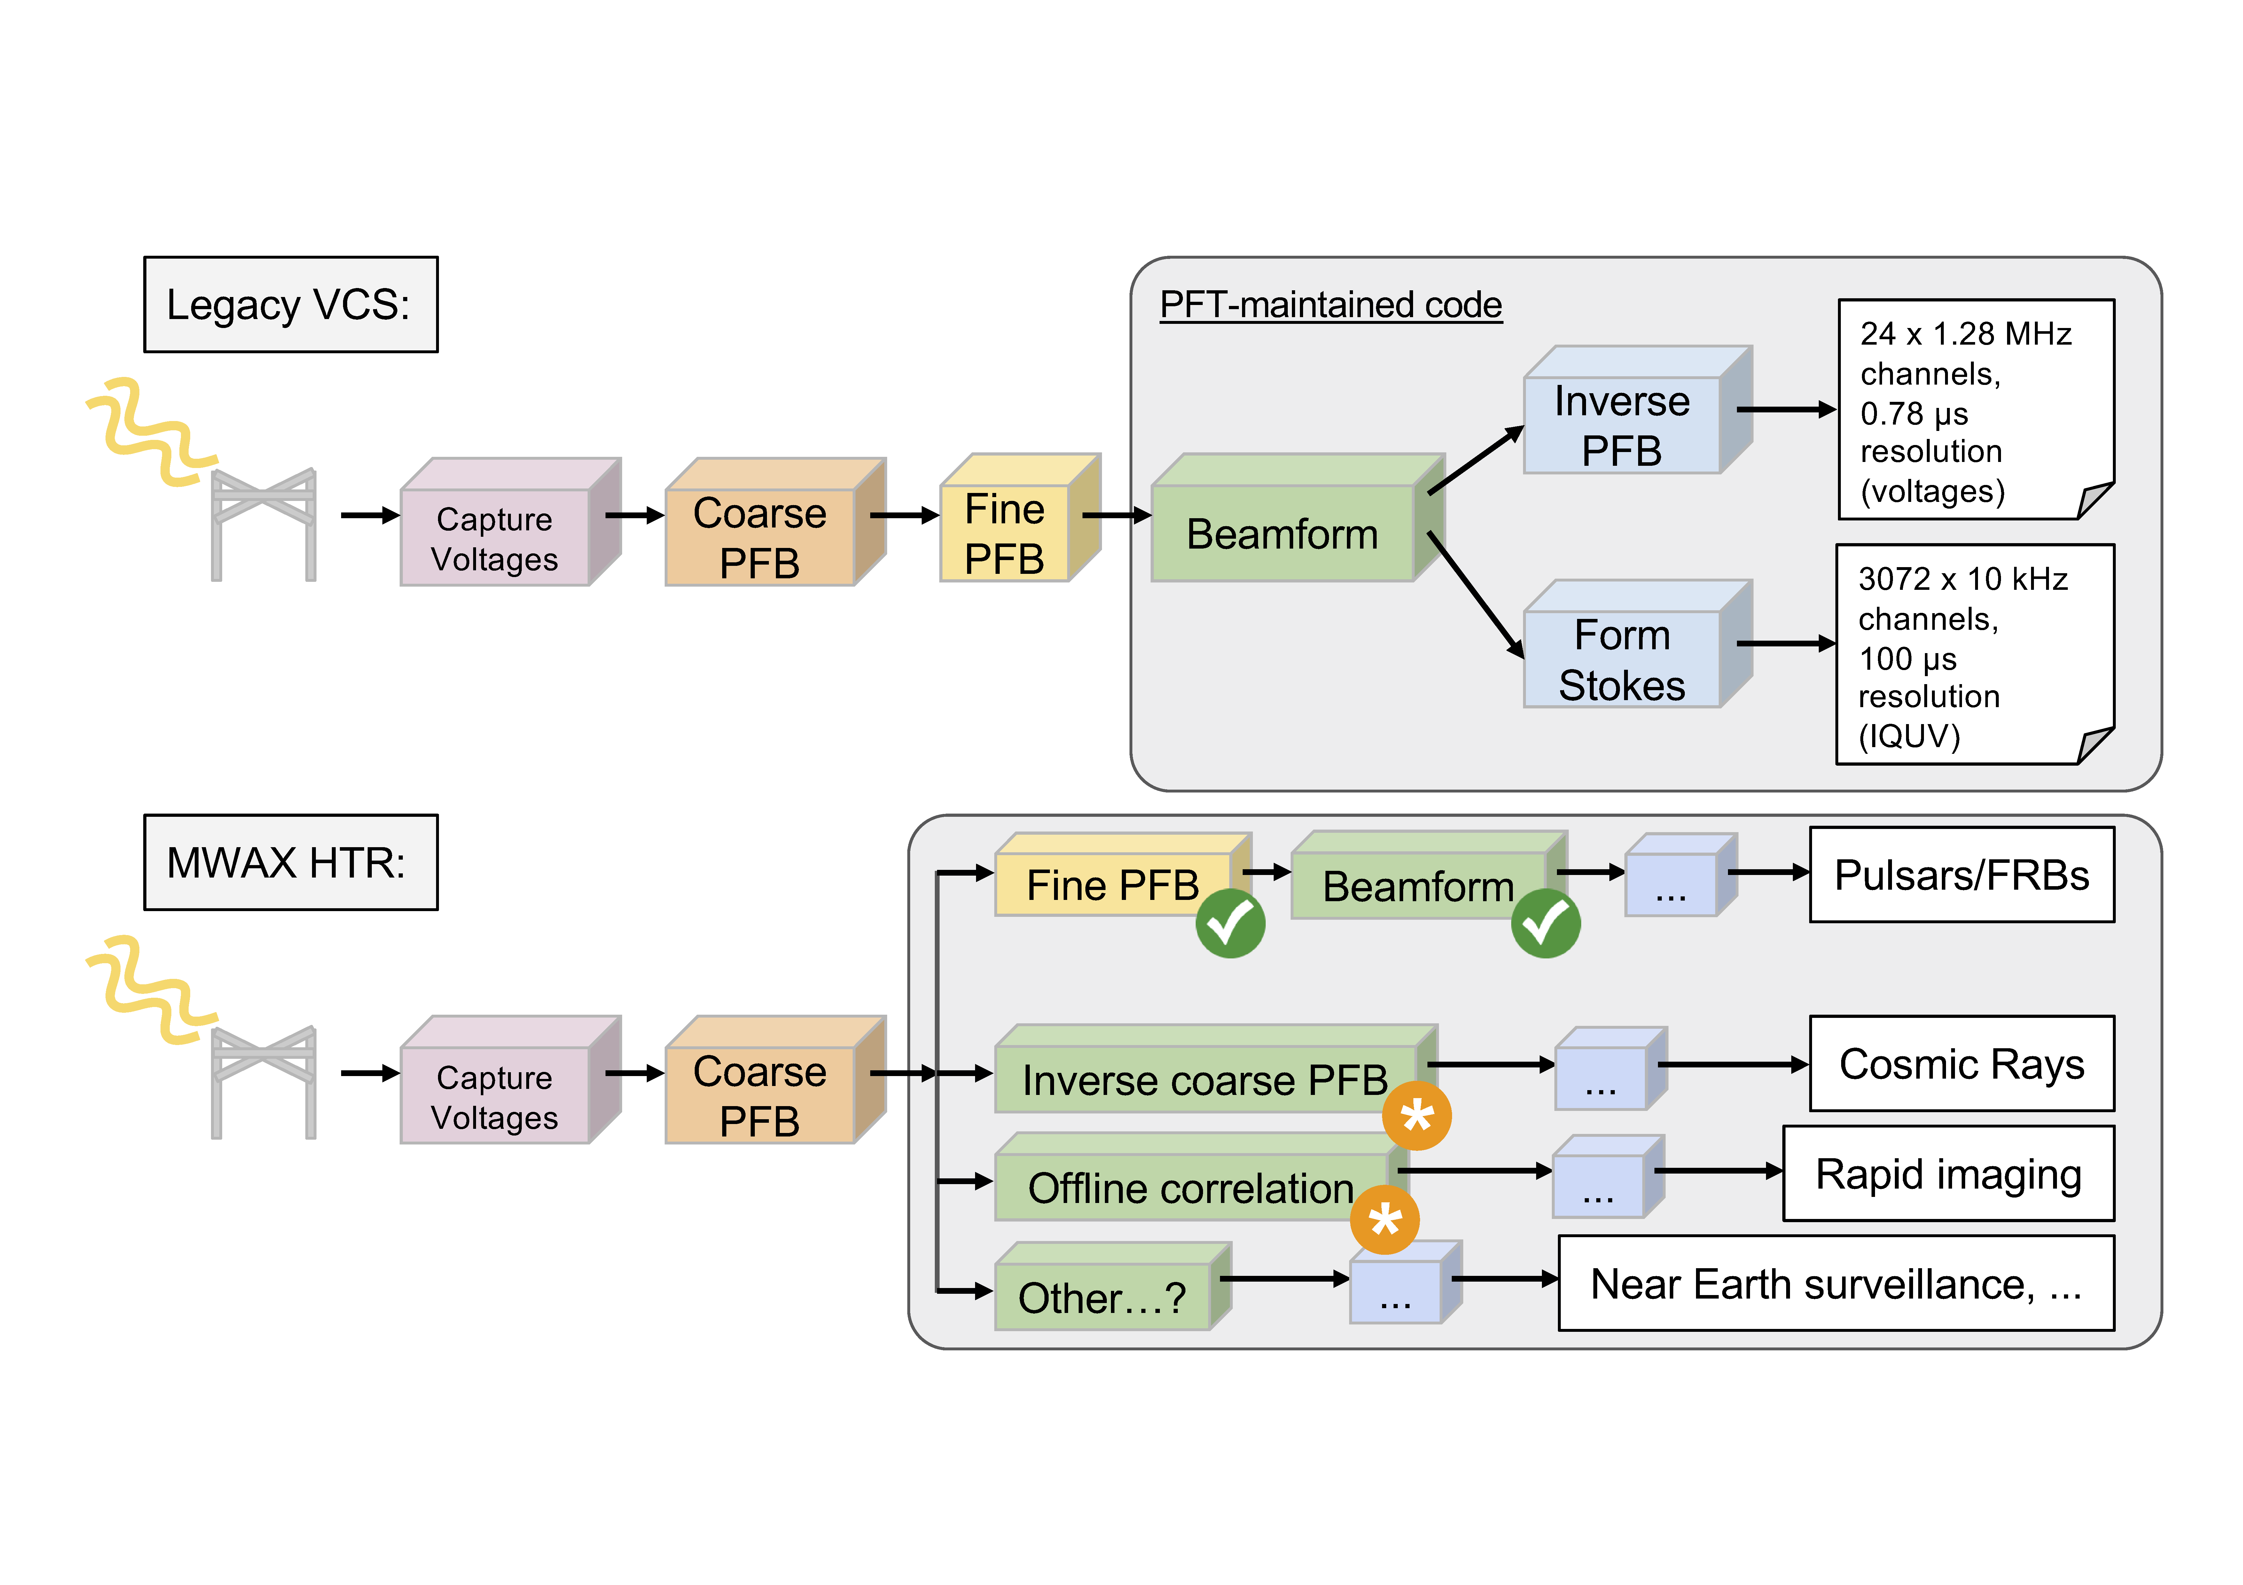
MWAX Voltage Capture System (VCS)
VCSBeam
Code: https://github.com/CIRA-Pulsars-and-Transients-Group/vcsbeam
Documentation: https://cira-pulsars-and-transients-group.github.io/vcsbeam/
Slide from Sam McSweeney
4
Notes:
8/29/24
4
4

Slide 5
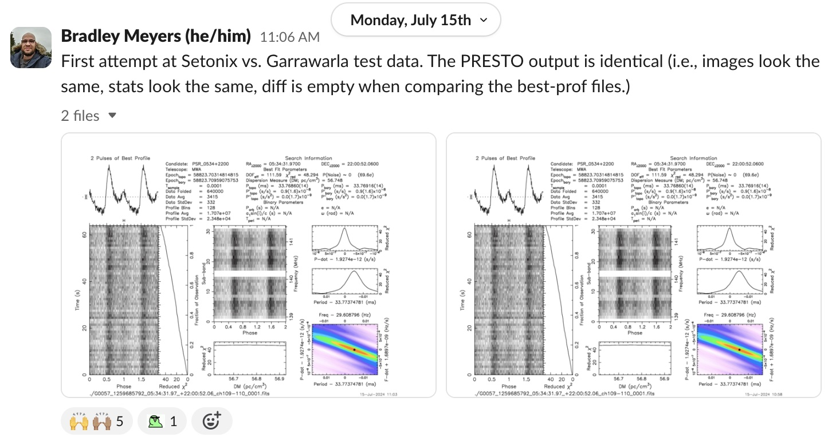
Setonix migration – VCSBeam first light
Garrawarla (CUDA)
Setonix (HIPP)
2 coarse channels, 5 minutes of Crab data
Supported by Pawsey “uptake” project (Team: Meyers, Di Pietrantonio, Harris, Sokolowski)
Next steps: More in-depth comparison (e.g. VDIF output) , including profiling
Initial Profiling: 3-27% MPIcomms overhead, 21-28% GPU proc/sync, 52-68% for I/O
5
Notes:
8/29/24
5
5
December – EOL for garrawarla (you heard from Greg yday) so this is a crtitically important task
Will explain these plots – for now just stare at them and see if you can spot any difference!
An important milestone to ensure the continuation of PFT science in the near future
Supported by the uptake project, so we have Pawsey engineers helping us with this (Cristian and Chris Harris)
Certainly more work to do – ask me later if you wish, or Bradley – some initially profiling makes it amply clear that I/O is a substantial part of the processing budget

Slide 6
Science Updates & Highlights: SMART survey and Pulsar Science

Slide 7
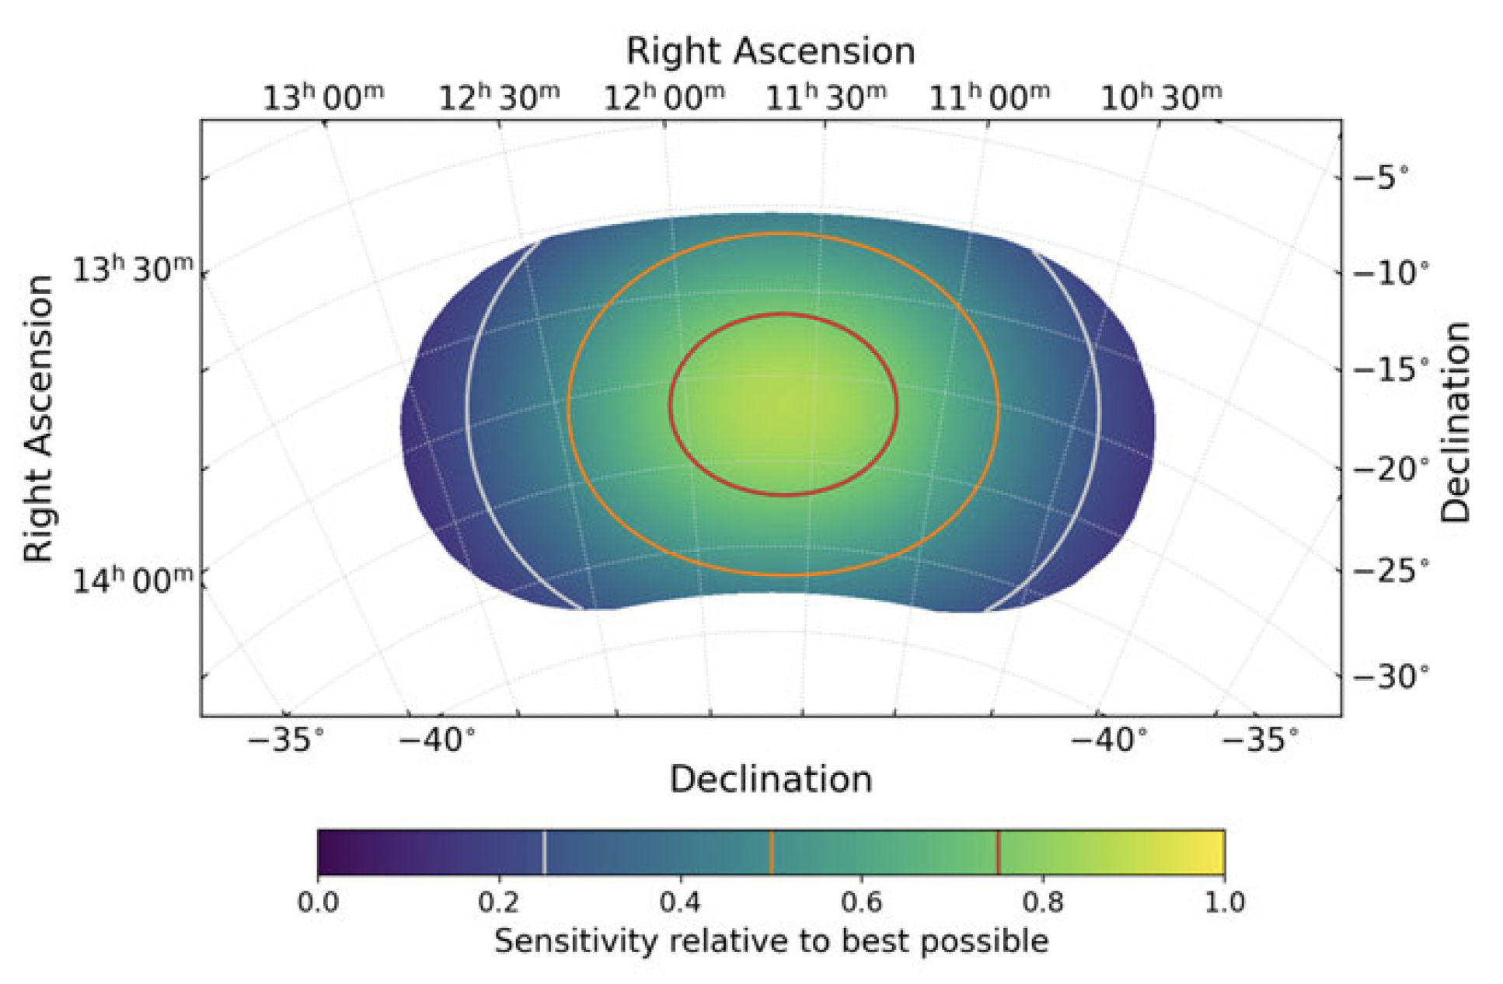
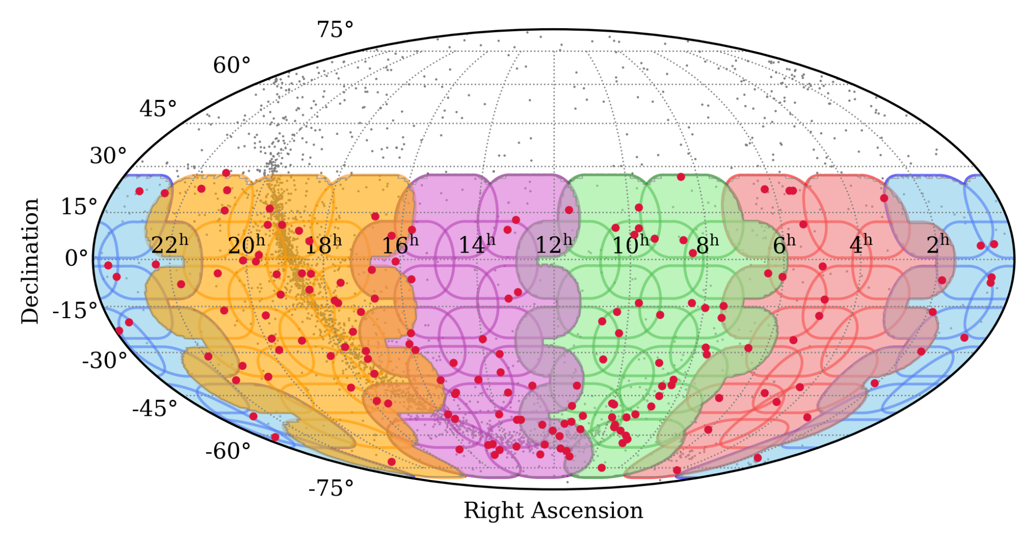
SMART Survey Update
Exploits the MWA’s large Field of View, the voltage capture system (VCS) capability, and the compact configuration of the Phase 2 array
Southern-sky MWA Rapid Two-metre (SMART) pulsar survey
Covers declinations < +30°
71 observations (VCS) at frequencies 140-170 MHz
~10° overlap of fields; i.e. 1-3 obs. per pulsar
80 min dwell time; i.e. <100 hours of telescope time
(Bhat et al. 2023a/b, PASA, 40, e020/e021)
Data collection completed!
Four Petabytes of VCS data
42-84 TB per observation
“First pass” for parts of the sky
200+ known pulsar redetections
5 pulsar discoveries after analysing <5% of the data
Notes:
SMART survey – an ambitious project to survey the southern skies at low freq for pulsars and fast transients – first southern sky pulsar in the SKA Low’s band – potentially more sensitive than previous southern surveys
Nicely leverages the combination of a large FoV + VCS, and takes advantage of the compact configuration that was available from time to time….
High efficiency in data collection - < 100 hours opposed to 1000s of hours by other telescopes, but processing cost is substantial, because of the low frequencies, and much finer griding in the search parameter space, e.g,DM
Data collection completed as of last year – we have 4 PB of VCS data that covers the entire sky south of 30 deg, all in VCS mode, and we have at this point has only done a “first pass” (shallow survey) of only a part of the sky….
Even that has been a pretty rewarding exercise, 200+ known pulsars detected at low frequencies, many for the first time, as shown by red dots, and several new pulsar discoveries from a small fraction of data scrutinised….

Slide 8
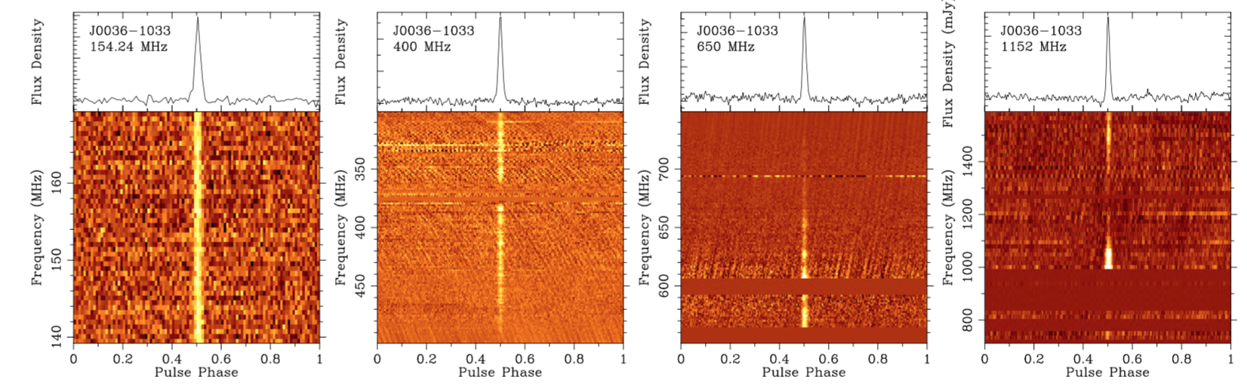
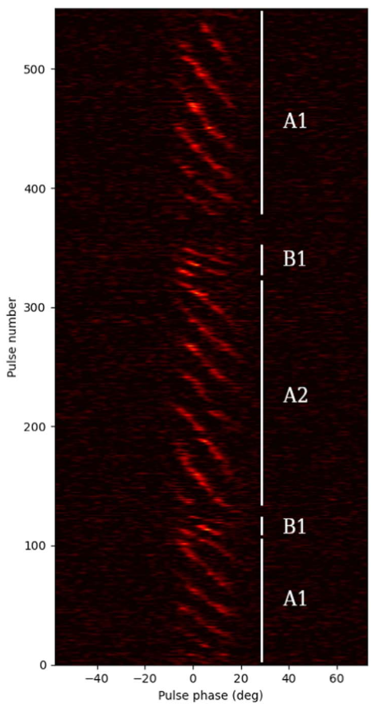
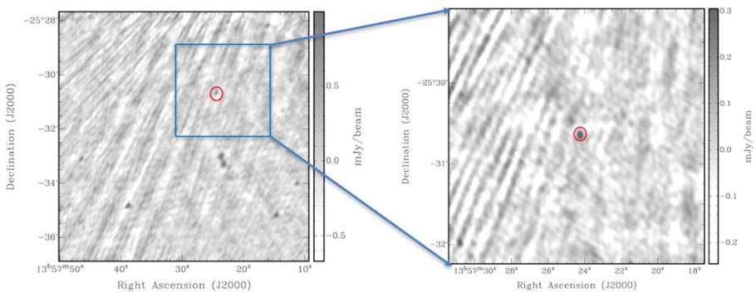
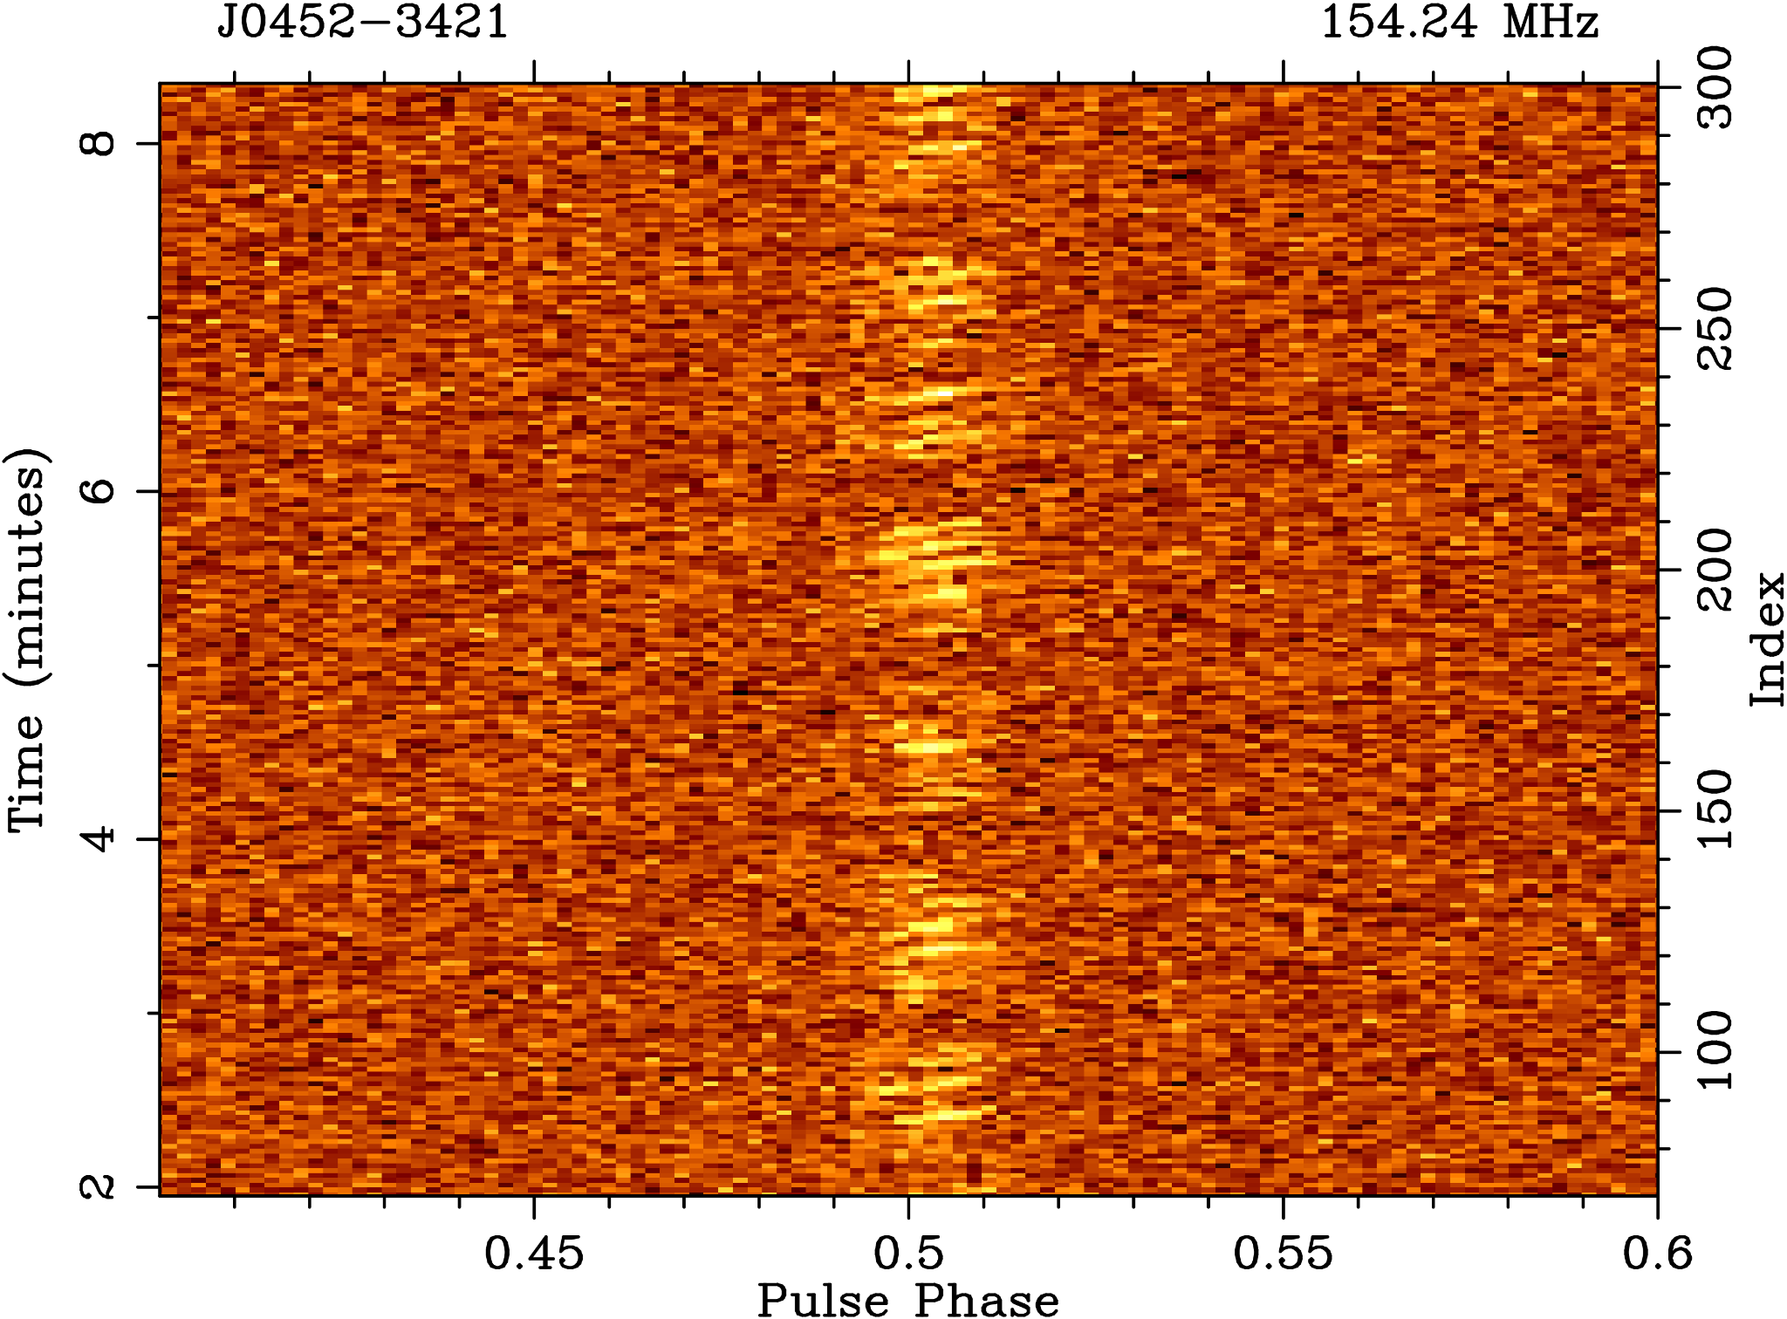
New Pulsars from the First pass
J0036-1033: steep spectrum, low-luminosity, and highly variable
(a factor of ~ 5-6), high-|b|, so promising for scintillation analysis
(Swainston et al. 2021, ApJL, 911, L26)
J0026-1955: sub-pulse drifting, nulling, high-|b|
(McSweeney et al. 2022, ApJ, 933, 210)
GMRT Follow-up (Janagal et al. 2023b, MNRAS, 524, 2684)
J1357-2530: uGMRT imaging localisation from concurrent imaging + beamforming observation (Bhat et al. 2023b, PASA, 40, e020)
J0452-3418: subpulse drifting, nulling (Grover et al. 2024a, accepted in ApJ)
Notes:
Here are our first goodies from a shallow pass processing of a small fraction of the data collected so far
Clockwise from top left --- first pulsar, 2nd , 3rd not there…. 4th pulsar, and pulsar #5 – all from the first pass (which is a shallow survey of a part of the sky)
Important point to note here is …. Not just adding pulsar count, but many were good enough to warrant individual focused study for various reasons, in some cases more than one….
First one is special because it is the first one, but turns out to be a steep spectrum low luminosity object, placing it in the bottom 2 percentile of pulsar population
2nd pulsar, turns out to be an independent re-discovery, and is a remarkable object in terms of sub-pulse drifting and nulling phenomena. Seen here as regular patetrns in emissioo structure when you pulse stakc…..
3rd one is a vanilla pulsar (and a re-discovery) but we had a lot of fun in giving it a final name and

Slide 9
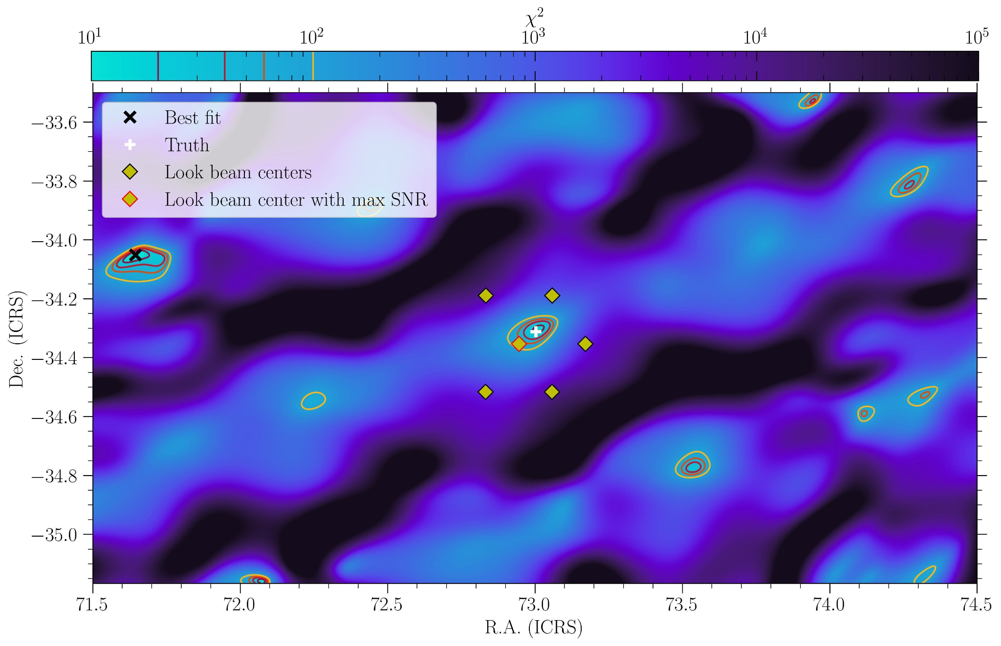
Localisation improvements for Tied-array Beam detections
Localisation attempt on PSR J0452-3418
Leverage knowledge of the tied-array beam power pattern on the sky
Detections in multiple beams of the same pulsar can be used to improve localisation
Complex beam pattern for compact (2 x Hex + core)
Much better precision than the beam width
  For SMART the beam FWHM ~ 24’
The true position is within a reasonable best-fit statistic interval. Missing: beam covariances…
Meyers & Bahramian (in prep.)
Notes:
Important for initiating follow-up for regular timing observations, and also for follow-up using other telescopes (e.g, GMRT and Parkes) that operate at higher frequencies – we need positions good to at least a couple of arcmin
In the past…. Earlier we used to use a likelihood approach, and in the process stumbled upon problems, so now developing a new method that is more robust and will give us localisation (error) maps – this is work in progress by Bradley and Arash… motivated by SMART needs but the idea is to make this more generic so you can use it for other science applications as well e.g. localise a transient detected in TAB or improve a pulsar position etc.

Slide 10
SMART calibration Observations
This processing can be done independently of any actual beamforming or searching procedure.
Systematically produced calibration solutions using the new generation MWA pre-processing tools (i.e. birli and hyperdrive) for each calibration observation associated with every SMART VCS observation.
These can then be stored (e.g. on NT/OzSTAR, or Data Central) and called upon for testing, or for full-scale search (beamforming) operations.
Almost completed – improving efficiency with the work leading up to MSP census and SMART data release papers in prep. (see paper proposals).
The solutions are also very handily available for non-SMART science that will make use of SMART observations.
Notes:
Consolidation of calibration observations + systematic processing of all calib obs – motivated by new tools, you heard Dev’s presentation (yesterday) new preprocessind and calibration tools we have (Birili and Hyperdrive)
Birli - can legacy or mwax data
Birili – instrument specific corrections, RFI flagging, format conversion [preprocessing] – again push comes from the SMART – but benefits will extend to lots of other projects as well… there has been a growing no of such….
Hyperdrive – direction independent calibration , ionospheric subtraction [calibration]

Slide 11
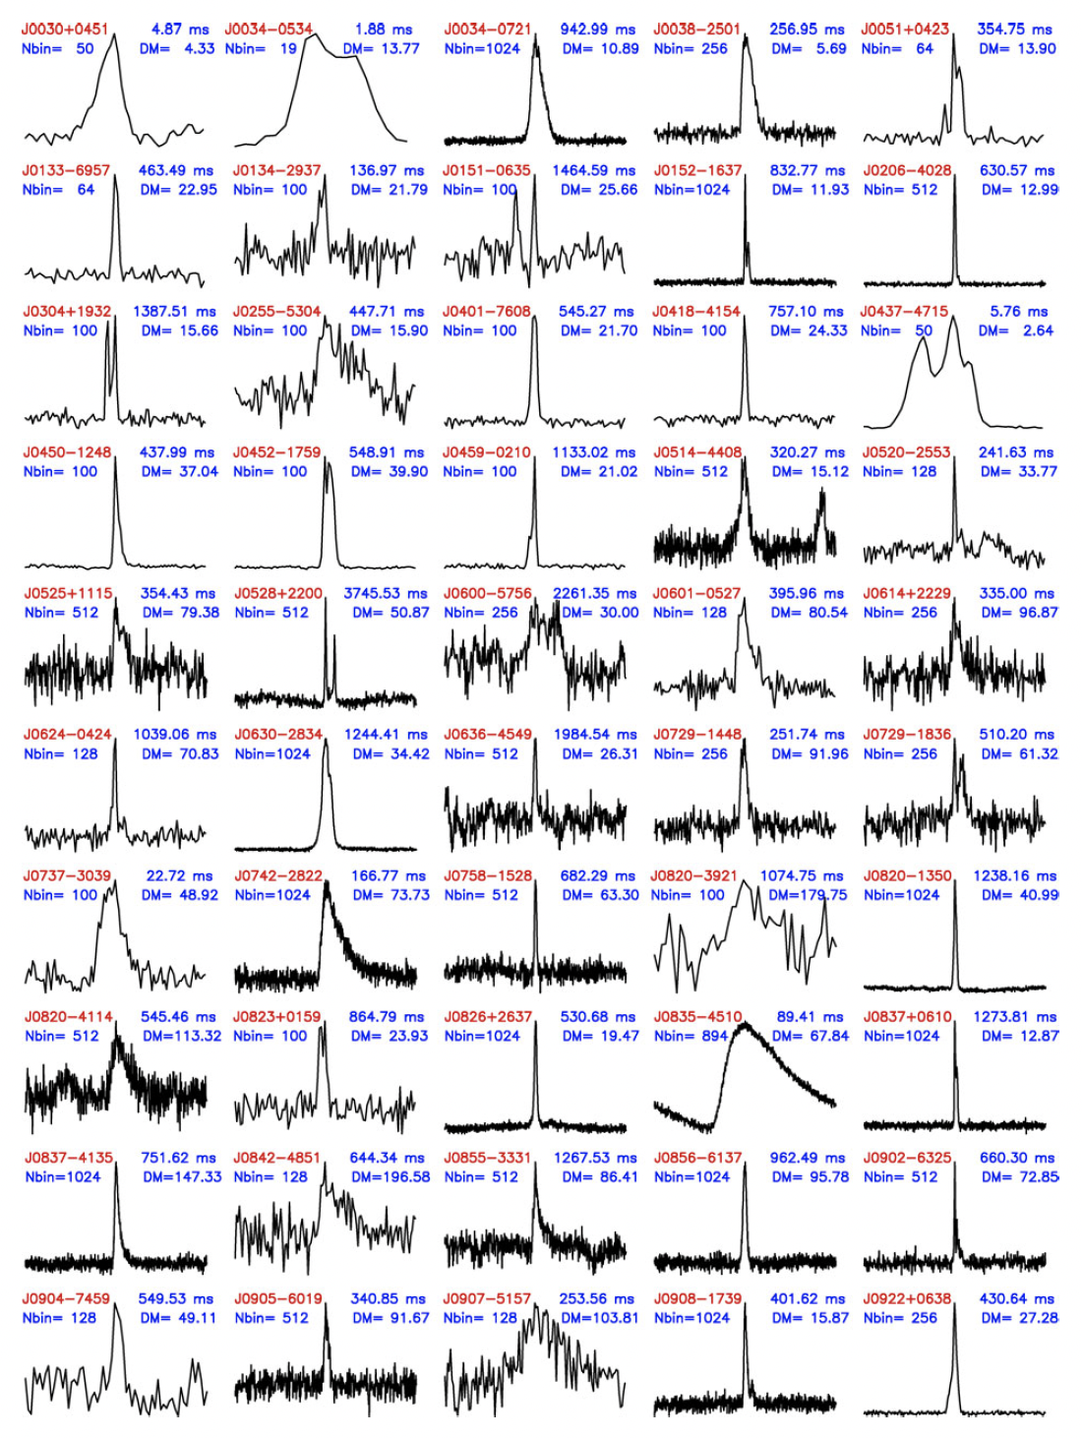
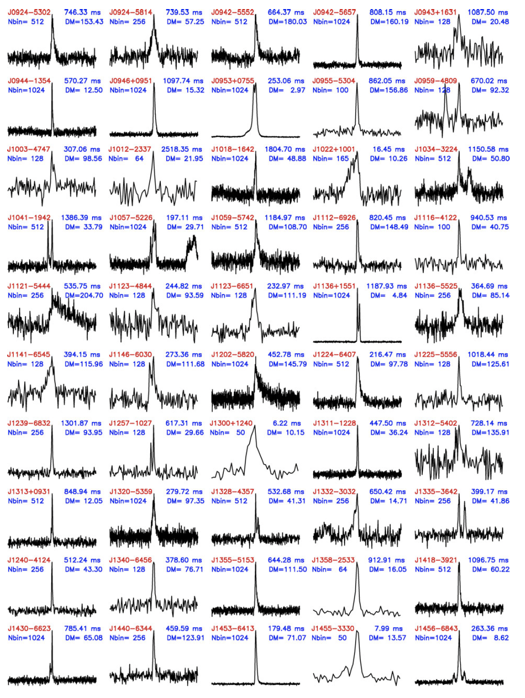
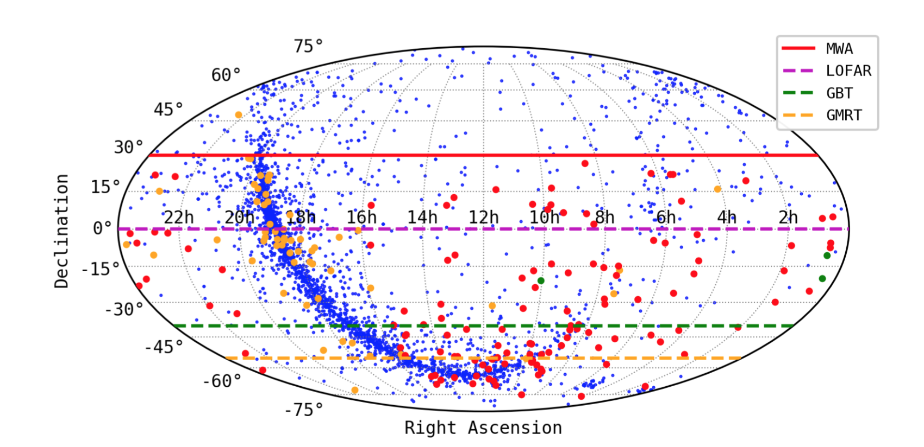
MWA Pulsar Census
SMART Paper II (Bhat et al. 2023b)
low-frequency detections of 180 pulsars
further characterization of four new pulsar discoveries
pulsar census from SMART data collected in 2018-2021

Slide 12
MWA Pulsar Census
Legacy data sets of the high time resolution radio sky at low frequencies
flexible reprocessing options, future algorithms, new phenomena, and an important reference for SKA-Low pulsar survey and science
SMART Paper III (Bhat et al. in prep.) and Paper IV (Lee et al. in prep.) – see paper proposals circulated last week
See Chris’ talk on MSP census

Slide 13
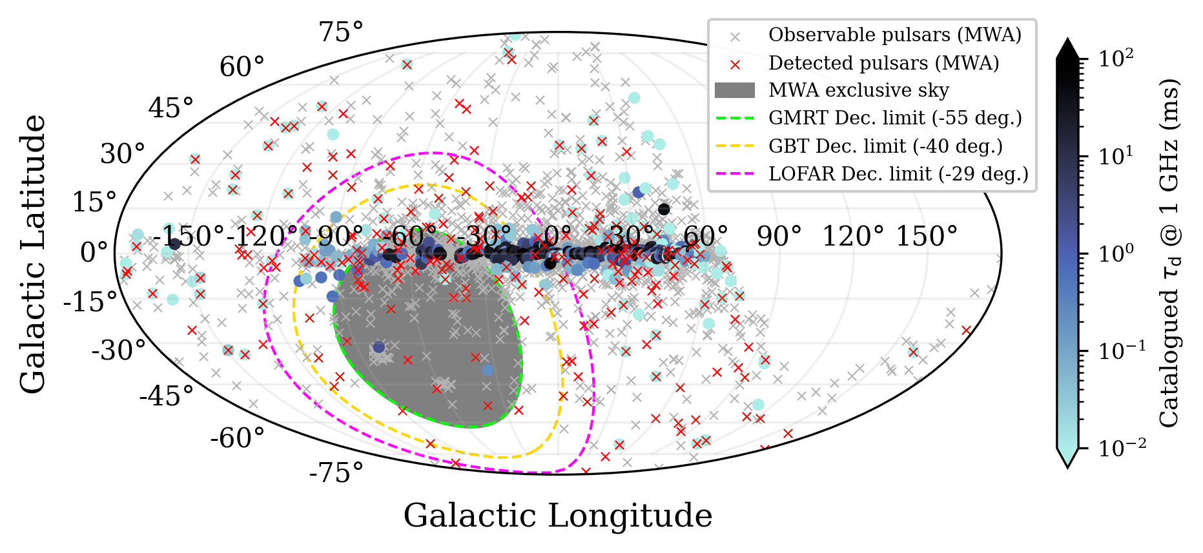
Pulse Broadening (Scattering) timescales from SMART data
Using the SMART data and detections of known pulsars across the observable sky
Interstellar scattering
measurements
non-existent for many
high-|b| pulsars
MWA can make unique
contributions to the
next-generation of
electron density models
Meyers et al. (in prep.) – see paper proposal circulated last week
(NE2001 successor
under development,
by Ocker & Cordes)
Notes:
Data products and pulsar measurements from upcoming SMART census papers will enable a range of science including population studies, emission beams, ISM modelling, survey simulations….
We would like to demonstrate a nice example of it …. In this case, reporting on a scatter broadening measurements of mwa pulsar detections….
Improtant for ….NE2001 ---- nice pictorial representation of something I was pitching as an important issue – paucity of measurements at high latitudes --- important because also the ISM not just for pulsars, for FRB interpretations what is shown here ….. a summary of pulsar detections so far from the MWA….. Expain the figure (briefly) red dots, blue dots, very little blue dots at high b parts of the sky

Slide 14

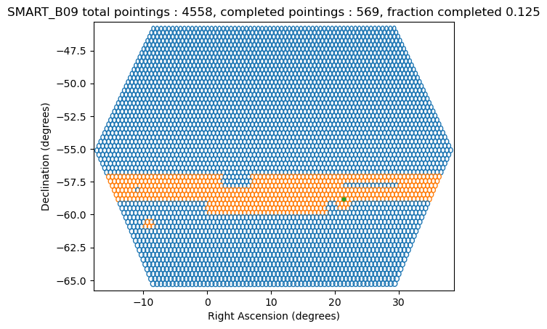
Commencing the second pass
Processed 1/8 of our first observation (4500 beams across the field of view), i.e. 560 tied-array beams
Some Numbers (Chia Min Tan)
Processing on NT (OzSTAR)
Beamforming :
  ~6 hours wall time to produce 11 pointings with 24 GPUs
  Wait time on queue can be up to 3 days
Search pipeline :
  FFT + FFA search
  ~7 hours wall time to process one pointing
  ~50 CPU hours per pointing
300 hours with 24 GPUs for 1/8th obs (or 2400 hours, for one full SMART observation)
4000 CPU hours for FFT+FFA search for 1/8th obs (or 31,500 CPU hours for one SMART observation
Need to spread out processing load (e.g. on DUG)
Notes:
Steven mentuioned DUG yesterday – a potential solution to address the needs of SMART

Slide 15
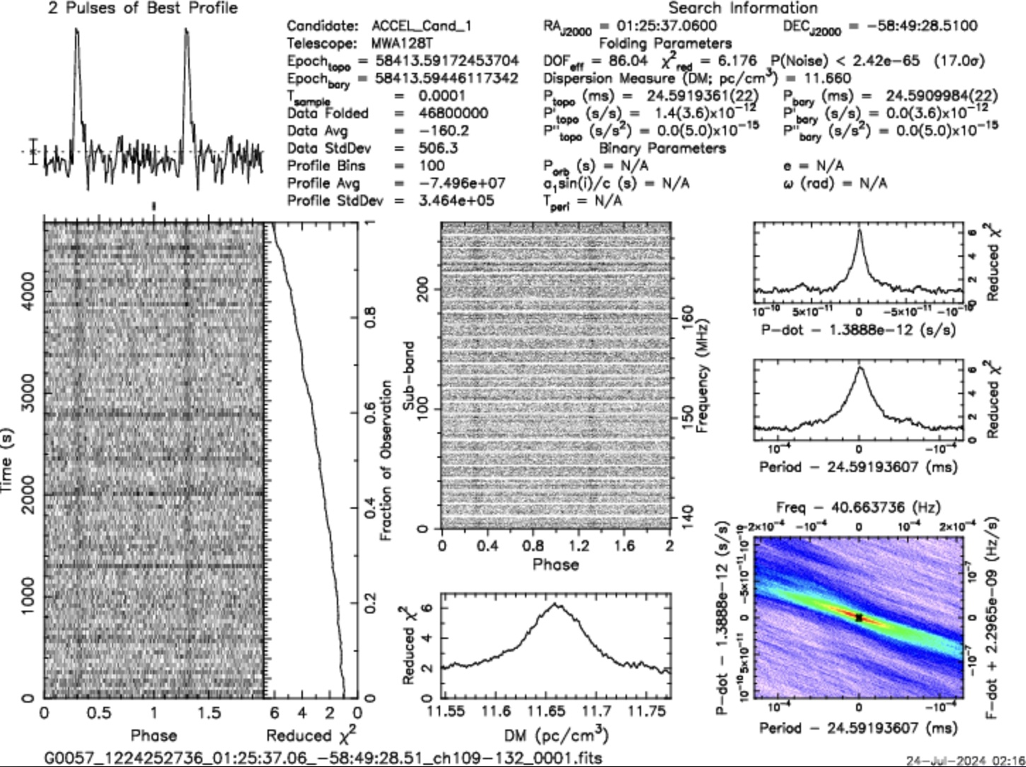
New pulsar candidate J0125

Slide 16
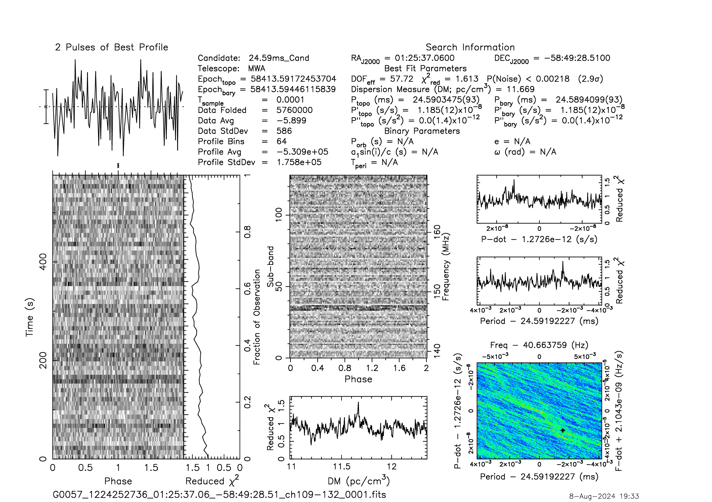
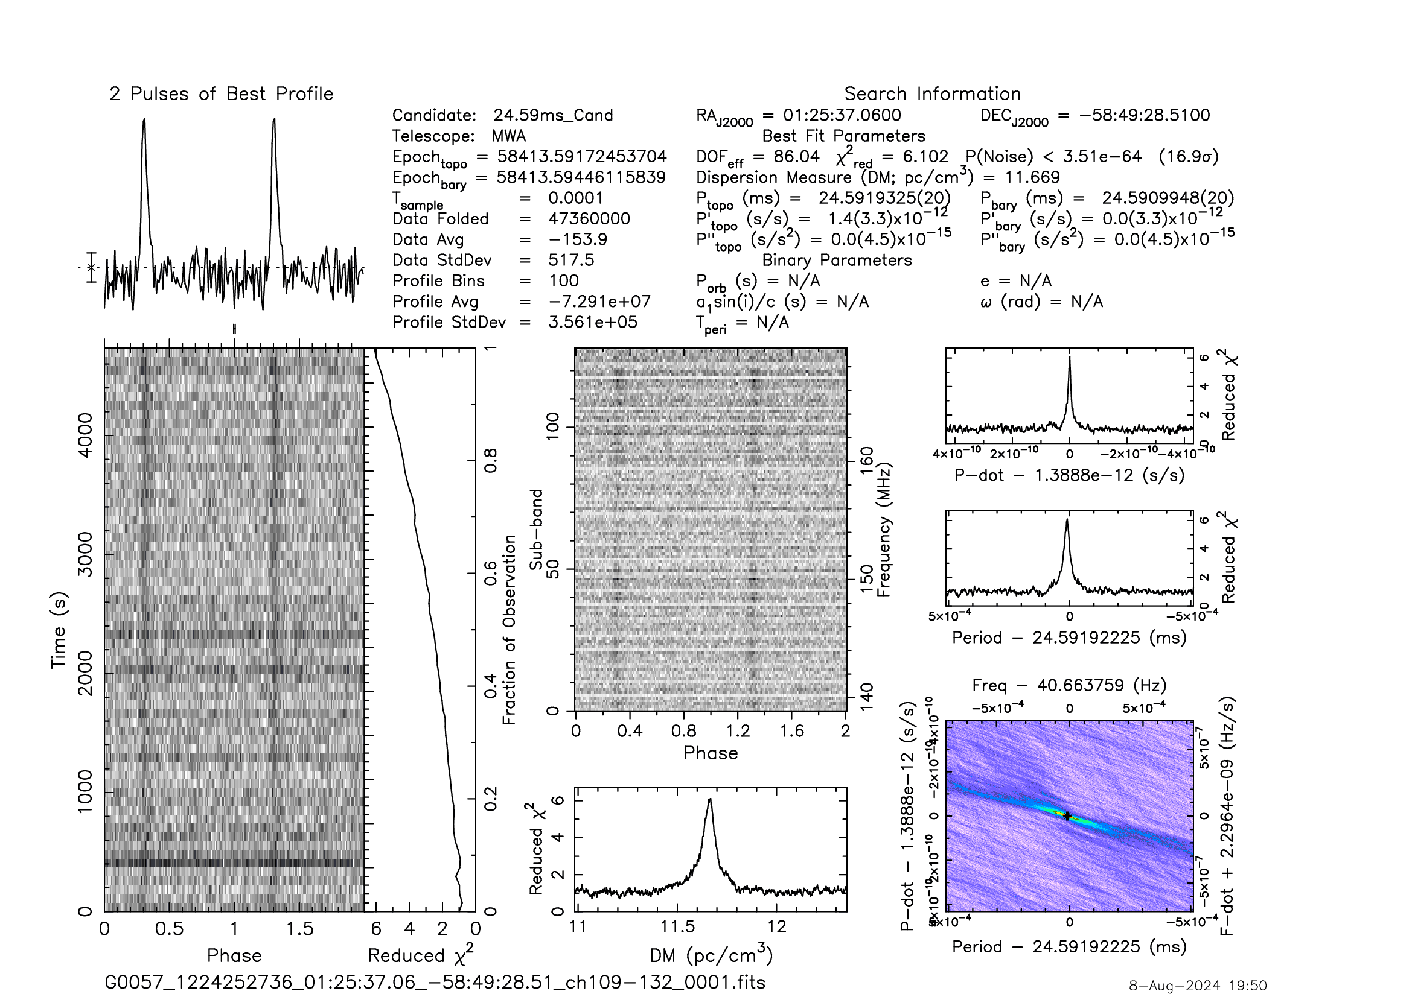
But why we didn’t find it earlier?
First pass processing (10 min obs)
Full observation (80 min) processing
Period: 24.6 ms
DM: 11.669 pc cm⁻³
S/N: 17 sigma in 80 min
S₁₅₀: ~4-6 mJy (indicative)

Slide 17
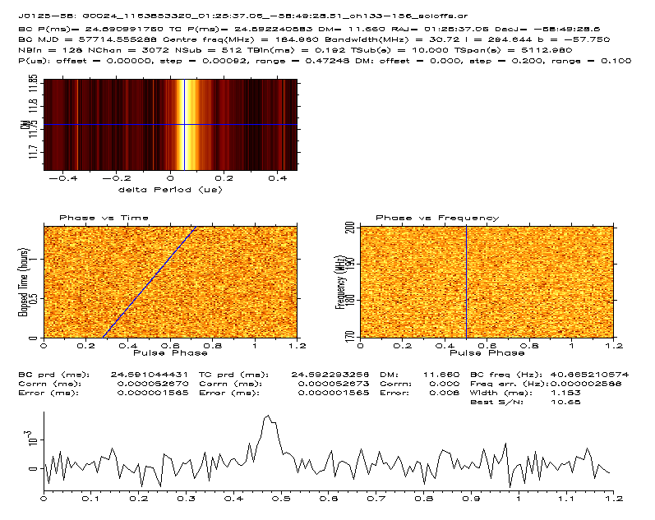
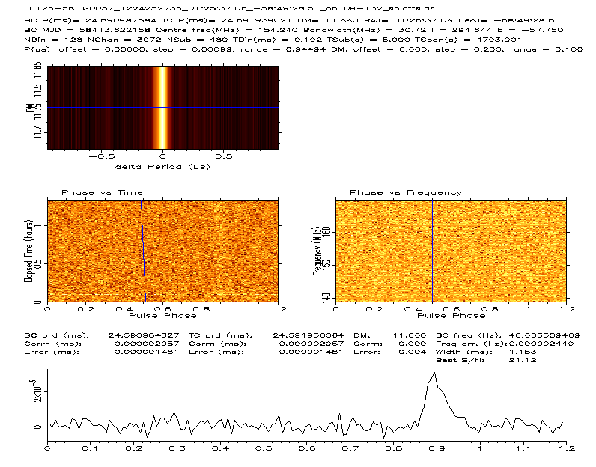
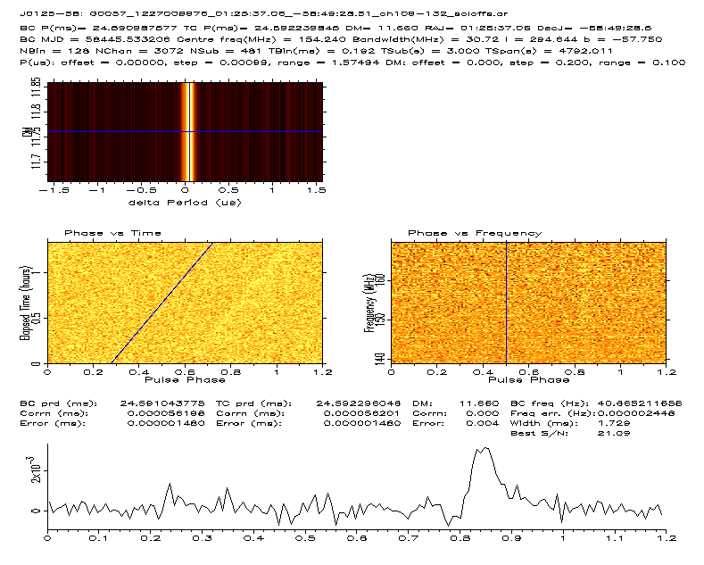
Seen in two other observations
3rd obs (Archival data) MJD 57714
Discovery Observation MJD 58413
2nd Obs (confirmation) MJD 58445
Preliminary indications
  Likely part of a binary system
  Potentially a “partially recycled” object
Non-detection at Parkes, beyond GMRT sky
MWA follow-up in progress….

Slide 18
SMART data processing: HPC Challenges and Opportunities
Dedispersion at low frequencies
  Exploring GPU accelerated options, like:
    AstroAccelerate (tuned for SKA-mid, loses most of its efficiency at low-frequencies)
    dedisp (time-domain and Fourier domain options)
I/O for beamforming/reduction tasks
  Large (many-TB) raw data sets, potentially many medium (many-GB) outputs
  Lustre filesystems have performance issues, SSD storage tends to be not large enough
Performance extensions to community pulsar search software
  Popular, well-tested and trusted software (e.g. presto) is showing its age
  Some parallelism, but still much to exploit (even on CPU front)
  GPU Fourier-domain acceleration/jerk searches? GPU fast folding algorithms?
  Key point: Needs to be easy to use!!
Discussions in progress with the HPC team at EPFL (Emma Tolley, Piyush Panchal)
Develop fresh insights into the problem, identify bottlenecks, explore solutions, etc.

Slide 19
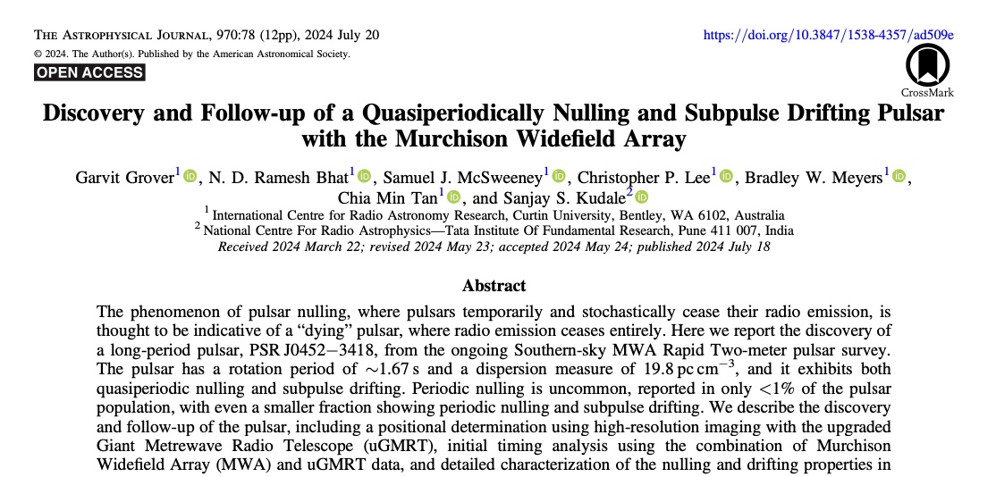
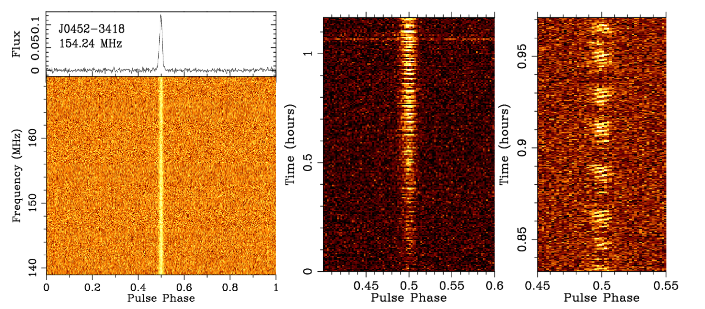

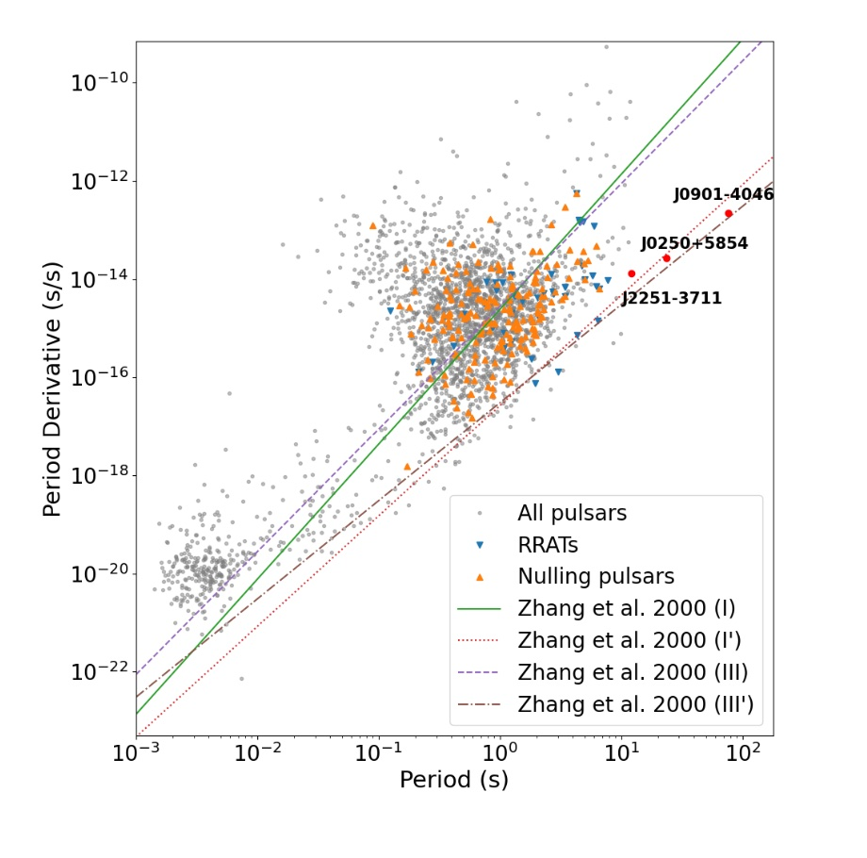
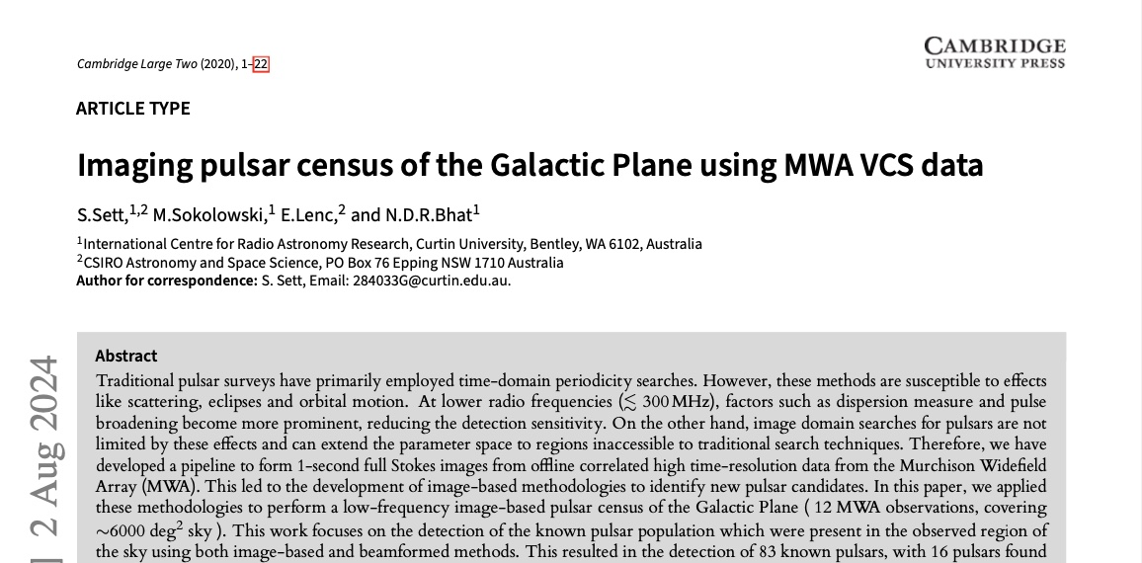
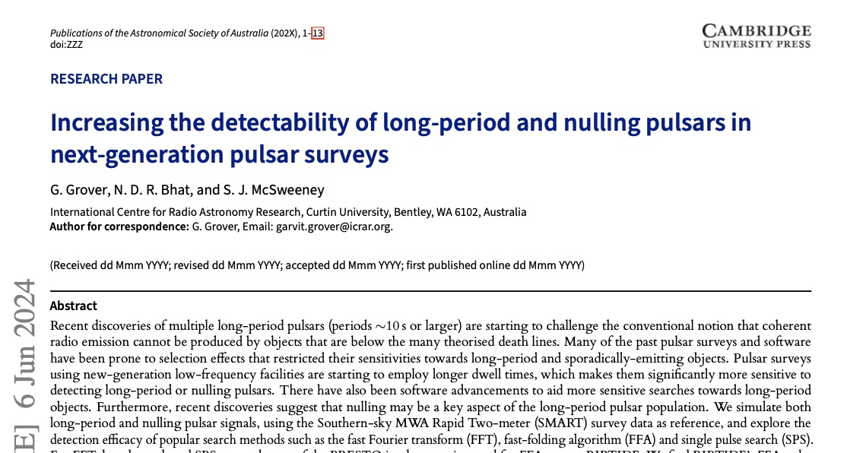
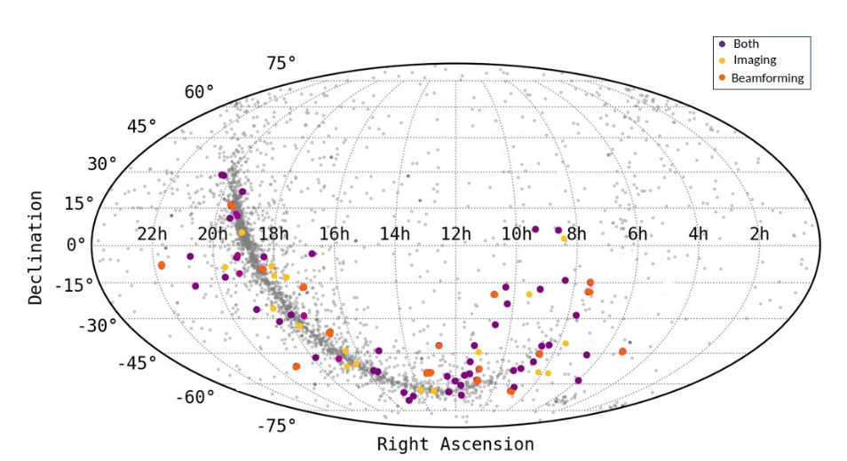

Recent Pulsar Publications
Grover et al. (2024a), ApJ, 970, 78
Garvit Grover
PhD student
Curtin
See Garvit’s talk
Grover et al. (2024b), accepted in PASA
Sett et al. (2024), accepted in PASA
Susmita Sett

Slide 20

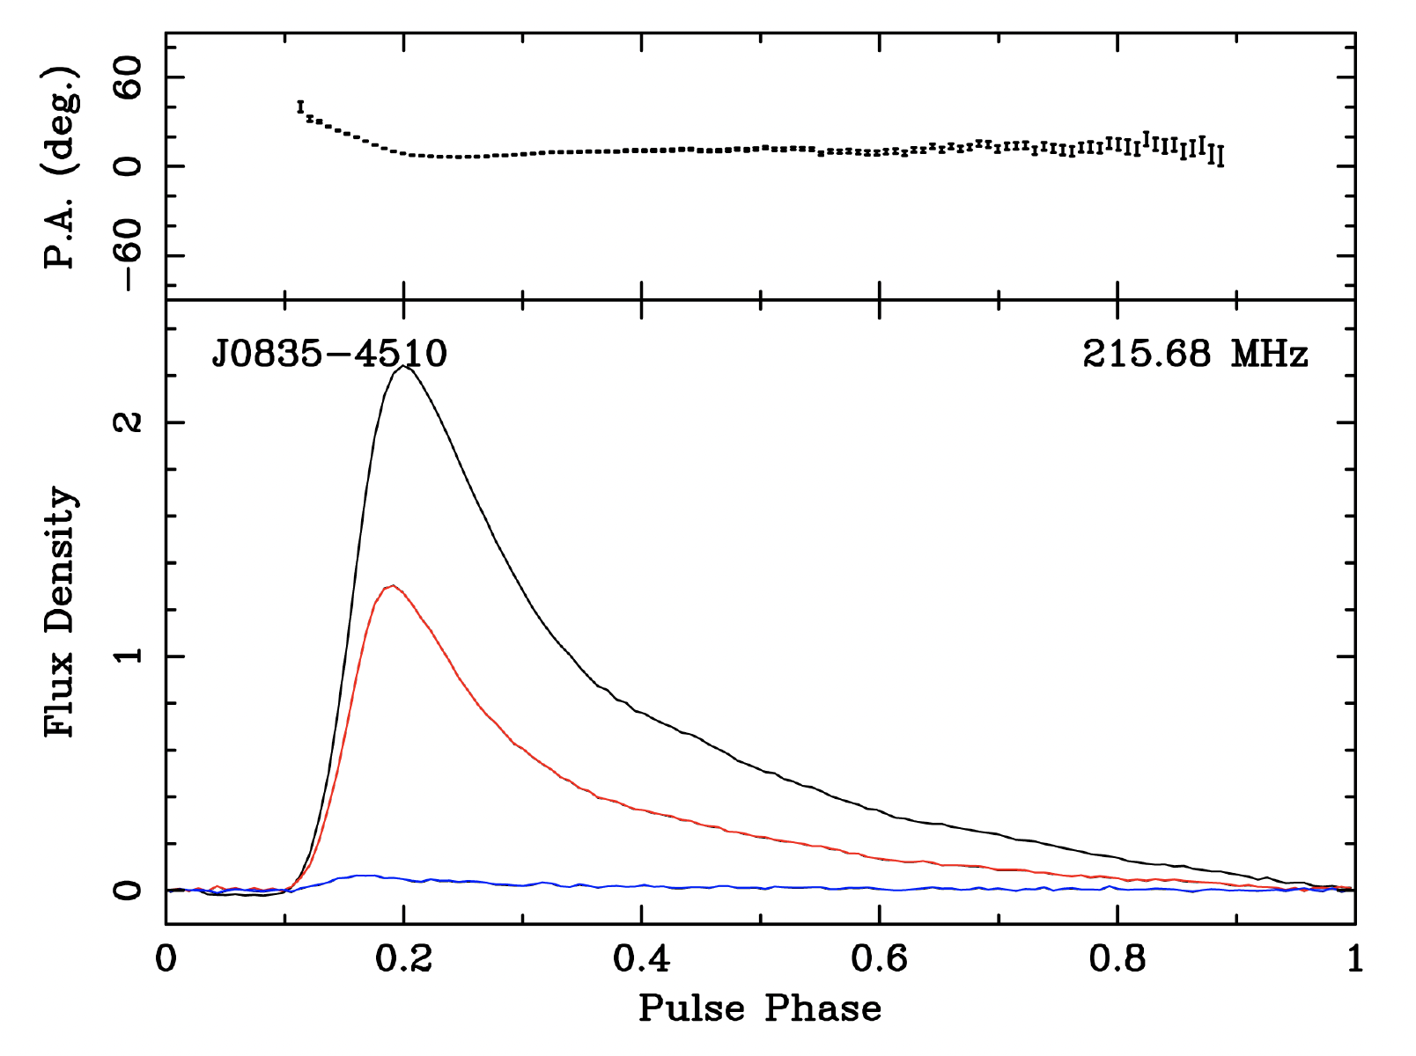
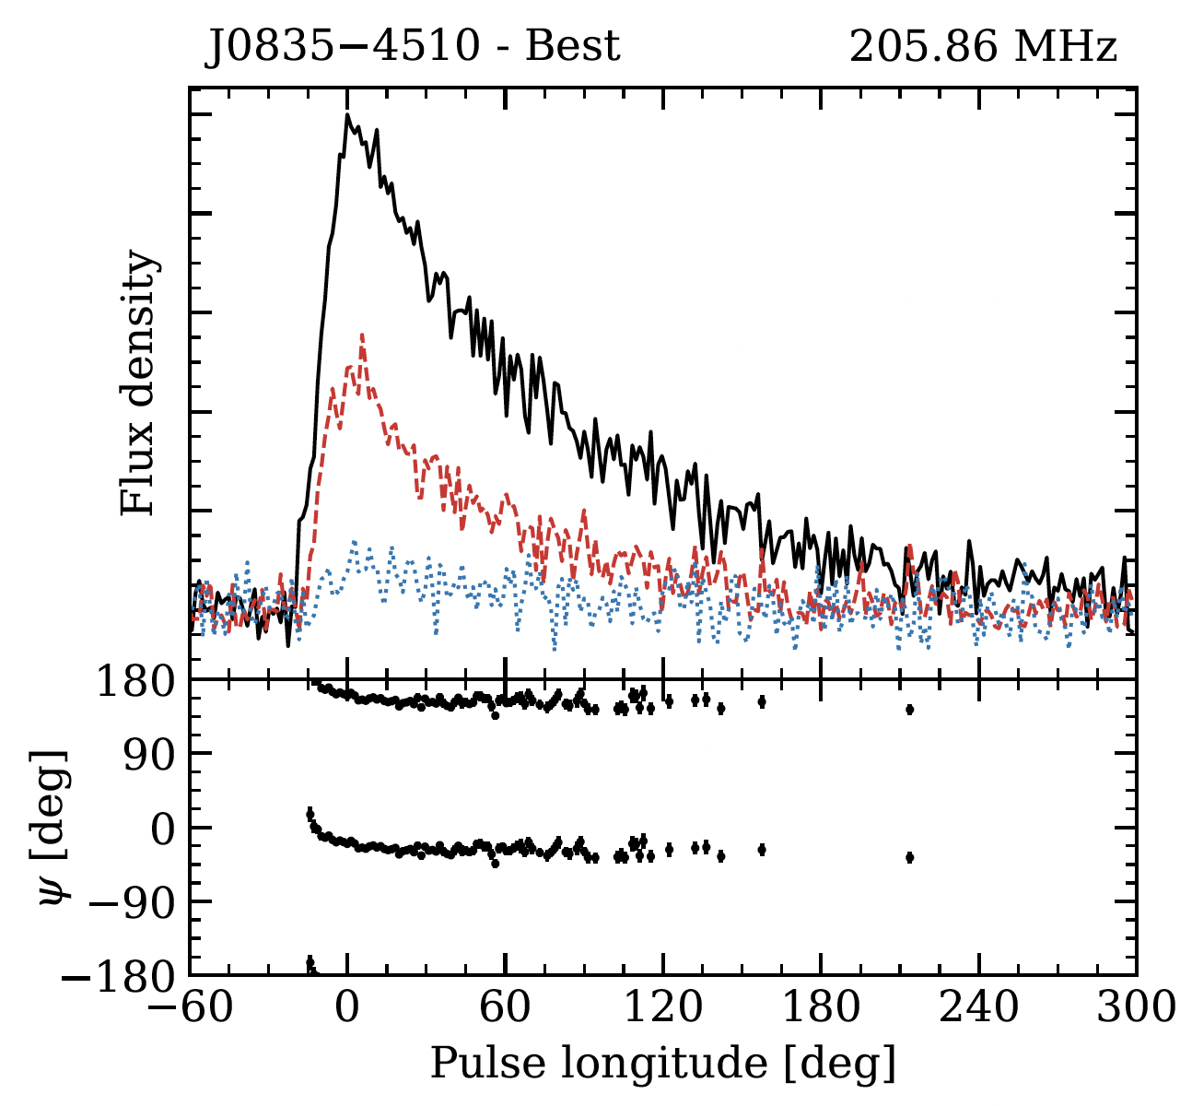
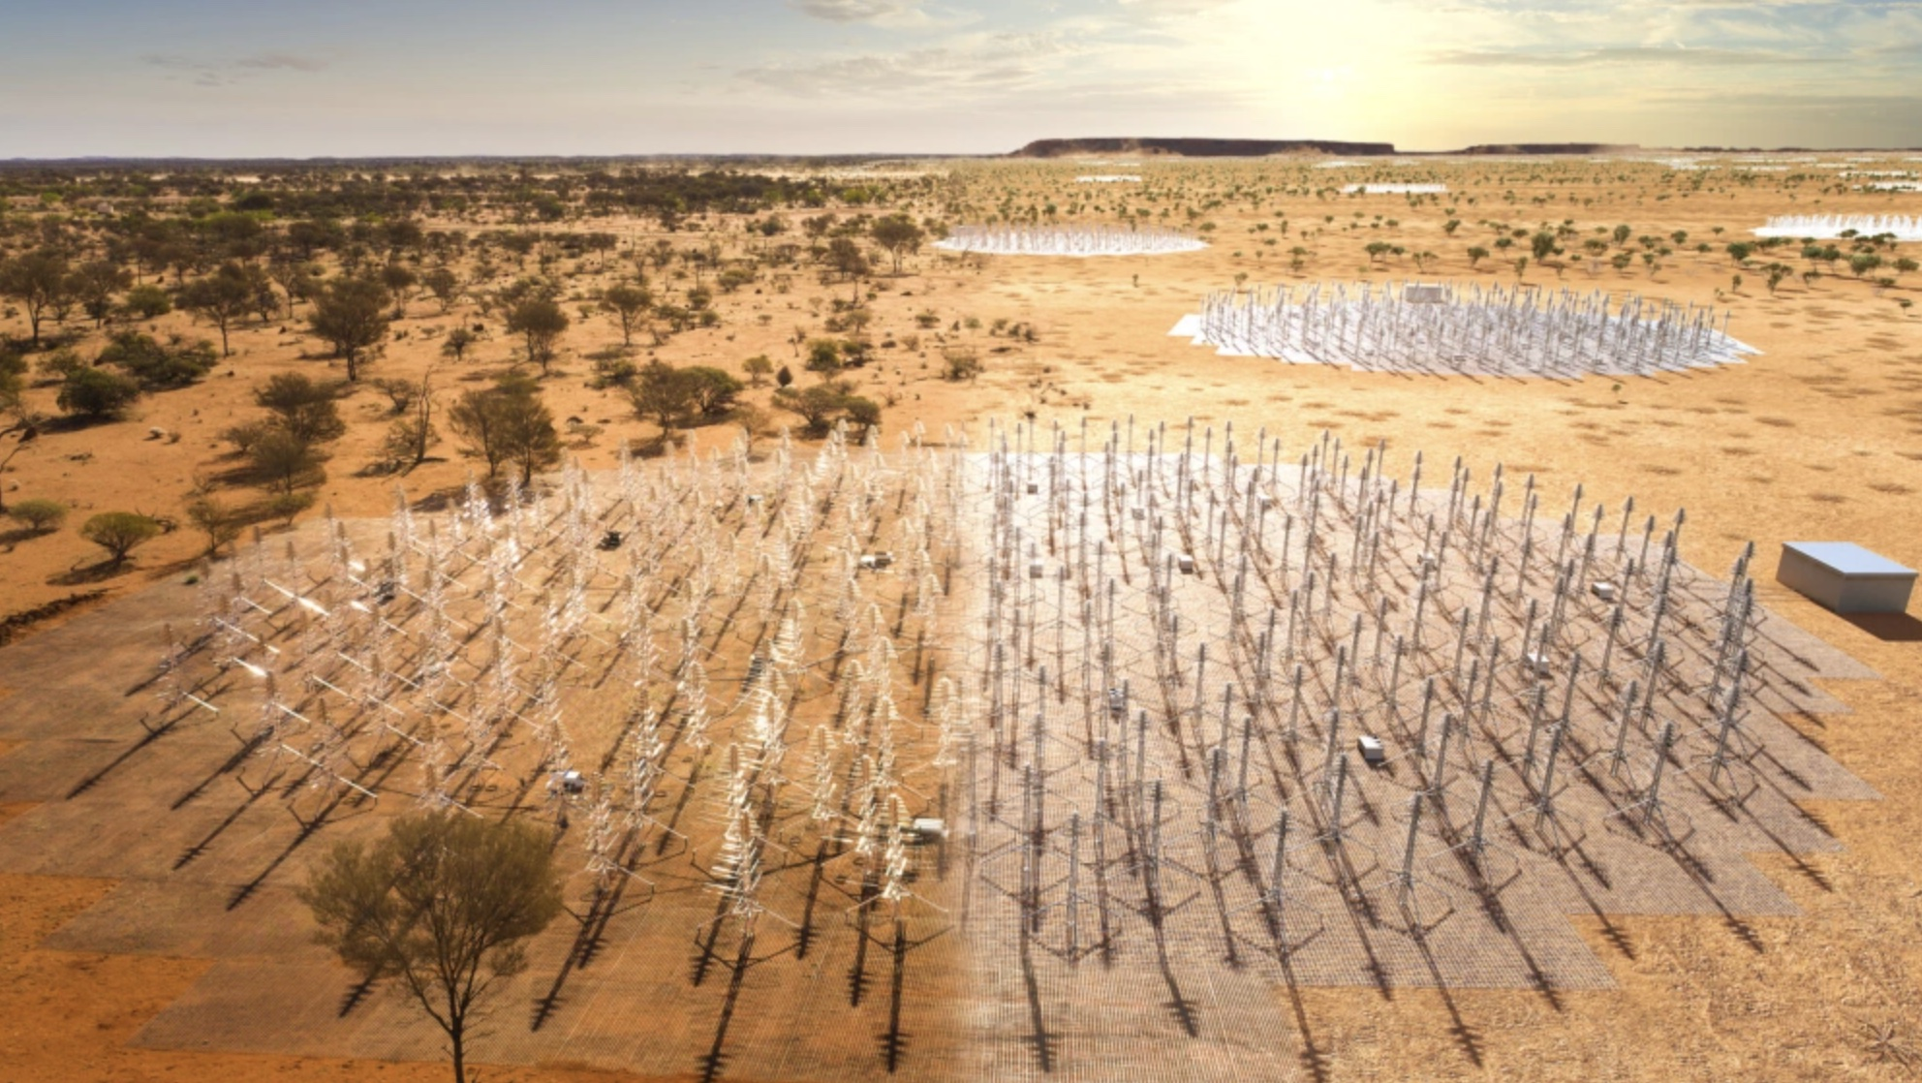
AAVS2 System Verification & Polarimetry
AAVS2 (Aperture Array Verification System 2.0) is an SKA-Low prototyping station
Bandwidth upgrade (32 x) enabled sensitive pulsar observations with full polarisation information
Validation of AAVS2 polarimetry is important for gaining confidence in SKA-Low station data, and as a useful cross-check of MWA polarimetry
MWA pulsar detections provide an important reference point to validate this exercise
Vela pulsar profiles near ~ 200 MHz are consistent between AAVS2 and MWA
Evidence for micro-structure (~AU scales) in the interstellar magnetic field toward the Vela pulsar (Lee et al. 2024)
Chris Lee
PhD student
Curtin
MWA
AAVS2
Lee et al. (2024), accepted in PASA

Slide 21


MWA Pulse broadening study of J1935+1616
Multipath due to electron density microturbulence
    A unique tracer of the wavenumber spectrum
    Deleterious for precision pulsar timing (PTAs etc.)
Wavenumber spectrum
  Inner scale → upper cutoff on wavenumber q
J1935+1616
  Claims in literature that 𝛽 > Kolmogorov
  Based on model fitting pulse broadening function to pulse shapes vs. frequency
  Results depend on the shape of PBF
  Exponential PBFs (the most used) yield biased results based on simulations
  PBFs for Kolmogorov media with a finite inner scale are ‘heavy tailed’ and yield different results
MWA
  Valuable for providing highly scattered pulses → better discrimination between PBF models
  G099 project to extend the frequency coverage from 80 MHz to 230 MHz
Jim Cordes (Cornell)
Abra Geiger

Slide 22
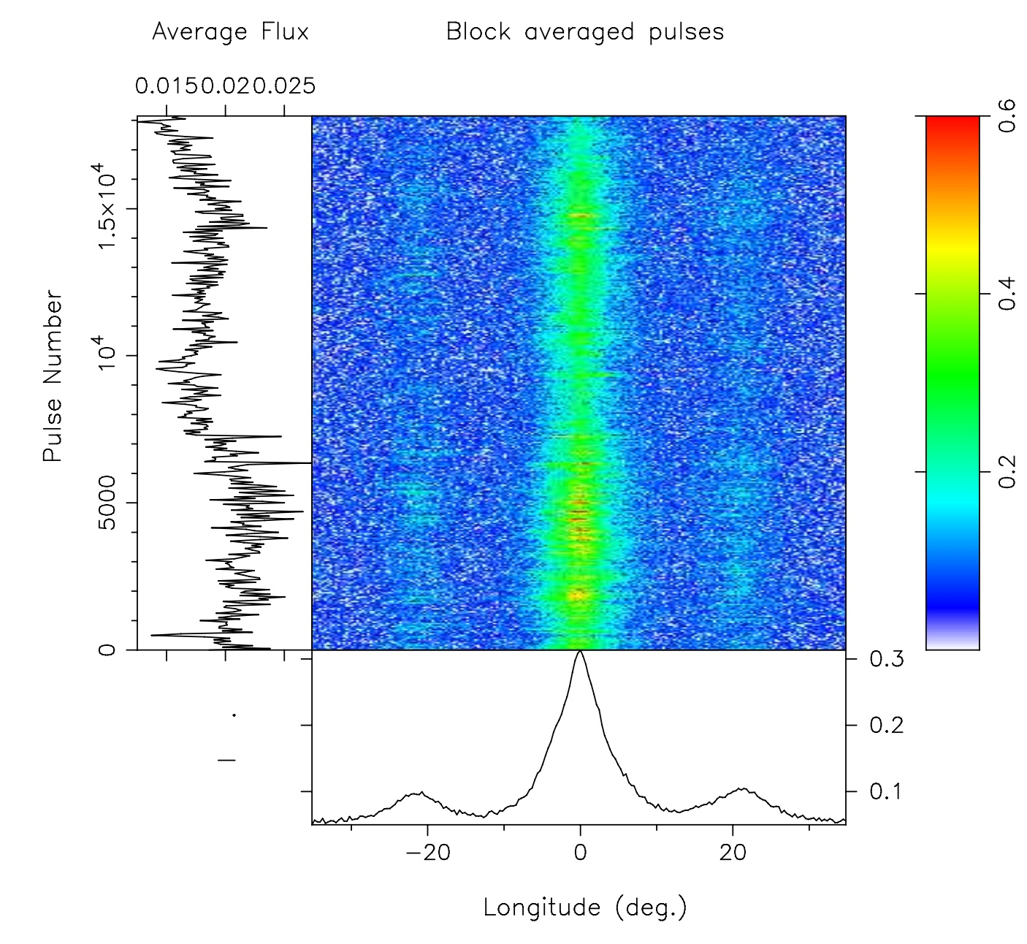

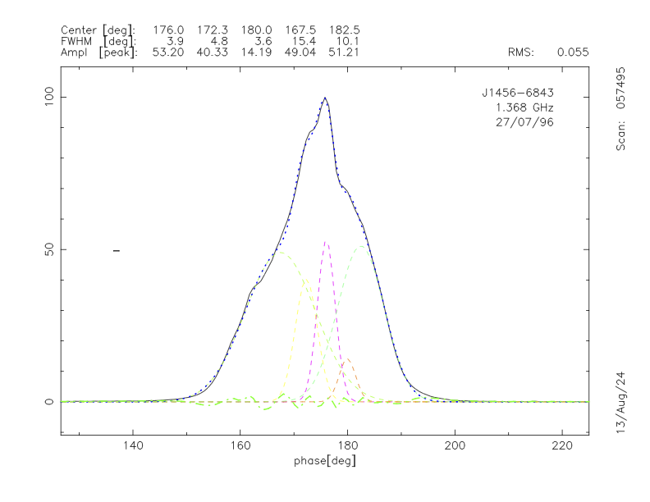
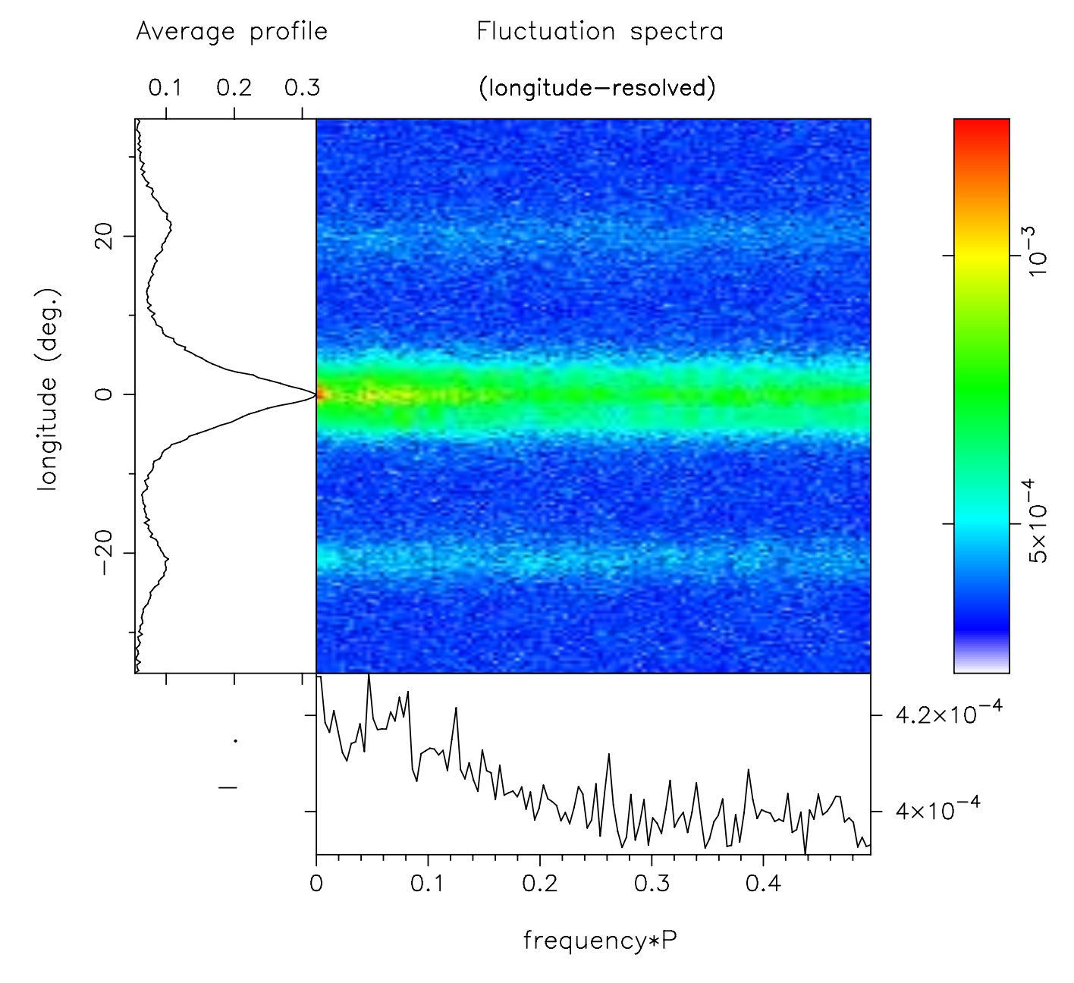
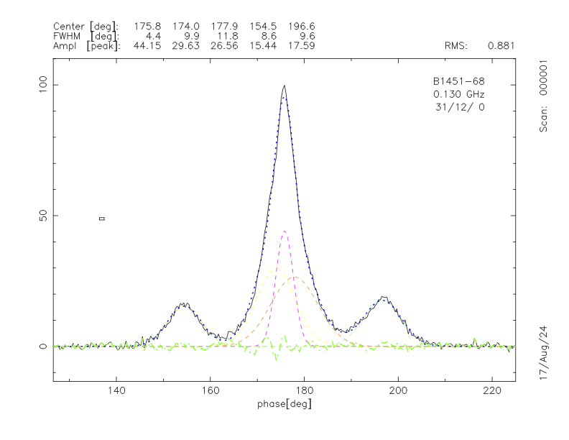
Low-frequency emission from B1451-68
Pulse stack from SMART obs (18,223 single pulses)
Joanna Rankin
Univ of Vemont
Parkes data at 1.4 GHz
LRFS (Longitude Resolved Fluctuation Spectrum)
Rankin, et al. (in prep.)
MWA data at 150 MHz
G0104 project to extend the freq. coverage, do full profile modelling, and estimate the emission heights (retardation/aberration effects)
Notes:
Joanna Rankin, another pulsar expert, who has been in the field since the day 1 of pulsar astronomy, thinks this particular is super interesting,….
Pulsar does nothing (and absolutely nothing unusual ) if you look at single pulse perspective e.g…. See the pulse stack and LRFS on right 2 panels (we can’t get someone like Sammy excited with this…. ) no drifting no nulling…. (and Bradley looked for arcs there is nothing…)
But look at the profiles – top one some ancient data from Parkes (90s) and bottom panel MWA data (from SMART) G0104 to complement SMART and archival obs to cover ~70 MHz to 300 MHz. A paper is in prep….

Slide 23
Science Updates & Highlights: Fast Transients

Slide 24
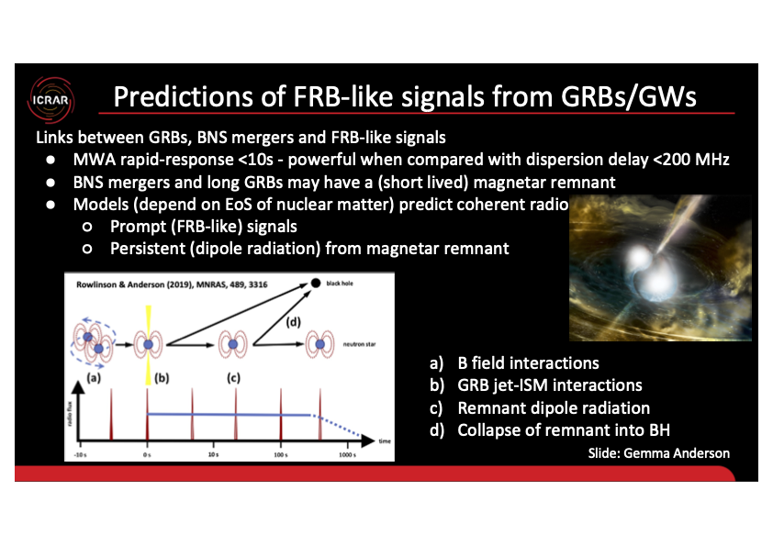
VCS Triggering for GRBs
Notes:
Figure illustrates 4 models predicting coherent radio emission (both prompt and persistent) from a BNS merger (detected as a short GRB and/or gravitational wave event). B, c and d may also apply for a long GRB (massive stellar collapse)
Models
a) The reignition of the pulsar emission mechanism when the two neutron stars get within a few seconds of merger (only applies to short GRBs/BNS mergers)
b) When the GRB jet first impacts the surrounding medium there could be a pulsed, coherent radio signals (applies to both long GRBs and short GRBs/BNS mergers)
c) Rather than forming a black hole, the event forms a supramassive, rapidly rotating, highly magnitised neutron star often referred to as a magnetar (unlike magnetars in pulsar astronomy). We would expect it to emit dipole radiation. If its pole is directly pointed at us, which may be the case given we detected the bright gamma-ray jet, we could detect it as pulsed or persistent emission (applies to both long GRBs and short GRBs/BNS mergers)
d) If the magnetar is unstable then when it has spun down enough it will collapse into a black hole, which may emit an FRB-like pulsed signal due to magnetic reconnection (applies to both long GRBs and short GRBs/BNS mergers)
All of these models are highly dependent on the equation of state of nuclear matter so triggered observations are directly probing this.

Slide 25
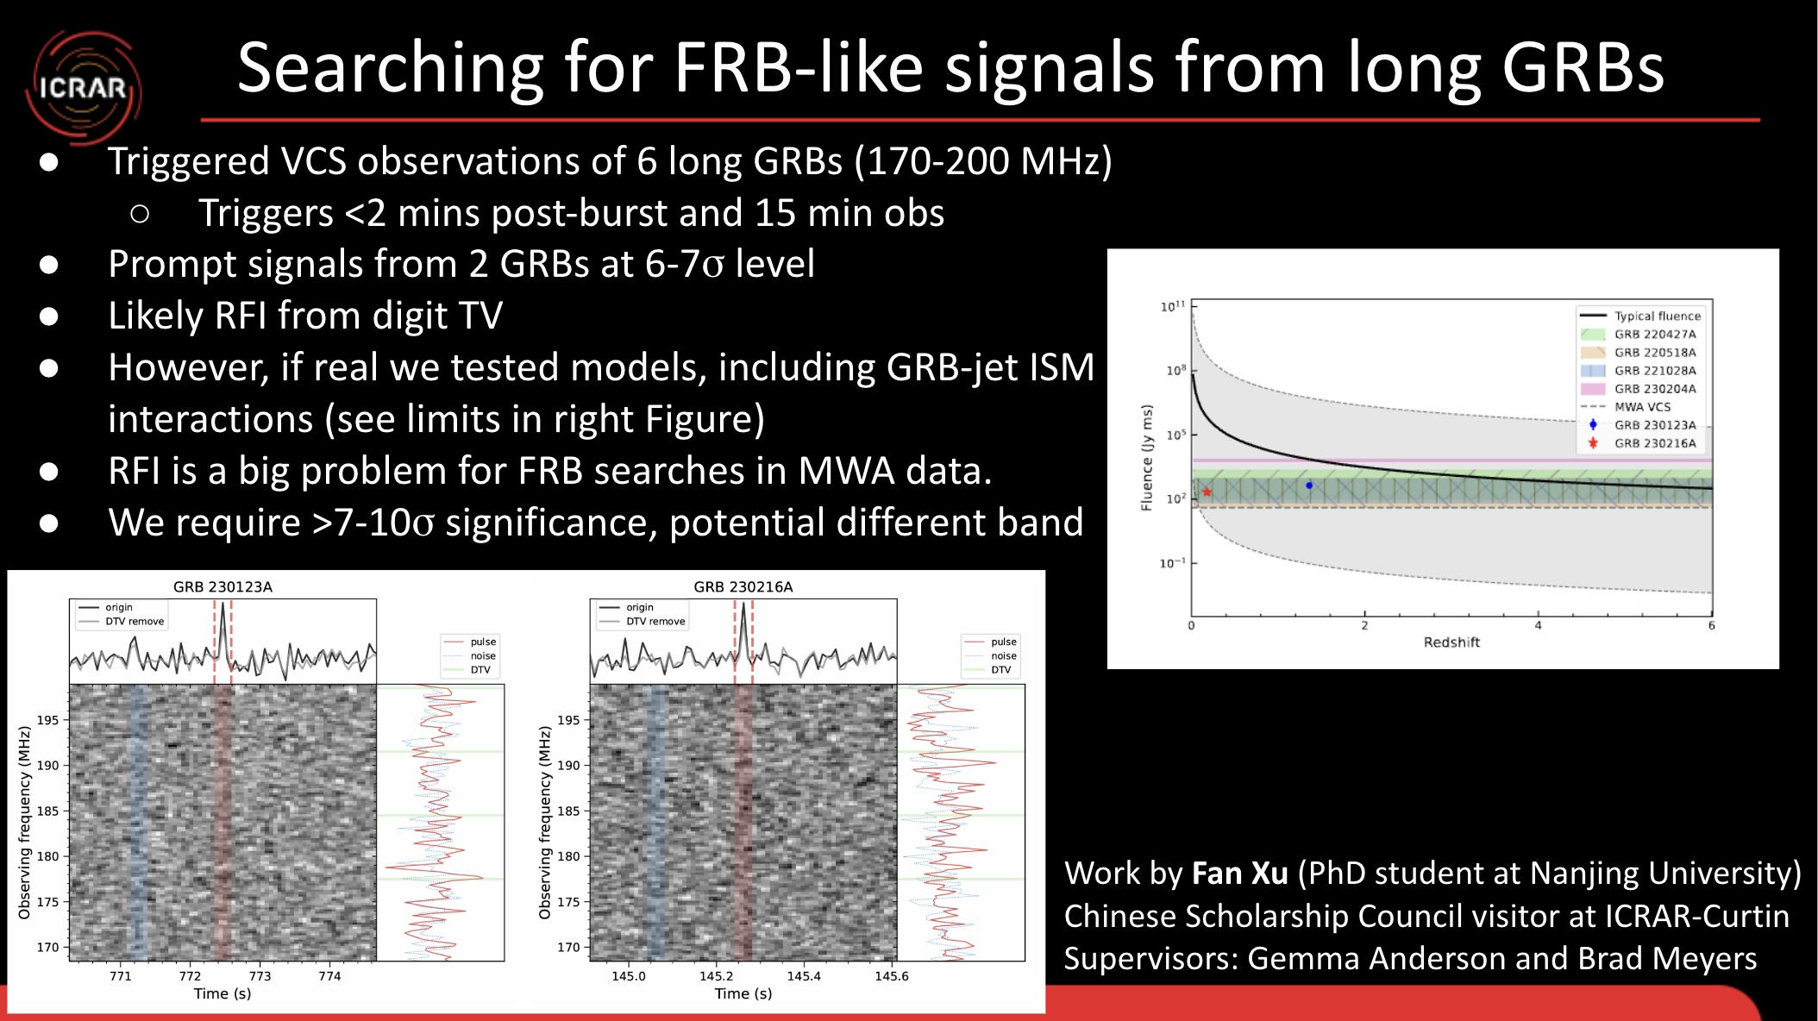
VCS Triggering for GRBs
Notes:
We use the VCS to trigger to be sensitive to the expected short timescale signals we are search for
The bottom (left) figure shows the prompt signal candidates. The centre of the DTV RFI bands are shown as green horizontal lines. However, note that these bands are quite broad and actually cover most of the 170-200 MHz observing band (Note we didn’t actually do any DTV signal removal as may be suggested by the figure).
The Right figure shows model b) which is looking for an FRB-like signal from the GRB jet-ISM interaction. The black line shows the expected fluence as a function of redshift for an “average” magnetar (B field and period P) formed from a GRB as directed from the plateau phase of many GRB X-ray light curves. The shaded region shows the range in that distribution.
Shaded colours show the fluence limits we have placed from our VCS triggered observations. We also show the fluence measured from our two pulsed candidates. Their redshift was assume based on their DM.
Latencies are much lower now since optimising the triggering system.

Slide 26
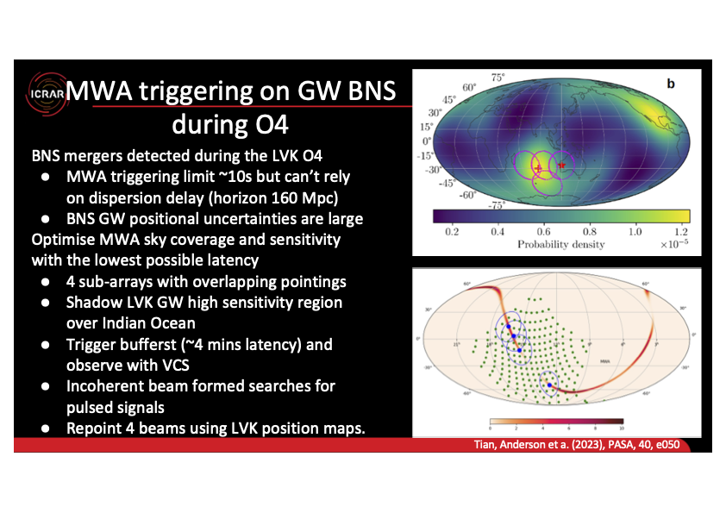
VCS Triggering for GW BNS
Notes:
LVK: LIGO-Virgo-Kagra, O4 observing run
Top plot shows sensitivity of the LVK array projected on Earth. There are two high sensitivity regions over USA and Indian Ocean. MWA is marked by red star, highest sensitivity position over indian Ocean is red cross. The magenta circles show the best coverage of this region using 4 sub-arrays. We will shadow this part of the sky and dump voltages if a trigger comes in. this removes latency problems. We continue to observe up to 1.5 hrs. If position maps are sent via alerts then the 4 beams will be repointed as illustrated in the bottom figure.
Bottom figure: simulated GW detection showing LIGO position probability of event (orange/red). Our software chooses the best MWA sweet spot pointings (Green dots) and overlaps the beams (blue circles) to best cover that position in the MWA sky.

Slide 27


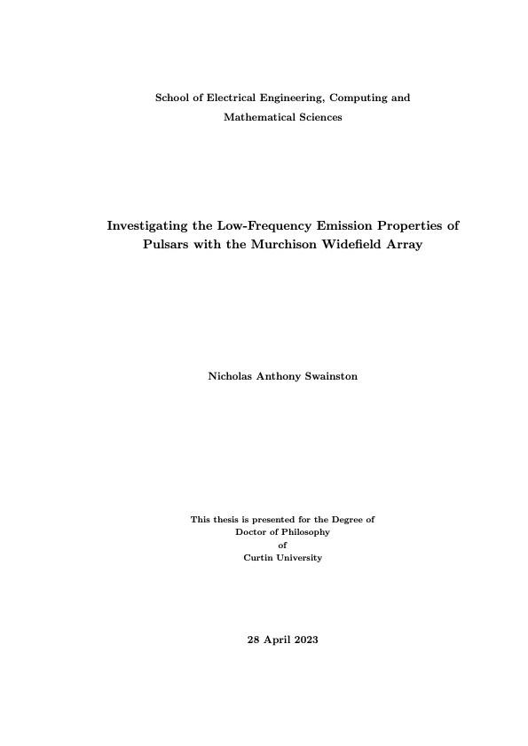

PhD completions
Parul Janagal
Nick Swainston
Congratulations on Graduation!
Congratulations on Graduation!
27
Notes:
8/29/24
27
27

Slide 28

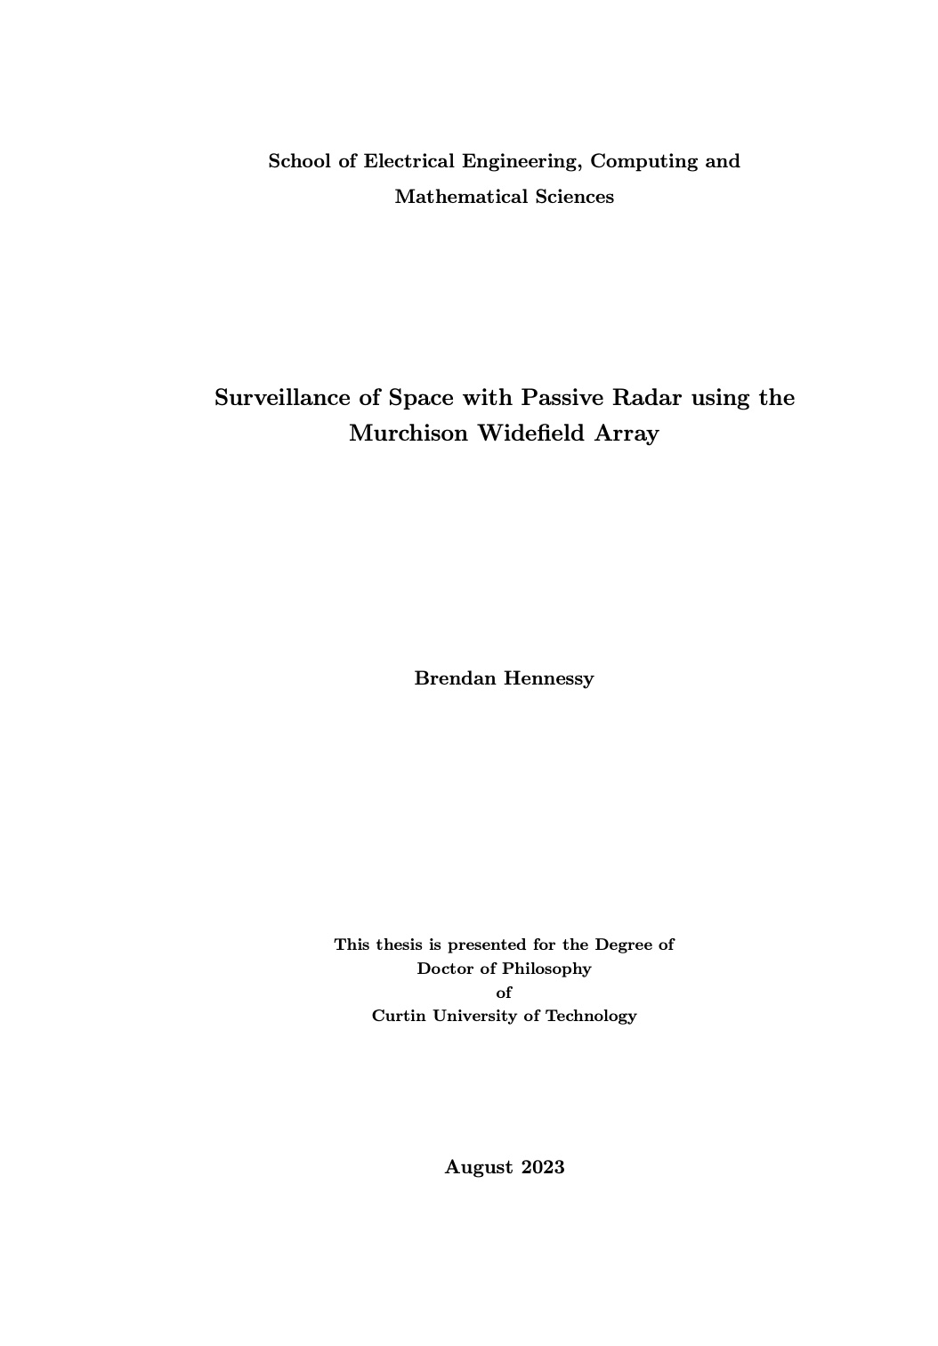
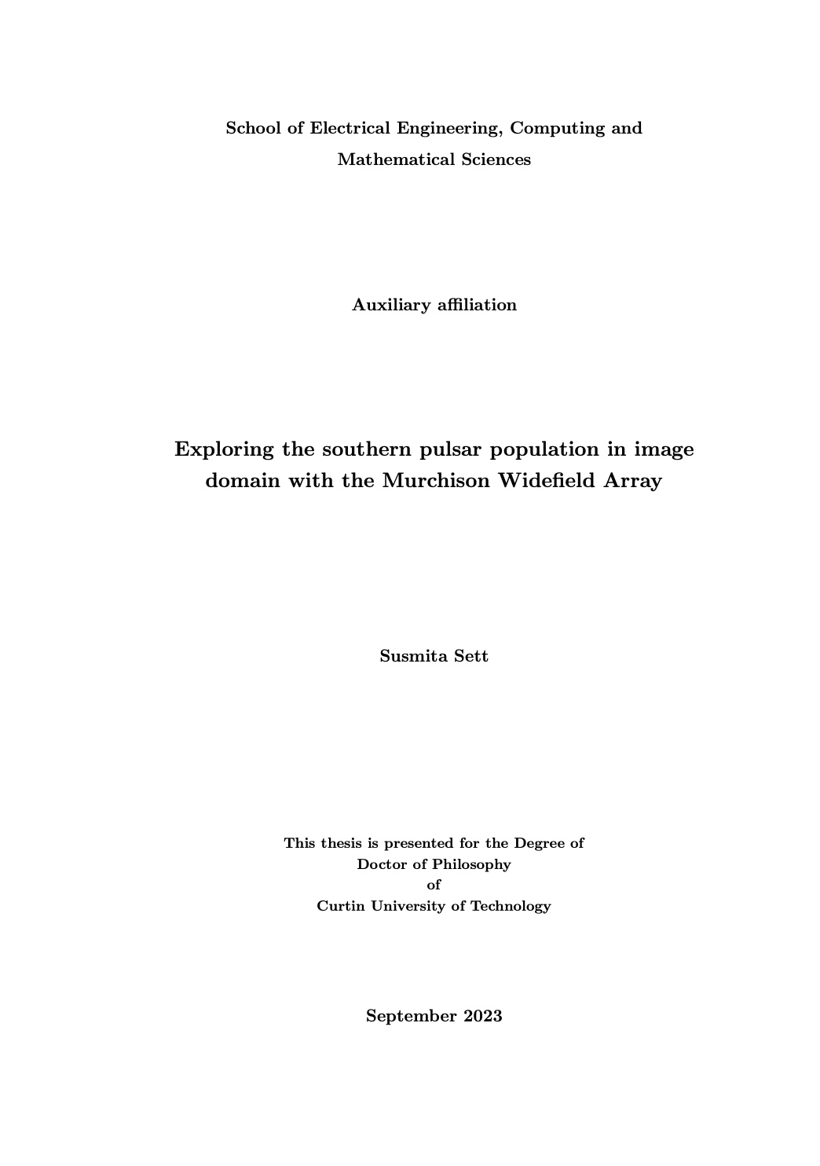
PhD completions
Susmita Sett
Brendan Hennessy
Congratulations on Approval to graduate!
Congratulations on Approval to graduate!
Congratulations on Submission!
Congratulations on Submission!
28
Notes:
8/29/24
28
28

Slide 29
Looking Ahead – MWAX Beamformer
  A decade of productive science; but VCS recording + processing is posing a major limitation in scientific opportunities (64 TB/hour with MWAX VCS!)
  Real-time processing + beamforming capability will open up a multitude of science opportunities
  MWA as a low-frequency monitoring telescope:
    Monitoring pulsar timing array (PTA) targets, contribute to PTA science goals (e.g., DM variations, ISM characterisation, etc.)
    Rich ISM science (e.g., scintillation arcs, flux variability, etc.)
    Targeted searches (Globular clusters, Fermi-LAT targets, etc)
    FRB monitoring (e.g., repeaters)
    Low-frequency VLBI (e.g. LAMBDA) in prep for SKA-Low VLBI
    Rapid follow-up of transients (GRBs, GW events) and fast turnaround
  Regular timing of SMART discoveries
    More demanding constraints emerging as we transition to the second phase of SMART processing (e.g., J0125 may require daily observations for initial phase connection, which is tedious/efficient with the VCS mode)
29
Notes:
8/29/24
29
29

Slide 30
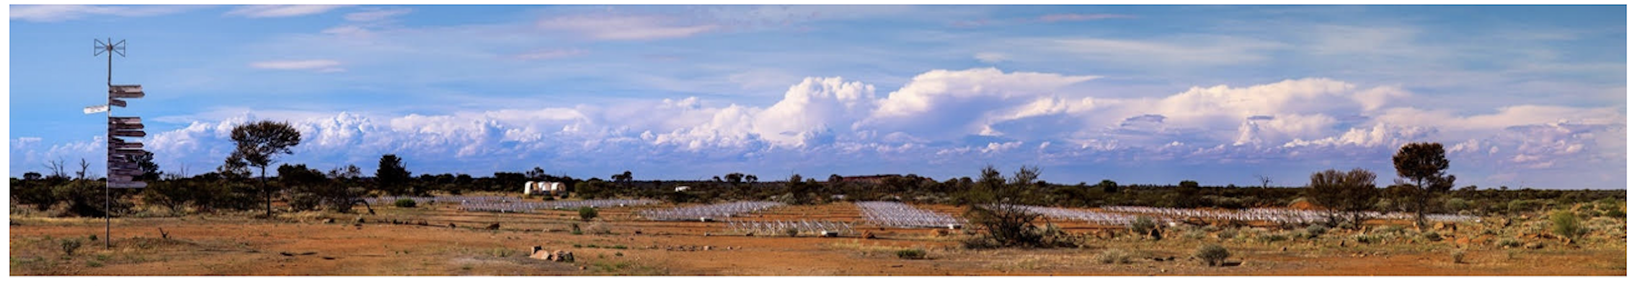
Summary
  The MWA presents a fantastic opportunity for an amazing range of Pulsars and Fast Transient science
  Opportunities for skill developments (HPC, software), and student and ECR training
  A productive decade of scientific and technical accomplishments: 40+ VCS publications, 10 PhD completions
  Low frequency detections of 230+ pulsars, 5 discoveries from the first pass of SMART processing (and a new pulsar candidate!)
  Exploring HPC optimisation for the SMART search pipeline (in collaboration with the EPFL group)
  Bright and promising future ahead, and beamformer functionality for MWAX will open the door to a range of new science: an untapped potential of MWA

