Slide 1
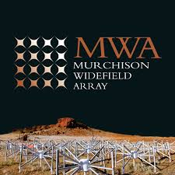
Overview of the SHI Activities from MWA
MWA Project Meeting 2024
EPFL École Polytechnique Fédérale de Lausanne (EPFL) , Lausanne, Switzerland
29th August 2024

Slide 2
Young Group Members
Sohan Dey
Puja Majee
Angelica
Deepan
Devojyoti Kansabanik
Surajit Mondal
MWA Project Meeting 2024, EPFL, Lausanne

Slide 3
Recent Areas of Work
Optimal Trigger-based Scheduling of Solar Observations (Deepan, Devojyoti, Divya)
Solar Radio Imaging with Polarimetry (Devojyoti, Soham, Divya)
Improving the imaging
Linear Polarization detection
Type II studies (Puja)
GraDS
Comparison of type II observations with MHD simulations
Coronal Mass Ejections (Devojyoti/ Rohit)
Evidence for inhomogeneity in CME plasma (Devojyoti)
Heliospheric science with MWA
IPS (Angjie & John)
Heliopolarimetry (Devojyoti)
WINQSEs (Surajit / Rohit)
MWA Project Meeting 2024, EPFL, Lausanne

Slide 4
Unpredictable Solar Events
I. Optimal Trigger-based Scheduling of Solar Observations (Deepan, Devojyoti, Divya)
Multiple types of solar events
Big Sunspots not always means Big radio bursts
Active solar emissions are of primary interest from a space-weather perspective, but are unpredictable
MWA Project Meeting 2024, EPFL, Lausanne

Slide 5
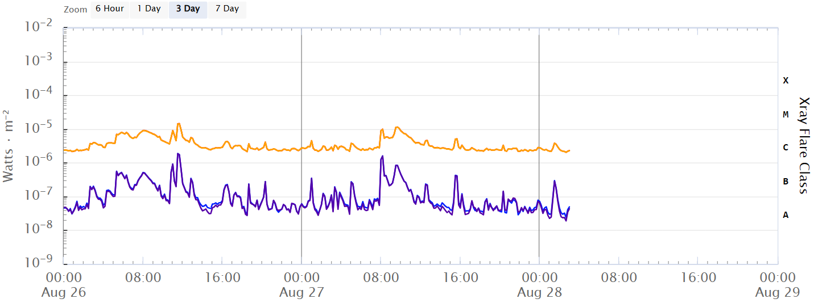
GOES X-ray real time data
I. Optimal Trigger-based Scheduling of Solar Observations (Deepan, Devojyoti, Divya)
Although the hard X-ray and radio emissions are related, it is hard to a-priori determine the spectral bands of radio emission
Previous attempts to observe based on near real-time GOES X-ray flares were not too successful
The 3,500+ hours MWA solar observations missed the vast majority of active emissions which took place
MWA Project Meeting 2024, EPFL, Lausanne

Slide 6
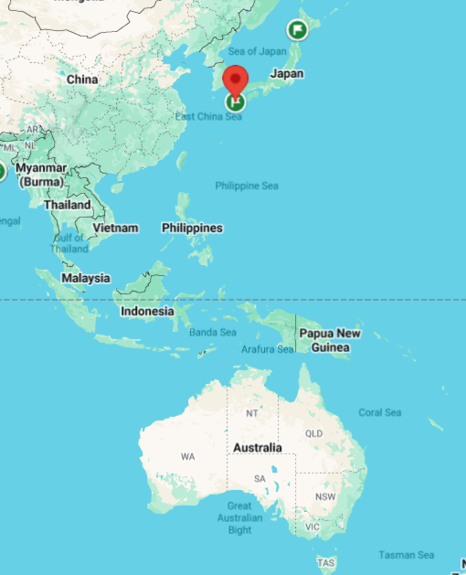
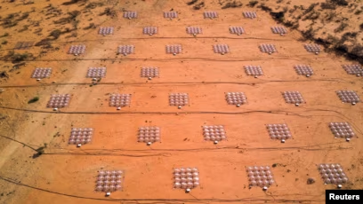
Triggered Solar Observations
I. Optimal Trigger-based Scheduling of Solar Observations (Deepan, Devojyoti, Divya)
Deepan Patra (NCRA-TIFR), Devojyoti Kansabanik (CPAESS-UCAR, USA), Yuki Kubo (NICT, Japan), Divya Oberoi (NCRA-TIFR)
Triggered MWA solar observations using YAMAGAWA solar radio spectrograph located at similar longitude as the MWA
YAMAGAWA
MWA
MWA Project Meeting 2024, EPFL, Lausanne

Slide 7
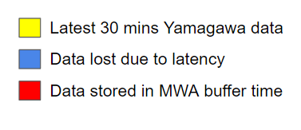
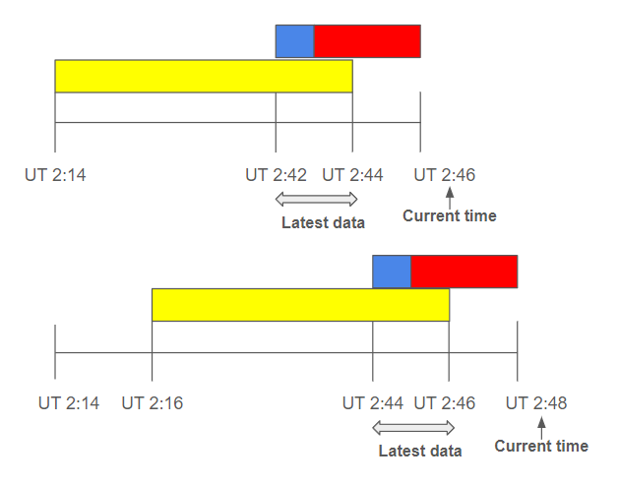
Near Real-time Triggering using YAMAGAWA
I. Optimal Trigger-based Scheduling of Solar Observations (Deepan, Devojyoti, Divya)
YAMAGAWA observes in the frequency range 70-9000 MHz, covering the entire MWA band.
In collaboration with NICT, Japan a real-time YAMAGAWA raw data link has been established.
This provides new 2-minutes of YAMAGAWA dynamic spectrum with a 2-minute latency.
A Schematic Diagram of Near Real-time Triggering Framework
The MWA is pointed towards the Sun during the daytime in NO_CAPTURE mode and picket-fence spectral settings.
Trigger is generated based on the most recent 2-minute data marked as “latest data”.
Once a trigger is received, the last 3-minute buffer data (red block) is dumped and another 2-minute of MWAX observation are initiated.
Loss of data due to latency is only 1-minute (blue block)
MWA Project Meeting 2024, EPFL, Lausanne

Slide 8
An Example of Triggered Observation
I. Optimal Trigger-based Scheduling of Solar Observations (Deepan, Devojyoti, Divya)
End time: 2024-08-23 03:45 UTC
Raw YAMAGAWA dynamic spectrum (DS) received in near real-time.
Instrumental bandpass and RFI are removed
Binary DS showing the flux with the value more than 15σ.
Island detection and clustering algorithms have been used to detect only solar signals.
If events are detected in the last 2-minute (red shaded regions in Figs 3 and 4), then triggered.
1
4
Type-II solar radio burst detected
2
3
MWA Project Meeting 2024, EPFL, Lausanne

Slide 9
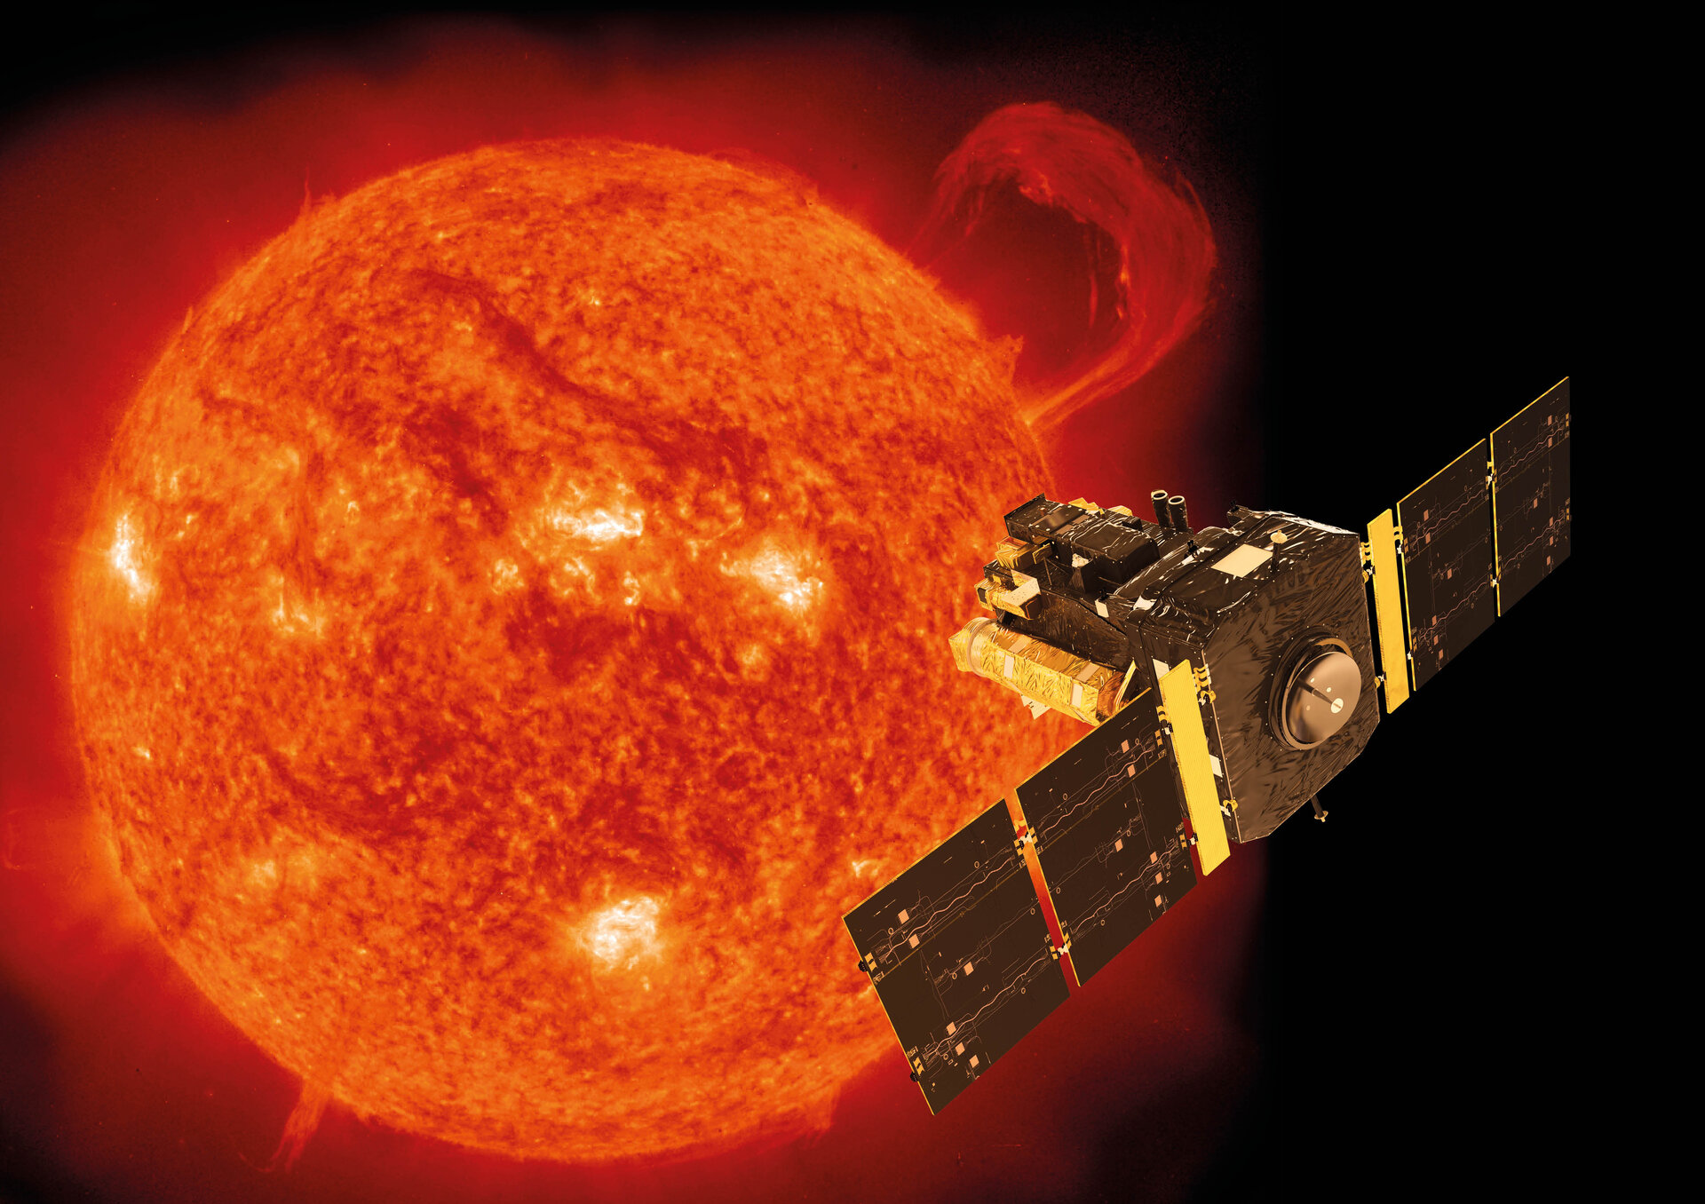
MWA Helioschedule
I. Optimal Trigger-based Scheduling of Solar Observations
Devojyoti Kansabanik (CPAESS-UCAR, USA), John Morgan (CSIRO, Australia)
MWA, due to its wide field of view, is an excellent instrument for observing coronal mass ejections (CMEs) in the interplanetary space.
IPS observations and Faraday rotation measurements of background radio sources can provide an excellent remote sensing tool for CME plasma diagnostic.
Occurrence of CME and its propagation are not possible to know a-priori.
CMEs take few hours to reach in the heliosphere (>20 R⊙ , ~5.3 degree), hence rapid triggering like solar observations are not needed.
However, an automated triggering system is required to automatically schedule heliospheric observations with the right telescope pointing to observe these CMEs.
SEEDS/CaCTUS
Near real-time CME catalog provides CME propagation information
Helioschedule
Determine telescope pointing and observation timing
Helioschedule
Determine telescope pointing and observation timing
MWA Project Meeting 2024, EPFL, Lausanne

Slide 10
Linear Polarisation Detection
II. Solar Radio Imaging with Polarimetry
(Devojyoti, Soham, Divya)
Early detections
Akabane and Cohen (1961): 200 MHz; bandwidths 10 and 20 kHz; weak linear pol (< 20%) in 10 kHz BW
Bhonsle and McNarry (1964) 74 MHz; 10 kHz; high linear pol
Daene and Voigt (1964) 23.5 MHz; 1.5 kHz; high linear pol
Chin et al. (1971) 25.3 MHz; 100 Hz; ~100% linear pol
Dodge (1974) 34 MHz; 50 Hz; high linear pol but no Faraday rotn (RM upper limit ~10³ rather than the expected ~10⁶)
Conventional wisdom
Any linear pol present should get washed out due to the extremely Faraday rotation due to the magnetized coronal plasma
Current status
Many non detections + comparatively primitive equipment + conventional wisdom ⇒ Deep rooted belief that early detections must be instrumental artifacts Grognard & McLean (1973); Boischot & Lecacheux (1975)
Linear pol must be zero is routinely used for instrumental calibration (e.g. McCauley et al. 2019, Liu et al. 2022, Morosan et al. 2023)
MWA Project Meeting 2024, EPFL, Lausanne

Slide 11
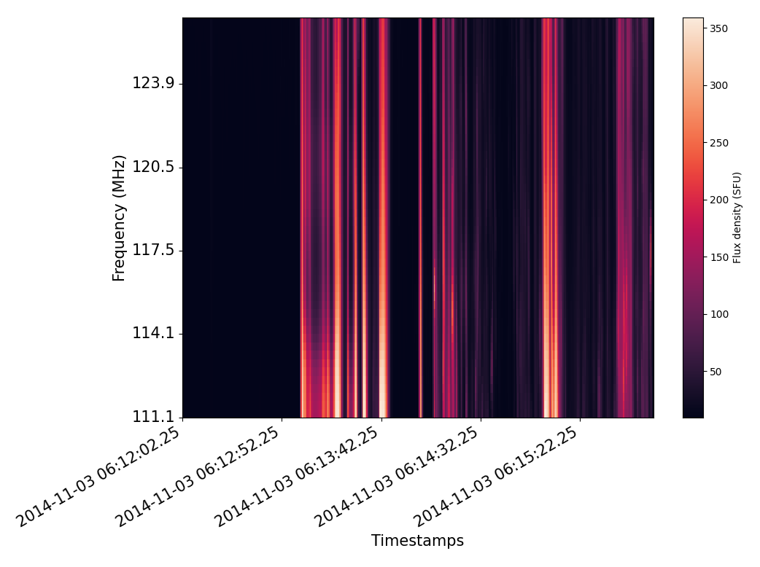
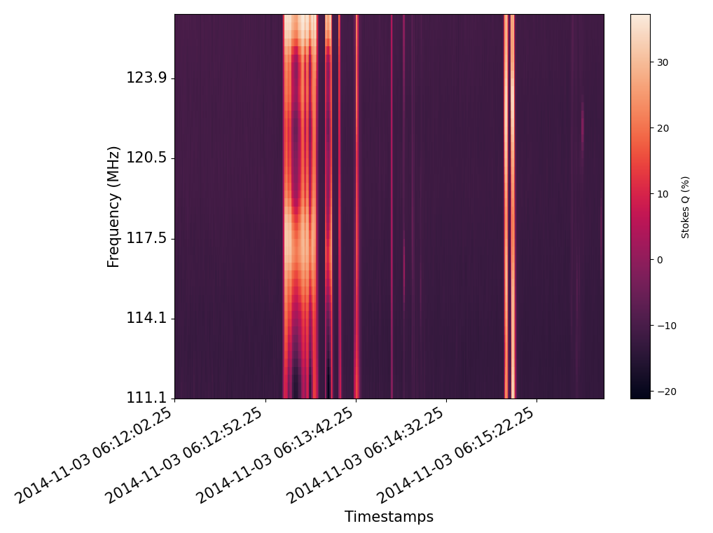
Motivation for revisiting a decades old issue
II. Solar Radio Imaging with Polarimetry
(Devojyoti, Soham, Divya)
Uncalibrated fractional Stokes Q from a type III solar burst shows features which cannot arise from instrumental leakage, which is expected to change slowly and smoothly across time and frequency
Stokes I
Stokes Q (%)
350
30
50
-20
06:12:02 2014/11/03
06:12:52
06:13:42
06:14:32
06:15:22
06:12:52
06:13:42
06:14:32
06:15:22
Time (UTC)
Time (UTC)
MWA Project Meeting 2024, EPFL, Lausanne

Slide 12
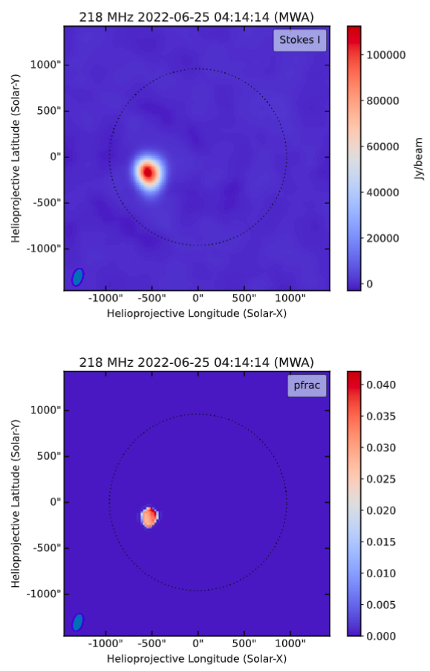
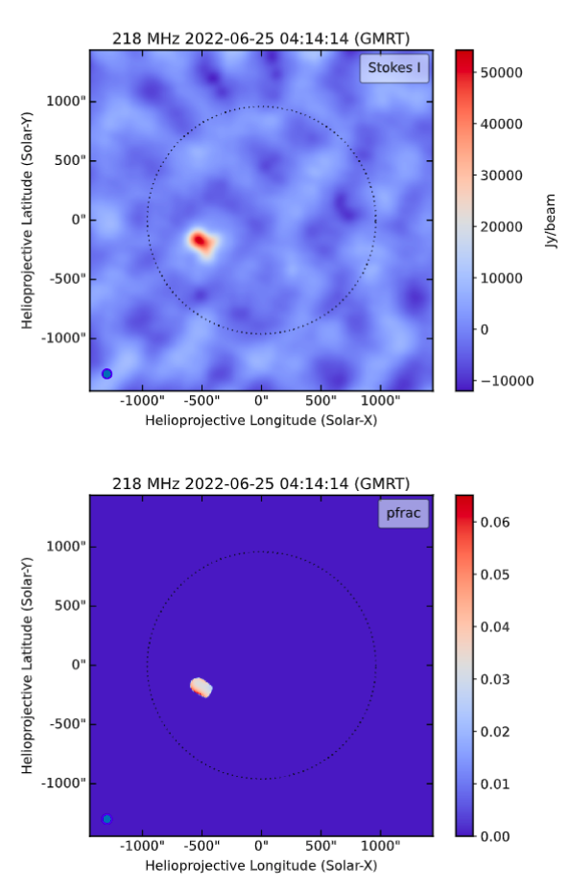
Robust imaging detection of linearly polarized solar emission
First
II. Solar Radio Imaging with Polarimetry
(Devojyoti, Soham, Divya)
Simultaneous observations at overlapping frequencies with 2 independent instruments show consistent detection of linear pol
Routinely find low levels of linear pol in active solar radio emissions (types I, II and III)
Interesting and previously unappreciated physics
Overcomes intrinsic calibration bias - setting Stokes Q and U to 0 by hand leads to wrong Stokes V
MWA
GMRT
Dey et al., in prep
MWA Project Meeting 2024, EPFL, Lausanne

Slide 13
Type-II Studies
III. Type II studies (Puja)
Plasma emissions driven by MHD shock, associated with CMEs
Can probe CME dynamics at different coronal heights; interesting from a space weather perspective
Polarimetric properties; probe the CME-entrained magnetic fields
H
F
MWA Project Meeting 2024, EPFL, Lausanne

Slide 14
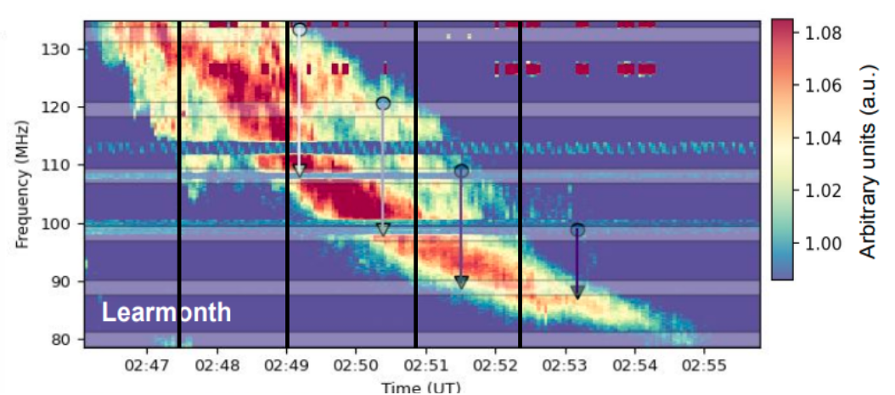
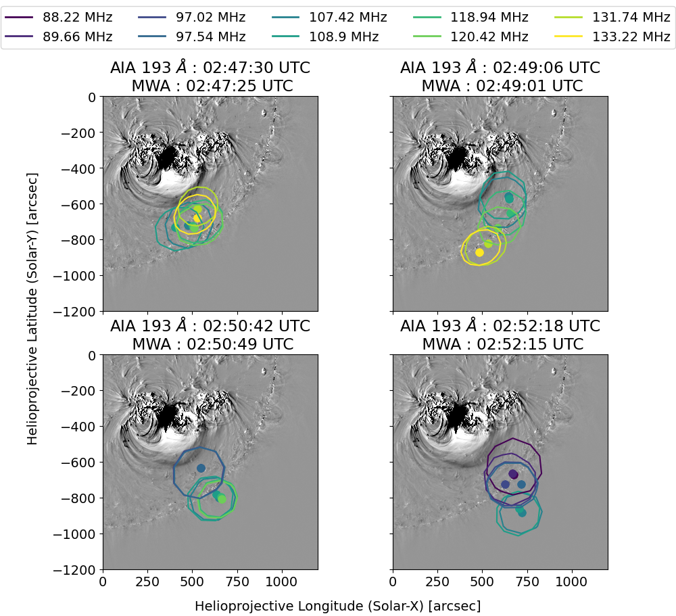
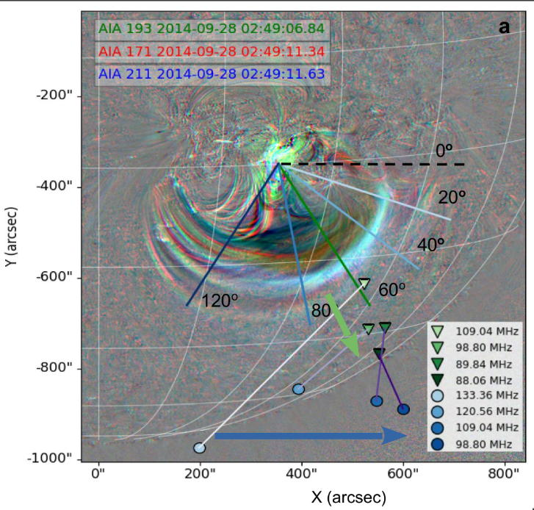
Earlier Study
III. Type II studies (Puja)
Recent Study
(Bhunia et al. 2022, A&A)
(Majee et al. in prep)
MWA Project Meeting 2024, EPFL, Lausanne

Slide 15
III. Type II studies (Puja)
Outputs from the Very First Run with AWSoM* model
(Coll: Nishtha Sachdeva¹)
* Alfvén Wave Solar Model (van der Holst et al., 2014)
¹Department of Climate and Space Sciences and Engineering, University of Michigan
CME-Shock
Supercritical & Quasi-perpendicular Shock
MWA Project Meeting 2024, EPFL, Lausanne

Slide 16
III. Type II studies (Puja)
Initial Results
CME-Shock, X>1
Supercritical, M_{alfven}> 2.1
Quasi-perpendicular, θ > 45º
MWA Project Meeting 2024, EPFL, Lausanne

Slide 17
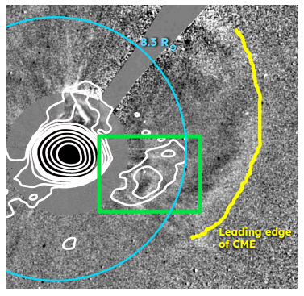
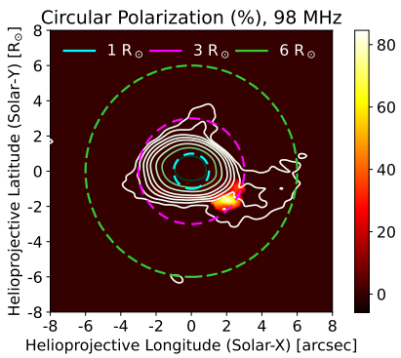
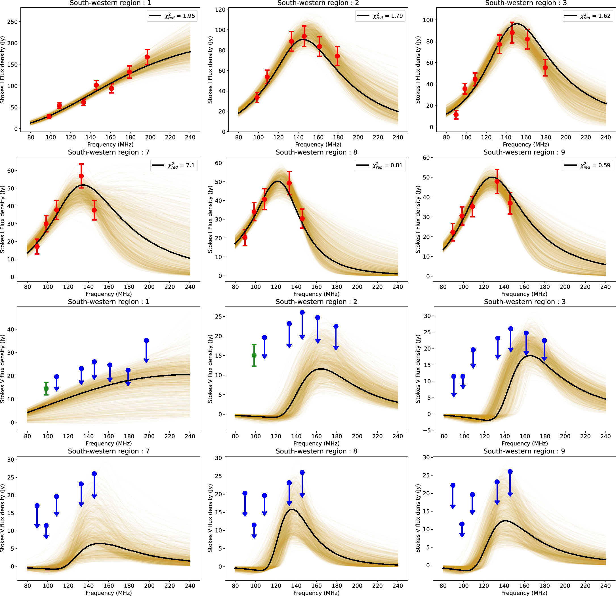
IV. Coronal Mass Ejection - Inhomogeneity
IV. Coronal Mass Ejections
(Devojyoti)
Common fits between Stokes I, V & upper limits on V are not always self-consistent assuming homogenous source model
MWA Project Meeting 2024, EPFL, Lausanne
Devojyoti Kansabanik et al 2024 ApJ 968 55

Slide 18
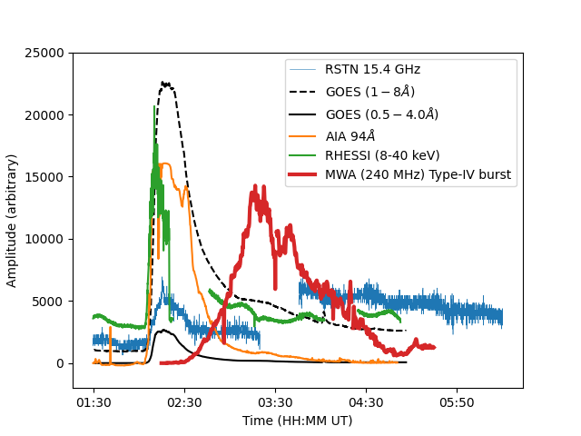
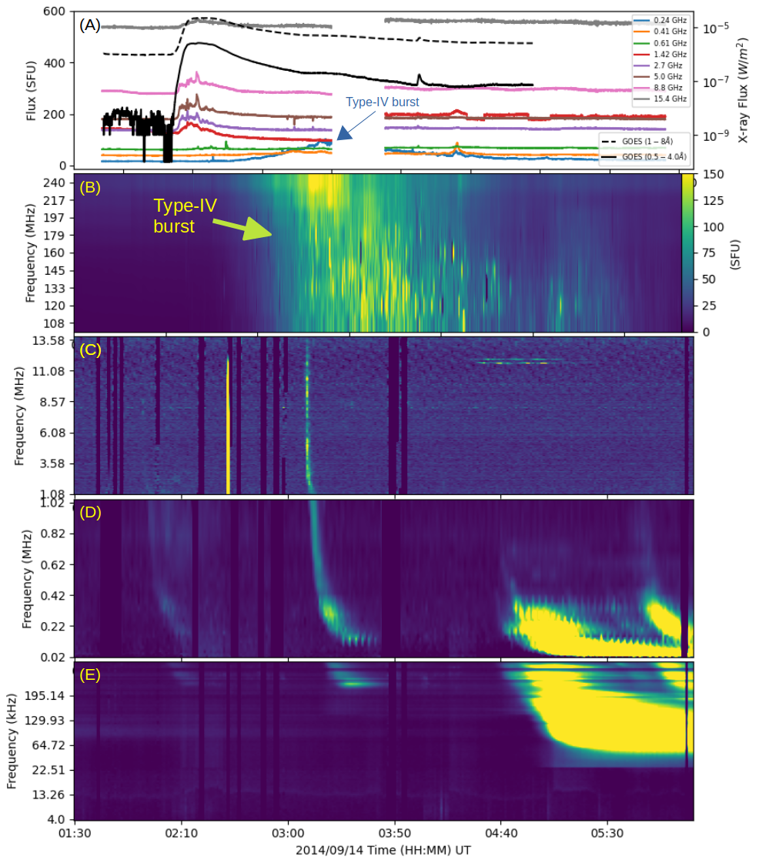
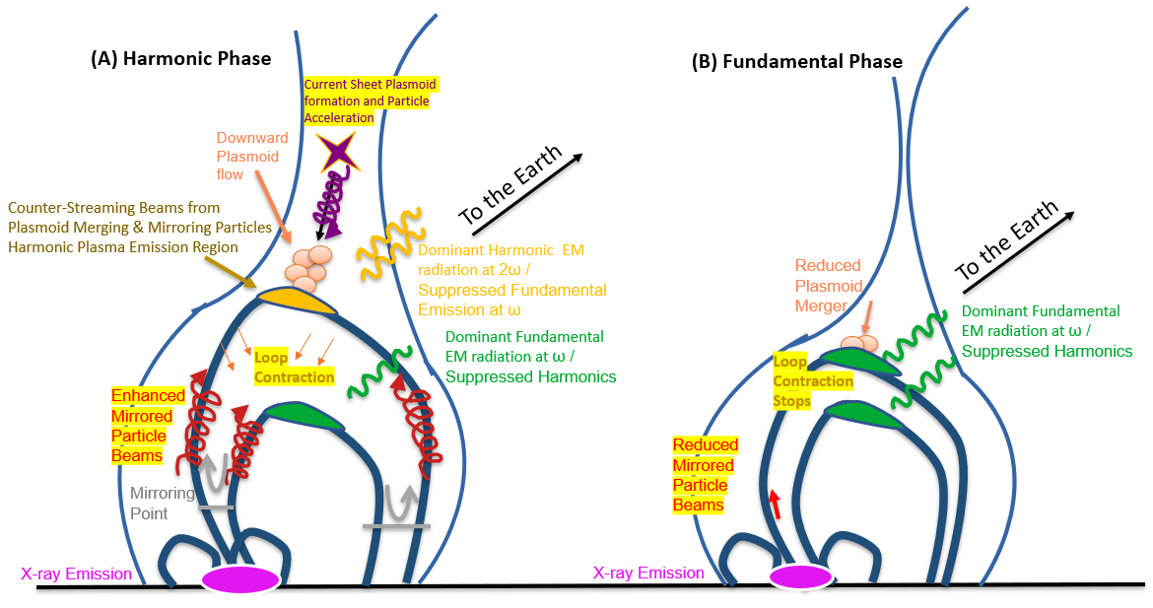
IV. Coronal Mass Ejections
(Rohit)
IV. Coronal Mass Ejection – Type-IV burst
Type-IV exhibit pseudo drift
Fundamental and Harmonic Emission at different stages of the CME
Evidence for the harmonic Emission due to the magnetic island merger
MWA Project Meeting 2024, EPFL, Lausanne
Sharma, R., et al. ( in prep)

Slide 19
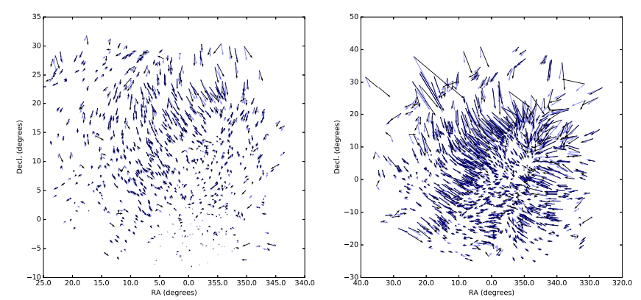
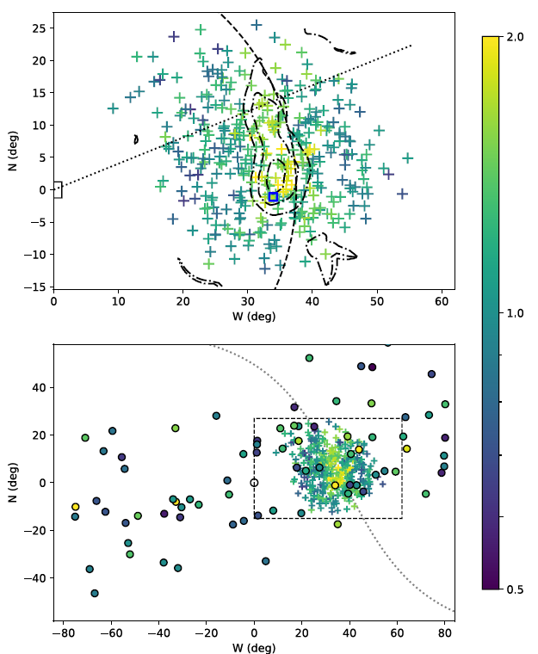
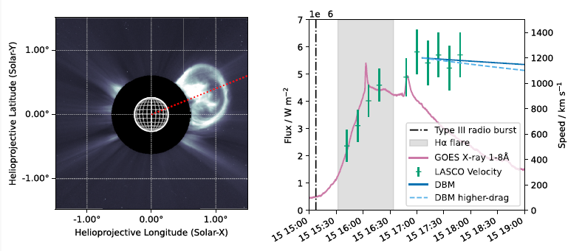
V. Characterization of CME using IPS
IV. IPS (John, Angjie)
Morgan, J., et al 2018
Localisation and imaging of a CME ∼33 hr after
launch at an elongation of ∼37° from the Sun.
Comparison of MWA & Institute for Space-Earth Environmental Research (ISEE) capture of the CME
Morgan, J., McCauley, P. I., Waszewski, A., Ekers, R., & Chhetri, R. (2023).
Detection and characterization of a Coronal Mass Ejection using Interplanetary Scintillation measurements from the Murchison Widefield Array. Space Weather, 21, e2022SW003396.
https://doi.org/10.1029/2022SW003396
MWA Project Meeting 2024, EPFL, Lausanne

Slide 20
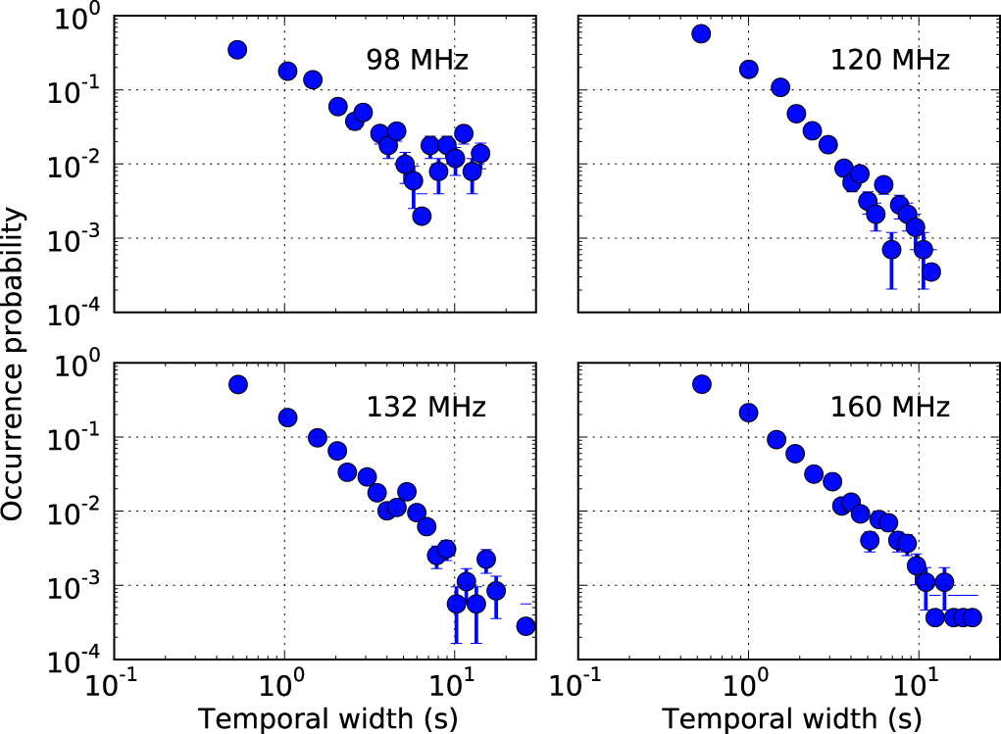
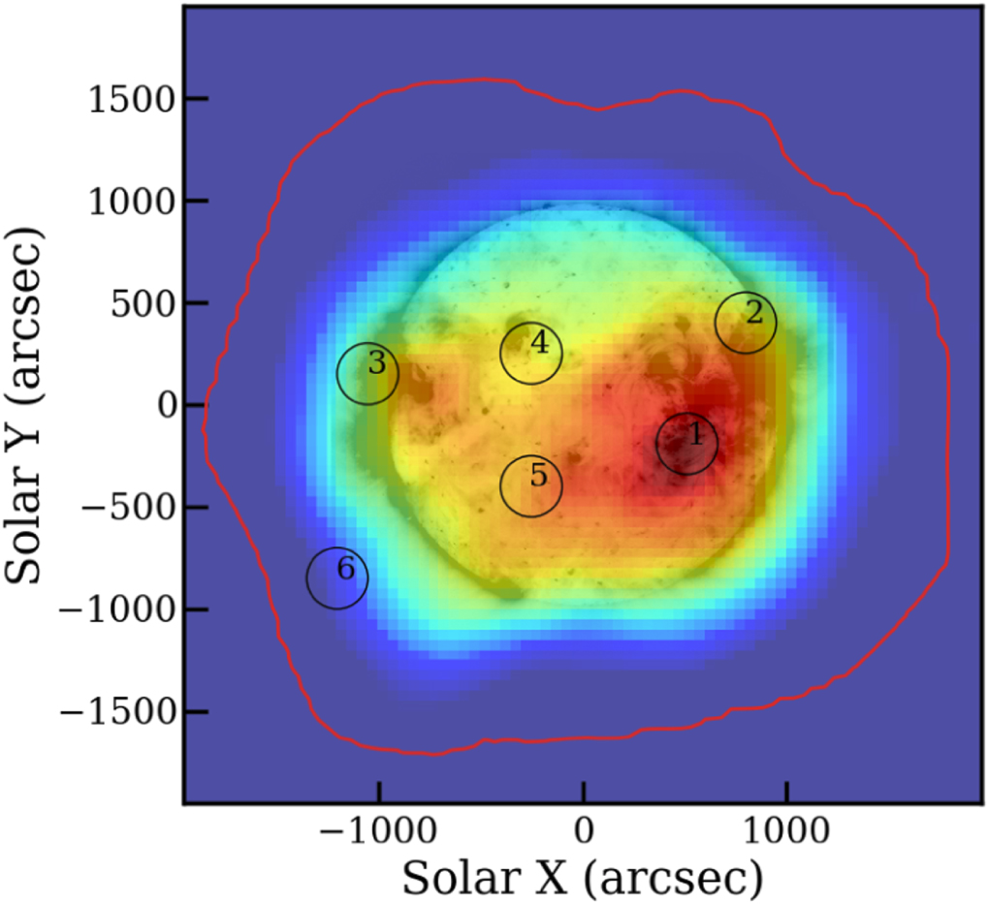
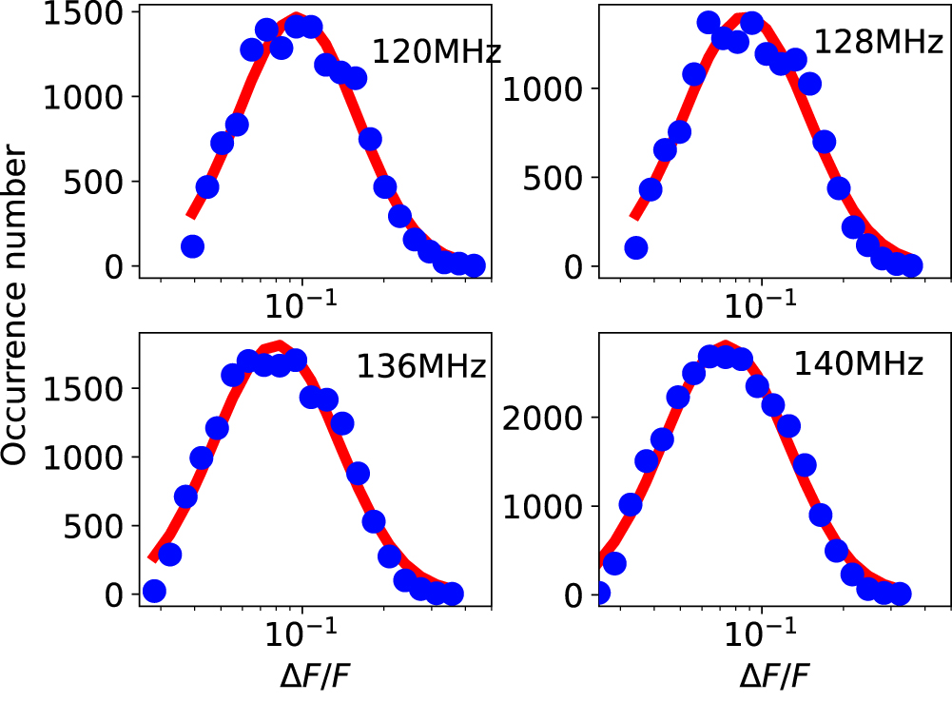
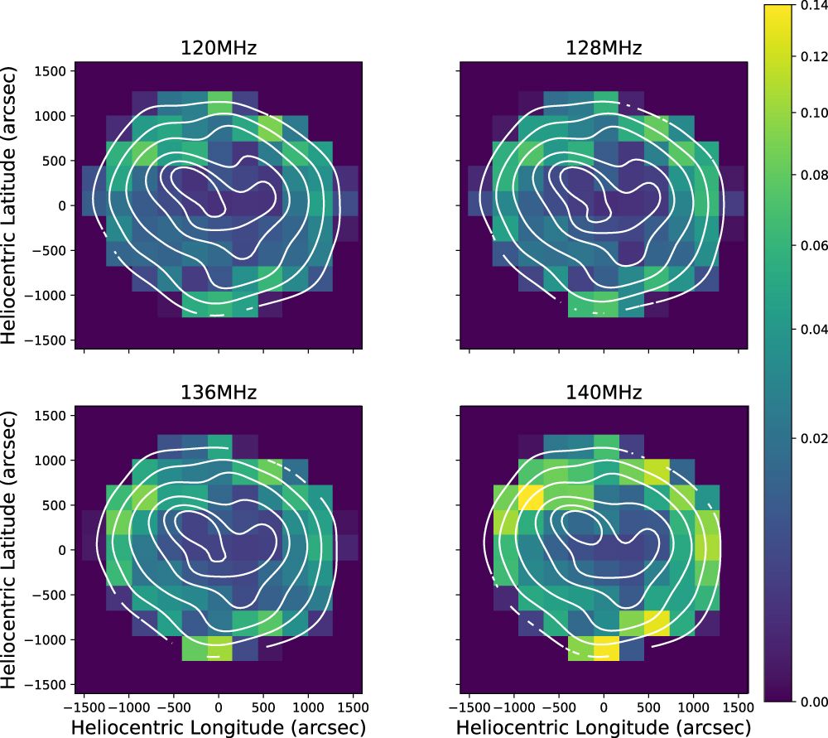
VI. Weak Impulsive Narrowband Quiet Sun Emissions
IV. WINQSE (Surajit, Rohit)
Sharma, R. et al. 2022
First detected by Mondal et al. 2020, and subsequently confirmed in a series of papers by Sharma et al. 2022, and Mondal et al. 2023a,b
Hypothesised to be arising due to coherent emissions from very weak electron beams. First direct imaging evidence shown in Sharma et al. 2022 using visibility subtraction technique
Mondal et al. 2023 a
Most of the detected WINQSEs are about 10 times weaker than quiet Sun.
Flux densities: Close to 2-3 orders of magnitude weaker than past works
Occurrence: Ubiquitous throughout the Sun
Fraction of time WINQSEs were detected at each location.
Future: Deploy on larger datasets / multi-wavelength studies
Mondal et al. 2020
MWA Project Meeting 2024, EPFL, Lausanne
Mondal et al. 2023a

Slide 21
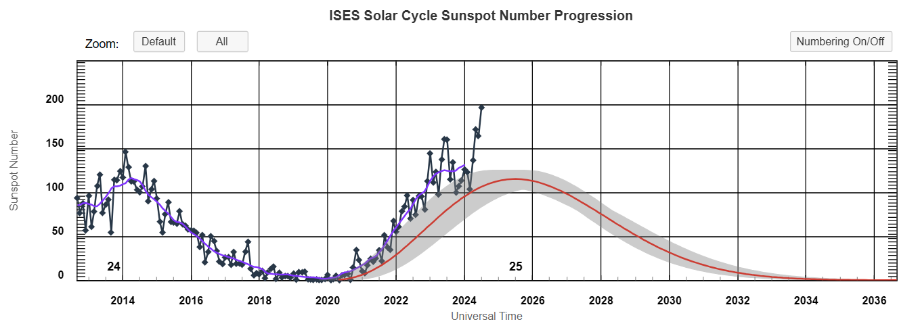
Max of the Solar Cycle
MWA Project Meeting 2024, EPFL, Lausanne

Slide 22
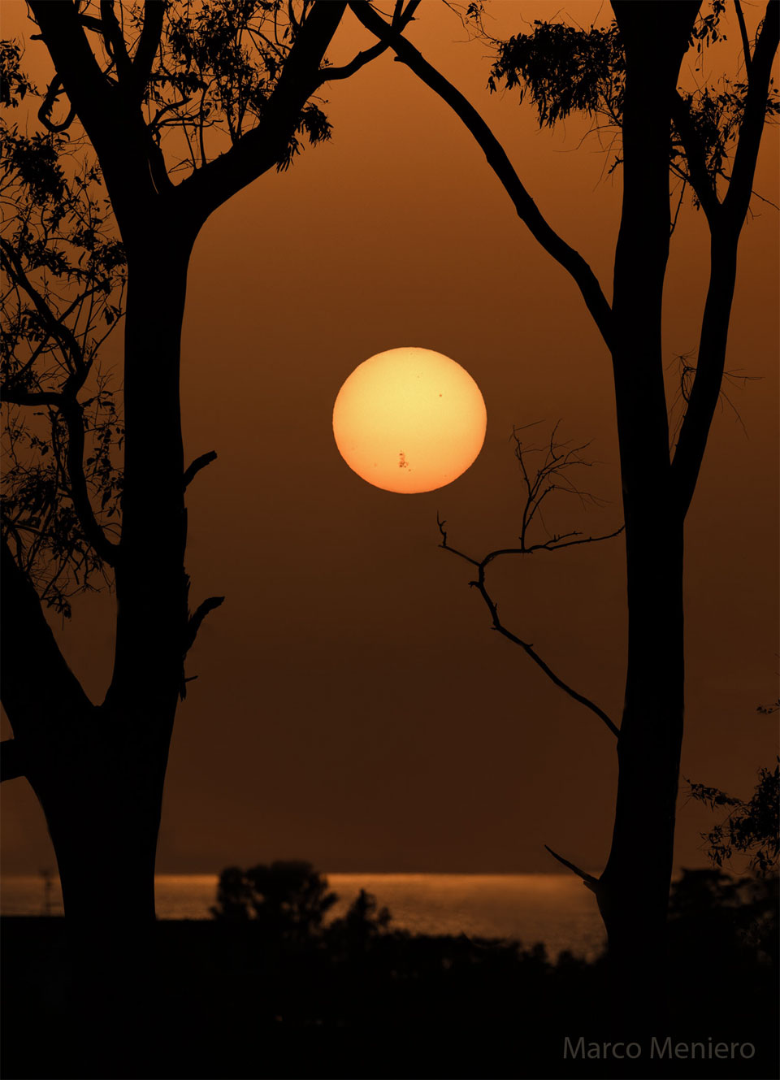
Campaign to track 13664 active region
MWA Project Meeting 2024, EPFL, Lausanne

Slide 23
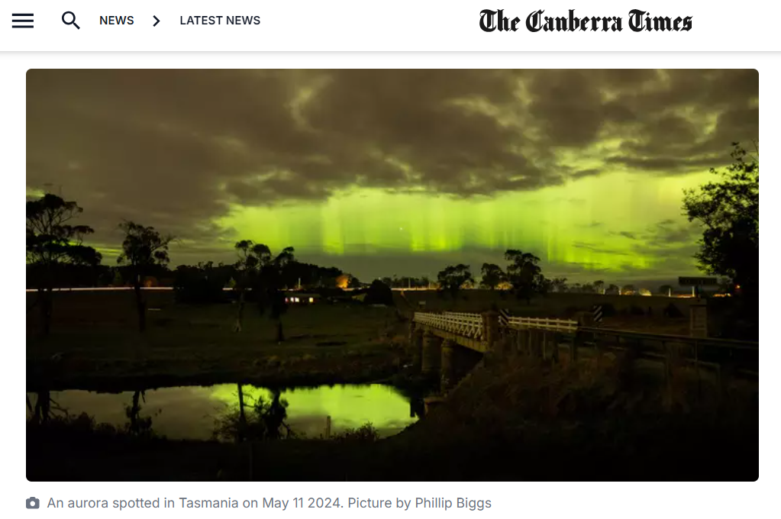
MWA Project Meeting 2024, EPFL, Lausanne

Slide 24
Summary
Progress in many SHI science problems
Trigger-based scheduling will help in capturing transient bursts and offer coverage with other instruments felicitating multi-wavelength solar studies of events
Focus on scaling up the developed techniques to input large solar MWA data
Simultaneously develop resources for SKA-low
Thank you
MWA Project Meeting 2024, EPFL, Lausanne

Slide 25
New studies from 2024
Spectropolarimetric Radio Imaging of Faint Gyrosynchrotron Emission from a CME : A Possible Indication of the Insufficiency of Homogeneous Models
Deciphering Radio Emission from Solar Coronal Mass Ejections using High-fidelity Spectropolarimetric Radio Imaging
Resolving moving heliospheric structures using interplanetary scintillation observations with the Murchison Widefield Array
Detection and Characterisation of a Coronal Mass Ejection using Interplanetary Scintillation measurements from the Murchison Widefield Array
Deciphering Faint Gyrosynchrotron Emission from Coronal Mass Ejection using Spectro-polarimetric Radio Imaging

Slide 26
Atul’s Comments
I don't have anything particular in the last year. But I would request you to please emphasize the 2 new aspects/ tools of inquiry that came out of the robust burst source structural evolution tracking made possible by the MWA imaging capability.
1. Discovery of various modes of structural QPPs in radio burst sources and their systematic mode switching as flare evolves hinting to their links to local magnetic field evolution.
2. Turbulence estimation across heights methodology by modeling source size temporal evolution.
Papers concerned would be in 2021. But it's important to highlight these MWA discoveries and things purely possible with MWA in the band it operates. These are al
new tools ro explore conditions during and evolution of weak solar activity. The larger community is unaware still and since I took up other positions which never gave time to continue these, there was less further activity.
So if you feel this makes sense I can try to contribute a few slides.

