Slide 1
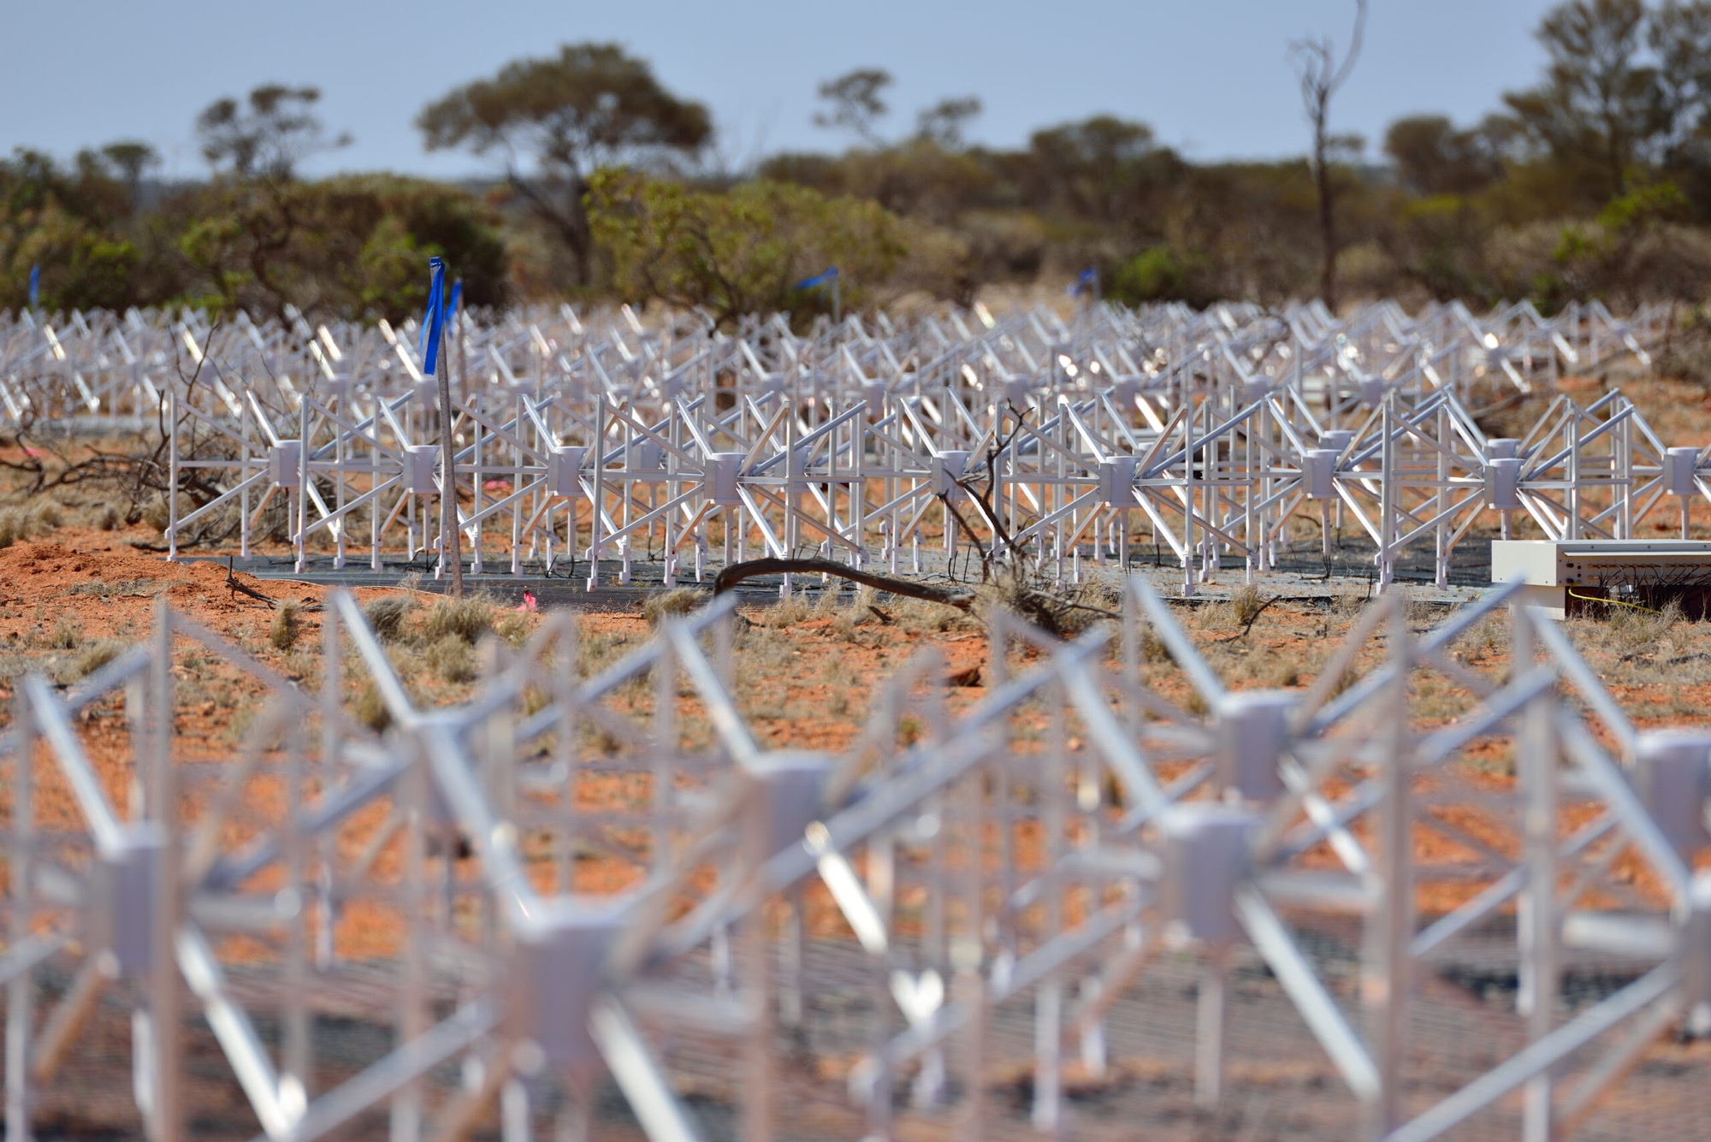

Canada, the MWA, and CANDIAPL
Gregory R. Sivakoff
sivakoff@ualberta.ca

Slide 2
Canadian Radio Astronomy Facilities:
The 2020 Long Range Plan Perspective
Current (2020) Facilities
ALMA
CHIME
MWA
Dominion Radio
Astronomy Observatory

Slide 3
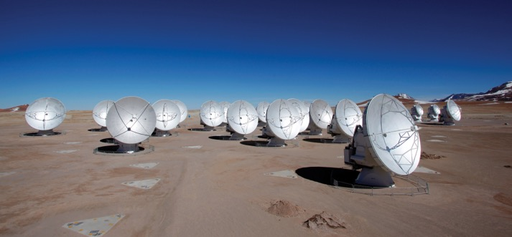
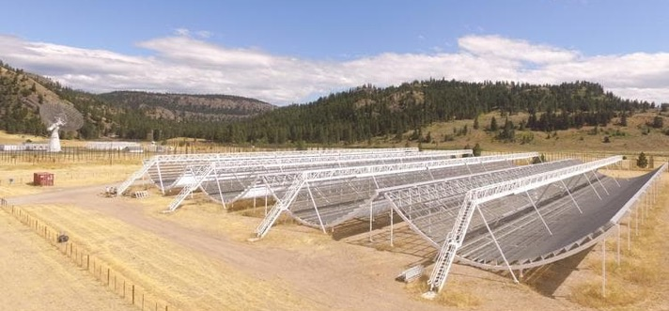
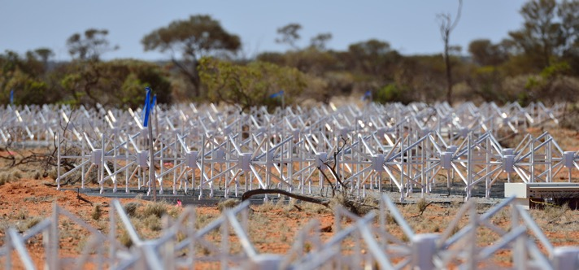
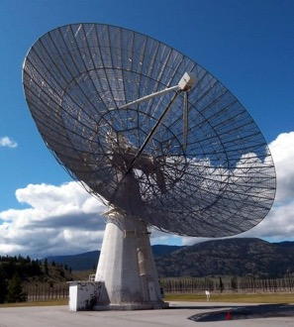
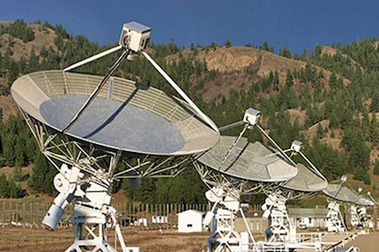
Canadian Radio Astronomy Facilities:
The 2020 Long Range Plan Perspective
Current (2020) Facilities
ALMA
CHIME
MWA
Dominion Radio
Astronomy Observatory

Slide 4
Canadian Radio Astronomy Facilities:
The 2020 Long Range Plan Perspective
Current (2020) Facilities

Slide 5
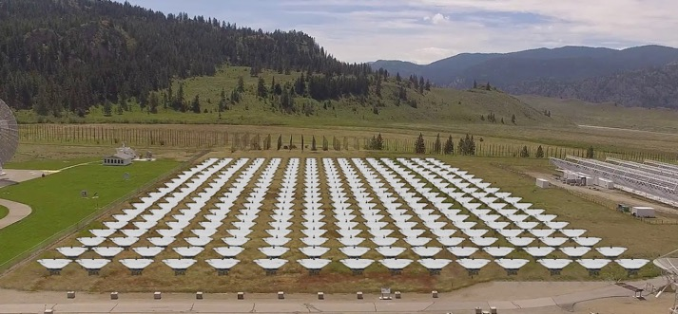
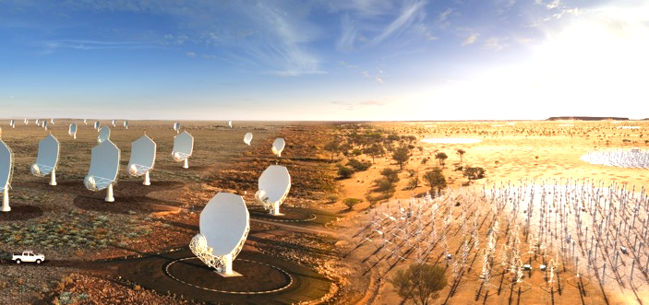

Canadian Radio Astronomy Facilities:
The 2020 Long Range Plan Perspective
Future (2020) Facilities
ALMA
CHORD
SKA
ngVLA

Slide 6
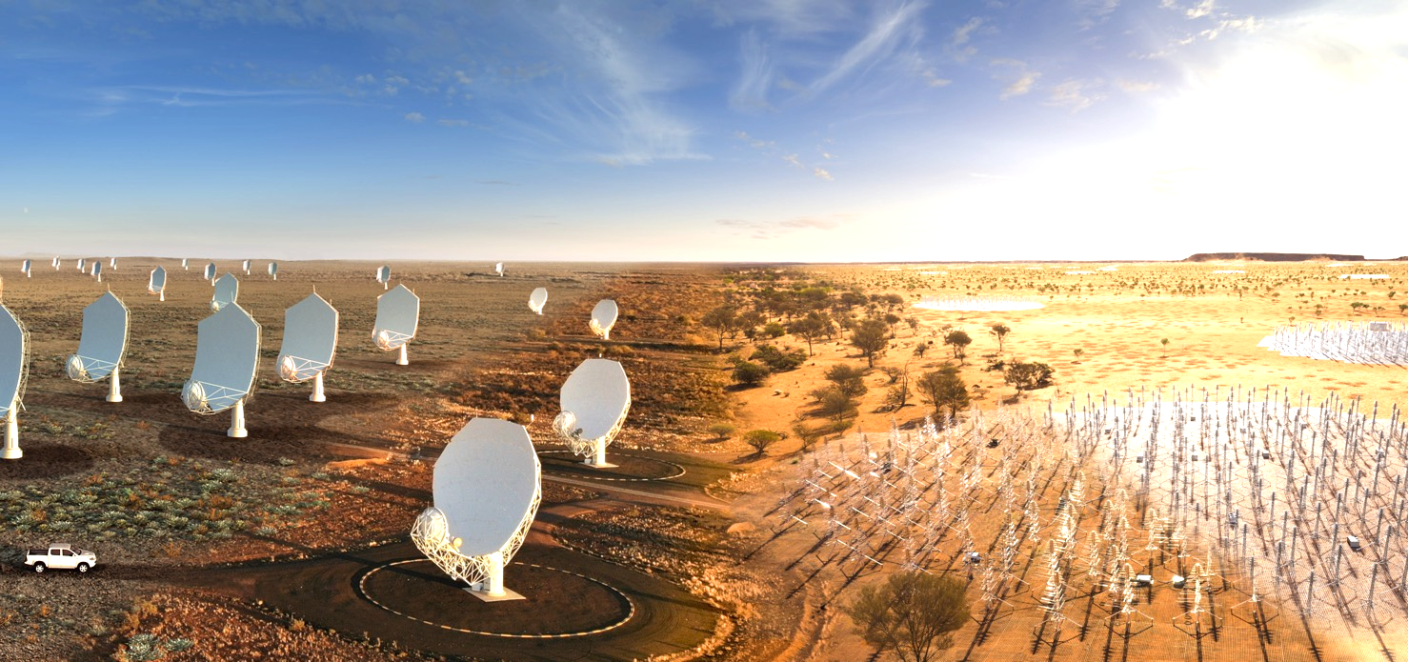
Canadian Radio Astronomy Facilities:
The 2020 Long Range Plan Perspective
Highest 2020-2030 Priority: SKA

Slide 7
Canadian Preparation for the SKA
(Approach I)
Canadian Astronomy Data Centre (CADC) +
Canadian Advanced Network for Astronomy Research (CANFAR)
Lowest Effort, Lowest Risk of Failure, Moderate Reward

Slide 8
Canadian Preparation for the SKA
(Approach I)
Canadian Astronomy Data Centre (CADC) +
Canadian Advanced Network for Astronomy Research (CANFAR)
Lowest Effort, Lowest Risk of Failure, Moderate Reward
Builds on CADC expertise
Enhance computing using annually allocation national resources (CANFAR) to prepare for large data needs.
Make results open source. (https://github.com/opencadc)

Slide 9
Canadian Advanced Network for
Astronomical Research (CANFAR) https://www.canfar.net/en/docs/overview/
CANFAR Science Portal
  (Browser accessible container-based science platform)
Storage Management
  (Web, command line, & python interface to data)
Group Management
Data Publication Service
  (Storage space plus DOI linking of data and papers)

Slide 10
Canadian Preparation for the SKA
(Approach I)
CADC/CANFAR: Why you might care
The group, data, and compute management that Canada has
been developing is well set up for SKA-data centres
You can adopt parts of this as suits your needs
Some potential for computing on Canadian compute resources, if we can add to Canadian astronomy’s national allocation

Slide 11
Canadian Preparation for the SKA
(Approach II)
Canada Foundation for Innovation (CFI) funding
towards projects related to SKA Pathfinders
Moderate Effort, Moderate Risk of Failure, Moderate Reward
Highly competitive calls come once every few years
Million-dollar scale projects possible

Slide 12
Canadian Preparation for the SKA
(Approach II)
Canada Foundation for Innovation (CFI) funding
towards projects related to SKA Pathfinders
Moderate Effort, Moderate Risk of Failure, Moderate Reward
Highly competitive calls come once every few years
Million-dollar scale projects possible
Multiple radio astronomy projects have been CFI funded, including CHIME (multiple upgrades), CIRADA, and CanDIAPL

Slide 13

Canadian Initiative for
Radio Astronomy Data Analysis
https://cirada.ca/ (2017–2023; ~8.8M CAD)
Unlocking the Radio Sky with Now-Generation Survey Astronomy
Generating Science Ready Data Products for
Very Large Array Sky Survey
  VLASS
ASKAP Widefield ASKAP L-band Legacy All-sky Blind survey
  ASKAP WALLYBY
Facets of Canadian Hydrogen Intensity Mapping Experiment
  CHIME

Slide 14
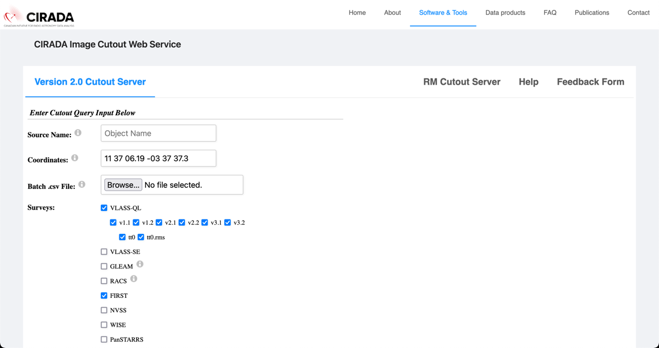
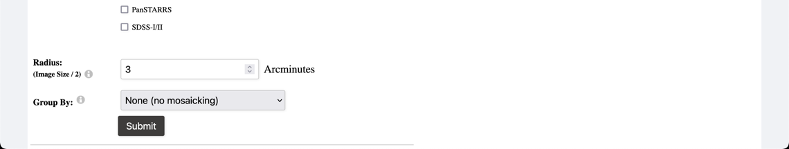
http://cutouts.cirada.ca/
Version 2.3 Cutout Server
Search by name (Sesame-resolved) or
equatorial coordinate (many formats allowed)
In user-selected combinations of
Radio: VLASS-QL/VLASS-SE by epoch,
GLEAM (4 bands), FIRST, NVSS
midIR: WISE (4 bands)
UVOIR: PanSTARRS (grizy), SDSS-I/II (gri)
Returns png/fits download of 2-90’ images
of individual files or mosaics can be returned
(either all from a survey, or by date-obs)

Slide 15
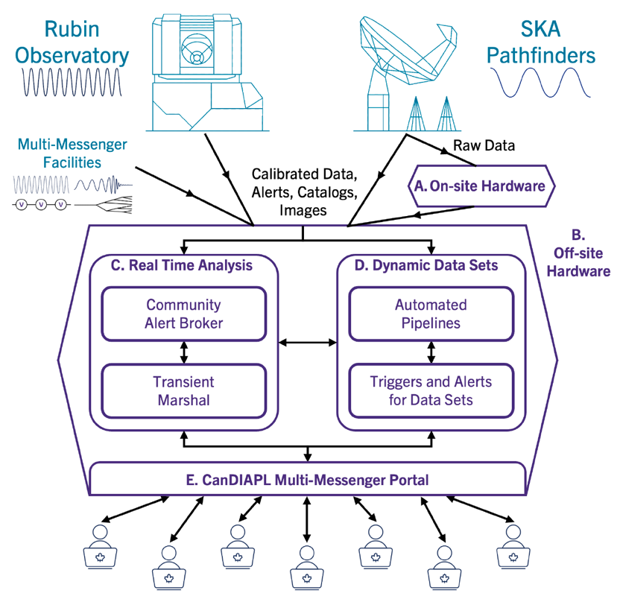
Canadian Data Intensive Platform
(CanDIAPL; 2023–2029; ~14.9M CAD)

Slide 16
Canadian Data Intensive Platform
(CanDIAPL; 2023–2029; ~14.9M CAD)
MeerKAT “Upgrade”
  ~1K cores, 8 TB RAM, 1.2 PB storage (goal)
  in South Africa supporting Canadian-led transient science
MWA Upgrade
  0.5M CAD Cash towards receiver upgrade
Off-Site Hardware
  ~5.4K cores, 43 TB RAM, 37 PB storage (goal)
  in Canada

Slide 17
Canadian Data Intensive Platform
(CanDIAPL; 2023–2029; ~14.9M CAD)
Software Infrastructure Developers & Operators (~78 FTE yrs)
  Community Alert Broker
    Integrates Rubin (External), Multimessenger (External) &
    SKA pathfinder (CanDIAPL) alerts
  Transient Marshal
    Integrates Rubin, Multimessenger, & SKA pathfinder data to identify sources of interest

Slide 18
Canadian Data Intensive Platform
(CanDIAPL; 2023–2029; ~14.9M CAD)
Software Infrastructure Developers & Operators (~78 FTE yrs)
  Automated Processing Pipelines
  Unsupervised production of science-ready data
    from calibrated observatory products
  Triggers and Alerts for Dynamic Data Sets
    Triggering and alert service for dynamic data sets of the static sky that automatically notifies users when their pre-defined query conditions are met

Slide 19
Canadian Data Intensive Platform
(CanDIAPL; 2023–2029; ~14.9M CAD)
Software Infrastructure Developers & Operators (~78 FTE yrs)
  Multimessenger Portal
    Integrated access point and science platform for CanDIAPL data

Slide 20
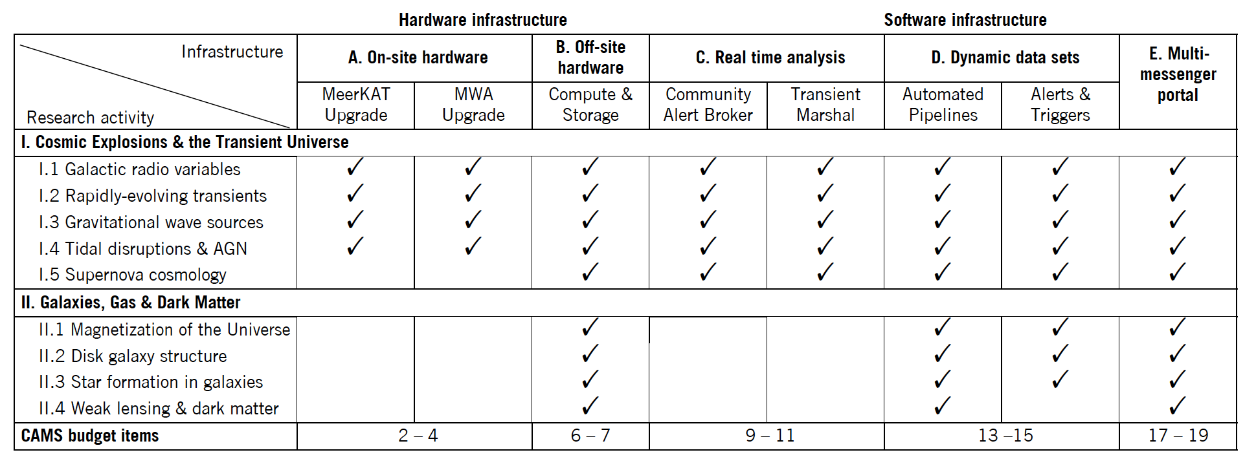
Canadian Data Intensive Platform
(CanDIAPL; 2023–2029; ~14.9M CAD)

Slide 21
Canadian Preparation for the SKA
(Approach II)
CIRADA/CanDIAPL: Why you might care
CIRADA provides several science-ready data products
for radio astronomy
Both provide or will provide open source code
CanDIAPL will provide next-gen multimessenger data products
CanDIAPL will help fund the MWA receiver upgrade

Slide 22
Canadian Preparation for the SKA
(Approach II)
CIRADA/CanDIAPL: Why you might care
CanDIAPL is looking to maximize what we can do collaboratively.

Slide 23
Canadian Preparation for the SKA
(Approach III)
Join SKAO
Highest Effort, Highest Risk of Failure, Highest Reward

Slide 24
Canadian Preparation for the SKA
(Approach III)
Join SKAO (269M CAD investment)
Highest Effort, Highest Risk of Failure, Highest Reward
SKA Canada Science Fellowship program (name TBD)
  Postdoc openings!
SKA Regional Centre for Canada funded
  Job openings!
  Significant computer and storage resources!

Slide 25
Canada and MWA
CanDIAPL is enabling the Canadian Consortium to continue being part of the MWA family
Recent faculty shuffle has led University of Alberta
to take over Canadian Consortium leadership
Capitalizing on CanDIAPL and Canadian SKAO membership,
I will be working to reinvigorate MWA interest in Canada
Lots of potential to work on data-centre issues

