Slide 1
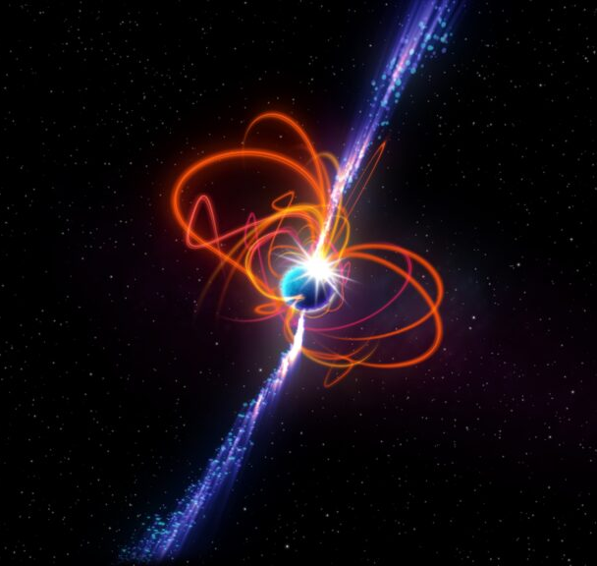
MWA Transient SWG 2024 Update
Ramesh Bhat (on behalf of Transients chair Gemma Anderson)
ICRAR-Curtin University
MWA Project Meeting - 30 Aug 2024
gemma.anderson@curtin.edu.au
Image credit: ICRAR

Slide 2
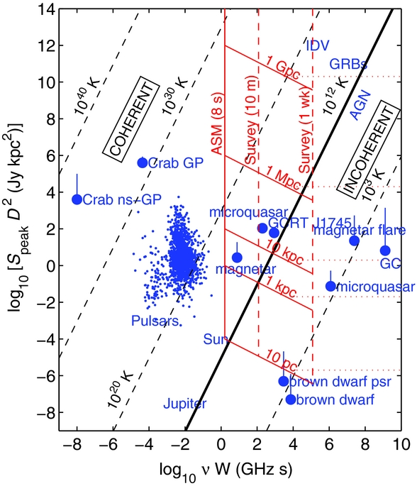
MWA transient predictions in 2013
“The potential sources of radio transient emission fall into five broad categories:
coronal emission from nearby stars/substellar objects
emission from compact objects such as neutron stars and accreting black holes
explosive events such as gamma-ray bursts (GRBs) and radio supernovae
(exo)planetary emission from nearby systems
and new phenomena discovered through the opening of new regions of observational phase space.”
Bowman et al. (2013), Science with the Murchison Widefield Array, PASA, 30, e031
Notes:
Produce obs flux density S and square of distance (like luminosity) vs produce of emission freq (nu) and transient duration (W). Directly relates to brightness temp
Predictions assume 50 mJy source detected in 8s
Vertical red - times of 8s, 5m and 1 week
Diagonal red - SD^2 limits for different distances going from local to Galactic to extragalactic transients
Dotted red - estimated confusion limit of 10 mJy

Slide 3
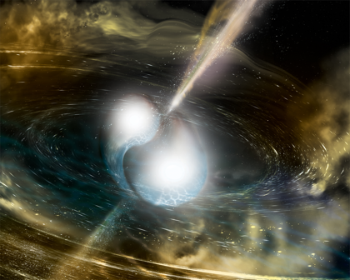
MWA Transients Projects Overview
Themes worked on since 2013
Image plane fast radio burst (FRB) searches
Blind and targeted
Rapid-response triggering
GRBs, GWs and FRBs
Space Situational Awareness
Targeted transient searches (image plane)
Exoplanets
Flare stars
Pulsars
X-ray binaries (XRBs)
gravitational wave (GW) events and explosive transients
Blind transient searches
Searches and discoveries
Cosmic ray detection
Artist's impression of GW170817/GRB 170817A (binary neutron star merger)
Credit: NSF/LIGO/Sonoma State University/A. Simonnet
Notes:
The main focus of MWA Transient work since 2013 up until 2024

Slide 4
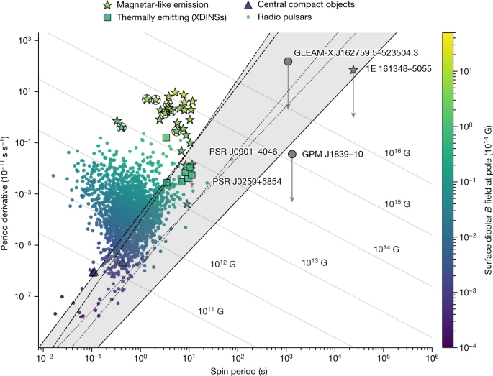
MWA discovery of ultra long period transients
Recap:
Discovery of GLEAM-X J162759.5-523504.3
18 min period
Active for 3 months in 2018 (Hurley-Walker et al. 2022, Nature, 601, 526)
Commenced MWA Galactic Plane Monitoring campaign in 2022
Discovery of GPM J1839-10
21 min period
Active for 30 years (Hurley-Walker et al. 2023, Nature, 619, 487)
Continued MWA Galactic Plane Monitoring in June 2024
Hurley-Walker et al. (2023)

Slide 5
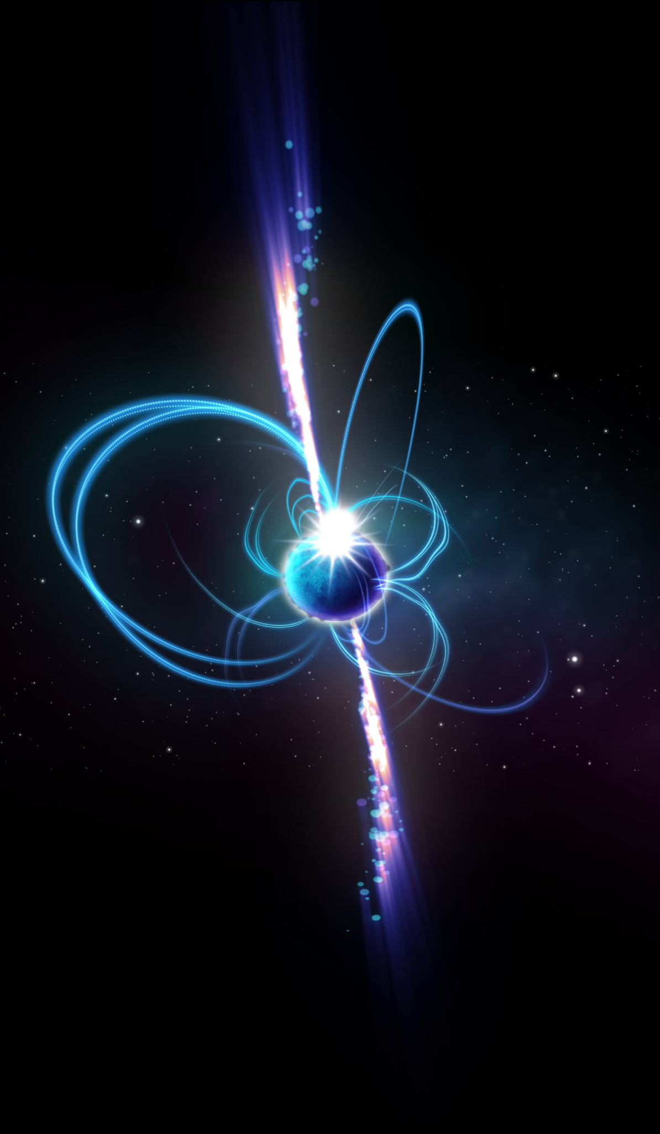
Galactic Plane Monitoring survey 2024
Slide: Dr Sam McSweeney
Goal: Find more radio transients like this!
Footprint:
Apparent population at 200 MHz
10x 30-minute pointings
June to September 2024 (ongoing!)
Revisit every 3 days
Survey status:
Data collection: Ongoing (throughout this semester)
Processing: Ongoing (on Setonix, producing candidates, mostly up-to-date)
Candidate classification: Ongoing
Recent improvements to event-detection filters (thanks Csanad!!)
Recent upgrade to ADACS-supported webapp (thanks Paul!!)
Notes:
Some notes, in case they’re useful:
Because it’s the Galactic Plane, calibration is hard, so we’re mostly limited to when the (central part of) the Galactic Plane is up at night.

Slide 6
Galactic Plane Monitoring survey 2024
Slide: Dr Sam McSweeney
Goal: Find more radio transients like this!
Timescale sensitivity range:
Time res. (4s)
Obs. length (~5m)
CHIME J0630
ASKAP J1935
GLEAM-X J1627
GLEAM-X J0704
GPM J1839
GCRT J1745
Pulse widths:
Timescales:
1s
10s
1m
10m
1h
Survey status:
Data collection: Ongoing (throughout this semester)
Processing: Ongoing (on Setonix, producing candidates, mostly up-to-date)
Candidate classification: Ongoing
Recent improvements to event-detection filters (thanks Csanad!!)
Recent upgrade to ADACS-supported webapp (thanks Paul!!)

Slide 7
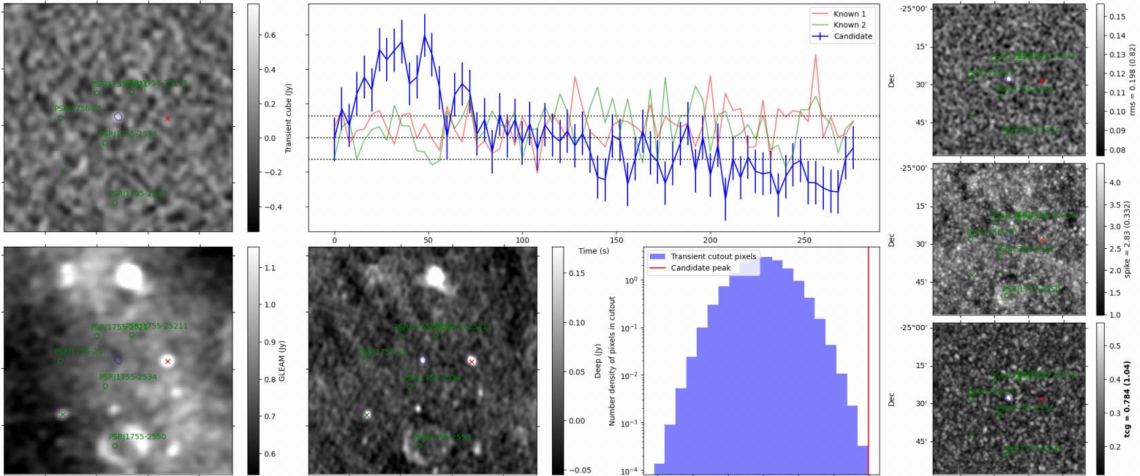
Galactic Plane Monitoring survey 2024
Verification / Early results
Slide: Dr Sam McSweeney
First light! Found first bona fide transient event (that wasn’t a pulsar or the moon). A known object (unfortunately), but an important and unexpected detection that helps us pin down its nature. Stay tuned!
Notes:
In case anyone asks, the little black rectangles are where I’ve redacted any information that could be used to determine where this thing was found. Just draw everyone’s detection to the big lump in the blue curve: That’s the transient!
The rest of the panels are just various diagnostic plots used to tell whether the candidate is real. Of these, the most interesting are the right-hand panels, which are the result of passing the time-cubes through Csanad’s three different filters. Needn’t go into detail though.

Slide 8
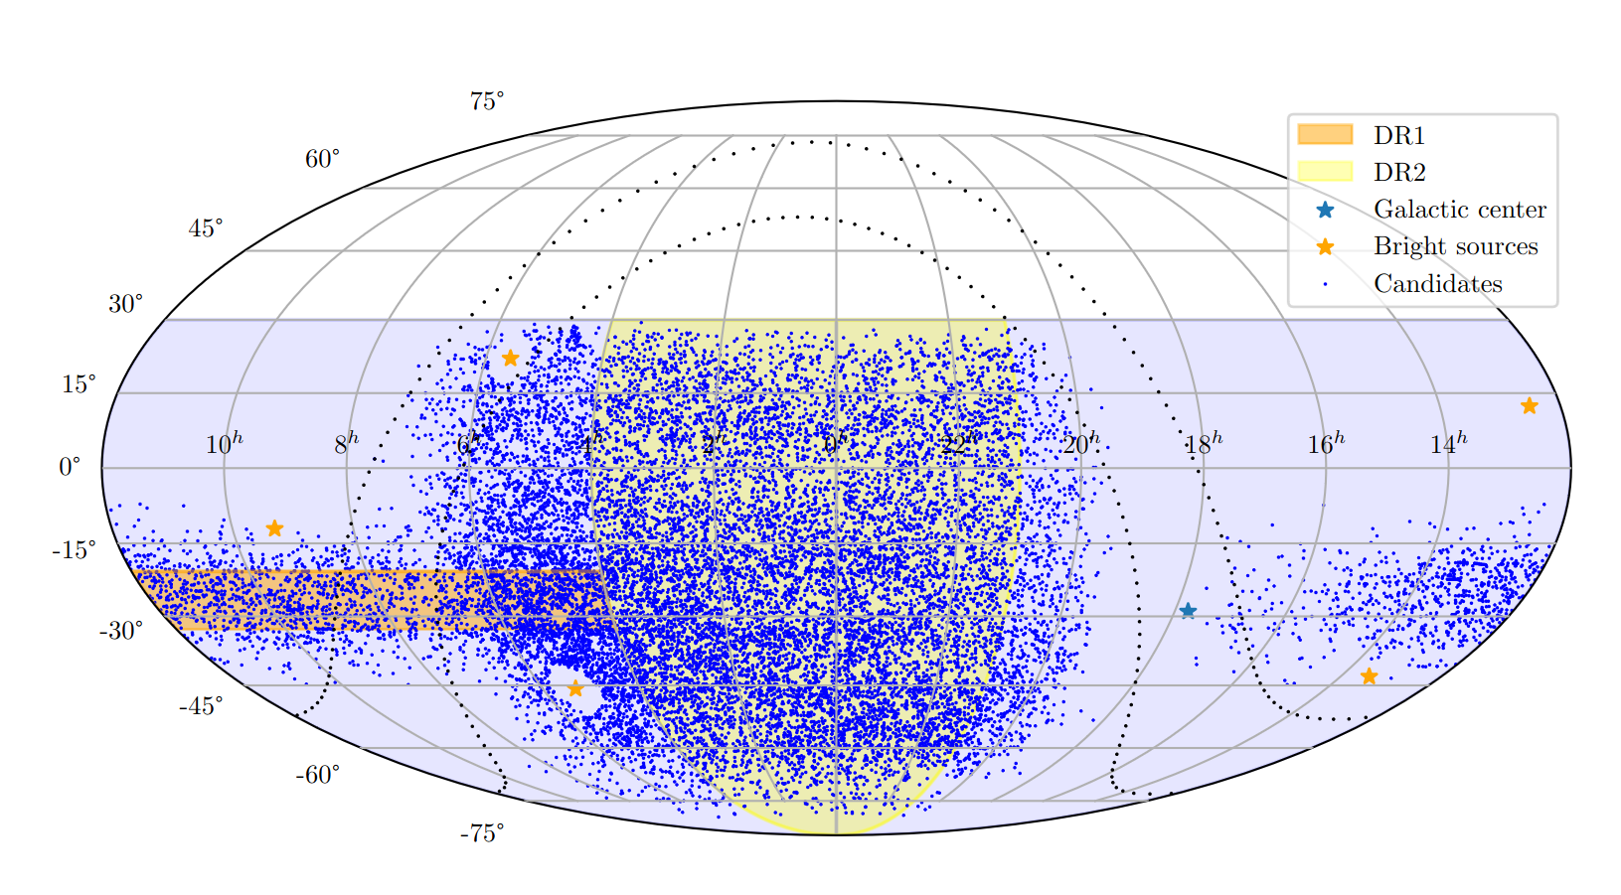
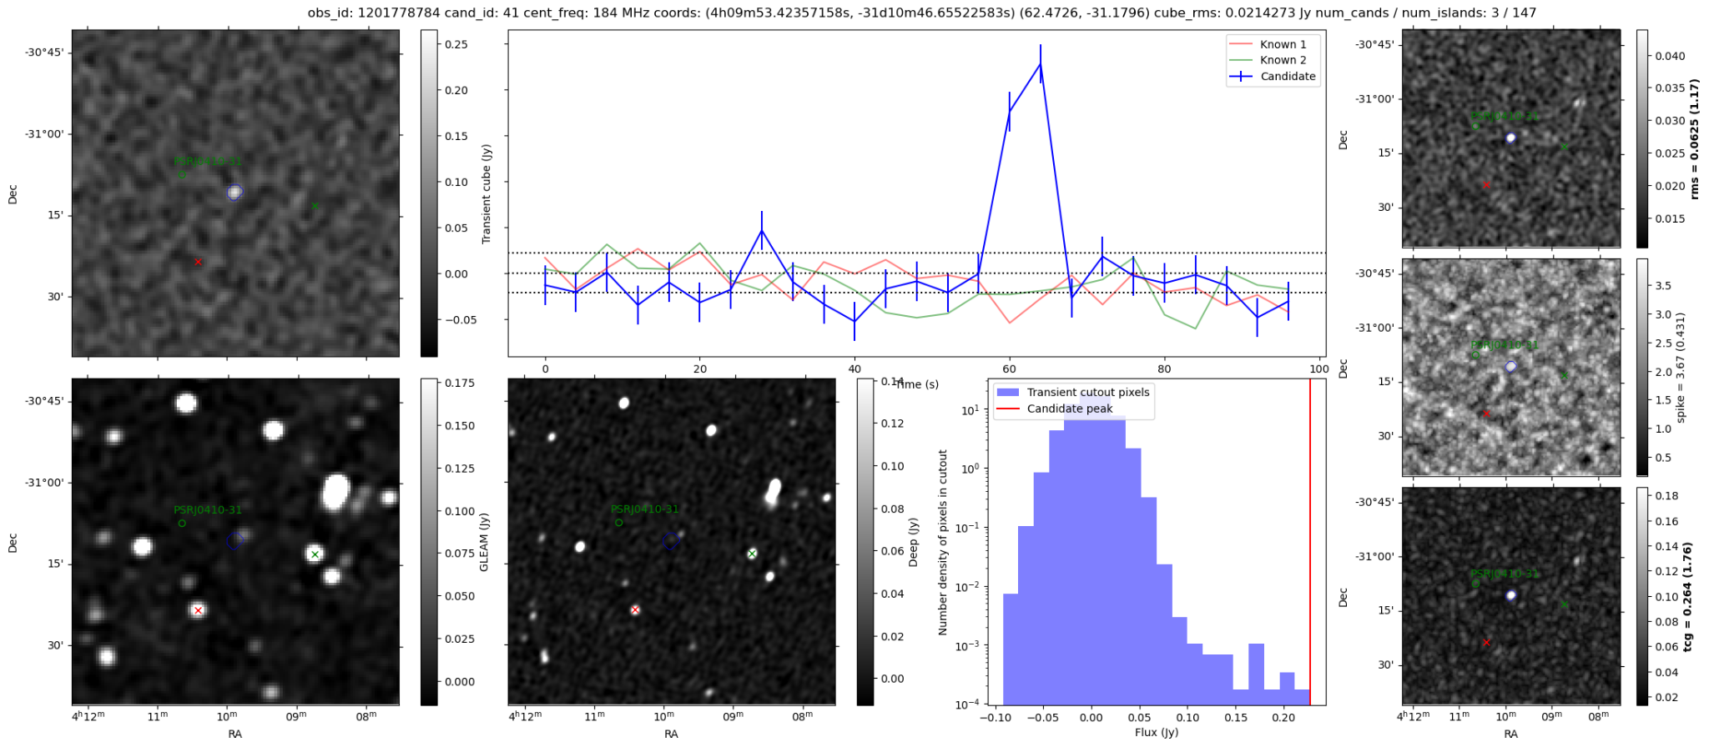
GLEAM-X survey search
72 — 231 MHz
7,099 observations (2 min each)
17,870 candidates
Slide: Csanád Horváth (PhD candidate)
Supervisor: Dr Natasha Hurley-Walker
Co-supervisor: Dr Sam McSweeney
Notes:
GLEAM-X was an observing campaign between 2018 and 2022 using the extended configuration of the MWA.
There are 7 frequency bands between 72 and 231 MHz.
This is an excellent dataset for transient hunting because of the large field of view of the MWA, long observations which overlap, and abundance of data granting many opportunities to catch these infrequent pulses.
Thus far, 7099 observations have yielded 17870 candidates awaiting manual inspection.
Each blue dot on the sky map is a candidate transient.
This is an example of a candidate which turned out to be a real transient, although not exactly what we were looking for.
It is a regular known pulsar, which we’ve improved the localisation of. What we’re picking up is actually the variation in the pulse brightness, likely due to scintillation, smeared into 4 second bins.
The user ranks how likely a candidate is to be real based on the light curve, radio-image cutouts of the region, and cutouts from the detection filters, using our web-based classification interface developed by the Australian Data And Compute Services (ADACS) team.

Slide 9
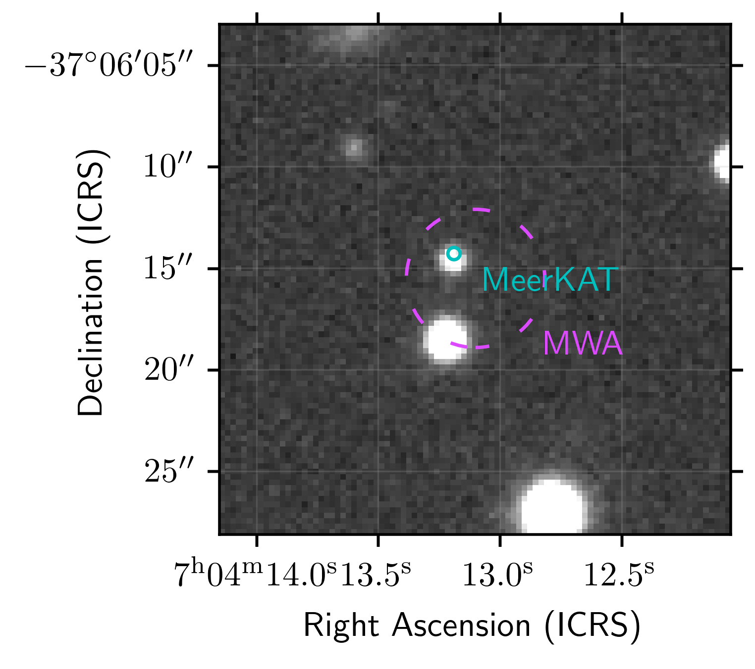
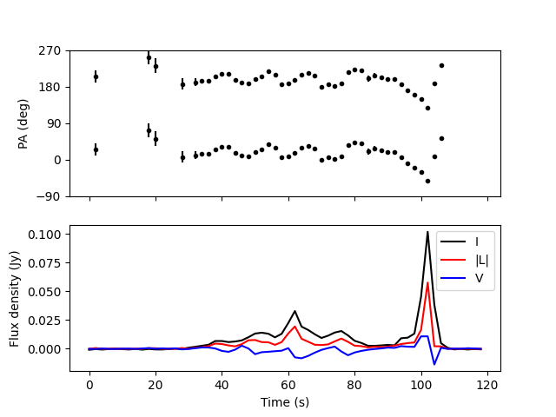
A long-period radio transient with an optical counterpart
Discovered via Csanad’s GLEAM-X search
|b| ~ 13°
P ~ 2.9 hr
Active for > 11 years
MeerKAT reveals
complex polarisation behaviour: McSweeney et al. in prep
Discovery paper by Hurley-Walker et al. submitted to ApJL
Slide: Dr Natasha Hurley-Walker

Slide 10
Radio follow-up and timing
MeerKAT PTUSE
Complex quasi-periodic microstructure in 10µs resolution MeerKAT data: highly accurate DM
Timing reveals tentative evidence of 6-year orbit; follow-up ongoing
A WD/M-dwarf binary?
← MWA
MeerKAT →
Slide: Dr Natasha Hurley-Walker

Slide 11
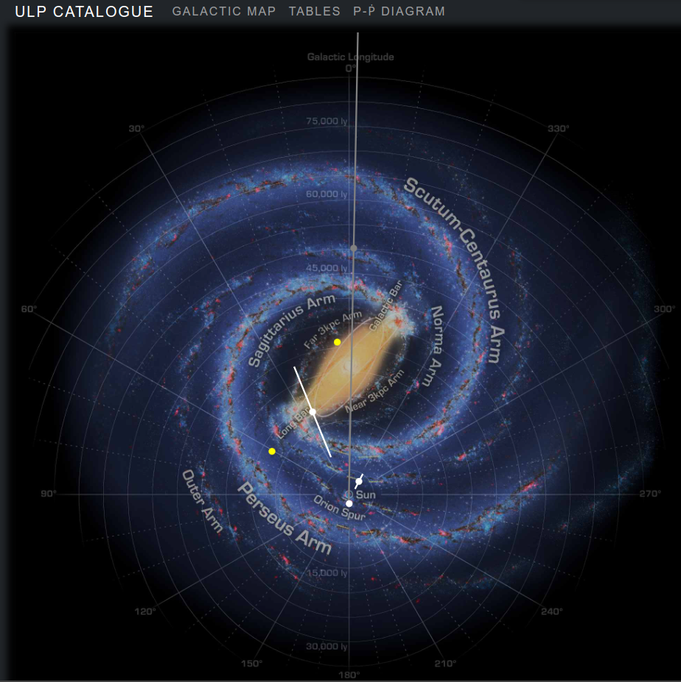
Long-period radio transients catalogue
Check out https://ulp.duckdns.org/ by Sam McSweeney
Discovery rate exponentially increasing so check here for new discoveries!
Notes:
Analogous to the ATNF pulsar catalogue or the McGill magnetar catalogue

Slide 12
Image plane pulsar detections

Slide 13
<
Notes:
These are discoveries in from the 2022 Galactic Plane Monitoring campaign

Slide 14
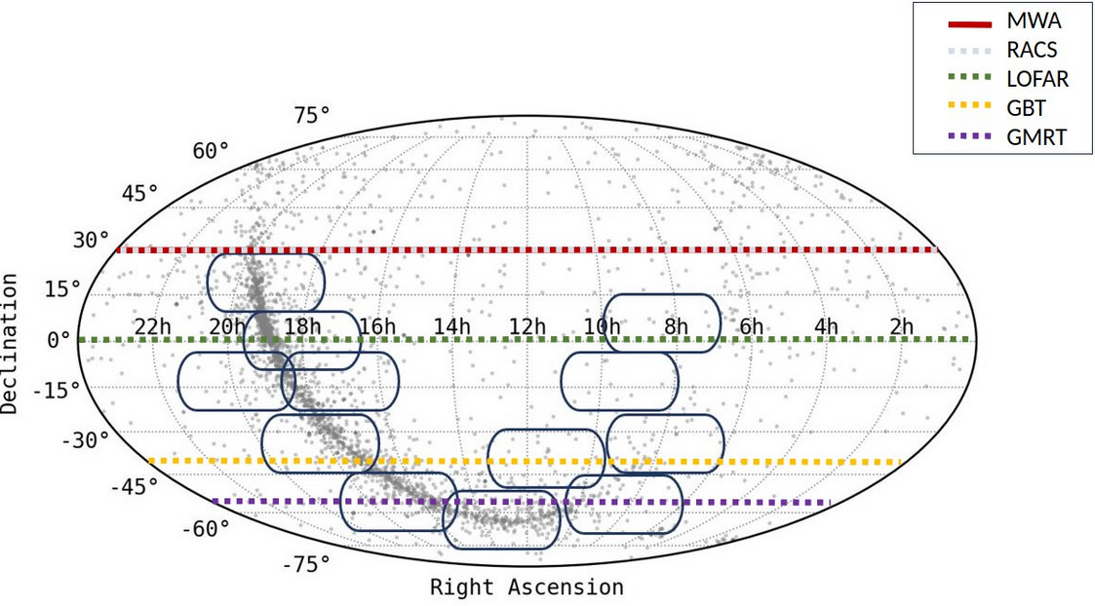
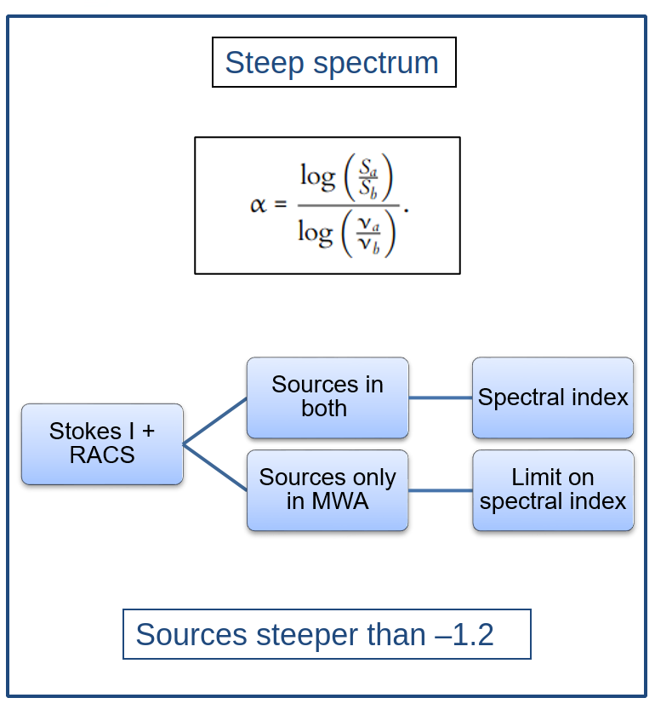
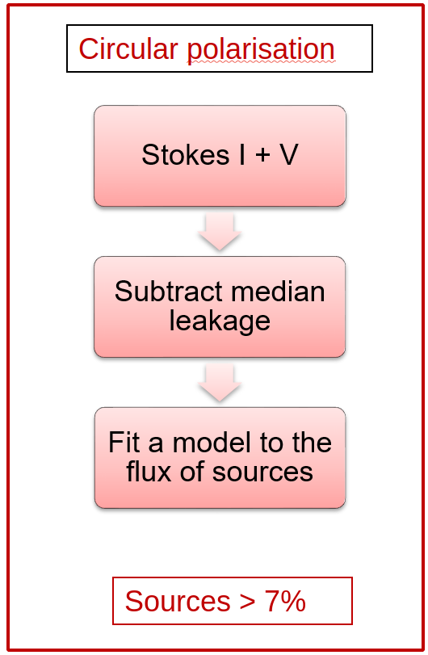
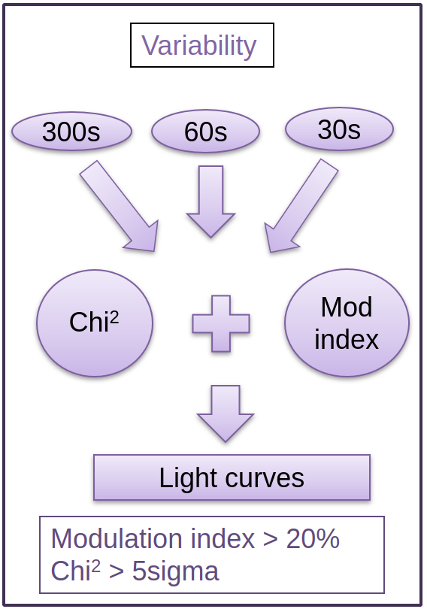
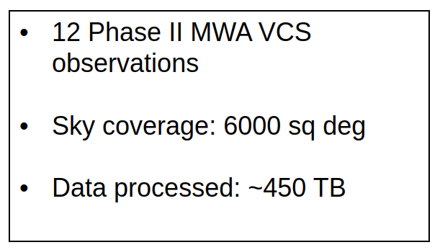
Imaging survey of Southern-sky pulsars with the MWA ​
Slide: Dr Susmita Sett
Notes:
Susmita’s work

Slide 15
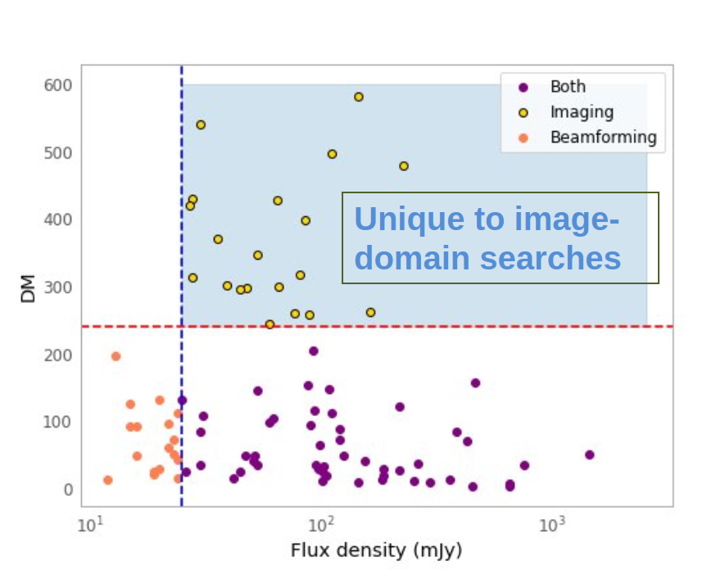
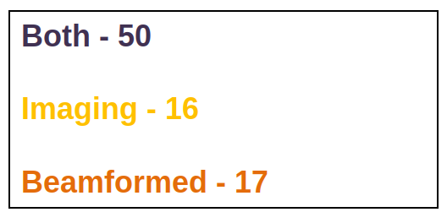
Summary
Imaging is performing as good as beamforming! ​
Slide: Dr Susmita Sett
Notes:
Susmita’s work

Slide 16
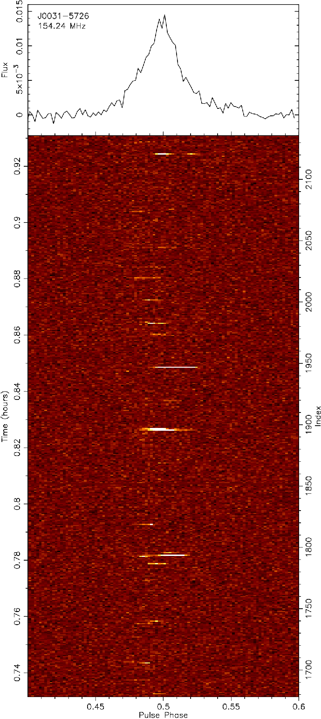
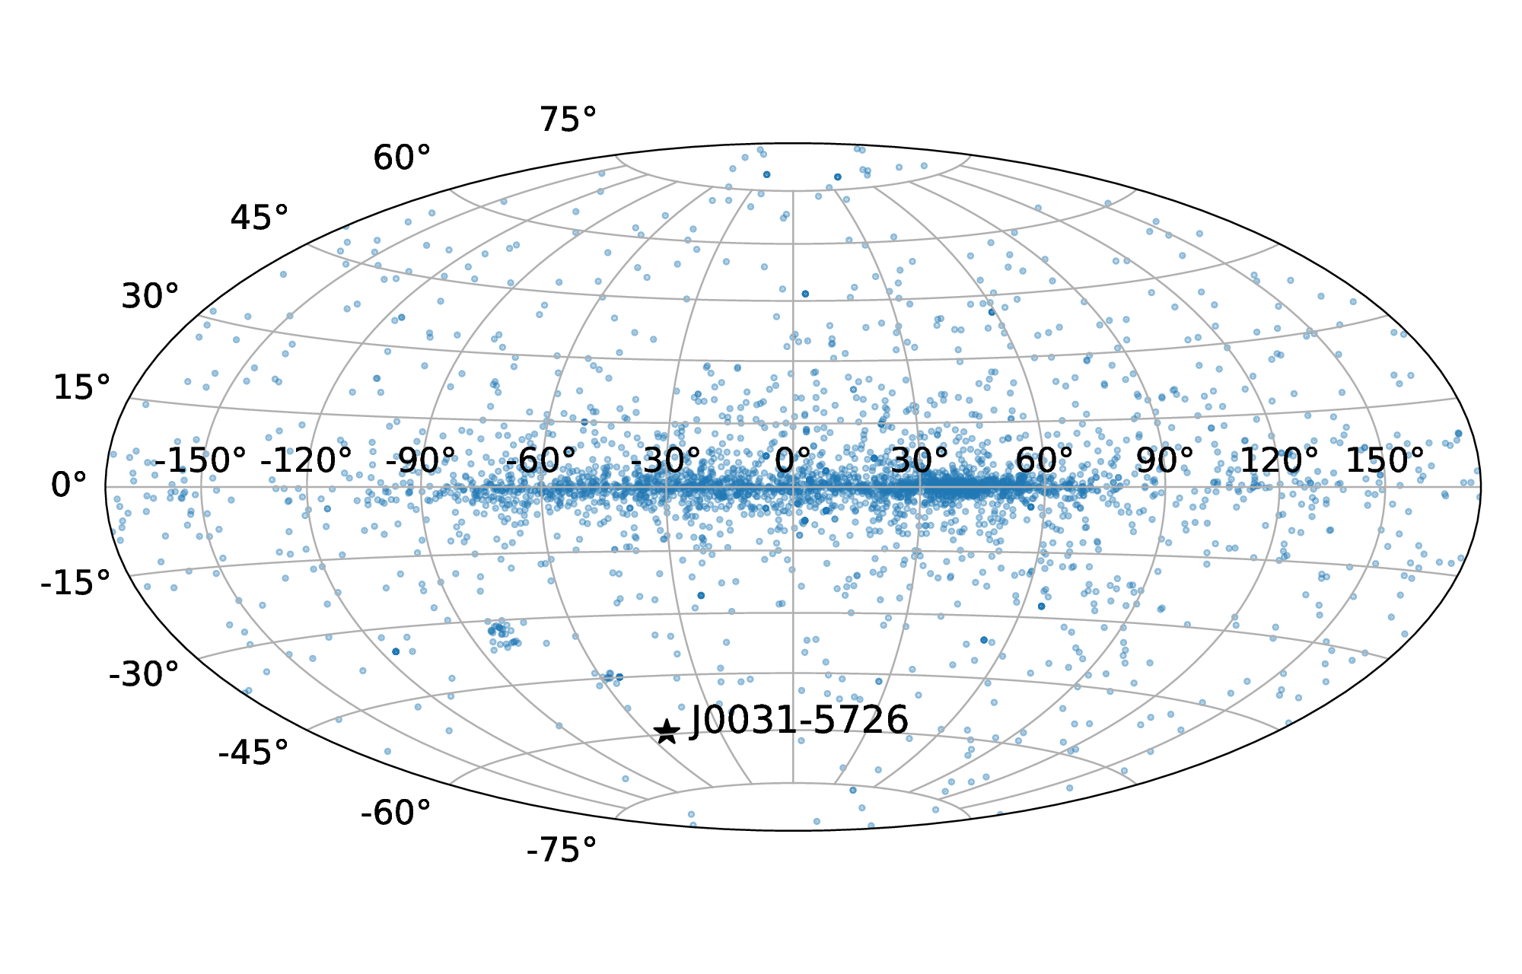
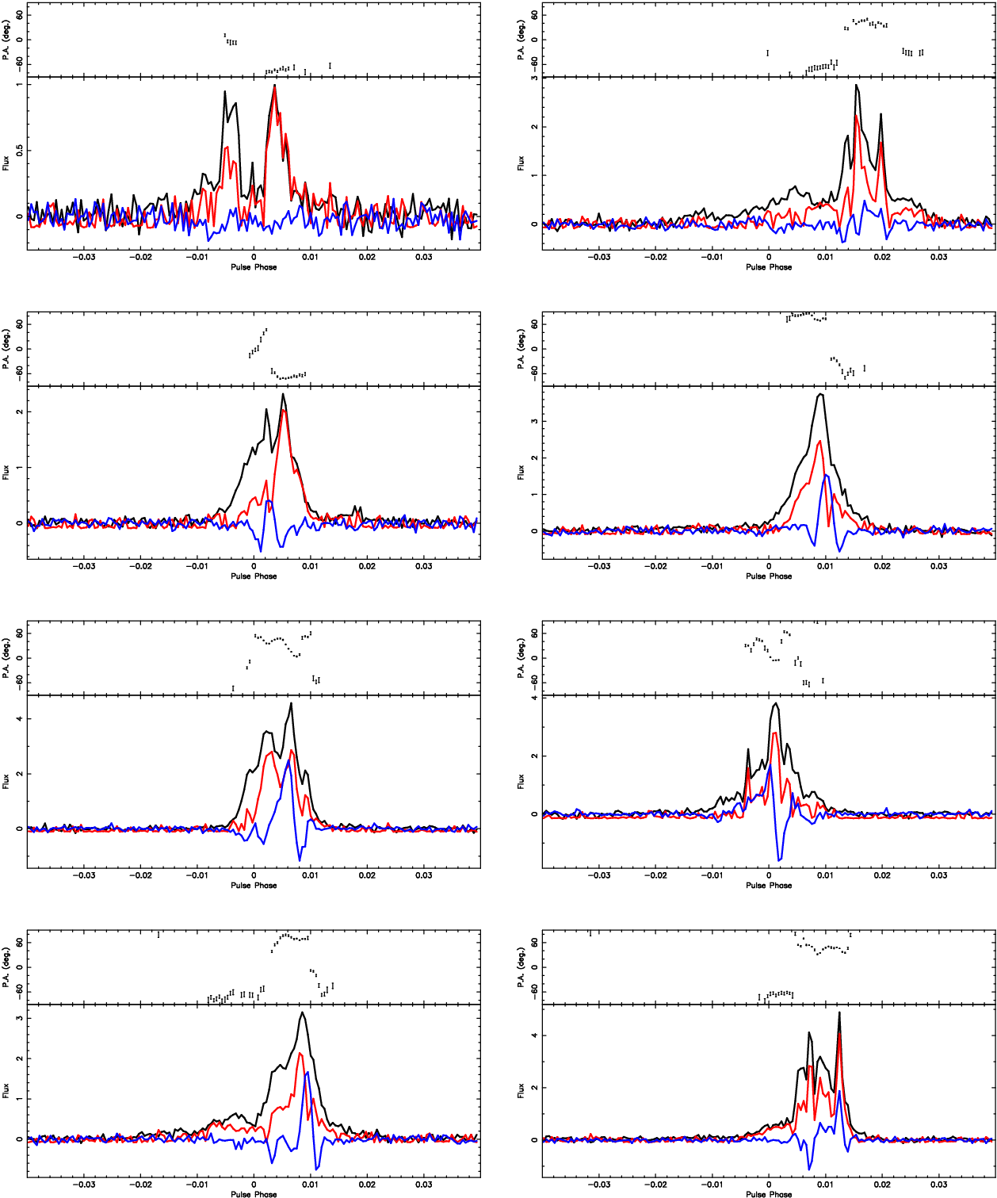
PSR J0031-5726, discovered in GLEAM-X!
Slide: Dr Sam McSweeney
Notes:
Points to speak to, and/or emphasise:
This was discovered in imaging data via its individual bursts, picked up by Csanad’s transient-detecting filters.
The pulsar at first looks like a bursty RRAT, but on closer inspection actually seems to be “on” all the time, but with the distribution of its single-pulse energies having a long tail.
Finding pulsars in imaging like this is not normal! Speaks to the possibility of there being more pulsars like this out there that image surveys are sensitive too!
Subsequently detected in SMART observations (but imaging people found it first!)
Well off the Galactic Plane with low DM, so could potentially be interesting for scintillation studies.
The brightest single pulses have really whacky polarisation (middle plots, black=total intensity, red=linear pol, blue=circular pol, mini upper panels=polarisation position angle)
This is currently in prep. Basically, we’re just nailing down the timing, and then should get out the door soon after that.

Slide 17
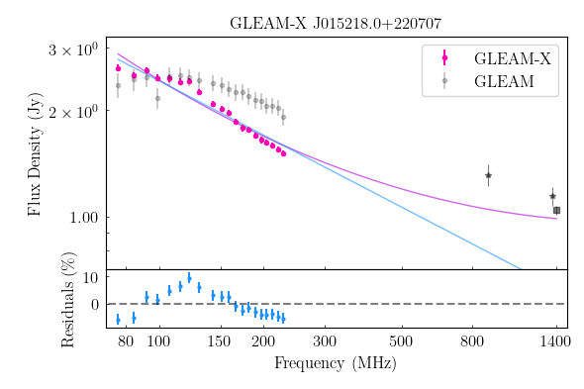
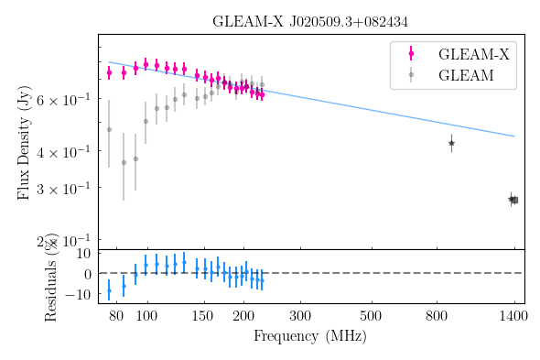
Variability of Peaked Spectrum Sources
Source previously classed as peaked (Callingham et al 2017) in GLEAM now either show no peak or evolving to lower frequencies on observable timescales
Similar observation times of widefield surveys crucial for PSS classification
Combination of RACS (grey stars) and GLEAM-X is powerful compared to previous older surveys (e.g. NVSS - grey squares - and SUMSS)
Slide: Dr Kat Ross
Notes:
The widefield of view paired with broad fractional bandwidth of GLEAM-X is ideal at detecting both peaked sources and curved sources. Comparing with GLEAM on timescales of ~7 years shows variability of PSS on observable timescales. Suggests these are incredibly compact AGN with rapidly evolving synchrotron components or perhaps a different class of object (e.g. frustrated with dynamic local environment?) The combination of RACS (taken in ~2019) with GLEAM-X (taken in ~2020) is powerful, reduces risk of unreliable PSS classification from variability in one epoch and the broad frequency coverage of the two surveys (soon to have RACS low, mid and high) will be crucial for reliable classification of PSS. Also drives the need for repeated widefield broad frequency bandwidth surveys to identify and detect any evolution of AGN/PSS.

Slide 18
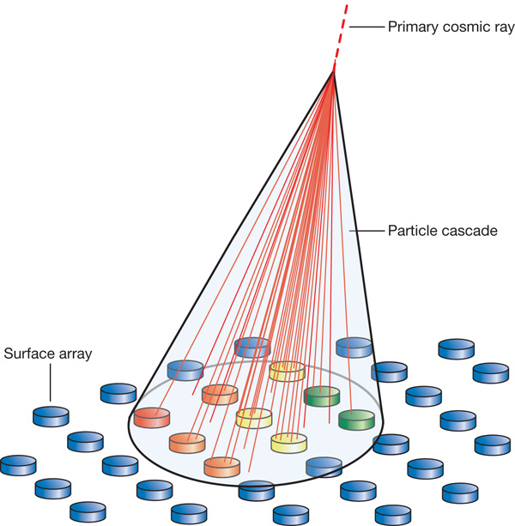
MWA detections of cosmic ray showers
Instillation of particle detectors to detected particle showers from a cosmic ray cascade (10¹⁶-10¹⁸ eV) and trigger MWA.
MWA will record for 8 seconds to capture particle shower footprint
~1 trigger/hour with ~16ns resolution
MWA observations will analyse shape (footprint) of the cascade (top Figure).
Footprint shape relates to the nature (protron, iron) of the primary cosmic-ray particle.
Aim to detect circular polarisation that has only been predicted (see lower Figure).
Figure credit - Top: Julio Rodriguez Martino, Bottom: Hannan Chen
Acting as a pathfinder for SKA-Low! >1.5 M euro of grants to SKA high-energy-particle group is based on the viability of this MWA work
Notes:
The cosmic ray showers last ~100 ns. I think that 8 seconds is the minimum time we can record data from MWA
Top Figure - illustrates how a facility such as the core of MWA could be used to measure the footprint of the particle shower. Different colours on the detector arrays illustrate different arrival times.
Bottom Figure - frequency-dependence of Stokes V for a 10^16 eV cosmic ray, as simulated by CoREAS, showing the transition from a dipolar to quadrupolar ground pattern, as predicted for a transition from a "moving-dipole" to "geosynchrotron-like" emission mechanism.

Slide 19
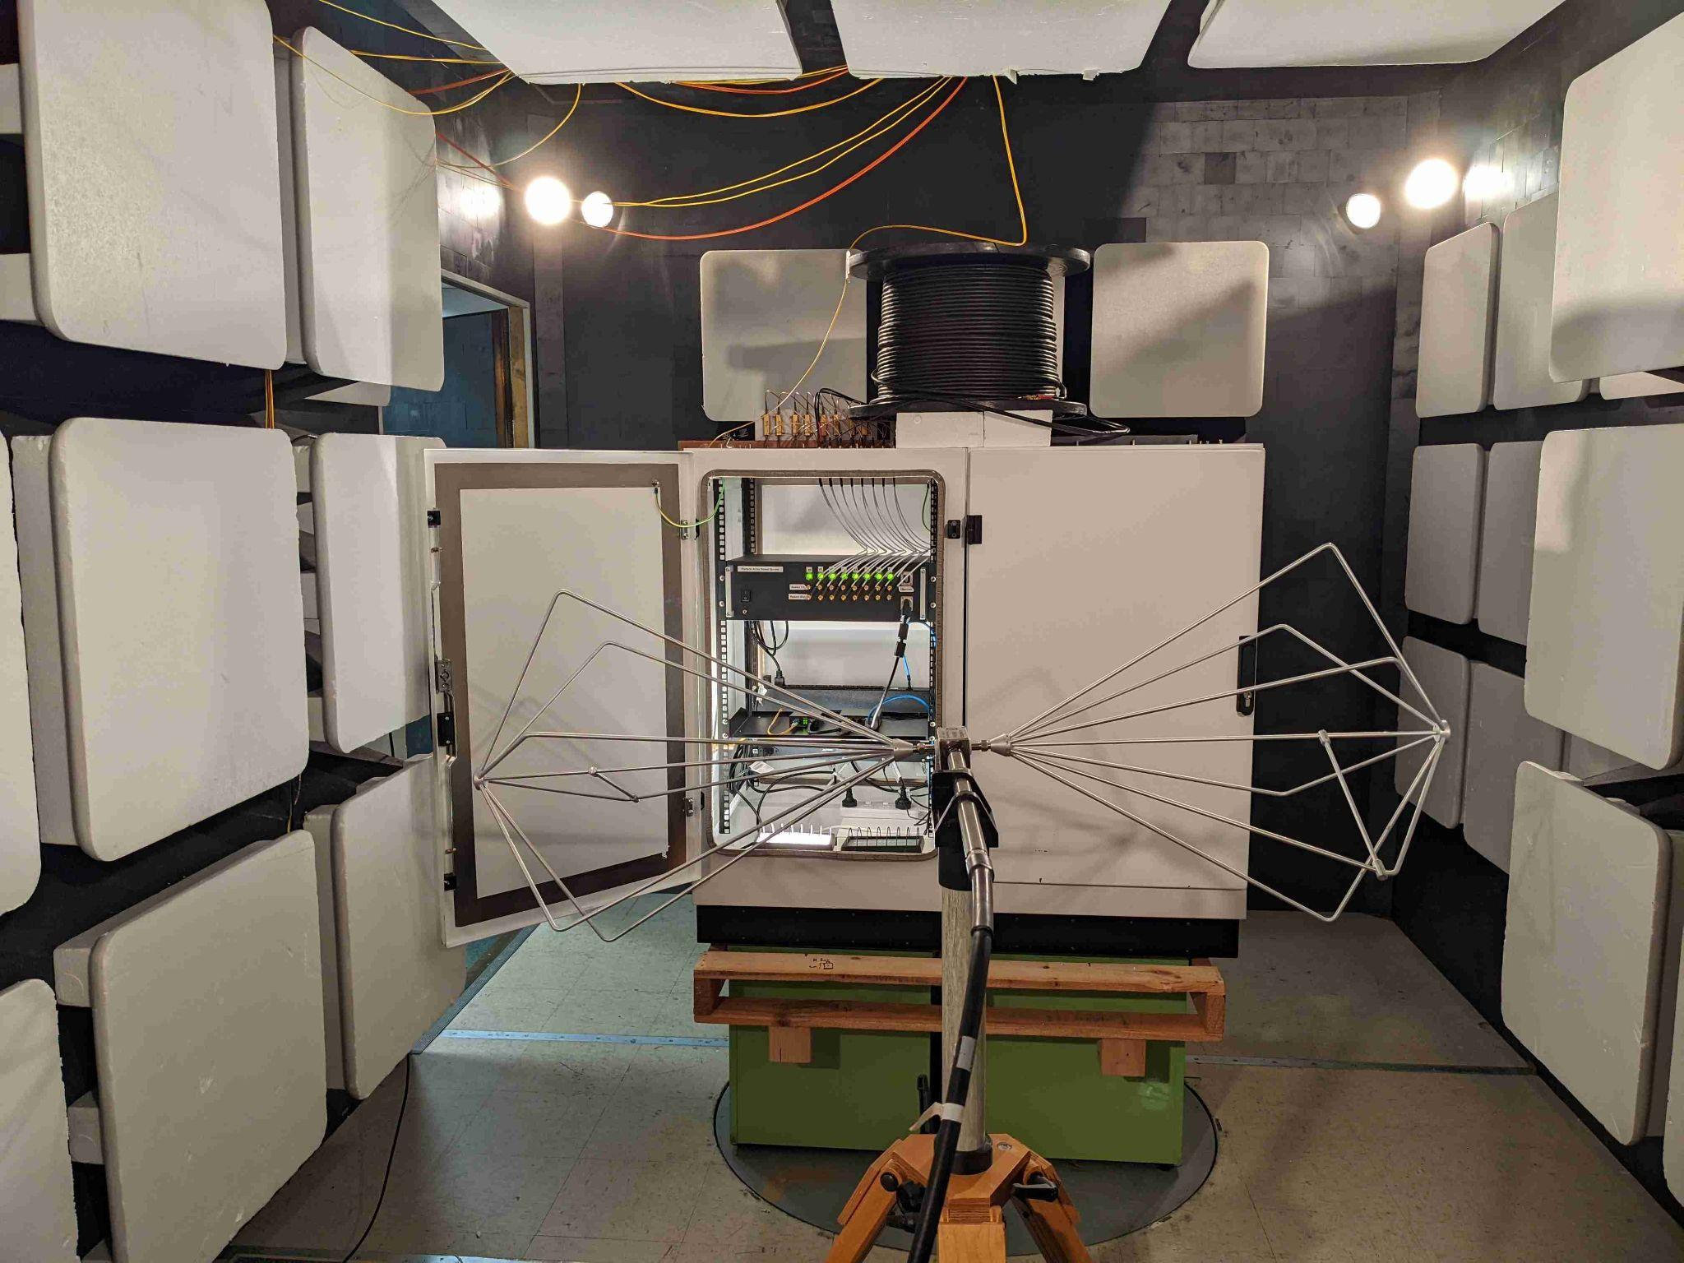
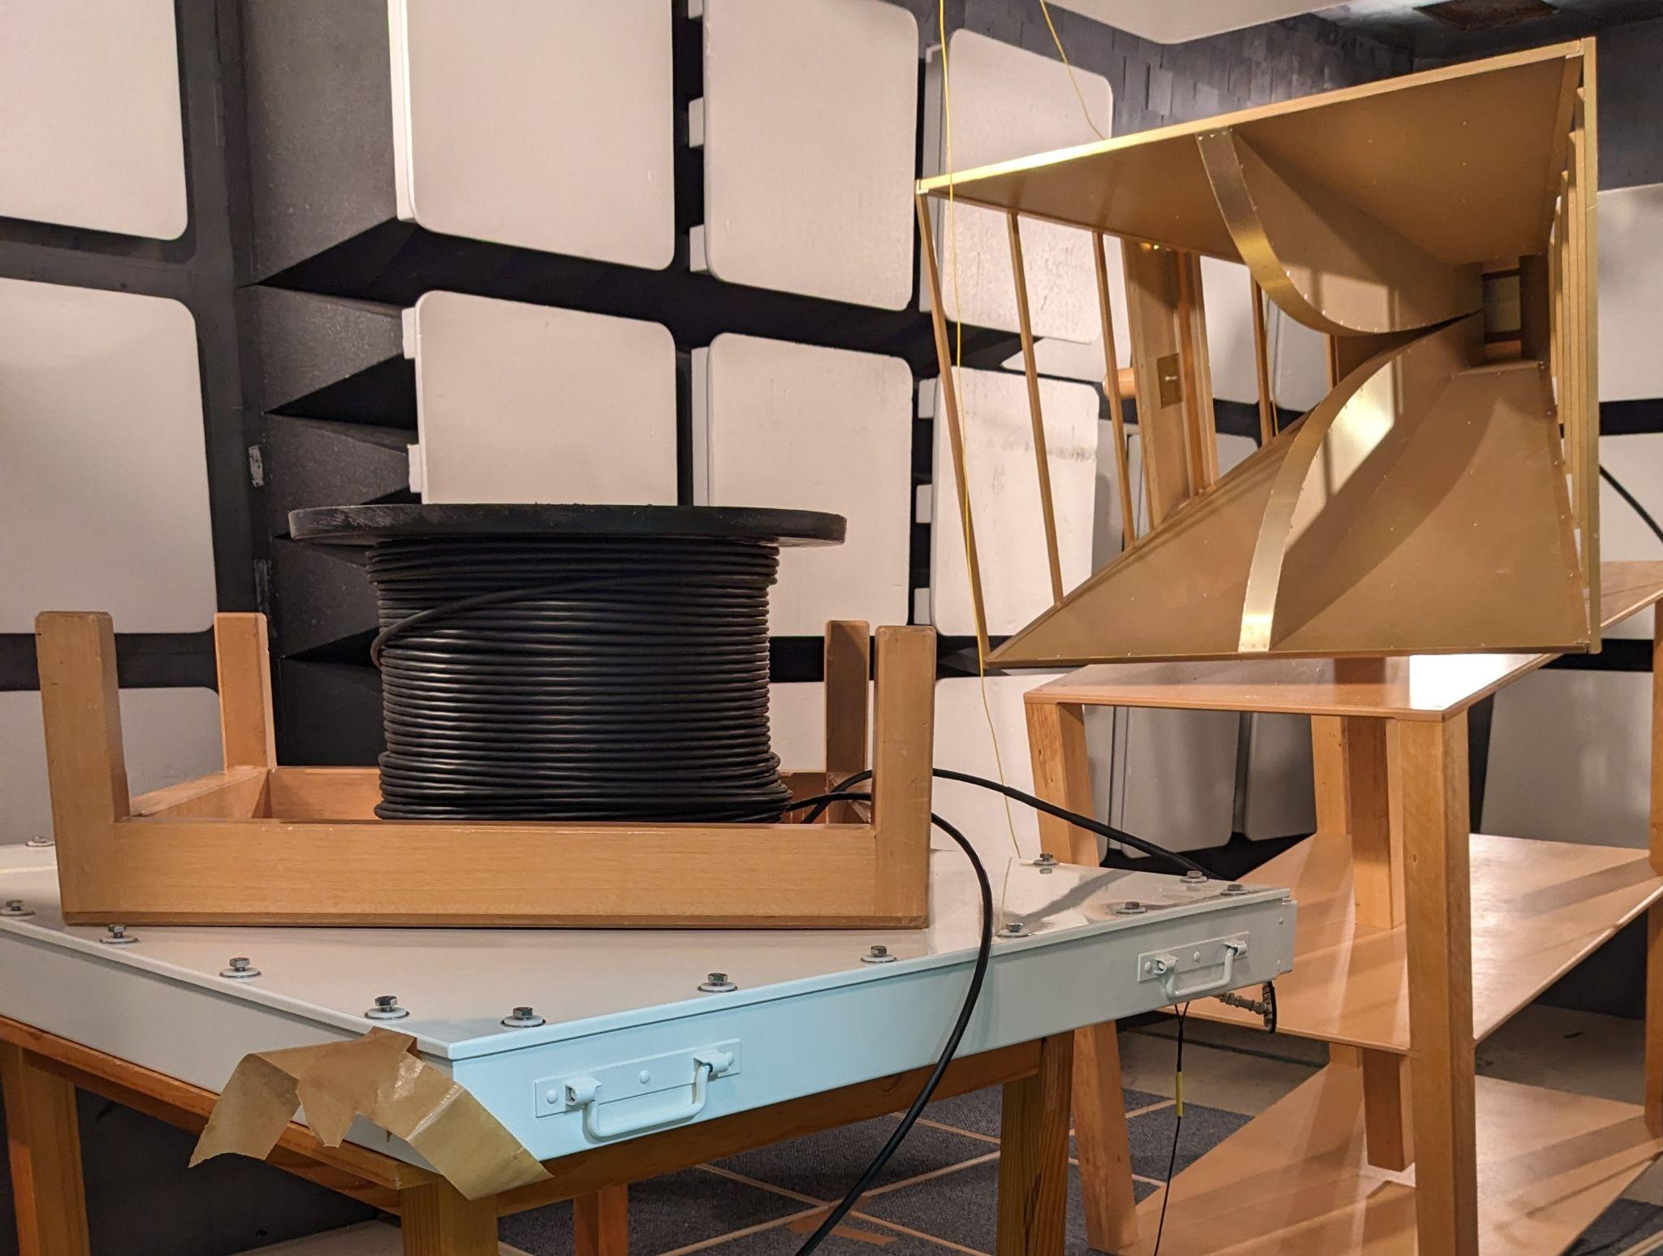
Particle Detector Array:
Field cabinet: Power supply and network connection.
Components received from team in Manchester: Justin Bray, Ralph,Spencer, Bob Watson, John Edgley, Keith Grainge.
EMC testing complete.
Assembly and System Testing in Perth:
Dave Kenney, Luke Verduyn, Clinton Ward, Andrew Williams, Greg Sleap, Andy McPhail, Paul Roberts, Edwin Dickinson, Clancy James.
“Pizza Box” particle detector
Slide: Dr Edwin Dickinson
Notes:
Component parts of the particle detector array have been received from Manchester. The parts have been assembled into their field configuration and tested for electromagnetic compatibility.

Slide 20
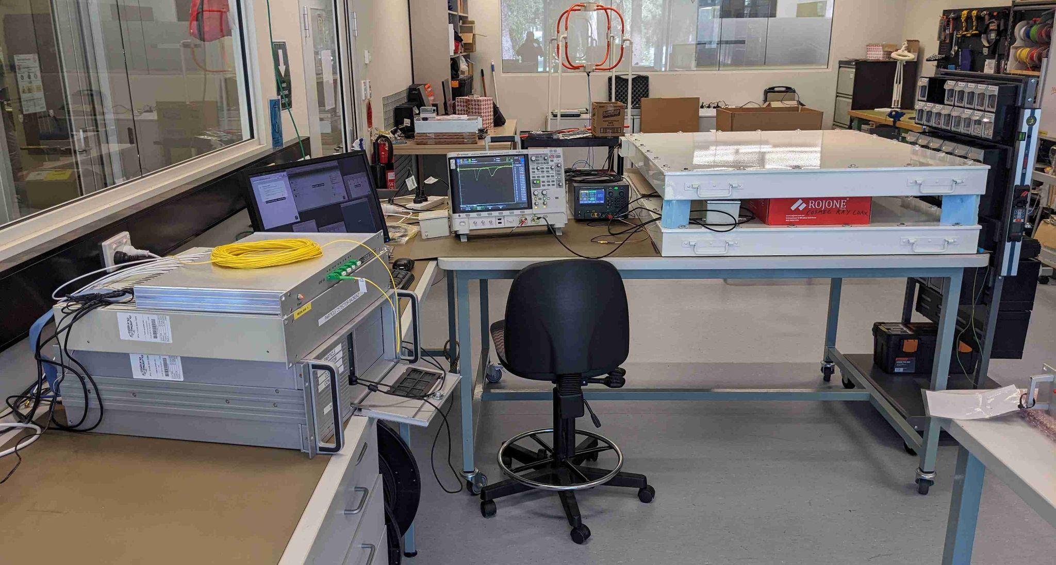
Bench testing:
Scintillator signal.
“Pizza Box” detectors.
Optical receiver.
Digitizer.
Server.
Muon.
Notes:
The system is currently being bench tested using muons, which are a component of the large showers of particles created by the interaction of cosmic rays with atoms of the atmosphere. The charged muons create a flashes of light within the blocks of plastic scintillator housed in the “pizza box” detectors. The light is detected by silicon photomultipliers and converted to optical signals for transmission to the recording system. In the field, if coincident signals are received from multiple detectors of the array, distributed over 10s of metres, then they are presumed to result from the same shower. The signals are recorded and a trigger is sent to the MWA to record a sub-observation of 8 seconds of radio data from around the arrival time of the shower. The particle and radio data will be used to infer the mass, energy and arrival direction of the cosmic ray that created the shower. Such information will be useful in constraining models of cosmic ray production and acceleration. Deployment is anticipated later this year.

Slide 21
Planned Work: MWA archive transients search
ASVO
Goal: process 10,000 hours of night-time MWA observations to search for seconds — minutes timescale transients
Team: Natasha Hurley-Walker, Kat Ross, Sam McSweeney, Dev Null (advisory)
Students: Aaqil Sadiq, Joleen Chong
Compute: DUG Technology (Perth-based supercomputing facility)
Timeline: Automated pipeline by end of 2024!
download
Calibrated visibilities
clean
Considering how we might save and serve these
Residual vis
MFS image
invert
Residual time cube
Candidates
filters

Slide 22
So how have we gone since 2013?
“The potential sources of radio transient emission fall into five broad categories:
coronal emission from nearby stars/substellar objects
emission from compact objects such as neutron stars and accreting black holes
explosive events such as gamma-ray bursts (GRBs) and radio supernovae
(exo)planetary emission from nearby systems
and new phenomena discovered through the opening of new regions of observational phase space.” Extragalactic Galactic
Bowman et al. (2013), Science with the Murchison Widefield Array, PASA, 30, e031
Prompt/coherent?
?
Notes:
What has actually happened since 2013

