Slide 1
MWA Receiver Upgrade Project
Progress & Upcoming Work
Jake Jones
Notes:
( 30s ) ( Introductions & Context )
Good afternoon!
So, for those of you who don’t know me, I'm Jake, I work on the MWA operations – engineering team.
And, today, I'll be giving an update on out progress and upcoming plans in our endeavour to upgrade the MWA receivers.
First of all, I just want to thank Yajun and the rest of the team from SHAO for their great work developing these new receivers. They are going to be a great addition to the MWA!

Slide 2
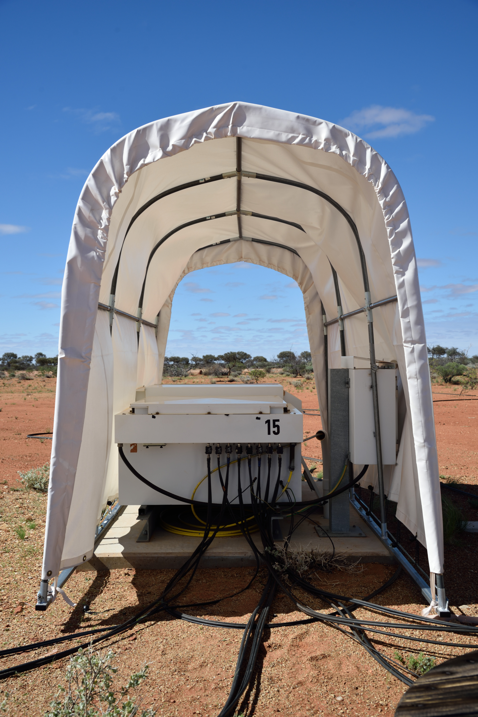
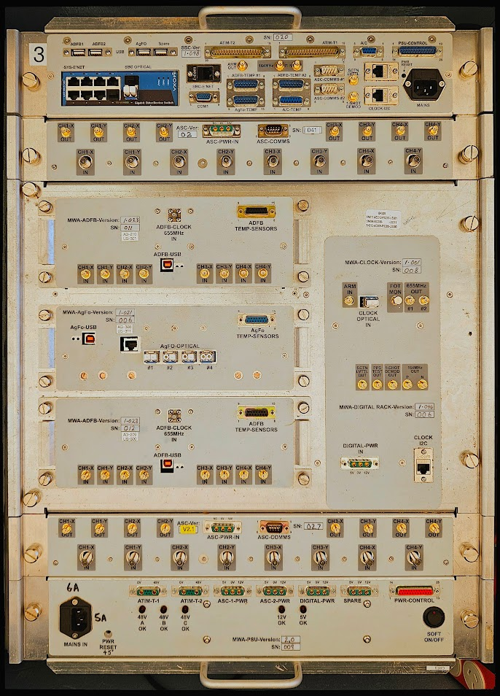
Partner Institutions
The Existing MWA Receivers
RRI Receivers
16 in Total – 8 Tiles each
8-bit ADCs
5-bit output precision
Critically Sampled PFB:
Aliasing near coarse channel edges
Ageing hardware
Notes:
(120s) # Background / Existing Recs
Now our current set of receivers, called the RRI receivers, look like this.
On the right we have the electronic equipment that makes up the receiver.
So the existing receivers look a little like this, On the left we have the airconditioned box, sitting on a concrete pad and a weather shade over top of it.
We have 16 of these receivers, each of which digitise 8 tiles each.
Now.. These receivers have served us well for a very long time, however they do have some shortfalls:
Namely, they only have 8 bit ADC's,
They round down to 5 bits of precision before transmitting data
They have a critically sampled PFB that exhibits aliasing that is very hard to deal with,
Finally, they are simply starting to age and become more unreliable.
So this is why we're looking towards upgrading the receivers.

Slide 3
Partner Institutions
MWA Phase III
Phase III Receiver:
At least a 12-bit ADC
8-bit output precision
Supports 2 modes:
Compatibility Mode (critically sampled)
Oversampled mode.
Use standard ethernet networking for data transport.
Phase III Milestones
New Correlator
256 Tiles (concurrent)
Oversampling PFB
Requires New Receivers
Notes:
(60s) # Motivation & Context: What is Phase III? And why new receievrs?
The goals for what we call Phase III of the MWA has always been to have the capability to process 256 Tiles simultaneously, and also to improve the spectral artifacts by implementing an oversampled PFB.
Both of which require new receivers
So, why do we want to upgrade the receivers?
Well, our existing receivers have served us well, but they have some shortfalls.
Namely, they are starting to age. (Built using legacy software that’s no longer supported, no ability to modify/fix, sometimes all we can do is turn it off and on again 5 times in a row.)
They only have 5 bits of output precision
And they exhibit issues near their channel edges due to aliasing.
Phase III is …

Slide 4
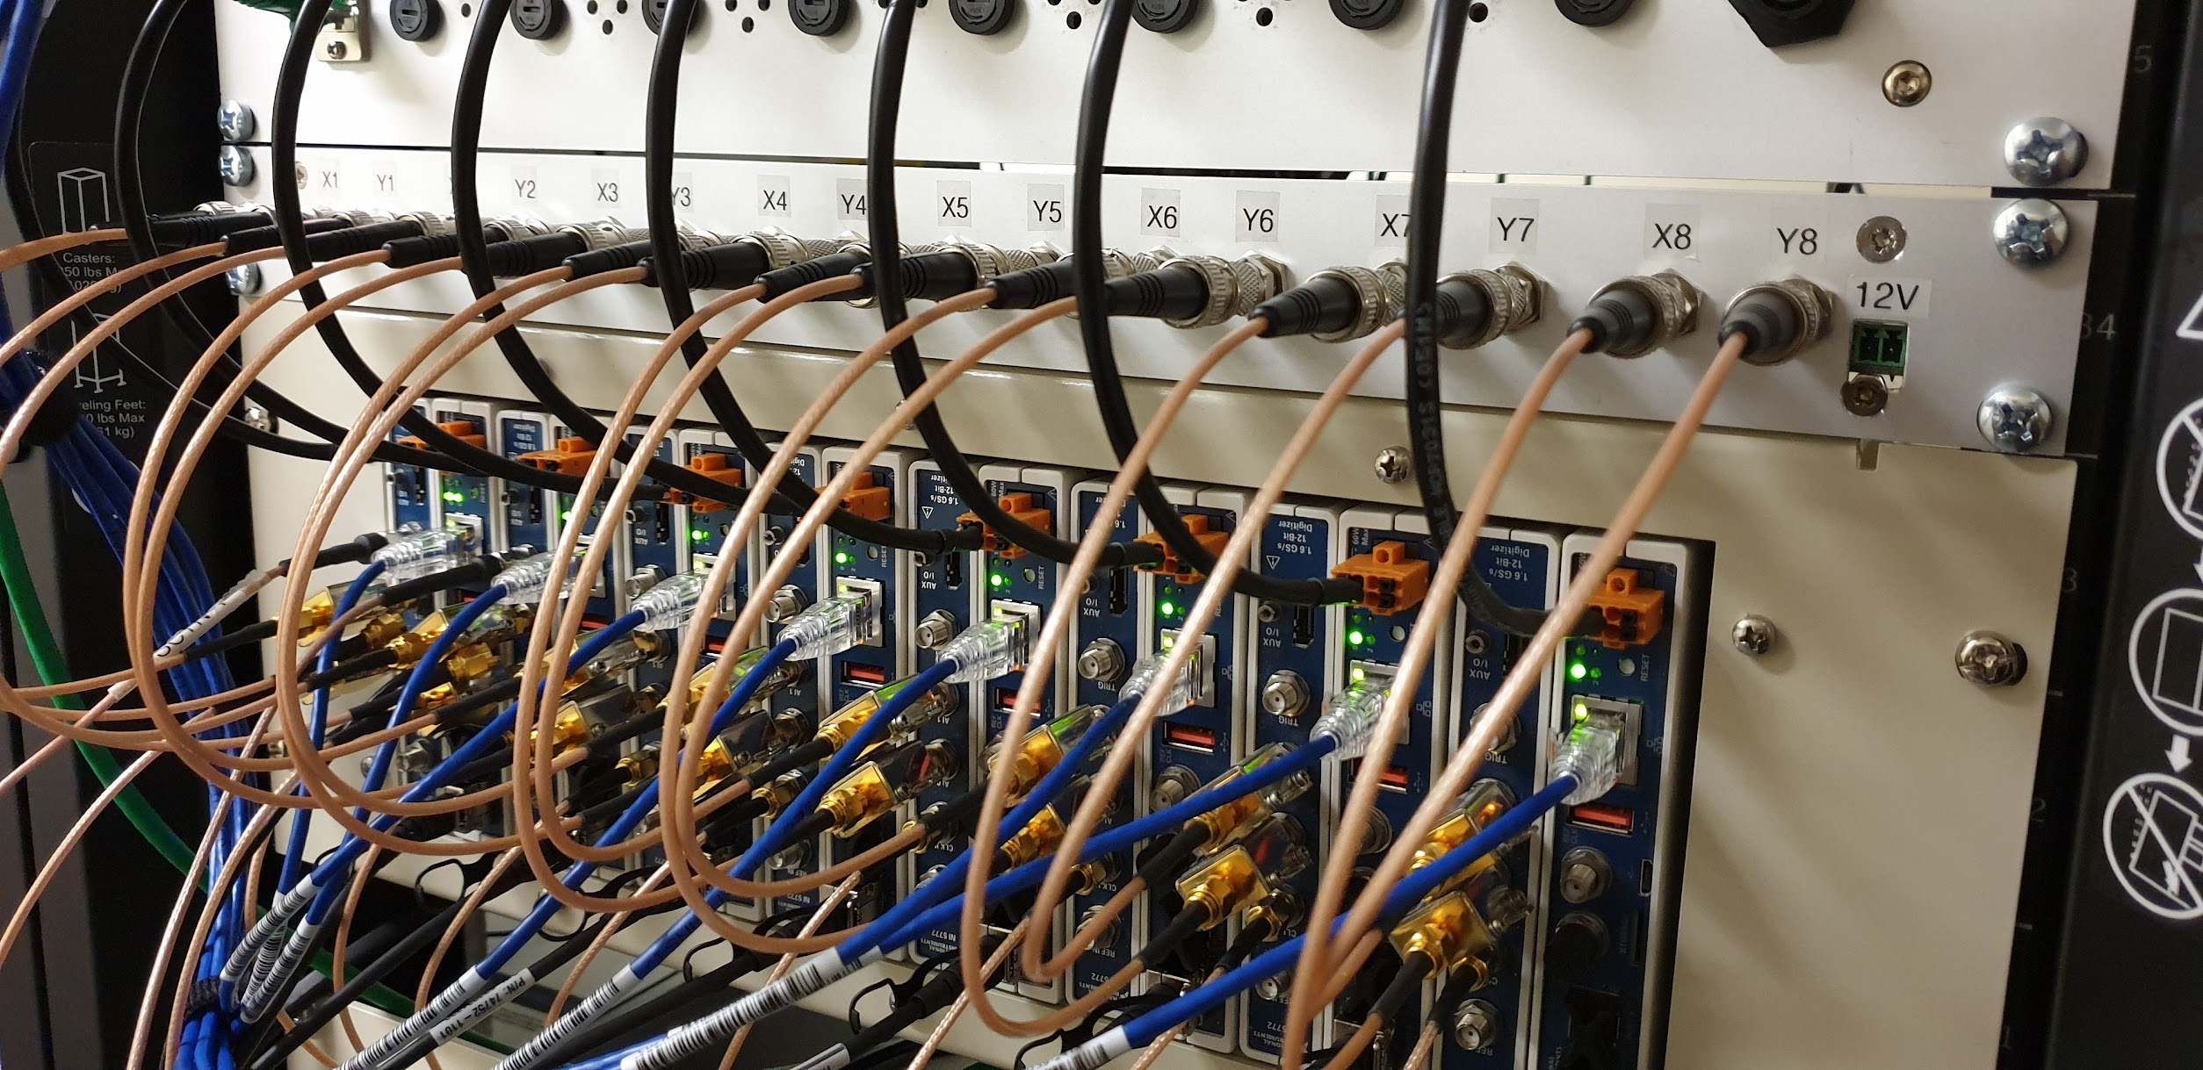
Partner Institutions
The NI Receivers
Phase III capable receiver
12 bit ADCs
Supports compatibility & oversampled Modes
In service since 2022
Solar Panel Tiles
Group F
Group G
Notes:
(30s)
So, we already have the National Instruments based receivers or NI receivers for short.
2 of them (so 16 Tiles worth) have been in service since 2022, and they are currently connected to the F & G group solar Tiles.
Unfortunately, we only have two of these receivers, and they are very expensive... Which leads me to the new SHAO receivers.

Slide 5
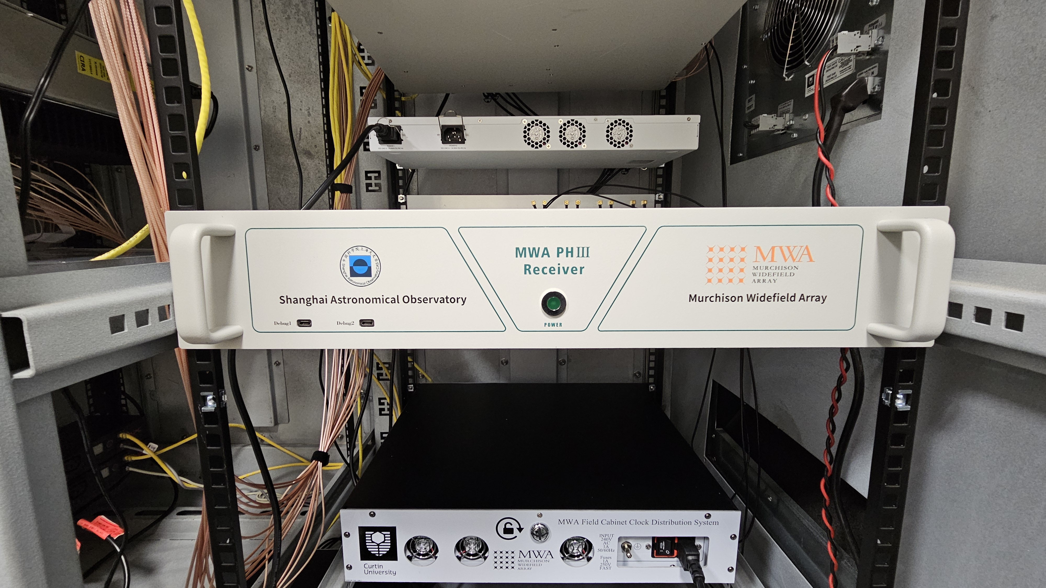
Partner Institutions
The New SHAO Receivers
Phase III capable receiver:
12-bit ADC
Two Modes:
Compatibility Mode
Oversampling Mode
Standard 10GbE Networking
Notes:
(30s)
At this point I need to thank Yajun and the whiole team from SHAO for their great work developing the new receivers.
They have developed a phase III capable receiver?
Oversampling
12 bit ADC
Modern hardware
Developed Prototype. And recently delivered the remaining 15 receiver modules.

Slide 6
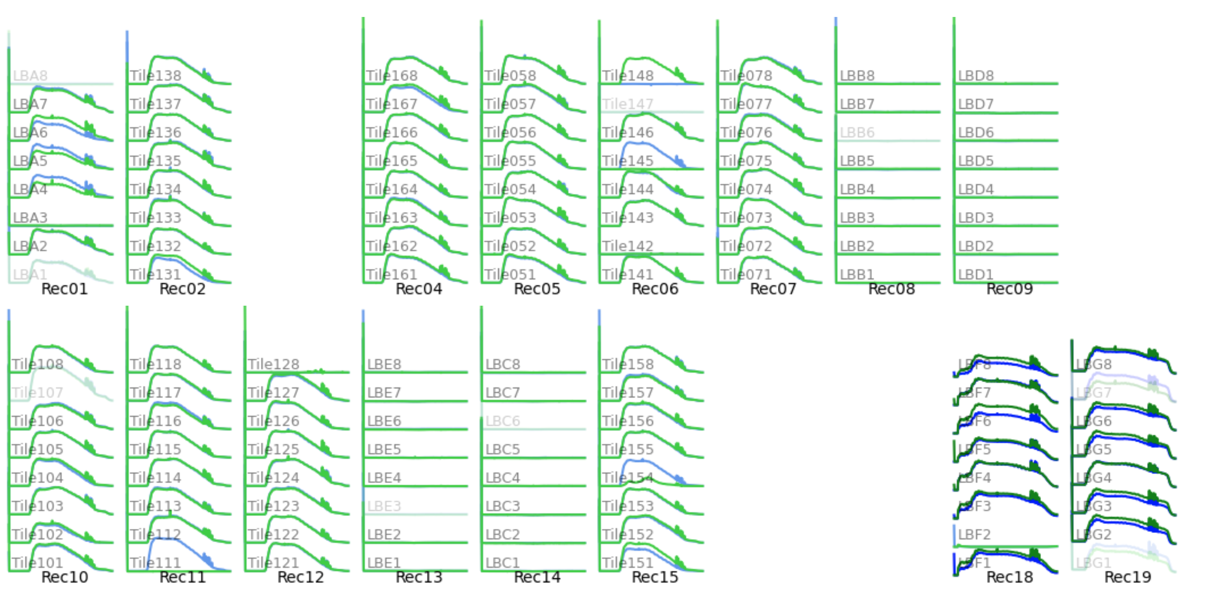
Partner Institutions
Deployment of the First Prototype
​Prototype Unit Deployed in April 2024
Purpose:
Validate basic functionality
Integrate with M&C system
MWA-SHAO Rec
Notes:
(45s)
Connected to Solar Tiles via RFoF (G Group)
So while the SHAO receiver was deployed we did a series of tests, to validate basic functionality, starting with observing calibrator sources.

Slide 7
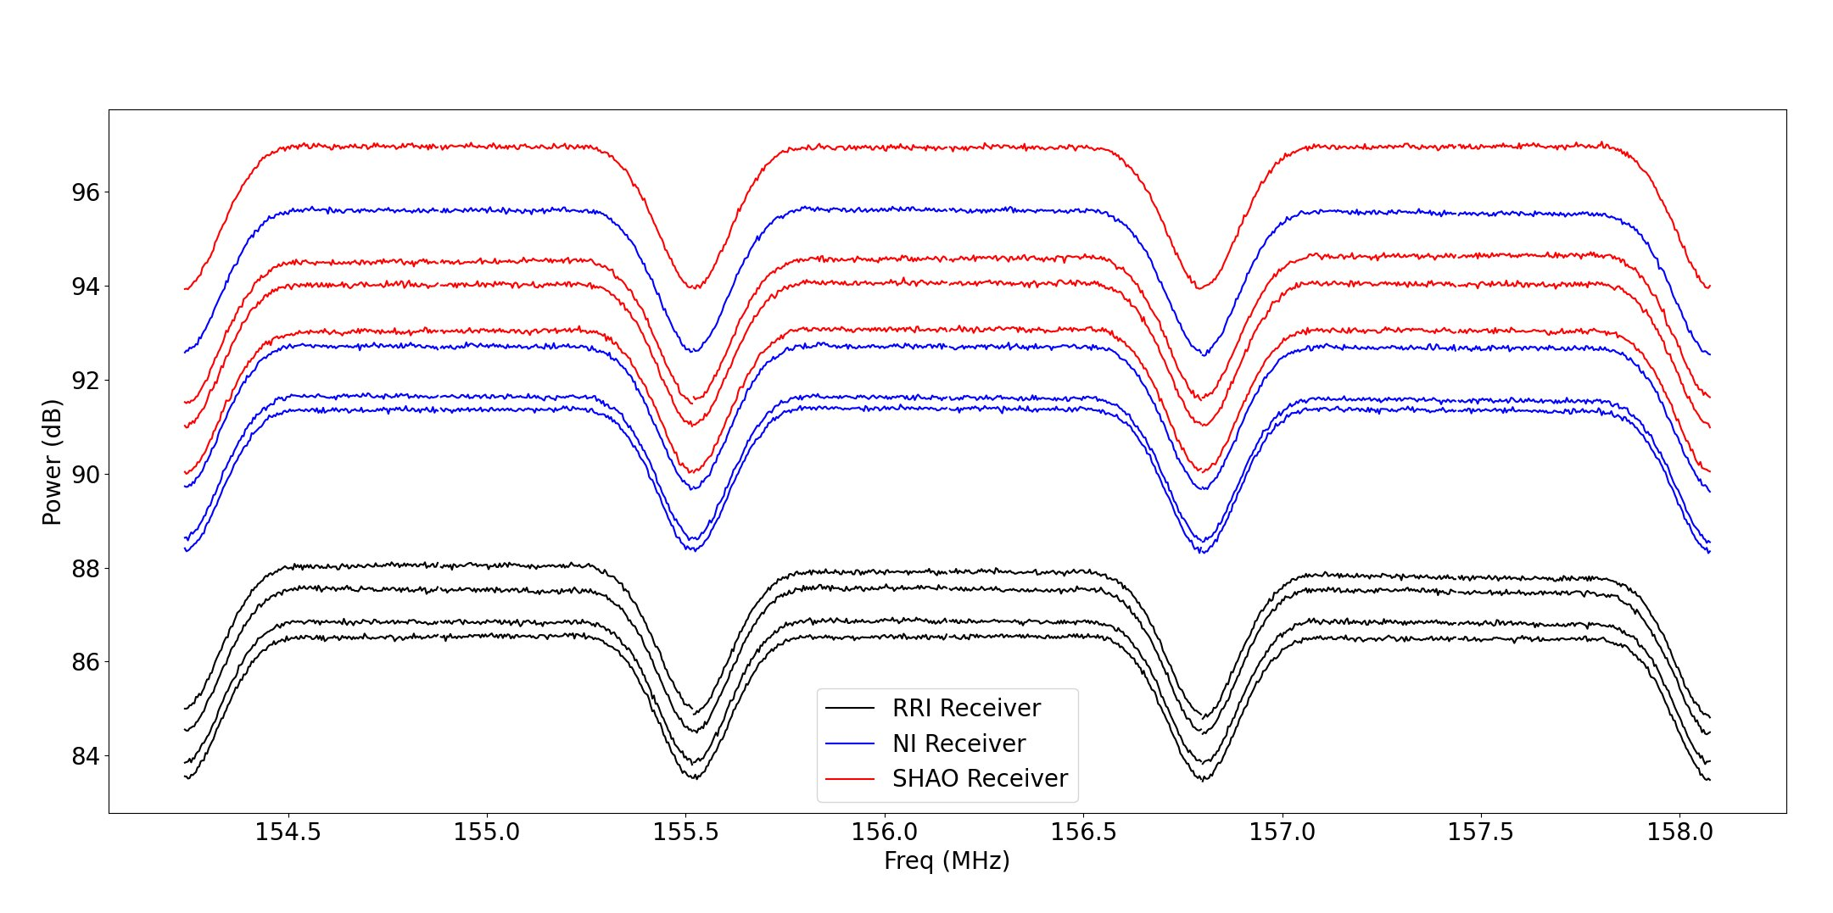
Partner Institutions
Results: Critically Sampled Mode
Auto-Correlation vs Frequency (3 coarse channels)
Computed from VCS observation
Exhibits the expected frequency response of the critically sampled PFB
SHAO receiver exhibits same response compared to the NI and RRI receivers.
Notes:
(45s)
The idea is that legacy mode emulates the exact same PFB filter as the existing RRI receivers.

Slide 8
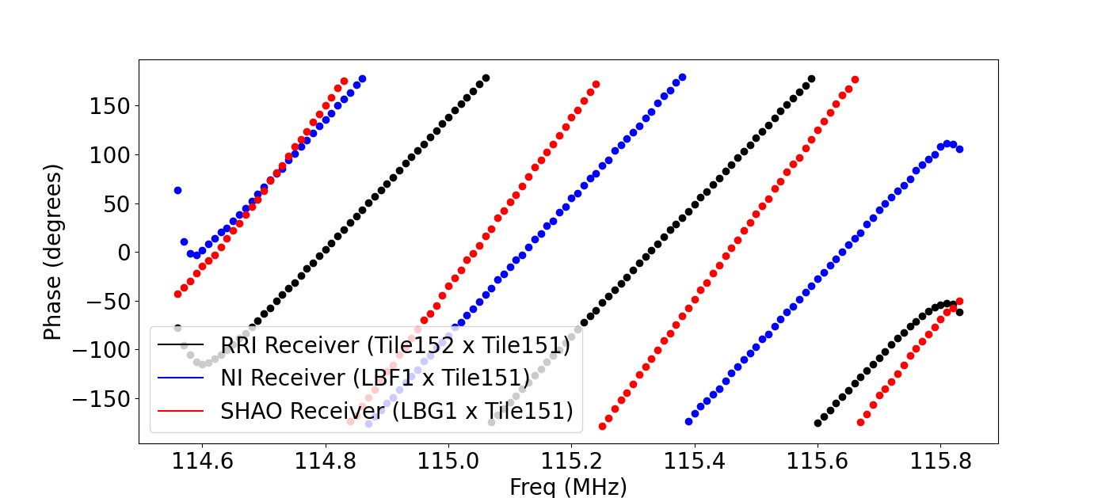
Partner Institutions
Results: Critically Sampled Mode
Correlated Phase vs Frequency
Computed from VCS observation
Critically sampled PFB exhibits non-linear phase near the channel edges due to aliasing.
Notes:
(30s)

Slide 9
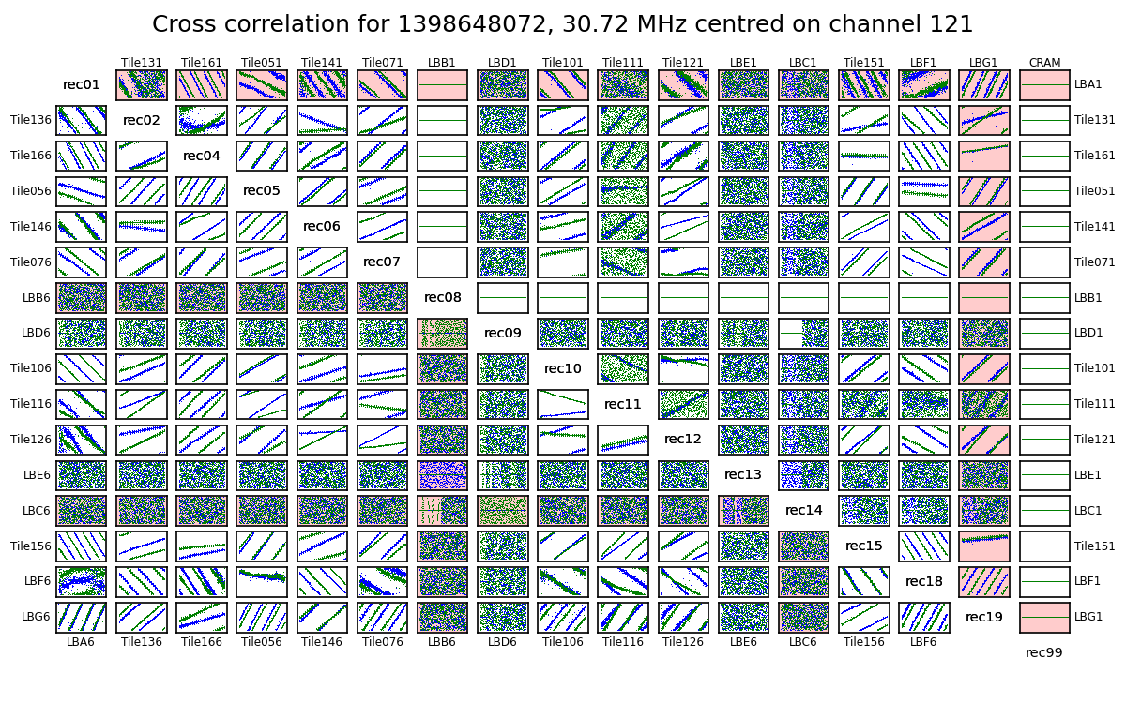
Partner Institutions
Results: Critically Sampled Mode
Source: Sun
Using MWAX we successfully correlated data from the MWA-SHAO Receiver.
We see good correlation between SHAO receiver and other tiles.
MWA-SHAO Rec
Notes:
(45s)
We often do what we call a fringe test when assessing the state of the array.
This simply shows the phase vs frequency, for various baselines.

Slide 10
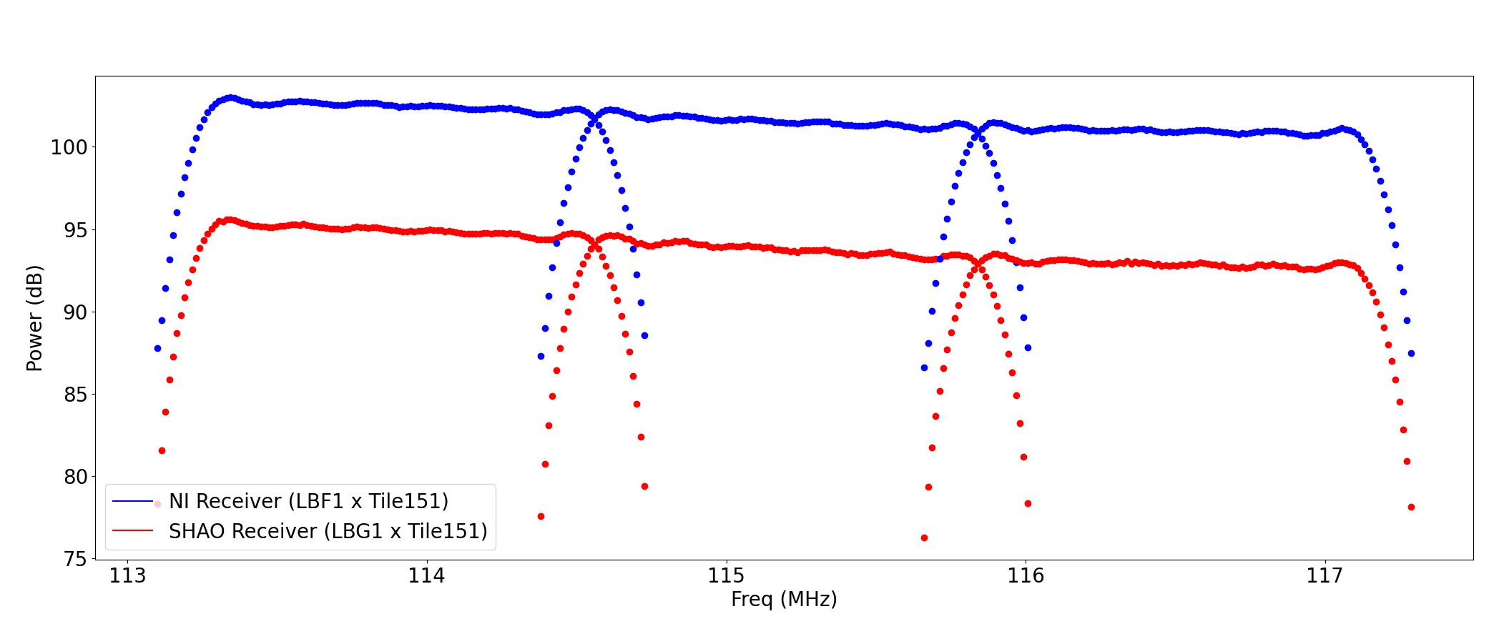
Partner Institutions
Results: Oversampling Mode
Computed from oversampled VCS observation
No de-ripple applied
Filter rolls off only in overlapping region.
Auto-Correlation vs Frequency (3 coarse channels)
Notes:
(45s)

Slide 11
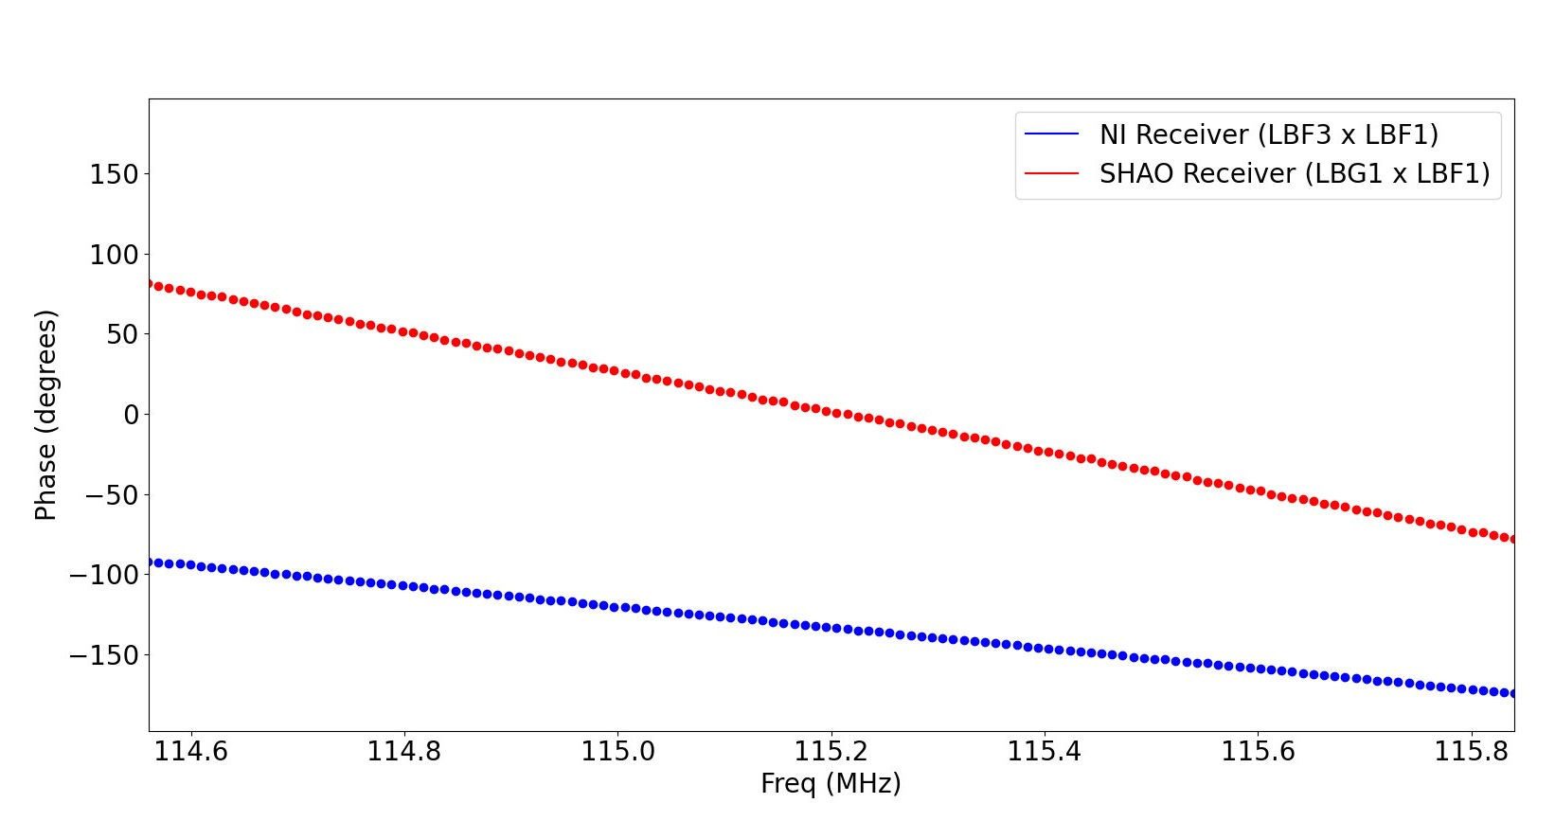
Partner Institutions
Results: Oversampling Mode
Correlated Phase vs Frequency
Computed from oversampled VCS observation
Linear phase across the channel passband
Oversampling mode has eliminated the non-linear phase near the channel edges.
Notes:
(45s)

Slide 12
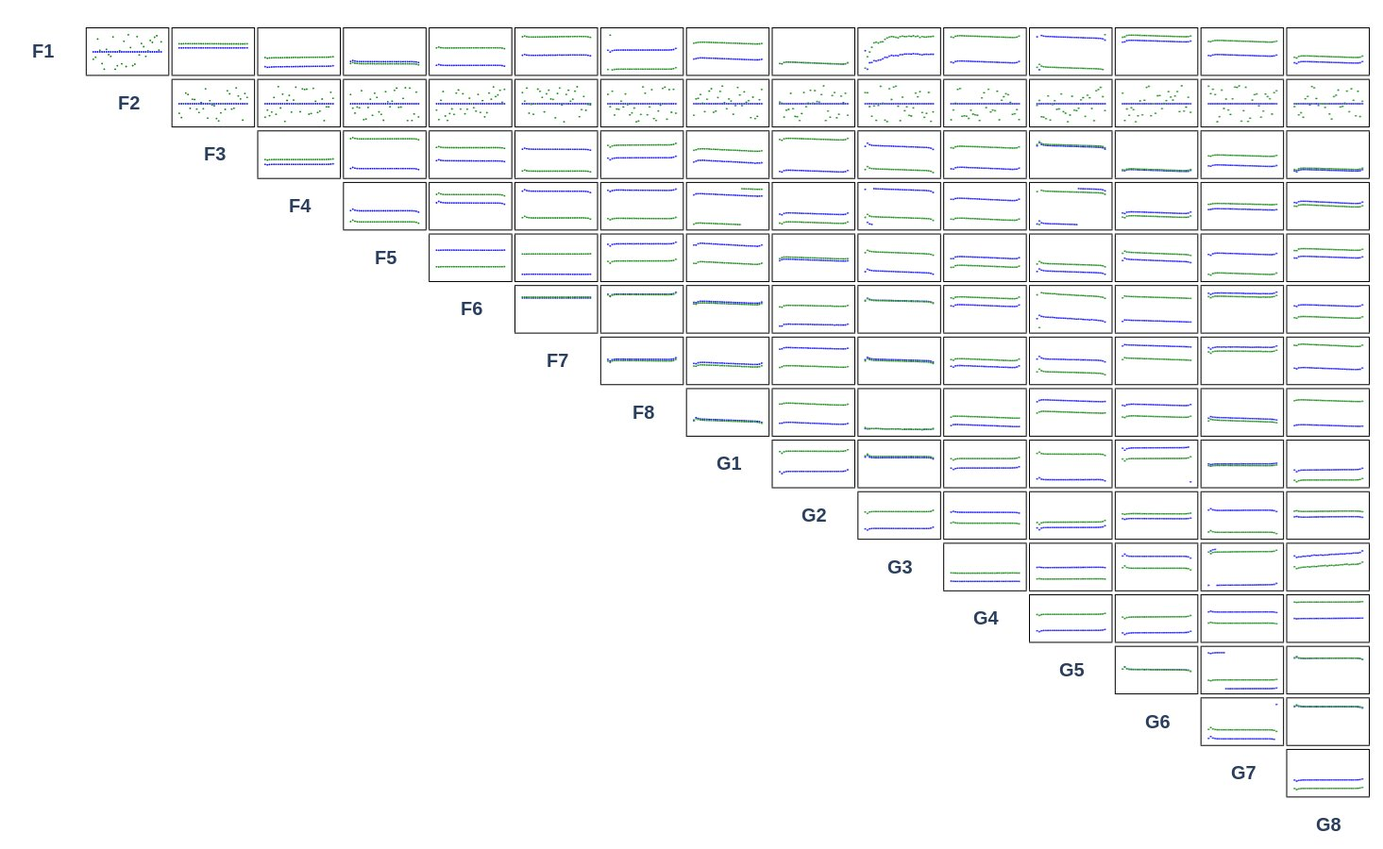
Partner Institutions
Results: Oversampling Mode
Phase vs Frequency for each baseline
Only 16 active tiles.
1x NI Receiver
1x SHAO receiver
MWAX successfully correlated data from the MWA-SHAO Receiver in oversampling mode
We see good correlation between SHAO receiver and other tiles.
Notes:
(45s)
We successfully validated the basic functions of the receivers, and integrated them within the Monitoring & control system.

Slide 13
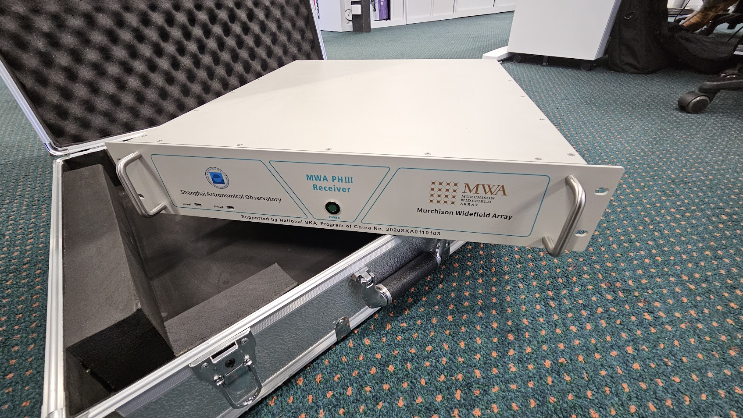
Partner Institutions
Deployment of 16 New Receivers
Last month we received delivery of 16 new SHAO receivers!
Notes:
(30s)
And so with the initial prototype deployment complete, we received shipment of the remaining SHAO receivers, making for a total of 16.
Now, the team is fully focused on getting these new receivers deployed, which requires a whole lot of extra work.

Slide 14
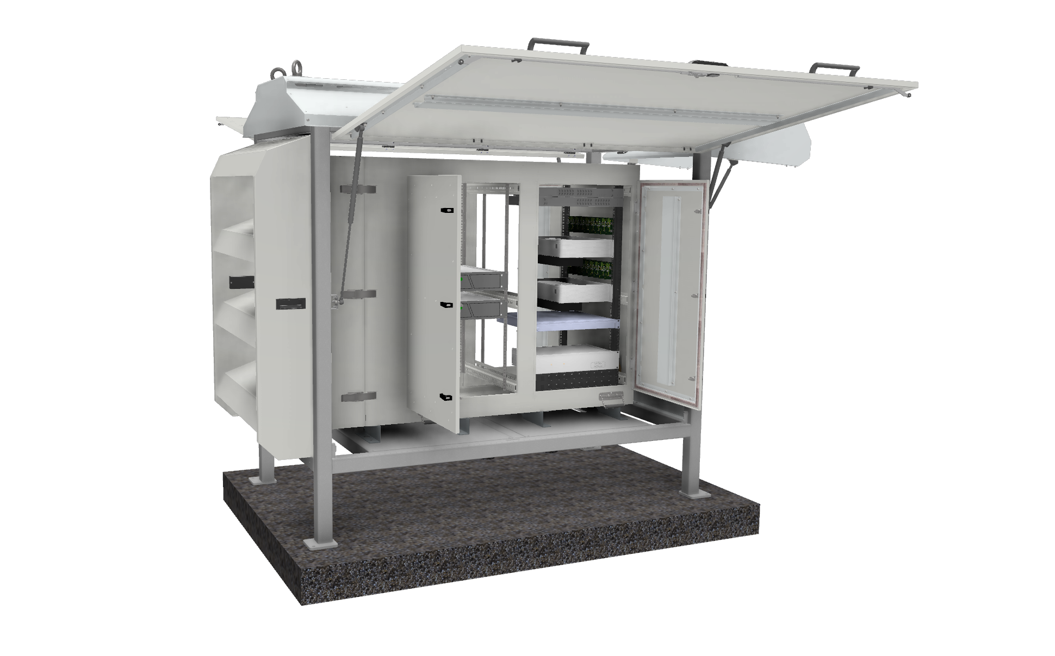
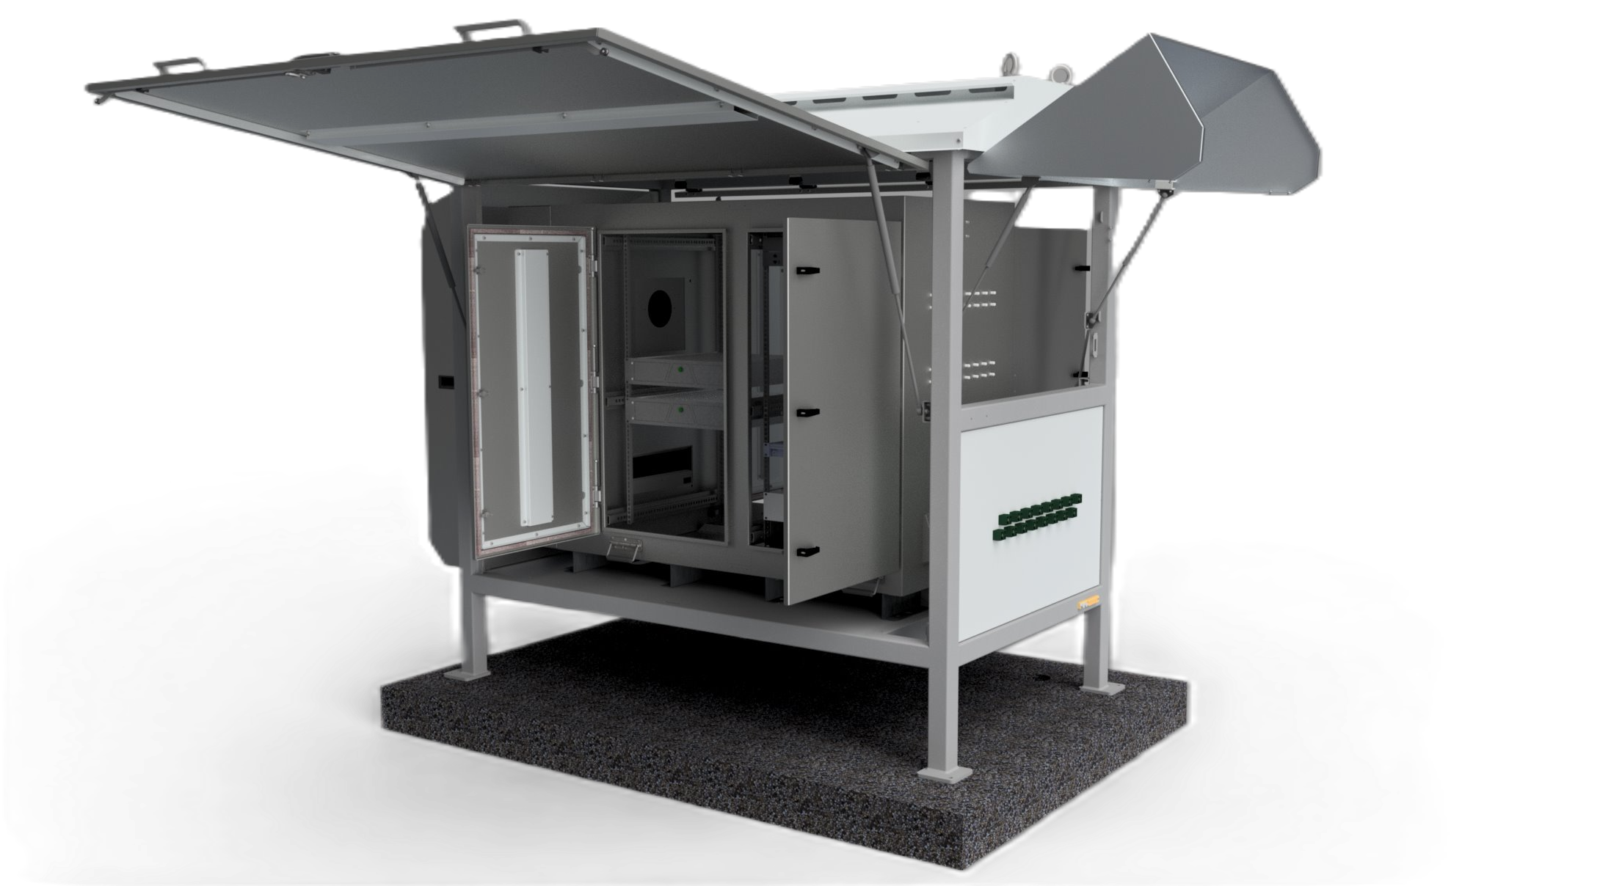
Partner Institutions
Receiver Field Cabinet
Credit: Luke Verduyn
Notes:
(60s)
Since we're increasing our number of receivers, we need somewhere to put them.
So our resident mechanical engineer, Luke, has been developing a new receiver field cabinet enclosure.
The cabinet consists of two parts, weather enclosure and EMC shielded cabinet.
Upon completion of the project there will be a total of 8 of these field cabinet, as each cabinet support 16 tiles instead of 8.

Slide 15
Partner Institutions
Weather Enclosure
Protect inner cabinet from the Sun and the rain.
Easy to service.
To be fixed onto the existing concrete pads.
Notes:
(30s)

Slide 16
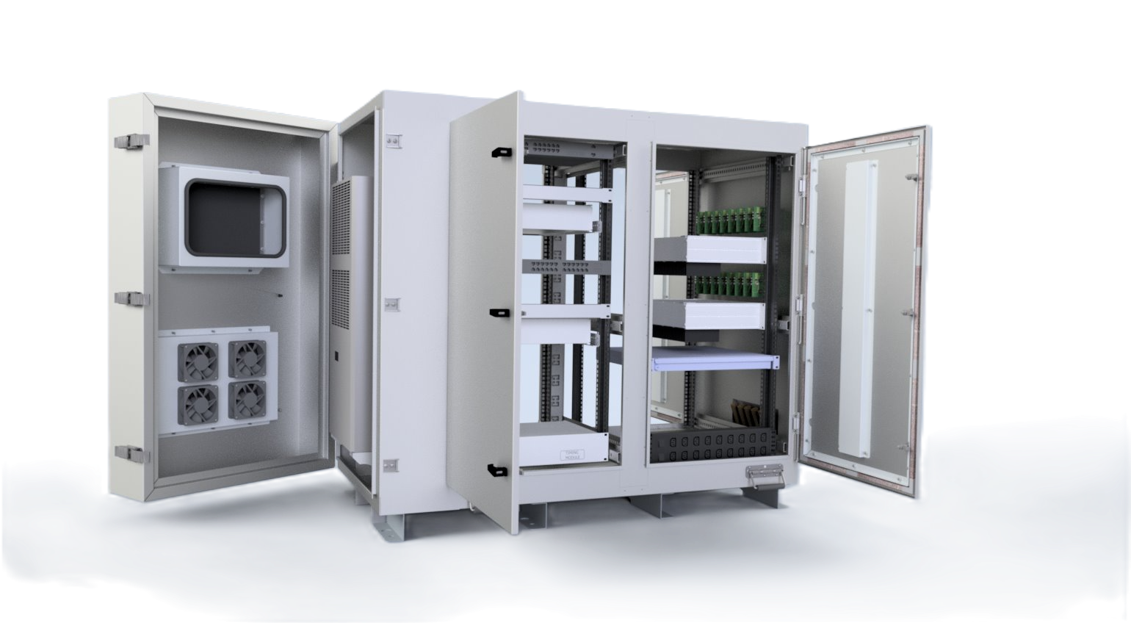
Partner Institutions
Receiver Field Cabinet
EMC Shielded
Air Conditioner
Standard Server Rack
2x SHAO Receivers per cabinet
16 Tiles
Notes:
(60s)
We're not replacing the existing receivers, we're deploying alongside.
So we need new physical enclosures to house the new receivers.
Supports 16 tiles and will contain Two of the new SHAO receivers.
We will build 8 in total, supporting 128 Tiles.

Slide 17
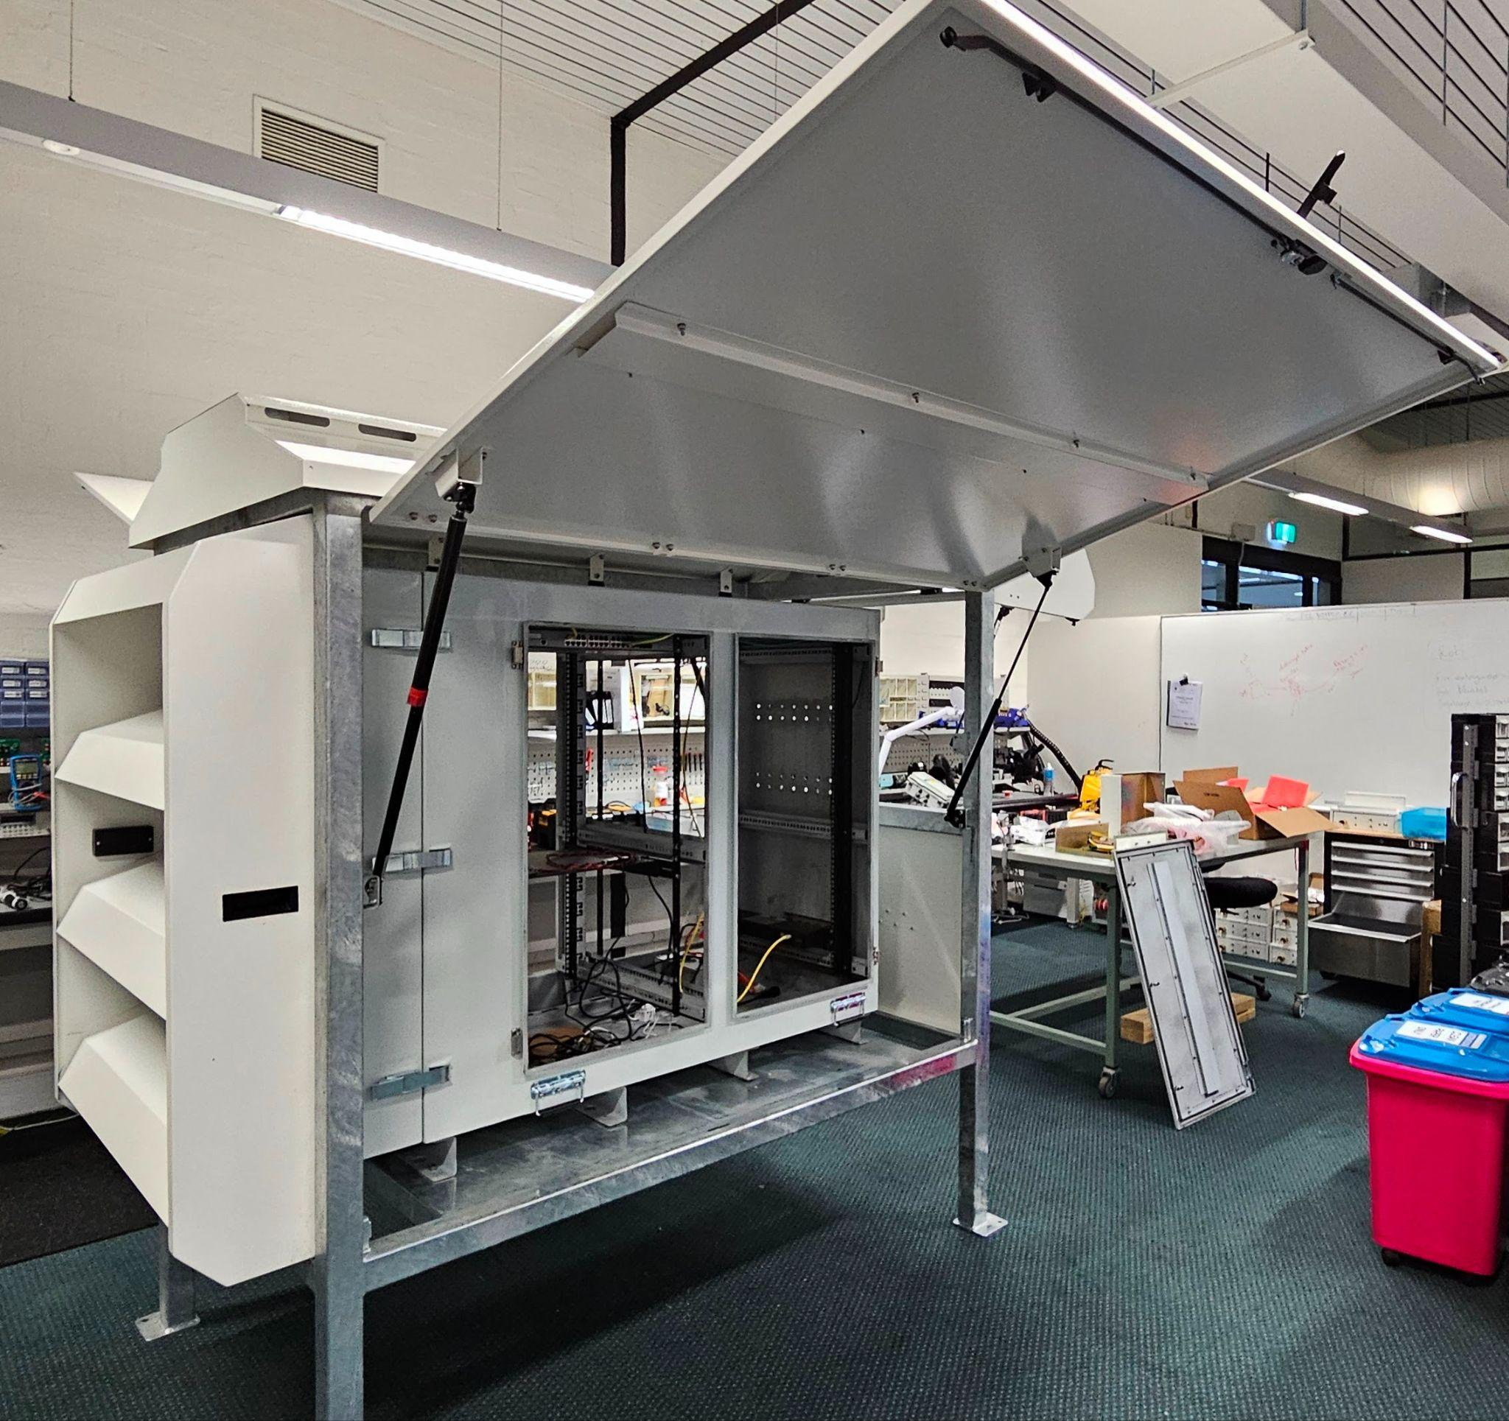
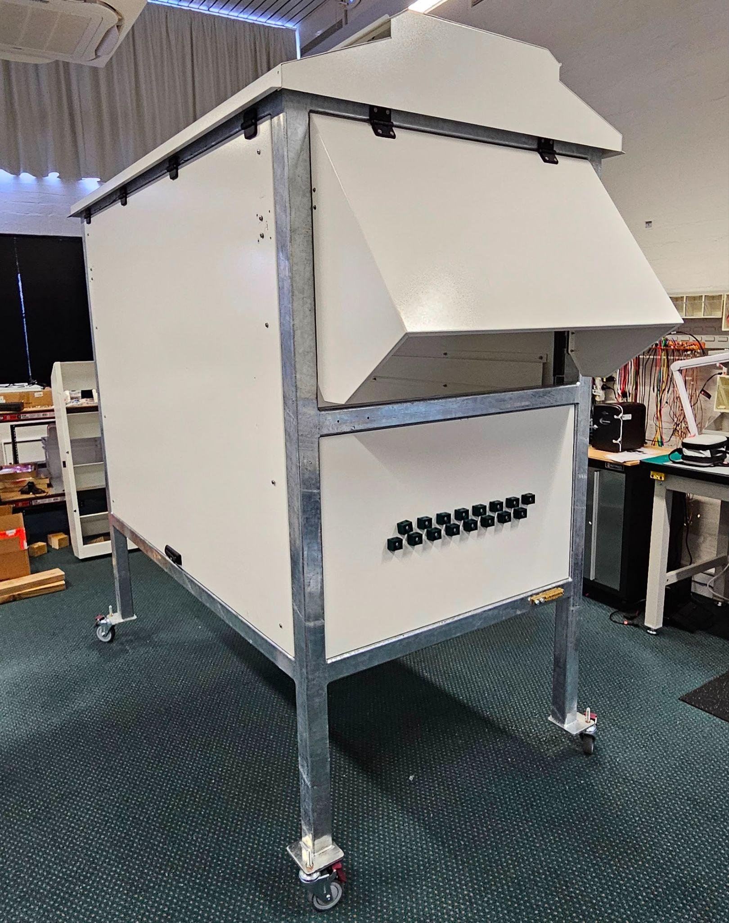
Partner Institutions
Receiver Field Cabinet Prototype
Notes:
(30s)
This is from one month ago
Here is the cabinet and weather enclosure being test fit.
The process of doing so allowed us to identify some minor issues, such as the need to strengthen the doors to increase their rigidity.

Slide 18
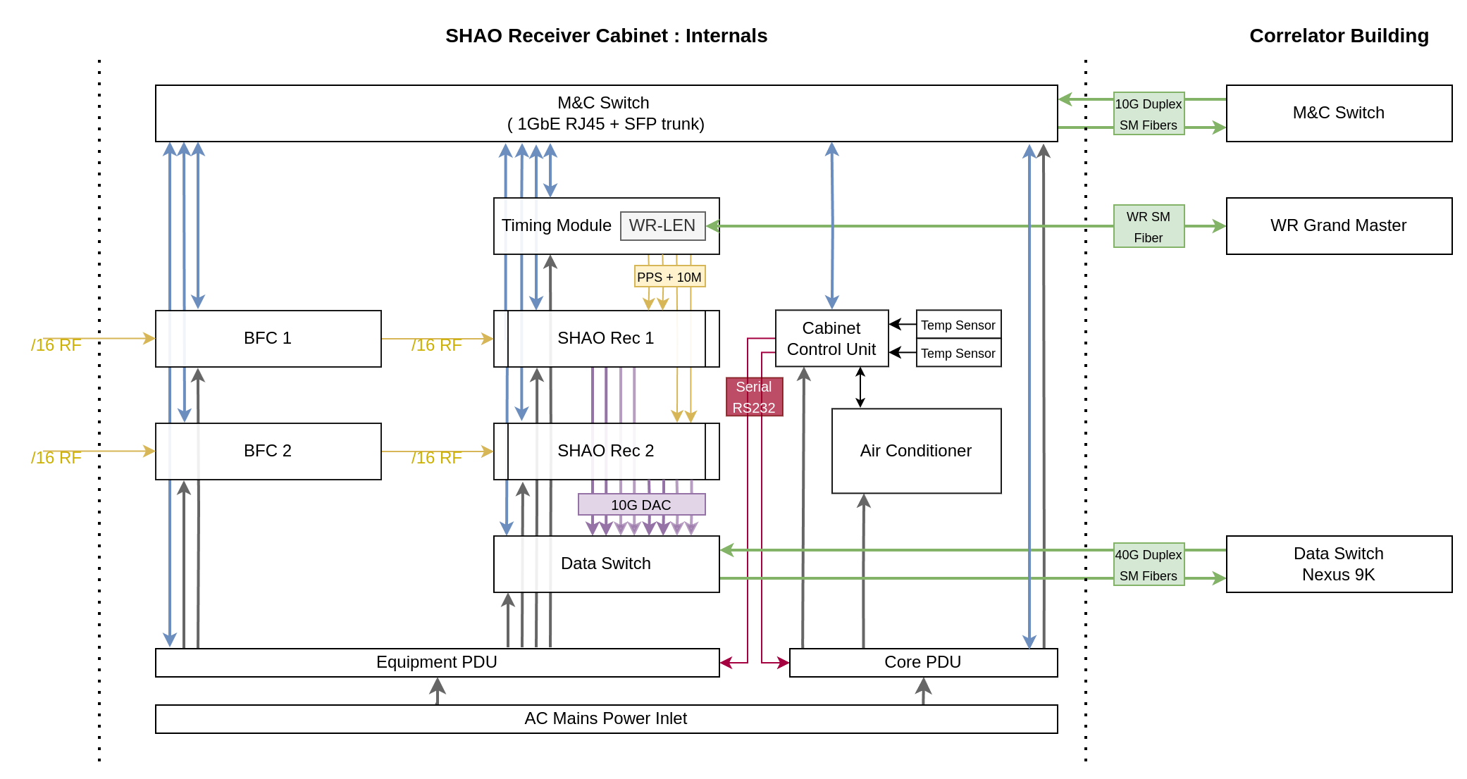
Partner Institutions
Field Cabinet Equipment
Notes:
(30s)

Slide 19
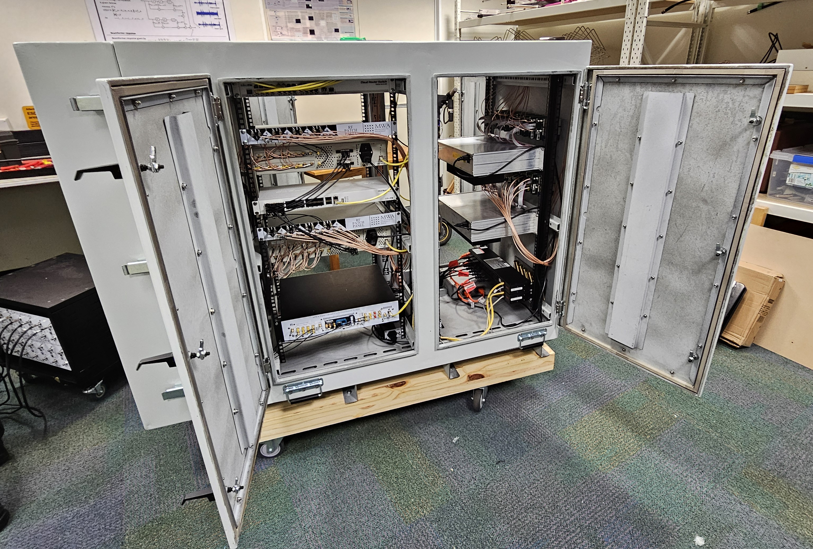
Partner Institutions
System Integration & Testing
Test fit all internal equipment within the rack.
Powered on and operated the full system in a lab setting.
Operated the air-conditioner under full load. (at ambient temperature of 30 degrees)
Notes:
(90s)

Slide 20
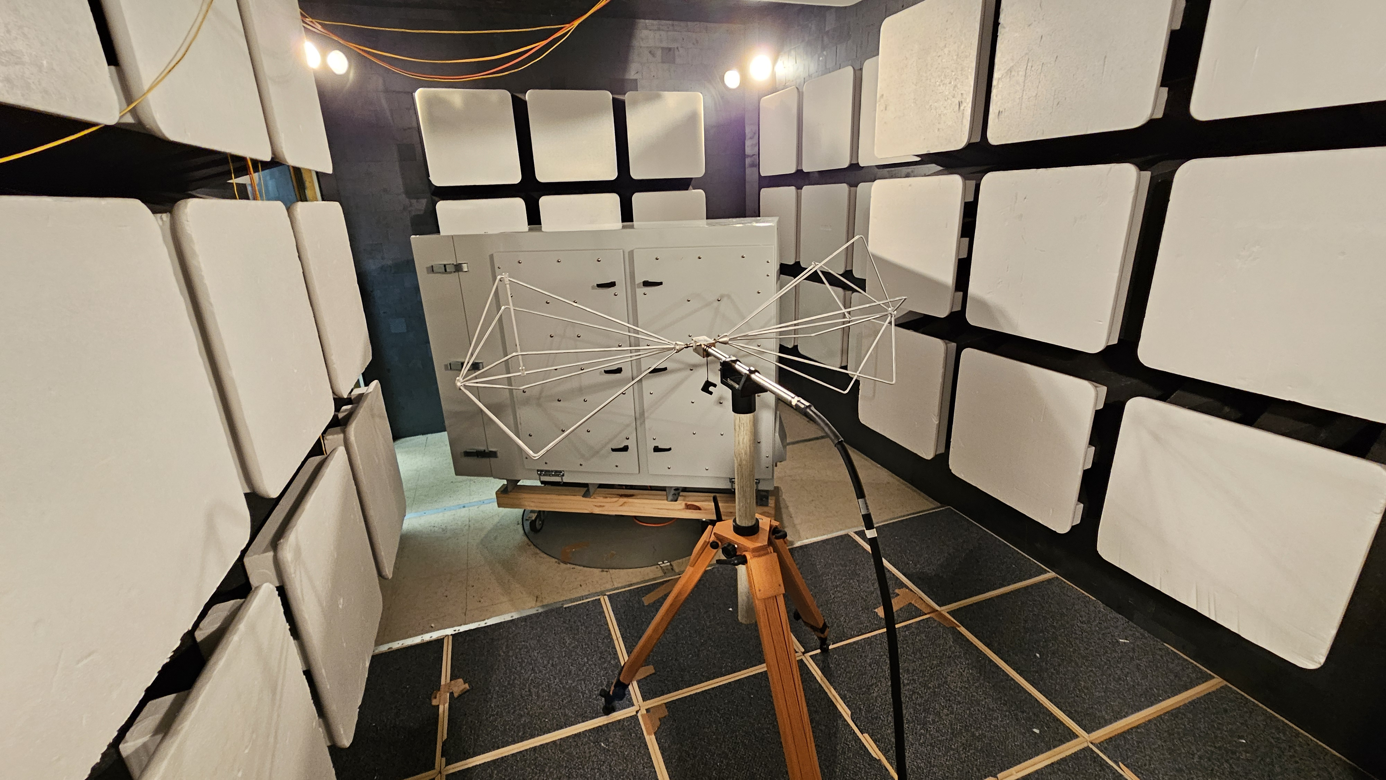
Partner Institutions
Upcoming Plans
Electromagnetic Compliance Testing is underway
1 Month: Deploy the first prototype field cabinet
The next 8 field cabinets are in production
All 8 cabinets to be deployed by mid next year (2025).
Notes:
(60s)

Slide 21
Partner Institutions
Summary
Validated the prototype SHAO receiver by deploying and integrating it within the telescope
Designing and fabricating 8 new receiver field cabinets to support an extra 128 tiles.
Deploying the first prototype cabinet (with 2 new SHAO receivers) in a month's time.
Thanks to SHAO for developing the receiver
Thanks to everyone on the operations & engineering team
Notes:
(60s)

Slide 23
Partner Institutions
Overview
Components that make up an MWA Receiver:
Air-Conditioned EMC Enclosure
Notes:
(50s) (What are the core components of an MWA Receiver?)
The core function of a receiver is to coherently digitise the analog signals, channelise it in frequency, before transmitting a subset of those frequency channels to the correlator.
However, in order to achieve this,
So just to recap, an MWA receiver can be reduced to a number of core components.
They include the Analog Signal Conditioner which amplifies and filters the signal prior to digitisation
Next is the timing & synchronisation system which drives the Analog to digital converter. It’s critical that this is works in order to have coherently sampled signals.
Next is the Polyphase filter bank which channelises the data.
Before the final data transmission system.
And finally the Monitoring & Control system is critical in order to actually control the receiver and to collect telemetry.
The functionality of each of these components need to be tested and verified thoroughly before we can be confident enough to deploy the receiver to the MRO.

Slide 24
Partner Institutions
New Receiver Rollout
Current Configuration
2 x NI Receivers
14 x RRI Receivers (+ 2 Spare)
Future:
16 x SHAO Receivers
Notes:
(60s)
# The Current State of the Array
Extended Configuration
We have two new NI receivers in service on the F & G group solar panel tiles.
With the remaining 2 RRI receivers available as spares.

