Slide 1




Imaging pulsar census of the Galactic Plane using MWA VCS data​
Susmita Sett
susmita.sett@curtin.edu.au
1

Slide 2


OUTLINE
  Introduction​
  Image based methodologies and first results​
  Image based Galactic plane survey​
  Pulsar census​
  Summary
2

Slide 3


KEY QUESTION?​
Will low frequency image based pulsar searches be important for future surveys?
3

Slide 4


PULSARS
Neutron Stars​
Mass ~ (1.2 - 2.1) M ☉​
Diameter ~ 20 km​
Rapidly rotating (~ 1.5 ms to 76 s)
Steep spectral index (α ~ -1.8)​
Circularly polarised​
Variable​
(Image credit: MARK GARLICK/SCIENCE PHOTO LIBRARY
4

Slide 5
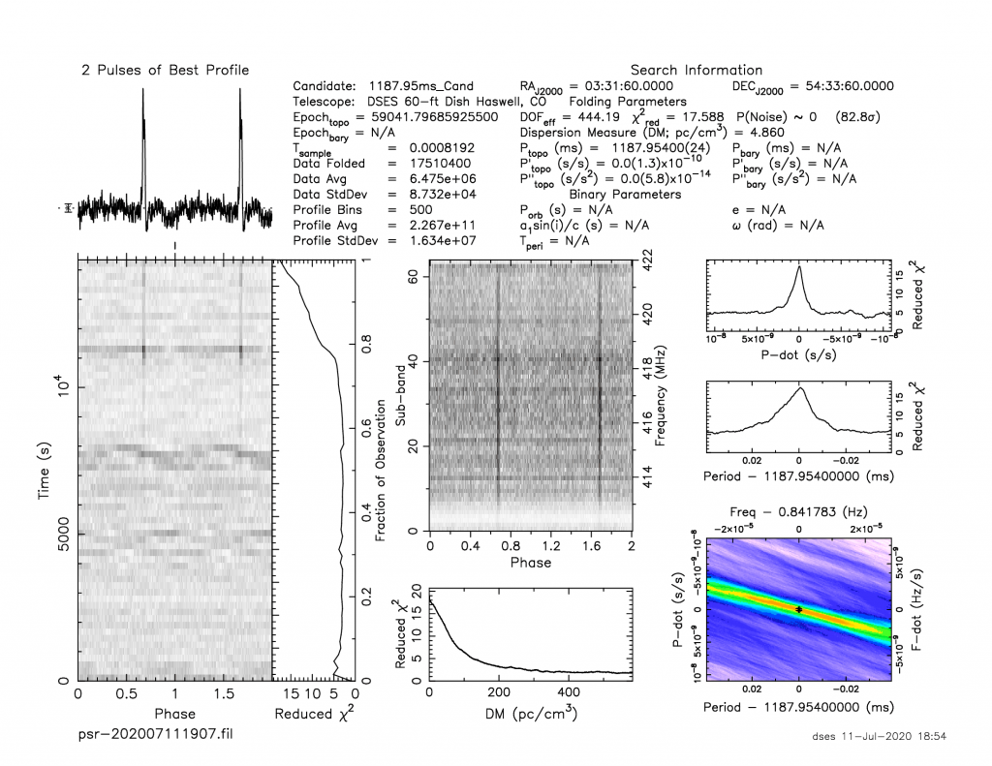
PERIODICITY SEARCHES
Sensitive searches​
​
Led to majority of pulsar discoveries​
​
Computationally expensive
5

Slide 6
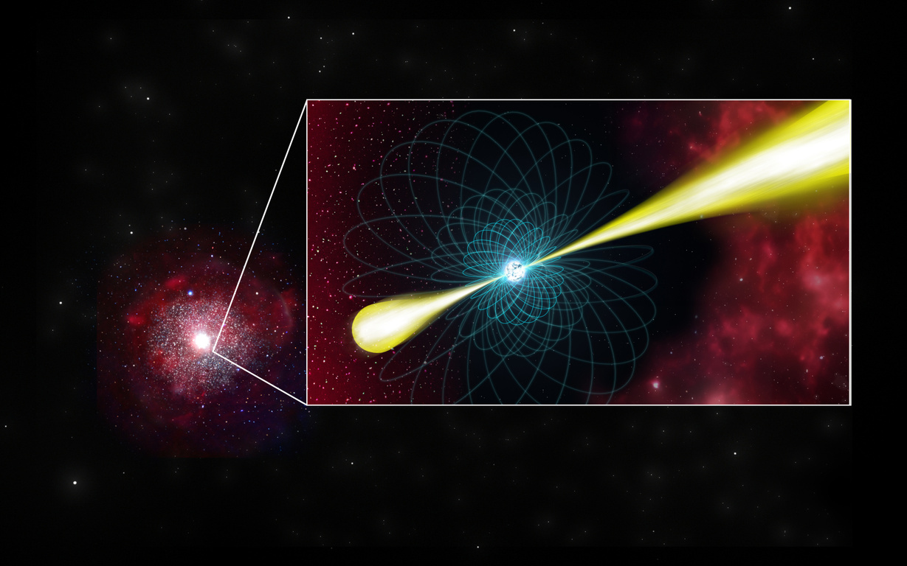
IMAGE DOMAIN SEARCHES
  Less computational resources are required​
  More likely to detect high DM or highly scattered pulsars​
​
  Less sensitive than traditional searches​
6

Slide 7
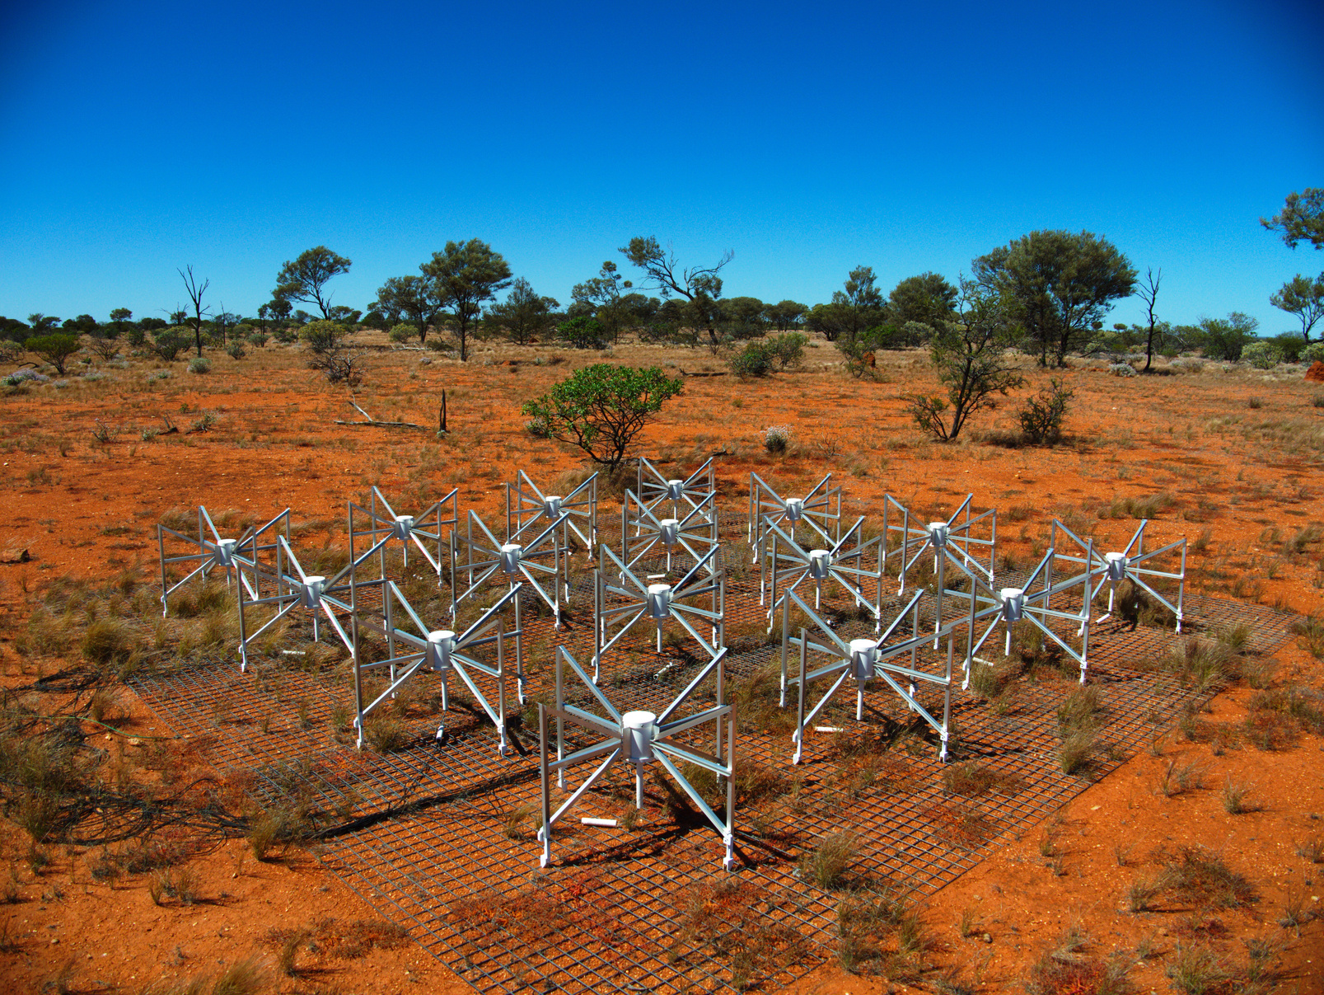
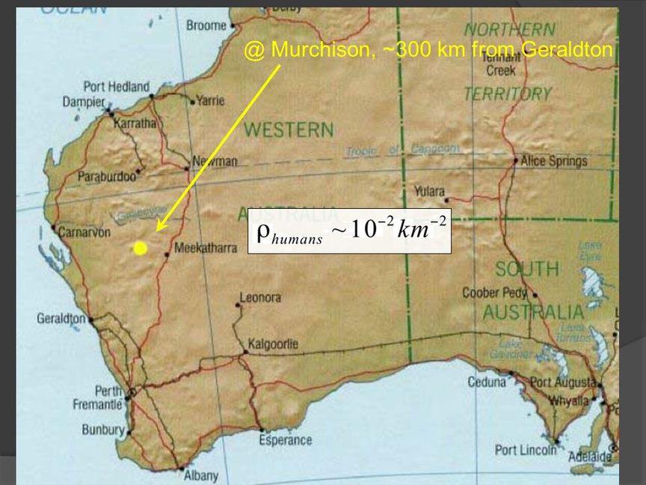
MURCHISON WIDEFIELD ARRAY (MWA)​
Low frequency SKA precursor telescope​
​
Frequency range 70-300 MHz​
​
Voltage Capture System (VCS) - Voltage data (100 microseconds / 10 KHz) ​
7

Slide 8
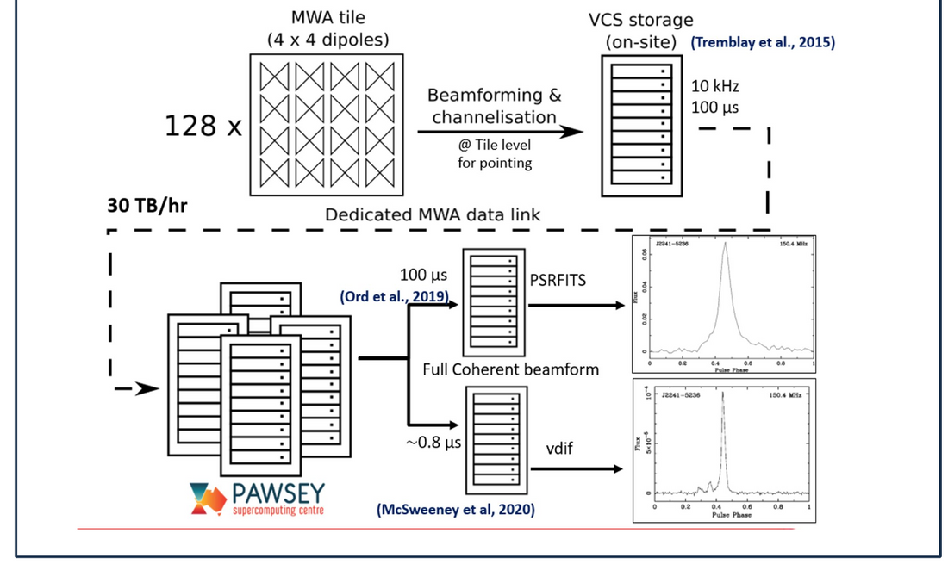
PULSAR OBSERVING WITH THE MWA
Voltage Capture System (VCS) - Voltage data (100 microseconds / 10 KHz) ​
8

Slide 9
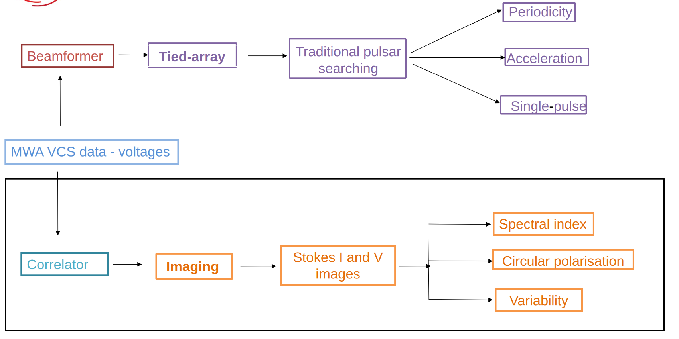
PULSAR OBSERVING FLEXIBILITY OF THE MWA
9

Slide 10
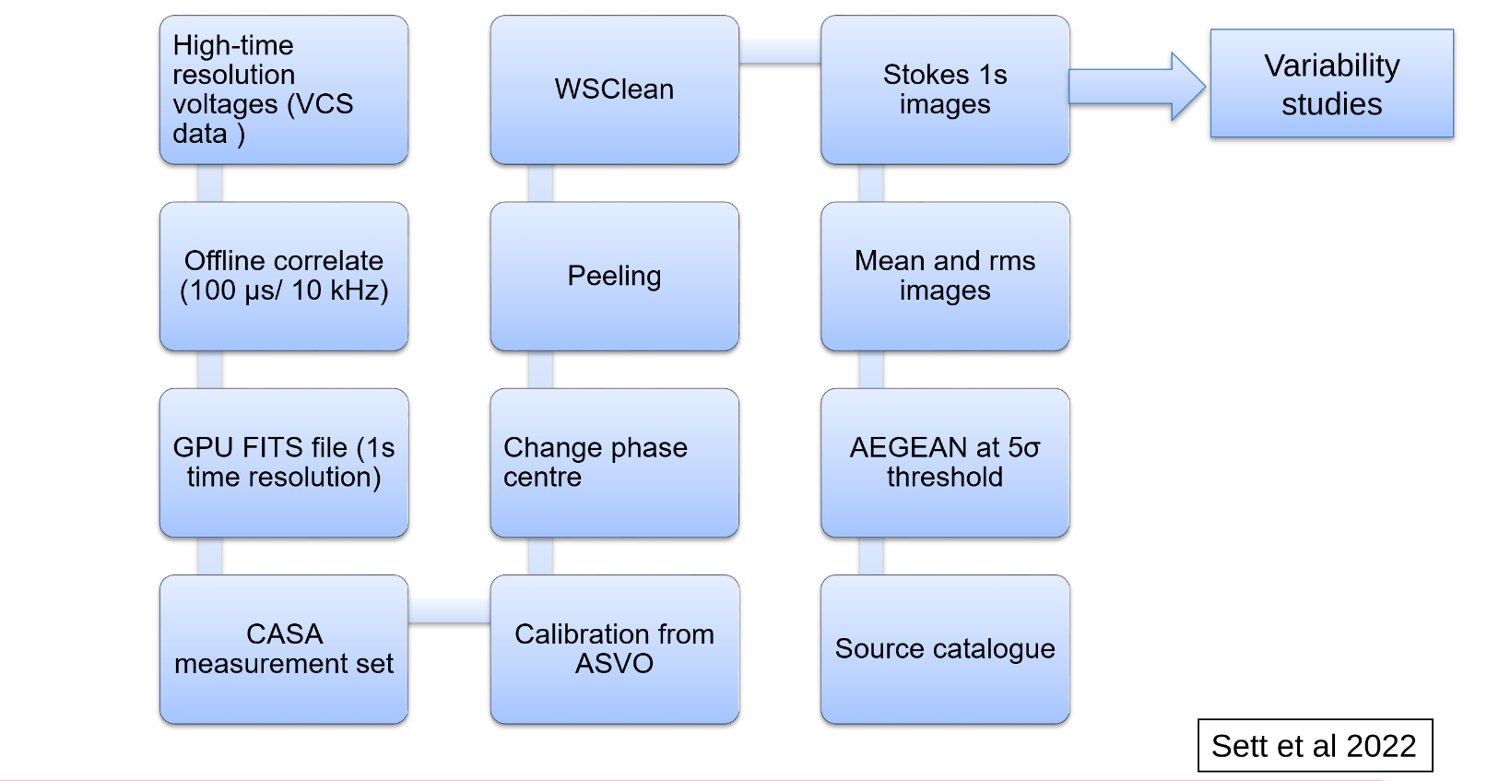
IMAGING WITH THE VCS DATA
10

Slide 11
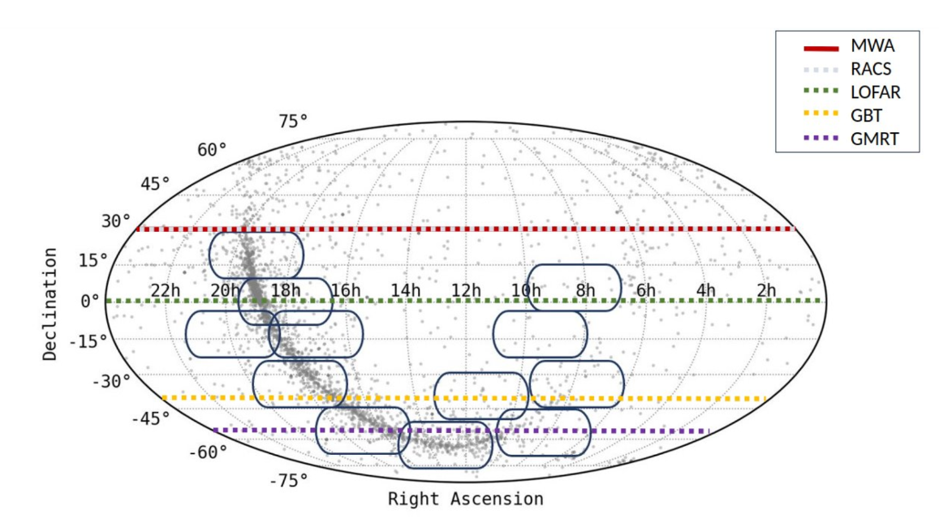
IMAGE BASED GALACTIC PLANE SURVEY
  12 Phase II MWA VCS observations
​
  Sky coverage: 6000 sq deg​
  ​Data processed: ~450 TB TB ​
Is imaging performing as good as beamforming?
11

Slide 12
Methodology and initial results
~4300 pulsars in ATNF catalogue
~1000 pulsars in 3DB beam power
85% below detection threshold
~4% in SNRs
110 pulsar sample
17 in beamforming only
16 in imaging only
50 in both
83 pulsar detections in this pilot survey
3 MSPs, 4 binary pulsars and 14 first low-frequency (150 MHz) detections
12

Slide 13
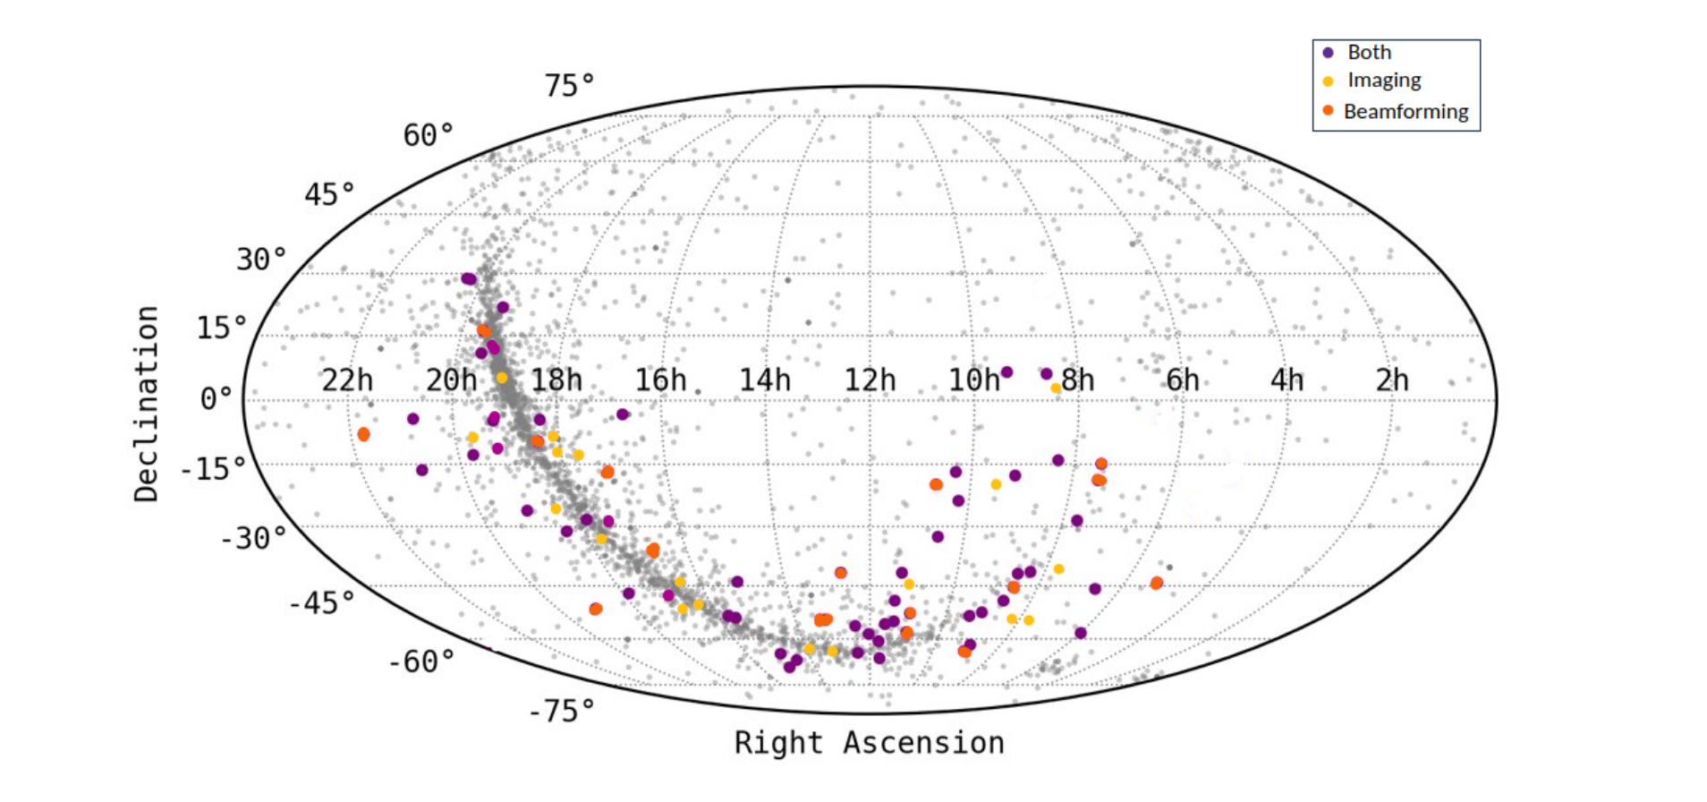
Pulsar detections in this survey
13

Slide 14
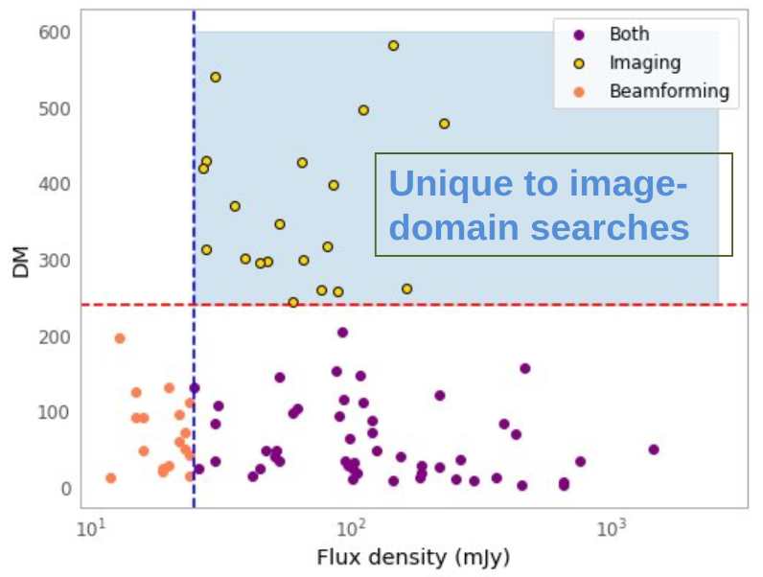
TIME DOMAIN VS IMAGING DETECTIONS​
Both - 50​
​
Imaging - 16​
​
Beamformed - 17​
For 14 pulsars these are the first reported low-frequency detections​
14

Slide 15
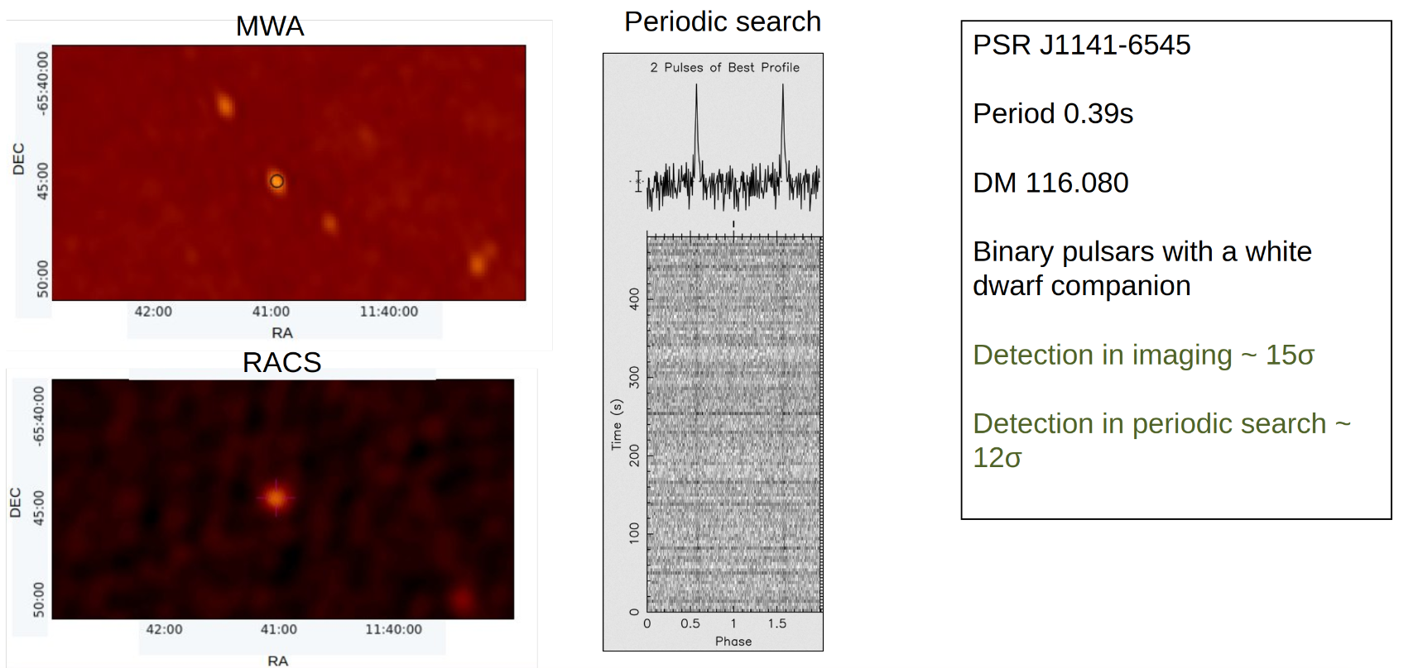
INTERESTING DETECTION IN BOTH METHODS
15

Slide 16
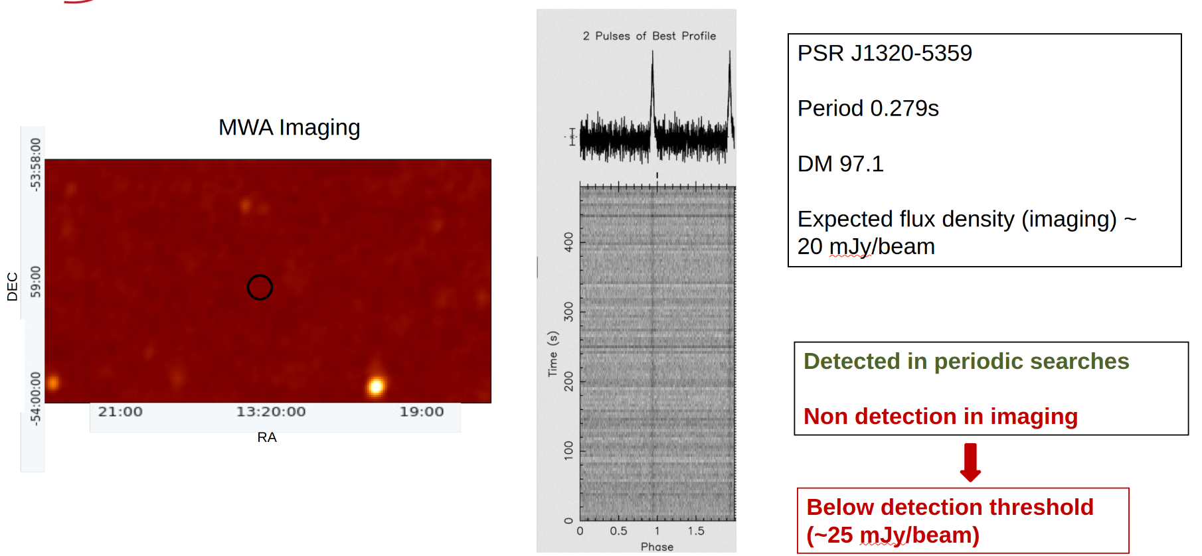
ONLY A TIME DOMAIN DETECTION
16

Slide 17
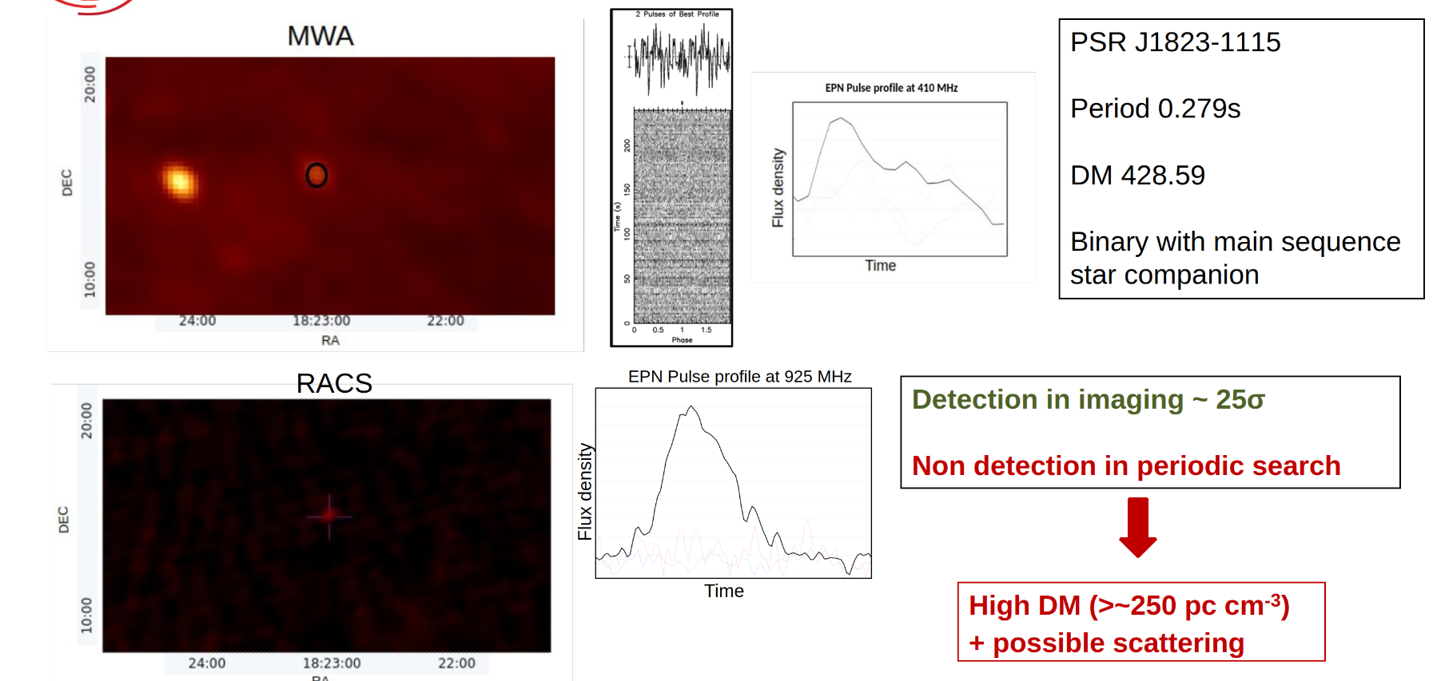
DETECTION ONLY IN IMAGING
17

Slide 18
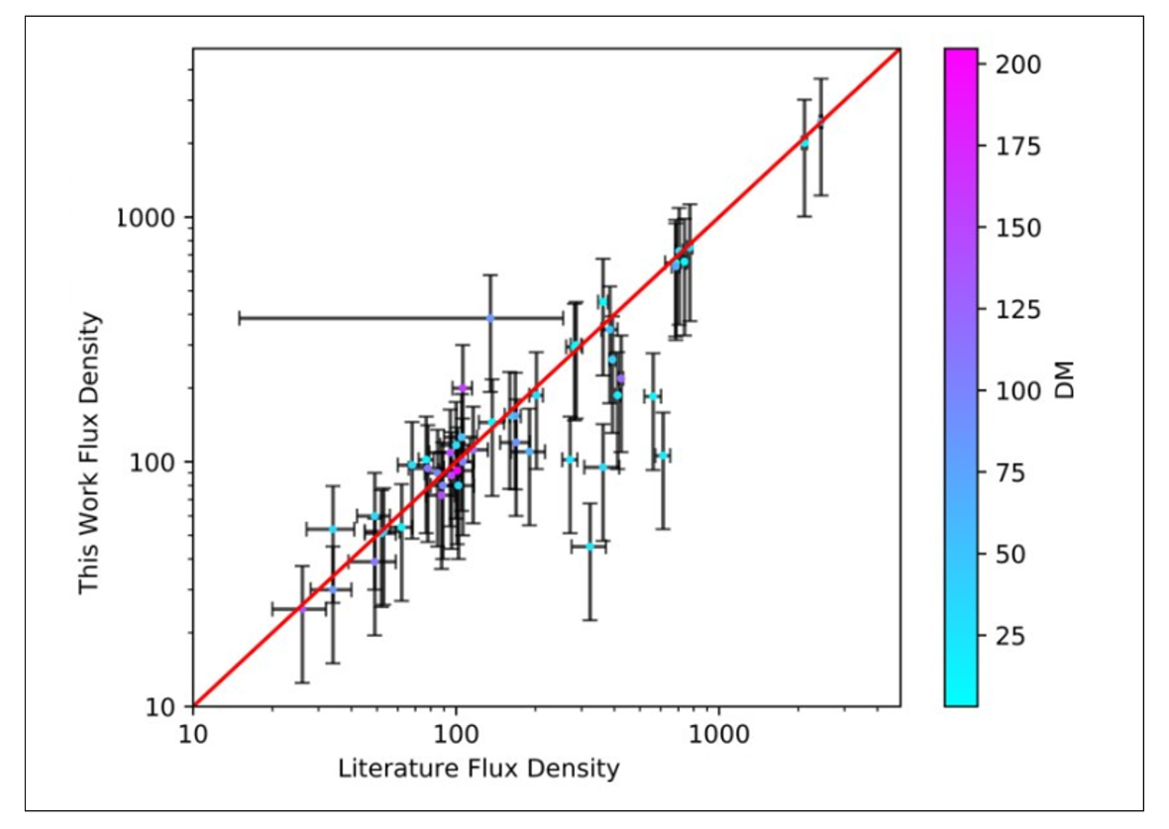
Flux comparison with literature
18

Slide 19
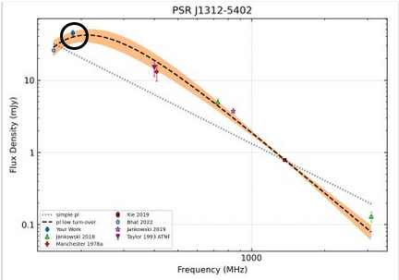
SPECTRAL ENERGY DISTRIBUTION
Measurements of flux density at low frequency is important in disregarding poor spectral fits!​
19

Slide 20
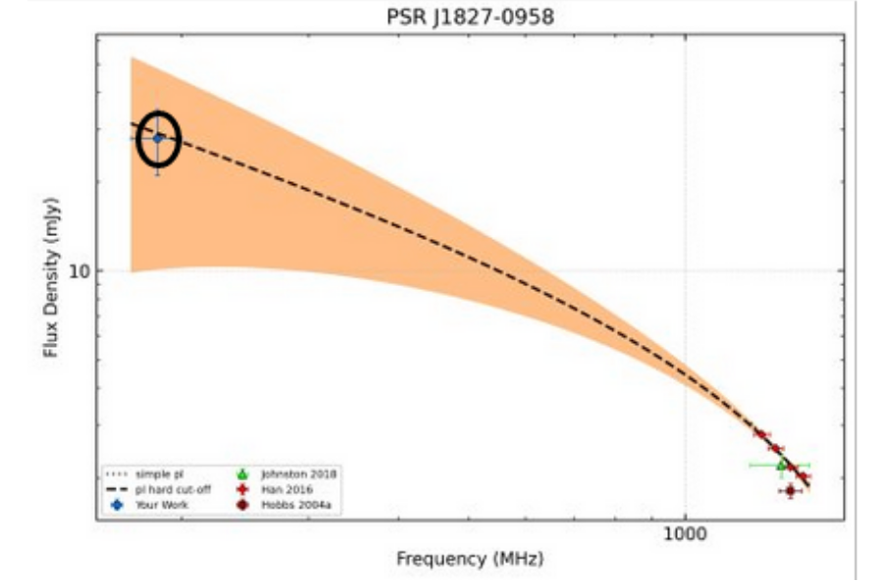
More low frequency detections of pulsars
20

Slide 21

Overall pulsar census
  First low frequency (<400 MHz) detections of 14 pulsars
  Imaging has detected a lot of high DM pulsars ​
21

Slide 22

FUTURE OF IMAGING SURVEYS
Are low frequency image-based searches important in new pulsar discovery in the future?​​
In our work, we add 25% more to the pulsar detections via image-based searches!​
What does this mean for SKA Low??
Keane et al 2014 predicted that SKA Low will be able to detect ~8000 pulsars using beamformed search​
Image-based searches
YES!
22

Slide 23
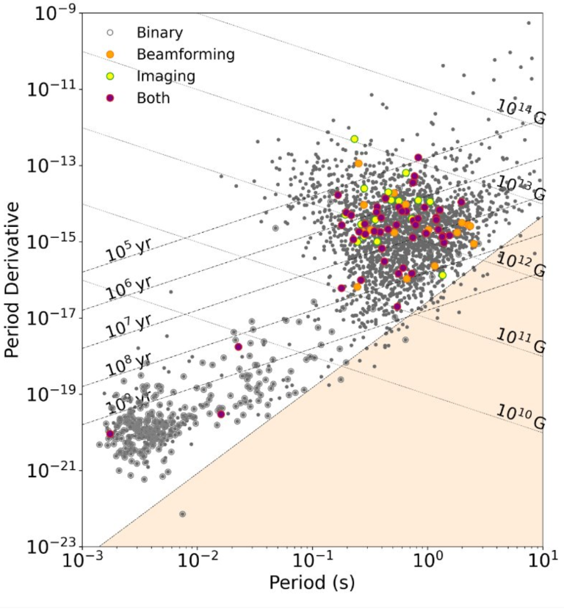

Summary
  Redetected 83 pulsars
  16 only imaging detections
  14 first low frequency detections
  Some interesting pulsar candidates
  Establishes the importance of image based surveys
23

