Slide 1
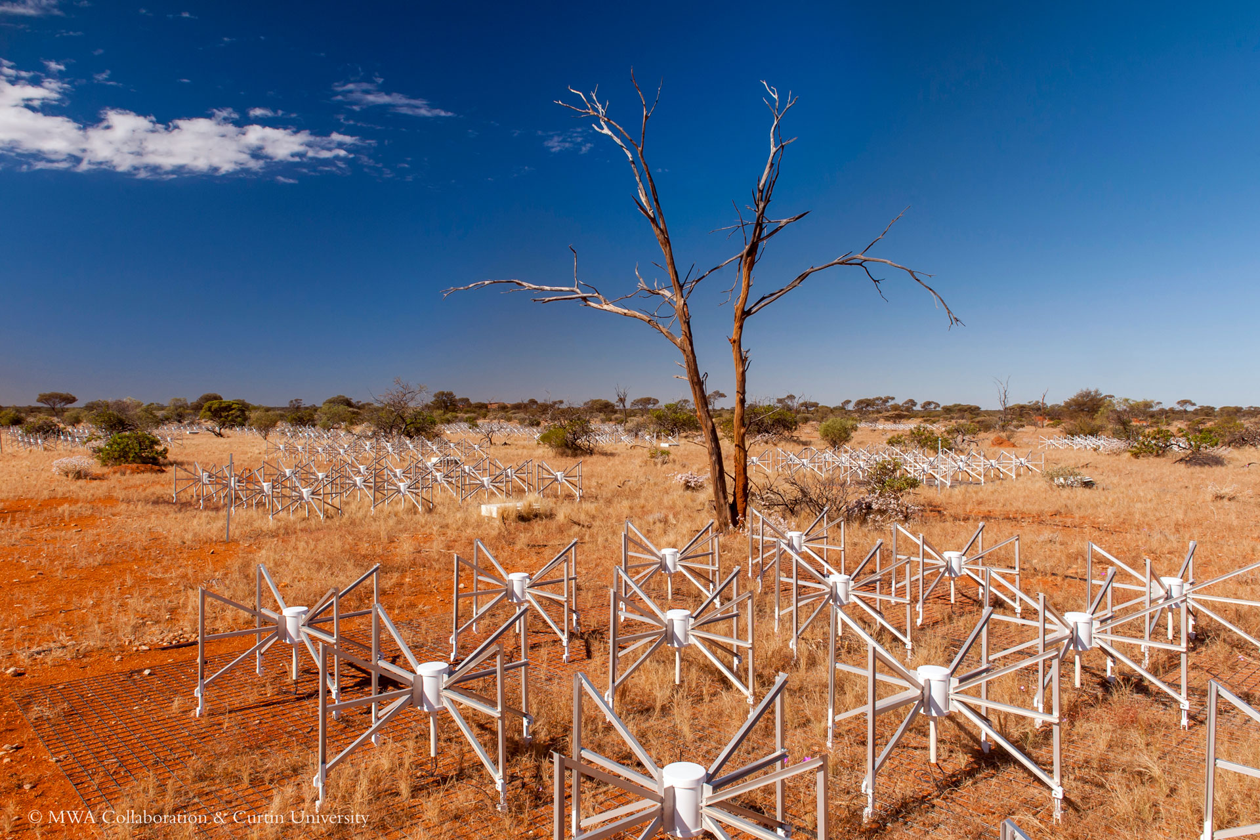
extracting information from the cosmic dawn
Cathryn Trott, on behalf of the MWA EoR Collaboration
We acknowledge the Wajarri Yamatji people as the traditional owners of the Observatory site
Inyarrimanha Ilgari Bundara

Slide 2
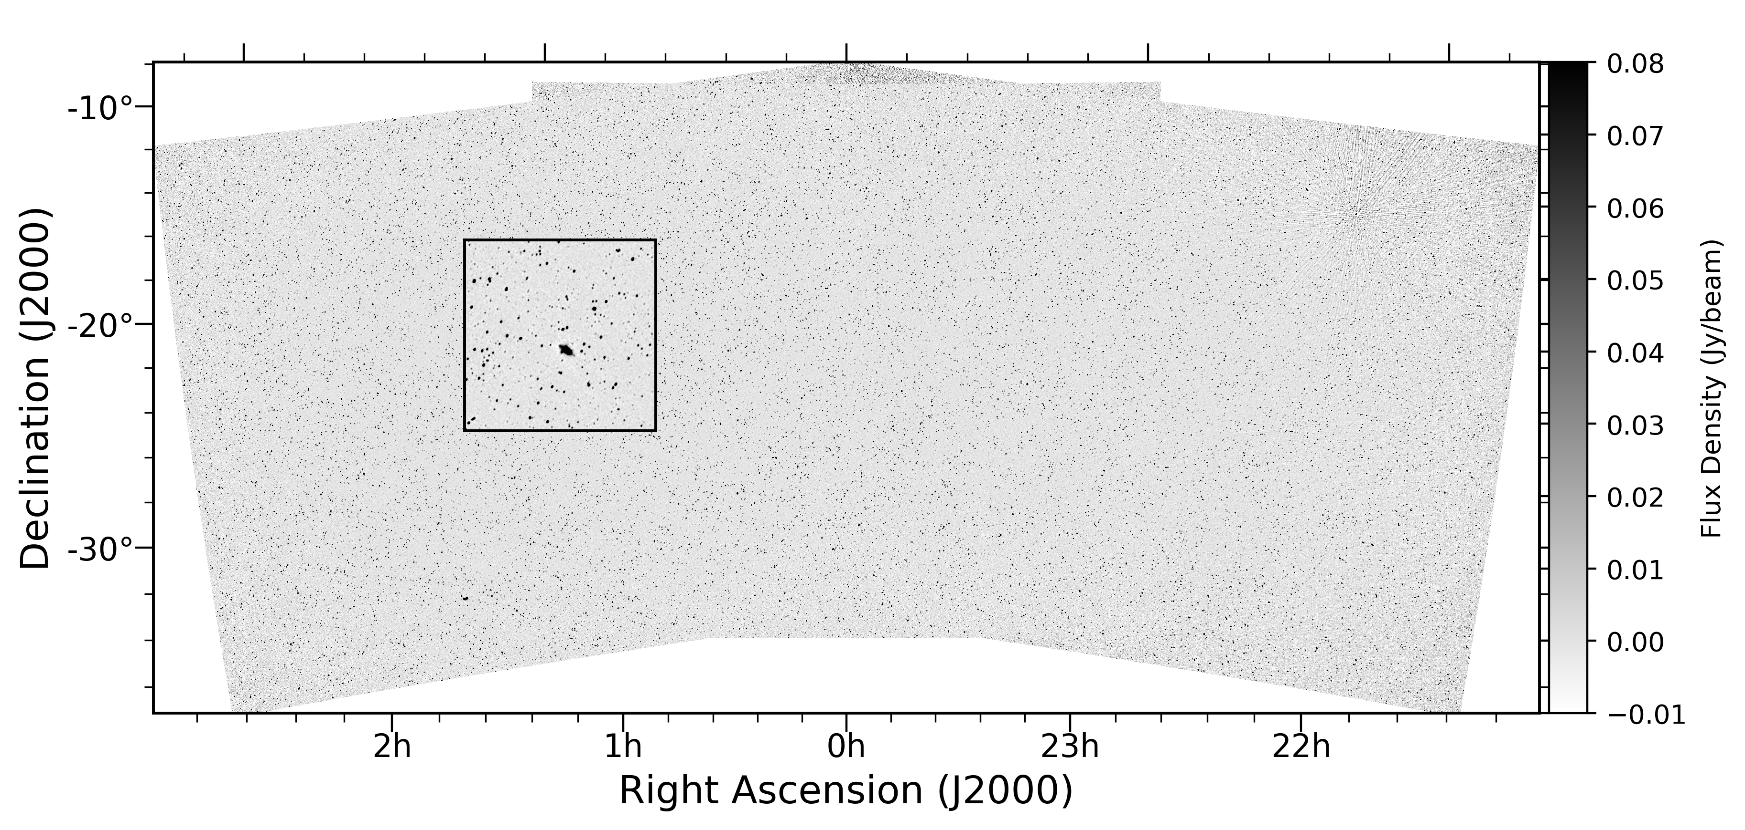

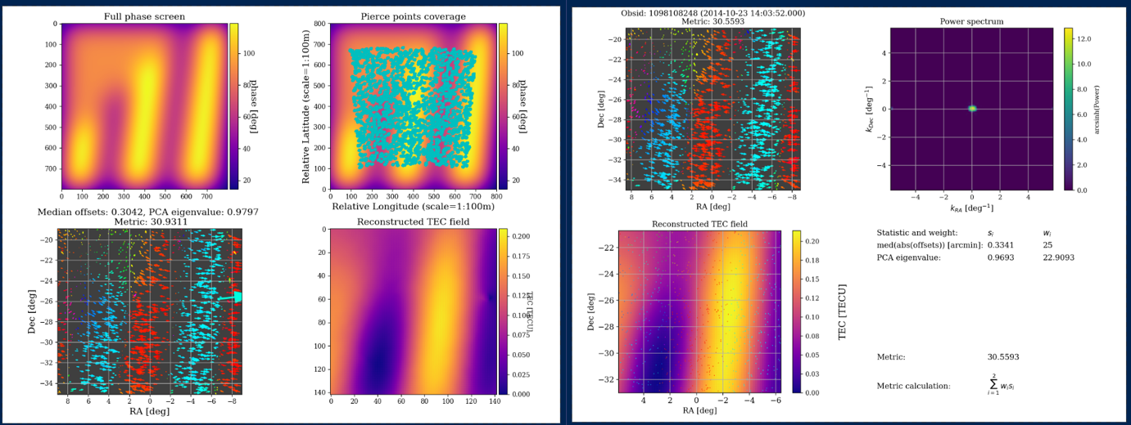
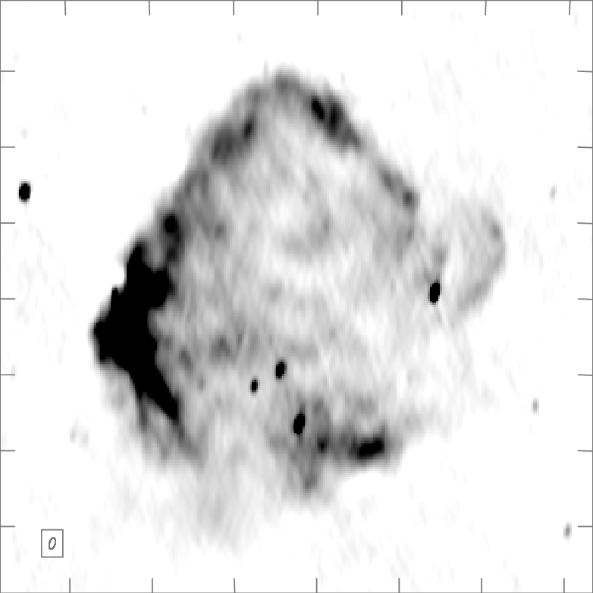
MWA background work
SKY
IONOSPHERE
TELESCOPE
ANALYSIS
Full end-to-end simulations

Slide 3
MWA background work
SKY
IONOSPHERE
TELESCOPE
ANALYSIS
Joseph et al 2018;
Chokshi et al 2021;
Chokshi et al 2024;
Barry et al 2024;
Selvaraj et al 2024a,b
Lynch et al 2021;
Cook et al 2022;
Kriele et al 2020
McKinley et al 2022
Barry et al 2019a, b;
Trott et al 2020;
Rahimi et al 2021;
Jordan et al 2024
Nunhokee et al 2024
Jordan et al 2017;
Trott et al 2017
Full end-to-end simulations
Line et al 2024a, 2024b

Slide 4
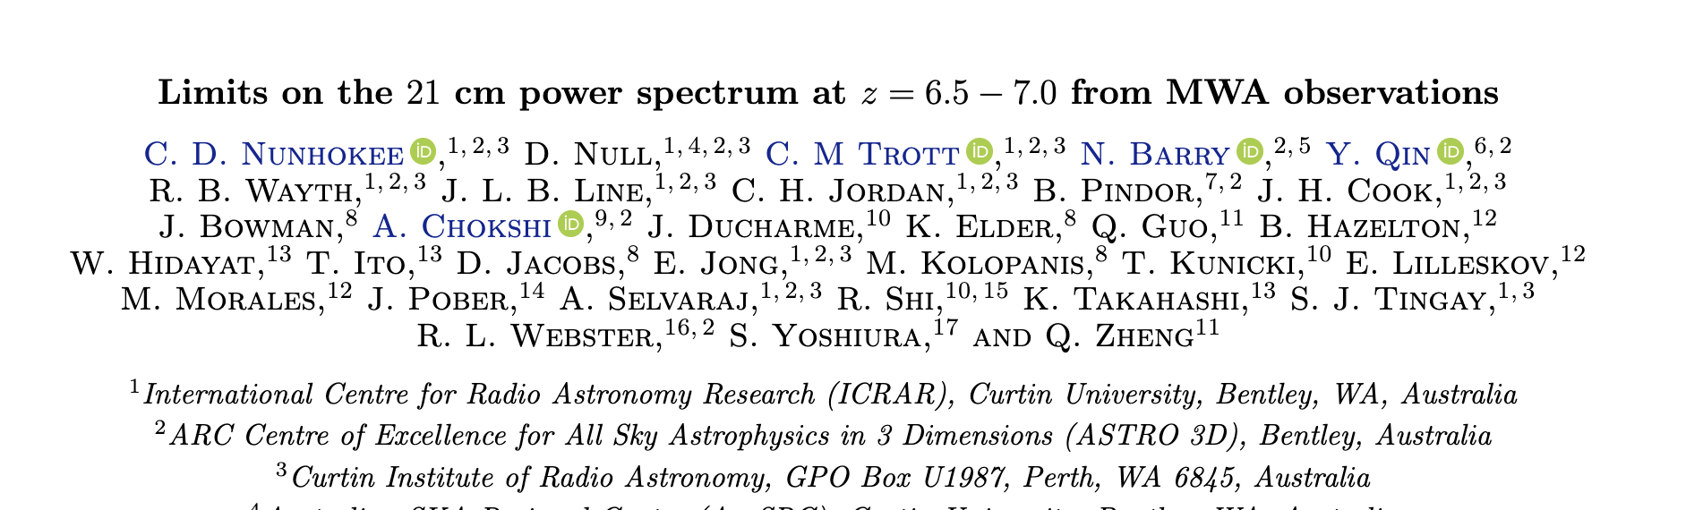
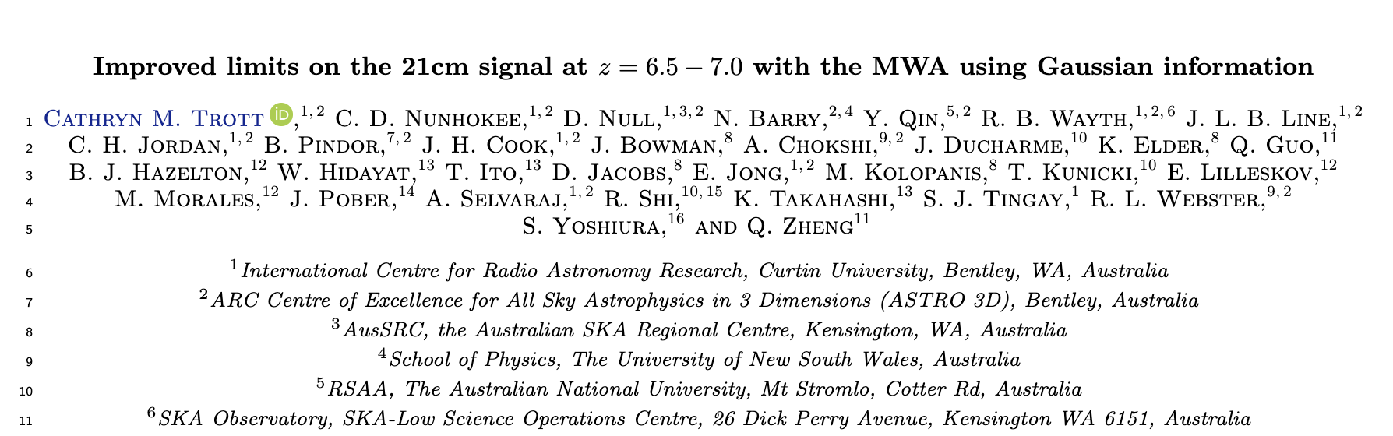
post-processing analysis

Slide 5
post-processing analysis
>19,000 MWA observations (>650 hours of observing), amounting to 260TB of data, to produce a few hundred numbers (~300 Bytes)
The factor of 10¹² reduction in data demonstrates the challenges inherent in detecting this weak cosmological signal.

Slide 6
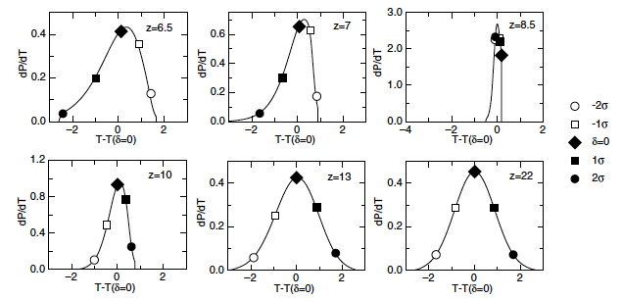
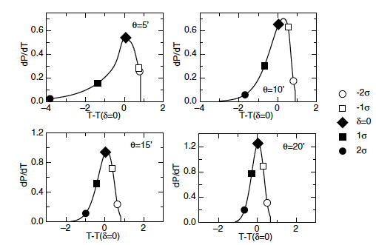
21cm signal is highly-gaussian
(Distribution of brightness temperatures on a given spatial scale)
10 arcmin scales
z=7
More gaussian on large scales, and at early times (linear structure growth theory + 21cm bias)
Wyithe & Morales (2007)

Slide 7
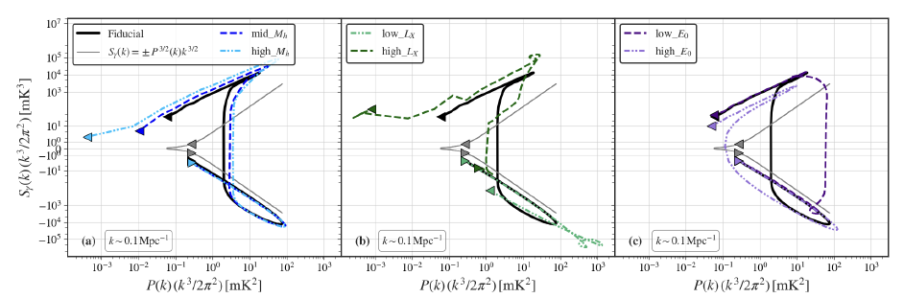
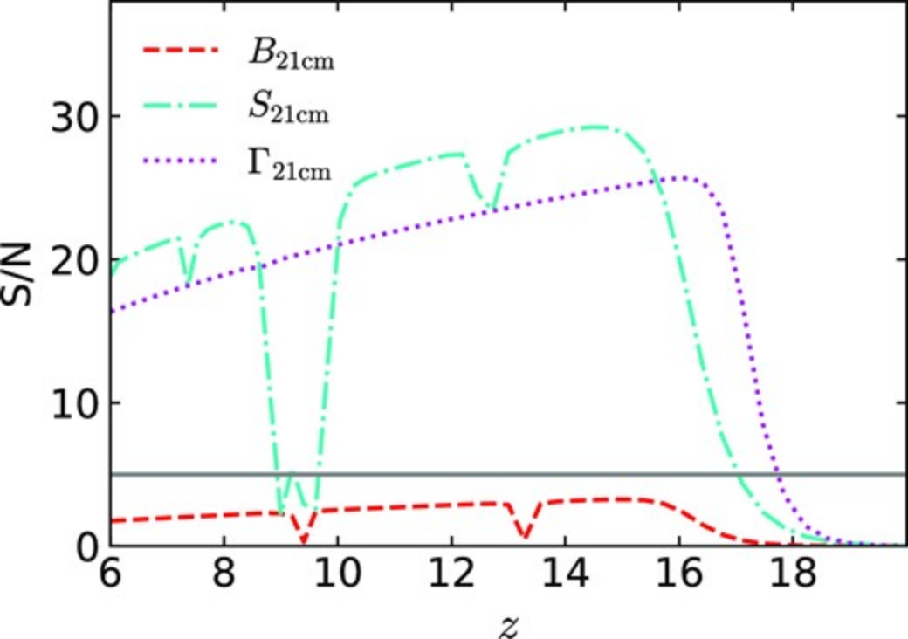
can we measure non-gaussianity with the mwa?
SKA1 SNR (1000h, full core)
Cook et al (2024)
MWA: 260 hours, <<filling factor, >>SEFD:
SNR << 1
NO!
Second moment (power spectrum) contains most of the cosmological information
Non-gaussianity in MWA is not 21cm
Ma & Peng (2023)

Slide 8
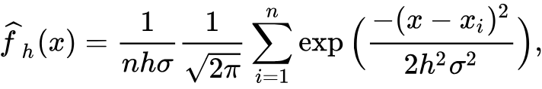
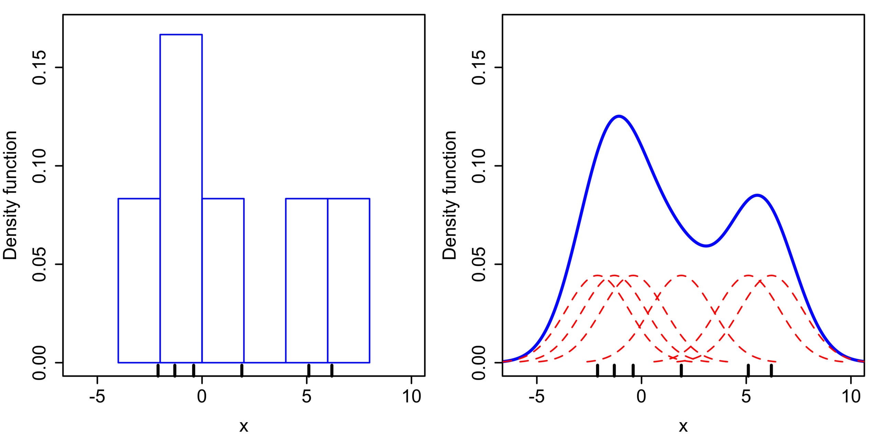
a kde-based estimator of data and distributions
Kernel Density Estimator: empirical estimate of the PDF of data (a fancy histogram)
K() is a kernel function, which is determined by the data properties
h is a scaling factor
Need to ensure that 21cm signal strength and kernel is well-sampled
Use radiometric noise on visibilities to set the kernel width
Perform for real and imaginary separately
Also compute second moment from CDF for comparison
8/19/25
8

Slide 9
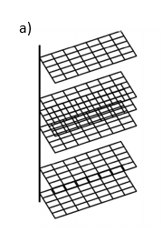
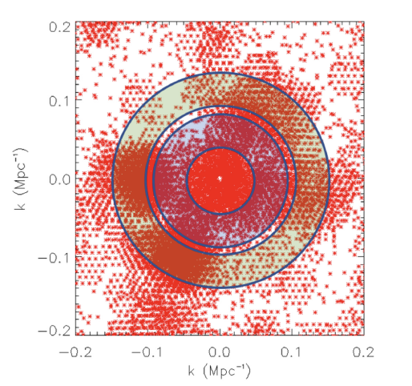
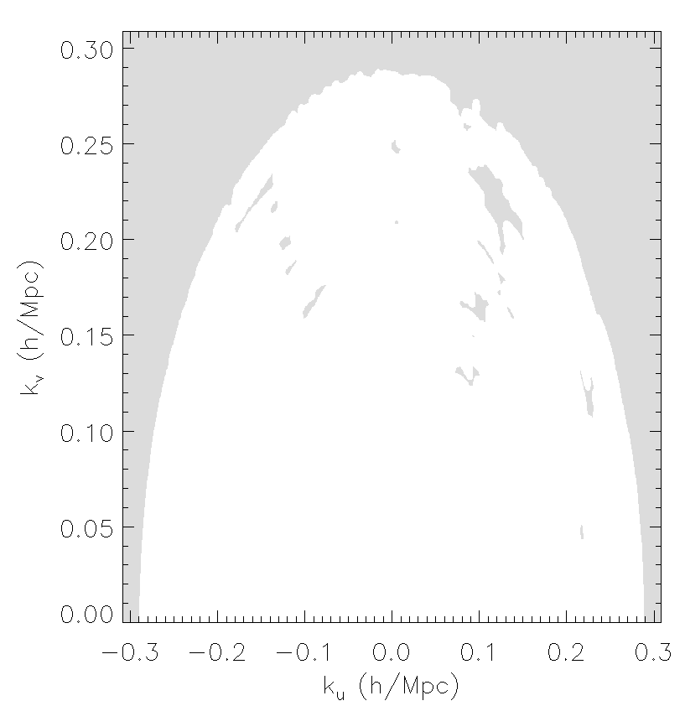
how do we use this with our data?
Use our measurements in k-space (u, v, eta) as samples (realisations) of the distribution
Example uv annulus with data Occupancy of uv-plane
nu
eta
v
v
u
u
You have 1 billion visibilities, why don't you estimate directly from them? Because we can't take advantage of coherent averaging, and therefore our thermal noise is too high.
How do you know the gridded vis produce a fair sample? Need a filled uv-plane.
What other tests can you do? Real and imaginary are similar; EW and NS are similar.

Slide 10
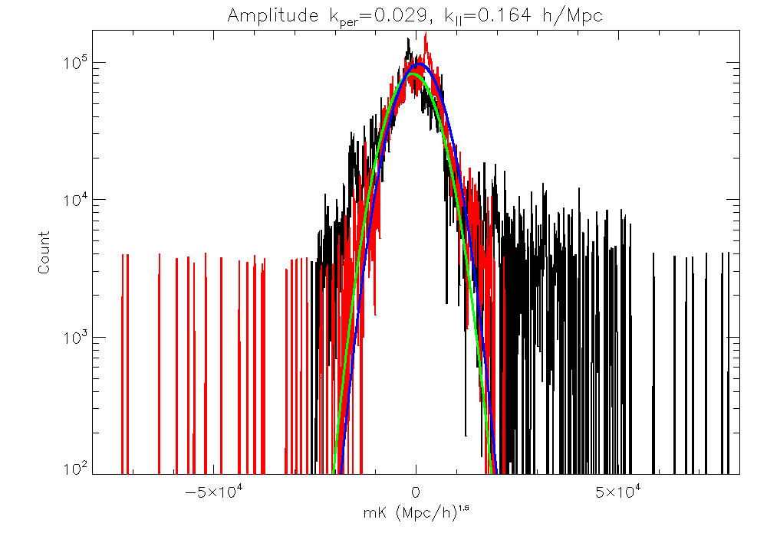
how do we use this with our data?
Use our measurements in k-space (u, v, eta) as samples (realisations) of the distribution
Fit a Gaussian to each of the real and imaginary distributions and extract second moment
(Check goodness-of-fit, check mean values, check residuals)

Slide 11

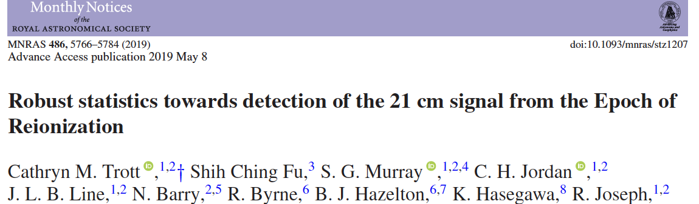
what do we expecT?
Realistic end-to-end simulations:
Diffuse + point source + extended source foregrounds
21cm-only
Everything
8/19/25
11

Slide 12
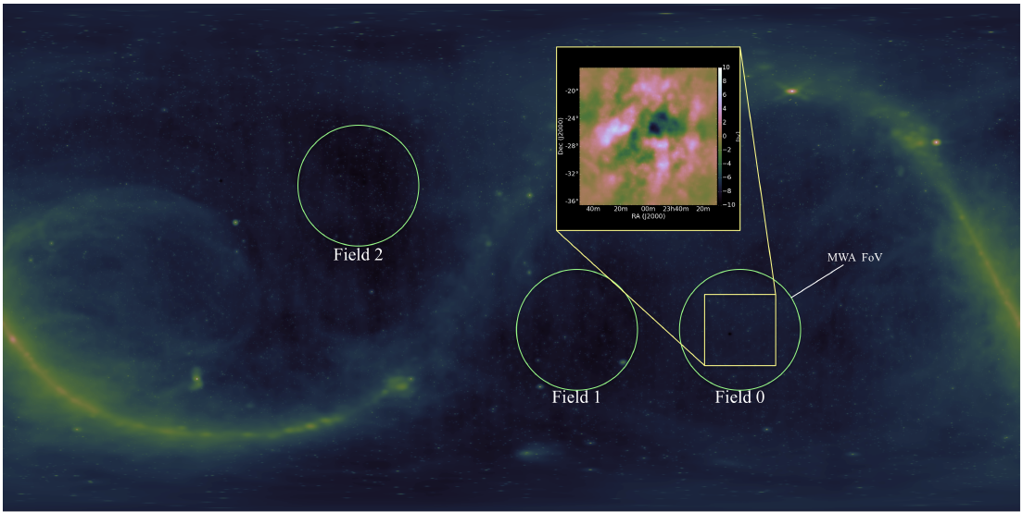
MWA background work
Hyperdrive calibration software (Jordan et al 2024)
Extended source and point source sky model improvements via LoBES (Lynch et al 2021, Cook et al 2022, McKinley et al 2022)
WODEN end-to-end simulation tool (Line et al 2024a, 2024b)
Broad suite of QA tools being applied to data (Nunhokee et al 2024)

Slide 13
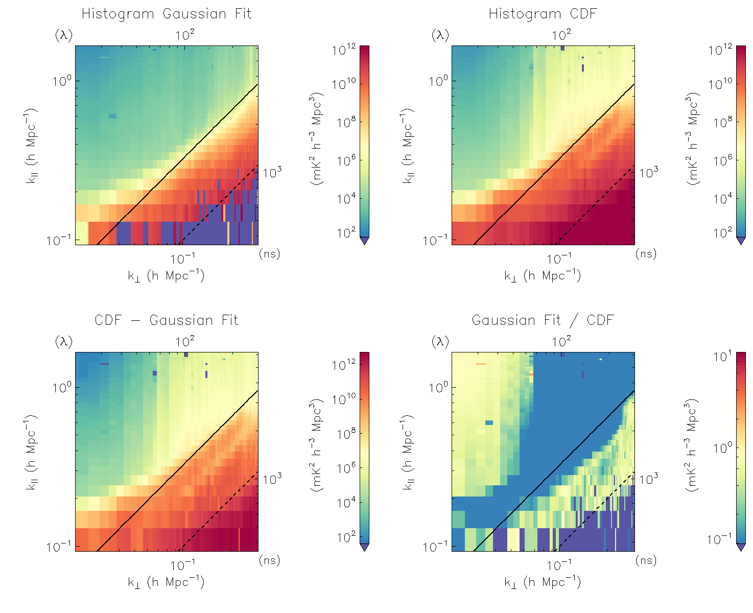
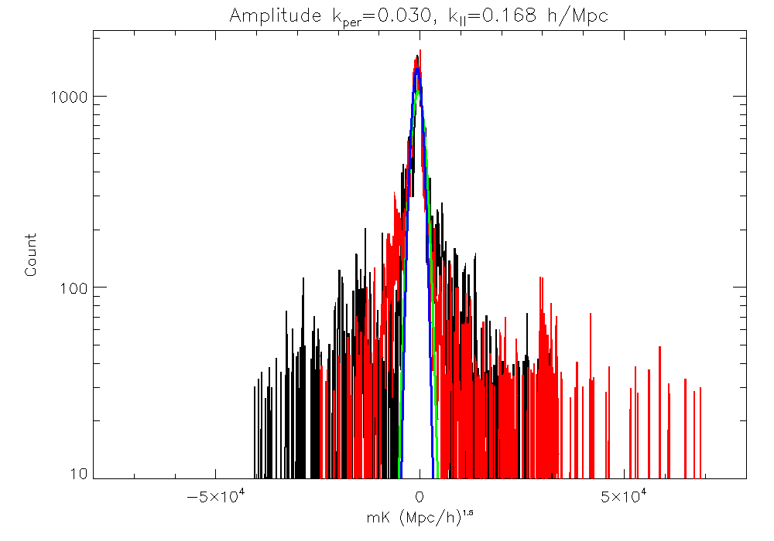
results: foregrounds only
13

Slide 14
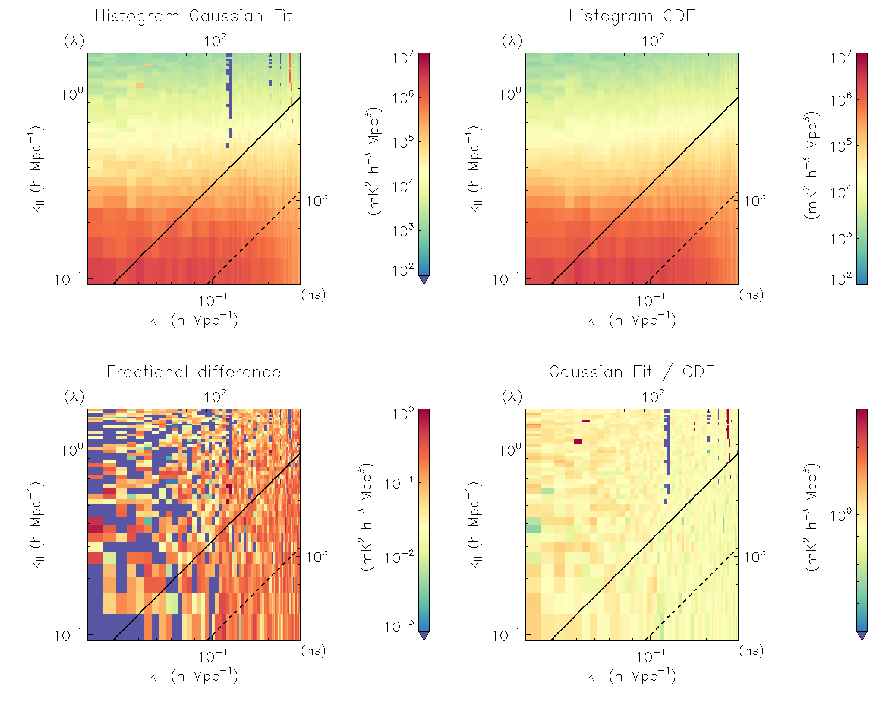
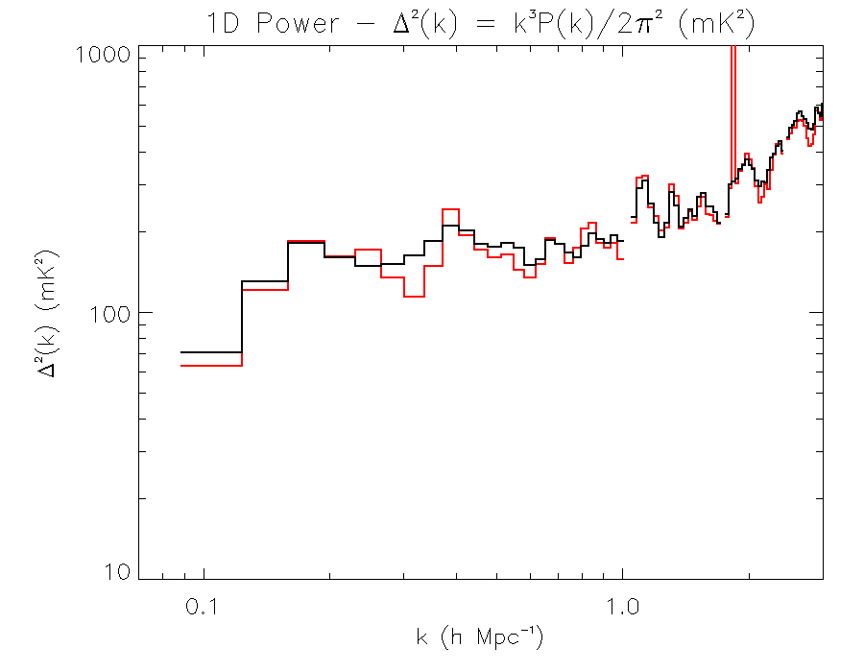
results: 21cm only
Takeaway – data are Gaussian
14

Slide 15
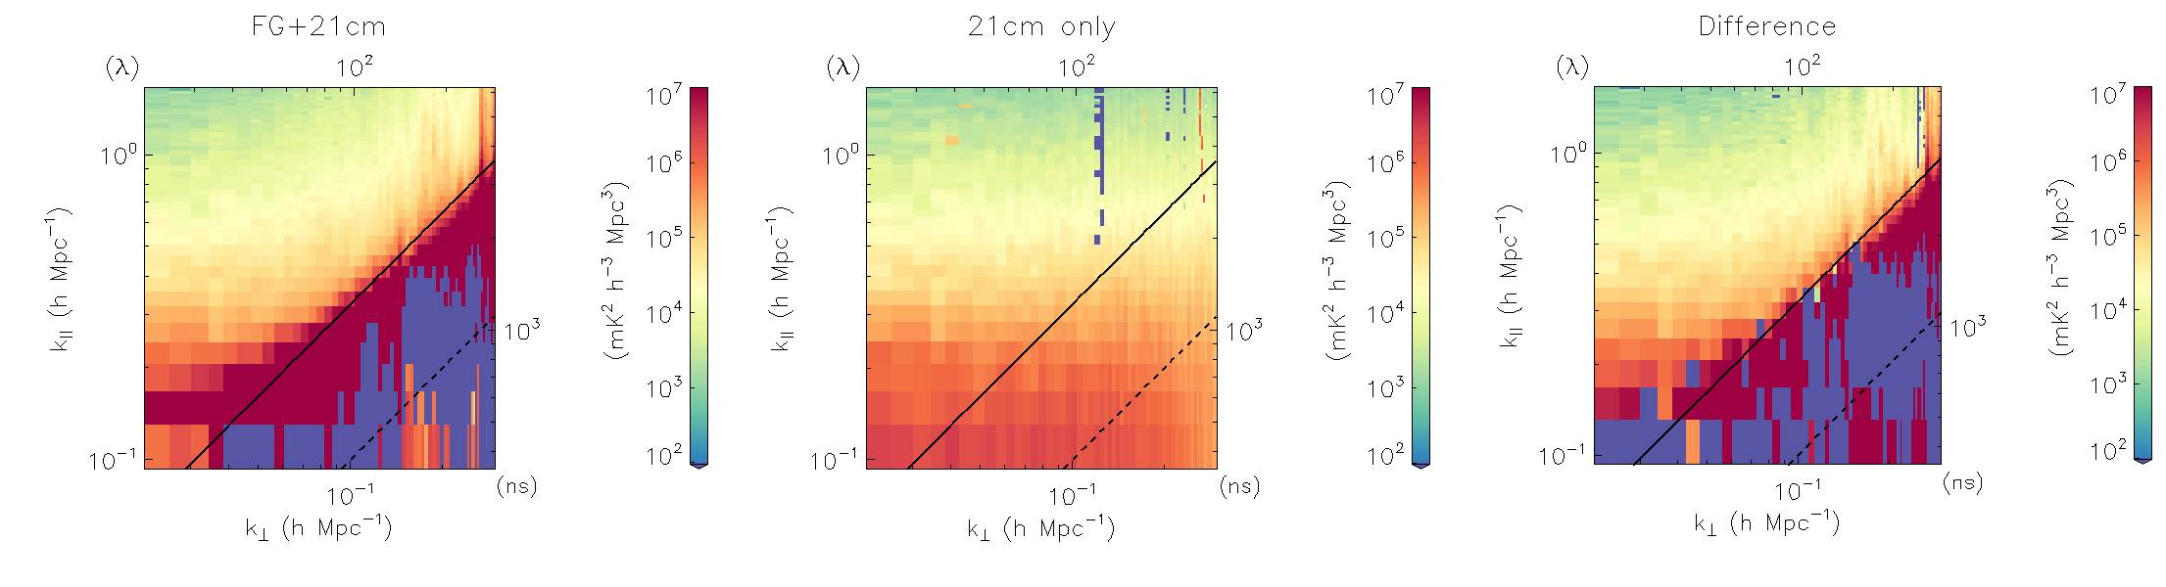
results: foregrounds + 21cm
Takeaway – non-Gaussianity can be attributed to FG
15

Slide 16
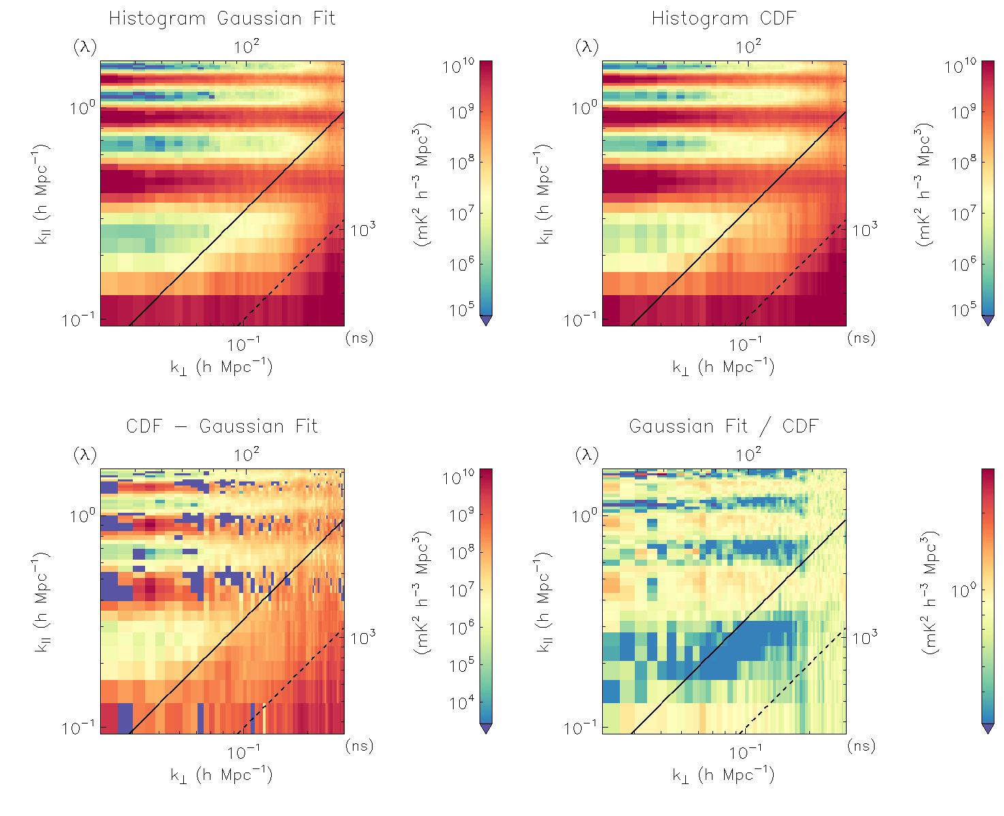
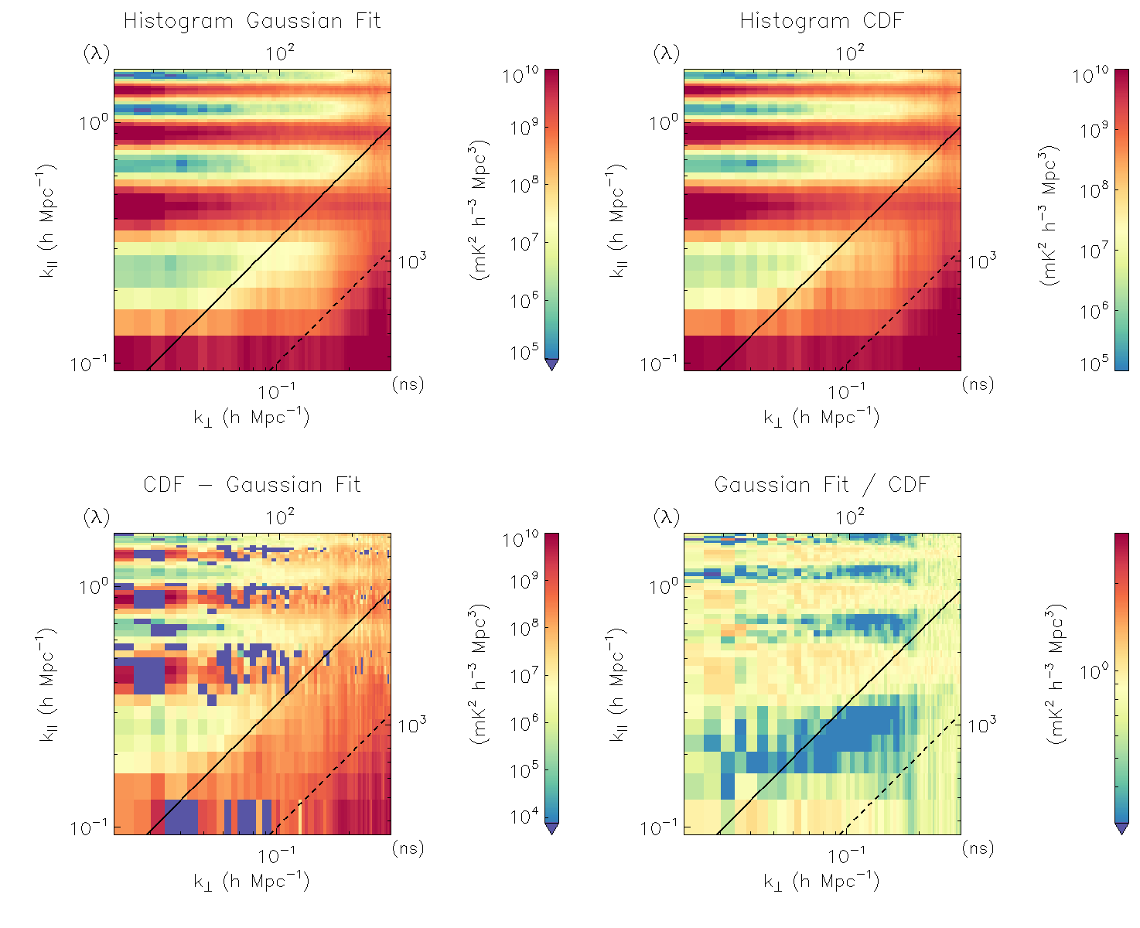
results: the data
16

Slide 17
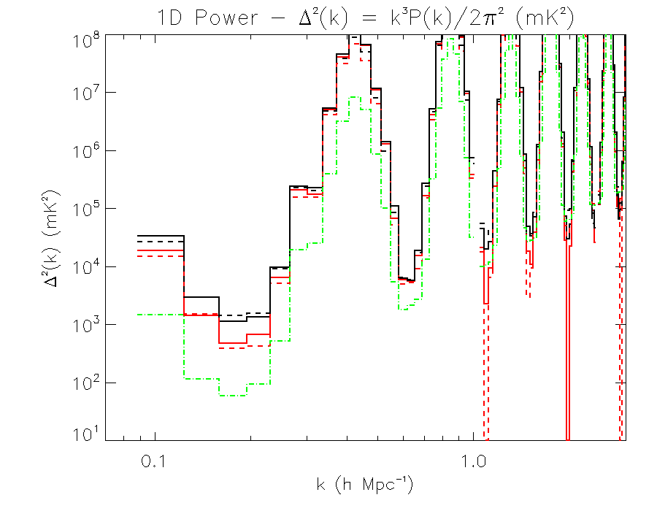
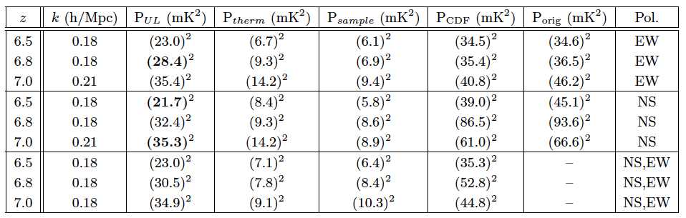
results: the data
Black - CDF
Red – KDE-estimated histogram fit
Green – 2 sigma thermal+sample
17

Slide 18
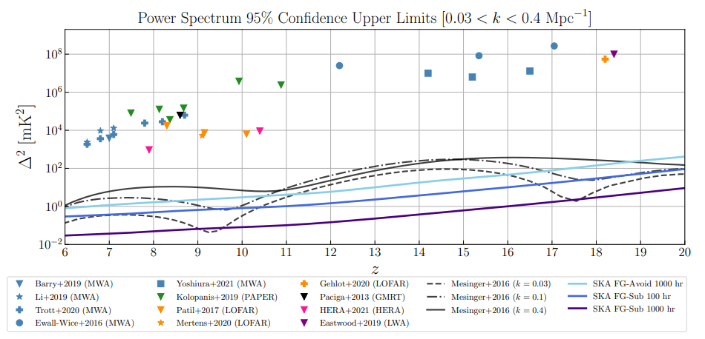
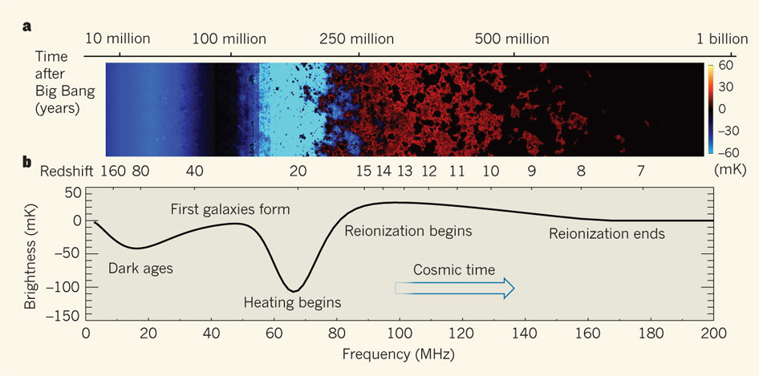
published results
HERA Collaboration

Slide 19
published results
A factor of 100 improvement on 2016
A factor of 4 improvement on 2020
HERA Collaboration

Slide 20
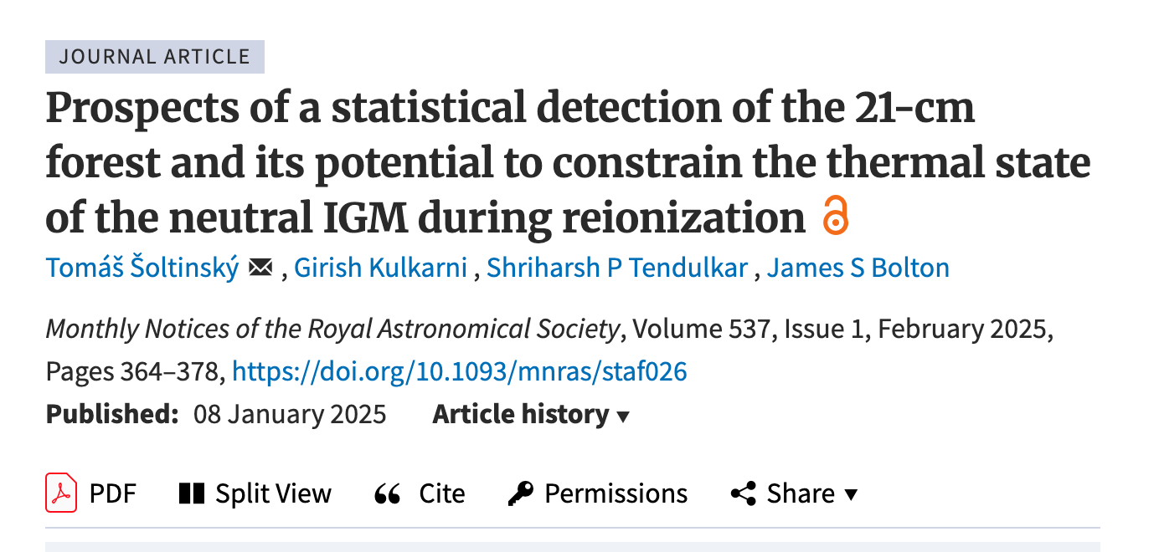
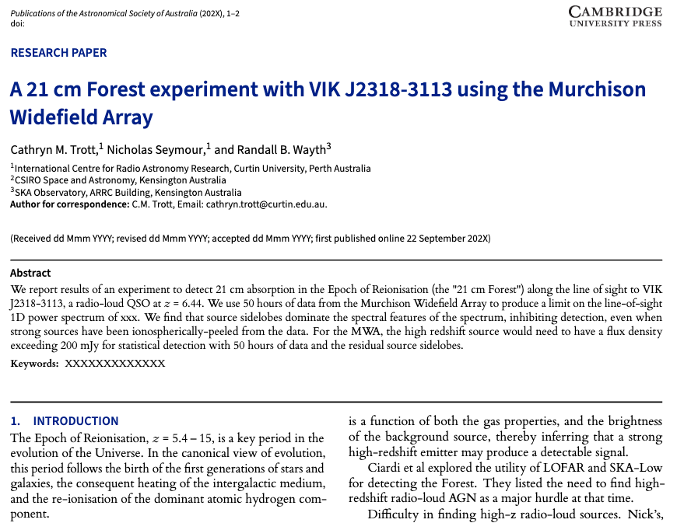
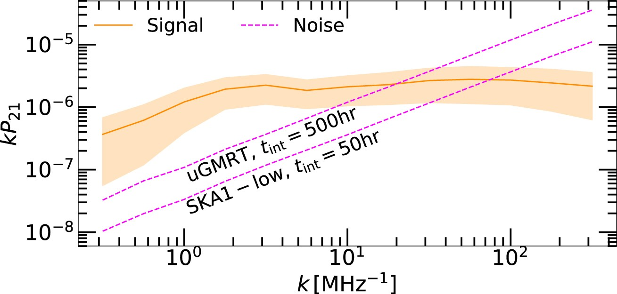
21cm forest

