Slide 1


Compression over deletion: Keeping the MWA archive
Richard Dodson,
A. Williamson, A. Wicenec, M. Meyer, j. Rheem M. Rioja, P. Elahi
Notes:
Thank you for the opportunity to speak
27 Aug 2025, 16:10 20m
The MWA archive is creaking; data is being deleted.
All of that data represents valuable observing time, yet some of that data has never been examined.
However, if we could reduce the sizes of the files we could both avoid discarding the data and
fully exploit the MWA archive to extract the full potential of the instrument, Compressing the data is an obvious solution; for visibilities only lossy compression can deliver a significant saving and we have been investigating the impacts on the final data products, and find these can be minimal.
We are using the lossy compression tool MGARD, which is a richly featured multi-grid compression application.
We will present our results, demonstrating that no significant losses are introduced.
We are building all our tools into a simple user interface, which will allow a user to pull their data from the archive, compress it by an order of magnitude and replace the original version, rather than delete it.

Slide 2
Outline
Motivations:
  Deep (spectral line) obs. forced to stack images
  I/O is the performance limit
  Storage is one of the largest cost drivers for SKA
Insights:
Stacking Images is wrong (mathematically, scientifically, morally)
Radio Interferometric Data is Noise Dominated
⇒One can be much less precise
Tools:
ADIOS & MGARD from ORNL
Comparing with DYSCO
OSKAR for simulations (perfect calibration)
Real Data from ASKAP/DINGO, LOFAR,
MWA/GLEAM & Solar
Notes:
The motivation is that we are being very wasteful, reading full precision data when we do not have to.
But the most compelling reason is we just should not be stacking in images
We have been exploring this with the compression package MGARD, as we had very easy access to that tool. It comes free with the parallel read/write tool ADIOS, and we had integrated that in CASACore.
We compared to DYSCO
We used simulated or real data, from ASKAP/MWA/LOFAR

Slide 3
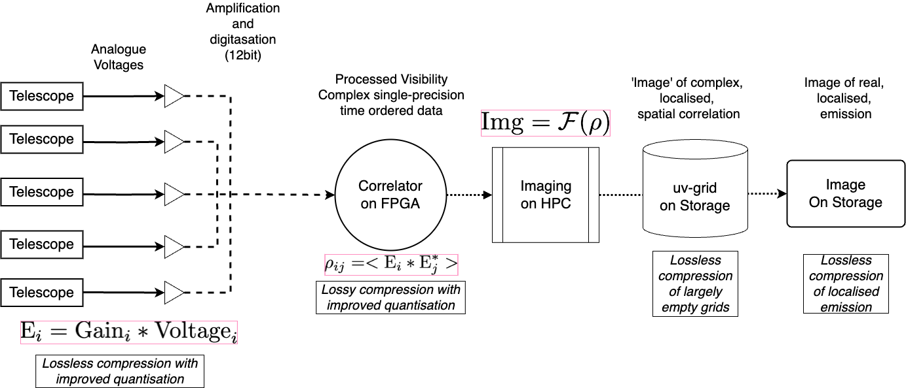
Locations for compression
Where can we compress the data?
3)
4)
2)
Current focus of our work.
The traditional location for compression.
Radio Sky is empty; high potential
1)
Original focus of our work. Grid is largely zeros, highly compressible
Possible for SKA and other pathfinders
EHT-2030 application
Notes:
Run through where we might apply compression, and where we have done so far.
At antenna voltage stream; i.e. blindly improve the quantisation. The main people looking for this (from us) are the EHT comm. Who are going for mad bandwidths
Streams are transitory – correlated and forget. Best policy: Do it real time
Raw Correlator outputs are our current focus, and what I will end on. Here we are applying lossy compression, as lossless does not provide much
The original application of this work, and the driver, is the ASKAP deep HI science project DINGO. Here we are losslessly compressing gridded data, where most of the grid is unpopulated.
Gridded data is the ultimate baseline-data averaging. Because you average to the uv-cell itself (which is the occupation space of the antenna FoV in uv-space).
The traditional place for region based compression is the imaging domain. Our team is investigating this, with ORNL taking the lead.

Slide 4
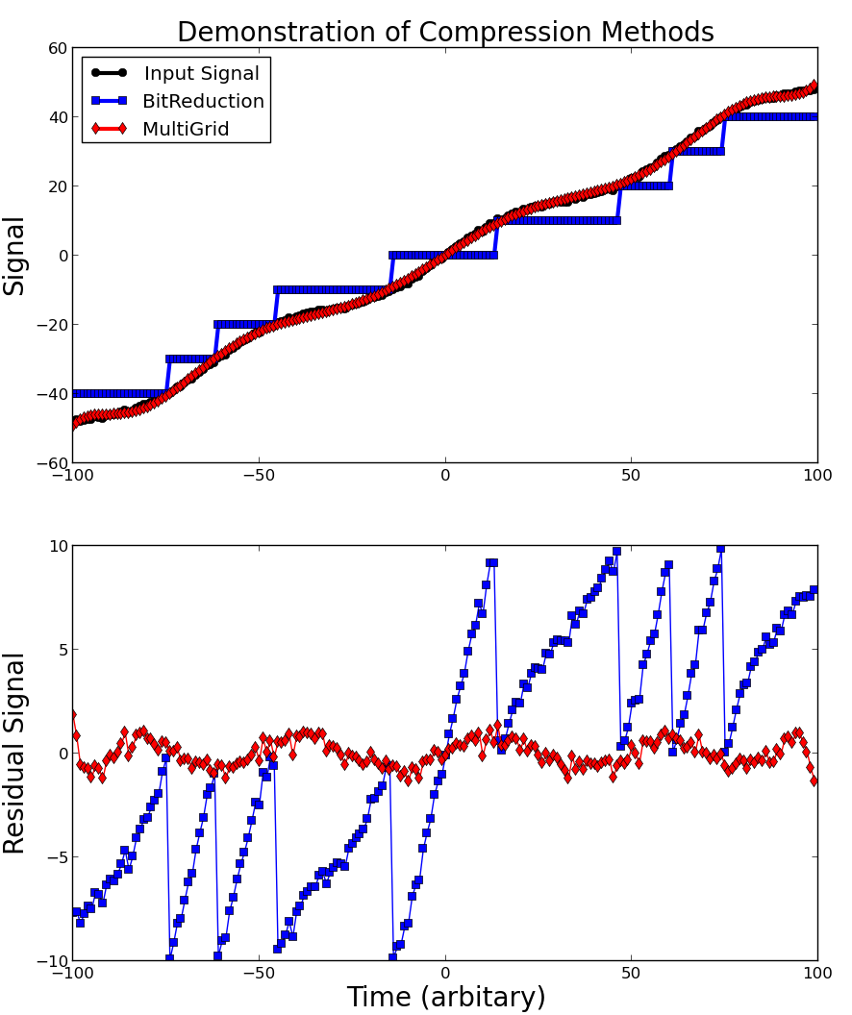
Options: Multi-Grid vs Bit-Truncation
Bit Truncation is very simple:
For every 32bit float, reduce the representation:
More importantly
MGARD one selects error level, not bit level
Also: MGARD has multiple options and is embedded in a high performance read/write tool (ADIOS), both of which are accessible via CASACORE libraries
Versions of ASKAPSoft have these natively
Expanding this to do the same for WSClean
Signal: Linear + Sinusoid + Noise
Lossy Approaches
DYSCO: bit reduction/10
MG: polynomial + bit reduction/10
Multi-Grid methods detrend the data, in multi-dimensions
Then reduce the representation in the residuals
In noise dominated (ie. no trend) these are extremely similar
But if there is a trend MG will be better
Notes:
A slight aside on how the approaches used by DYSCO and MGARD (as representatives) differ
We all understand bit reduction; it taking the option of working with single precision or double precision in the opposite direction – reducing to an arbitrary smaller number of bits.
Mult-Grid has the same step, but after detrending the data in multiple dimensions
If there is no trend then these are very similar, but if there is there can be a huge benefit
For example, in this toy case for a linear signal with noise and a sinosoidal varition
(aggressive - to make the point) bit reduction gives a step like representation, where as MG - as one detrends with (in this case) a polynomial fit - has much smaller residuals.
Furthermore,
for DYSCO I set a bit level of fixed reduction in size. For MGARD I set a maximum allowed error in the reproduction. I feel this is more correct
wIth MGARD it comes in a parallel IO manager – which is also needed

Slide 5

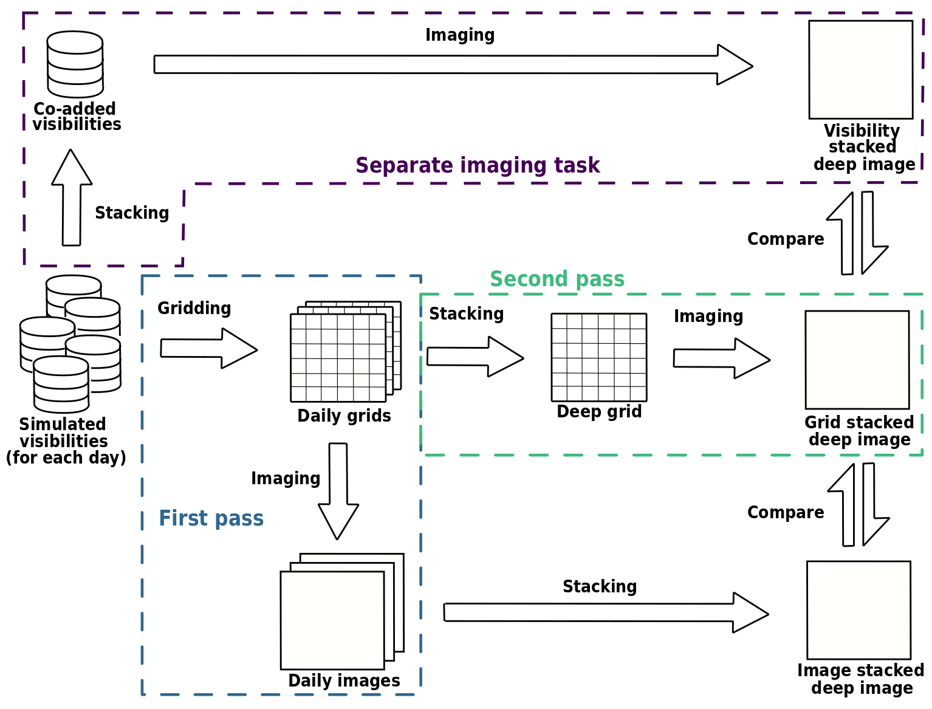
#3: DINGO: Original focus
Deep Investigation of Neutral Gas Origins
Kristof Rozgonyi PhD
`Deep Interferometric Imaging .. Gridded Visibilities’ 2021
DINGO: the deep ASKAP HI survey
3,200 hours, 350MHz (in 2 sections) on one field
Traditional
(eg CHILES)
Minor and Major cycles
Grid Stacking
DINGO
Data reduced by gridding
Minor cycles
As data can not be retained
Image Stacking
ASKAP & SKA
No further devolution
Notes:
Default approach is to image every day (at low resolution (30')) and store that for summing at the end of the experiment.
Because the data can not be retained.
The CHILES approach is traditional. Combine all the data every pass and image
because all the data is retained.
DINGO strategy is halfway. Combine the individual days, clean and store residuals. Then sum the grids for deconvolution at the end
Default does not allow for further deconvoltion
Traditionally allows for major cycles
DINGO allows for minor cycles only (currently)

Slide 6
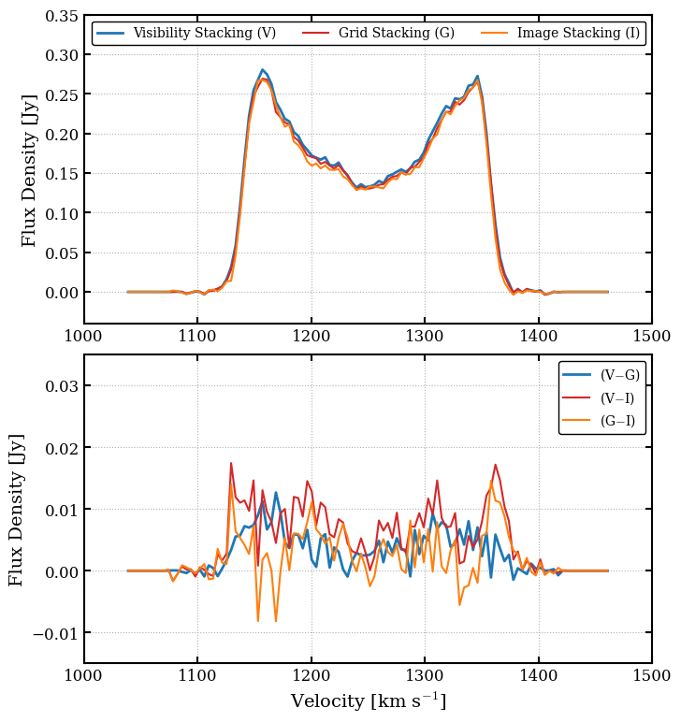
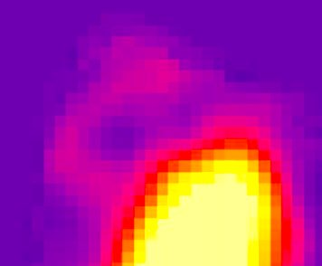
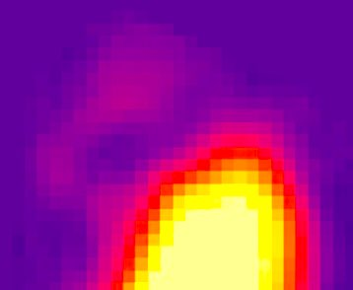
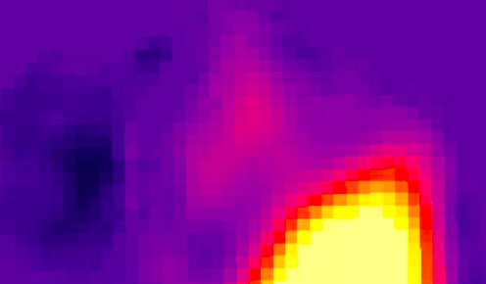
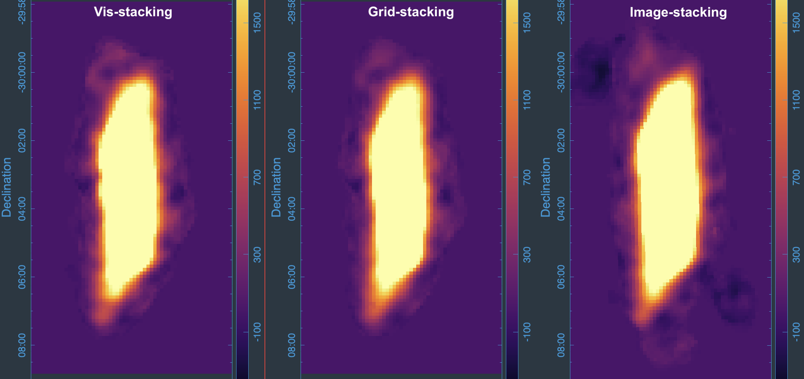
DINGO & Grid Stacking
Deep Investigation of Neutral Gas Origins
Uniform
Kristof Rozgonyi PhD
`Deep .. Imaging by Gridded Visibilities’ 2021
Jonghwan Rhee,
`DINGO: Deep Imaging in the SKA-Era’, in-prep 2025
Grid Stacking significantly improves deconvolution:
Vis vs Grid vs Image
White is good
Comparison of the reconstruction (i.e. PSF)
For:
Image stacking
Grid stacking and
Visibility stacking
Impact of weighting scheme notable
Particularly for Image-based approaches
Mean of Sum vs Mean of Means
NGC7361
Image vs Vis
From: Williamson 2024, (prep) 2025; Rhee+ (prep) 2025
Notes:
Kristof Rozgonyi demonstrated this in his PhD:
He did a three way comparison of Traditional Imaging (stacking all the visibilities onto one grid and imaging) to Stacking the daily images, and to stacking the daily residual grid– which is saved (rather than the image) after deconvolution cycles, which is then imaged
Comparing the traditional deconvolved PSF (which we take as truth) –- to stacked grids we see good agreement. But to stacked images we do not.
Particularly if a weighting scheme is applied. If your PSF is wrong your deconvolution is wrong.
That was with simulations – do we see the same in the data? Yes
Looking at (and around) the strong galaxy NGC7361:
We take Traditional imaging (vis-stacking) as truth - all look roughly correct, but when we zoom into the filiments and push the colour coding
You see the image stacking is diverging significantly
-------------
This figure compares the difference of the 3 approaches
Rows show Vis-Grid, Image-Grid, Image-Vis
Columns show no weighting, natural weighting, uniform weighting
Vis-Grid is not too bad - sub uJy level differences,
Image-Any is not too good - up to mJy differences.
The first col works pretty well, The last pretty badly
What is happening in this case is that assuming a single
signal weight for the whole image is the error

Slide 7
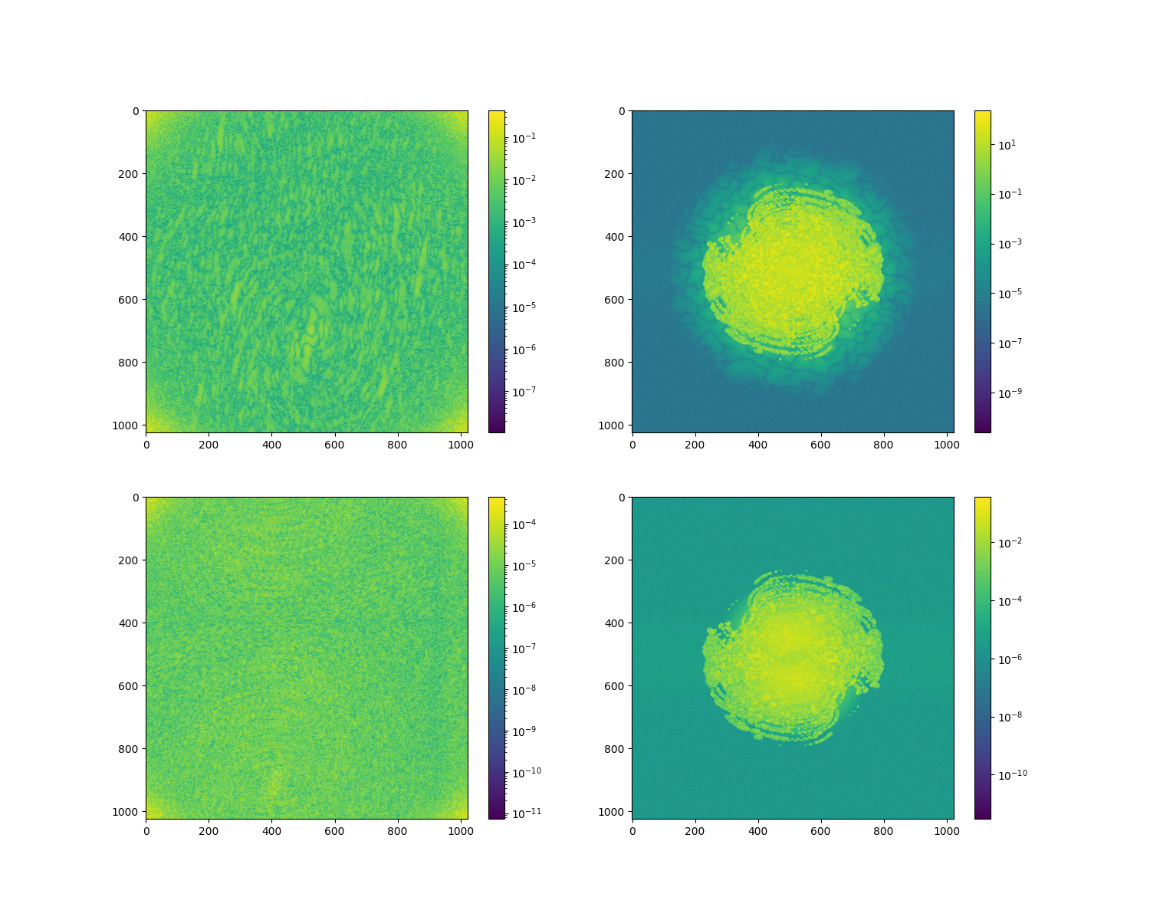
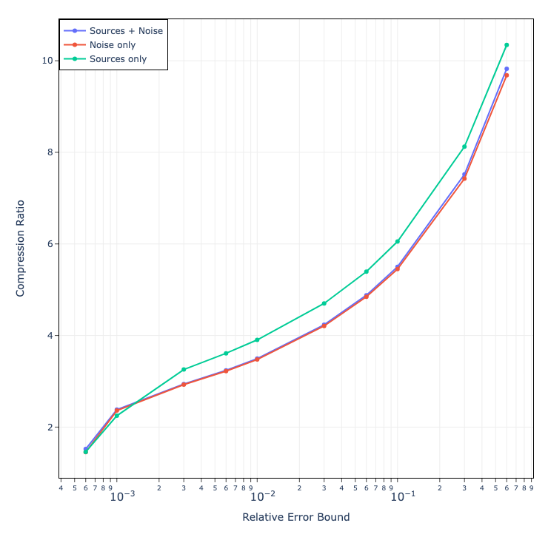
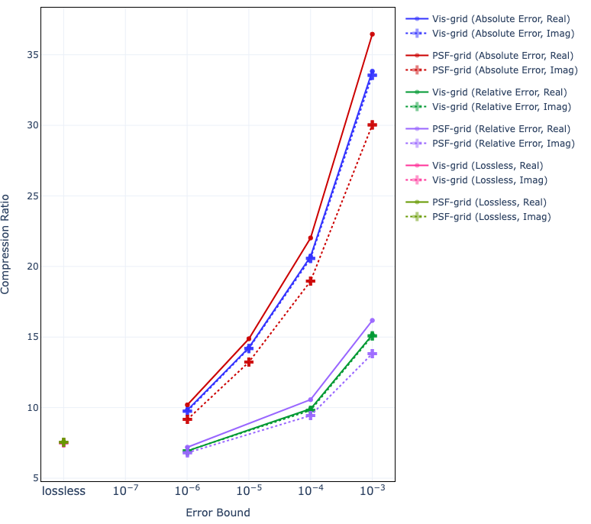
Grids: Compression Ratios
Gridded data in Radio Interferometry are largely zeros – perfect for compression.
But also took the opportunity to explore MultiGrid lossy compression
BUT ALSO:
Lossless Compression 7-fold
Compute-time 7 times faster
i.e. I/O dominated
For MGARD one gives an allowable physical error bound
Relative EB, Absolute EB and others
Compression on Grid:
MGARD results acceptable, but Using Lossless for now
From: Williamson+ 2025
Notes:
That was the science driver - but to minimise the storage we were requesting (complex grids, PSFs and PCFs rather than an image) we had to compress our products.
We started by using the lossless MGARD modes inside ADIOS (replacing the parallel fits writer with an ADIOS CASA table manager)
Whilst here we looked at the MGrid methods, also provided by MGARD.
Great results with higher compression - but being cautious - and mindful that you don't want to find errors after observing for 1000s of hours - we are sticking to lossless
As that achieves the requirements.
Factor of seven compression of grids AND factor of seven increase in processing speed.

Slide 8
#2: Visibility Data: Limits to precision
The signal chain adds first stage amplifier noise
  By design should be the dominant limit to sensitivity
The voltage data into the correlator is bit limited
  Geodetic data can be sign-only (1 bit).
  SKA will use 12-bit
The correlator integrates a limited number of samples (so still bit limited)
  Samples per visibility bin is not that high
  (with many channels)
Compression can be thought of as another additive noise. With good design, like the others, it can be held to be less than the dominant terms
Notes:
Some of the limits to the precision of our data:
Fundamentally the design should be limited by the first stage amplifier noise - all subsequent amplification should not add significant noise (i.e. operate in the linear reguime)
Additionally there is a limit in the precision of the digital data - the extreme is 1 bit, but we are at 12bit - which then averaged over many cycles (in time and frequency). But the limit remains at some level
Compression can be thought of as another additive noise, which if it is less than the finst stage noise will have (should have) no effect on the image
MGARD working in the SIGNAL domain rather than the BIT domain allows us to ensure this

Slide 9
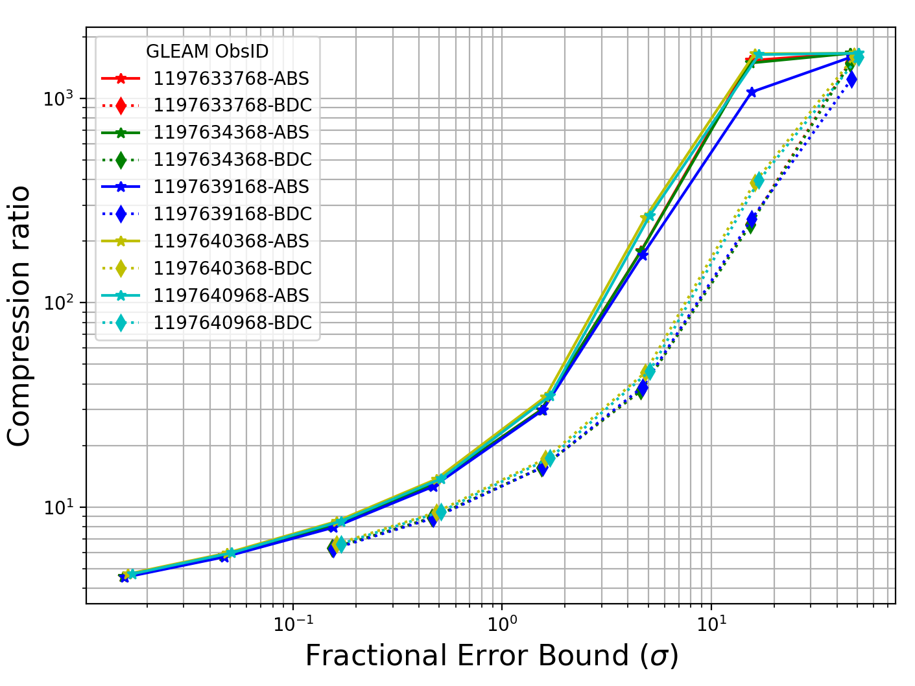
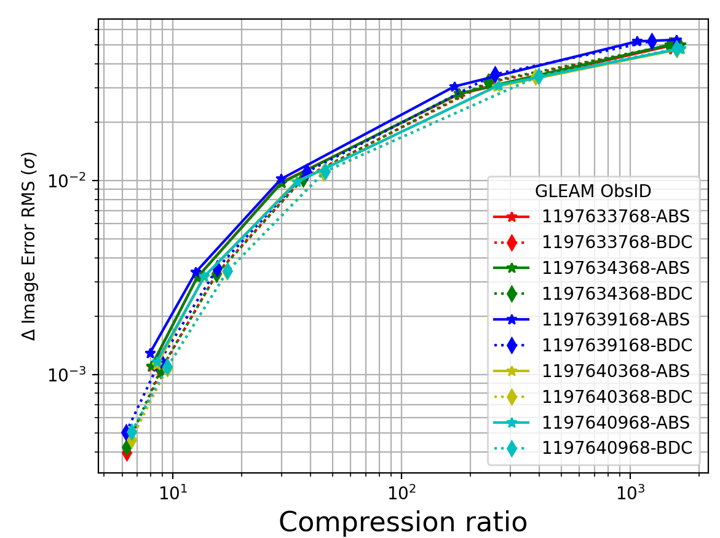
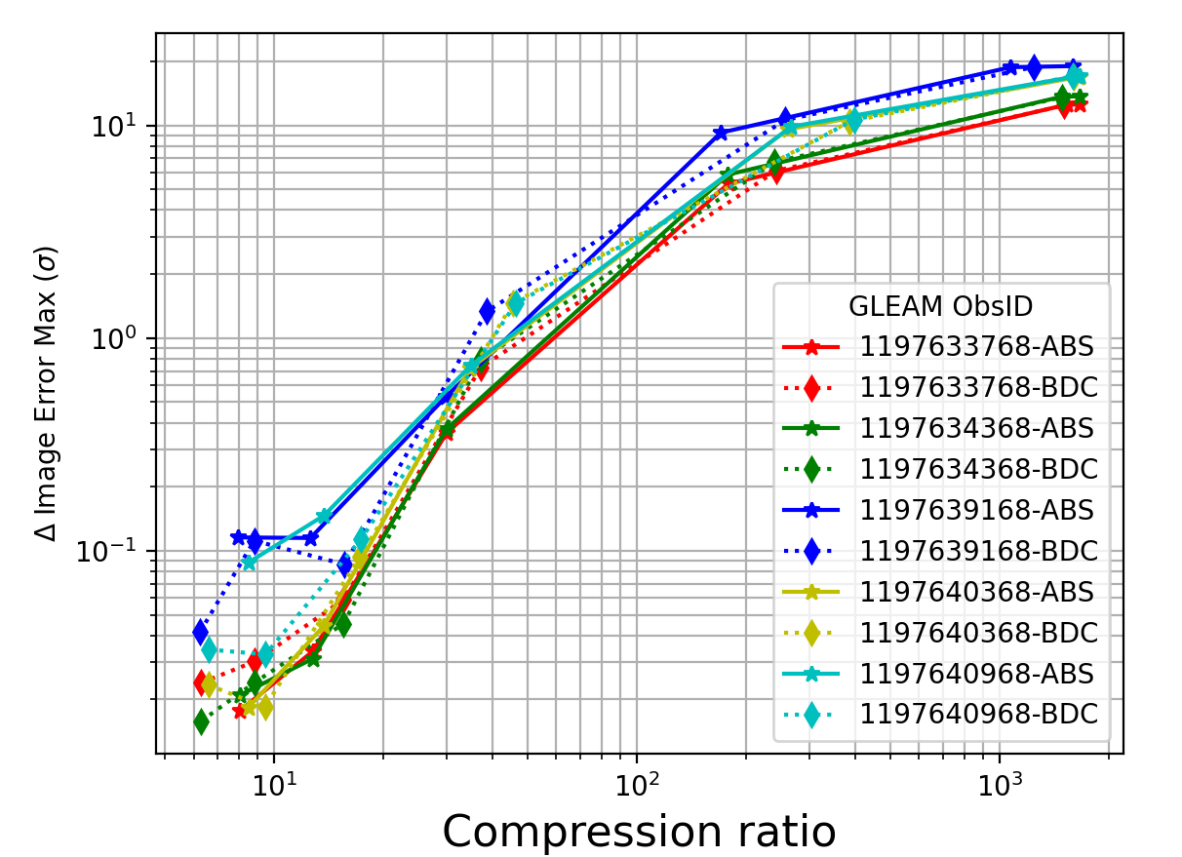
Visibilities: Compression Ratios
Compression as function of Error Bound:
10-fold compression for compression at 10% σ
Image parameters as function of Compression:
10-fold AND increase RMS ~0.1% σ Max <0.1σ
See also: Dodson+ (PASA) 2025
Notes:
Then we turned to raw visibilities. We applied the same tools to raw data. Note, if casacore is compiled with ADIOS/MGARD this is invisible to the user.
All the tests in this slide are MWA GLEAM (ie continuum) data
We see great compression for moderate error bounds: 10 fold for ~0.1sigma of visibilities RMS
Looking at the effects on the images we see 0.1% increase in image RMS. A more stringent test is the max abs error (I.e. error peak close to image max pixel). These are 10% or less of image RMS.
Why is the working? Compression is an additive noise – we are adding only a fraction of the system temp. Very small impact on final image
To turn to actual examples: here are the degree of compression and the detectable impact on the images for some 150MHz GLEAM observations
That is continuum, temporallu stable, MWA-correlated datasets. All from a single night, spread in 10min steps. This data is noise dominated
We form the statisics on the difference between the images from the never compressed and compressed data.
One sees the compression ratio increases as one allows the errors to increase, here plotted as a fraction of the visibility standard deviation
Two methods of compression are being trailed here - compress with a common limit for the whole file and with a limit that tightens for longer baselines (because fewer samples will be averaged together in this case).
For all the data the image RMS tracks the degree of compression tightly (unlike for the error bound - where BDC and ABS diverge).
However for the max error we do see a few signs of separation between the BDC and ABS methods
Max is a better test, as it picks up localised errors around the strong sources compared to the average errors across the iamge.
10fold compression only introduces a increase in image rms by 0.1% of sigma, and a increase in the max error by 0.1sigma

Slide 10
Output: Image comparison
RMS does not capture a lot of effects.
One bad area will not raise average RMS
Solutions:
RMS of difference between Uncompressed&Compressed
Peak Values: Max/Min
Distribution: Kurtosis and -Min/RMS
Localised RMS (on a 8x8 grid)
&
Two-point correlation (FFT)
picking out the maximum on a particular scale
New Suggestion: Check the closure quantities

Slide 11
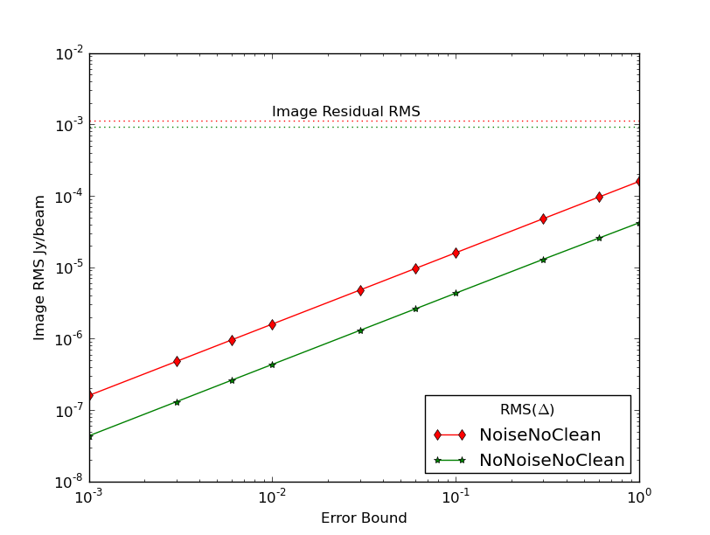
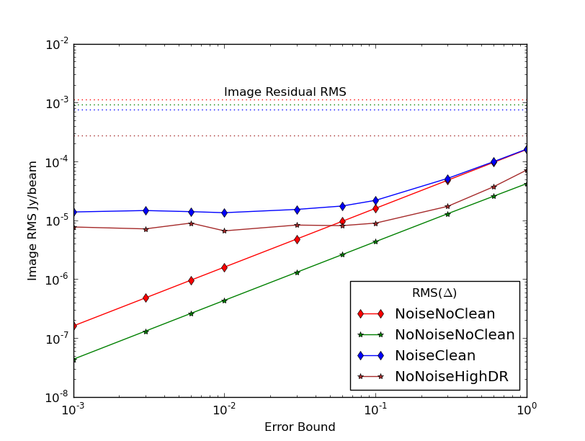
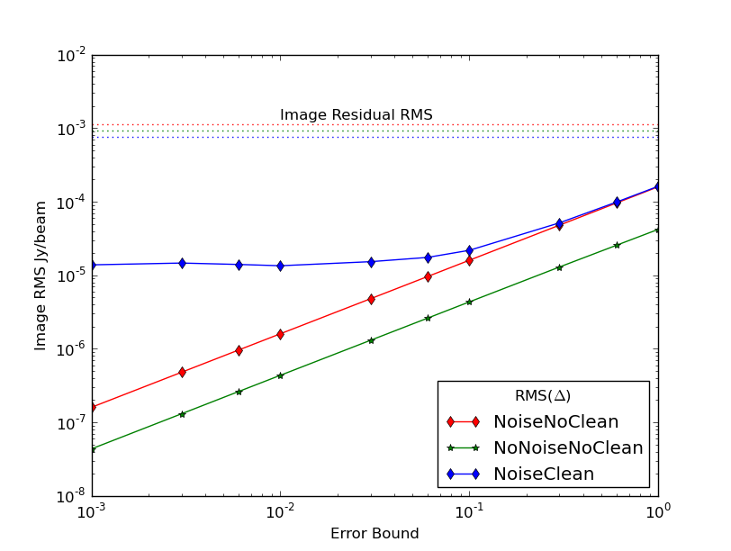
Output: Image comparison
RMS of Compressed-Uncompressed Images shows:
No-Clean – No Deconvolution
Linear Case
More precise error bound
Closer to uncompressed
All the error bounds > native RMS
No-Clean – No Deconvolution
Linear Case
With Deconvolution limit a limit
DR 1,000:1 1% of native noise
DR 10,000:1 ~0.1% of native noise
See also: Dodson+ (PASA) 2025
Notes:
The RMS is the simplest case to describe
Reduce the error bound, reduce the difference.
In all case the introduced noise was much less than the native image noise
Intruding CLEAN muddies the water – the PSF sidelodes are mixed with the subtle changing noise floor to give a constant error for all compression bound
Only way to improve things is to improve the PSF – reduce the sidelobe size

Slide 12
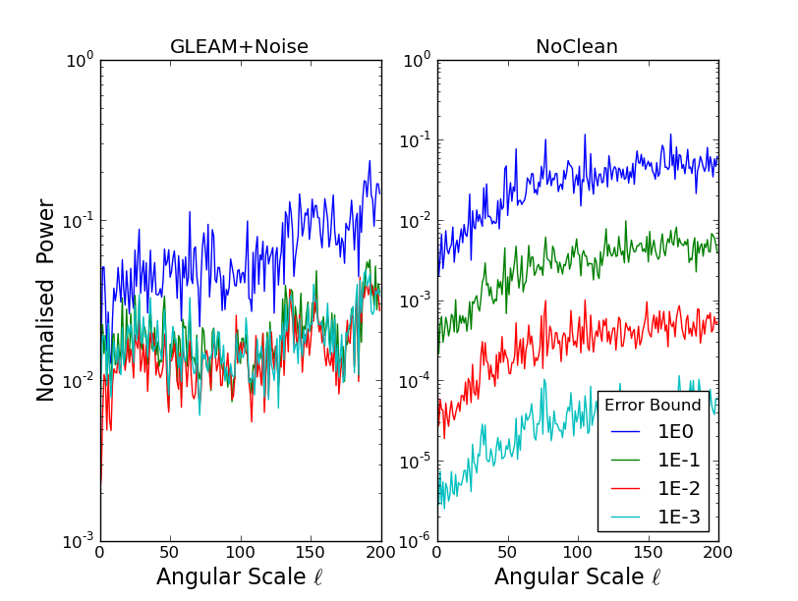
Output: Image Fidelity
Two point correlation:
Max peak of FFT picks
up any ripples
DR 1,000 data with noise
Hit deconvolution limit
Higher error bound
Without CLEAN & High DR
Higher precision required
Smaller error bound
Notes:
The 2D correlation can be used to puck out ripple
No ripples introduced

Slide 13
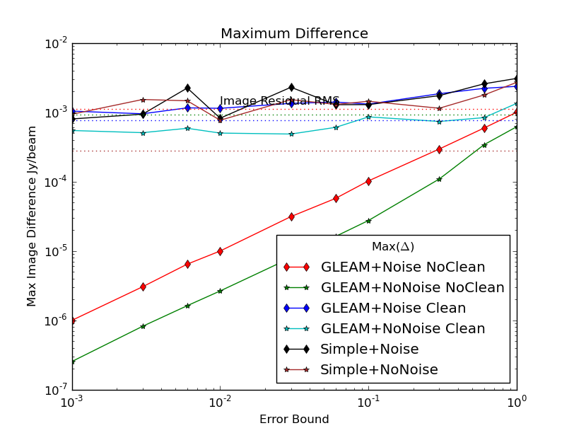
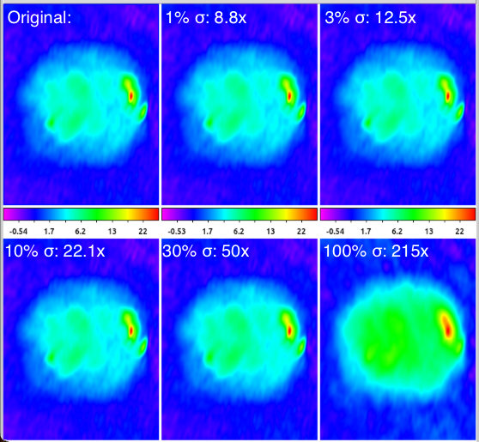
Visibilties: Image comparison
From: Dodson+ (PASA) 2025
Maximum difference of Compressed-Uncompressed Images shows:
Maximum difference when cleaning
Close to RMS levels
No deconvolution relationship continues – problems are in CLEAN, not compression
CLEAN algorithm is mixing subtle changes in noise with deconvolution close to strong source
Tests with ng-Imagers are important
Impact of compression on Solar Images
Notes:
RMS does not give you the worst case errors. I prefer to use max error
As before Max errors with deconvolution track the image RMS, but without CLEAN there is no mixing of PSF with the random RMS noise
ng-Imagers might avoid this
Solar data is real data that is signal rather than noise dominated, but it is also varying temporally (and spectrally).
Making these a very intesting test datasets
We compressed the whole file to see the impact of the blurring over the time/frequency axis - as shown in images this time
Visually the differences are even harder to tell - clear by 100% sigma - but only just detectable at 50 fold or 1/3 sigma.
Having said that I would stop at 1% sigma - to be safe

Slide 14
Next: Baseline Dependent Av.
Baseline Dependent Averaging is a `kinda’ compression.
Data you know will change slowly you average in time.
We have reproduced this with MGARD Region of Interest feature (RoI)
Solar MWA Data:
In line to be deleted.
Perfect test environment (stuff ups don’t matter)
(Very) High Signal to Noise Case:
Sort data into baseline order,
compress in chunks,
with larger error bounds on shorter data.

Slide 15
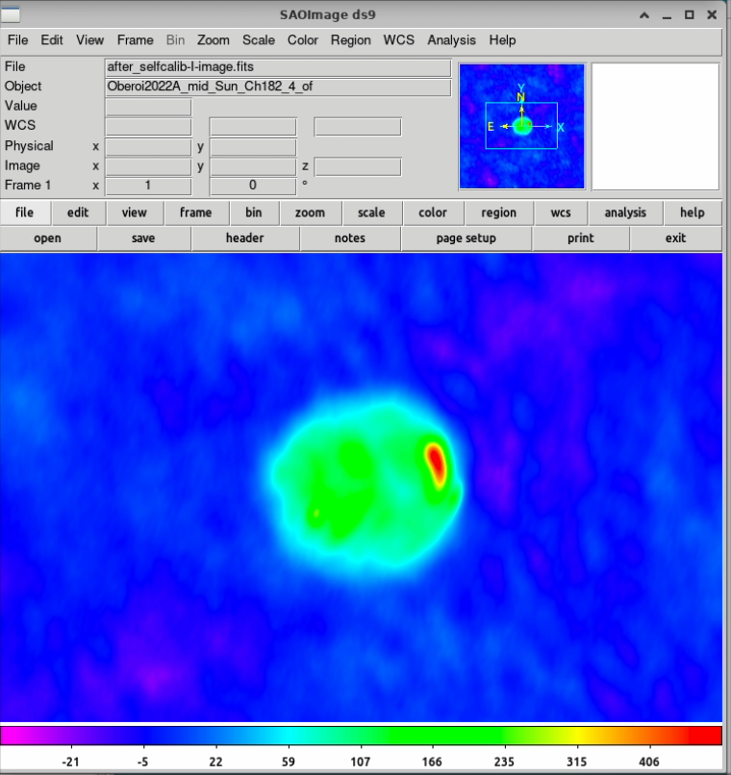
(Re-)Enabling Science
Deep Imaging via Image Stacking will be systematics limited
About half of the HPSO are deep, so this must be addressed.
Both Grid stacking or Compressing Visibilities would bypass this limit. Allowing thermal limits and the potential of SKA to be reached.
DINGO will continue to follow grid stacking (for now) as that is the current plan
Also: Financial limits are significant. Storage is expensive
Reducing footprint also saves money & improves processing time
Case in point MWA archive
Where we are offering the path of compressing rather than deleting
Nevetheless (IMO) we are not sensitivity, but compute limited.
Processing that takes too long never gets done.
Lossy Compression of the visibilities reduces file size, speeds up imaging and allows fuller investigation of the potential science.
Notes:
Going back to the what Compression brings to us
Systematics will be the killer for SKA -- because it is so sensitive. Data must be retained
DINGO is our test demonstration of that at the moment
We suggest two solutions here, both of which have been tested fully (Grids more than Raw). Both are allowing one to keep the uv data, which has been repeatedly stressed as essential
For DINGO, because we achieve the requirements - we will stick to lossless
For the MWA we recommend visibility lossy compression, firstly to make space on the archive
But also I think there will be great impact is on the compute limits -- processing that is too slow is as good as wasted observing
Lossy compression reduces file size, reducing/removing IO bottleneck, allowing full investigation of the parameter space
Allowing the study of finely divide data such as this solar data we were using to test compression - imaged in 12 second steps where the variation is extremely rapid and science rich.

Slide 16
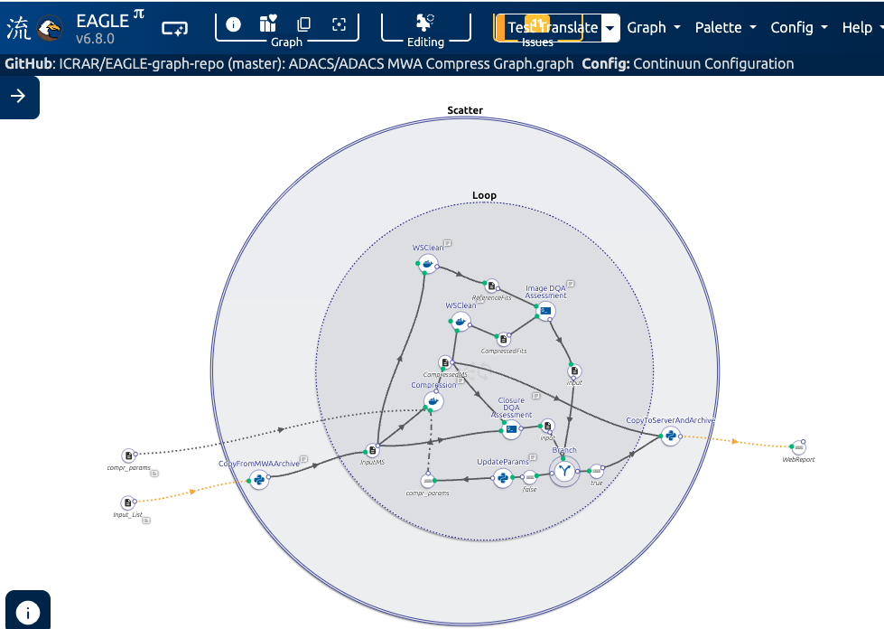
Support Grants
User driven DALiuGE graph with input ObsID and target limits
ADACS #1: Develop pipeline for lossy visibility compression
15 weeks of effort to combine existing components under DALiuGE
ADACS #2: Combine Three DINGO methods into one script
15 weeks of effort to combine existing pipelines under DALiuGE
Pawsey #1: Optimise DINGO Components
Improving performance by speeding up components
Notes:
To implement this:
We aim to deliver the the anonymous user a web interface that will compress a list of MWA data ObIDs, check no errors are introduced and report back with a link to the lossy-compressed MS file
This can replace the arcive data with no lossy of science (based on the users limits). I expect it to be 10 times smaller

Slide 17
Future …
Model | Target projects
Voltages | ngEHT/CRAFT/(SKA Transient Buffer)
Visibilities | MWA/GASKAP/ALMA/(SKA in receive)
Grids | Stacking for DINGO
Images | Cubes for DINGO/GASKAP
Notes:
Plenty more to investigate

Slide 18
Proposed Plan
Model | Time Line
Voltages | Vital for SKA Buffers: but who is the client?
Visibilities | Current focus: for MWA archive then ..
Grids | Continuing: Lock in Alex’s work
Images | Oak Ridge: Should be standard ..
ADACS #1:
One Docker to support all
MWA: ADIOS Read/Write + WSClean
ASKAP: ADIOS Read/Write + ASKAPSoft
ALMA: ADIOS Read/Write + CASA
ADACS #2 & Pawsey #1:
DALiuGE graphs for DINGO
With component speed ups

Slide 19
Conclusions:
DINGO imaging pipelines bedded in
200hr of pilot data processed in `default’ image-stacking mode at 30arcsec
1 beam of pilot data processed in grid-stacking mode at 10arcsec
Lossless compression reduces storage requirements and processing speeds 7-fold
We have demonstrated the required steps for getting the thermally limited deep images where the raw visibilities can not be retained
Applying similar approaches to raw visibilities has shown that:
  We can introduce compression 4-10 times without affecting the results
  In RMS (1% to 0.001% additive noise)
  In Max error (with CLEAN ~RMS level,
  without CLEAN to 0.001% additive noise)
  In features (with CLEAN ~1% of RMS level, without to 0.001%)
  does better on smooth features
  The limits are due to the deconvolution algorithm
We can reduce storage requirements, massively
Or keep data for longer, and process it faster
Notes:
DINGO: progressing well. Bedding in. Imaging deeper and at high resolution
LOSSY: appears to work well. Will provide the tools as an application for users to confirm it has no impact on their data
Potentially saving a big bundle of money and a lot of archive space

Slide 20
Notes:
In this paper we demonstrate the application of MGARD compression to a broad selection of MWA data to confirm that
this is a suitable tool to reduce the storage requirements.
%
We have demonstrated that continuum MWA observations, which are noise dominated, are preserved.
We have demonstrated that solar MWA observations, which are signal dominated, are preserved.
We have demonstrated that temporal flares in these solar observations are preserved.
We have demonstrated that calibration is equally effective before and after compression.
%
We introduce a new compression approach which we call Baseline Dependent Compression, following the concept of Baseline Dependent Averaging.
Under this shorter baselines are compressed independently from the longer baselines by a greater degree,
as they would have longer atmospheric coherence times,
as well as longer dwell time in the gridding uv-cells.
%
We have demonstrated the related concept of Time Dependent Compression, where individual time steps are compressed independently,
so to allow for greater compression on flaring behaviour that will appear more point-like.
%
In all cases we can achieve a compression of about an order of magnitude or more,
with marginal impact on the image qualities, even where subdivided in frequency or time.

Slide 21
Where is possible
Why is possible
Method - multigrid
DQA
Compress Ratio to Image Quality
High Low SNR
Baseline Dependent Compression
Stefan W work 2018
Notes:
In this paper we demonstrate the application of MGARD compression to a broad selection of MWA data to confirm that
this is a suitable tool to reduce the storage requirements.
%
We have demonstrated that continuum MWA observations, which are noise dominated, are preserved.
We have demonstrated that solar MWA observations, which are signal dominated, are preserved.
We have demonstrated that temporal flares in these solar observations are preserved.
We have demonstrated that calibration is equally effective before and after compression.
%
We introduce a new compression approach which we call Baseline Dependent Compression, following the concept of Baseline Dependent Averaging.
Under this shorter baselines are compressed independently from the longer baselines by a greater degree,
as they would have longer atmospheric coherence times,
as well as longer dwell time in the gridding uv-cells.
%
We have demonstrated the related concept of Time Dependent Compression, where individual time steps are compressed independently,
so to allow for greater compression on flaring behaviour that will appear more point-like.
%
In all cases we can achieve a compression of about an order of magnitude or more,
with marginal impact on the image qualities, even where subdivided in frequency or time.

Slide 22
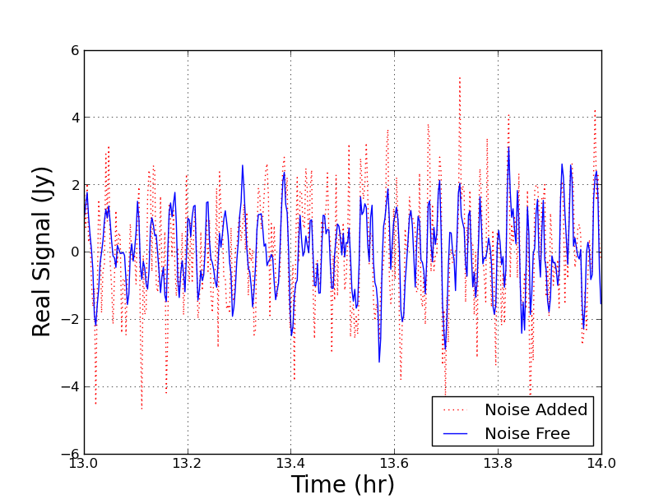
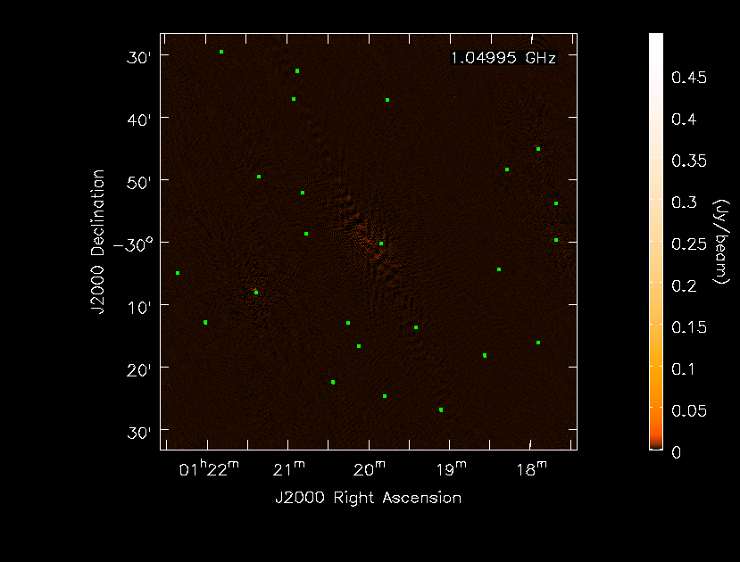
Input: Simulated SKA data
Simulations used:
OSKAR (i.e. no quantization of correlations)
SKA-Mid AA2 @ 1GHz & 1000 channels/1hr
GLEAM Catalog &/or Simple `Maser’ Source
Imaging with WSClean
GLEAM model + 64 antennas allows a maximum dynamic range of 1,000:1 – sky noise dominates
The simpler model achieves a DR of 10,000:1 – thermal noise dominates (for longer)

Slide 23
Input: Pathfinder data
Data used:
LOFAR
MWA Continuum (i.e. Noise dominated)
MWA Solar (i.e. Signal dominated)
GLEAM model + 64 antennas allows a maximum dynamic range of 1,000:1 – sky noise dominates
The simple model achieves a DR of 10,000:1 – thermal noise dominates (for longer)

Slide 24
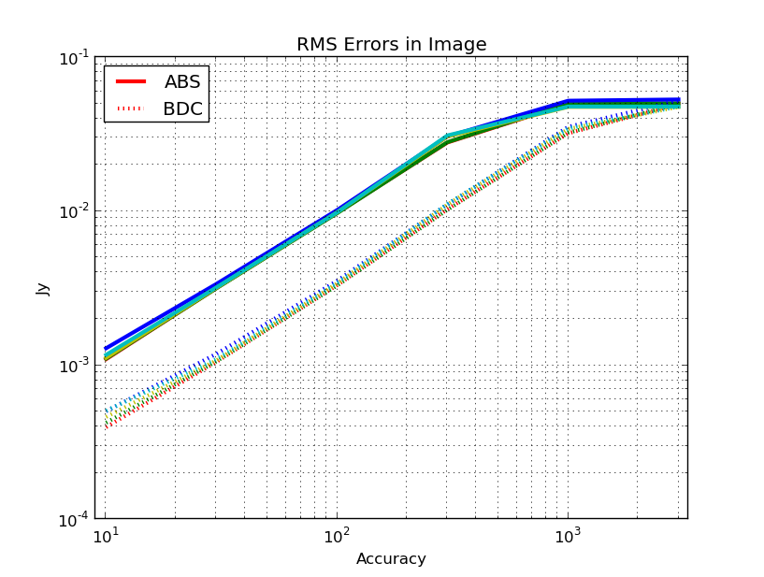
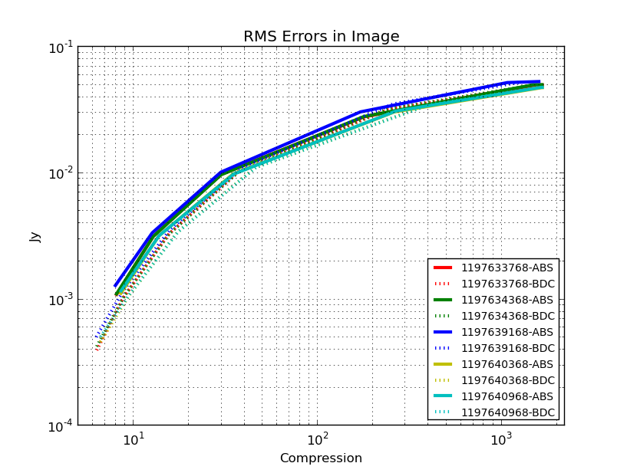
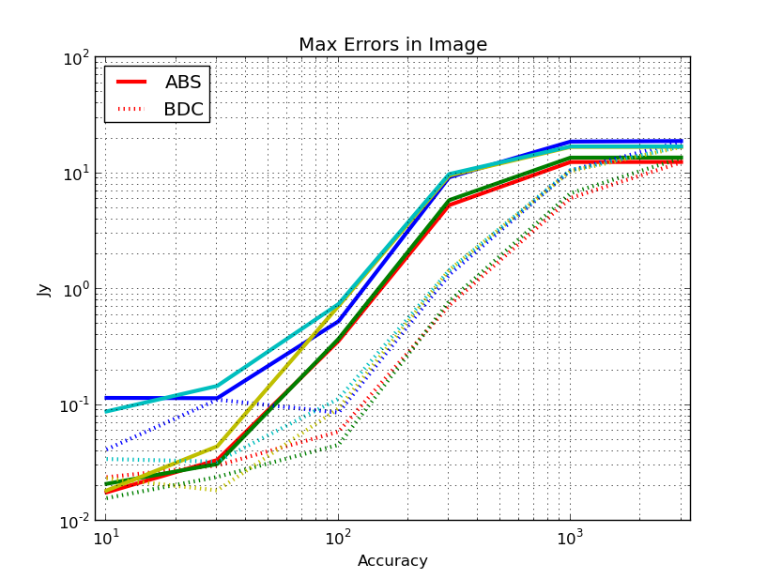
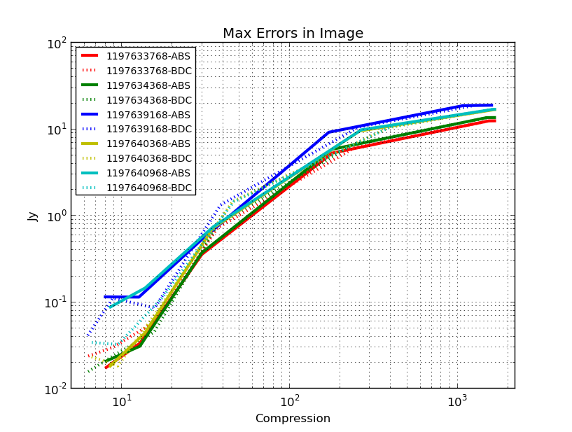
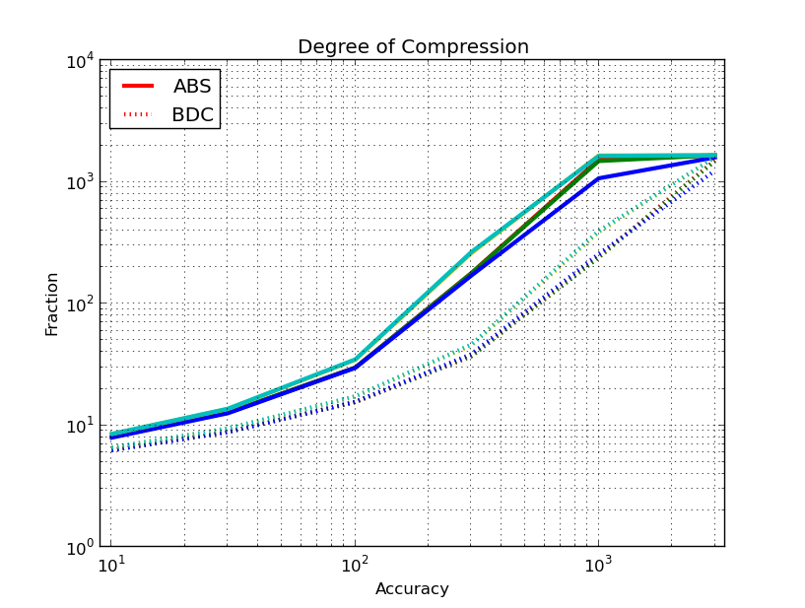

Slide 25


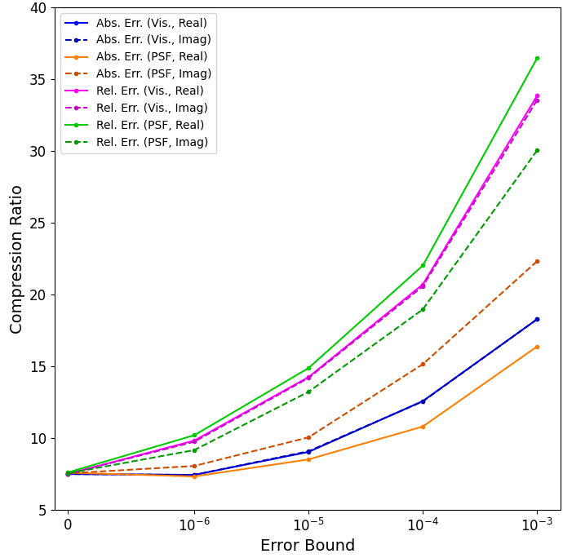
ADIOS2: Parallel Writing & Inline Grid Compression
Jason Wang integrated ADIOS into CASACORE for his PhD (2016)
ADIOS now includes MGARD as an inline compression – if IO bound no performance impact
Visibility Grid is largely zeros – so even lossless compression is good (factor of ~7) and that provides 7-fold IO improvement
MGARD
CR=7.5 - 37.5
Lossless
CR=7.5
1σ
But large lossy compression degrades the data – greatest impact on the PSF
https://adios2.readthedocs.io/en/v2.10.0/index.html https://www.sciencedirect.com/science/article/pii/S2352711023002868 Williamson etal CUG 2024: paper in press
Notes:
Compression is a great feature. If processing is IO bound this has no computre performance impact - but huge IO performace impact. Seen 7 fold improvement.
For Grids this is an optimal approach - high compression possible upto factor of 30
But (of course) high compression degrades the data. Mostly seen in PSF
Thus limit ourselvrs to solution where we are not adding more noise to images
Also having great results with raw MS files. Discuss afterwards

Slide 26
Motivation
Plus - Cost Drivers:
SKA data reduction `must’ be completed on the day
– as there is no space to keep things on the buffer
There is no space as multiPB storage is very expensive
Minus - Image artifacts:
Reduction of precision must have an impact
Very hard to predict extent of the impact
Developing a range of tests to provide this
Applications:
Different projects have different needs
DINGO: Can (and want to) stack in uv
GENERAL: Reduce the size of the measurement set

Slide 27
Current focus
DINGO compression lossless & the uv-grid
  Obviously, a good idea, as most values were zero
We also explored lossy as extending it was easy…
  Obviously, I expected it to fail
  Everyone knows raw-visibilities are Gaussian
  white noise, which can not be compressed.
Completely wrong
Works really well
Lesson for me

