Slide 1
BLINK: An End-to-End GPU-accelerated Fast Radio Burst Search Pipeline for the MWA
Cristian Di Pietrantonio
Supervisory team: Marcin Sokolowski, Christopher Harris, Daniel Price, Randall Wayth, Clancy James, and Ramesh Bhat.

Slide 2
The BLINK project at glance
GOAL: to search for low frequency (< 300 MHz) Fast Radio Bursts (FRBs) within MWA Voltage Capture System (VCS) archival observations.
Phase 1
Developing GPU-accelerated software to be run on the Setonix supercomputer.
Phase 2
Pilot search on 1 to 10 hours of VCS observations to test the system and refine search parameters.
Phase 3
Large-scale search on the Southern-sky MWA Rapid Two-metre (SMART) pulsar survey (and beyond).
We are here!

Slide 3
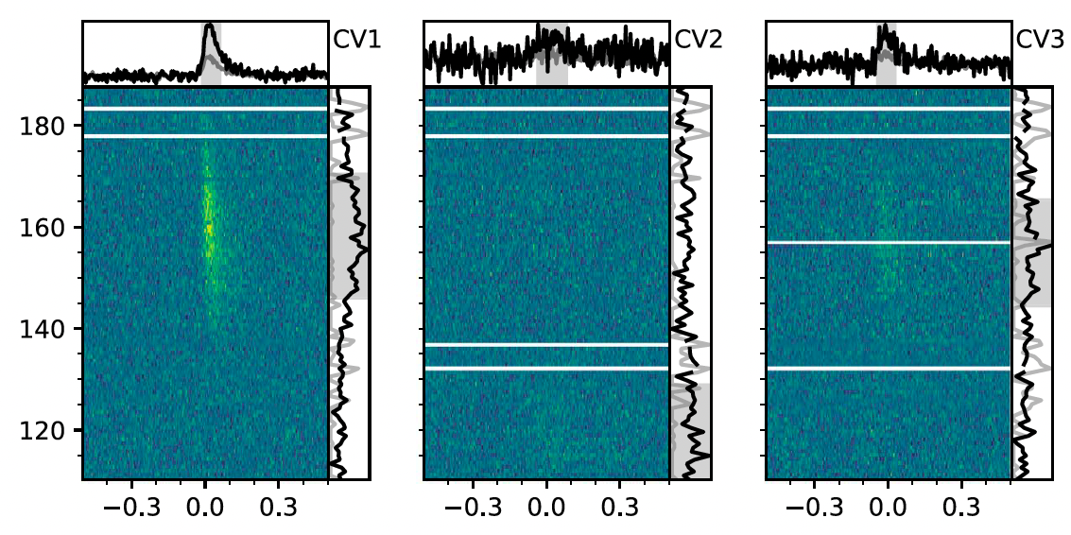
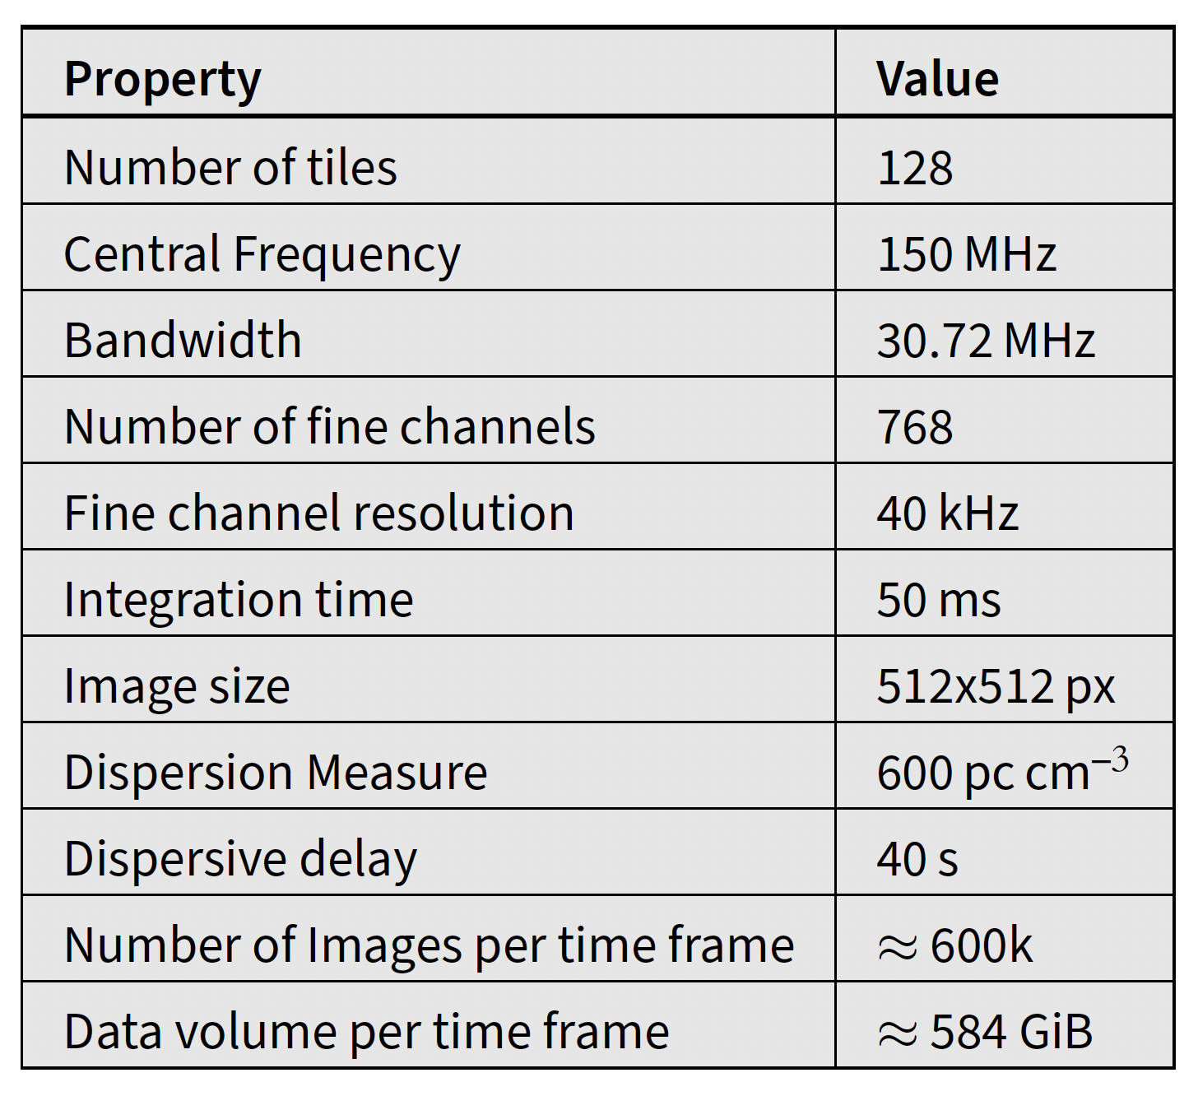
FRBs at low frequencies
Blind searches for FRBs at low frequencies are challenging due to accentuated signal scattering, scintillation, and dispersive delay.
Table 1. Representative FRB search configuration one would have to adopt with the MWA Phase II Compact.
Frequency (MHz)
Time (s)
Figure 1. Low frequency FRB 20180916B detected by LOFAR down to 110 MHz during a targeted search (Pleunis et al, 2021). So far there have been only a handful detected at such low frequencies.

Slide 4
Why is it important?
Multiple low frequency detections would:
complement information provided by FRBs at higher frequencies
provide more information to study:
  progenitors (magnetars? binary systems of neutron stars?)
  emission mechanisms
  energies emitted
  emission structure (sub-burst structure, repetition and periodicity)
  FRB local environments (associated persistent radio sources, environment magnetization levels)

Slide 5
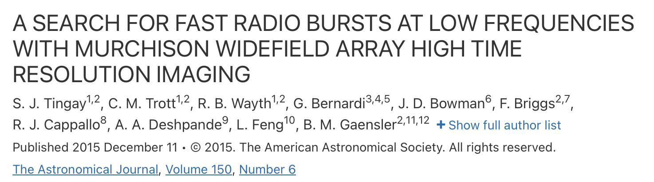
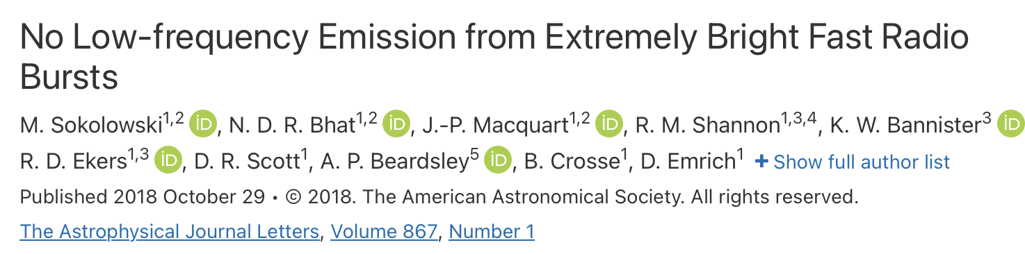



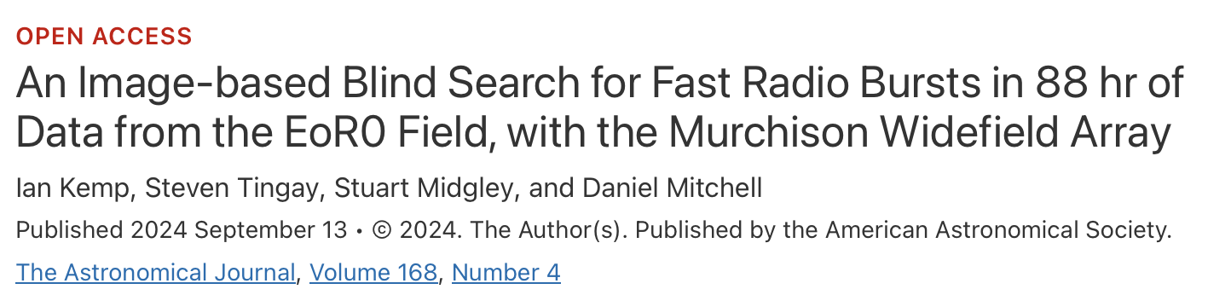
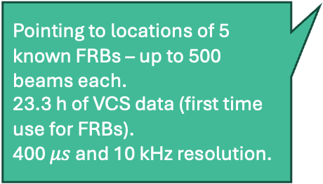
Previous FRB searches with the MWA
Shadowing ASKAP antennas that were detecting FRBs.
Image-domain search in 170-200 MHz bandwidth.
0.5 s and 1.28 MHz resolution.
10.5 h of observations over 400 deg² of sky.
Image-domain search in 139-170 MHz bandwidth.
2 s and 1.28 MHz resolution.
Pointing to locations of 5 known FRBs – up to 500 beams each.
23.3 h of VCS data (first time use for FRBs).
400 $μs$ and 10 kHz resolution.
Imaging-based search in the EoR0 field (167-198 MHz).
~100 hours worth of observations.
2 s and 1.28 MHz resolution.

Slide 6
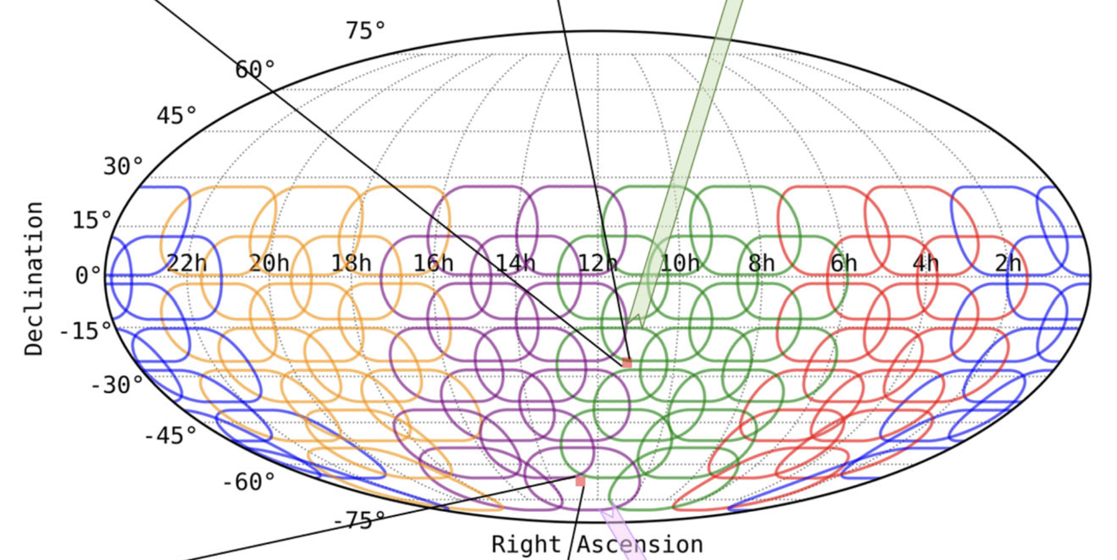
SMART survey: you are up next!
The Southern-sky MWA Rapid Two-metre (SMART) survey at glance
Designed by Bhat et al (2023a) performing sensitive searches for pulsars and fast transients in the sky south of +30° in declination
155 MHz central frequency, 30.72 MHz bandwidth, FoV 610 deg²
100 μs / 10 kHz time and frequency resolutions
~100 hours observing time. Equivalently, SMART observed (about) half of the sky for 1.5h
4 PB of voltage data
Figure 2. A cutout of a figure in (Bhat et al, 2023a) showing the sky tessellation of the SMART survey.

Slide 7
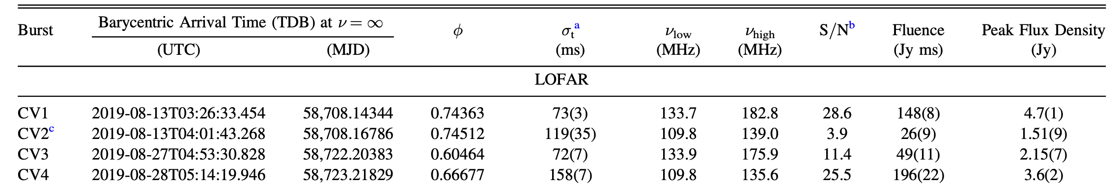
Expected sensitivity and fluence limits
Table 2. Theoretical sensitivity and minimum detectable fluence of the SMART survey at different integration times.
Integration time (ms) | Sensitivity (Jy) | Limiting Fluence (Jy ms) - 10𝛔 threshold
10 | 0.71 | 71.46
20 | 0.51 | 101.06
50 | 0.32 | 159.79
Table 3. A sample of the reported burst detections by LOFAR of FRB 20180916B (Pleunis et al, 2021). Bursts with same fluence as CV1 and CV4 would have been detected in the proposed search at 20ms time resolution.
.

Slide 8
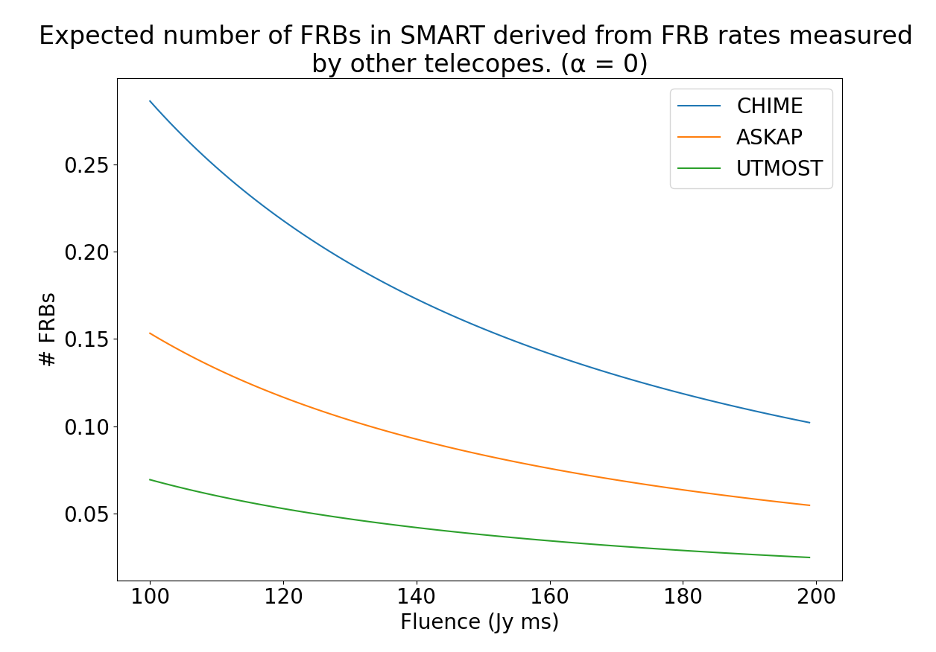
Expected # of FRBs
We are expecting to find (close to) one FRB based on measured FRB rates at higher frequencies.
The rate has been scaled down to 150 MHz assuming no frequency scaling (⍺ = 0). The measured spectral index ⍺ ≤ -1 at higher frequencies cancels out with the accentuated propagation effects.
Figure 3. Expected number of FRBs in the SMART survey as a function of limiting fluence, based on daily rates measured by other telescopes at higher frequencies. Each measured rate has been scaled down to 150 MHz. Based on the work of Sokolowski et al (2024).

Slide 9
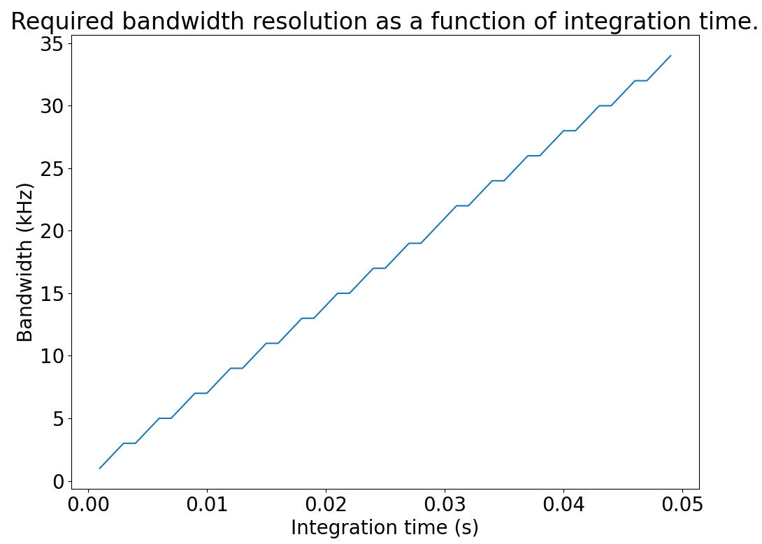
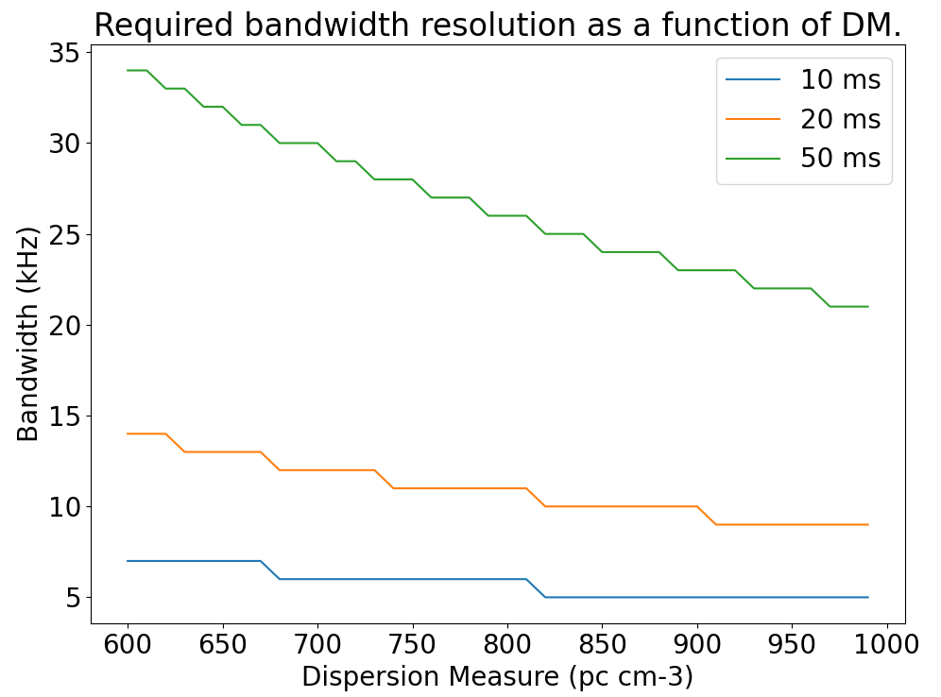
Fine channel bandwidth requirements
Figure 4. Bandwidth (centered at 150 MHz) as a function of the time required to traverse it with a DM of 600 pc cm⁻³.
Figure 5. The required bandwidth resolution is also dictated by the DM searched for: the higher the DM, the finer the required bandwidth.

Slide 10
Computational technique
Figure 4. The computational cost per time sample of beamforming and imaging at an integration time of 50 ms and observational frequency of 150 MHz for am MWA Phase II Compact observation. Beamforming requires two orders of magnitude more computation than imaging.
Figure 5. In traditional imaging (“long exposure”) data volume decreases because of averaging in time and frequency. In high time & frequency resolution imaging data volume increases because of the large number of images, possibly at high pixel (angular) resolution.

Slide 11
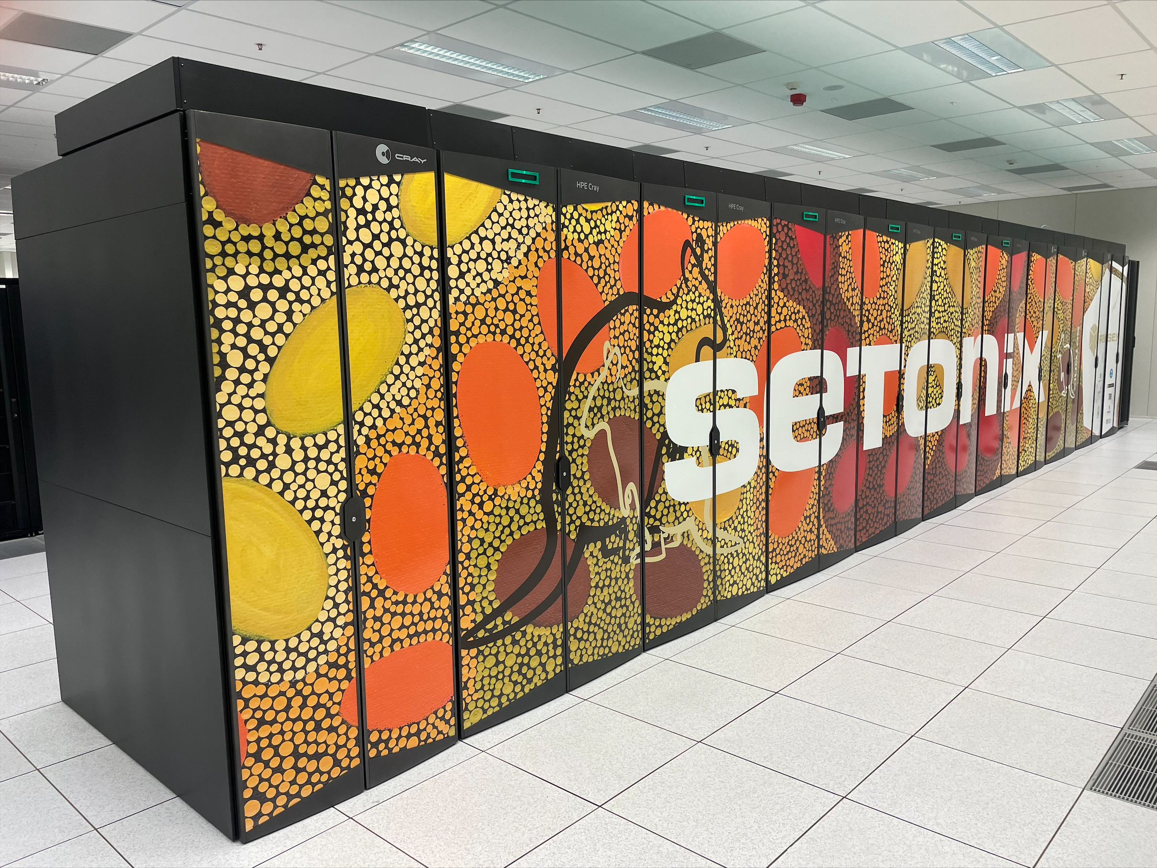
The BLINK GPU Imaging & FRB Search Pipeline
Efficient implementation of high time resolution imaging and signal dedispersion running at scale on the GPU partition of Pawsey’s Setonix supercomputer.
*
Figure 7. The Setonix supercomputer.
End-to-End GPU processing running as a single process for maximum throughput.
No intermediate I/O operations.
Data always reside in memory, data movement minimised.
Figure 6. Schematic representation of the BLINK pipeline.

Slide 12
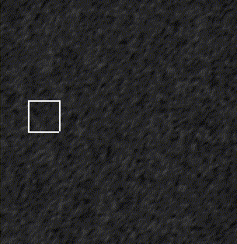
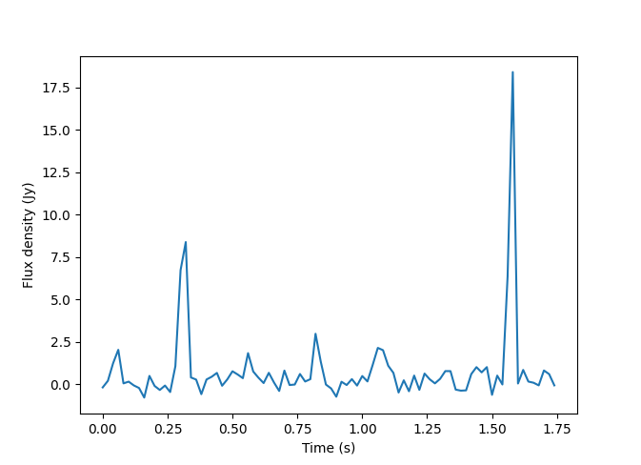
Test Case 1: Imaging pulsar B0950+08
Imaged an observation containing the pulsar B0950+08 with image resolution 1200 x 1200 pixels (13° x 13°) at 20 ms / 40 kHz time and frequency resolutions. The process produced ~38K images per second of observation.
Figure 9. Dedispersed time series of the signal within the brightest pixel at the position of B0950.
Figure 8. Animation showing bright pulses of pulsar B0950 in 20 ms images.

Slide 13
Performance Comparison with WSClean
A speedup of 3687x
WSClean was run on a Garrawarla node - 40 CPU cores + V100 GPU
BLINK was executed on a Setonix’s MI250X Graphics Compute Die (GCD, a MI250X has two of them)
BLINK timing includes I/O for a fair comparison – but it won’t need to write images to disk to perform an FRB search.
Figure 10. The BLINK imaging pipeline delivers an enormous speedup compared to WSClean, making high-time resolution imaging for the MWA possible.

Slide 14
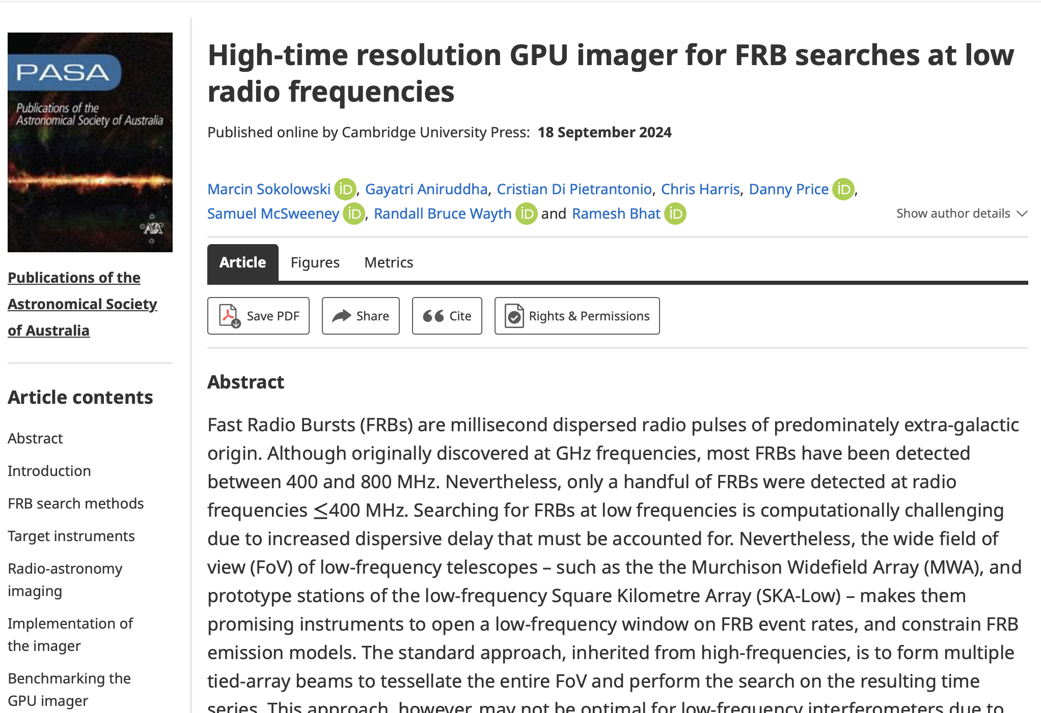
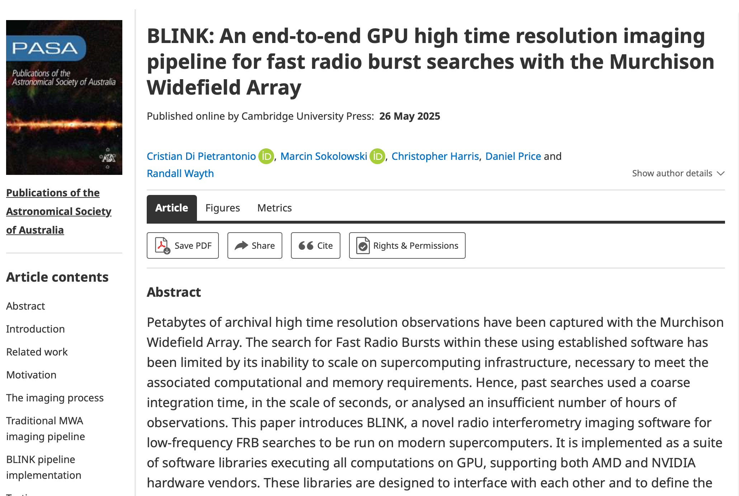
BLINK papers published in PASA
The BLINK source code is now publicly available on GitHub: https://github.com/PaCER-BLINK-Project

Slide 15
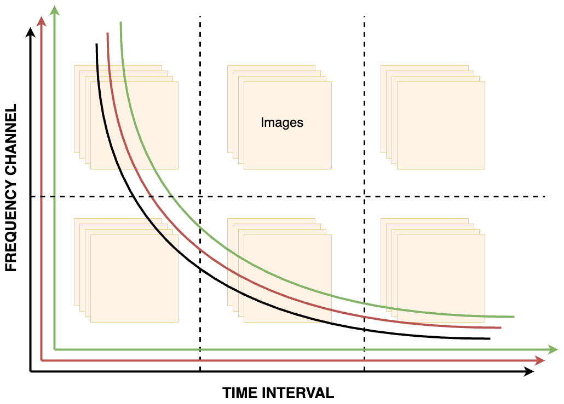
Incremental and distributed dedispersion
Can’t hold 40s (dispersive delay) worth of images in memory.
There is a dynamic spectrum for each pixel.
Split dynamic spectra in frequency and time.
compute de-dispersed time series for every pixel, at the same time and incrementally, as each second and coarse channel of an observation is imaged, then images are discarded.
A detailed description of the algorithm is the subject of my next Ph.D. publication, currently in preparation.
Figure 11. The BLINK dedispersion algorithm handles multiple dynamic spectra at the same time, pictured in different colors in the figure above. Dynamic spectra are partitioned across frequency and time to handle the large volume of data in multiple steps.

Slide 16
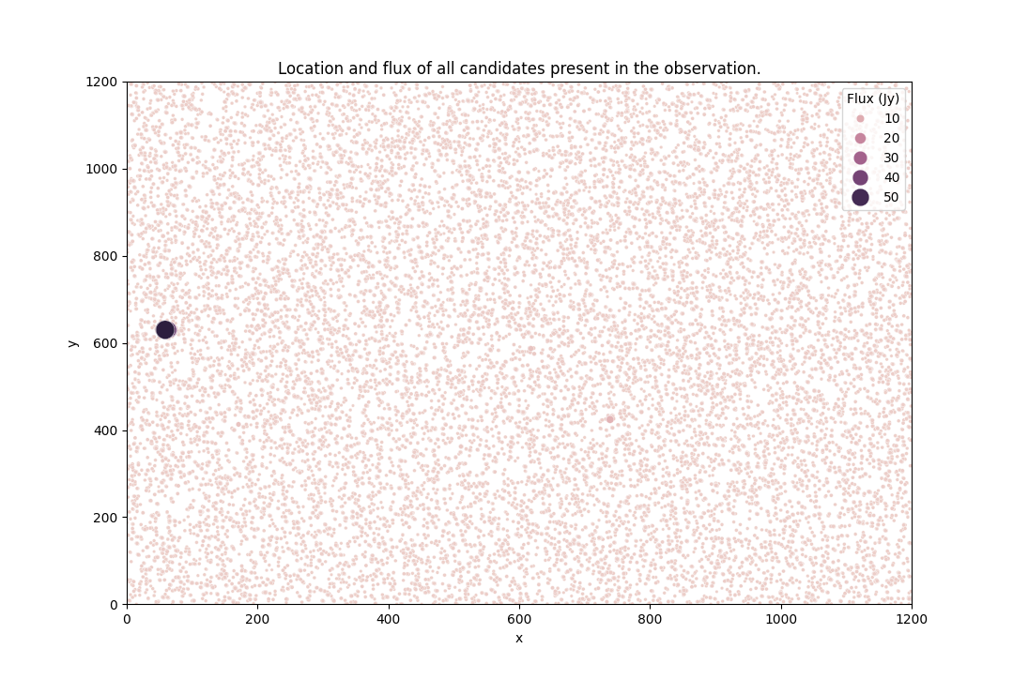
Peak detection & localization
The BLINK dedispersion algorithm produces dedispersed time series for every pixel coordinate.
Time series are searched for peaks using a Gaussian-based peak-finding procedure. Detections and the portion of time series they are found in, are saved on disk.
A detection map is a scatter plot mapping detections to their position in the FoV, their peak flux, and dispersion measure.
x | y | DM | Peak | Mean | Stdev
59 | 630 | 2.97 pc cm⁻³ | 54.85 Jy | 1.43 Jy | 6.02
Figure 12. The detection of B0950 (big black dot) within the imaged FoV.

Slide 17

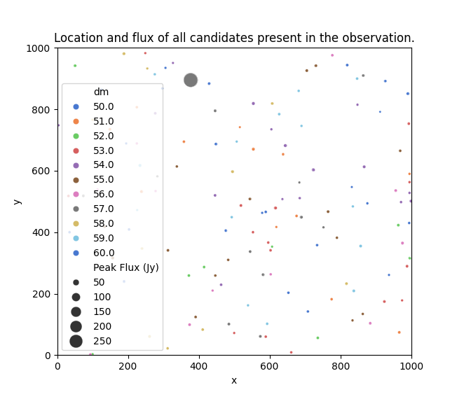
A more challenging test: the Crab pulsar
The Crab nebula
Figures 13 (left) & 14 (right). A long-exposure dirty image of the FoV containing the Crab nebula (left image). I run the BLINK FRB search pipeline on the observation, producing the detection map displayed on the right image. The detection (dot) of a bright (dot size) source is shown at the same position of the Crab nebula, with the same DM (dot colour) as the Crab pulsar. Several other minor detections are present in the FoV.

Slide 18
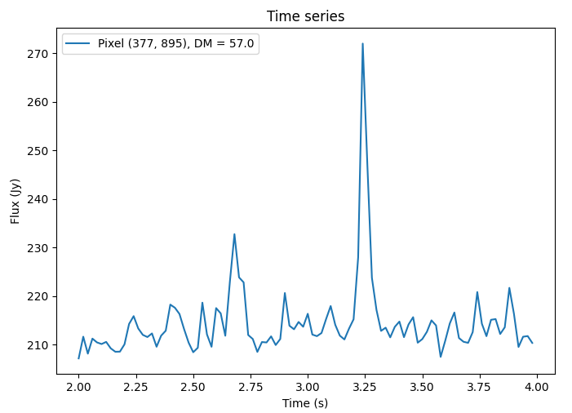
Time Series of the Crab Detection
Processing details:
10 seconds of observation
20 ms / 40 kHz resolution
1024 x 1024 px image size
10 DM trials (50 to 60 pc cm⁻³)
75 GB voltage data
1.6 TB worth of images produced and kept in memory
5.2 billion sweeps computed
12 minutes compute time on a fully utilised Setonix GPU node (0.2 node hours).
Figures 15. The time series where the brightest Crab detections were found. Two Giant Pulses (GP) of the Crab pulsar have been detected at the start of the observation.

Slide 19
The BLINK Project: development history
March 2021
PaCER project starts, led by Marcin. Profiling of existing software.
June 2023 – Cristian’s Ph.D. starts.
Correlation engine improved.
Implementation of GPU kernels to apply visibilities corrections.
GPU imager takes 1 hour to image 1 second of MWA Phase II Extended data at 1 second time resolution.
2024
GPU imager paper published in PASA by Marcin.
Cristian significantly improves the computational performance of the GPU imager.
Cristian starts the development of the BLINK imaging pipeline connecting all the software modules together.
Detection test with pulsar B0950.
2025
The BLINK imaging pipeline paper is published in PASA by Cristian.
Distributed and incremental dedispersion algorithm prototyped and implemented.
Multi-GPU support added to the pipeline, now orders of magnitude faster than WSClean.
Pilot search started with detection of Giant Pulses from the Crab pulsar.
2022
Cristian writes the correlation engine
GPU imager starts being prototyped by Marcin and Gayatri
Tested on MWA and EDA2 data.

Slide 20
Future work
H2 2025
Working on implementing remaining software requirements (for instance, difference imaging)
Improving sensitivity of the de-dispersion algorithm
Design and implementation of candidate filtering and scoring techniques
Pawsey and AusSRC summer interns will work on improving the imaging pipeline
H1 2026
Pilot search on 1 to 10 hours of VCS Phase II Extended observations to study and fine-tune scientific and computational performance of the pipeline
H2 2026
Large scale processing of the SMART survey

Slide 21
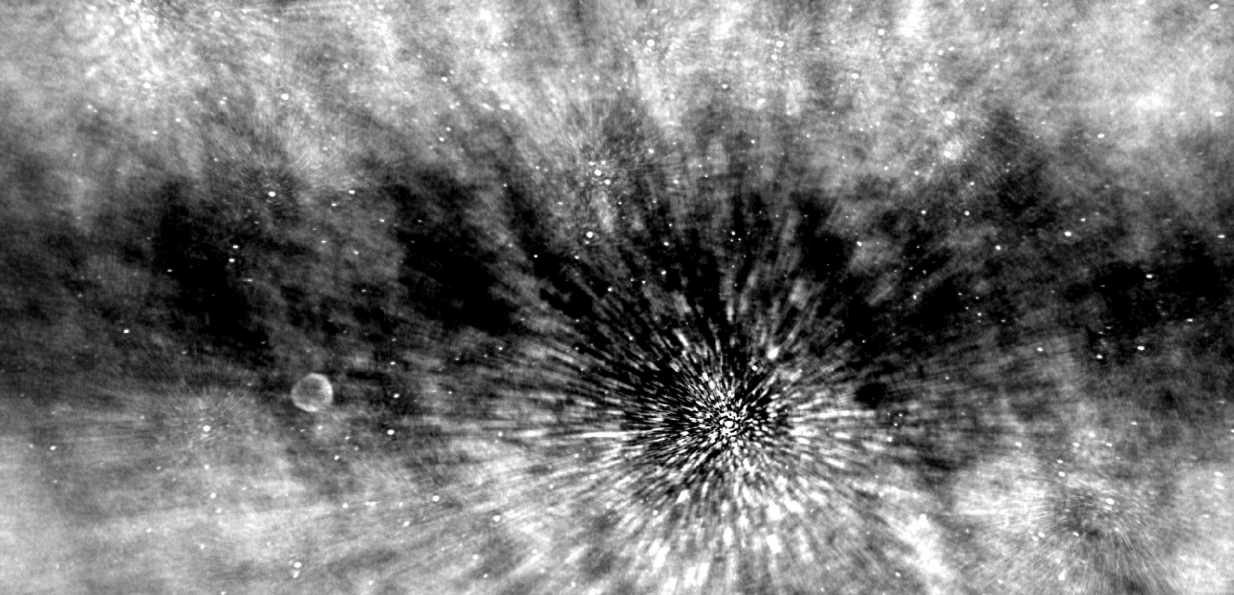
THANK YOU
Pictured above is a long exposure (dirty) image generated using BLINK on a 1.5h MWA Phase II observation.

