Slide 1


Deepest upper limits on the 21 cm power spectrum with MWA
Ridhima Nunhokee
On behalf of EoR MWA Collaboration
MWA Project Meeting
August 28 2025

Slide 2
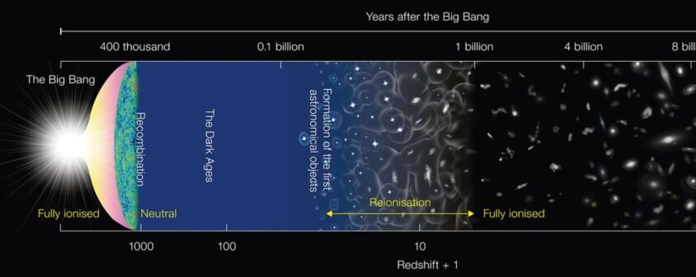
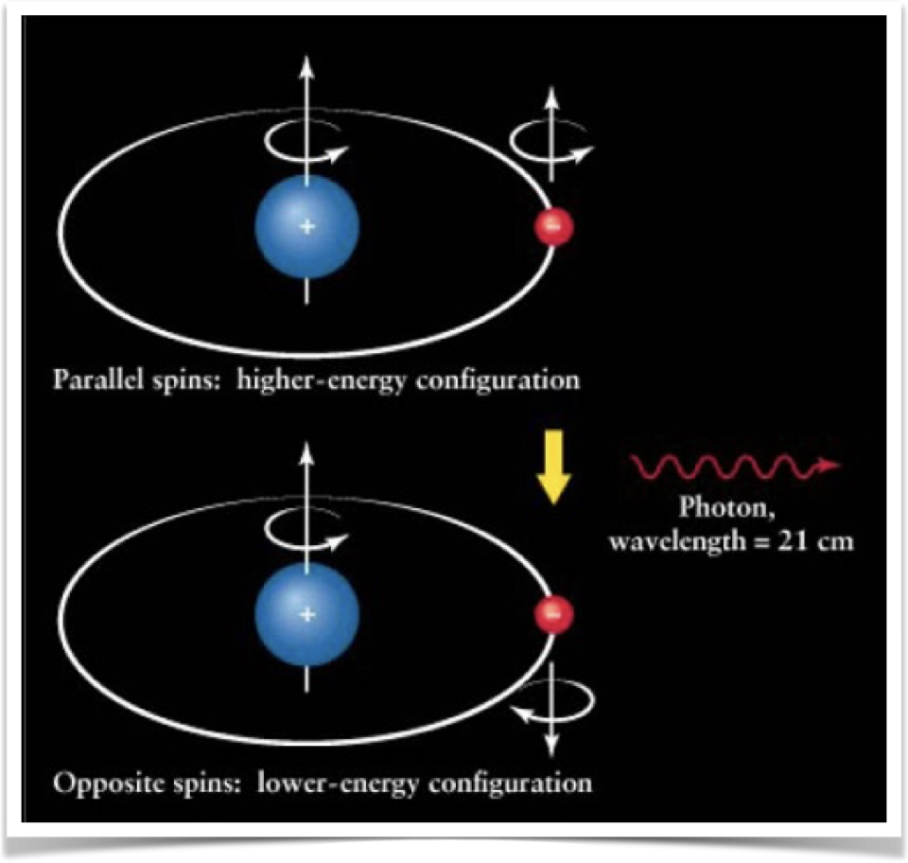
Epoch of Reionisation
EoR – period when the first star ionised the neutral hydrogen in the Universe.
21 cm hydrogen line: hyperfine splitting arises when the spin of the proton and the spin of the electron in a hydrogen atom align (higher energy) or are anti-aligned (lower energy).

Slide 3
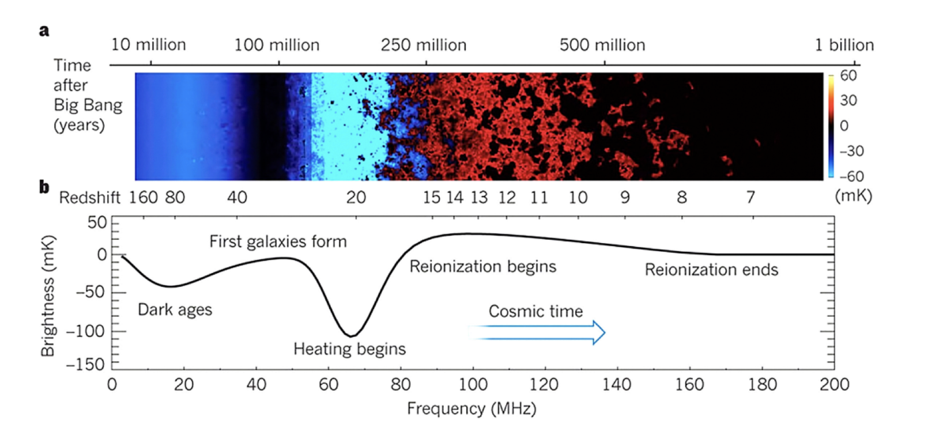
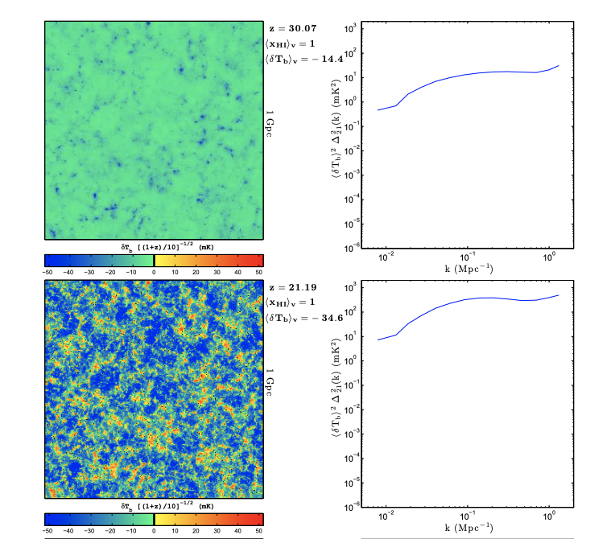
Evolution of 21 cm HI
Pritchard and Loeb 2012.
Furnaletto. 2015
Power Spectrum Analysis
  Fourier Transform of two-point correlation function
Pritchard, J. R., and Loeb, A. (2012)

Slide 4
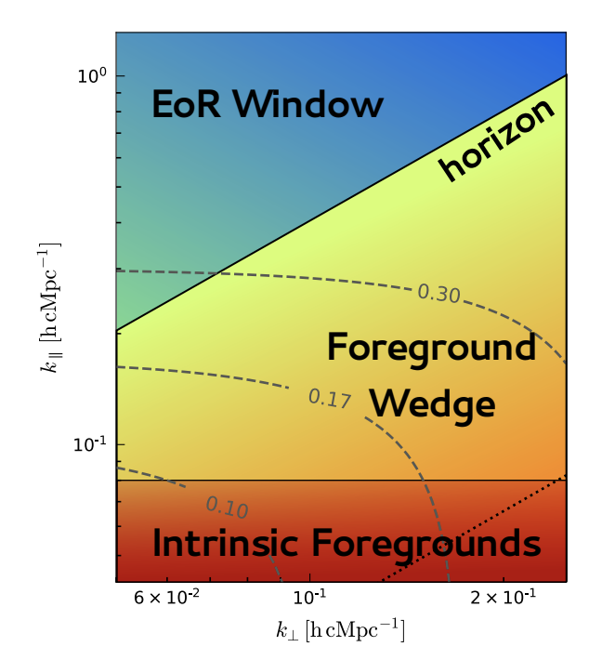
Evolution of 21 cm HI
Nunhokee et al. 2024
Mertens. 2018
Power Spectrum Analysis
  Fourier Transform of two-point correlation function
Pritchard, J. R., and Loeb, A. (2012)

Slide 5
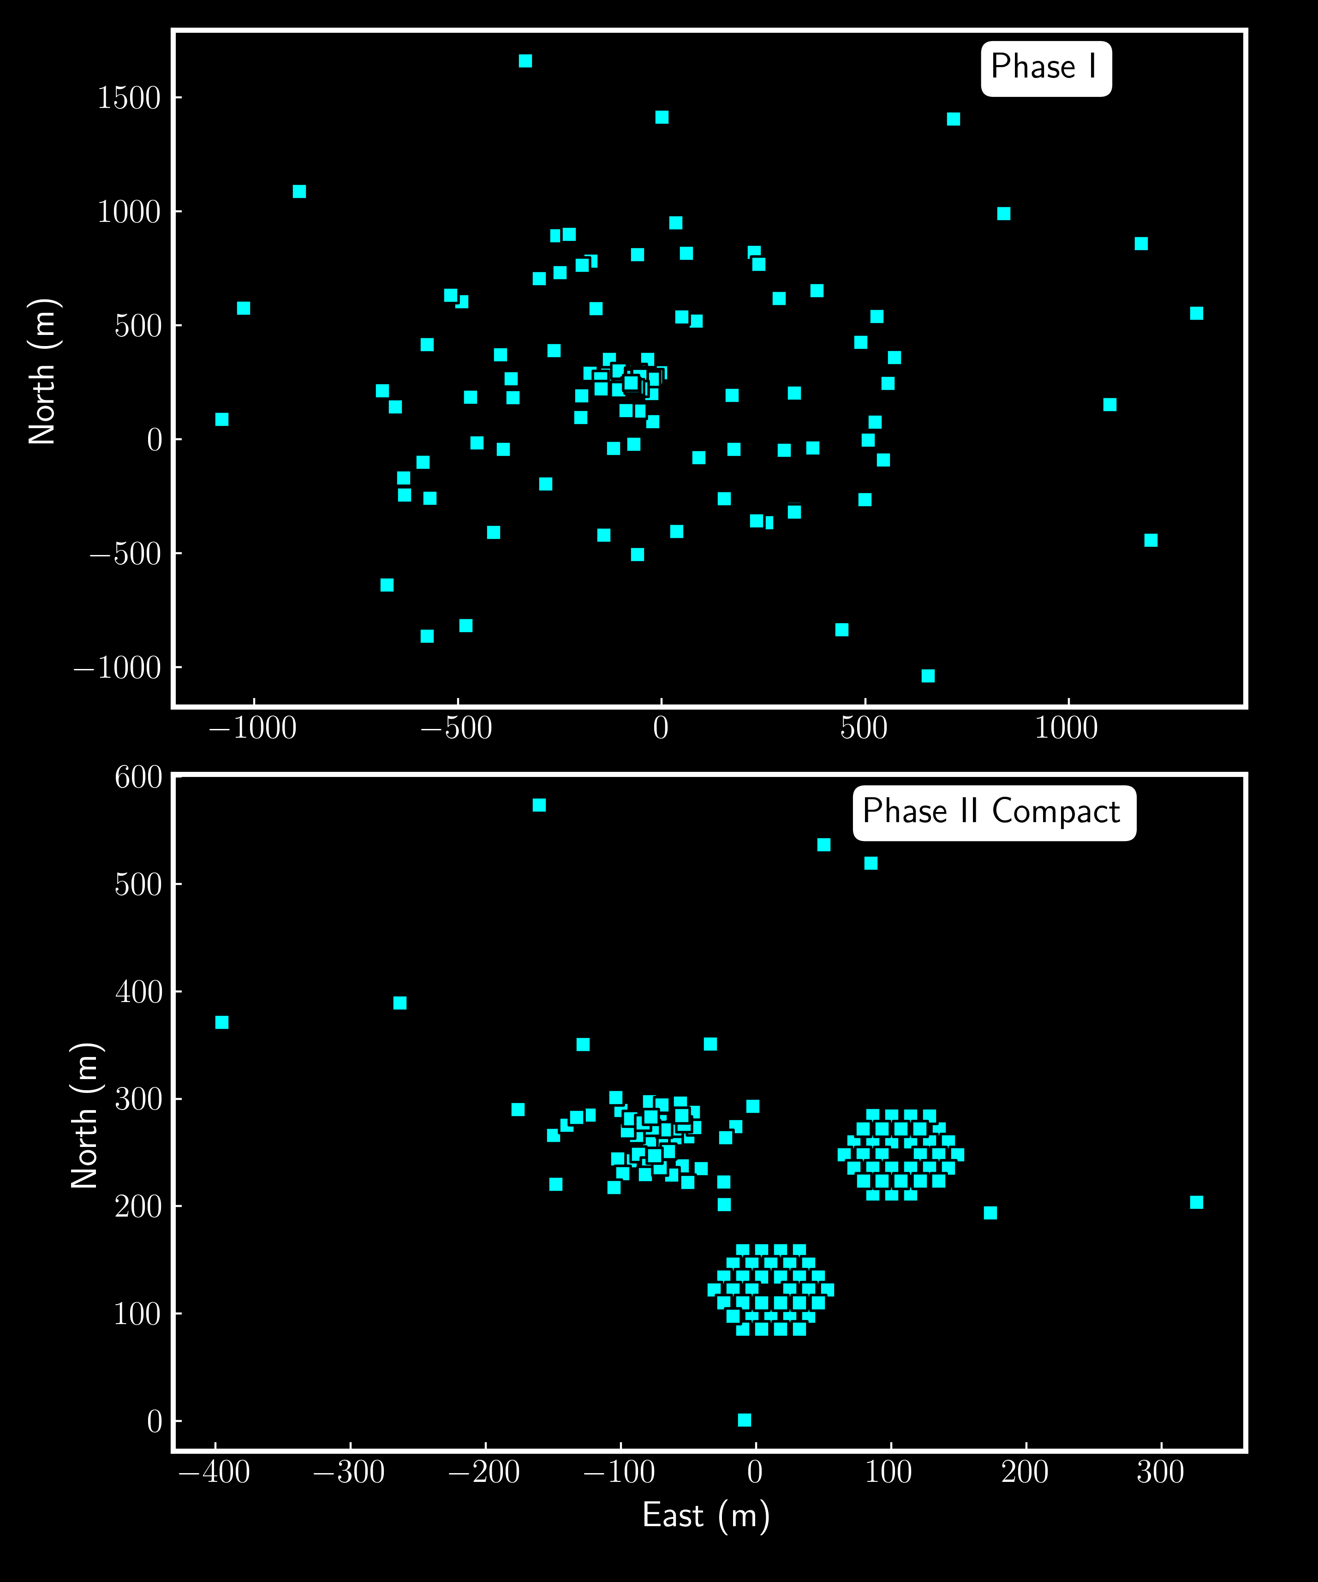
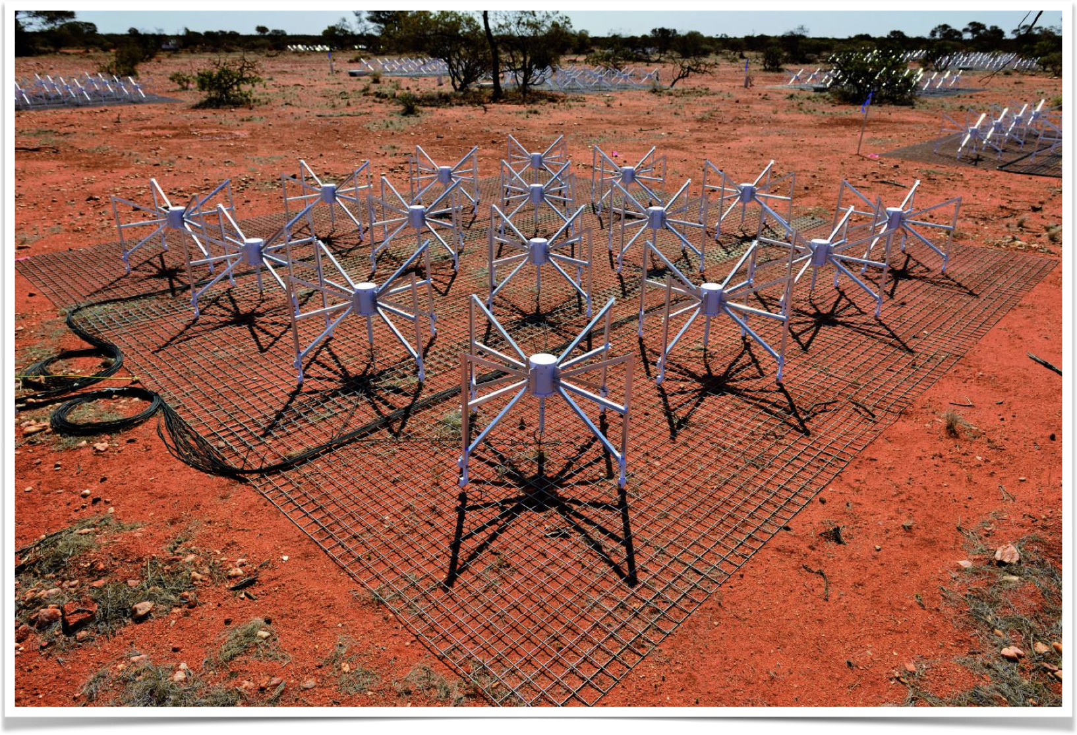
MURCHISON widefielf array
Murchison WideField Array
EW Pointing | Altitude | Azimuth
Pointing -3 | 69.2 | 90
Pointing -2 | 76.3 | 90
Pointing -1 | 83.2 | 90
Pointing 0 | 90 | 0
Pointing 2 | 83.2 | 270
Pointing 2 | 76.3 | 270
Pointing 3 | 69.2 | 270

Slide 6
MWA Upper Limits Timeline
Improved systematics, RFI flags; e.g signal from planes
Choosing best EoR fields and quality metrics
First limit
3 hours
2013
21 hours
2013-2016
453 hours
Ewall-Wice et al. 2016
Barry et al. 2019
Trott et al. 2020
Beardsley et al. 2016
Li et al. 2019
2013
32 hours
2016
40 hours
Novel techniques– calibration of cable ripple, quality metrics, subtraction of diffuse emission
Refining calibration strategies

Slide 7
MWA Upper Limits Timeline
Improved systematics, RFI flags; e.g signal from planes
Choosing best EoR fields and quality metrics
First limit
3 hours
2013
21 hours
2013-2016
453 hours
Ewall-Wice et al. 2016
Barry et al. 2019
Trott et al. 2020
Beardsley et al. 2016
Li et al. 2019
2013
32 hours
2016
40 hours
2013-2023
654 hours
Novel techniques– calibration of cable ripple, quality metrics, subtraction of diffuse emission
Refining calibration strategies
Improving calibration; data quality metrics integrating more data

Slide 8
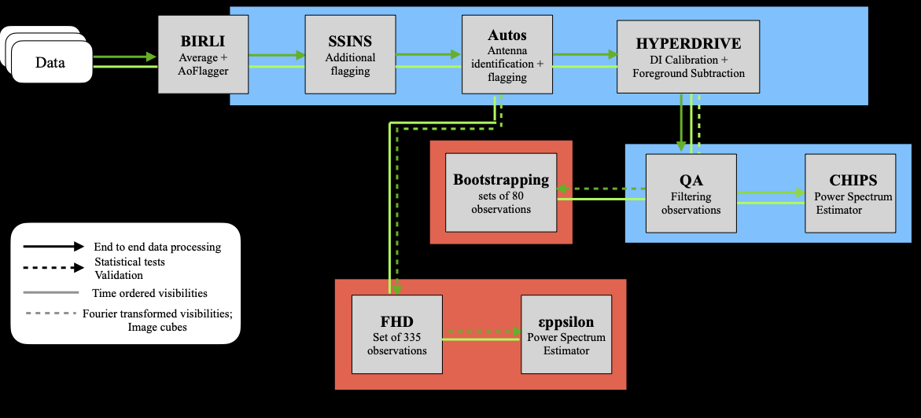
EOR
PIPELINE

Slide 9
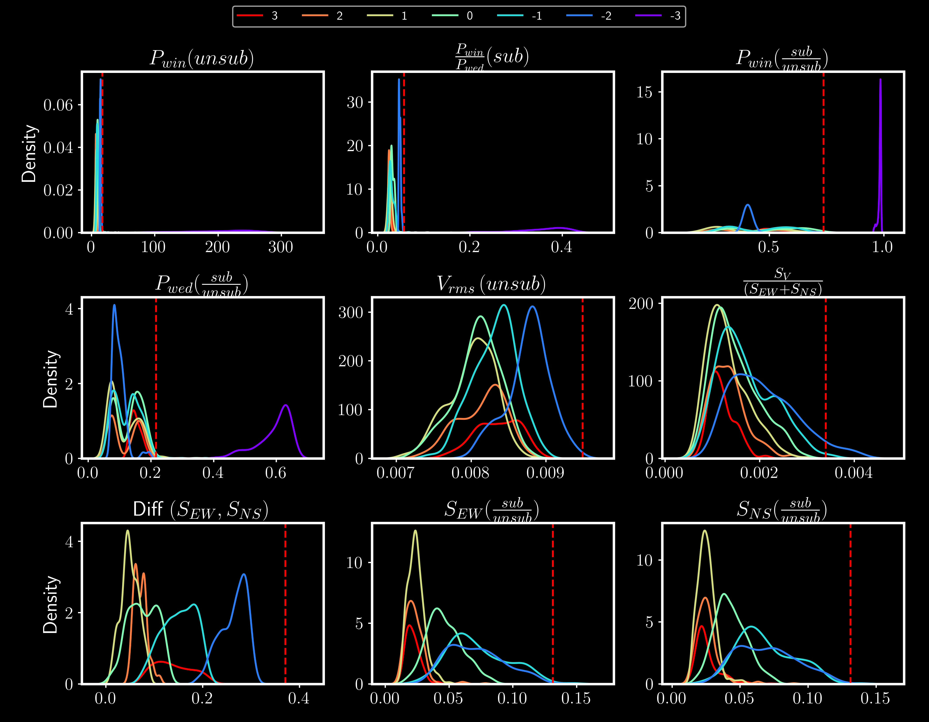
Distribution
of
Quality Metrics

Slide 10
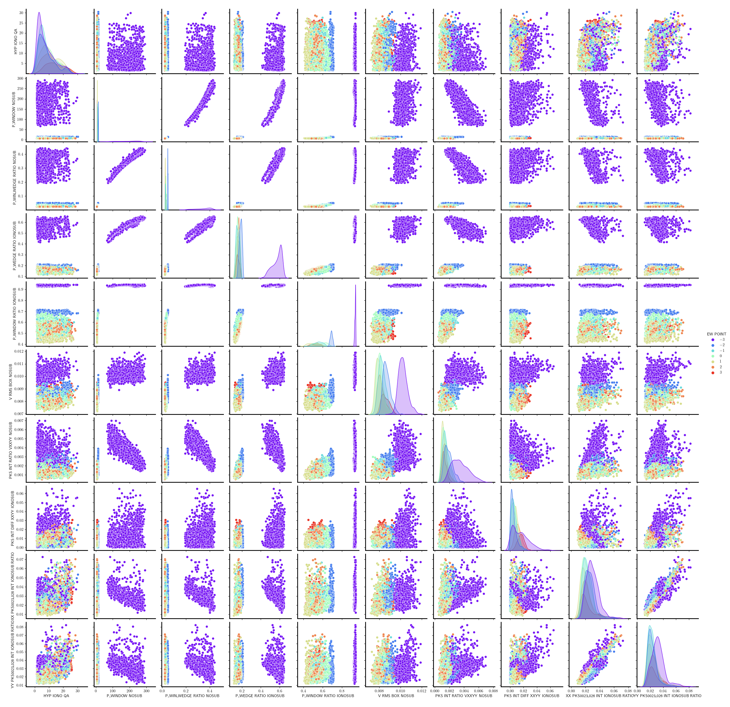
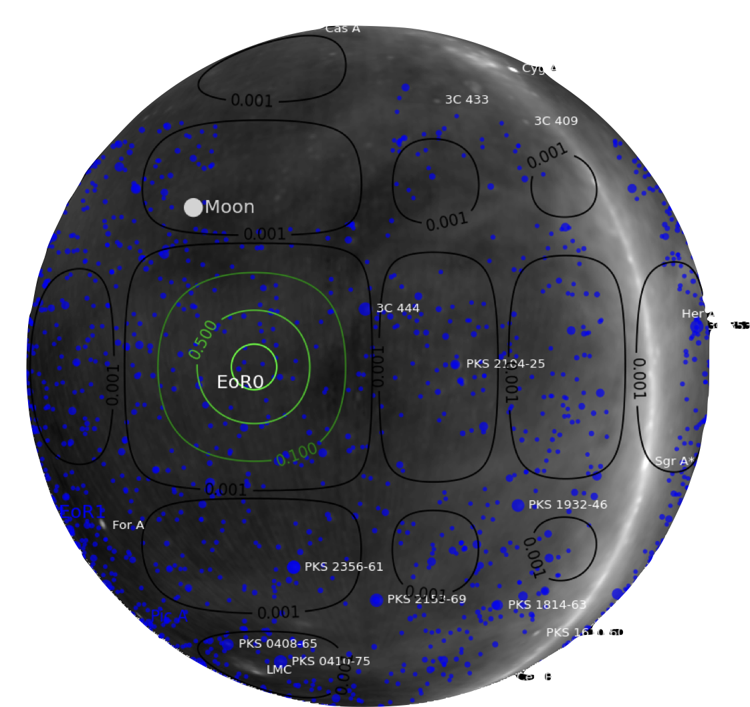
Pointing –3: contamination from the Galactic plane

Slide 11
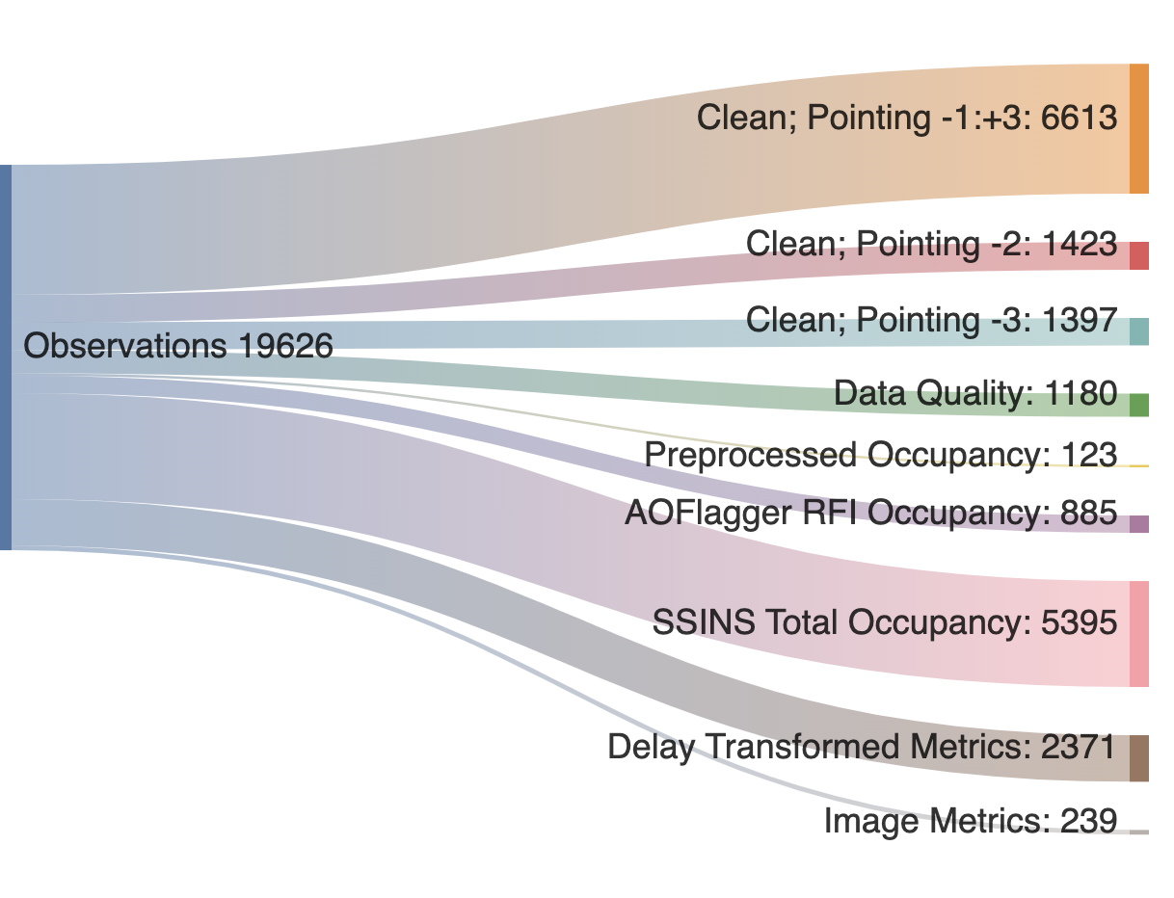
Mitigation Statistics

Slide 12
MWA Upper Limits Timeline
Improved systematics, RFI flags; e.g signal from planes
Choosing best EoR fields and quality metrics
First limit
3 hours
2013
21 hours
2013-2016
453 hours
Ewall-Wice et al. 2016
Barry et al. 2019
Trott et al. 2020
Beardsley et al. 2016
Li et al. 2019
Nunhokee et al. 2025
2013
32 hours
2016
40 hours
2013-2023
654 hours
Novel techniques– calibration of cable ripple, quality metrics, subtraction of diffuse emission
Refining calibration strategies
Improving calibration; data quality metrics integrating more data

Slide 13
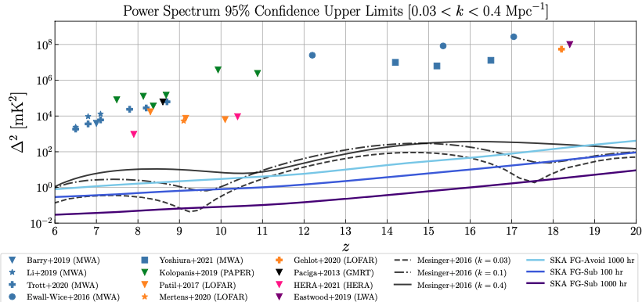
Where are we?
Adapted from Barry et al. 2020
yields first evidence for a heated IGM by placing lower bounds on the spin temperature

Slide 14
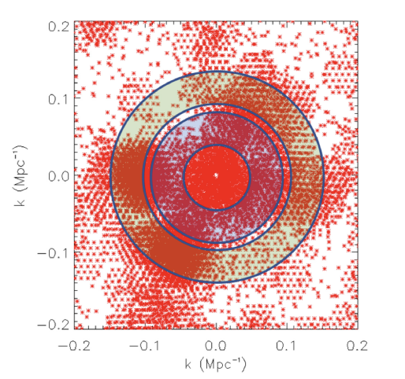
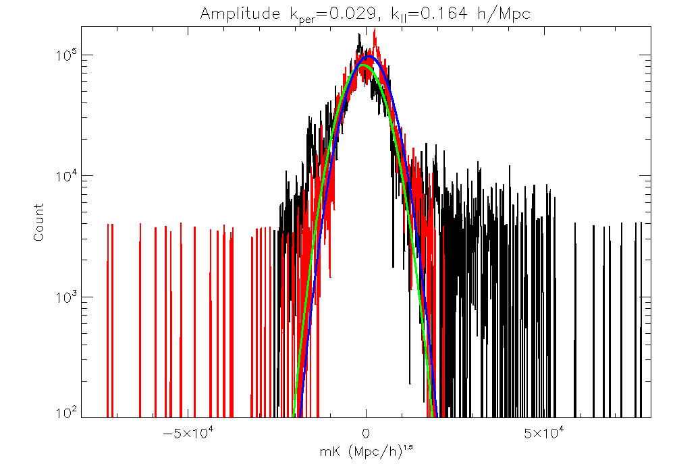
Using Gaussian Information
Use our measurements in k-space (u, v, eta) as samples (realisations) of the distribution
Listen to Cathryn Trott’s talk
Fit a Gaussian to each of the real and imaginary distributions and extract second moment
(Check goodness-of-fit, check mean values, check residuals)

Slide 15
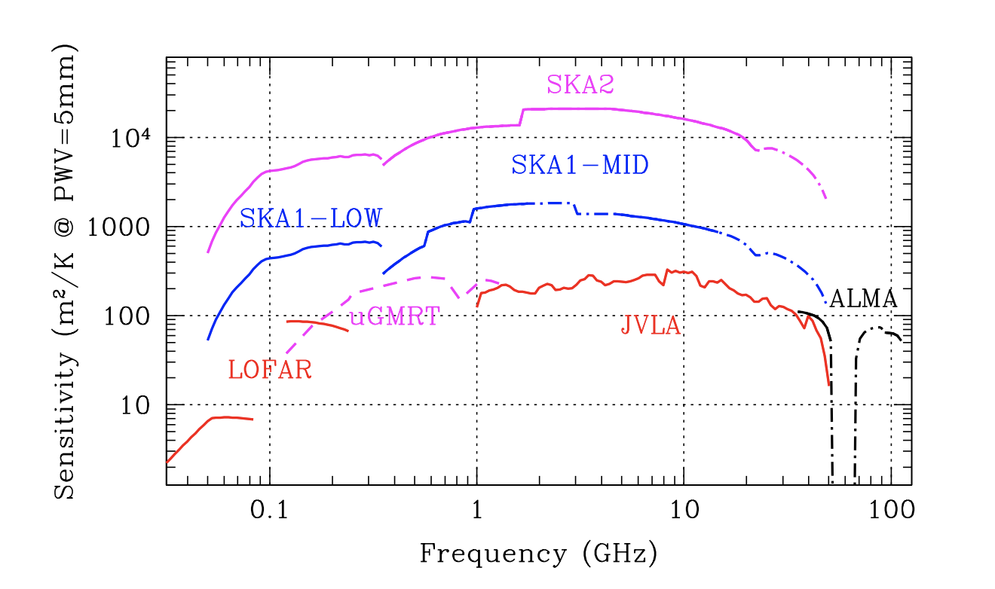
Working towards SKA?
Enhanced sensitivity due to the core configuration of SKA
Braun et al. 2019

Slide 16
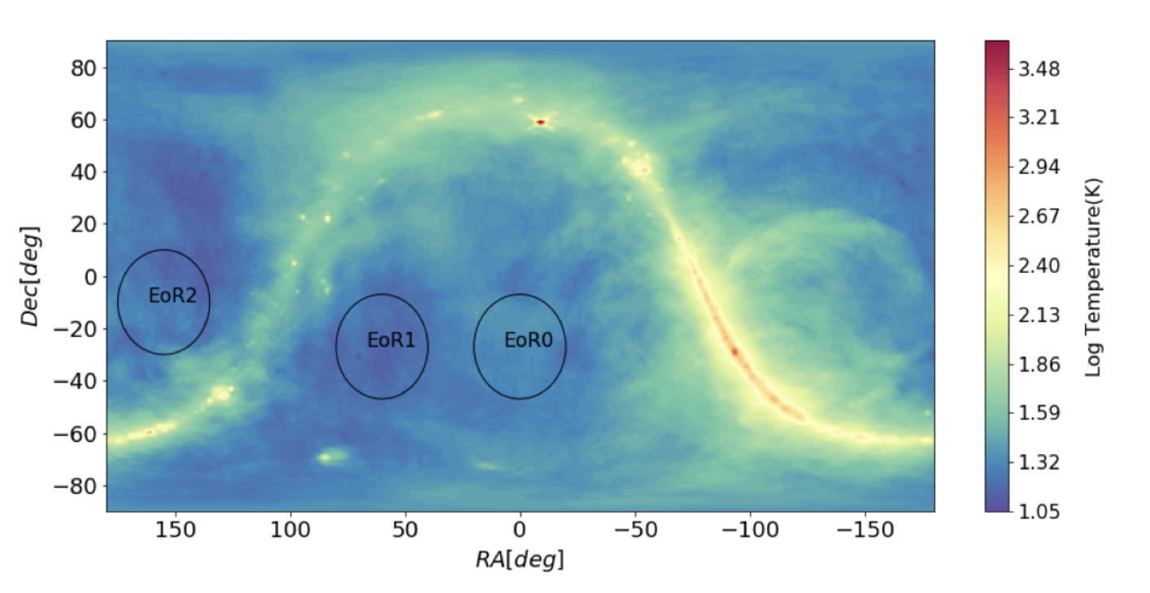
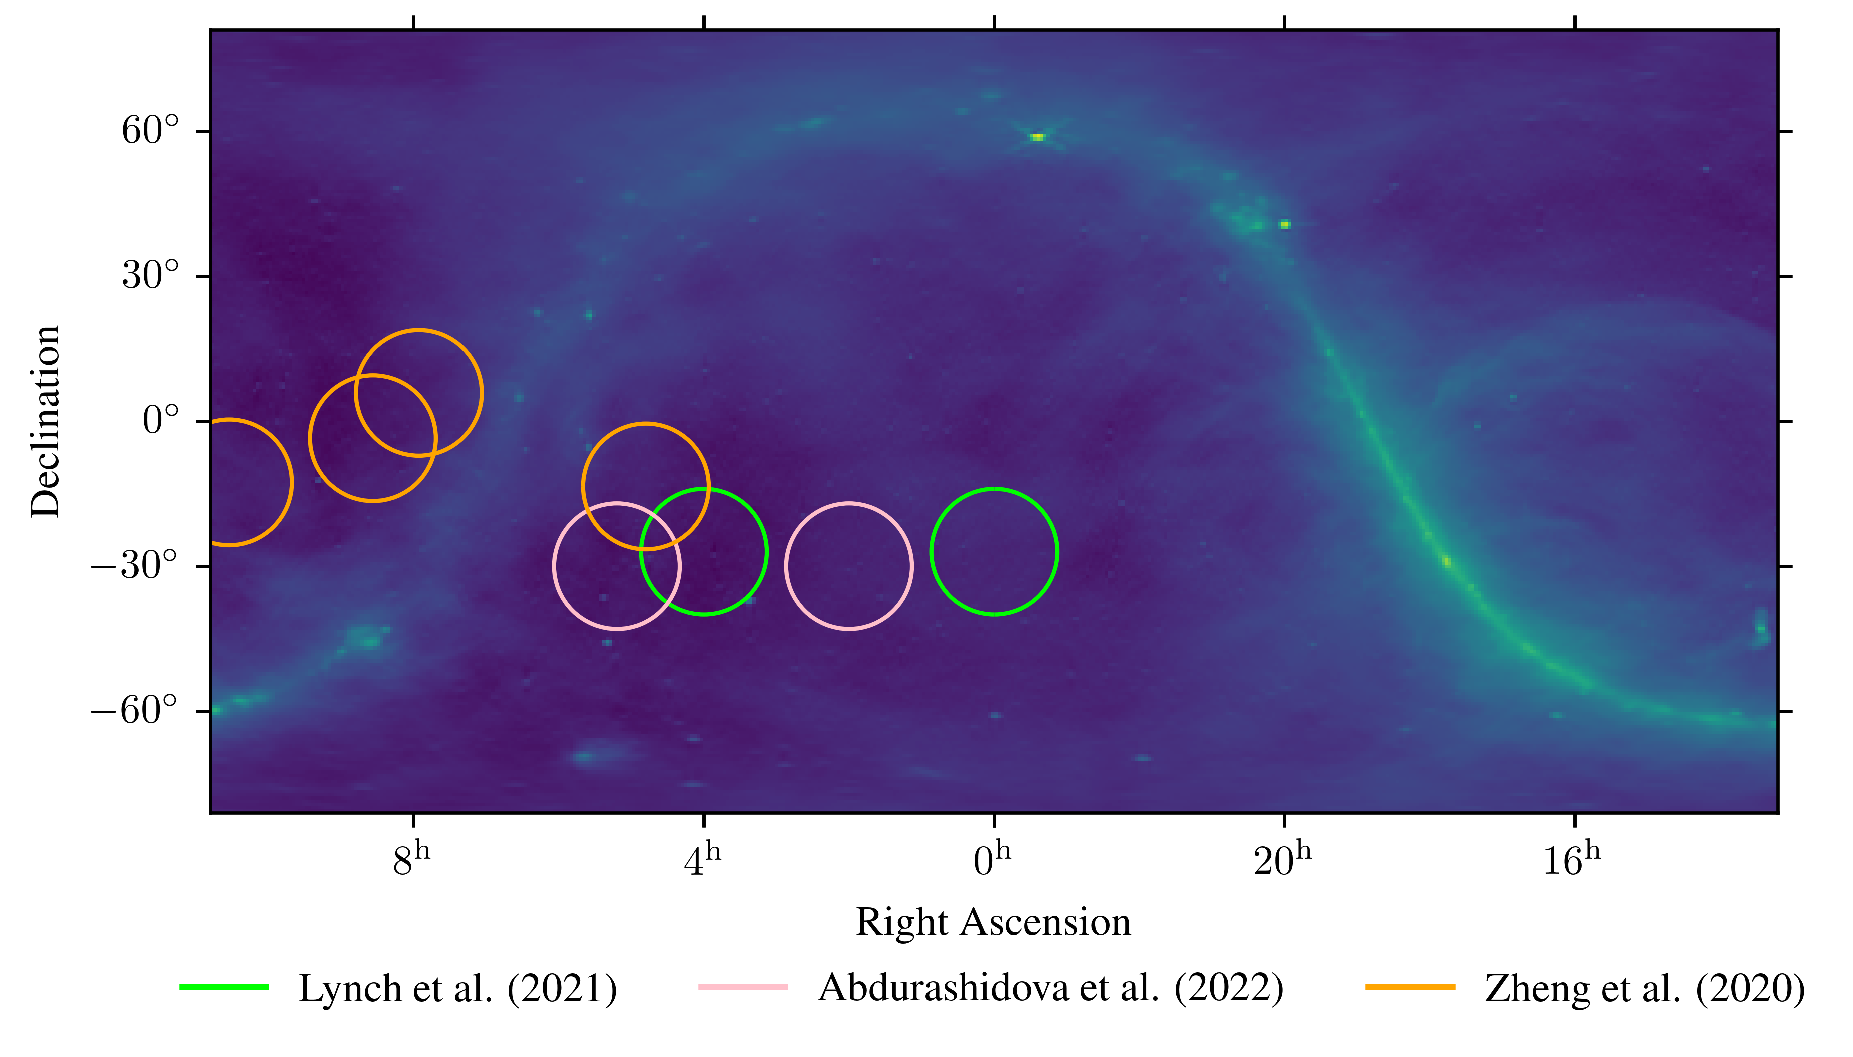
Working towards SKA?
Rahimi et al. 2021
Enhanced sensitivity due to the core configuration of SKA
Lessons learnt from MWA
  instrumental systematics
  RFI Environment
  Observing field for SKA EoR Science
  Sky Model (Eric Jong work in progress)
Jong et al. 2025 (under review)

Slide 17
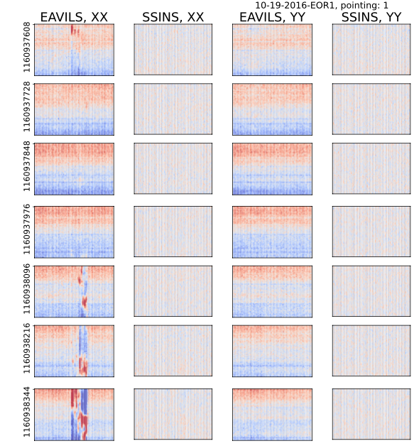
Lilleskov et al. in prep 2020
Next Steps
RFI Refinement
  identification of faint radio interferences buried under thermal noise and not sensitive to visibility amplitude

Slide 18
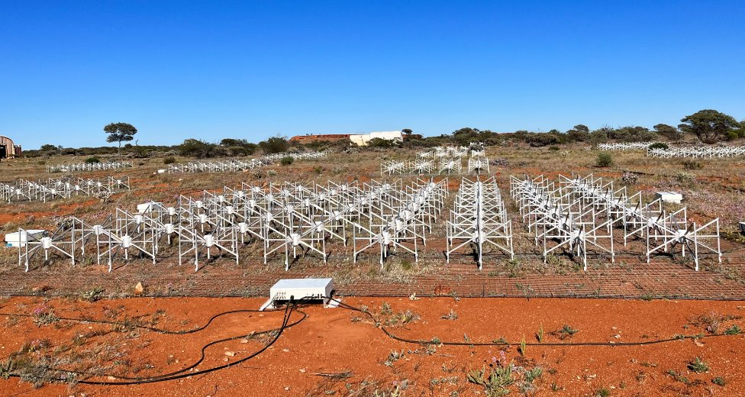
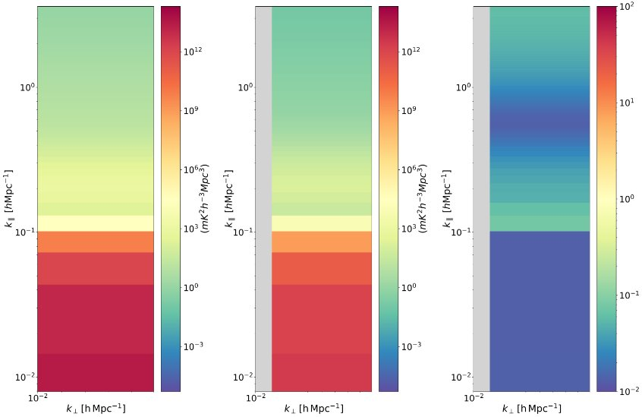
Central Redundant Array MegaTile (CRAM)
Next Steps
RFI Refinement
  identification of faint radio interferences buried under thermal noise and not sensitive to visibility amplitude
Improving on subtraction strategies in a hybrid configuration
Listen to Aishwarya Selvaraj’s talk
Selvaraj et al 2024

Slide 19
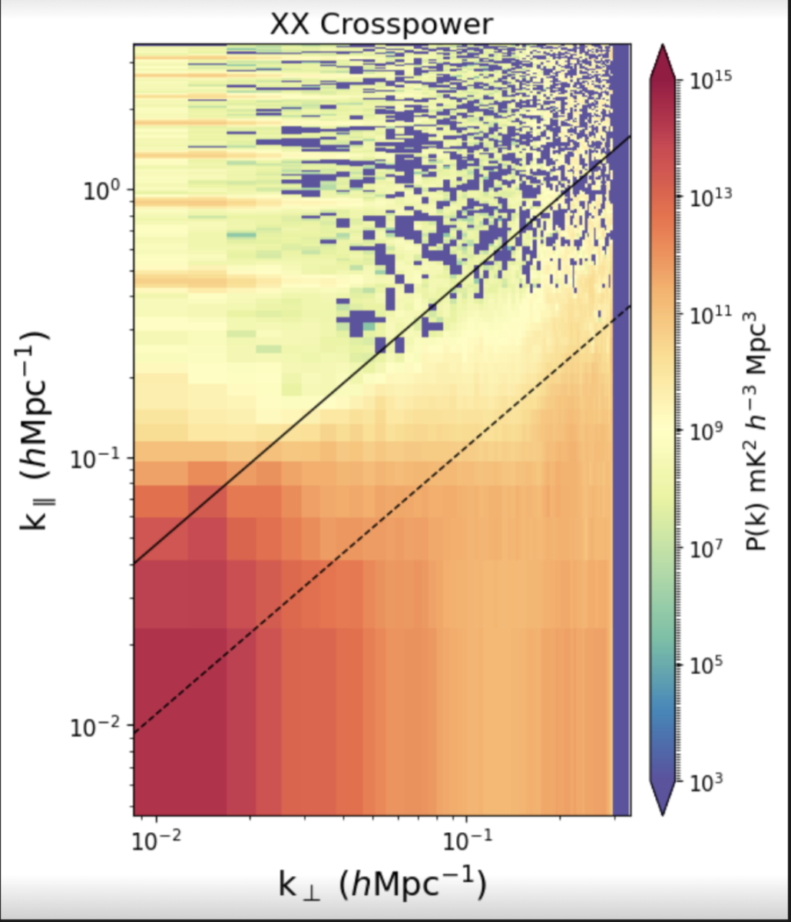
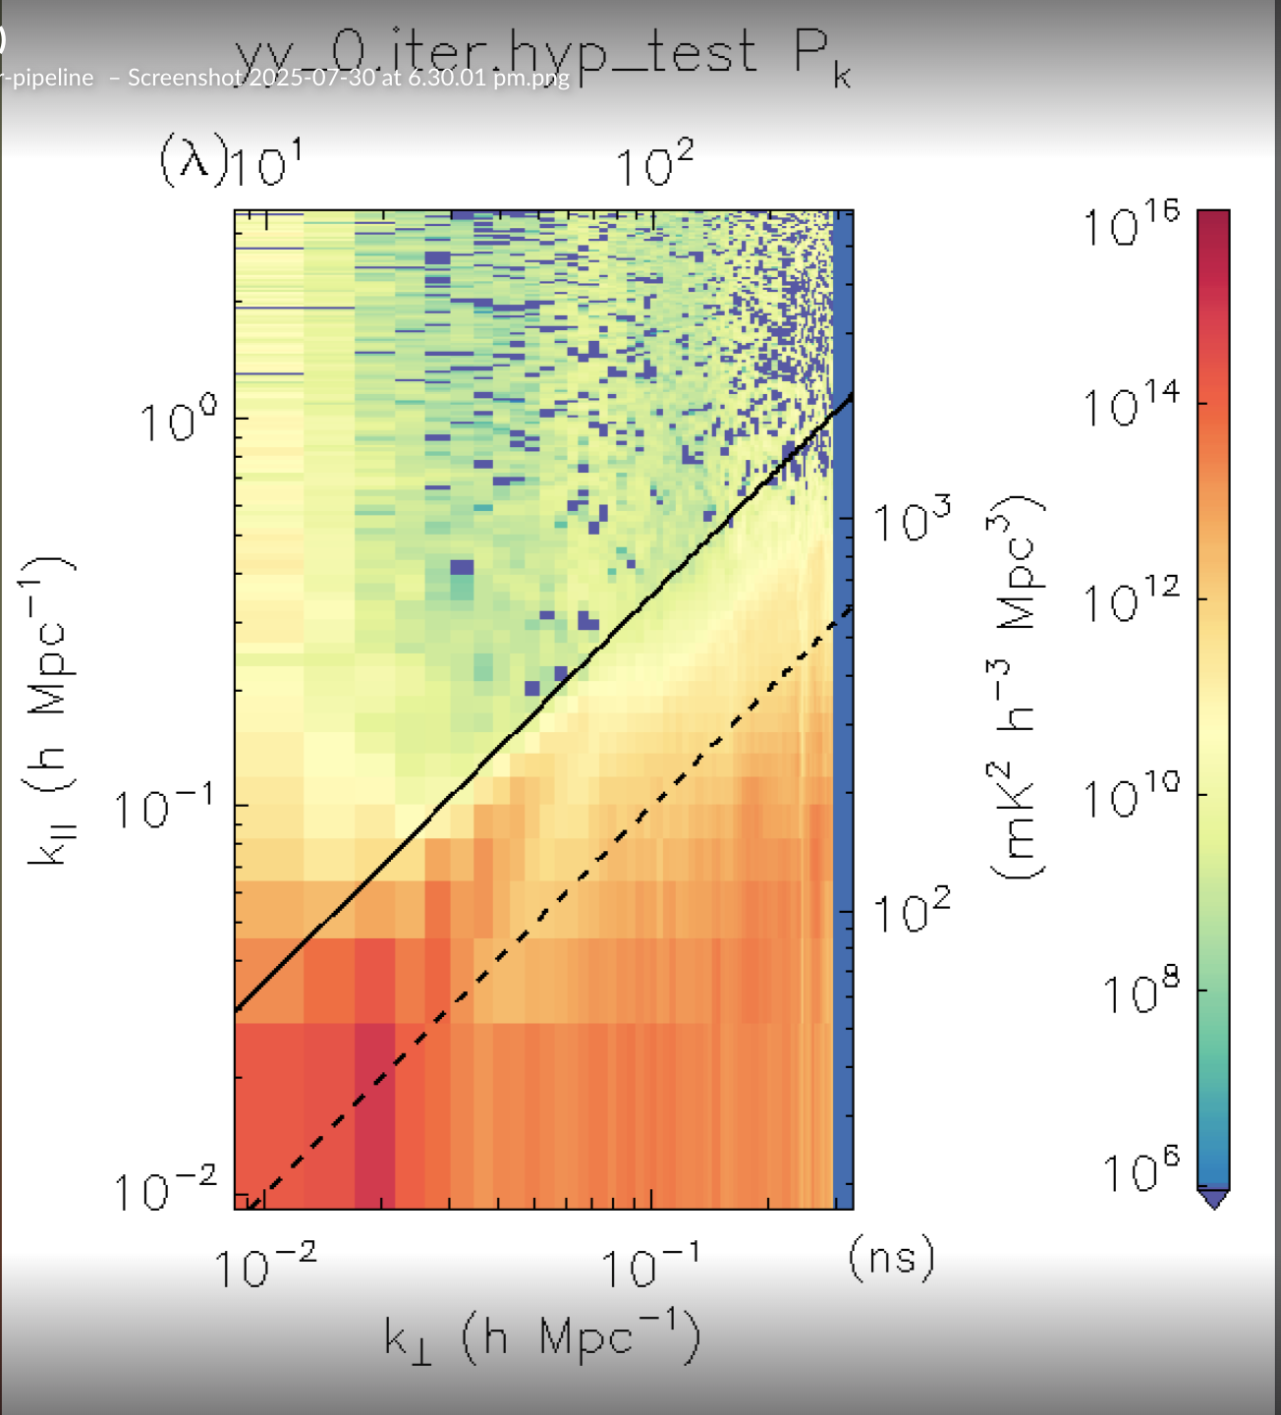
Next Steps
RFI Refinement
  identification of faint radio interferences buried under thermal noise and not sensitive to visibility amplitude
Improving on subtraction strategies and exploring other fields
Phase III data
  Refined channels with no harmonics

Slide 20
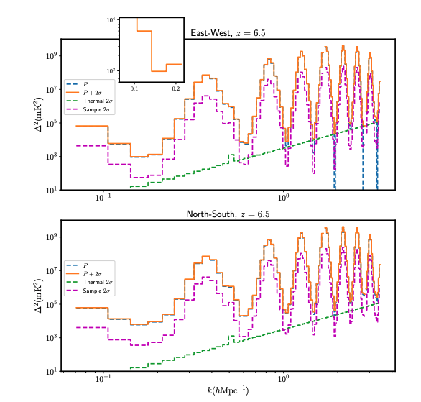
21 cm Power Spectra

Slide 21
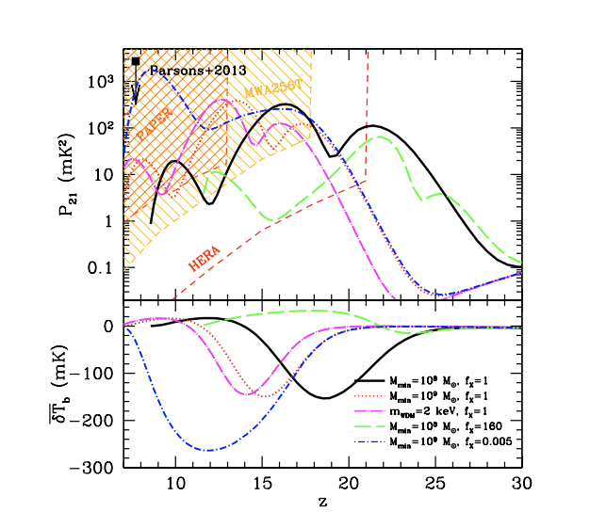
MWA Sensitivity
Furlanatto et al. 2015

