Slide 1

Speeding up the Pulsar Search Pipeline
Piyush Panchal (SCITAS, EPFL)
Supervisor: Emma Tolley (SCITAS, EPFL)
Collaborators: Ramesh Bhat, Bradley Meyers, Chia Min Tan, Christopher Lee (Curtin University)

Slide 2
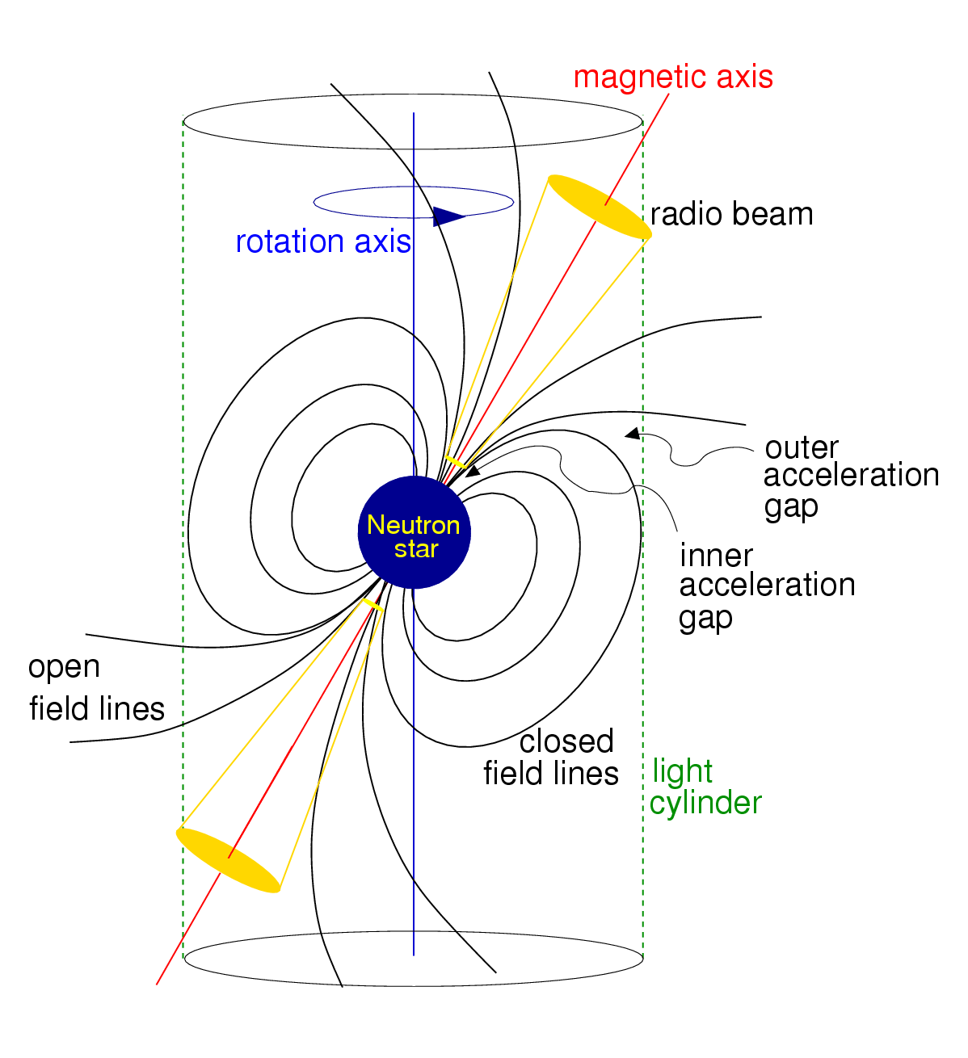
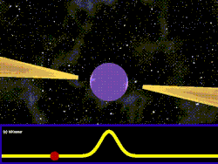
What is a Pulsar?
Rotating Neutron star
Strong magnetic field
EM radiation from poles
Source: Wikipedia
Source: Pulsar Wind Nebulae
Notes:
Question: Do Jerk / acceleration searches affect how folding is done? It would make sense if they do

Slide 3
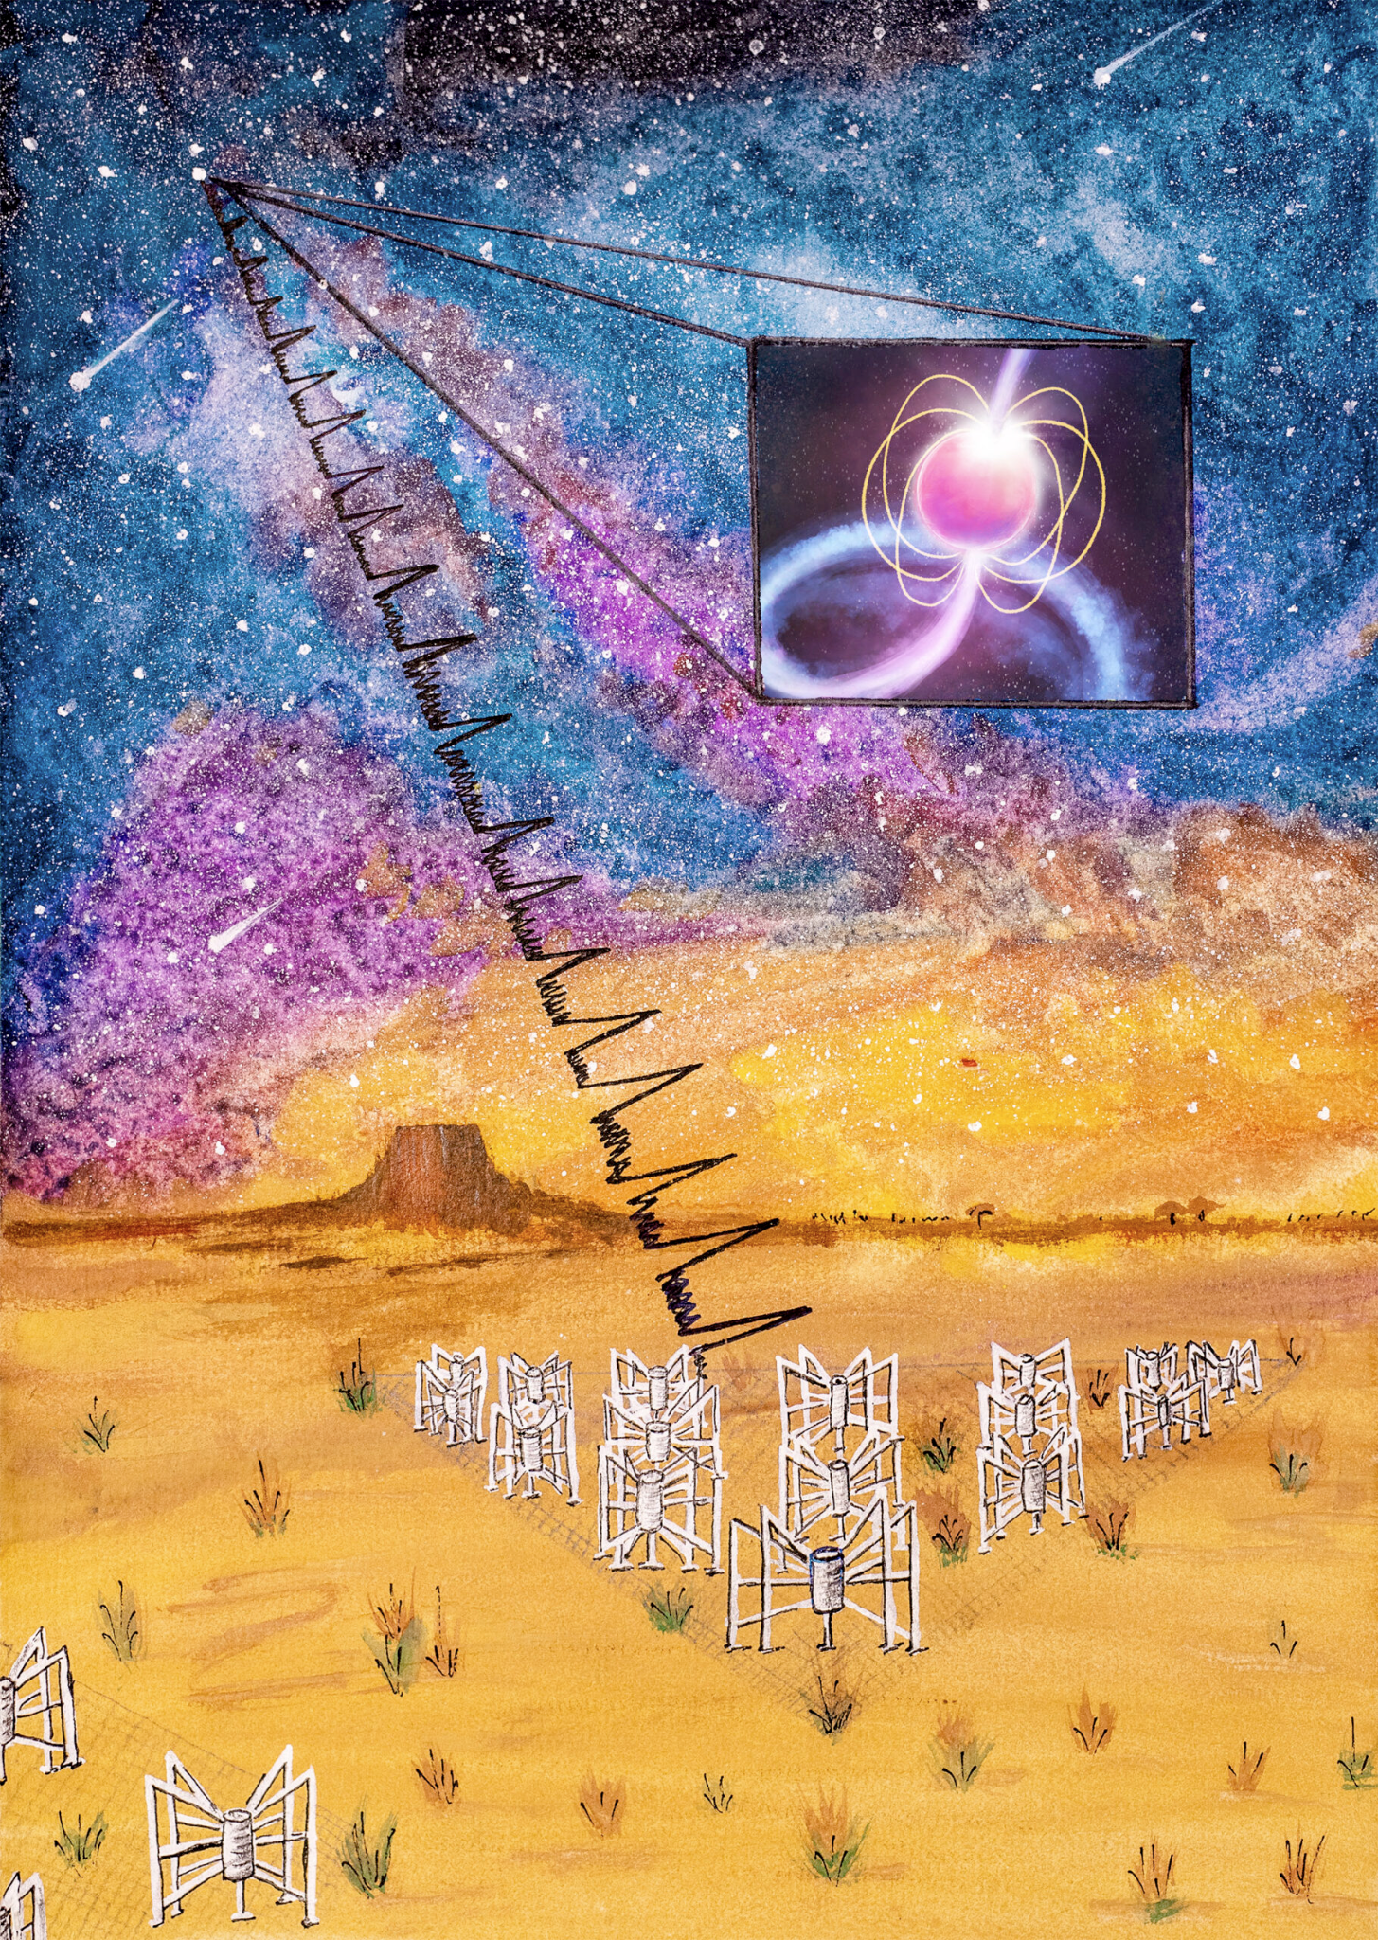
Detecting Pulsars
Source: mwatelescope.org
Periodic signal distorted by
  Pulsar motion: non linear phase
  Interstellar medium (ISM): dispersion, noise (low SNR)
Notes:
Question: Do Jerk / acceleration searches affect how folding is done? It would make sense if they do

Slide 4
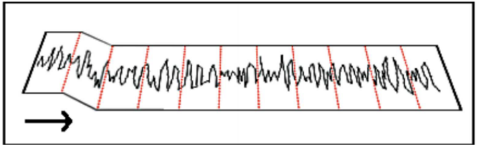
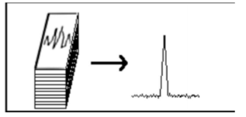
Detecting Pulsars
Source: mwatelescope.org
Periodic signal distorted by
  Pulsar motion: non linear phase
  Interstellar medium (ISM): dispersion, noise (low SNR)
Undo distortions, fold to detect pulse
  Unknown motion: acceleration/jerk search params
  Unknown ISM: de-dispersion for trial params
Source: Deshpande & Rankin
Notes:
Question: Do Jerk / acceleration searches affect how folding is done? It would make sense if they do

Slide 5
Detecting Pulsars
Source: mwatelescope.org
Periodic signal distorted by
  Pulsar motion: non linear phase
  Interstellar medium (ISM): dispersion, noise (low SNR)
Undo distortions, fold to detect pulse
  Unknown motion: acceleration/jerk search params
  Unknown ISM: de-dispersion for trial params
Software: Presto
  CPU only
  OpenMP (multi thread), MPI (multi node) parallelization
Source: Deshpande & Rankin
Notes:
Question: Do Jerk / acceleration searches affect how folding is done? It would make sense if they do

Slide 6
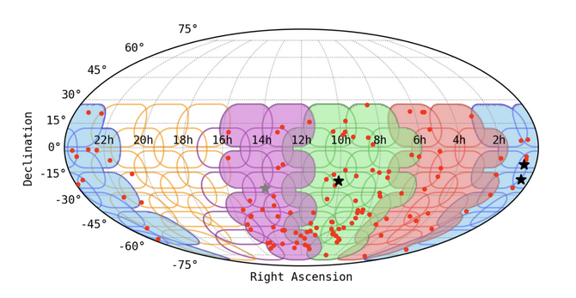
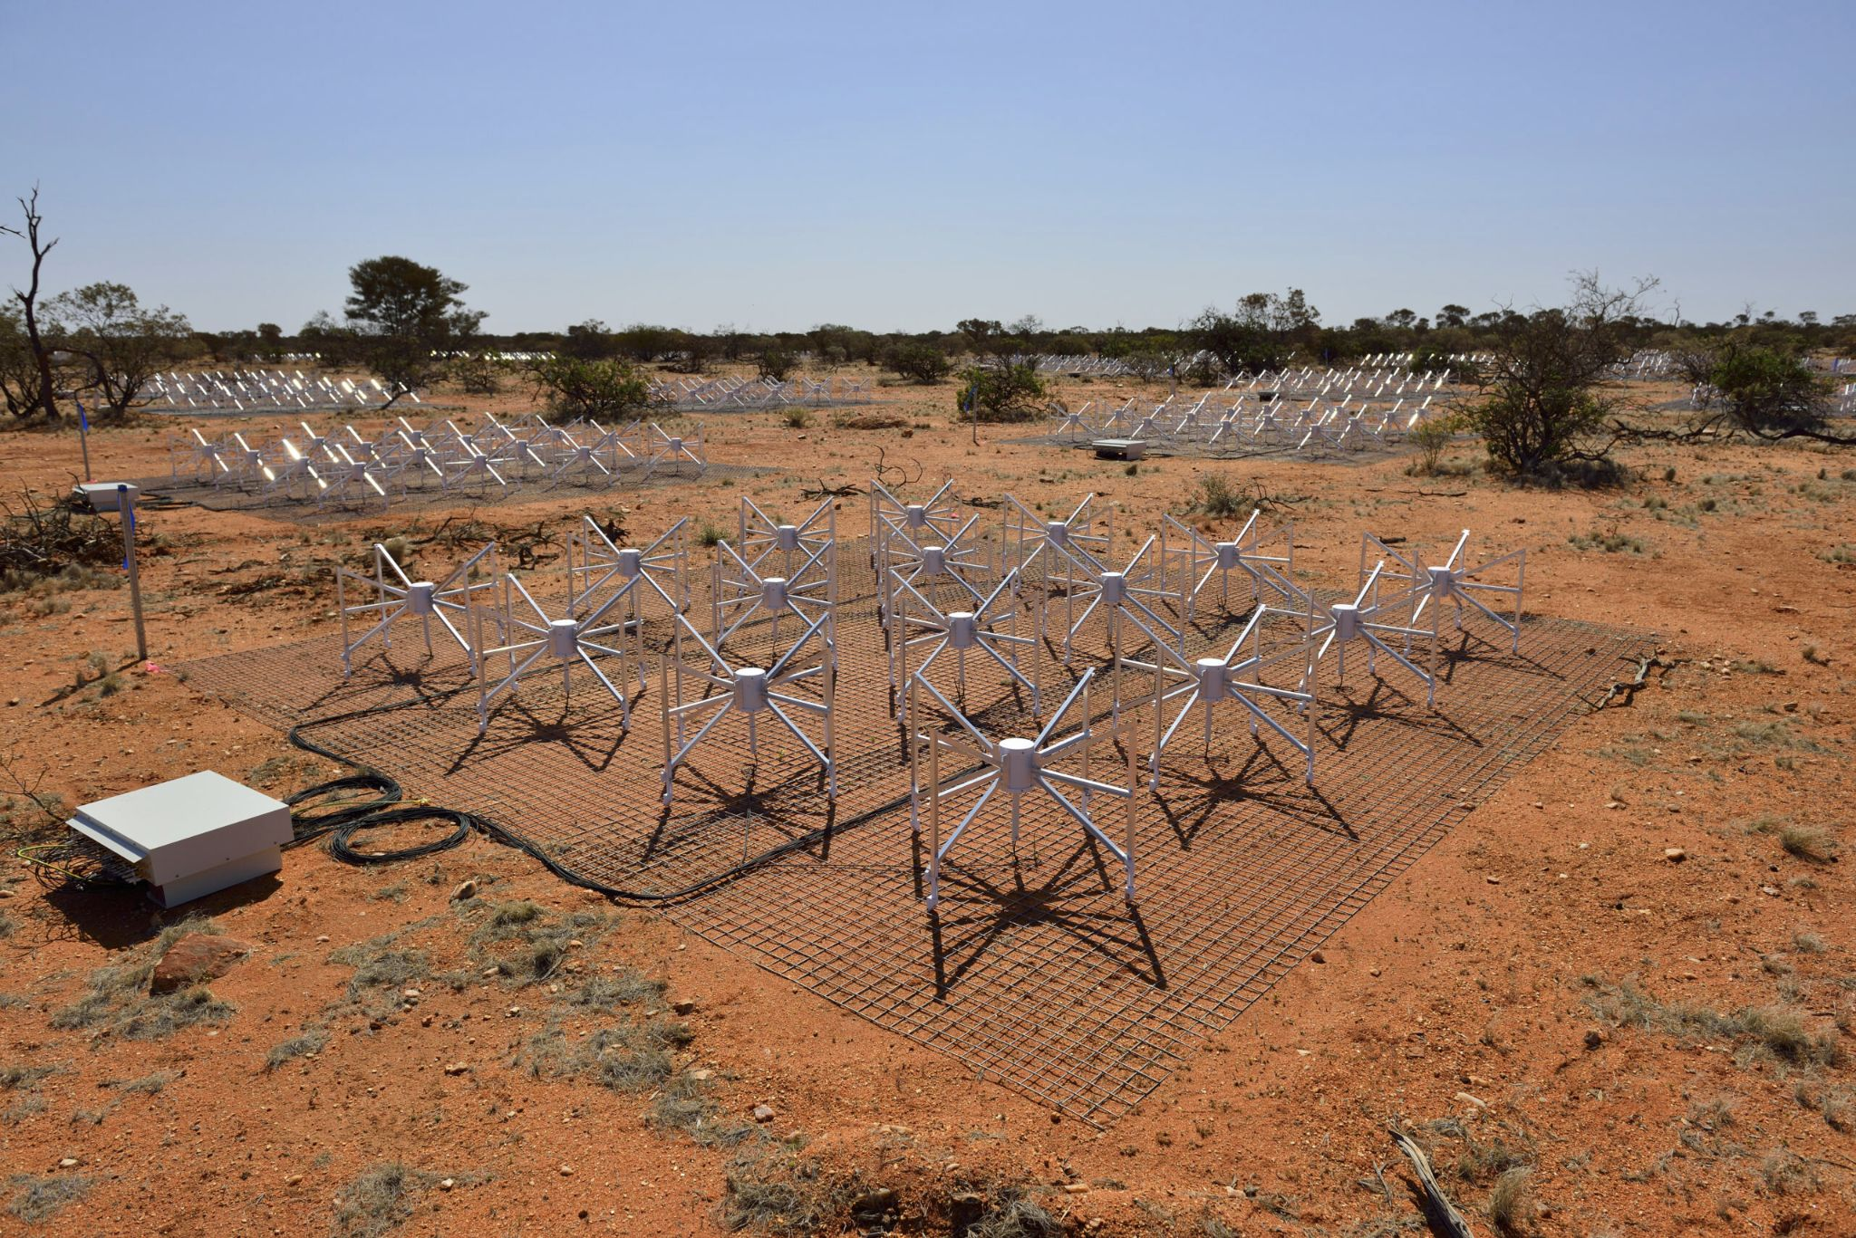
Problem
~4 PB data collected in MWA SMART Pulsar survey
Estimated processing time using Presto: 23 yrs
GPU acceleration of parallelizable search algorithms (~90% time):
  De-dispersion
  Acceleration/jerk search
Source: mwatelescope.org
Source: 10.48550/arXiv.2302.11911
Notes:
Question: Do Jerk / acceleration searches affect how folding is done? It would make sense if they do. (10 min, coarse DD, no RFI, accel)

Slide 7
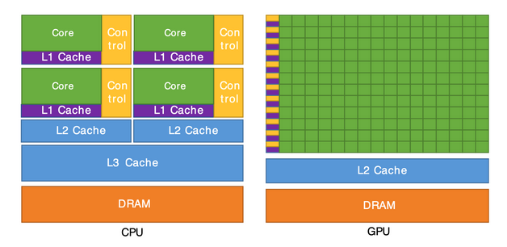
Why GPU?
CPU: Fast, few cores. Sequential computation, low latency.
GPU: Many, slow cores. Parallel computation, high throughput.
Same computation for different parameters in the search pipeline
Source: CUDA doc

Slide 8
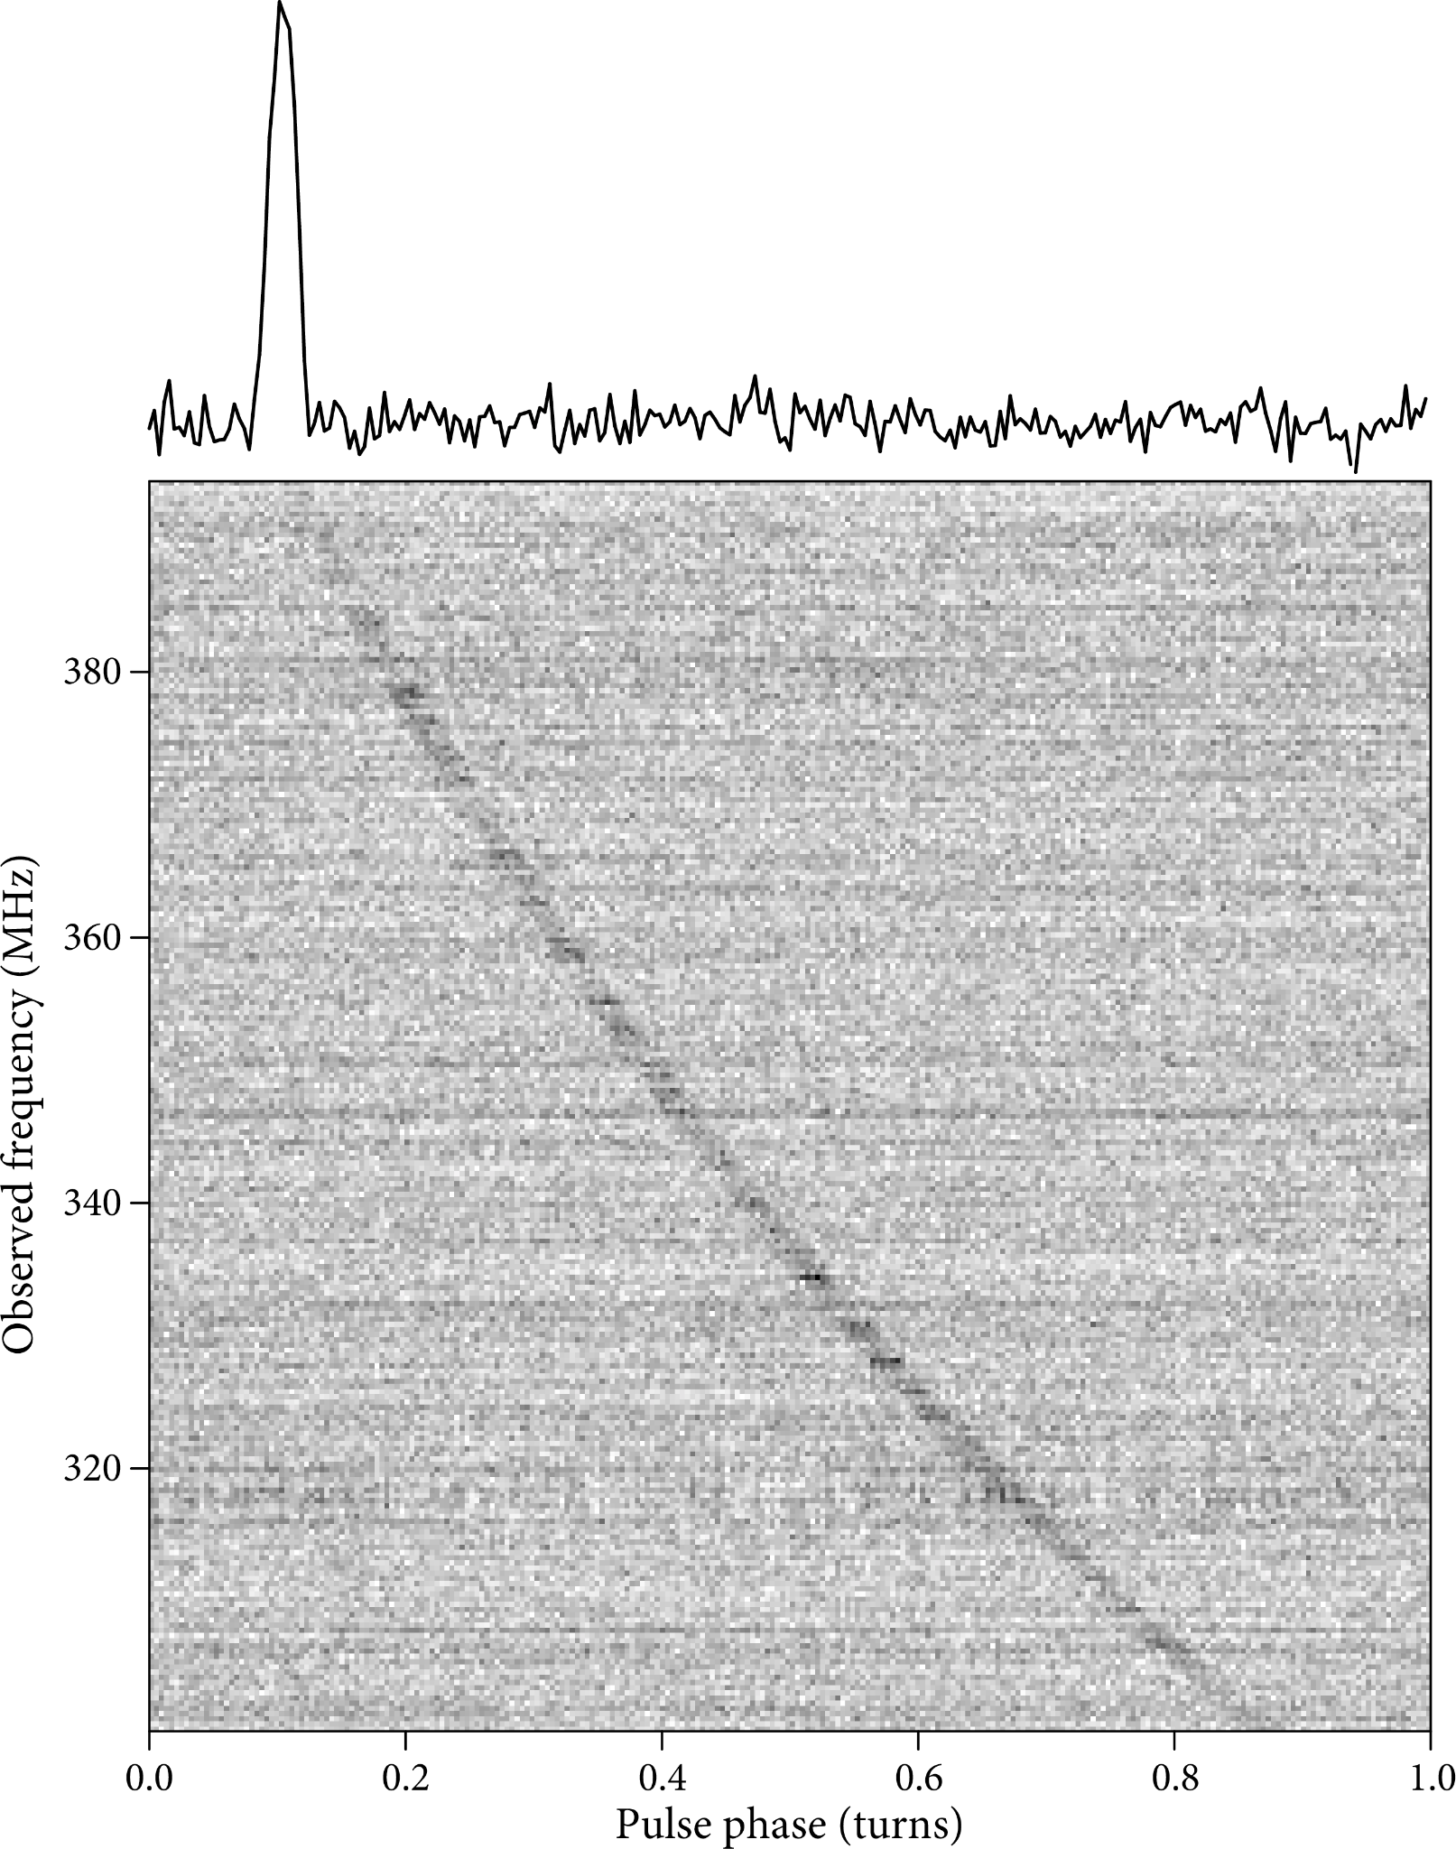
De-Dispersion
Undo frequency dependent delay from ISM
  Frequency domain
  Time domain
Trial dispersion measure (DM) values
  Shallow processing: ~2000
  Full Processing: ~10000
channels
Channel-wise shift
Time
Sum
Time domain
channels
Dispersed time series
Time
Freq. domain
Channel-wise FFT
Sum, IFFT
Source: www.cv.nrao.edu/~sransom/web/Ch6.html
channels
Multiply exp(-i * Ω * shift)
Fourier frequency (Ω)
Notes:
Incoherent and coherent dedispersion? What is that?

Slide 9
Time vs Frequency Domain Dedispersion
Next step: FFT of time series for each DM value (#DM FFTs)
channels
Channel-wise shift
Time
Sum
Time domain
FFT
channels
Dispersed time series
Time
Freq. domain
Channel-wise FFT
IFFT, sum
channels
Multiply exp(-i * Ω * shift)
Fourier frequency (Ω)
Notes:
Incoherent and coherent dedispersion? What is that?

Slide 10
Time vs Frequency Domain Dedispersion
Next step: FFT of time series for each DM value (#DM FFTs)
channels
Channel-wise shift
Time
Sum
Time domain
FFT
channels
Dispersed time series
Time
Freq. domain
Channel-wise FFT
IFFT, sum
channels
Multiply exp(-i * Ω * shift)
Fourier frequency (Ω)
Notes:
Incoherent and coherent dedispersion? What is that?

Slide 11
Time vs Frequency Domain Dedispersion
Next step: FFT of time series for each DM value (#DM FFTs)
Skip IFFT in freq. Domain dedispersion (#channel FFTs)
Suitable memory accesses for GPU in Fourier domain
channels
Channel-wise shift
Time
Sum
Time domain
FFT
channels
Dispersed time series
Time
Freq. domain
Channel-wise FFT
Sum
channels
Multiply exp(-i * Ω * shift)
Fourier frequency (Ω)
Notes:
Incoherent and coherent dedispersion? What is that?

Slide 12
FDD GPU Implementation
Contributions to dedisp (github.com/svlugt/dedisp):
FITS input (SMART data format), optimized reads, handling float input type
Compatibility with newer CUDA version
Bug fixes: failing CuFFT calls, incorrect Fourier freq., shift computation
Presto-like CLI
HIP implementation for AMD GPUs on Setonix
Next steps:
Implementing downsampling, barycentering
MPI + GPU implementation

Slide 13
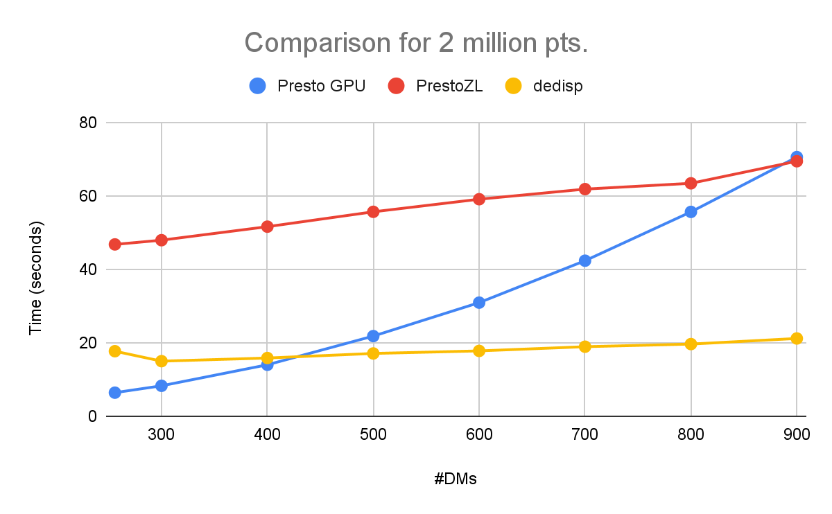
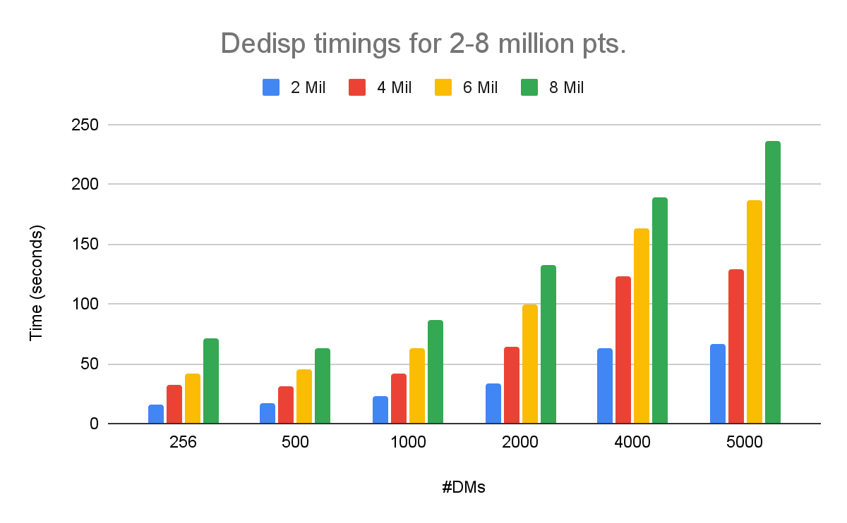
Dedispersion Timing Results
3072 channels, 2-8 Million pts.; no sub-bands, no barycentering
GPU runs on Kuma (AMD EPYC 9334, H100): Presto_GPU, PrestoZL, dedisp
CPU runs on Jed (21 nodes, Intel Xeon Platinum 8360Y, 10 cores/node): Presto
Presto timings (2 Million pts.): 2921 s for 1000 DMs, 12205 s for 4000 DMs
Notes:
Memory usage for my routine: RAM and GPU

Slide 14
Dedispersion Timing Results
3072 channels, 2-8 Million pts.; no sub-bands, no barycentering
GPU runs on Kuma (AMD EPYC 9334, H100): Presto_GPU, PrestoZL, dedisp
CPU runs on Jed (21 nodes, Intel Xeon Platinum 8360Y, 10 cores/node): Presto
Presto timings (2 Million pts.): 2921 s for 1000 DMs, 12205 s for 4000 DMs
Notes:
Memory usage for my routine: RAM and GPU

Slide 15
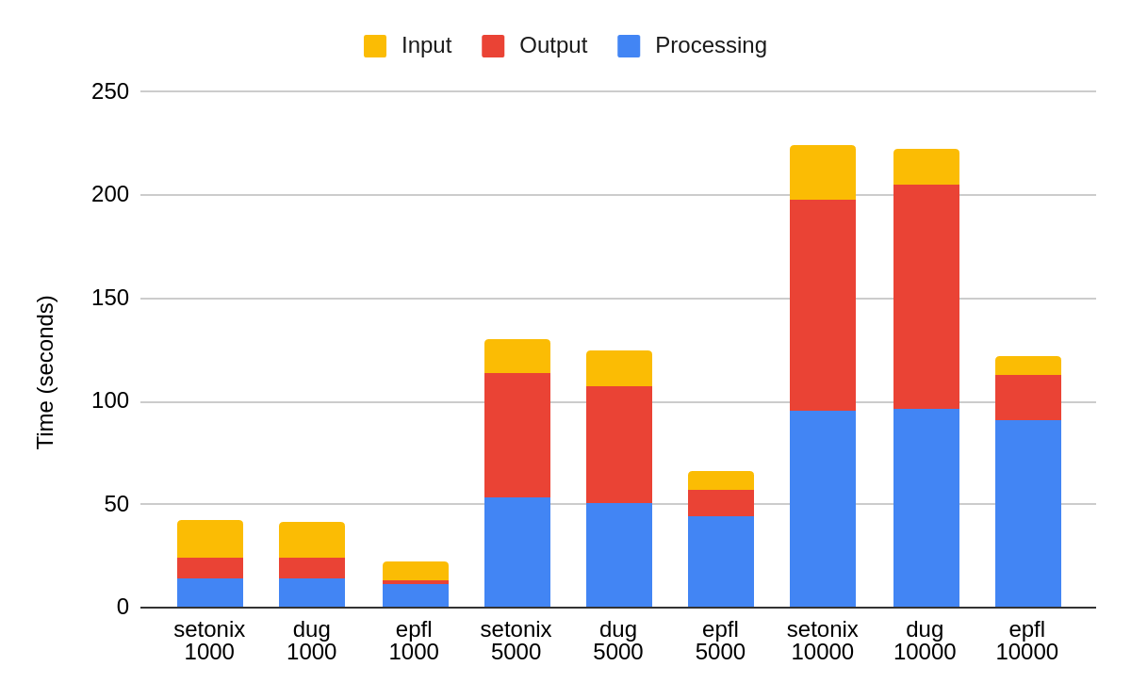
Dedisp Runs on Different Hardware (2 Million pts.)
Setonix (AMD MI250X), DUG (Nvidia A100), Kuma (Nvidia H100)
Notes:
Memory usage for my routine: RAM and GPU

Slide 16
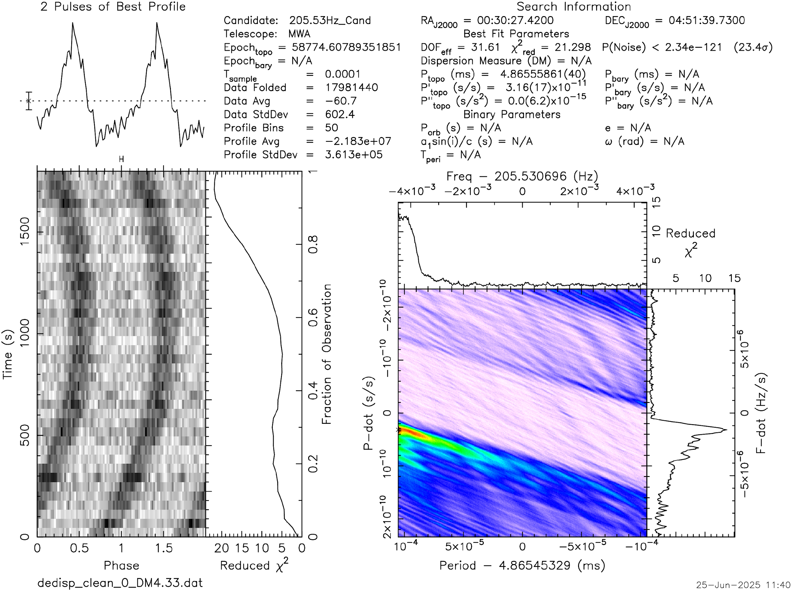
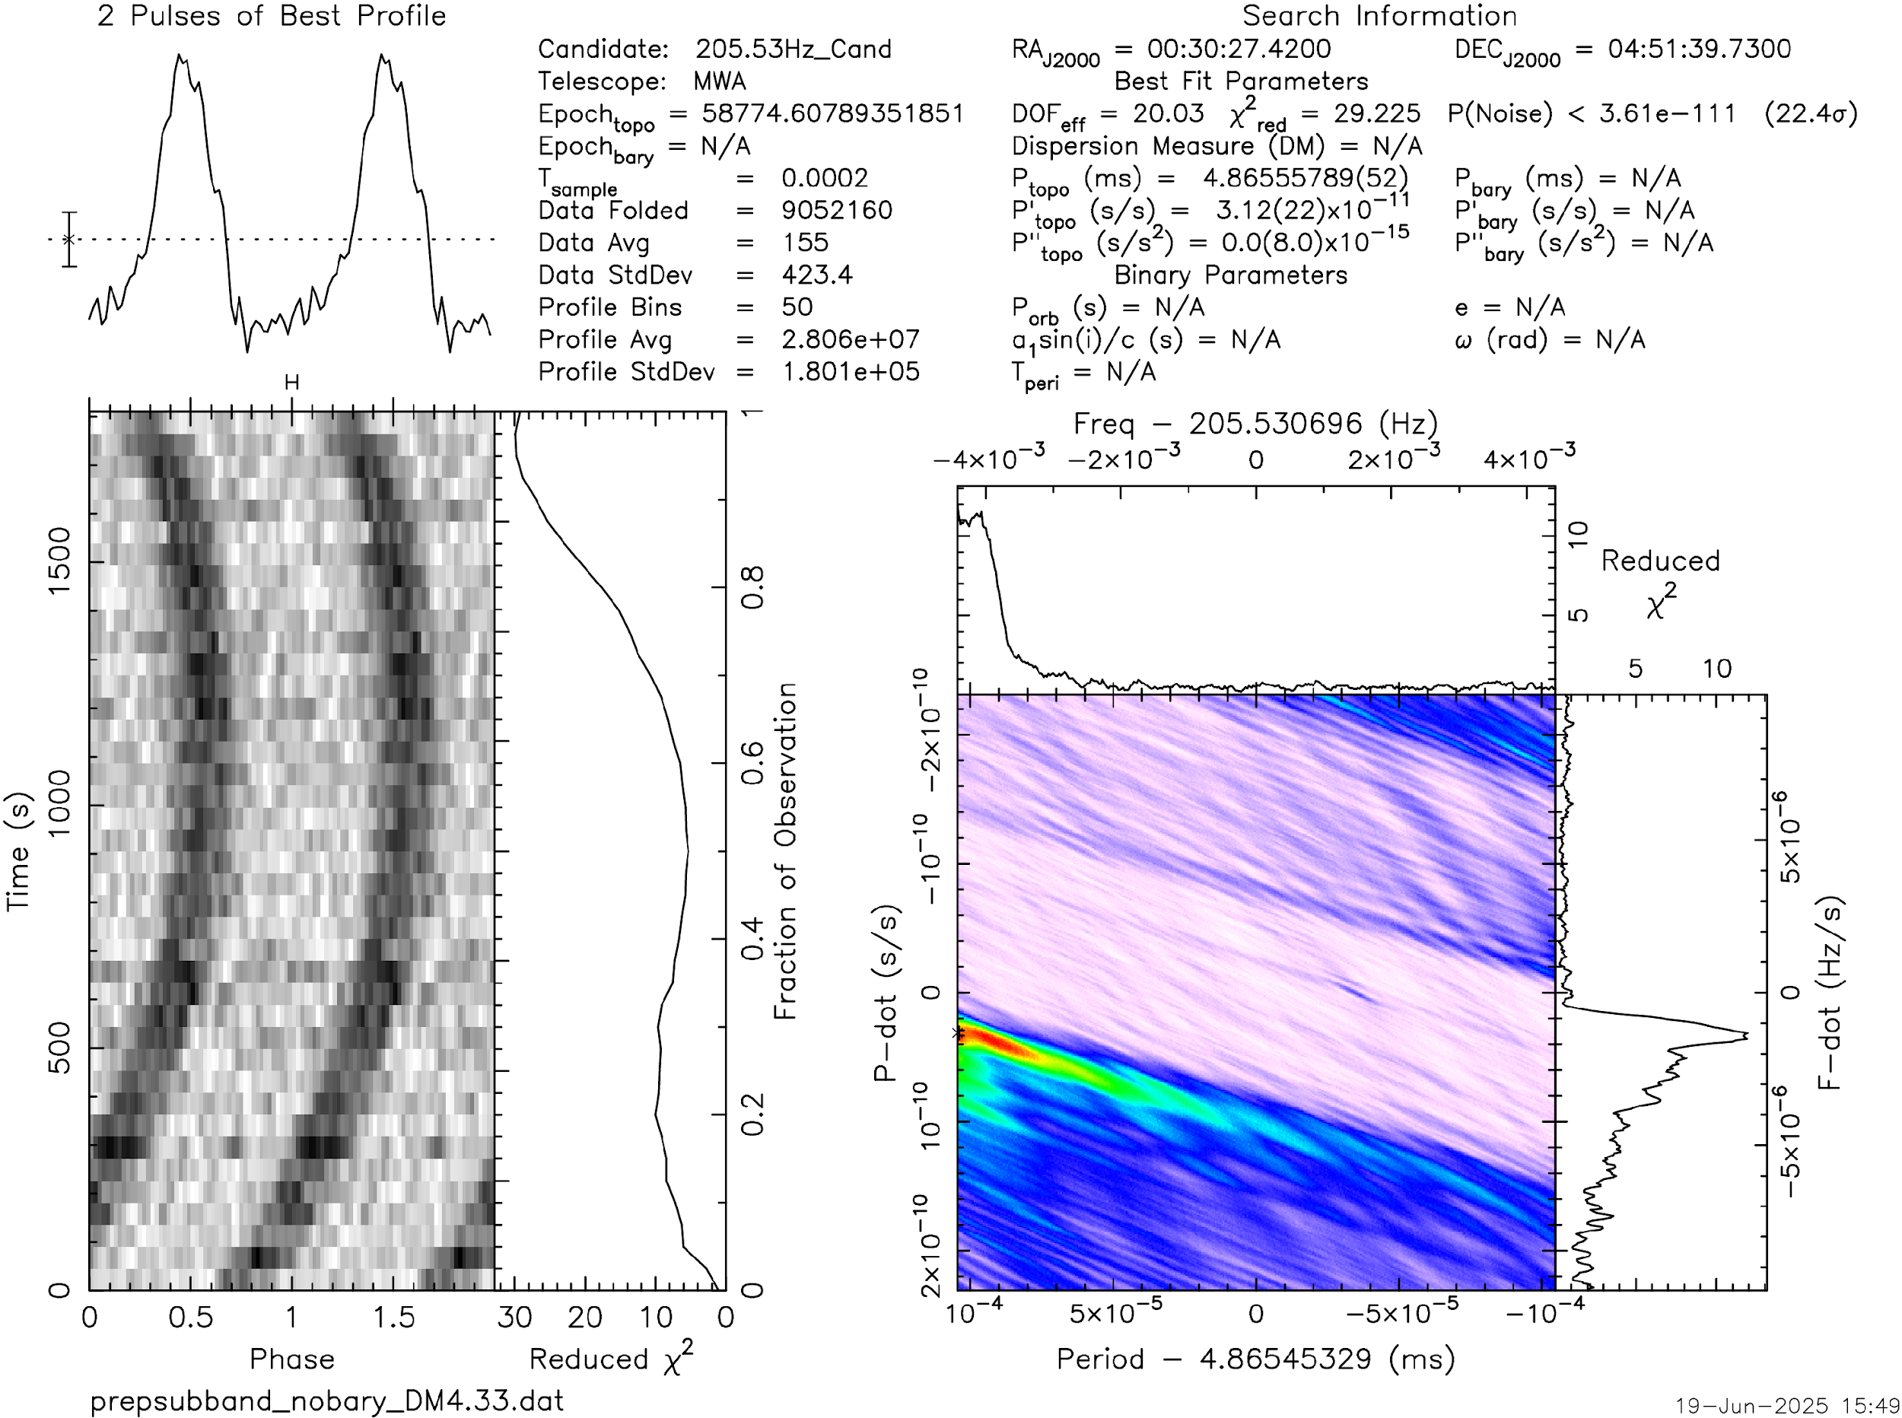
Non-Accelerating Pulsar Detection
Dedisp
Prepsubband
Images by Christopher Lee

Slide 17
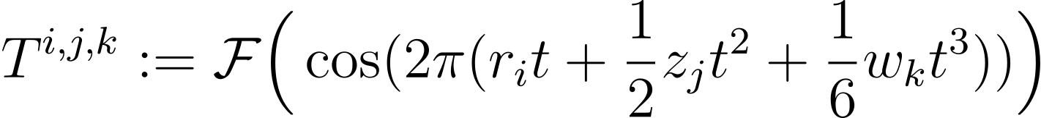
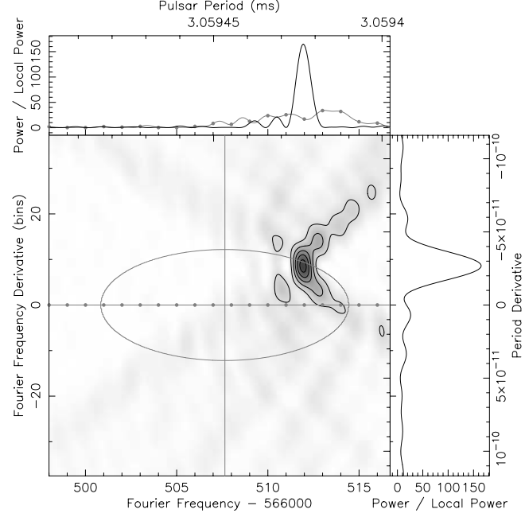
Acceleration/Jerk Search
Non linear phase arising from accelerating pulsar
Matched filtering in Fourier domain with templates (~15000 for full processing)
Parallelizable algorithm, same filters for all de-dispersed time series
Source: https://www.cv.nrao.edu/~sransom/accel_accel_searches.pdf
Notes:
Why jerk search for orbital motion? Read paper. #Z,w values used

Slide 18
Jerk Search GPU Implementation
Contributions to PrestoZL (https://github.com/zhejianglab/PrestoZL.git):
Parallel kernel generation on CPU, optimizing CPU side computations
Using pinned memory for transfers, reusing allocated mem, minimizing re-allocations
Slight improvements in CUDA kernels
Next steps:
Offloading work to CPU
Further optimizing CUDA kernels
HIP implementation
Multiple time series ingestion
MPI + GPU implementation

Slide 19
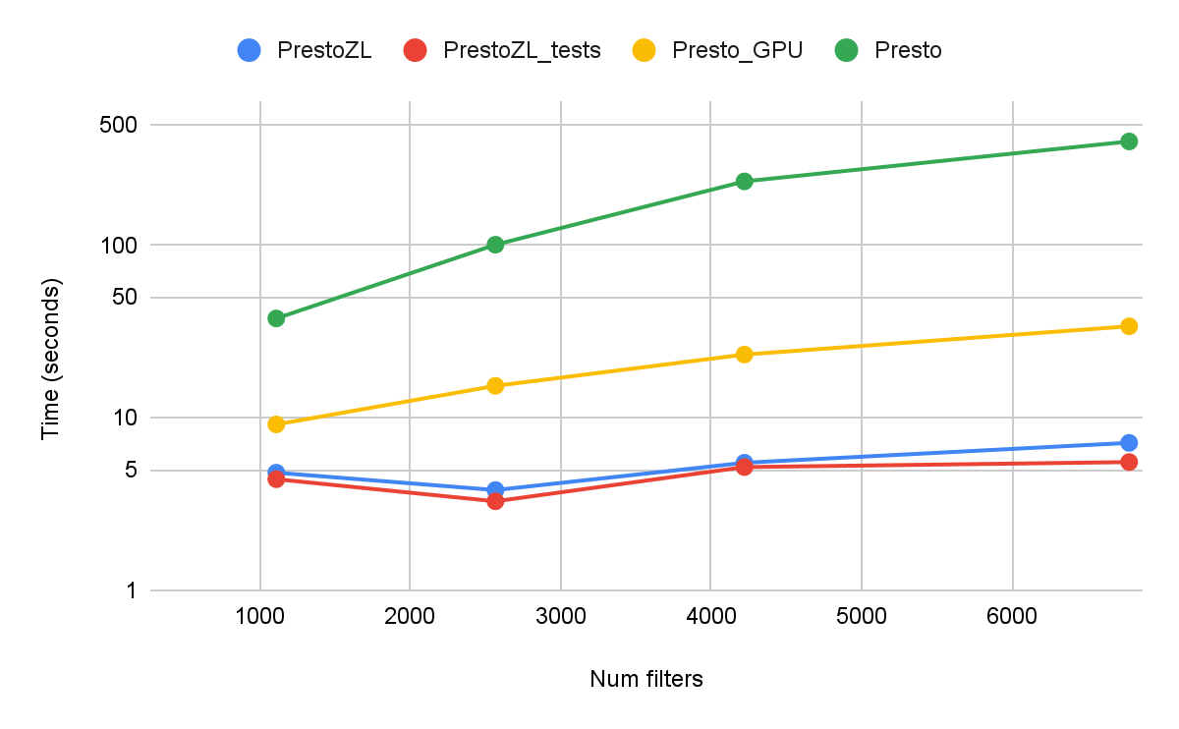
Acceleration/Jerk Search Results
2 million pts., 32 harmonics summing, interbinning, sigma 2.0
GPU runs on GH200: PrestoZL, PrestoZL_tests, Presto_GPU
CPU runs Intel Xeon Platinum 8360Y GHz, 8 cores (Jed): Presto

Slide 20


Conclusion
GPU acceleration of dedispersion and acceleration search
Superior performance than Presto (~100X), other GPU implementations
Further optimization, MPI+GPU implementation, AMD GPUs
Repos: PrestoZL_tests, dedisp_tests

Slide 21
Thank you for your attention
Questions?

Slide 22
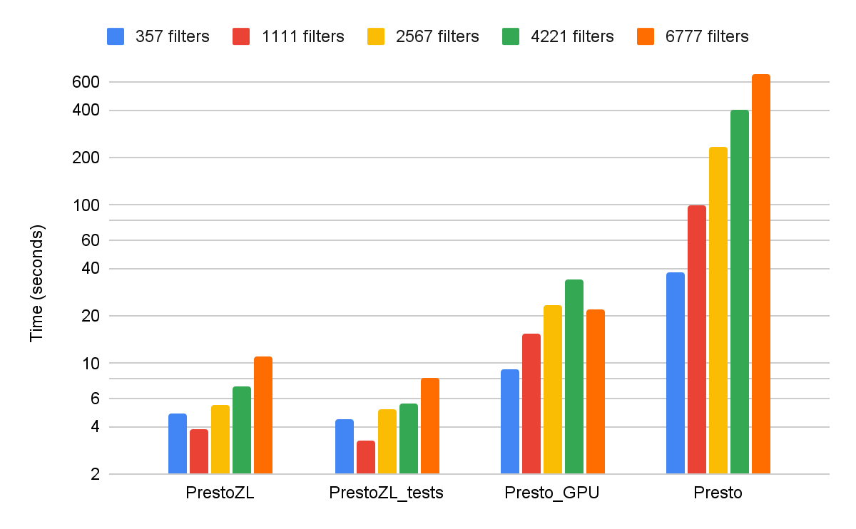
Acceleration/Jerk Search Results
2 million pts., 32 harmonics summing, interbinning, sigma 2.0
GPU runs on Grace Hopper node: GH200
CPU runs on Jed: Intel Xeon Platinum 8360Y GHz, 8 cores

Slide 23
Acceleration/Jerk Search Timings
 | 357 filters | 1111 filters | 2567 filters | 4221 filters | 6777 filters
PrestoZL | 4.808 | 3.813 | 5.488 | 7.159 | 11.039
PrestoZL_tests | 4.407 | 3.283 | 5.181 | 5.539 | 8.184
Presto_GPU | 9.154 | 15.315 | 23.254 | 33.903 | 22.109
presto | 37.656 | 100.72 | 234.445 | 399.493 | 676.087

Slide 24
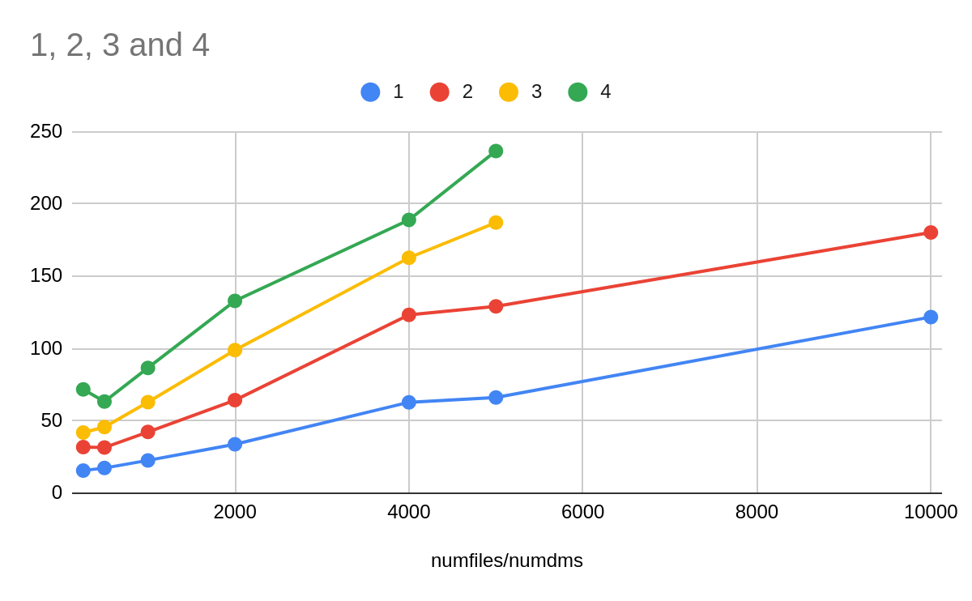
Dedisp Scaling

