Slide 1
Radio selections of high-redshift radio galaxies: The MHz-peaked spectrum population
AJ Hedge, Nick Seymour, Jess Broderick, Jordan Collier, George Heald

Slide 2
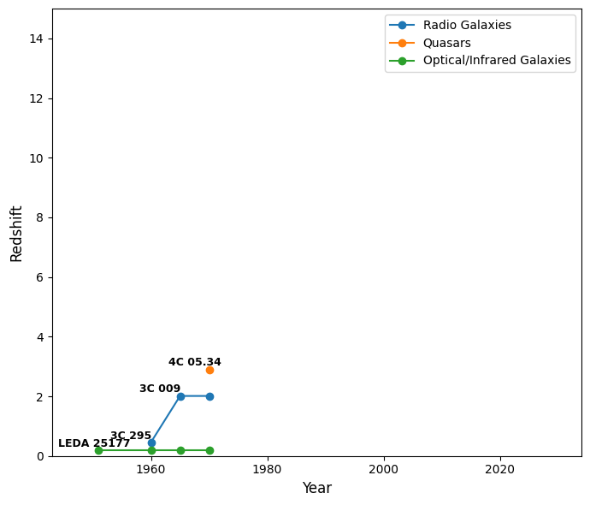
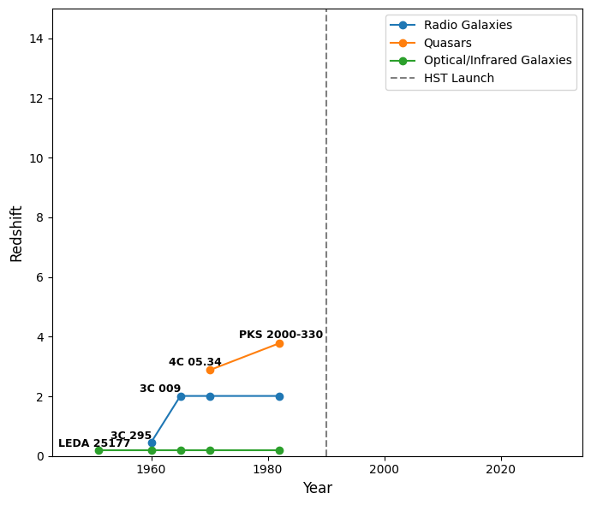
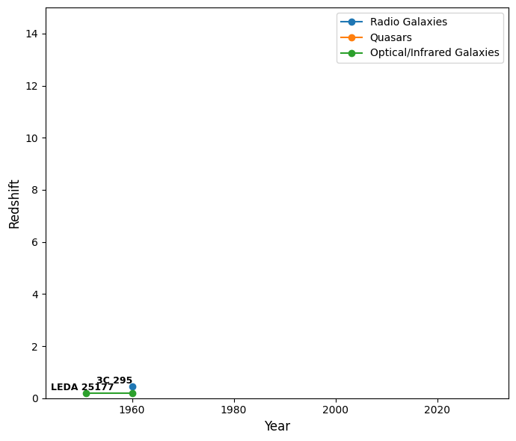
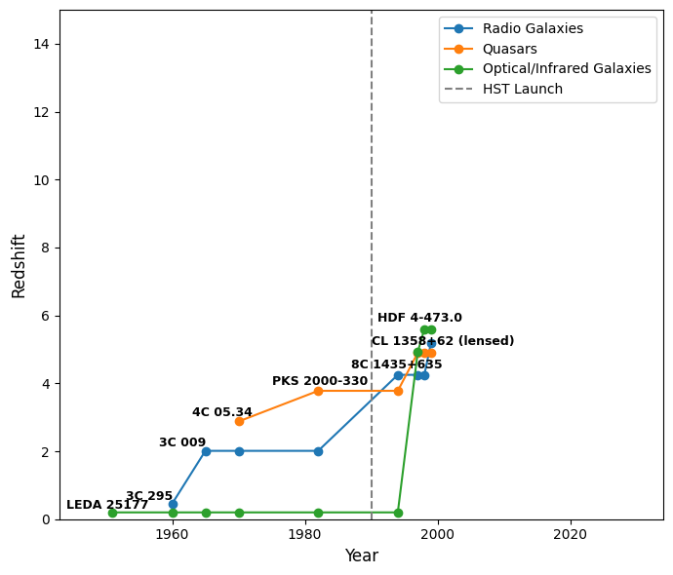
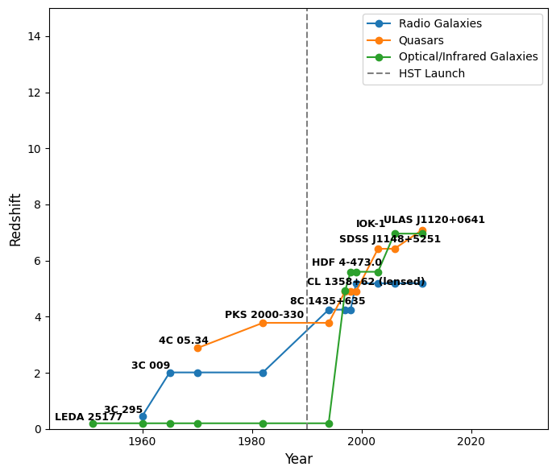
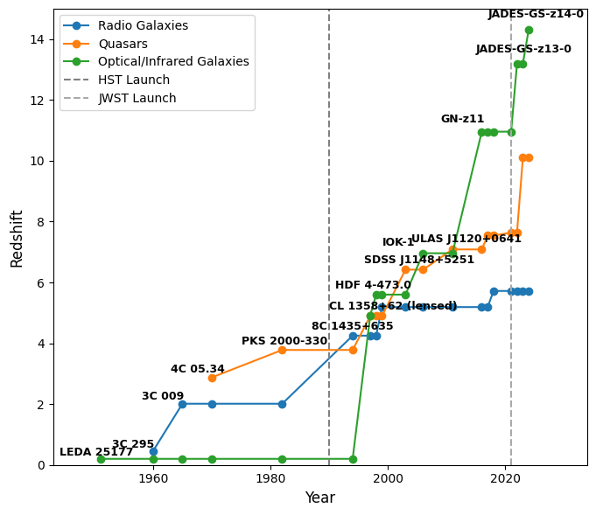
High-redshifts over the decades
Bright radio objects started out as some of the most distant objects known
After the advent of HST and its deep fields, optically-selected objects caught up quickly
After more time (and later JWST), radio-selected sources were left in the dust
Bright high-z radio sources still important! (21-cm forest, see Nick’s talk tomorrow)
So how do we find more of them?
*Non-exhaustive, likely with omissions, for context only
Notes:
In a rapidly approaching SKA era, the need to characterise radio sources and their host galaxies accurately has emerged as a non-trivial problem, especially for undetected host galaxies. For this population without clear hosts, overlapping with infrared-faint radio sources (IFRSs), the bottleneck in obtaining redshifts lies in dedicated follow-up at sub-mm or infrared wavelengths using over-subscribed instruments. Given the wealth of sensitive, all-sky observations in the radio, there has to be a better way of determining the redshifts for this IFRS-like population which include the elusive powerful radio galaxies at z>5.

Slide 3
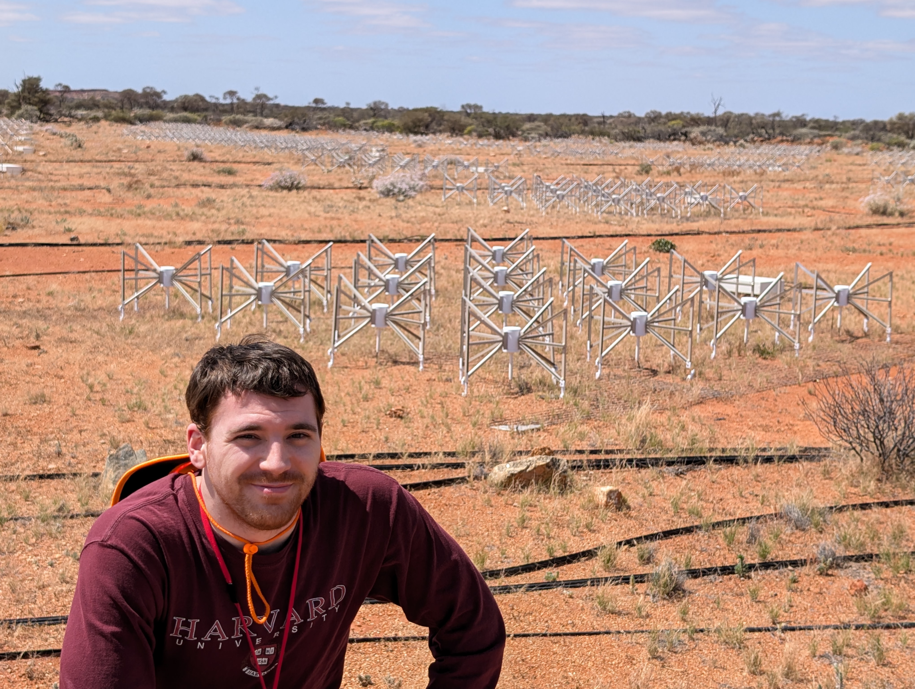
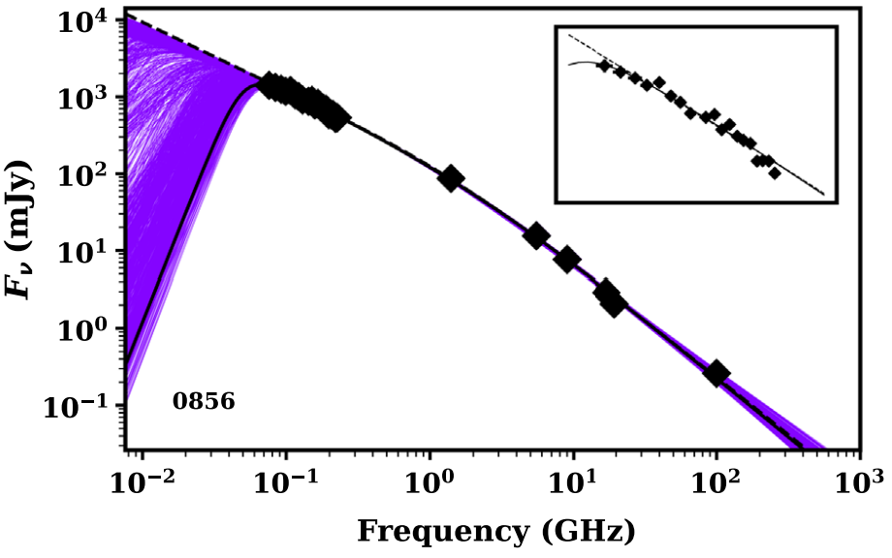
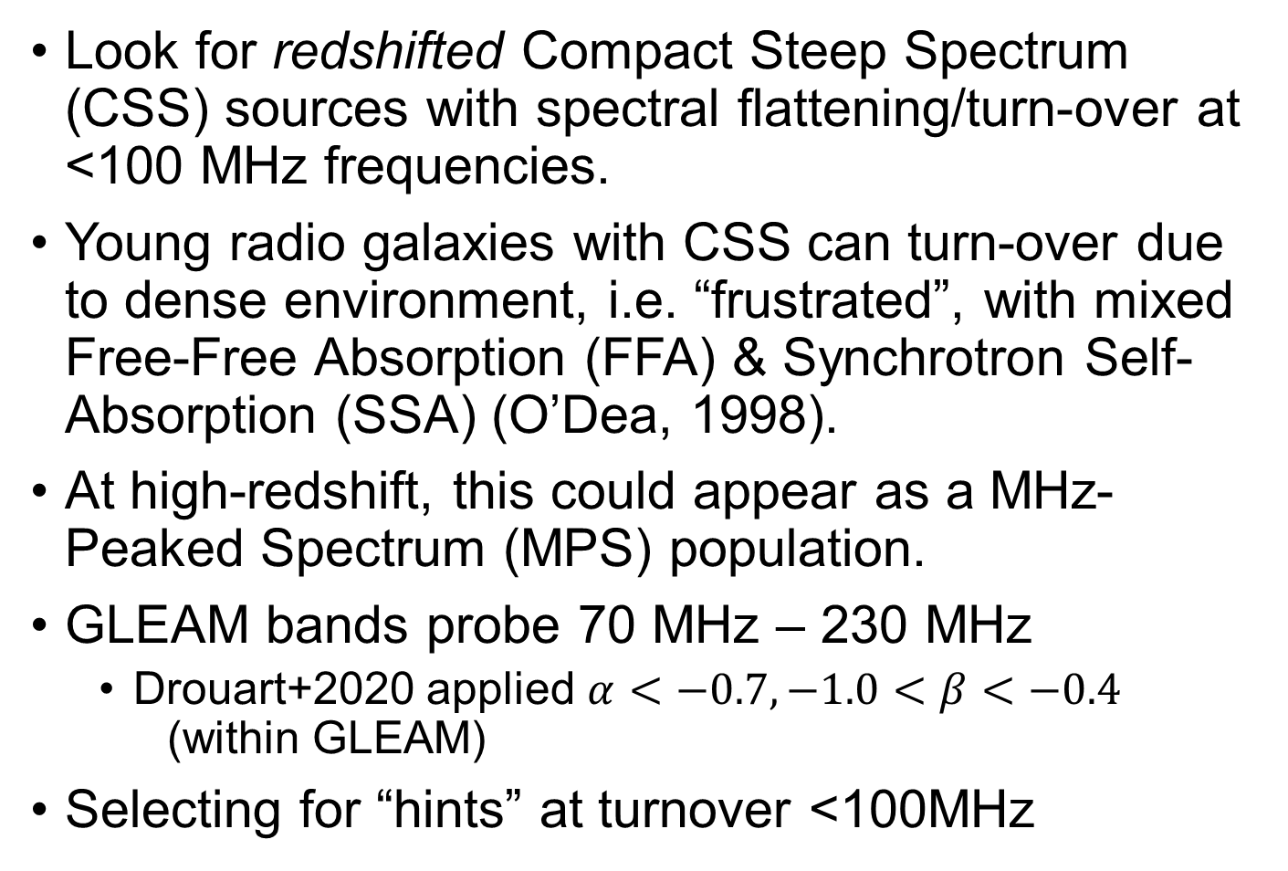
Low-frequency selection with GLEAM
Look for redshifted Compact Steep Spectrum (CSS) sources with spectral flattening/turn-over at <100 MHz frequencies.
Young radio galaxies with CSS can turn-over due to dense environment, i.e. “frustrated”, with mixed Free-Free Absorption (FFA) & Synchrotron Self-Absorption (SSA) (O’Dea, 1998).
At high-redshift, this could appear as a MHz-Peaked Spectrum (MPS) population.
GLEAM bands probe 70 MHz – 230 MHz
  Drouart+2020 applied $α<−0.7, −1.0<β<−0.4$ (within GLEAM)
Selecting for “hints” at turnover <100MHz
Drouart+2020
Notes:
Previously using the GLEAM survey, efforts were made to select low-frequency turnover high-redshift radio galaxies by their spectral index and curvature within GLEAM and then filter out by other characteristics and verify with follow-up at optical to sub-mm wavelengths.

Slide 4
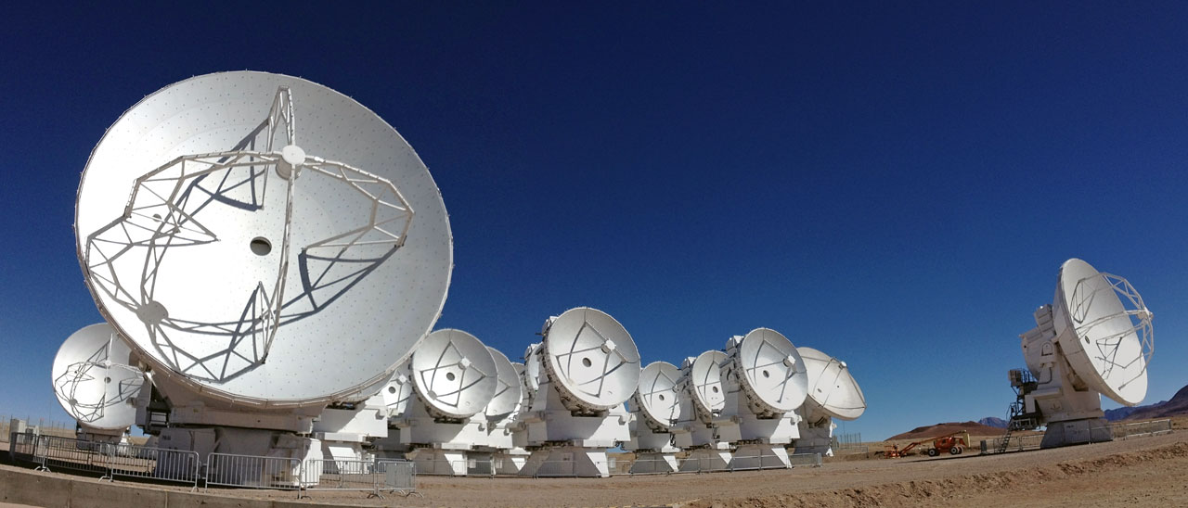
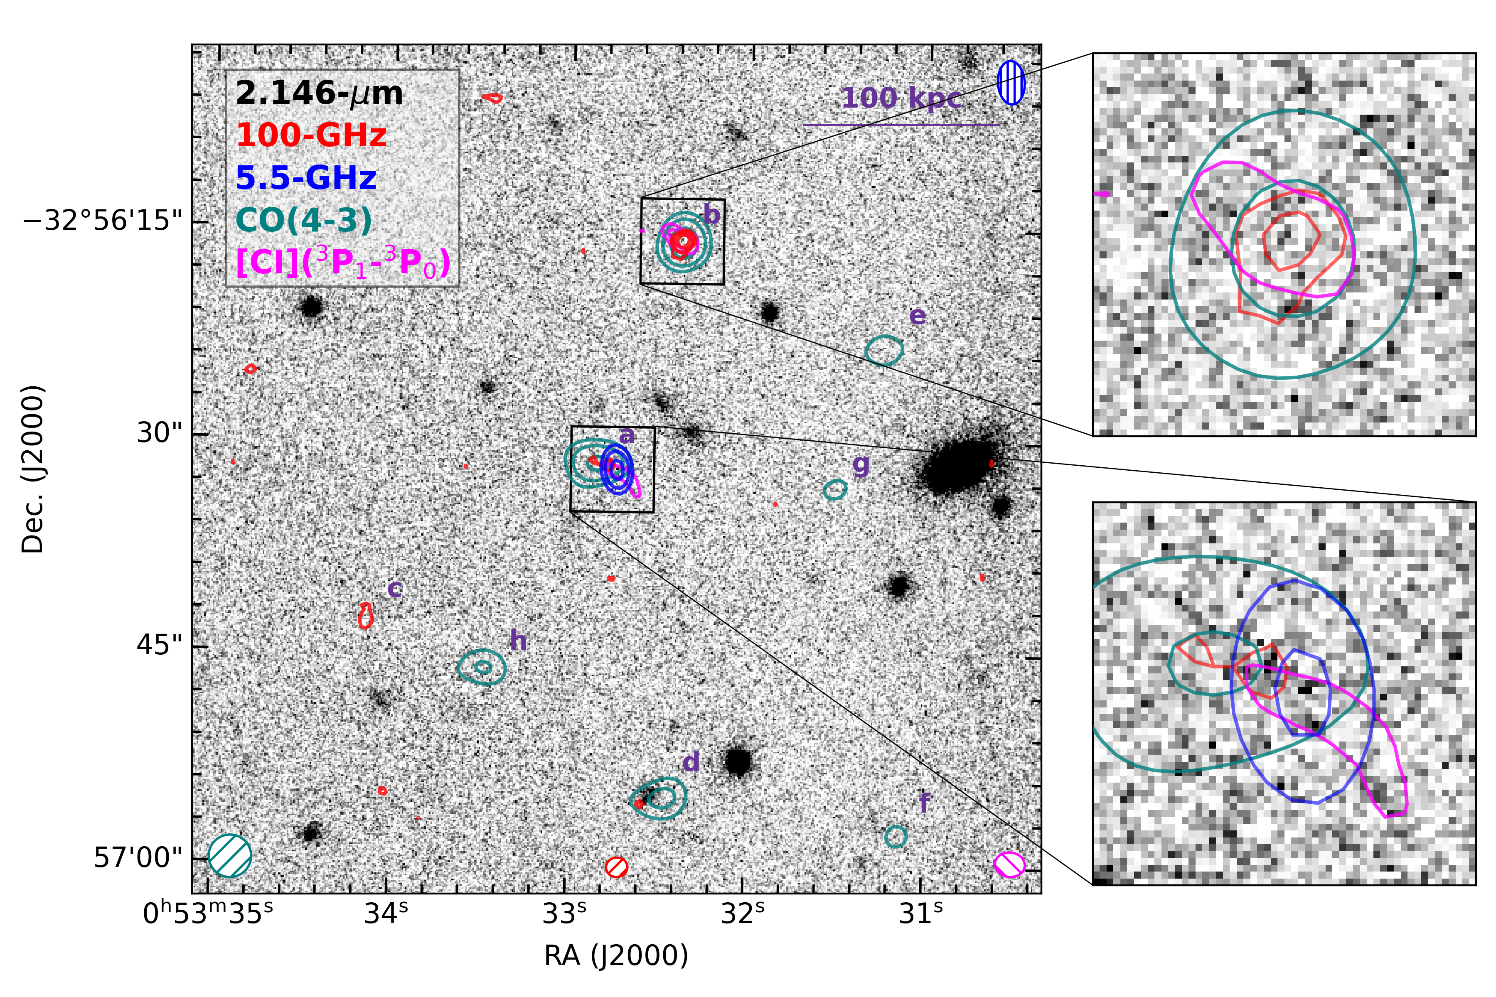
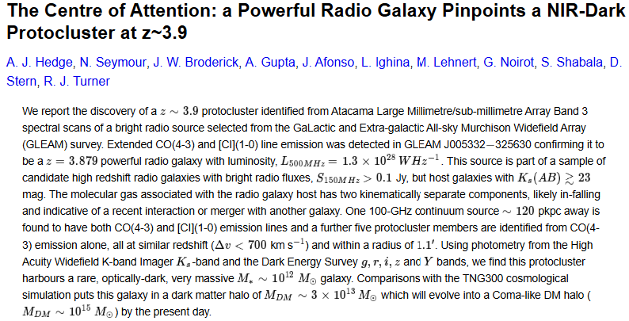
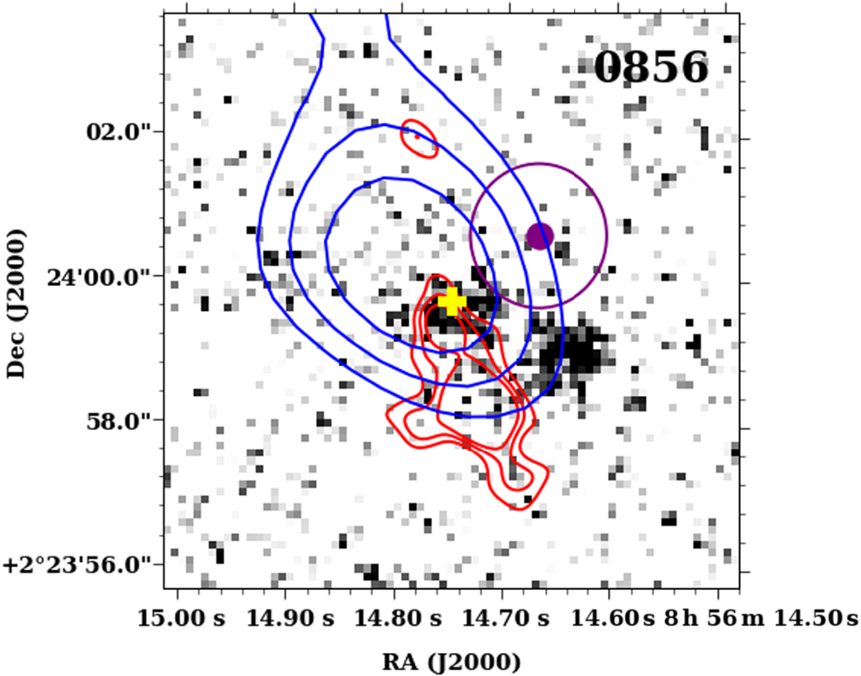
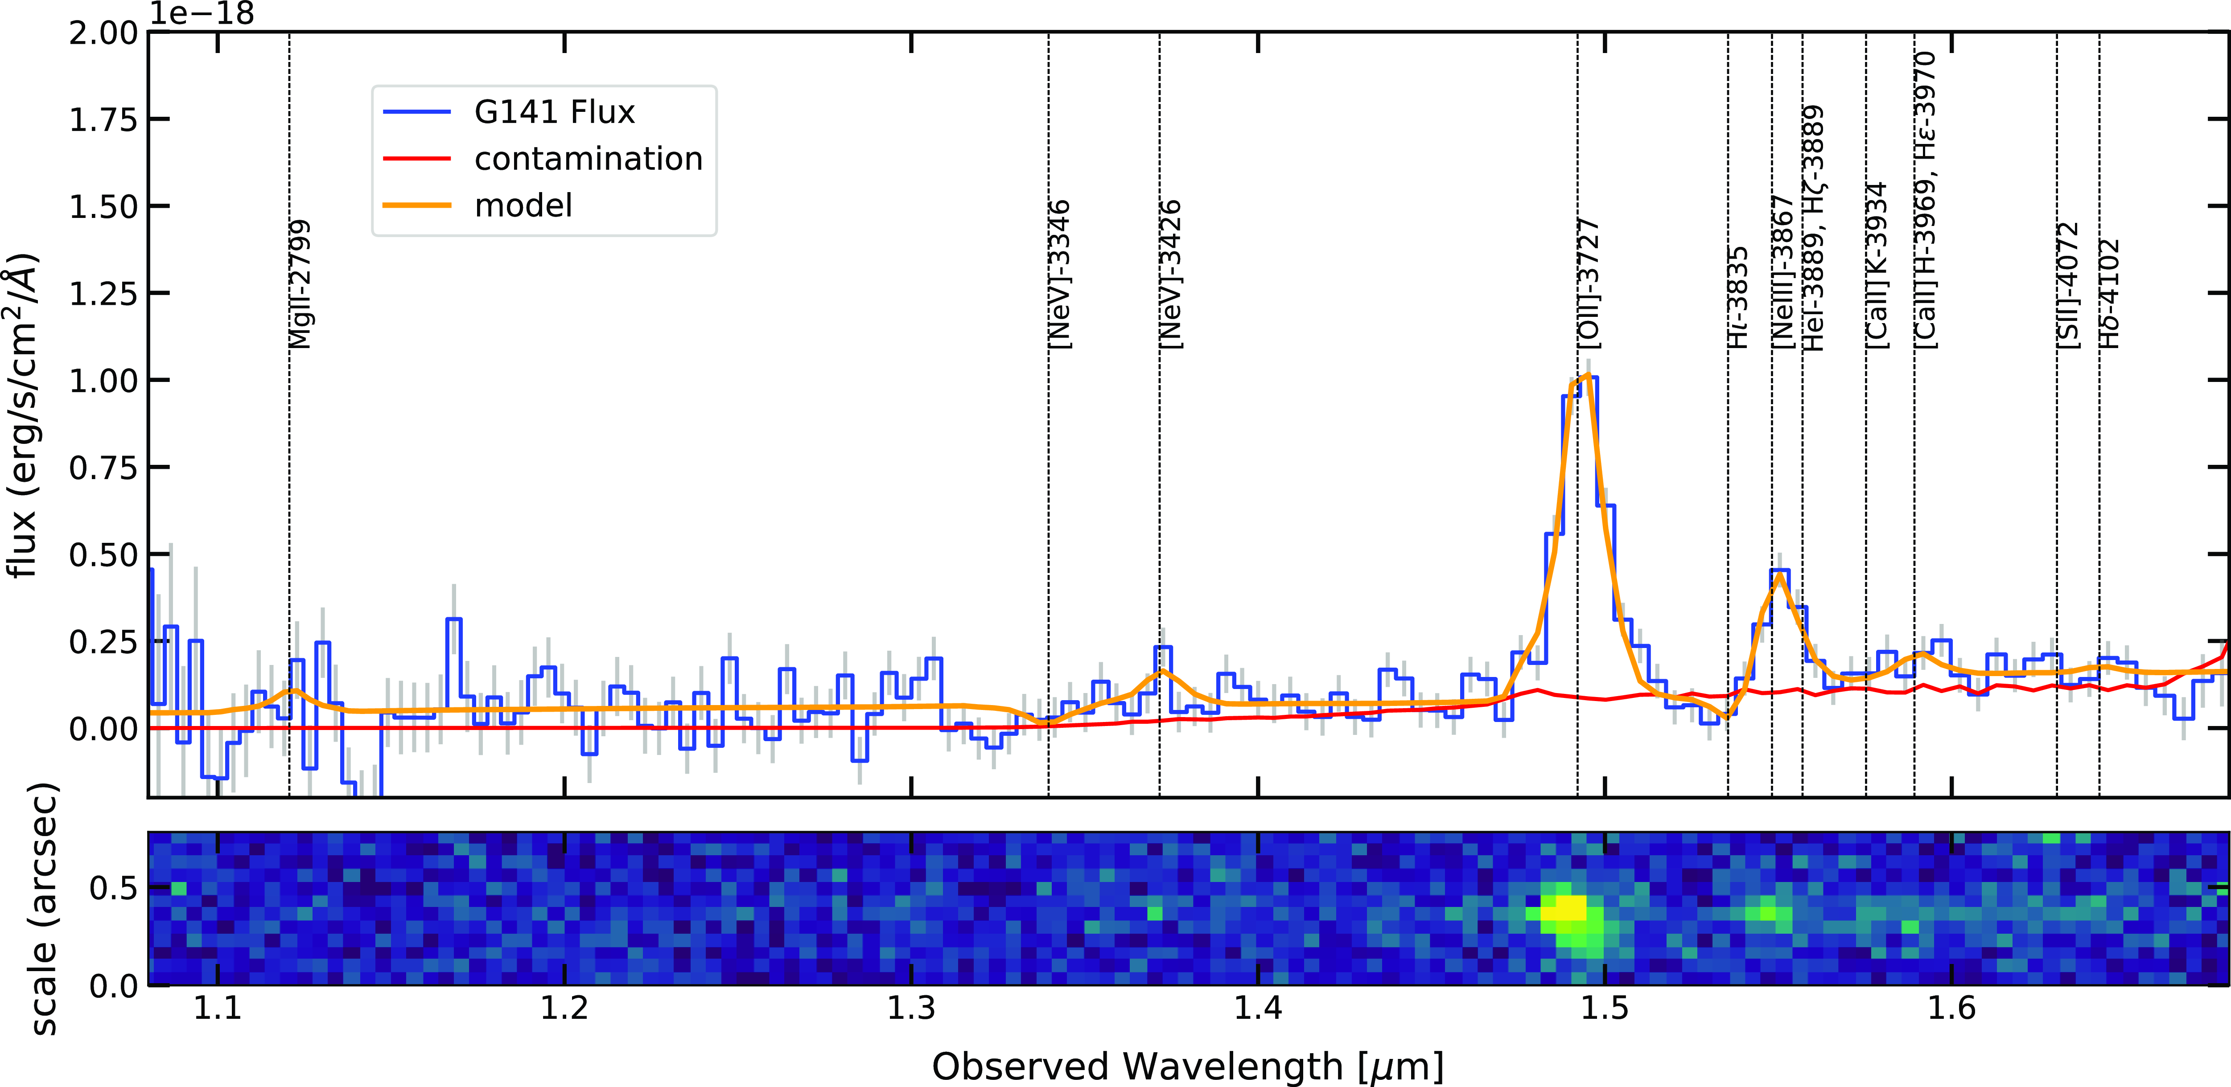
Confirmations (reliant on mm/infrared)
ALMA (mm) has yielded redshifts for 4 sources so far (1 in pilot sample, 3 in extended sample)
1 source (pilot sample) has been observed and confirmed with HST (covering near-infrared)
It’s a hard knock life trying to get time on such oversubscribed instruments at shorter wavelengths… so let’s go to longer wavelengths instead
Seymour+2024
Drouart+2020
Notes:
This approach has confirmed two HzRGs from the pilot survey and three HzRGs from the extended survey thus far, including one that resides in a protocluster.

Slide 5
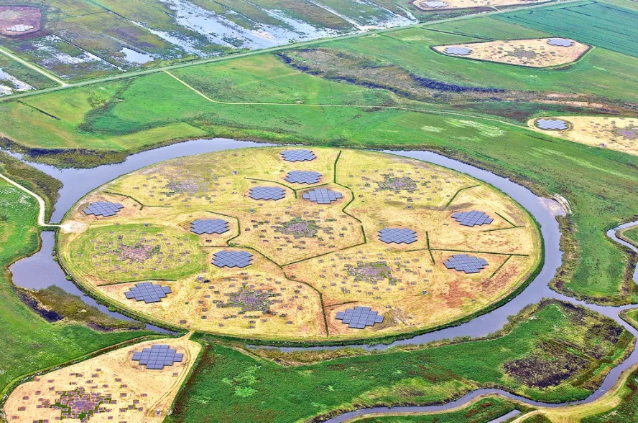
Pilot HzRGs: How low can you go?
From 2020, 7 nights of 3hr observations were taken
LOFAR Low Band Antenna 34-66 MHz
3 beams (1 for calibrator, 2 for target fields around pilot high-redshift radio galaxies)
Can we see turnovers?
First, can we even reduce the data??
Credit: ASTRON
Notes:
Two z>=3 radio galaxies that were verified from that pilot study now have LOFAR Low Band Antenna data spanning ~35-65 MHz, complementing GLEAM and opening a window into the MHz-peaked turnovers previously hinted at.

Slide 6


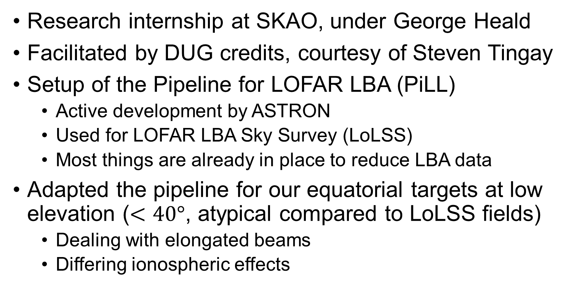
Reducing LOFAR LBA data
Research internship at SKAO, under George Heald
Facilitated by DUG credits, courtesy of Steven Tingay
Setup of the Pipeline for LOFAR LBA (PiLL)
  Active development by ASTRON
  Used for LOFAR LBA Sky Survey (LoLSS)
  Most things are already in place to reduce LBA data
Adapted the pipeline for our equatorial targets at low elevation ($<40°$, atypical compared to LoLSS fields)
  Dealing with elongated beams
  Differing ionospheric effects

Slide 7
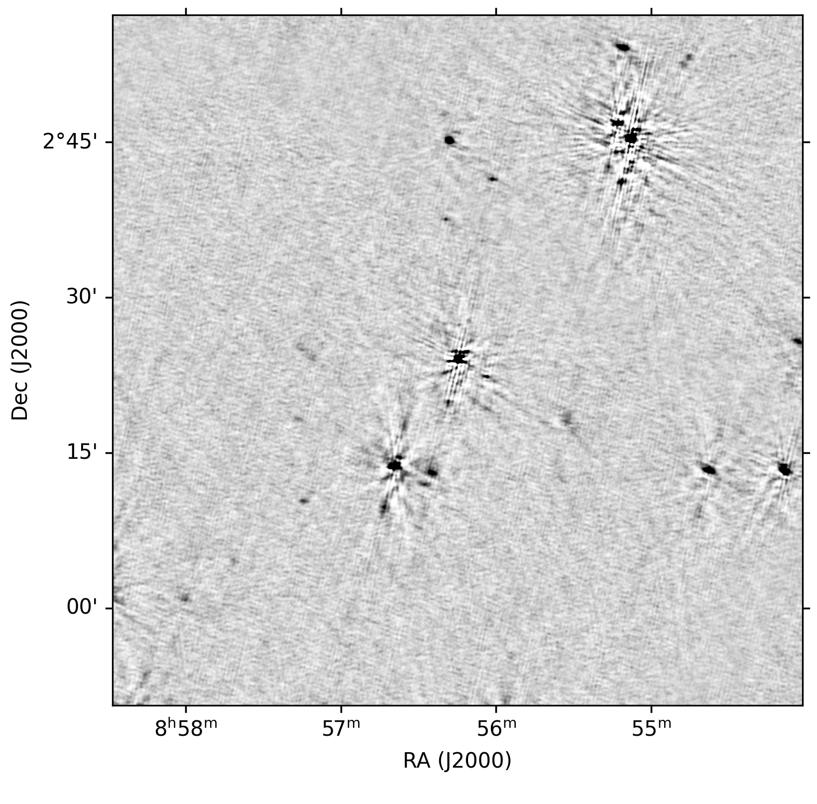
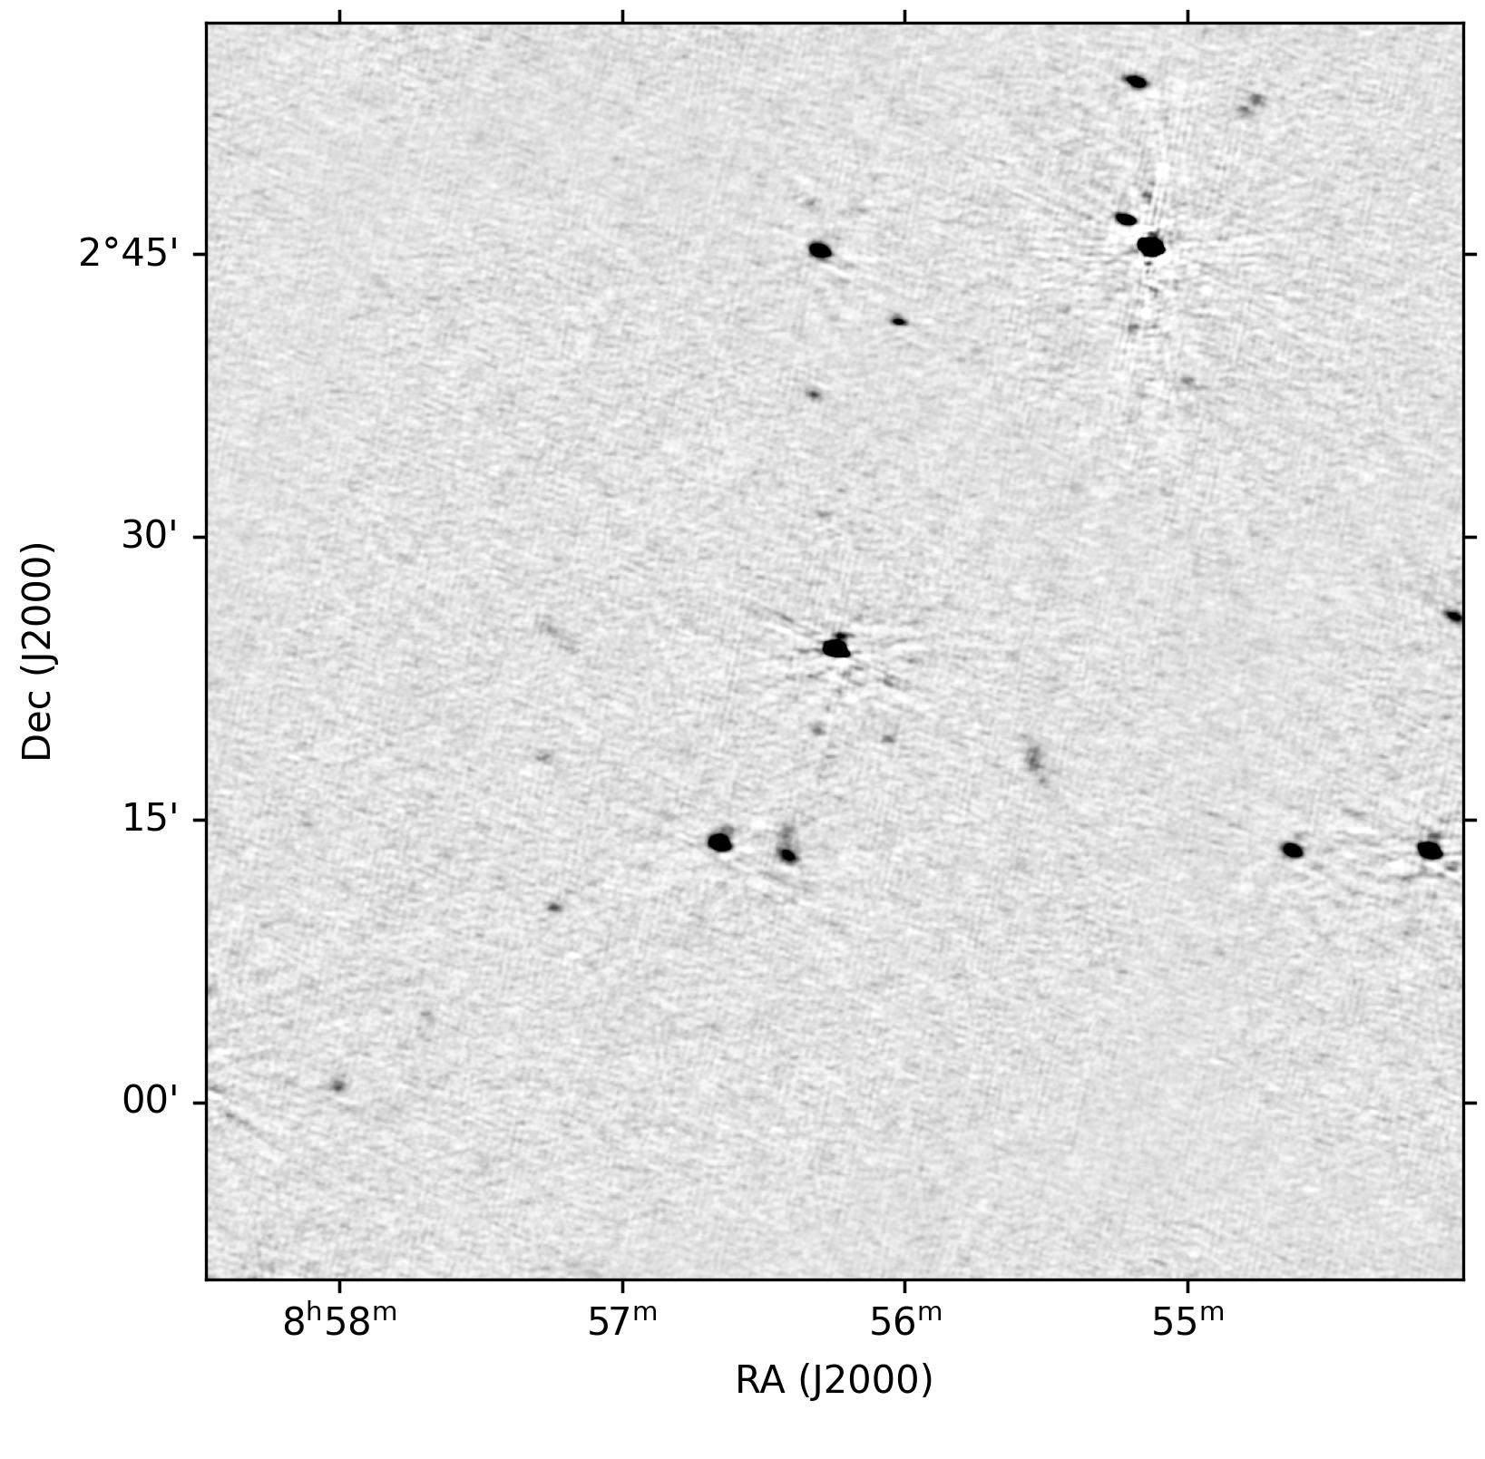
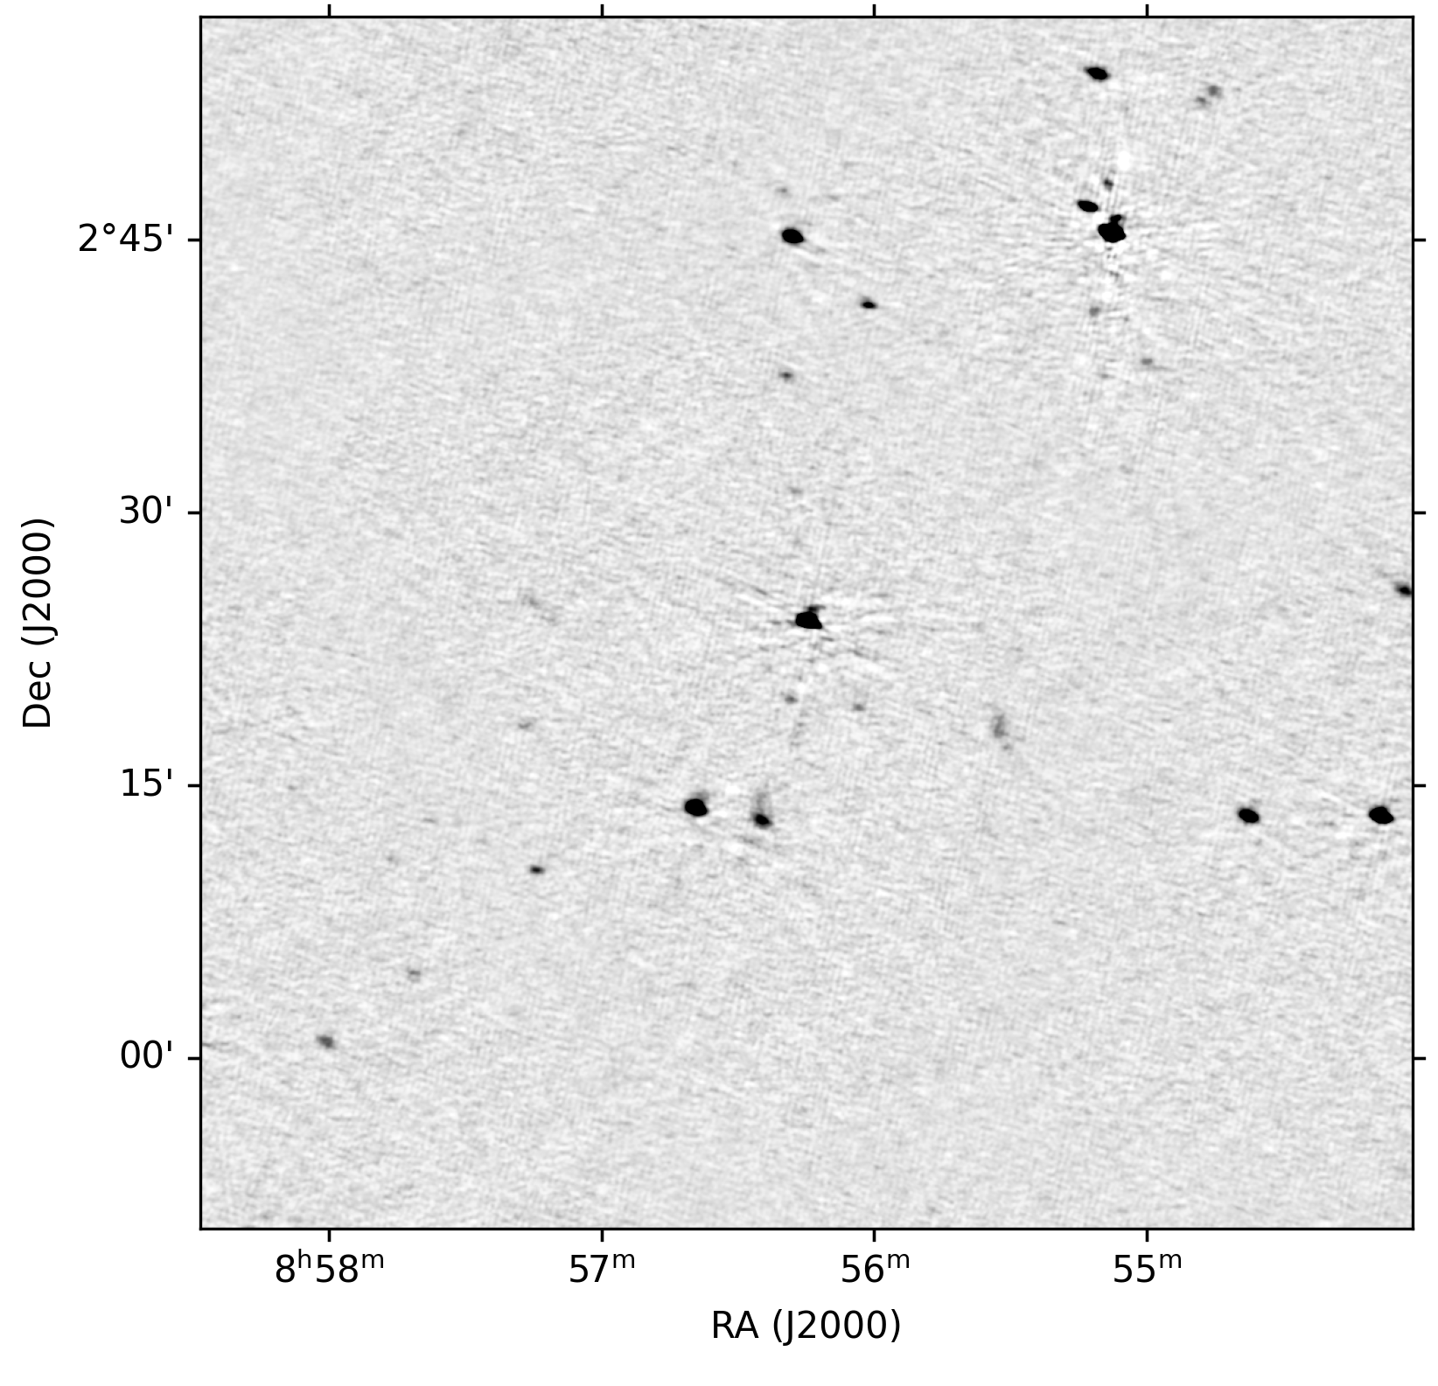
Reducing LOFAR LBA data
Calibrator amp cal (3C196)
Target fields TEC + scalar phase cal, for several patches of flux
Hopefully nice wide-field images (with 8x4 MHz subbands)
Direction-dependent facet phase (+amp) self-cal cycles
Example DDE corrections from DIE corrected image to 2 facet DDE self-cal cycles

Slide 8
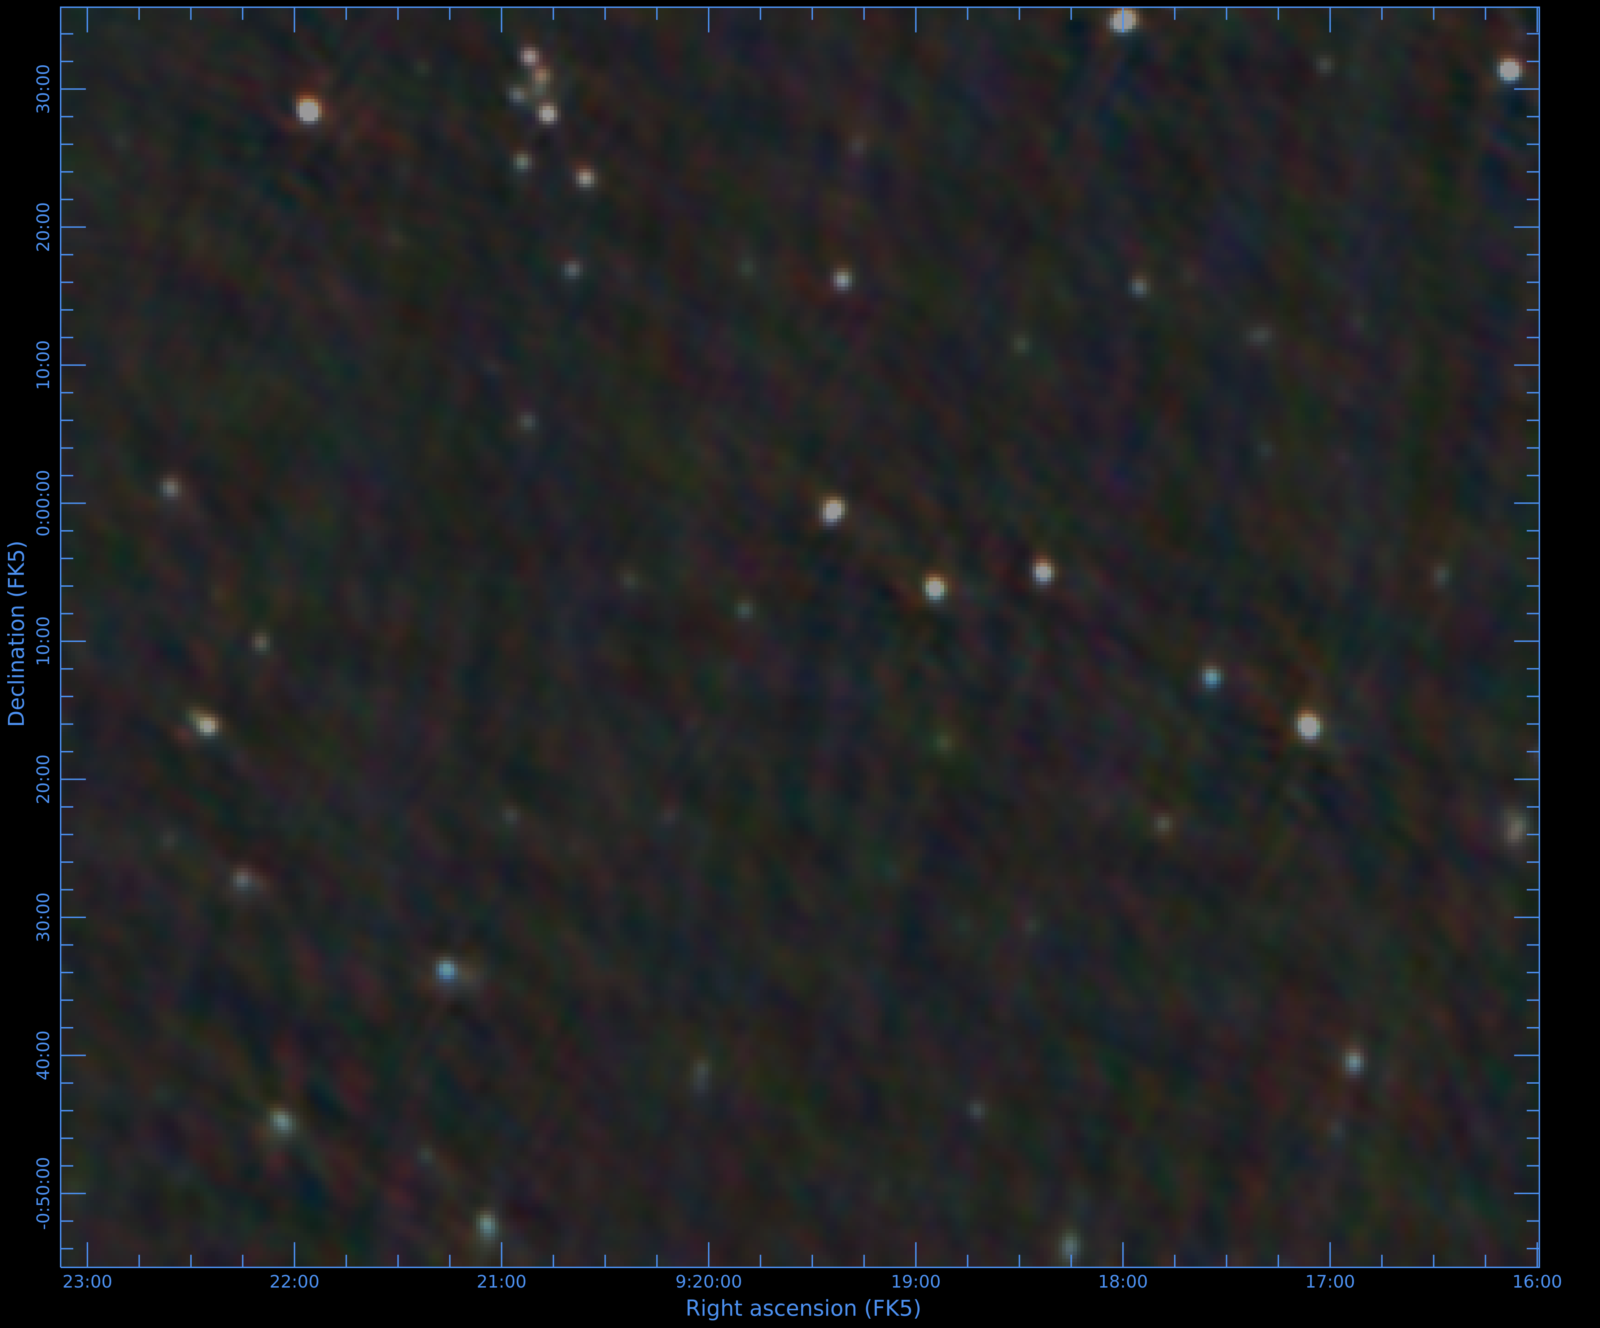
Reducing LOFAR LBA data
CARTA false-colour image generated from 4-MHz channels
Sources with sharp turnovers appear bluer!

Slide 9
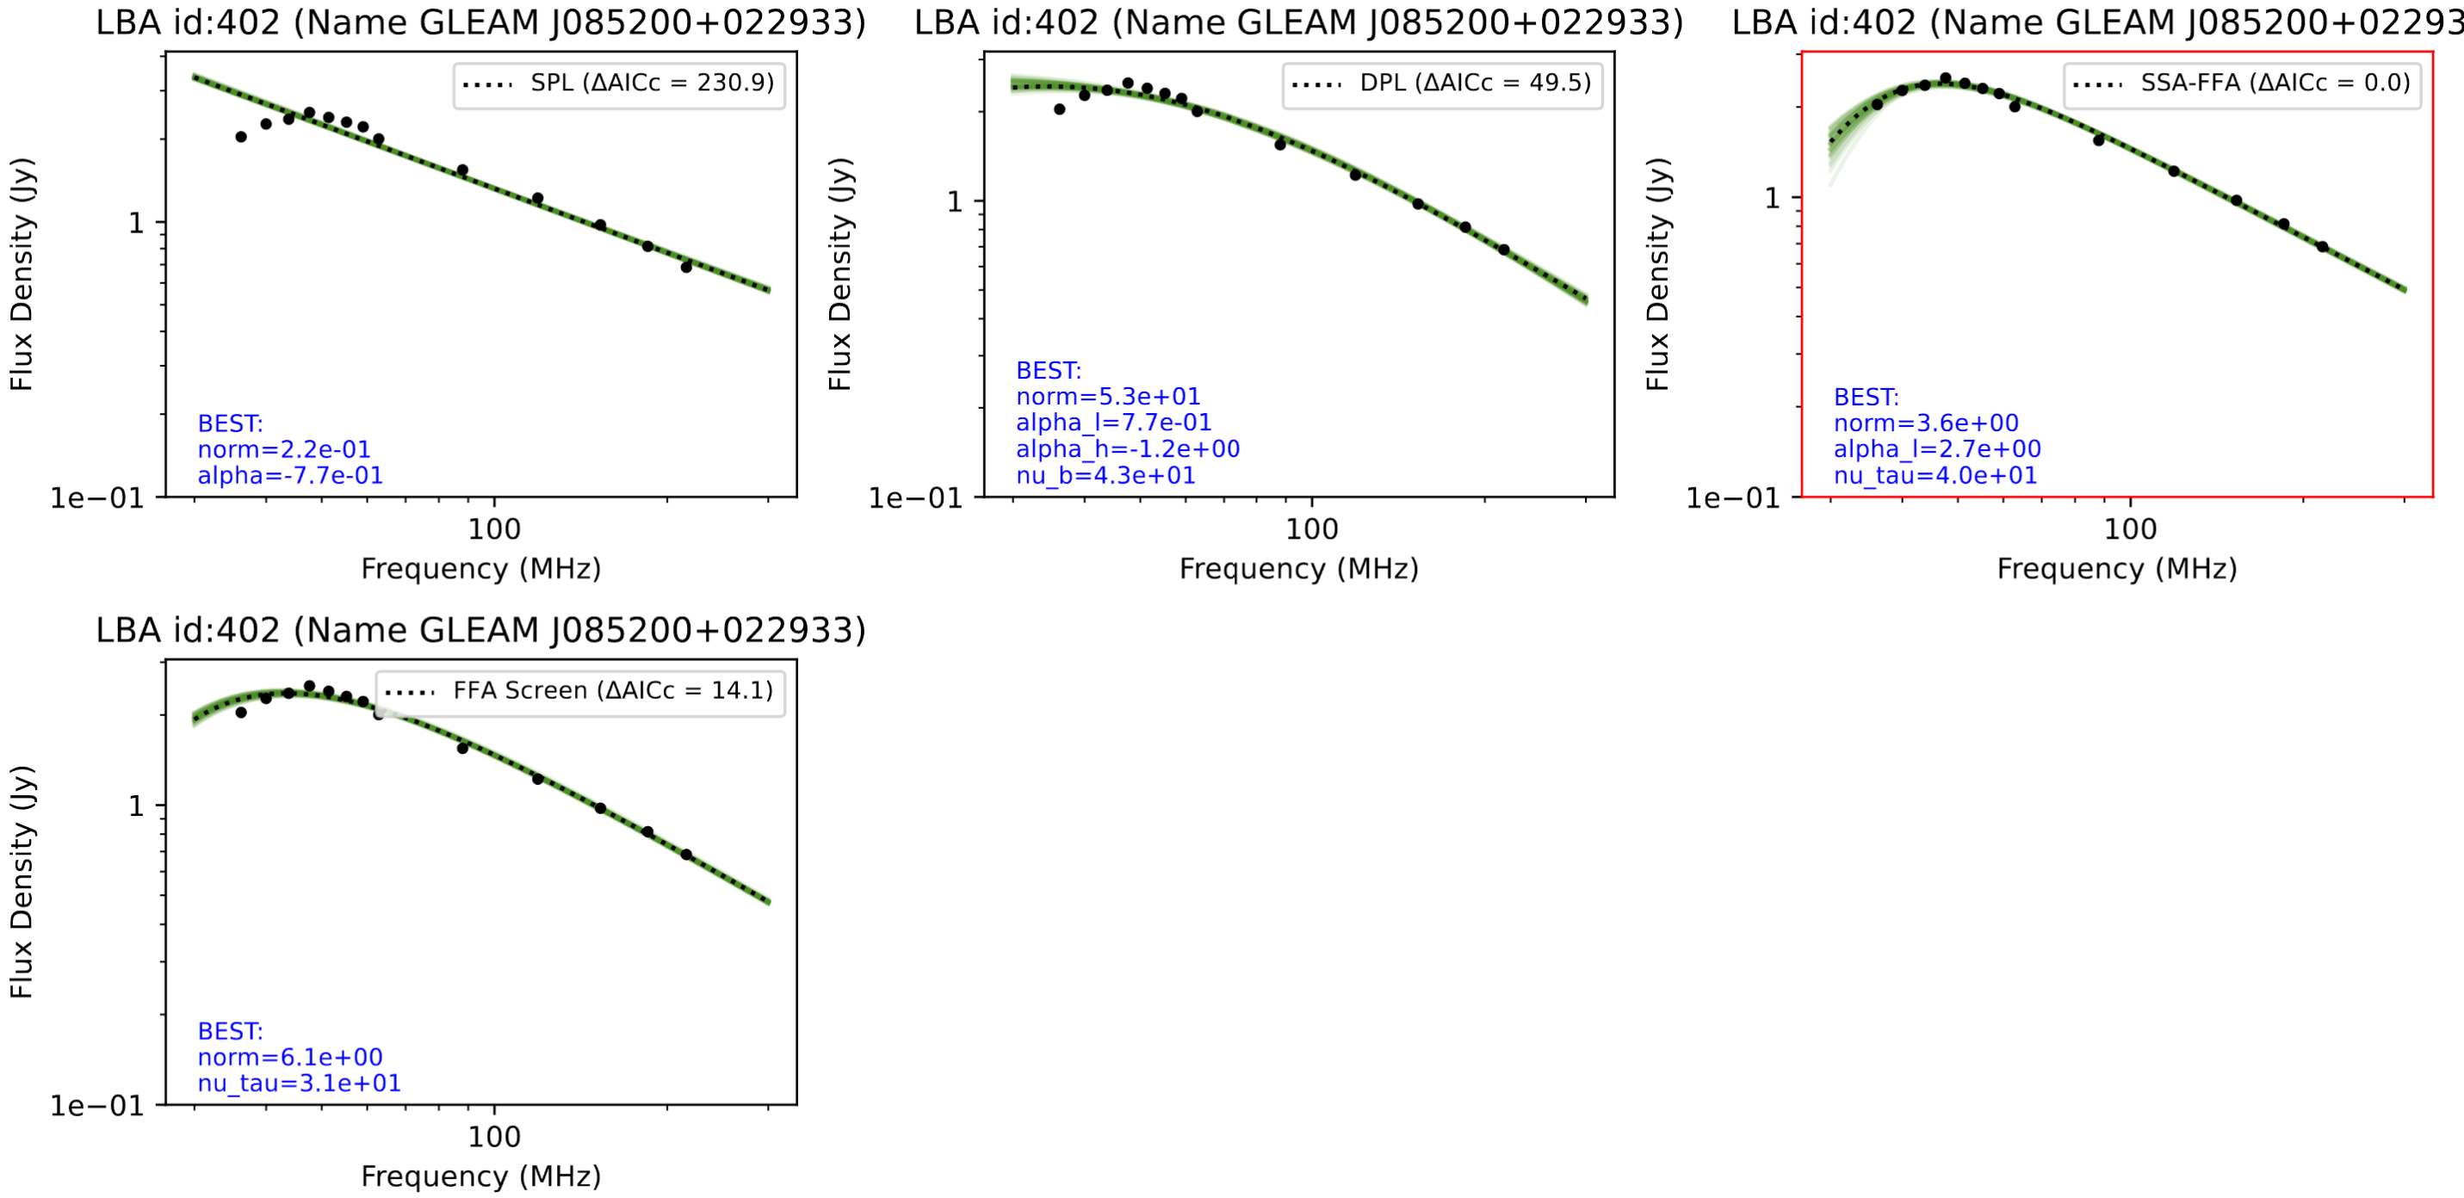
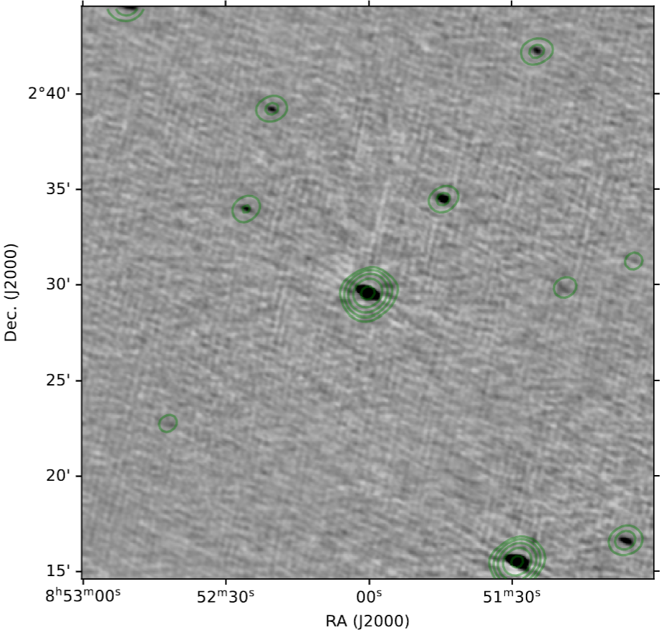
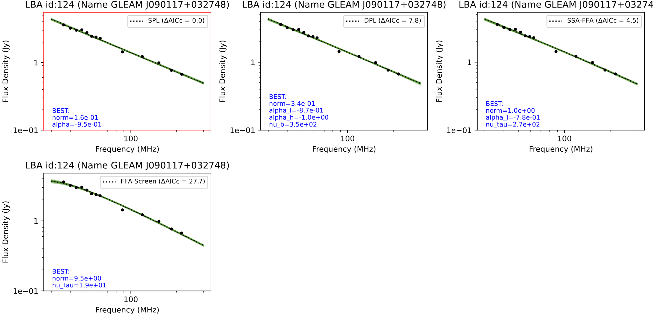
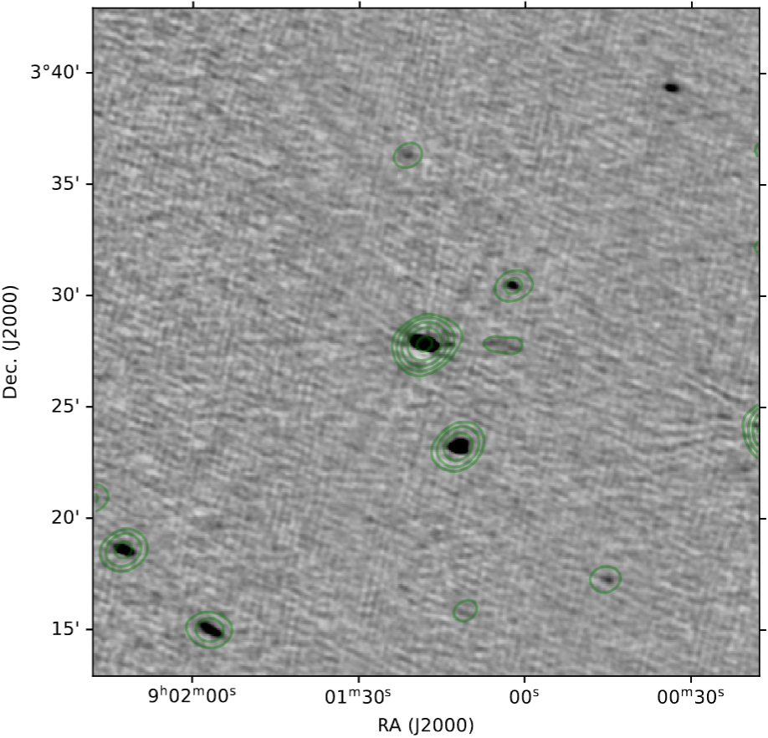
Low-frequency SED modelling
(Preliminary)
LBA + GLEAM
Attempt to fit several models
  SPL
  DPL
  FFA+SSA mixed plasma
  FFA surrounding screen
Select best via Akaike Information Criterion
30%+ have turnover or significant flattening
Contours from MIDAS survey, credit: Sean Patterson
Notes:
We compare the rest-frame turnovers and linear source sizes for these sources at very high redshift with known relations and investigate the MHz-peaked spectrum population of sources that are within the large LOFAR field of view.

Slide 10
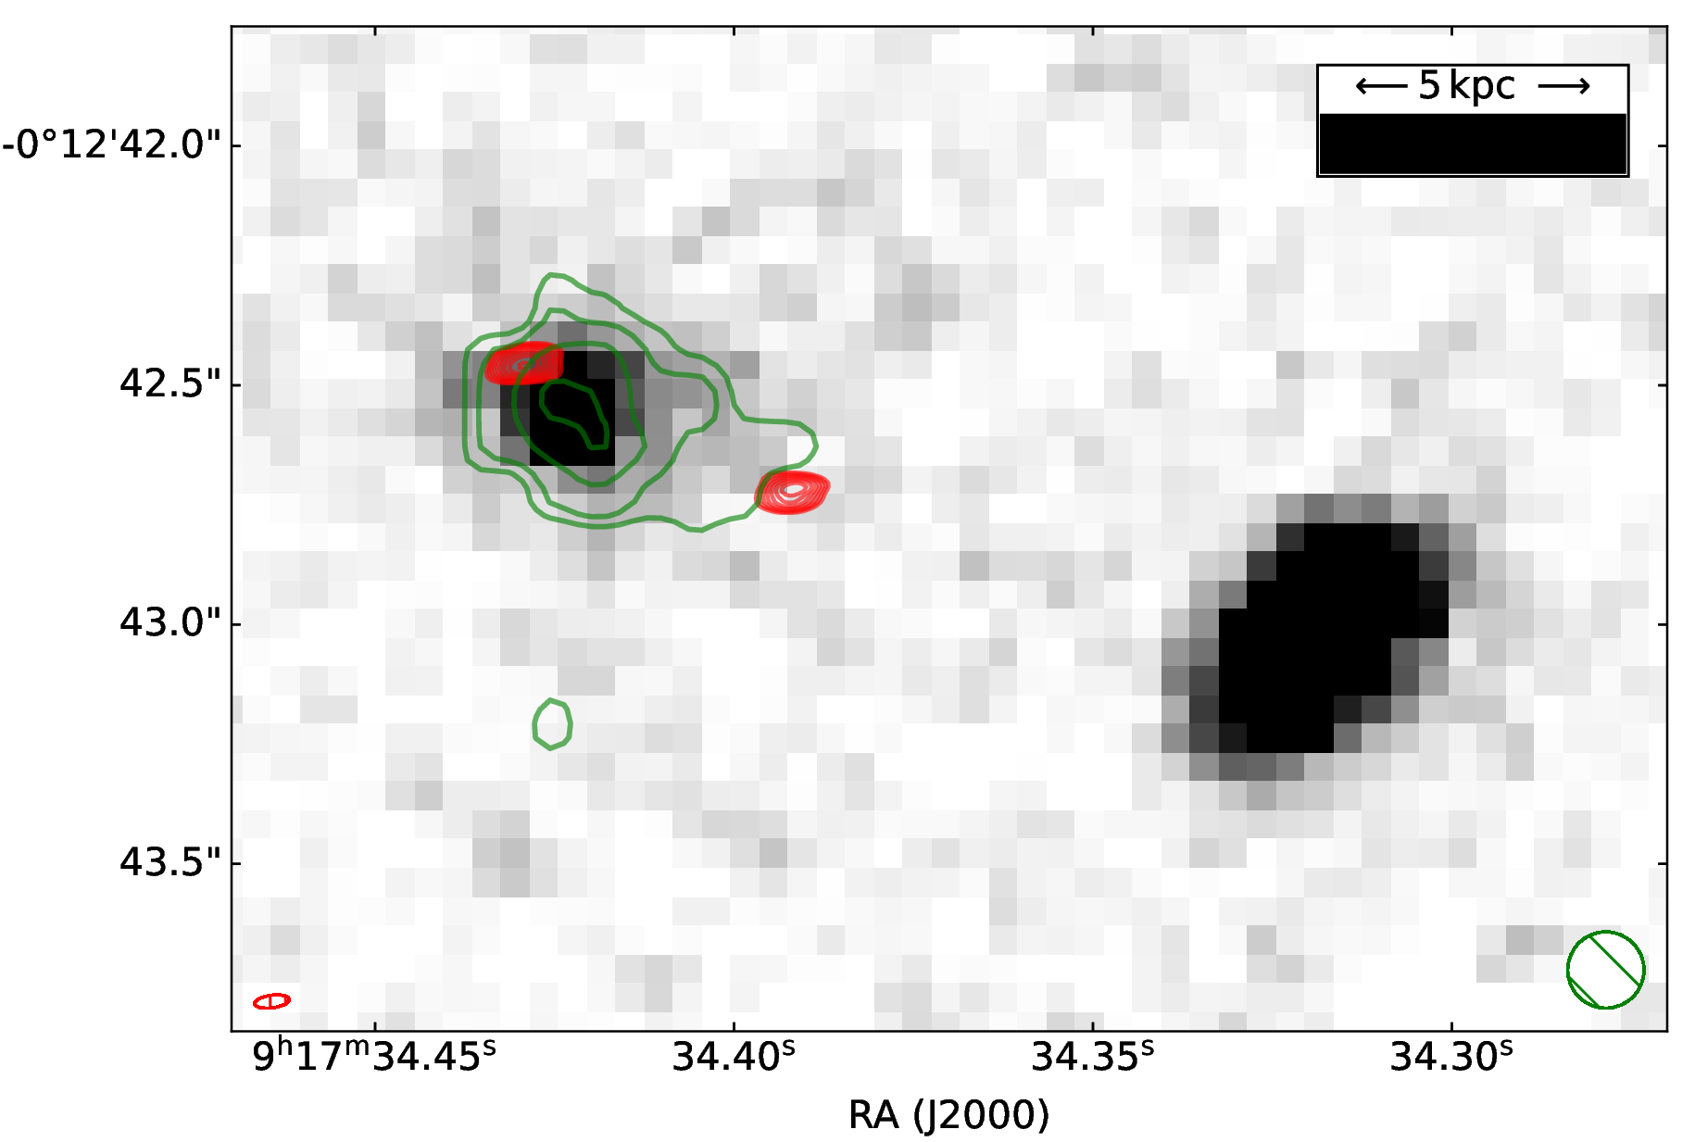
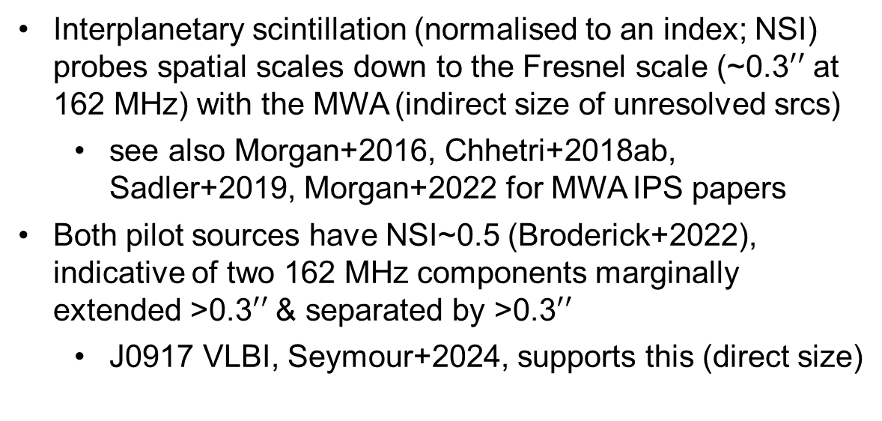
The dream: Turnovers and size constraints
With observed turnovers, size constraints and a redshift, such sources can be compared with the relation in O’Dea, 1998 (intrinsic turnover and linear size)
Can we obtain a prior for the redshift relative to the relation using observed turnover and angular size alone?
Interplanetary scintillation (normalised to an index; NSI) probes spatial scales down to the Fresnel scale (~0.3$′′$ at 162 MHz) with the MWA (indirect size of unresolved srcs)
  see also Morgan+2016, Chhetri+2018ab, Sadler+2019, Morgan+2022 for MWA IPS papers
Both pilot sources have NSI~0.5 (Broderick+2022), indicative of two 162 MHz components marginally extended >0.3$′′$ & separated by >0.3$′′$
  J0917 VLBI, Seymour+2024, supports this (direct size)
Seymour+2024
Notes:
We explore these as potential candidate high-redshift radio galaxies that can be selected or inferred from broadband radio SEDs that extend to <50 MHz.

Slide 11
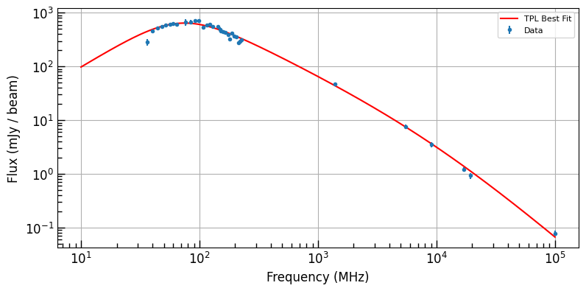
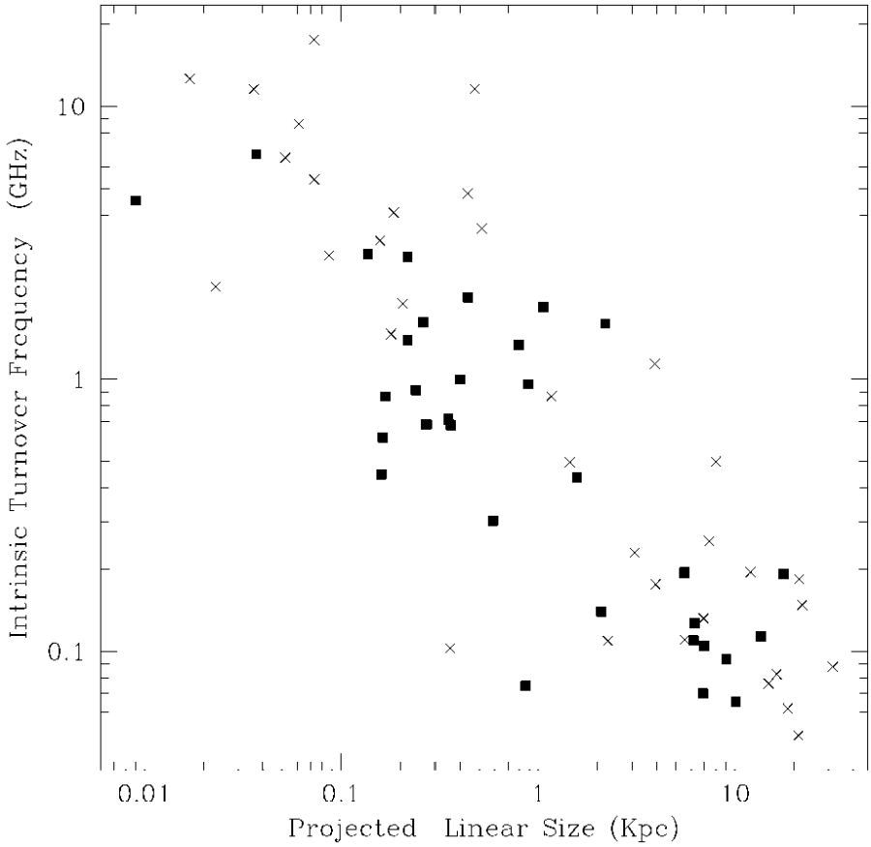
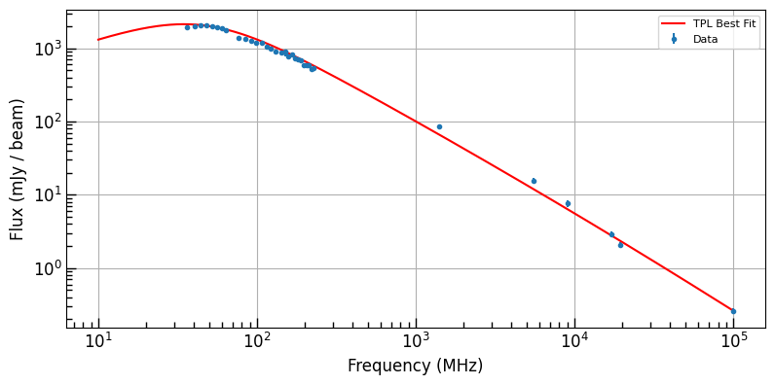
The dream: Turnovers and size constraints
Very clear turn-overs for the selected pilot HzRGs (as intended)!
Mostly in-line with O’Dea relation (promising)!
J0917 (z=3.00)
Observed turn-over @ 69 MHz
(276 MHz rest-frame)
J0856 (z=5.55)
Observed turn-over @ 45 MHz
(295 MHz rest-frame)
O’Dea 1998, adapted
Notes:
We explore these as potential candidate high-redshift radio galaxies that can be selected or inferred from broadband radio SEDs that extend to <50 MHz.

Slide 12
Summary
GLEAM-selected low-frequency (< 70 MHz) features validated by LOFAR LBA
Many sources in LOFAR LBA field of view also rich in spectral information
Future widefield VLBI campaigns + low-frequency turnovers to give radio redshift priors? (Pilot sources show potential)
  Especially useful for sources with undetected host galaxies
  Leverage the strengths of widefield radio, like how optical/IR leveraged deep fields and pushed to higher redshifts
Useful lessons for reducing at < 100 MHz with PiLL
DUG helped get the job done!

