Slide 1
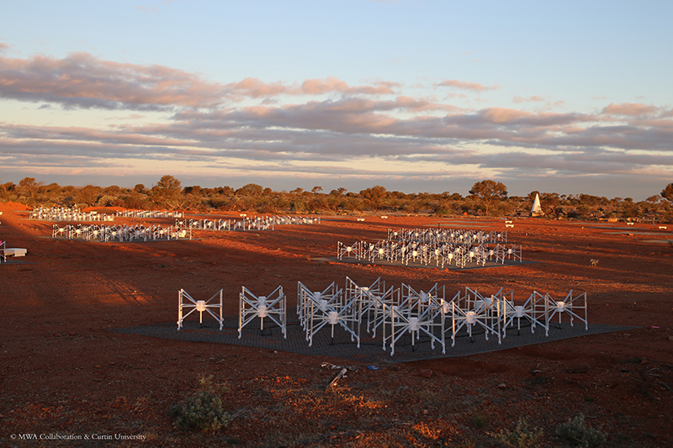
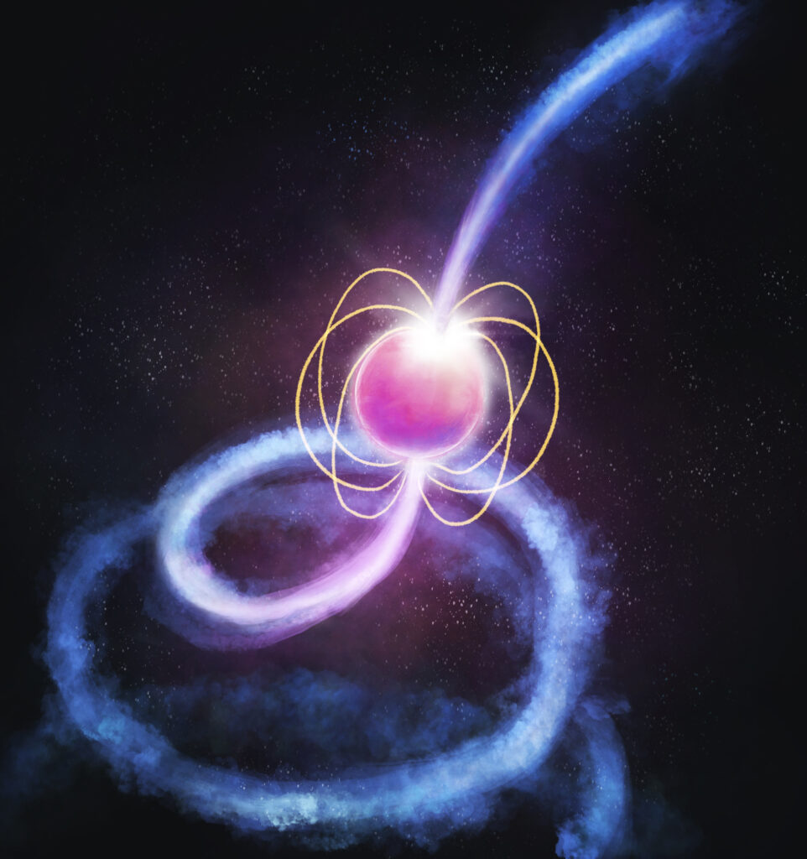



Pulsars and Fast Transients: Science Updates & Forward Look
Ramesh Bhat
The Pulsars & Fast Transients SWG
The MWA 2025 Project Meeting, 27-29 August, Perth

Slide 2
PFT Science with the MWA
  For the past ~10 years, PFT (pulsars & fast transients) science utilised the MWA VCS (voltage capture system) + software/processing pipeines that run on HPCs (e.g. Pawsey, OzSTAR/NT, DUG)
  Starting the 2025A semester, MWAX VCS is no longer offered for routine MWA proposals
  Notwithstanding large data rates (28 to 64 TB/hour) and processing challenges, VCS has enabled a decade of productive science spanning across pulsars and fast transients, and provided many opportunities for student/ECR training
  Importantly, VCS has enabled undertaking large projects such as the SMART survey – an all-southern-sky survey for pulsars and fast transients at 140-170 MHz
  Transitioning to the MWAX beamformer (from VCSBeam ➔ MWAXBeam) will open the door to an exciting range of new science opportunities, as we start a new chapter (e.g. monitoring science)
Notes:
SMART survey would not have been possible without VCS!
Ch1 VCS, Ch2 beamformer
Pulsars – nice intro by susmita and silvia

Slide 3
Science Updates from the past year

Slide 4
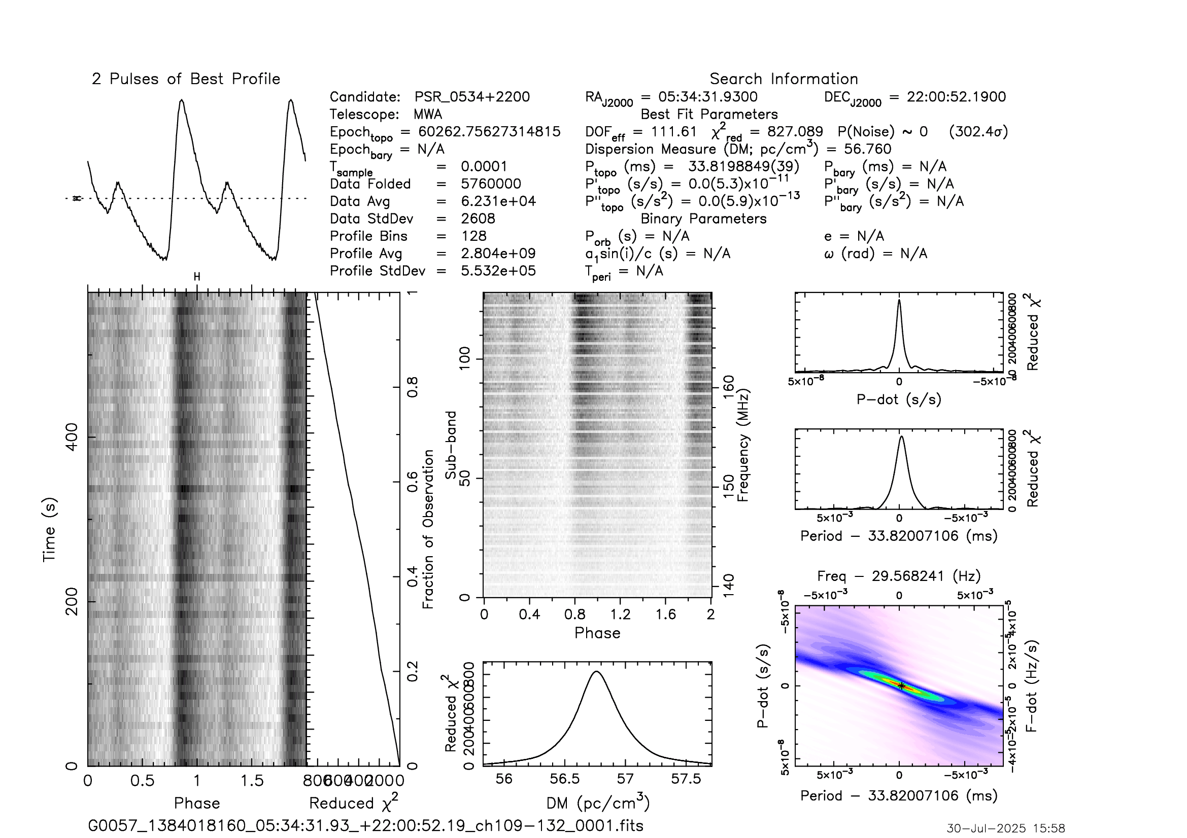
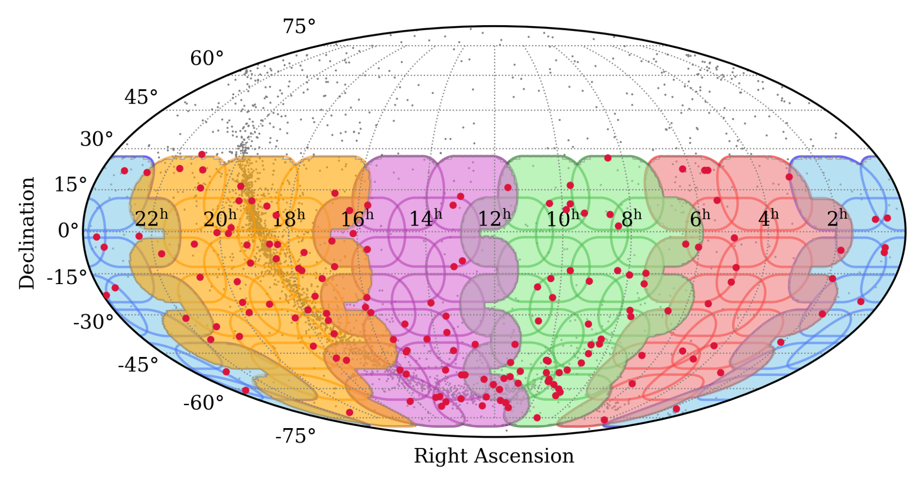
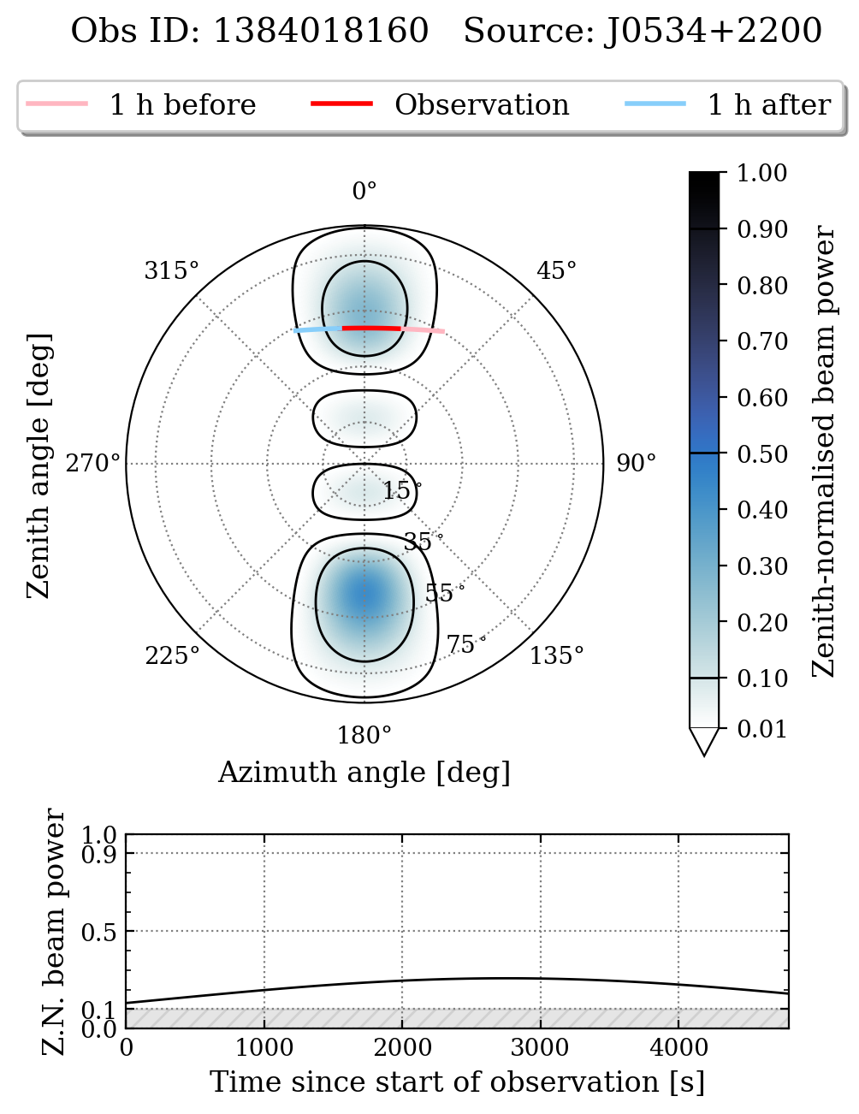
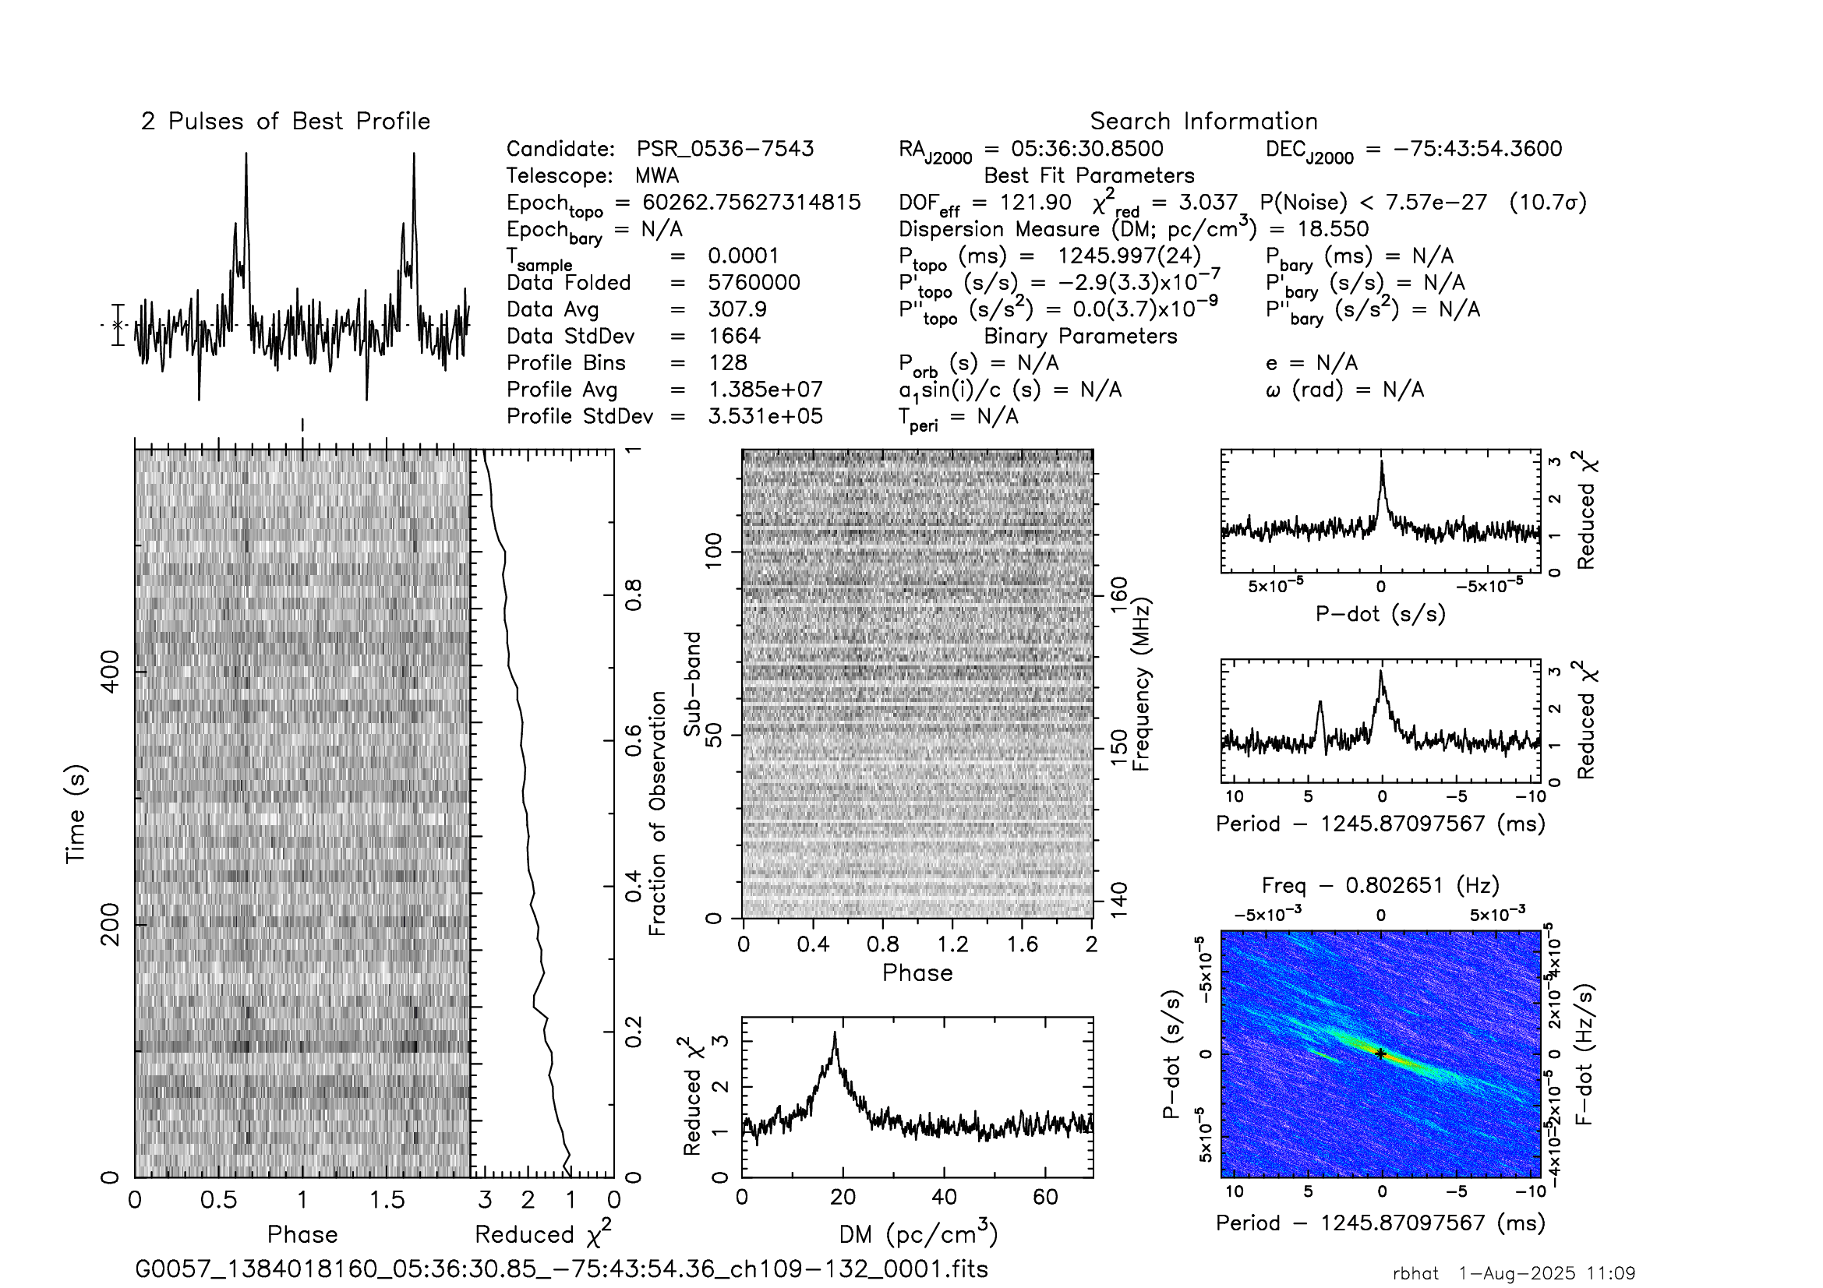
The Southern-sky MWA Rapid Two-metre (SMART) Survey
Detection of the Crab in SCP observation!
An all-sky survey for pulsars and fast transients that leverages the VCS capability and Phase II upgrade (compact configuration)
Detection of J0536-7543 in SCP observation
Data quality checks completed for the last SMART observation (i.e. covering the south celestial pole) – calibration, test pulsar detections all ticked off.
Notes:
Stefan - SCP was not observed or can’t be observed, but we have done it in VCS for SMART
Why would you detect the Crab? Answer is here…. (nice plot from Chris’ software)
But that was not the intent… test pulsar in the beam (edge of the beam!) is seen in 10 min….
So all ticked of….

Slide 5

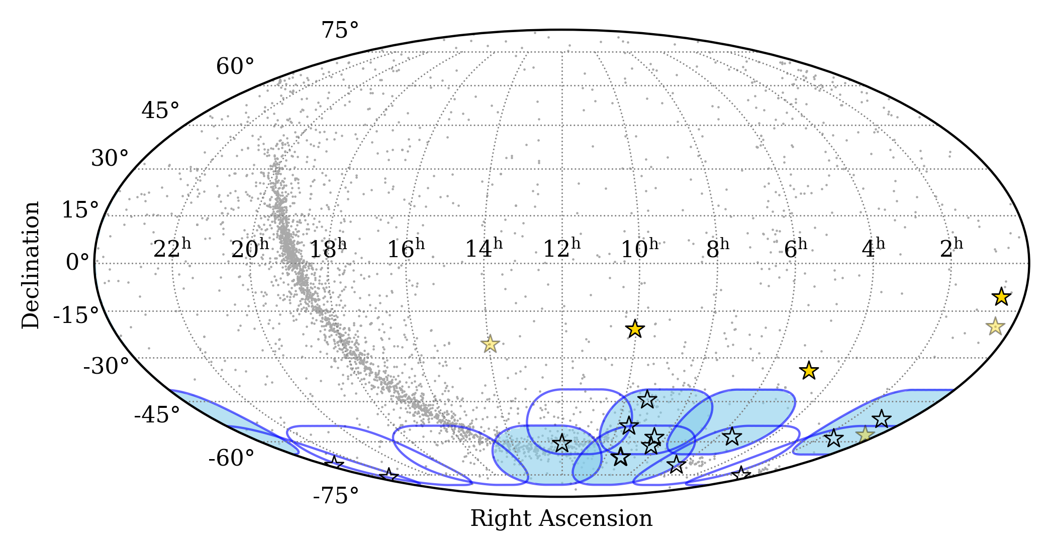
Ramping up Data Processing
Second pass processing commenced in Sept 2024:
Full observation searches, FFT + FFA for periodicity searches, single-pulse (transient) searches, targeted searches for MSPs
See Chia Min’s talk
Filled stars: first-pass discoveries
Unfilled stars: new discoveries
Filled ovals: processed
Unfilled ovals: in progress
Three-fold increase in the new pulsar count after processing < 10% of SMART
use of multiple HPCs (including OzSTAR/NT, DUG, Setonix and CNIC)
Completion of a “southern cap” pulsar survey by the end of the year
Notes:
You will hear from Chia Min in detail on progress with processing and new discoveries….
Gold – first pass discoveries
White stars – second pass ones
3-fold increase in the new pulsar count, some of them are real goodies, stay tuned for chia min’s talk….
Processed only a small fraction so far…. Will leave it to Chia Min and Piyush to delve into the details…
Current focus – completion of a southern cap survey (and includes south pole)

Slide 6
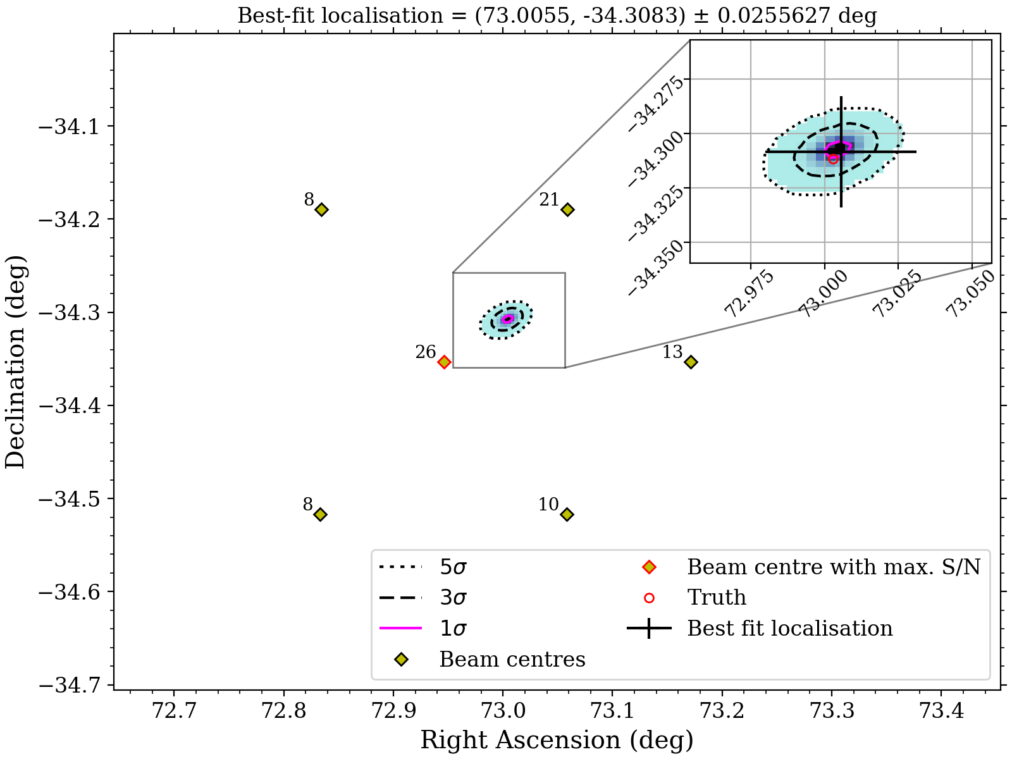
Localisation improvements for
SMART discovered pulsars
Localisation of PSR J0452–3418 (Garvit’s pulsar)
Leverage knowledge of the tied-array beam power pattern on the sky
  Detections in multiple beams of the same pulsar can be used to improve localisation
Complex beam pattern for compact (2 x Hex + core)
Much better precision than the beam width
  For SMART the beam FWHM ~ 24’
Example: PSR J0452-3418
  Precision (3-sigma): 0.9’
  Offset from truth: 0.4’
The true position is within a reasonable best-fit statistic interval.
Meyers & Bahramian (submitted, PASA)
Notes:
Important for initiating follow-up for regular timing observations, and also for follow-up using other telescopes (e.g, GMRT and Parkes) that operate at higher frequencies – we need positions good to at least a couple of arcmin
In the past…. Earlier we used to use a likelihood approach, and in the process stumbled upon problems, so now developing a new method that is more robust and will give us localisation (error) maps – this is work in progress by Bradley and Arash… motivated by SMART needs but the idea is to make this more generic so you can use it for other science applications as well e.g. localise a transient detected in TAB or improve a pulsar position etc.

Slide 7
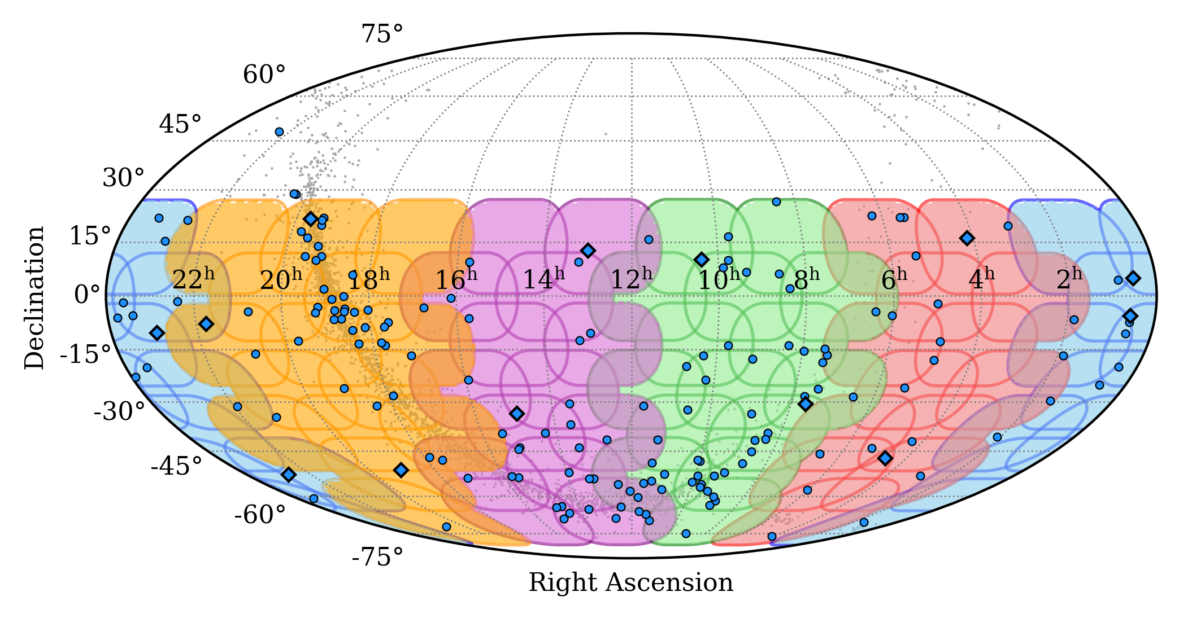
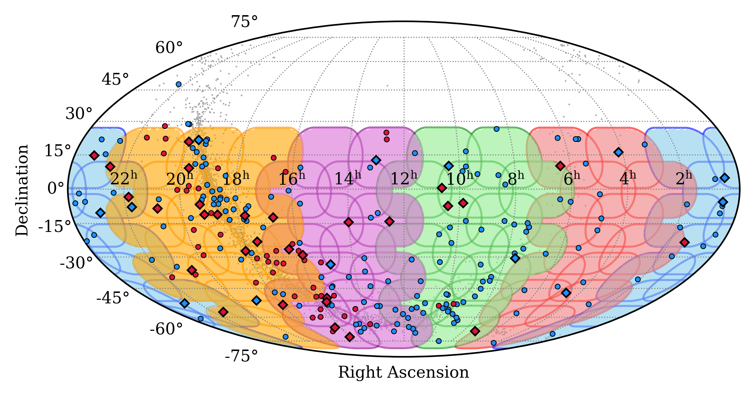
Progress with Data Release
SMART data are also being processed using the VCSbeam + pulsar detection pipelines, to produce a complete catalogue of low-frequency pulsar detections
Blue: pulsar detections in 2023 (Bhat et al. 2023b)
Red: detections in MWAX data + MSP census
Circles: slow pulsars
Diamonds: MSPs
2023
2025
See Chris’ talk on MSP census
Data products: full-resolution, multi-chan profiles, archives, measurements
250+ pulsar detections from the processing so far (cf. 180 in Bhat et al. 2023b)
More than doubled the # of detections from SMART (and includes 40 MSPs!!)
Data release (in papers III and IV): Lee et al. (2025), and Bhat et al. (in prep.)
Notes:
Finding new pulsars and doing science with them is the primary goal of SMART
But SMART data is also like a digital record of the entire sky so we can also use it to make a low frequency catalogue of pulsar detections
In smart paper II we reported 180 pulsars
Here is an updated plot from Chris, we have gone up to 250+ most from galactic plane
Plan is to make all data products available through data release – will be done in 2 ppaers III by Chris you will hear soon, and paper IV is in prep. We have made excellent progress, hopefully in a couple of months.

Slide 8
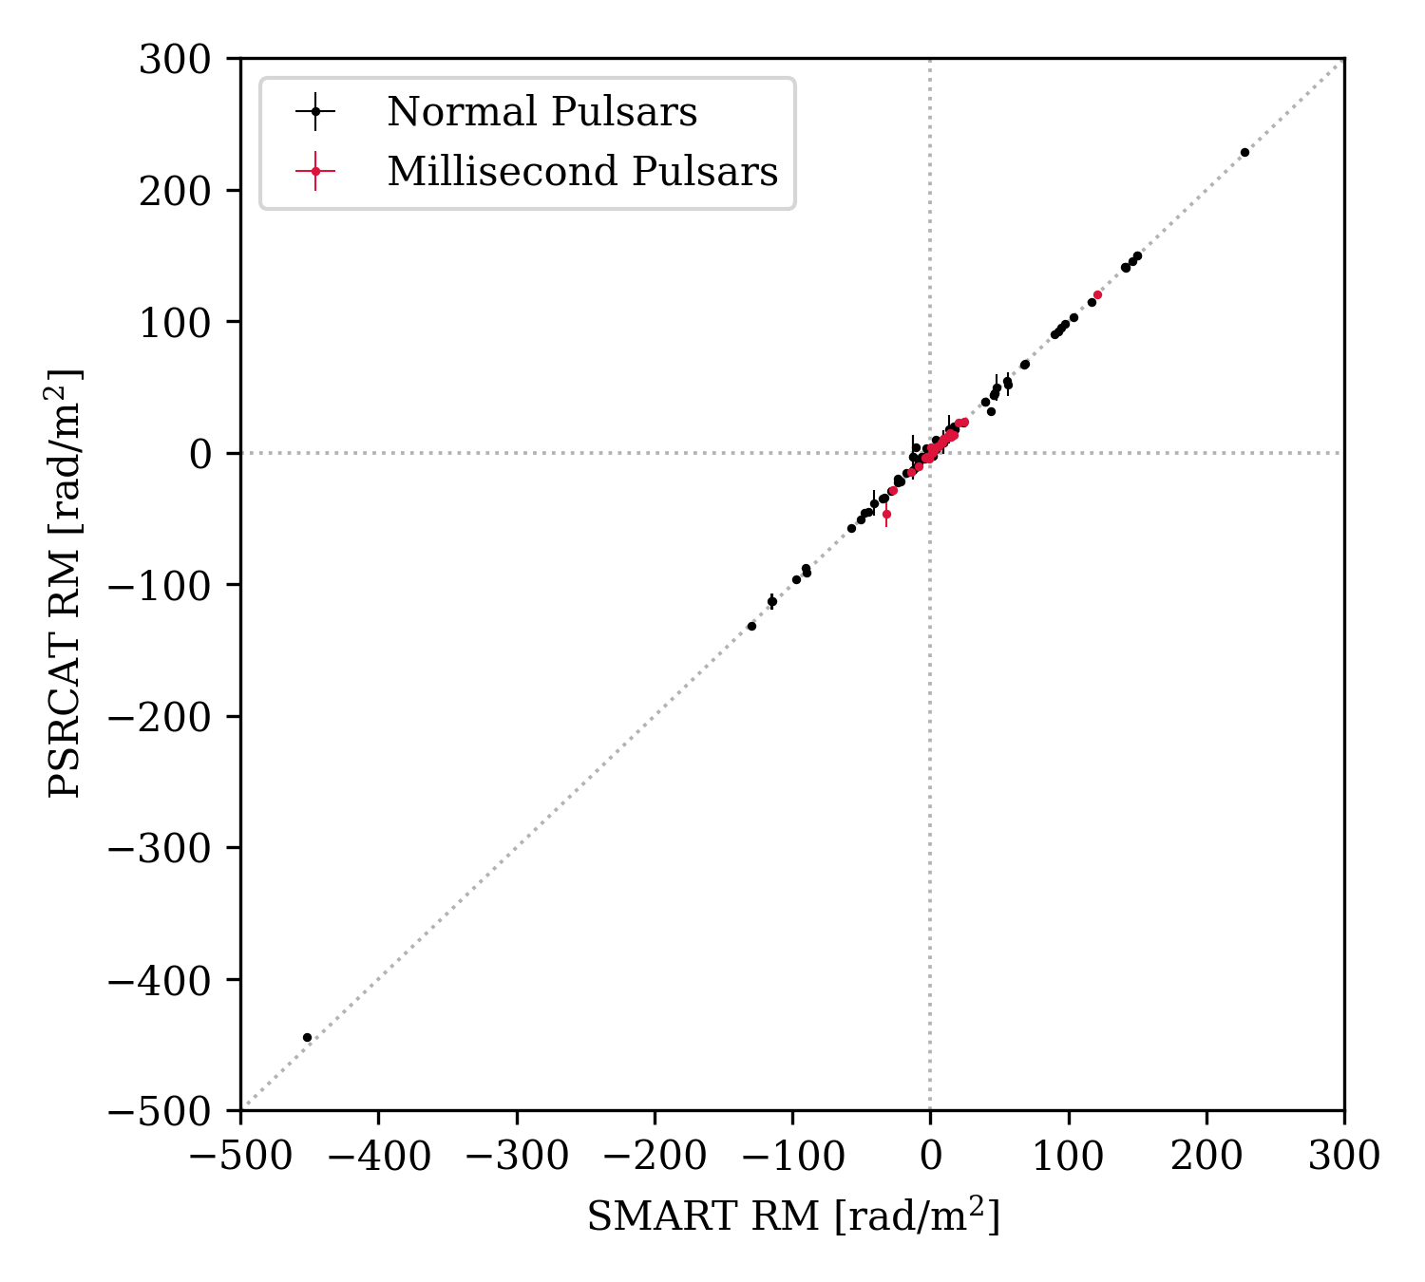
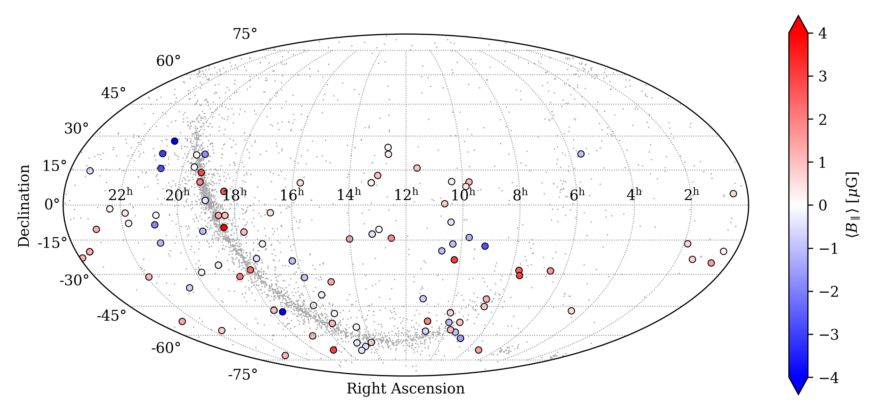
RM measurements from SMART
Precise RM measurements for 97 pulsars, 22 of which are MSPs (cf. Lee et al. 2025)
Notes:
SMART survey – an ambitious project to survey the southern skies at low freq for pulsars and fast transients – first southern sky pulsar in the SKA Low’s band – potentially more sensitive than previous southern surveys
Nicely leverages the combination of a large FoV + VCS, and takes advantage of the compact configuration that was available from time to time….
High efficiency in data collection - < 100 hours opposed to 1000s of hours by other telescopes, but processing cost is substantial, because of the low frequencies, and much finer griding in the search parameter space, e.g,DM
Data collection completed as of last year – we have 4 PB of VCS data that covers the entire sky south of 30 deg, all in VCS mode, and we have at this point has only done a “first pass” (shallow survey) of only a part of the sky….
Even that has been a pretty rewarding exercise, 200+ known pulsars detected at low frequencies, many for the first time, as shown by red dots, and several new pulsar discoveries from a small fraction of data scrutinised….

Slide 9

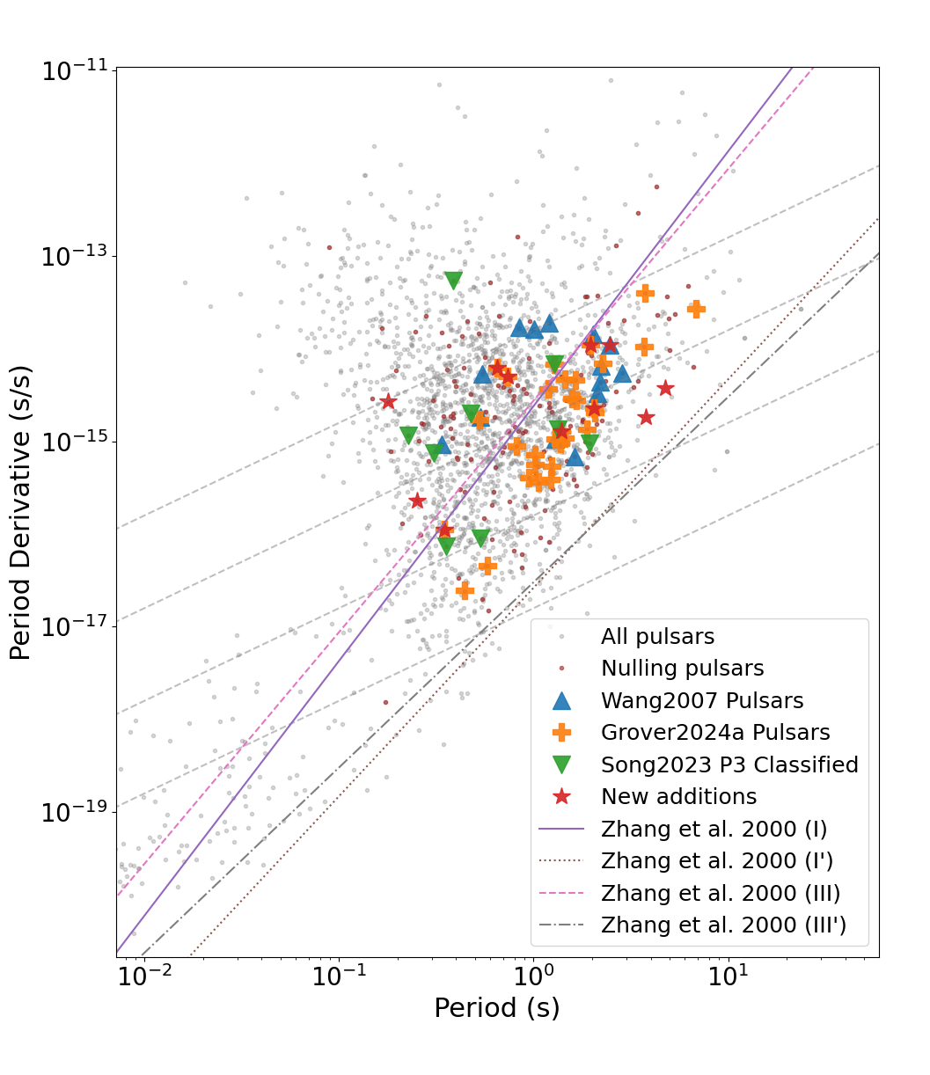
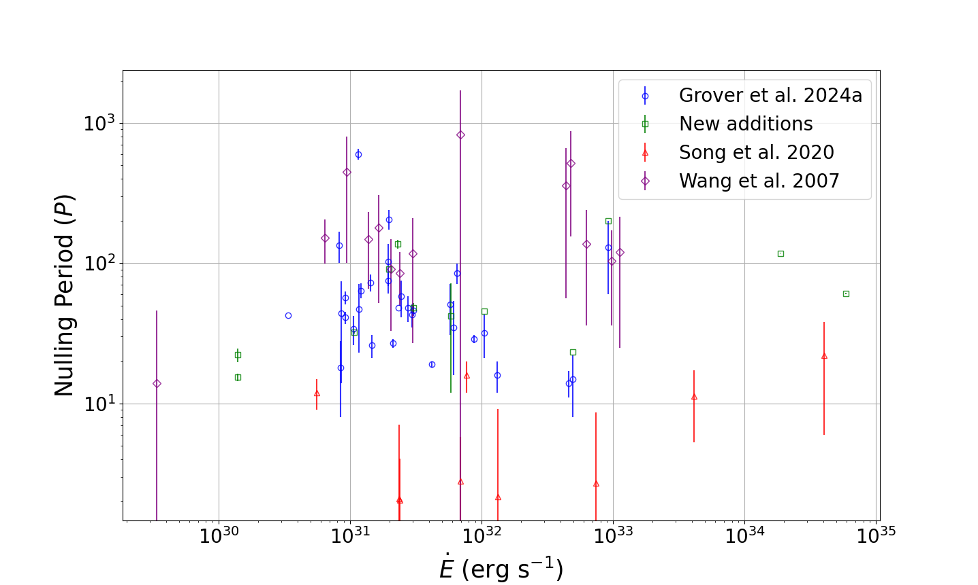
ONs and OFFs in Pulsar Radio Emission
Developed a new method (the Nsum algorithm) for characterizing the nulling phenomenon in pulsar radio emission
Demonstrated to be more robust when observation is limited by S/N
Explored links between nulling/pulsar parameters and “death” lines
Garvit Grover
PhD student (Curtin)
Grover et al. (2025), ApJ (submitted)

Slide 10
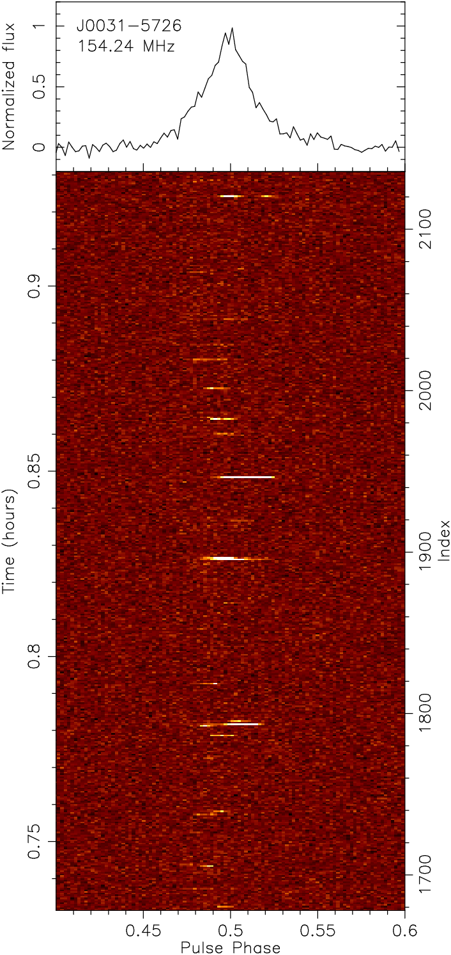
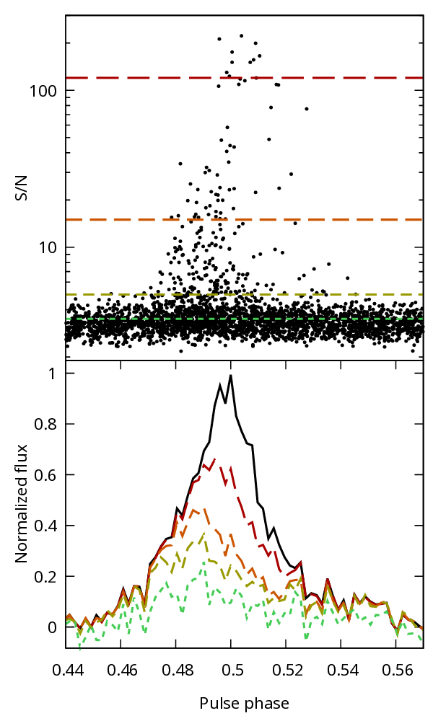
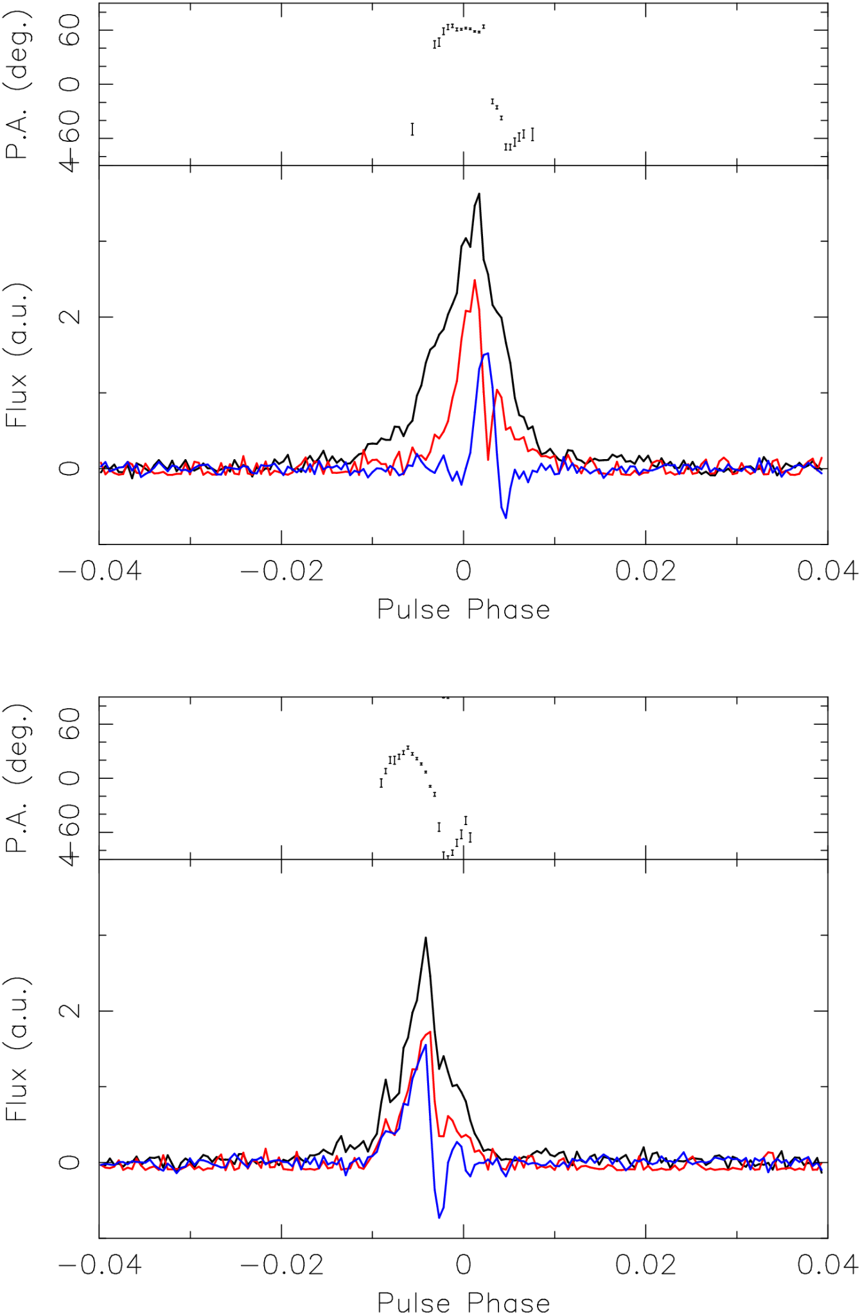
An RRAT-like pulsar discovered in GLEAM-X
PSR J0031-5726
Correlation between pulse brightness and pulse phase
Erratic, strongly varying single pulse polarisation
McSweeney et al. (2025)
Notes:
Things to say about this:
Discovered in GLEAM-X images via its super bright single pulses.
Followed up in SMART and found period ~= 1.57 s, DM ~= 6.8 (SMART would have discovered it, but GLEAM-X processed that part of the sky before SMART did)
Emphasise MWA as a “complete package” – discovered in GLEAM-X images, followed up in SMART + archival VCS.
At first, thought it was an RRAT, but there is faint, persistent emission throughout. Unclear if there is any true nulling.
The unclear distinction between bright vs faint pulses makes quantities like “waiting time” ambiguous.
Brightest pulses arrive preferentially on the trailing side of the pulse window, dimmer pulses on the leading side
Brightest pulses show extremely erratic polarisation, to the point that the integrated profile over 80 minute SMART observation (which is dominated by the brightest pulses) is largely depolarised!
May be some kind of “missing link” between RRATs and normal pulsars
(Will be true by the time this slide is used:) Submitted to [journal] (will confirm later)

Slide 11
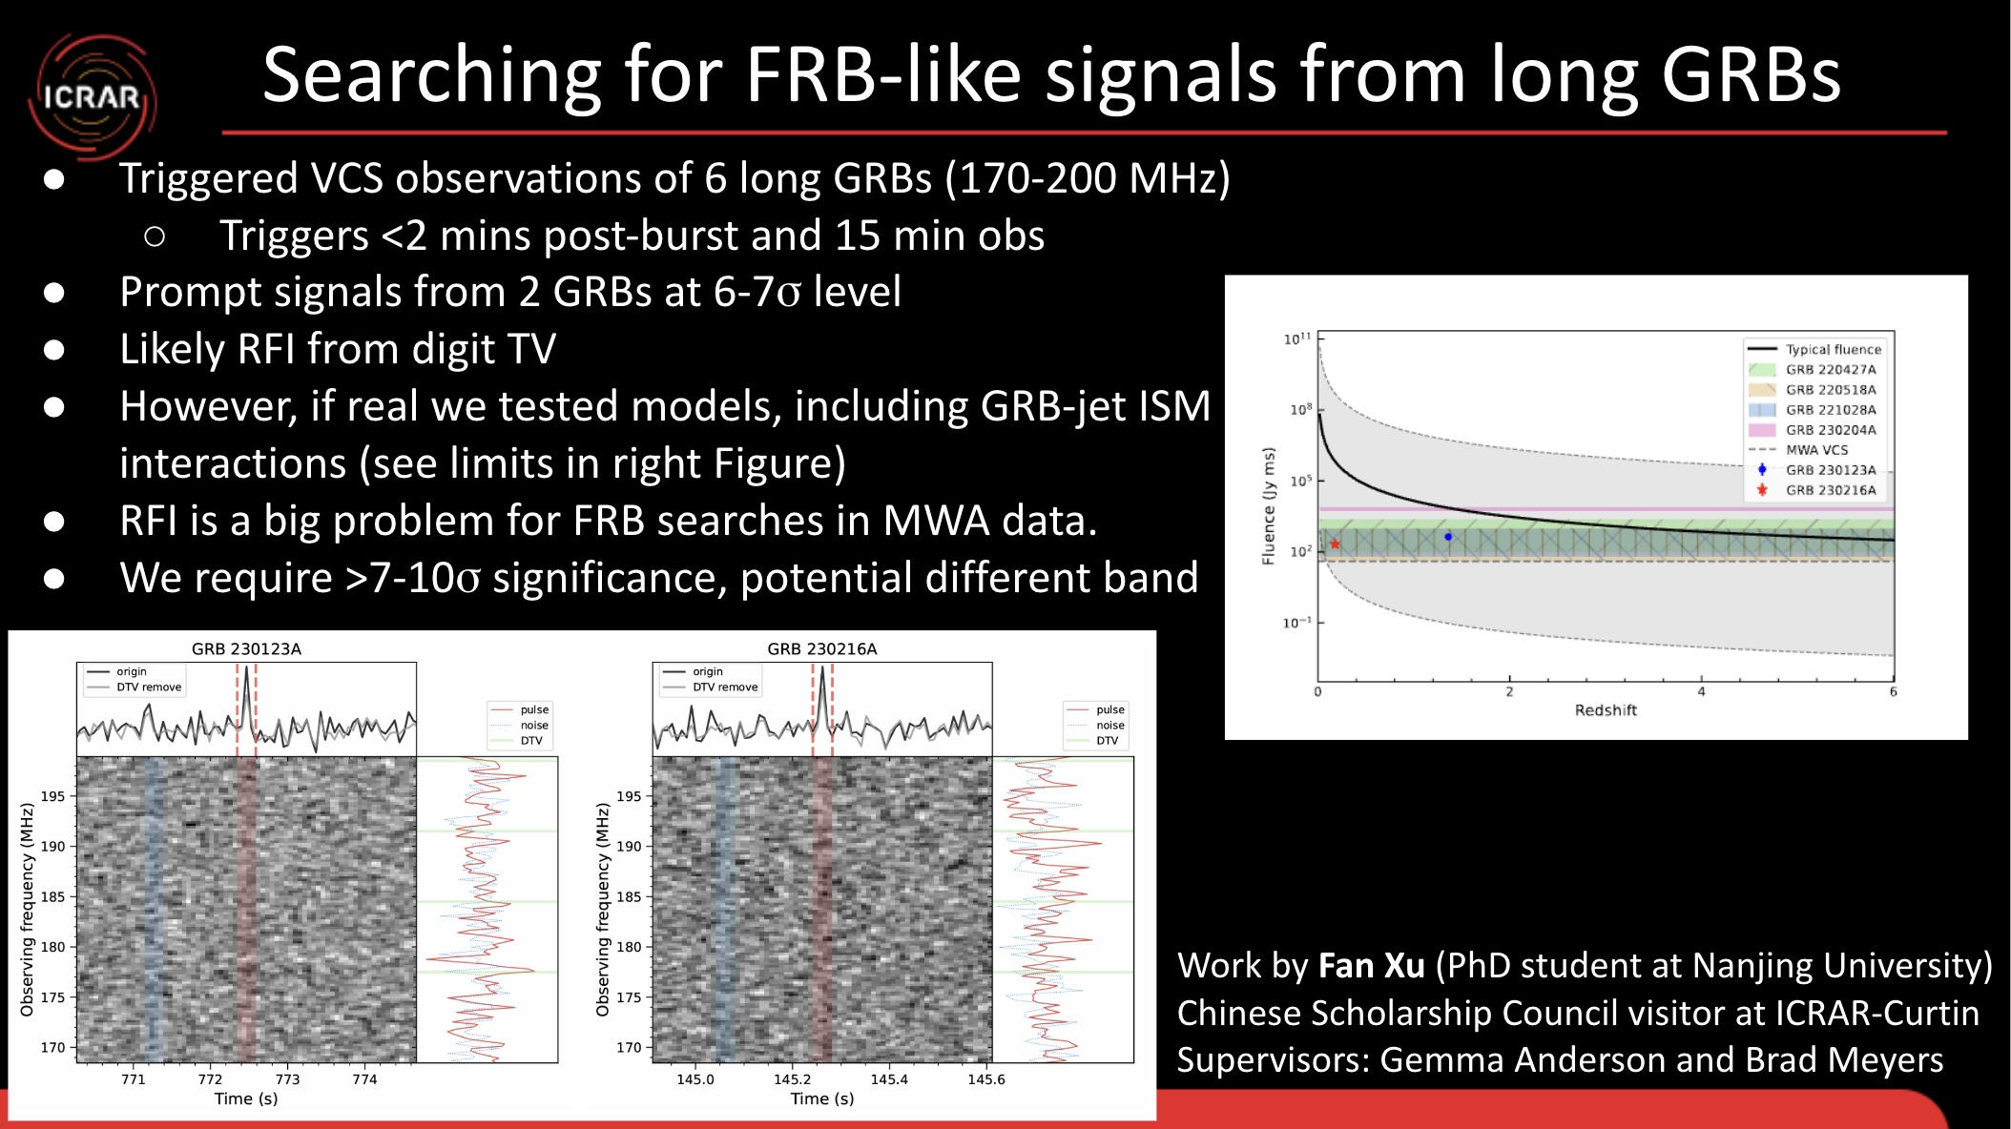
VCS Triggering for GRBs
Xu et al. (2025)
Notes:
We use the VCS to trigger to be sensitive to the expected short timescale signals we are search for
The bottom (left) figure shows the prompt signal candidates. The centre of the DTV RFI bands are shown as green horizontal lines. However, note that these bands are quite broad and actually cover most of the 170-200 MHz observing band (Note we didn’t actually do any DTV signal removal as may be suggested by the figure).
The Right figure shows model b) which is looking for an FRB-like signal from the GRB jet-ISM interaction. The black line shows the expected fluence as a function of redshift for an “average” magnetar (B field and period P) formed from a GRB as directed from the plateau phase of many GRB X-ray light curves. The shaded region shows the range in that distribution.
Shaded colours show the fluence limits we have placed from our VCS triggered observations. We also show the fluence measured from our two pulsed candidates. Their redshift was assume based on their DM.
Latencies are much lower now since optimising the triggering system.

Slide 12

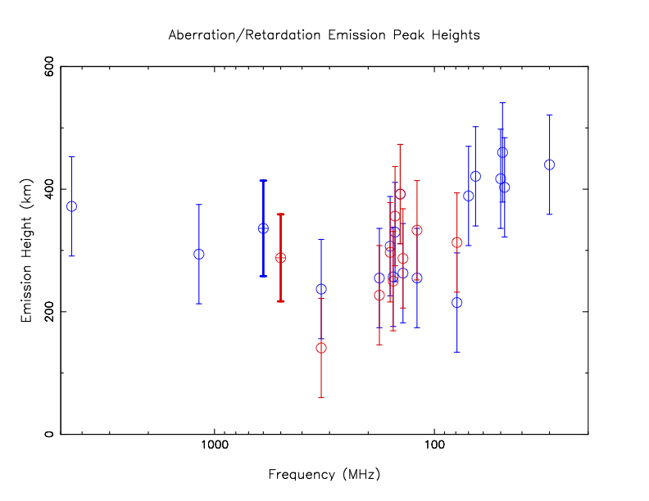
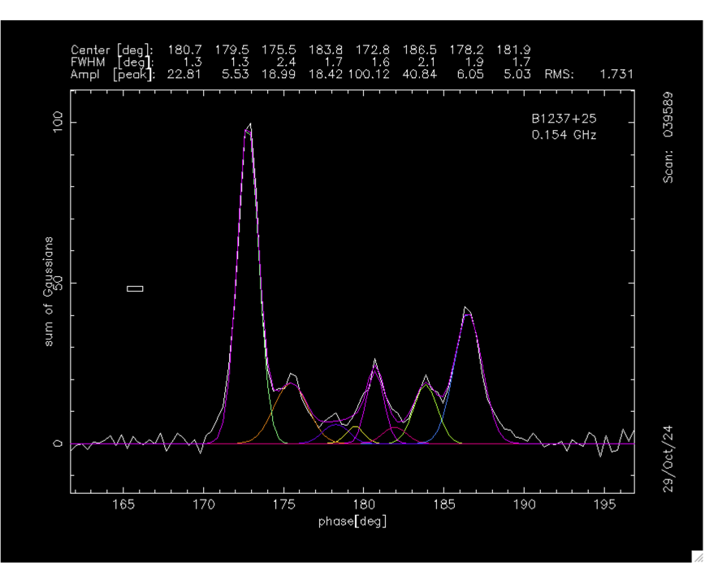
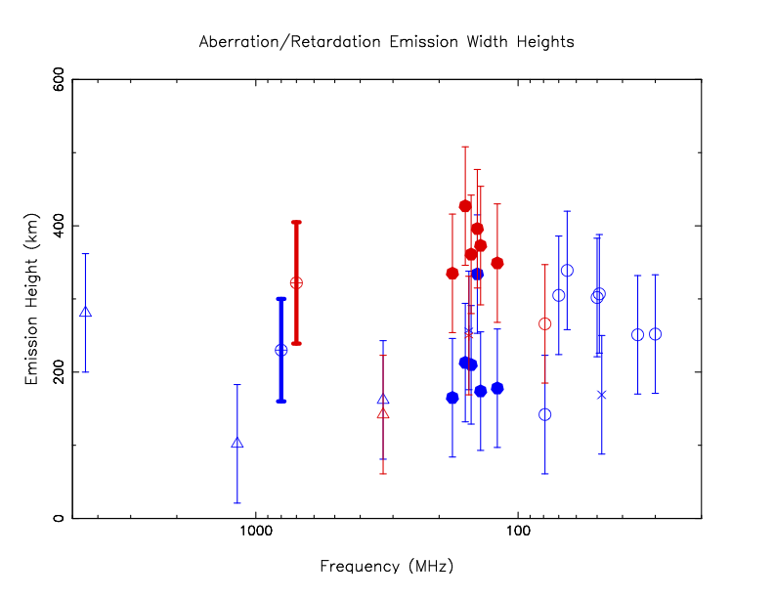
Emission Heights of PSR B1237+25 from Aberration/Retardation effects
Joanna Rankin
Univ of Vemont
Detection from SMART + profile modelling
4.5 GHz to 11 MHz
UTR-2
NenuFAR
LWA
LOFAR
MWA
Arecibo
~200 km to 400 km
Pulsar with a core + double cone profile
G0104 project to extend the freq. coverage, do full profile modelling, for similar analysis of B1451-68 (Rankin et al. in prep.)
Rankin et al. 2025 (MNRAS, submitted)
Notes:
Joanna Rankin, another pulsar expert, who has been in the field since the day 1 of pulsar astronomy, thinks this particular is super interesting,….
Pulsar does nothing (and absolutely nothing unusual ) if you look at single pulse perspective e.g…. See the pulse stack and LRFS on right 2 panels (we can’t get someone like Sammy excited with this…. ) no drifting no nulling…. (and Bradley looked for arcs there is nothing…)
But look at the profiles – top one some ancient data from Parkes (90s) and bottom panel MWA data (from SMART) G0104 to complement SMART and archival obs to cover ~70 MHz to 300 MHz. A paper is in prep….

Slide 13
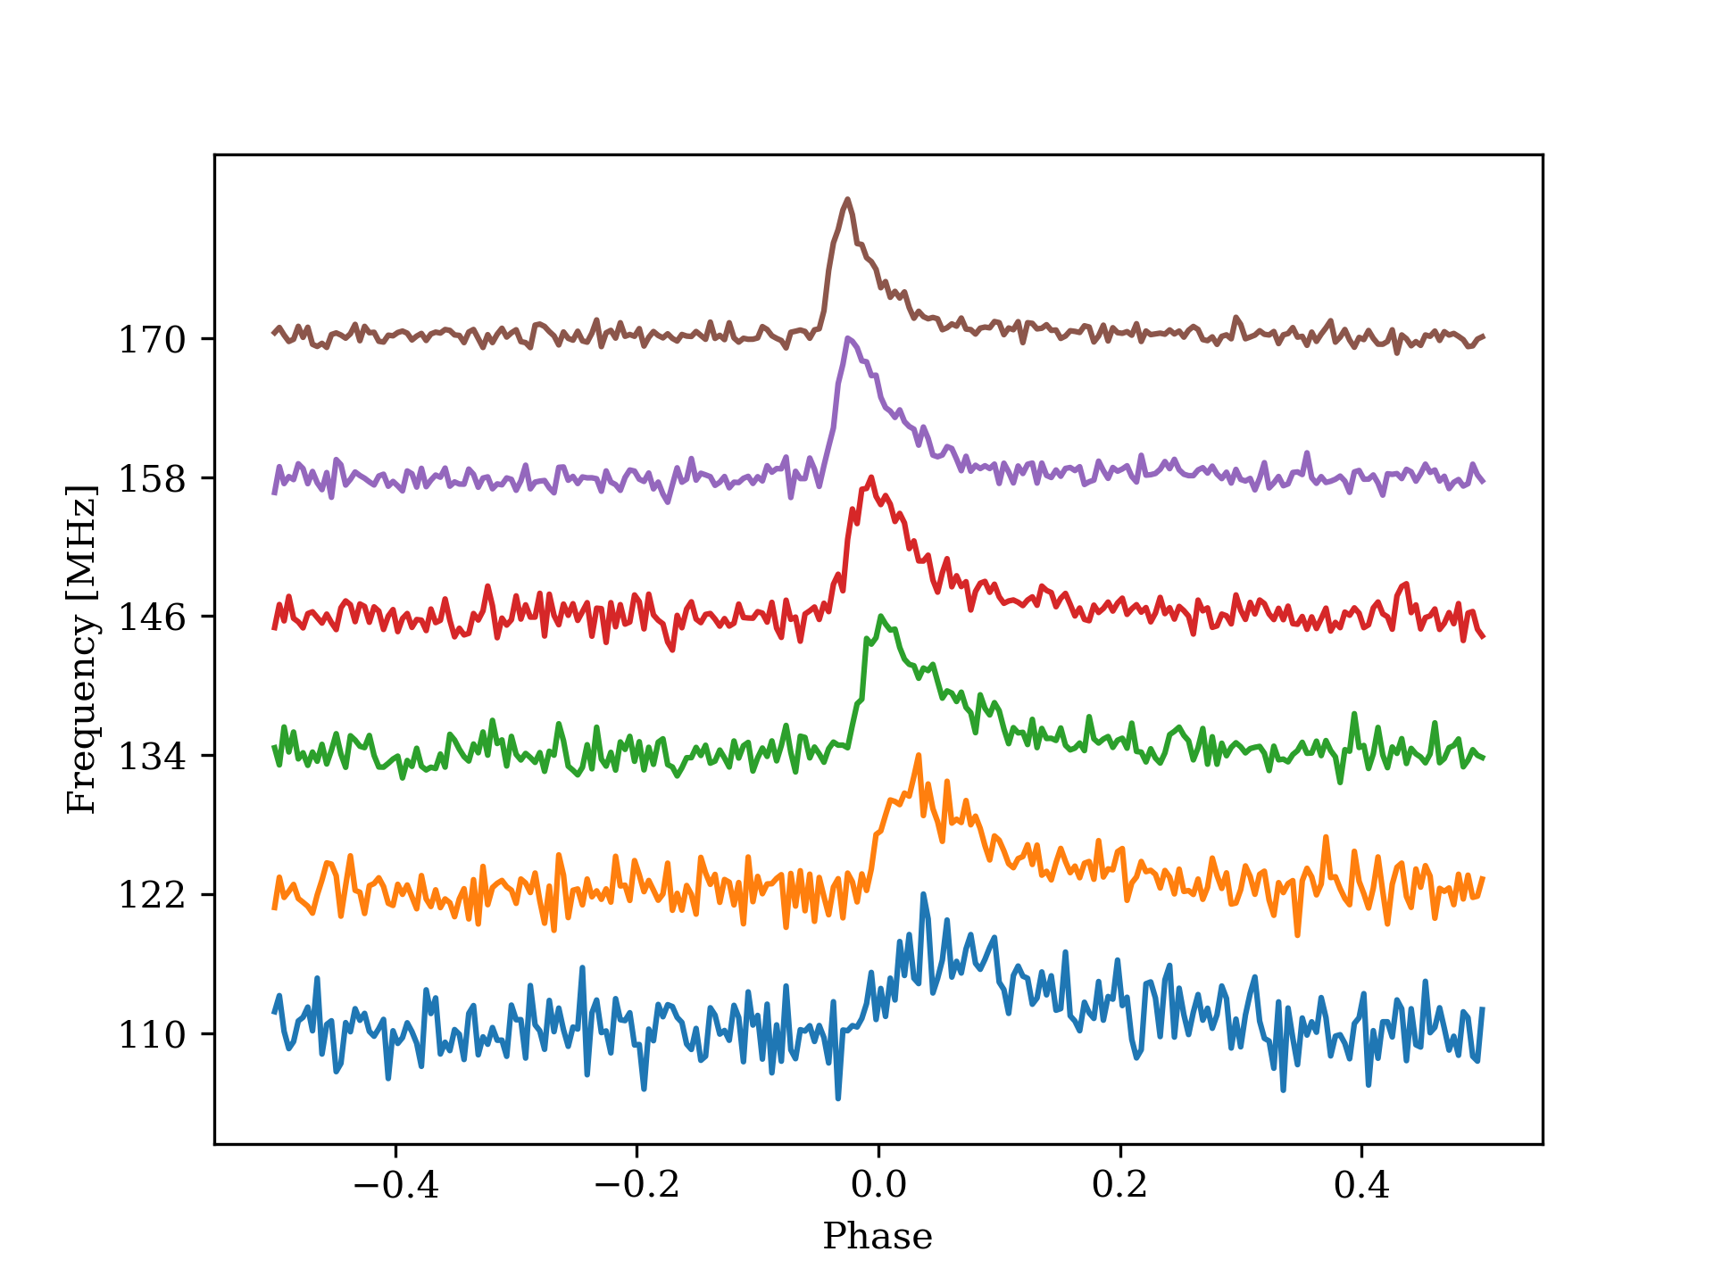


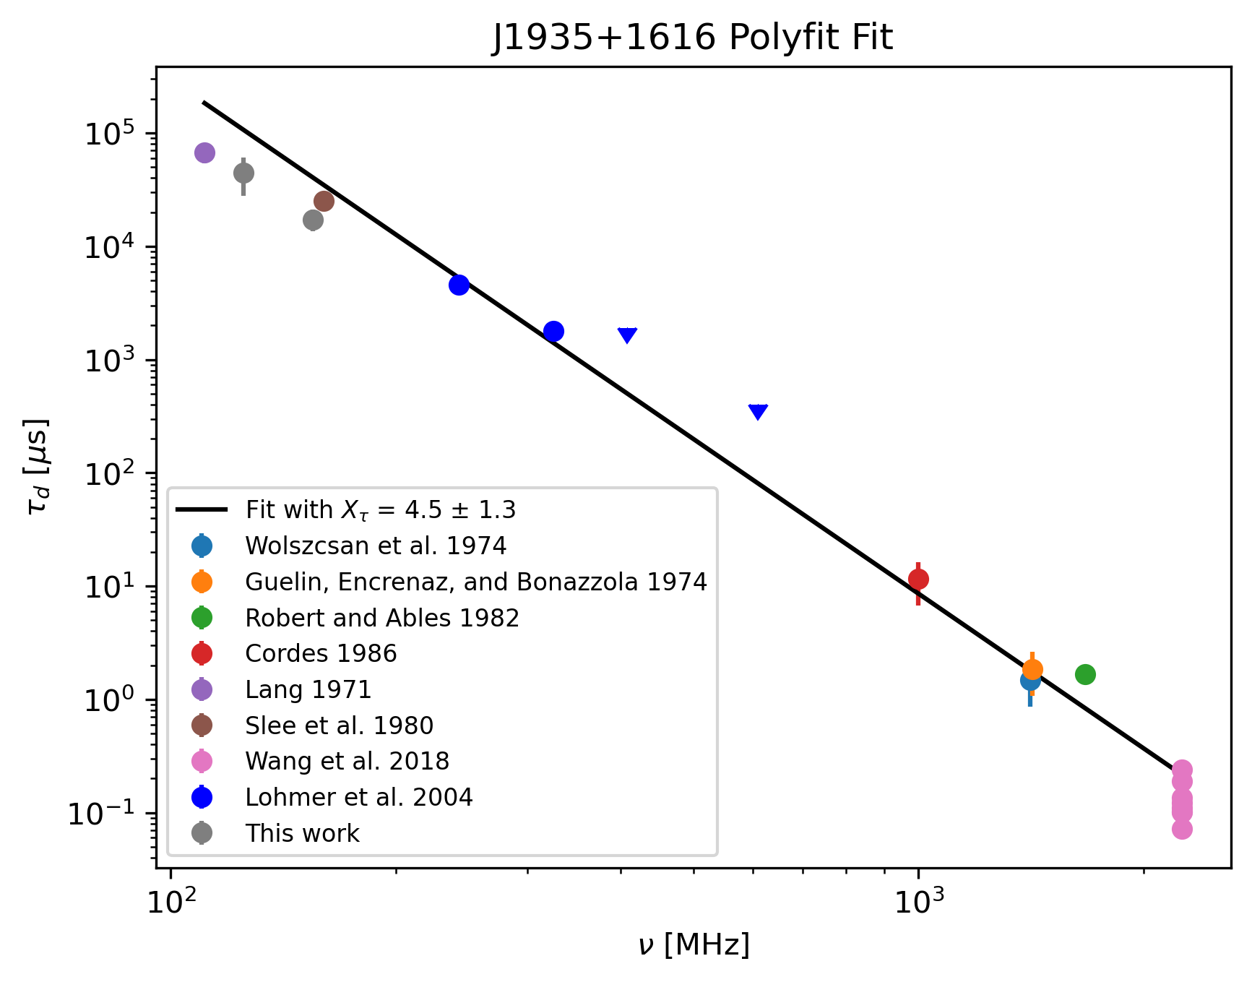
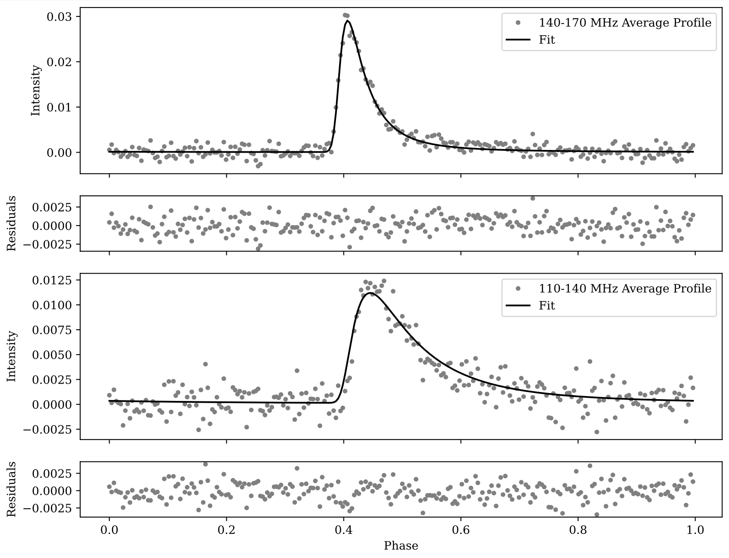
MWA Pulse broadening study of J1935+1616
Multipath due to electron density microturbulence
    A unique tracer of the wavenumber spectrum
    Deleterious for precision pulsar timing (PTAs etc.)
Jim Cordes (Cornell)
Geiger et al. (in prep.)
P=0.36 s DM=158 pc cm⁻³
Abra Geiger
  MWA measurements for better discrimination between PBF models
  G099 project to extend the frequency coverage from 80 MHz to 230 MHz
Consistency with an extended, Kolmogorov medium (with small inner scale) in contrast with the literature

Slide 14
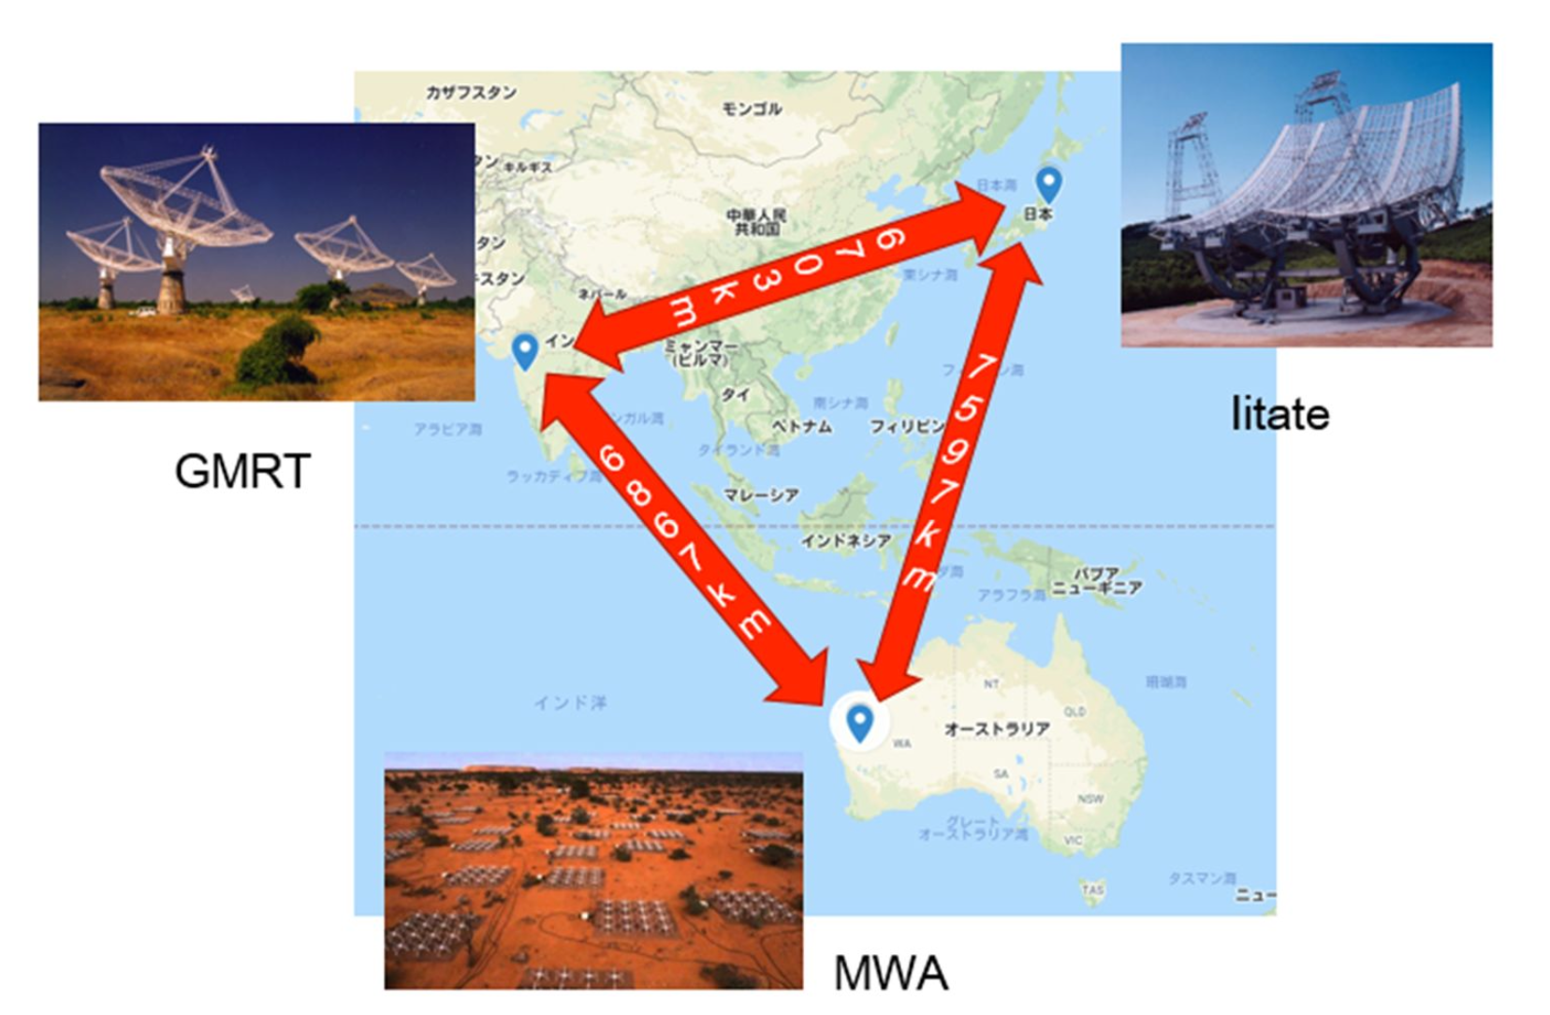
MWA-IPRT VLBI
Collaboration between Australia team and Japan toward low frequency VLBI at < 350MHz
S. Yoshiura, Y. Kono, T. Oyama, H. Misawa, F. Tsuchiya, H. Kobayashi,
K. Niinuma, K. Fujita, K. Takahashi, K. Kurahara, T. Jike,
R. Bhat, B. Meyers, A. Williams, S. Tingay
MWA phase-up beam is key!
Fringe detected
In 2025
Baseline sensitivity ~ 100 mJy
(ΔB=30MHz, Δt = 30s, EL=30°)
Established
in 2017
✅ 1st test observation of 3C273 at 209 MHz in Feb 2025
✅ Quick data check and data format conversion software
➡️ Correlation in Mizusawa VLBI observatory (on-going)
Next test observation @ 180 MHz - 210 MHz (TBD)

Slide 15
PFT Science in the MWAXbeam era

Slide 16
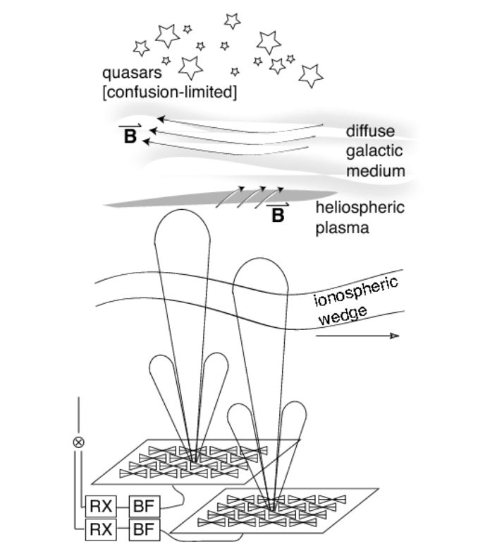

Transition to the MWAX Beamformer
  Transitioning from VCSBeam ➔ MWAXBeam will be a gamechanger for PFT Science
  MWAXbeam (real-time processing/tied-array beamforming) will enable a multitude of new science:
    Targeted pulsar searches (GCs, Fermi targets)
    Monitoring FRBs (e.g. active repeaters)
    Low-frequency VLBI (LAMBDA, SKA-Low)
    Triggering on transients (FRBs, GRBs, GW events)
  Timing new pulsar discoveries from SMART
  Pulsar Monitoring project in support of global PTA efforts (plus a lot of ISM science!)
VCSBeam
16
Notes:
8/28/25
16
16

Slide 17
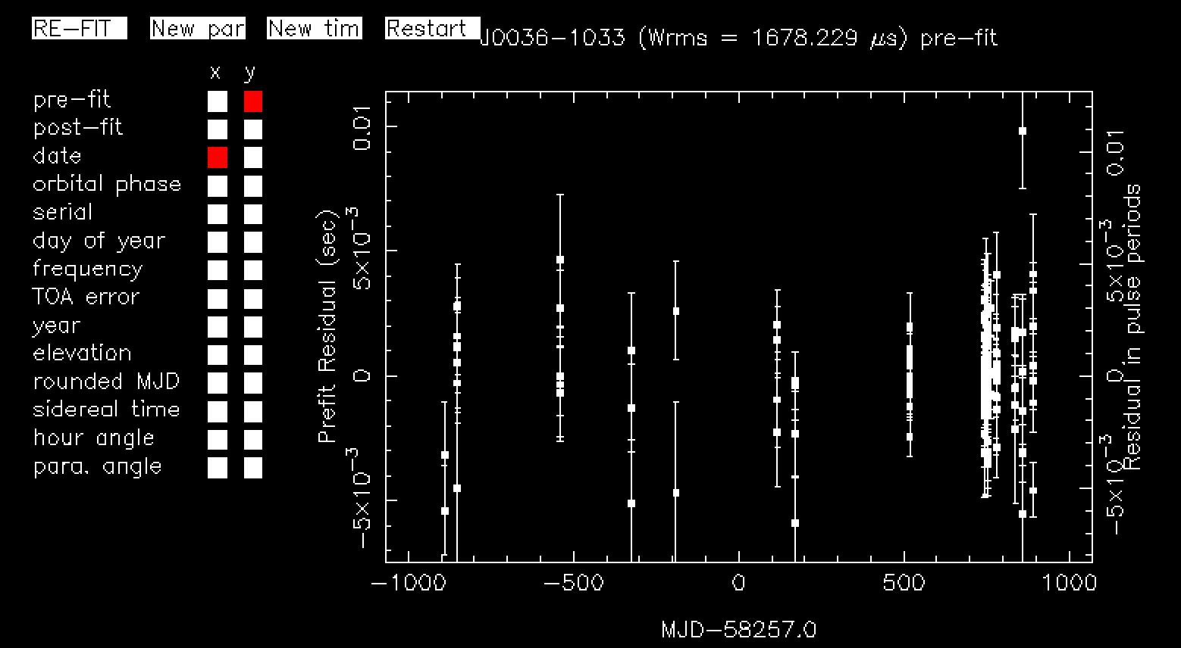
Timing SMART Discoveries
Regular timing observations are critical for new discoveries, for phase connection + coherent timing solution
  Timing solutions – logical next-step for all pulsar discoveries
  Initial phase connection most efficient with discovery telescope (cf. Swainston et al. 2021, for PSR J0036-1033)
  VCS mode is tedious and inefficient to meet target-specific cadence demands (multiple observations per day/week)
  Only 3 (out of 18) SMART pulsars have full coherent timing solutions!
  SMART is starting to discover binary & short-period pulsars (MSPs)
Full coherent timing solution for SMART PSR J0036-1033
MWAX Beamformer functionality will greatly accelerate science from SMART, and publishing timing solutions will facilitate efficient follow-ups with other telescopes
Notes:
SMART survey – an ambitious project to survey the southern skies at low freq for pulsars and fast transients – first southern sky pulsar in the SKA Low’s band – potentially more sensitive than previous southern surveys
Nicely leverages the combination of a large FoV + VCS, and takes advantage of the compact configuration that was available from time to time….
High efficiency in data collection - < 100 hours opposed to 1000s of hours by other telescopes, but processing cost is substantial, because of the low frequencies, and much finer griding in the search parameter space, e.g,DM
Data collection completed as of last year – we have 4 PB of VCS data that covers the entire sky south of 30 deg, all in VCS mode, and we have at this point has only done a “first pass” (shallow survey) of only a part of the sky….
Even that has been a pretty rewarding exercise, 200+ known pulsars detected at low frequencies, many for the first time, as shown by red dots, and several new pulsar discoveries from a small fraction of data scrutinised….

Slide 18
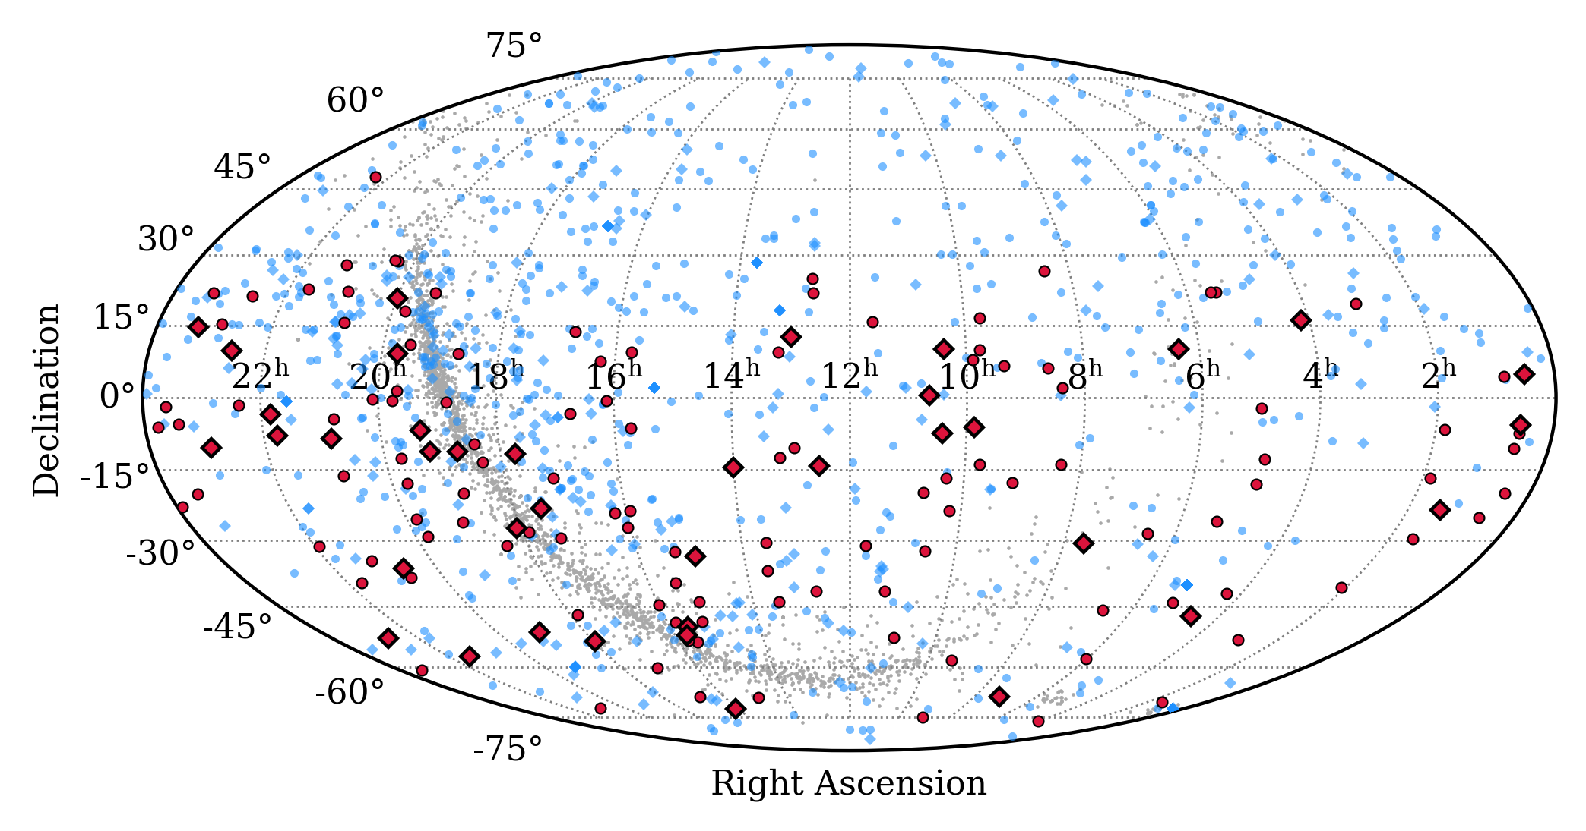
Pulsar Monitoring for PTAs & ISM
Low frequencies + Large FoV + Beamformer ➔ regular pulsar monitoring program to aid international PTA efforts, ISM science, and SKA-Low prep.
  Recent PTA results (2 – 3.5 sigma detections) ➔ ISM noise modelling is very important (see PPTA analysis)
  Characterise the Local ISM (~ 3 kpc) in great detail
  Low frequencies of the MWA are most ideal
  Beamformer functionality will enable regular monitoring of pulsars at PTA cadence
  Large field of view ➔ high observing efficiency (depending on # of simultaneous beams)
  MWA is the only low-frequency capable telescope for southern-sky PTA targets, where the future of PTAs lies in the SKA era
RED: SMART detections in the Local ISM (DM < 60)
Circles: slow pulsars
Diamonds: MSPs
Blue dots: ATNF catalogue
A niche science for Phase III, great value for PTAs + ISM science, publicly accessible data products (e.g. via the Swinburne pulsar portal) – in preparation for PTA GW astronomy in the SKA era.
Notes:
SMART survey – an ambitious project to survey the southern skies at low freq for pulsars and fast transients – first southern sky pulsar in the SKA Low’s band – potentially more sensitive than previous southern surveys
Nicely leverages the combination of a large FoV + VCS, and takes advantage of the compact configuration that was available from time to time….
High efficiency in data collection - < 100 hours opposed to 1000s of hours by other telescopes, but processing cost is substantial, because of the low frequencies, and much finer griding in the search parameter space, e.g,DM
Data collection completed as of last year – we have 4 PB of VCS data that covers the entire sky south of 30 deg, all in VCS mode, and we have at this point has only done a “first pass” (shallow survey) of only a part of the sky….
Even that has been a pretty rewarding exercise, 200+ known pulsars detected at low frequencies, many for the first time, as shown by red dots, and several new pulsar discoveries from a small fraction of data scrutinised….

Slide 19

Summary
  After a decade of productive science and learning (~50 publications, 10 PhD completions), the VCS era (Ch 1 of PFT science) is coming to an end
  Science extraction from SMART will continue to be a top priority in coming years, as we transition to (Ch 2) the MWAX beamformer era
  Search processing and science extraction ramping up (see talks by Chris, Chia Min, Qiuyang, Piyush)
  The MWAX beamformer will open the door to a wide-ranging new science, e.g. longer observations, targeted searches, monitoring projects, etc.
  It will accelerate science with SMART (via timing new discoveries) and will realise a long pulsar monitoring program to aid global PTA efforts and ISM science

