Slide 1



Improving pulsar search efficiency in next-generation pulsar surveys with artificial intelligence
Speaker: Qiuyang Fu
1
1
2
Qiuyang Fu, Mengyao Xue , Weiwei Zhu , N. D. R. Bhat , Kaichao Wu , Zihan Zhang , B. W. Meyers , Chia Min Tan , et al.
1
3
3
2
2
¹ National Astronomical Observatories, Chinese Academy of Sciences
² International Centre for Radio Astronomy Research (ICRAR), Curtin University
³ Computer Network Information Center, Chinese Academy of Sciences

Slide 2
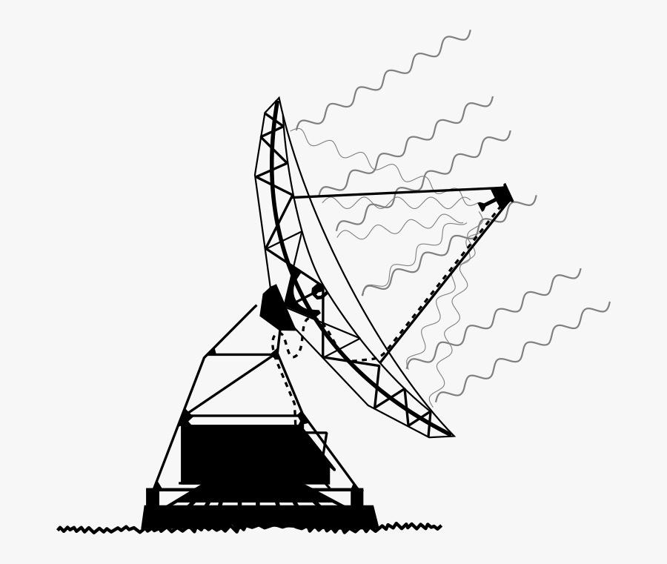
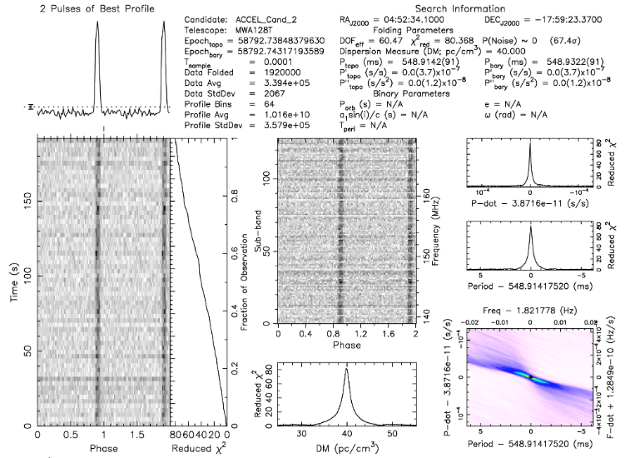
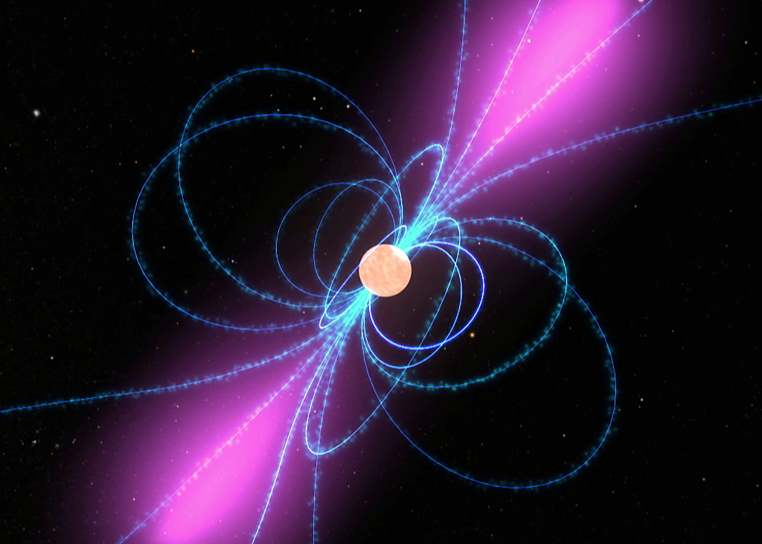

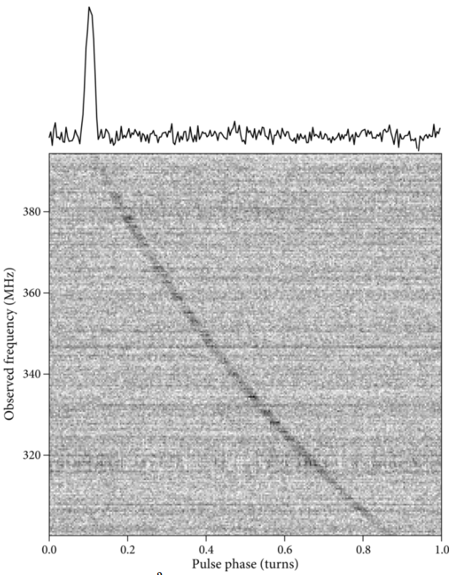
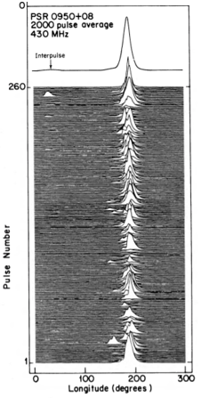
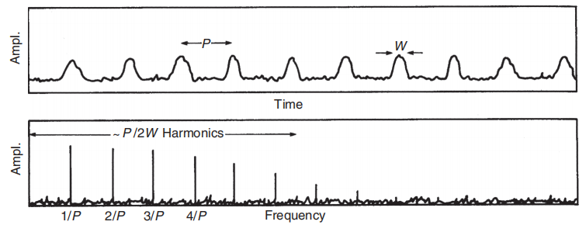
Background
Data
Search algorithm
Pulsar
candidates
sifting
Pulsar
1.Dispersion Measure
2. A single pulse signal is weak
Integrated pulse profiles according to the period
3. Fourier transform
Pulsar period
Credit: Pulsar Astronomy
Credit: Essential Radio Astronomy
Credit: Hankins &Cordes, 1981
01/16

Slide 3
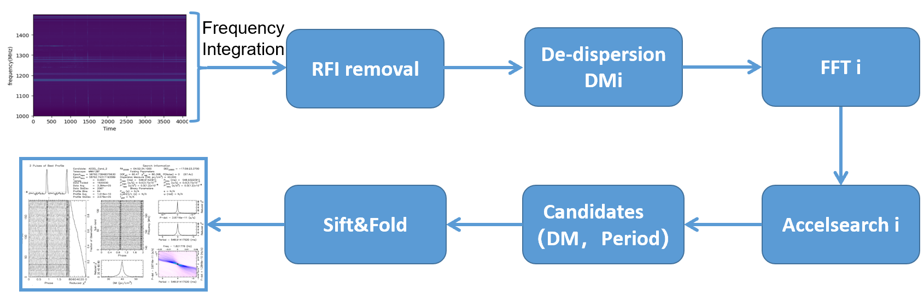

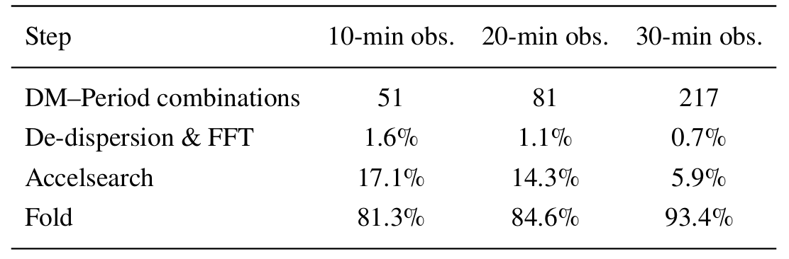
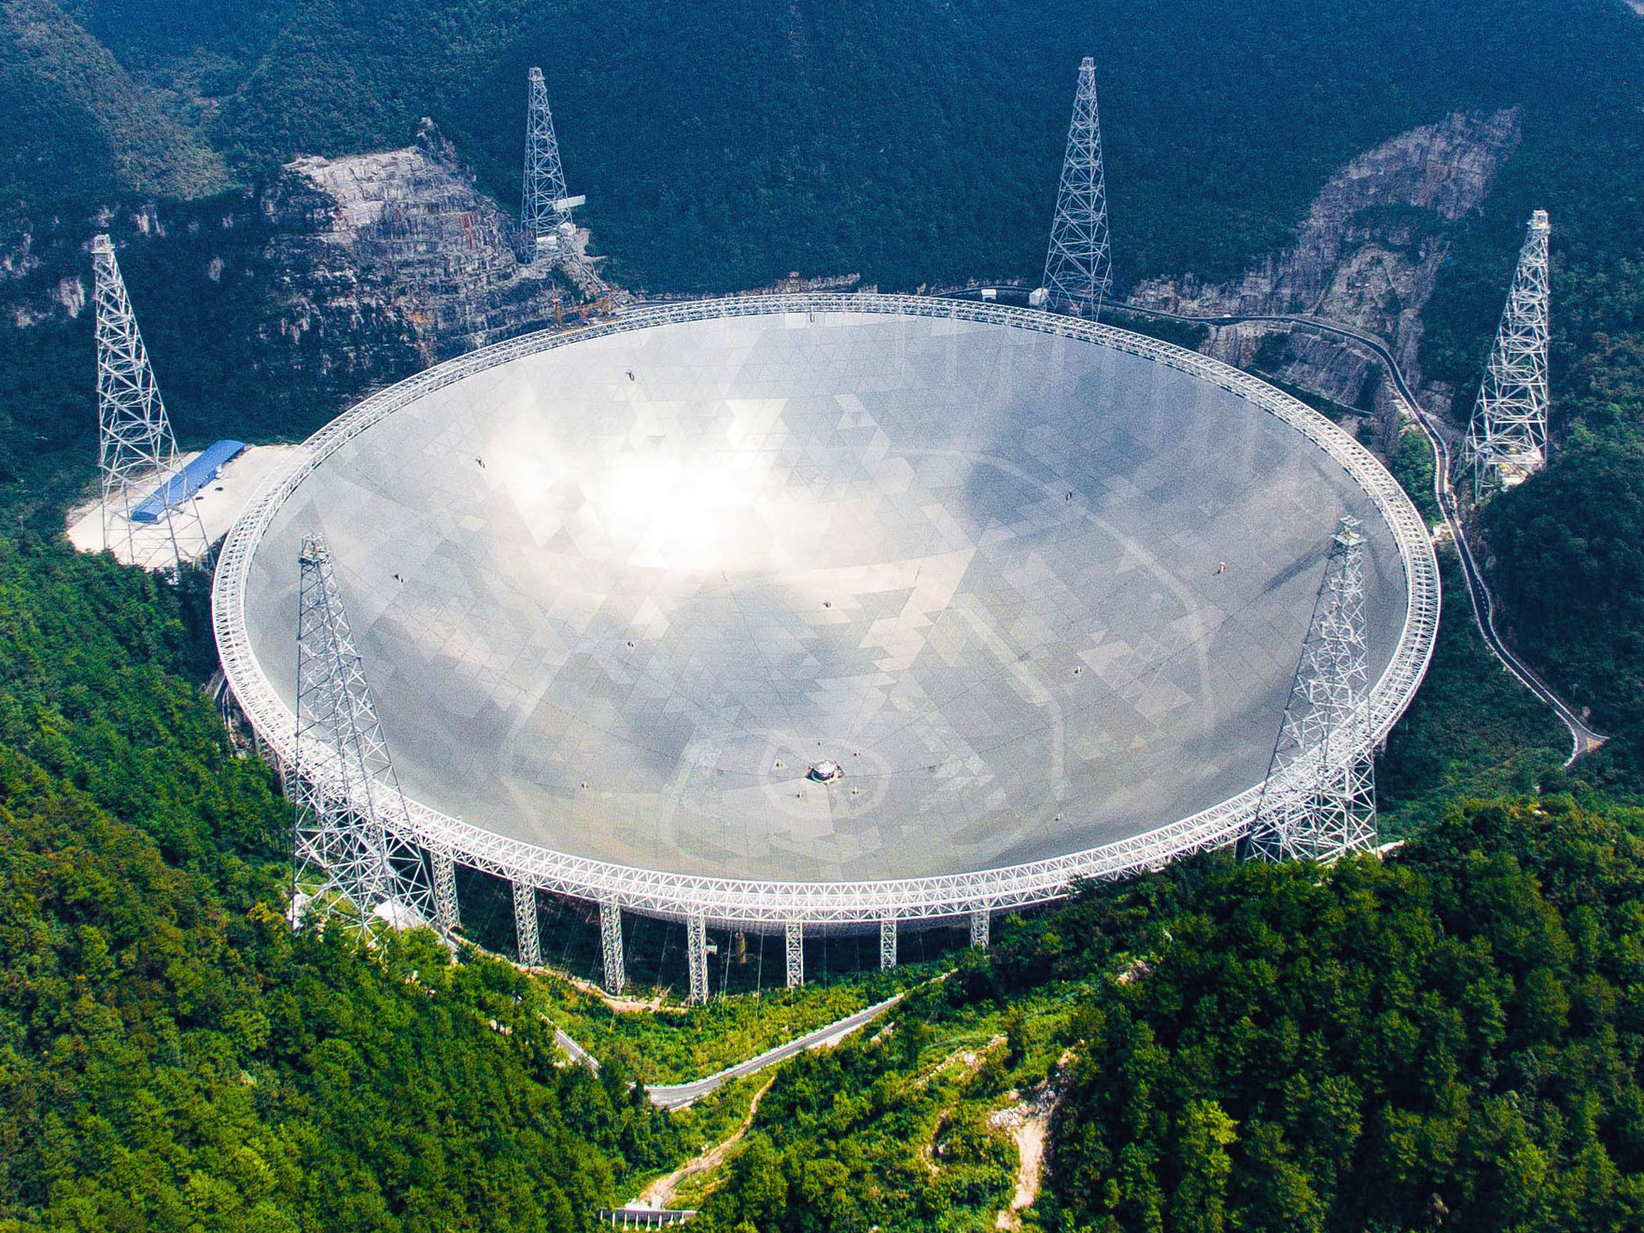

Background
Pulsar blind search time breakdown
FAST
30 minutes of FAST observation data
100 adjacent de-dispersion trials
obs. time DM-period Fold
(Five-hundred-meter Aperture Spherical radio Telescope)
02/16

Slide 4
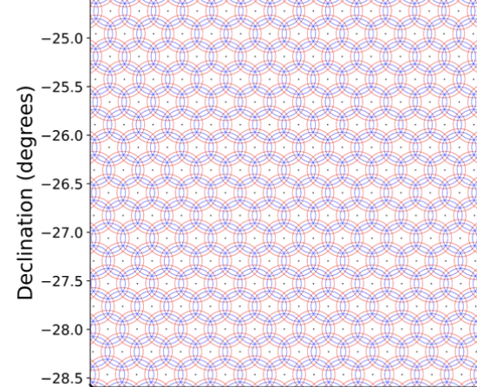
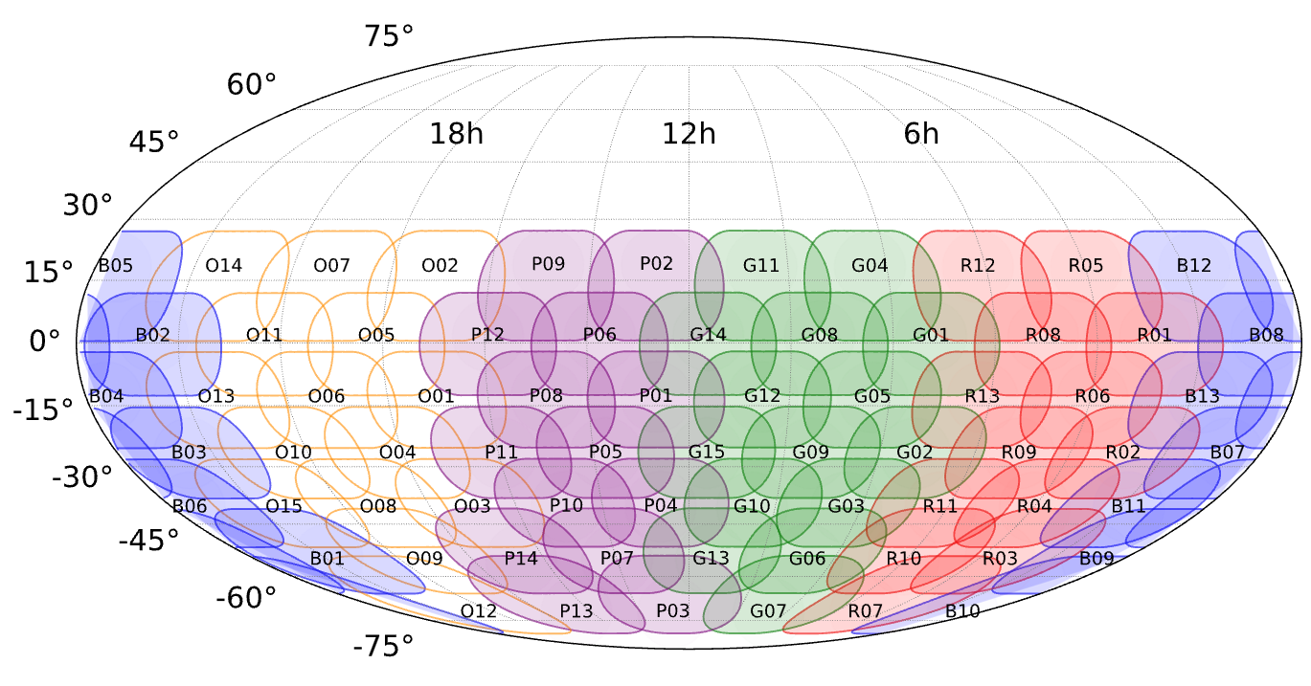
Background
Each observation is processed to generate ∼6000-8000 tied-array beams
Large Field of View (FoV) of MWA
MWA SMART Survey
(Dwell time 4800s)
80 min search data (no polarization)
=138GB for every point
Computational challenges from
massive data rates
Credit: Bhat N., et al., 2023
03/16
SMART Survey

Slide 5
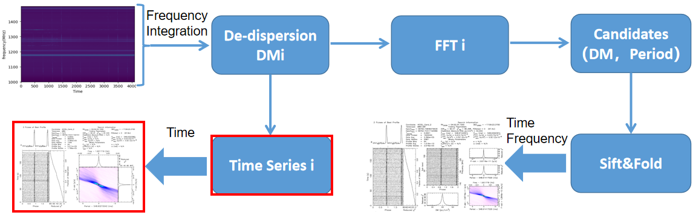
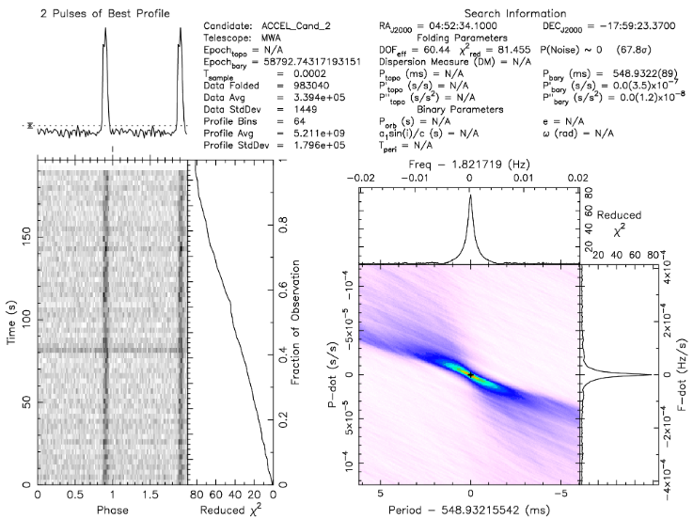
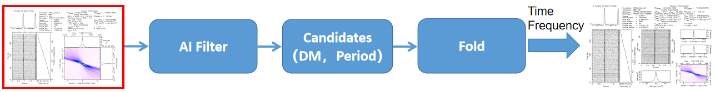
Method
a
b
c
d
Fold on full data
Filtering "snapshot" candidates generated from folding time series data
a
Reducing the number of folding full data
b
Accelerating folding to reduce computational costs
Fold on time series data
Software: PRESTO
04/16
“snapshot candidates”

Slide 6
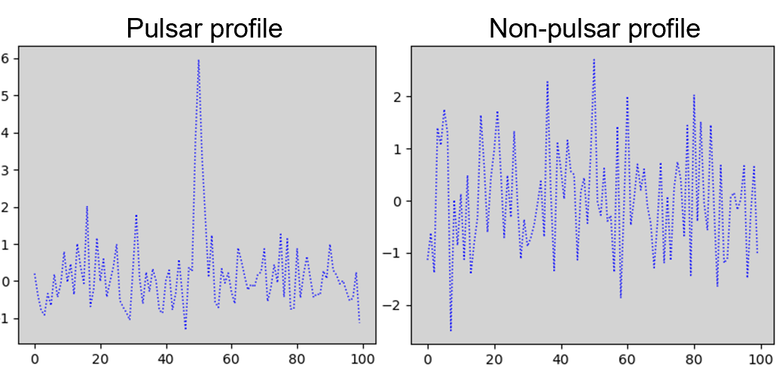
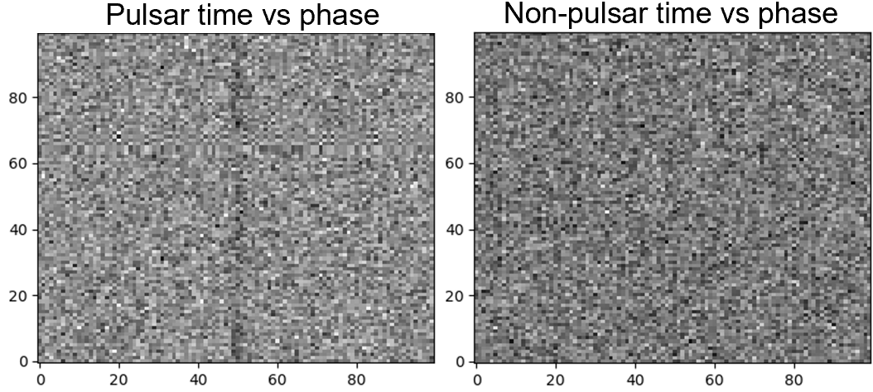
Method
a
a.profile -> 1-Dimension (nbin x 1)
nbin (prepold parameters):
The number of bins in the profile
(Defaults to the number of sampling bins which correspond to one folded period)
b
Different number bin
Different SNR
But
The neural network needs input data of the same size
b.time vs phase -> 2-Dimension (nbin x nbin)
.png
PRESTO
Search
Data
Candidates
.pfd file(information)
05/16

Slide 7
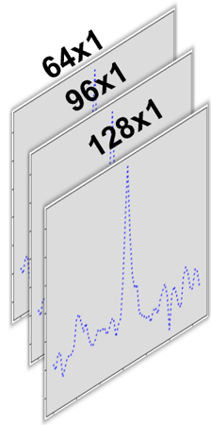
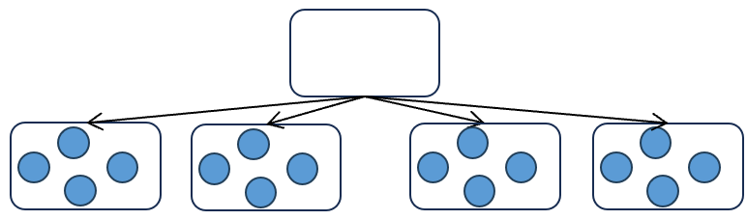
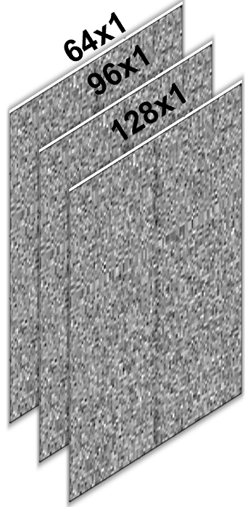
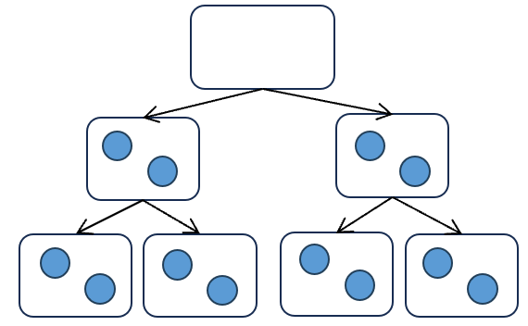
Data preprocessing
Wider or Deeper ？
Wider
Conv x 3
Deeper
Conv x 3
06/16

Slide 8
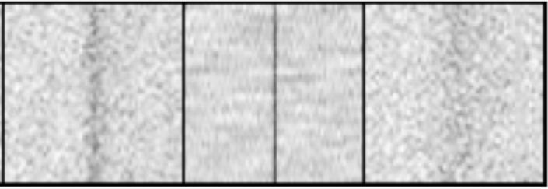
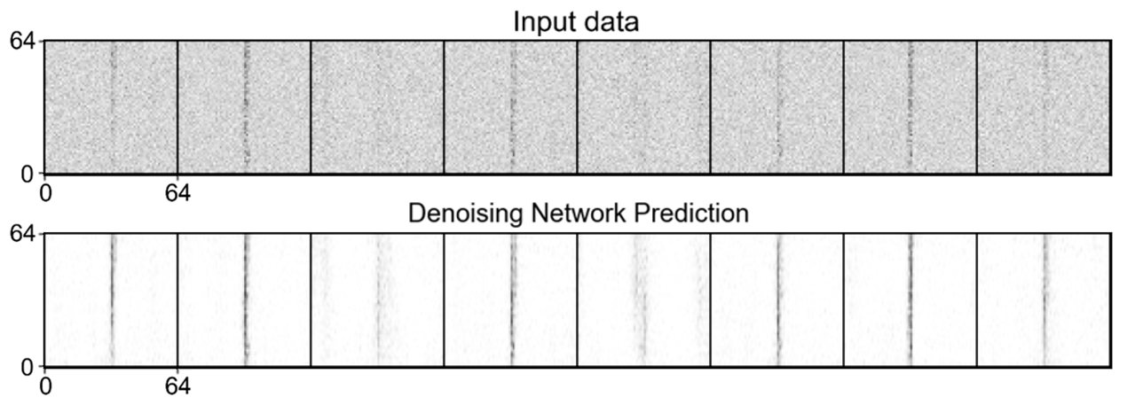
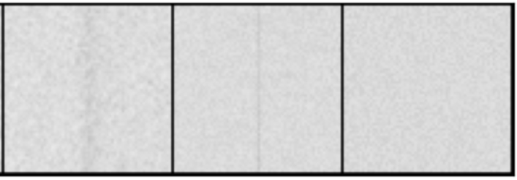
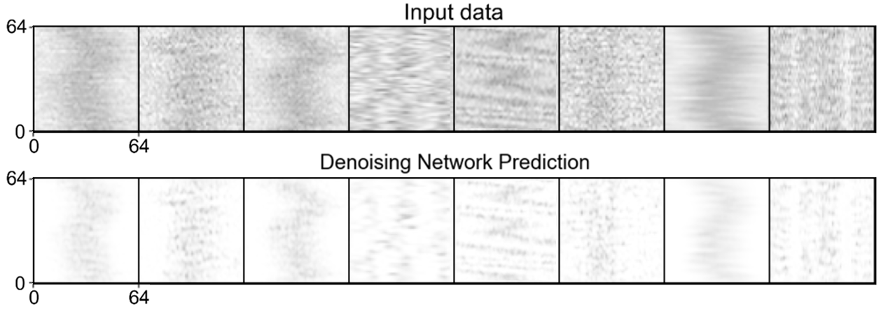
Data preprocessing
Denoising model for time vs phase features
Positive samples
x
Add noise
noisy_x
Negative samples
UNet
pred = UNet (noisy_x)
Minimize the loss_fn(pred, x)
07/16

Slide 9
Data preprocessing
Denoising model for time vs phase features
Positive samples
1-D data
pfd file
resize x3
2-D data
Diffusion Model
Denoised 2-D data
2-D data
Negative samples
1-D data
Denoised 2-D data
Feature Extraction
07/16

Slide 10
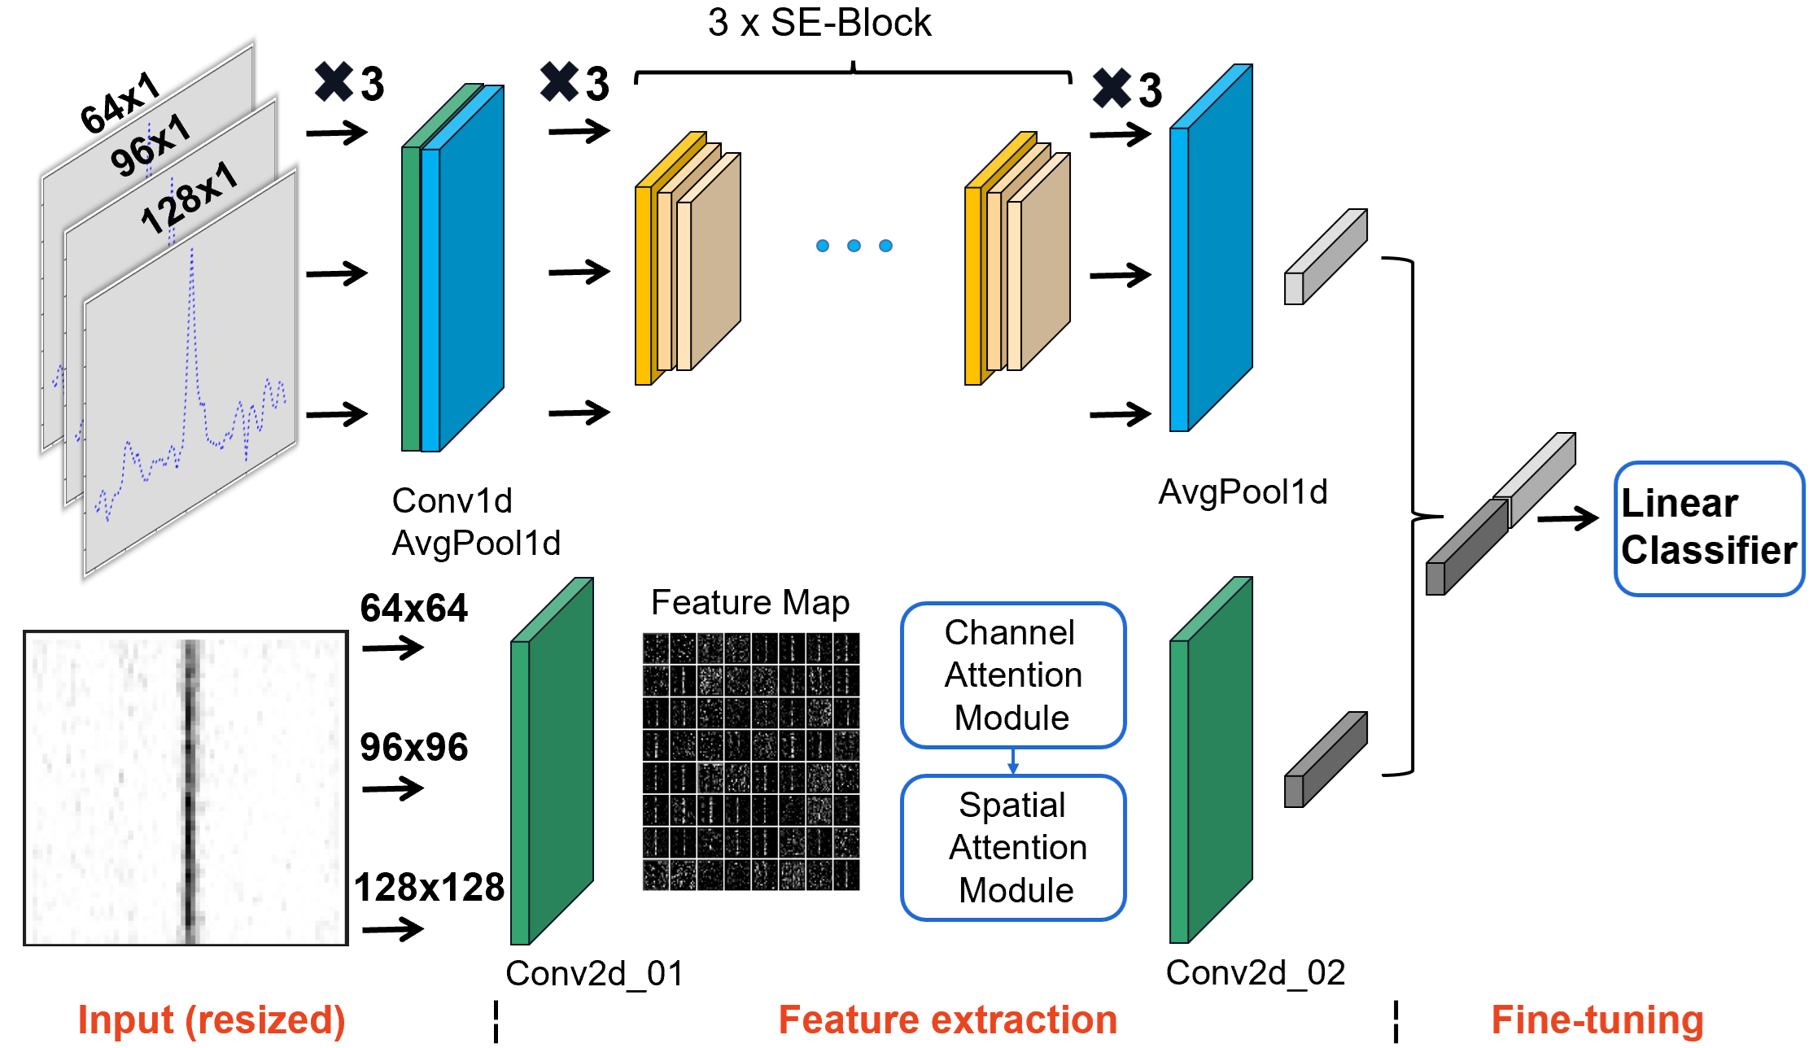
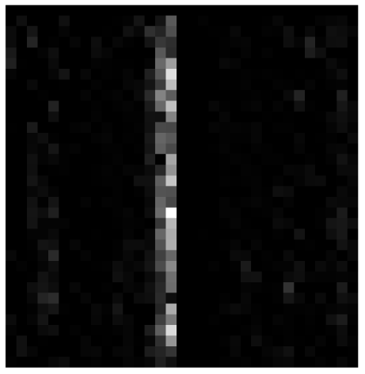
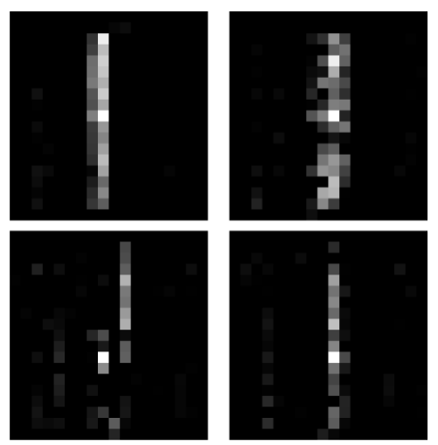
Model Architecture
(1-D data): SE-ResNet10_1D
for profile
(2-D data): CNN_Attention
for time-phase
Attention
Where?
Which?
MULTI
08/16

Slide 11
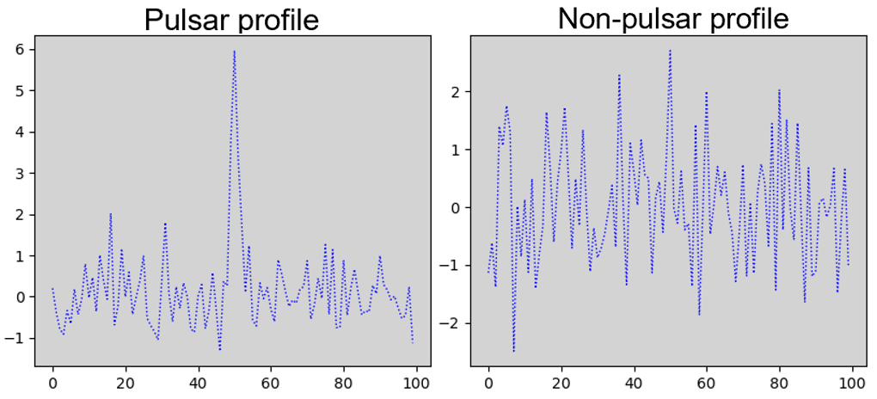
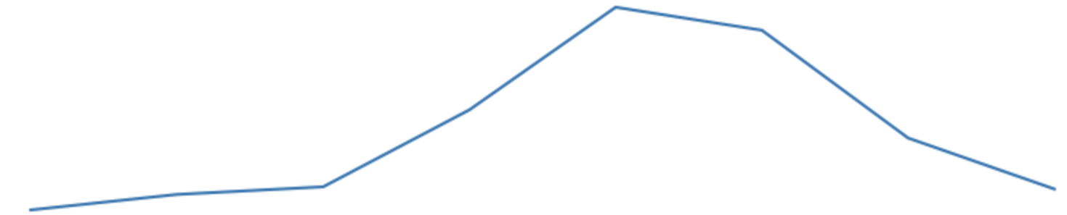
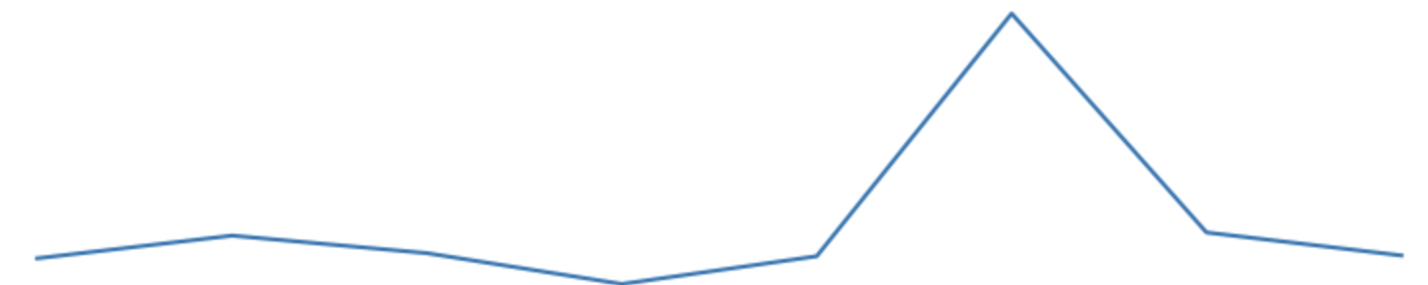
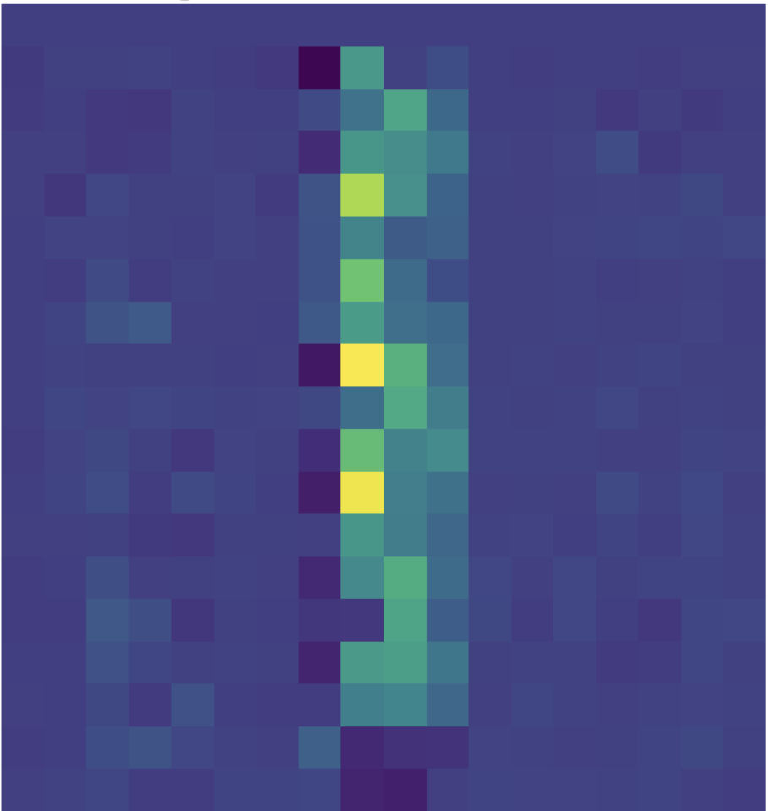
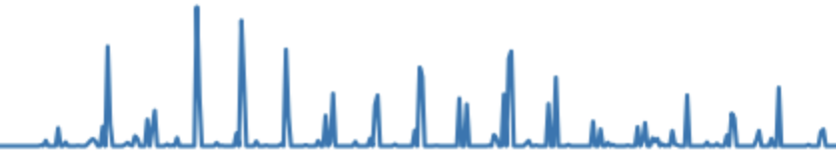
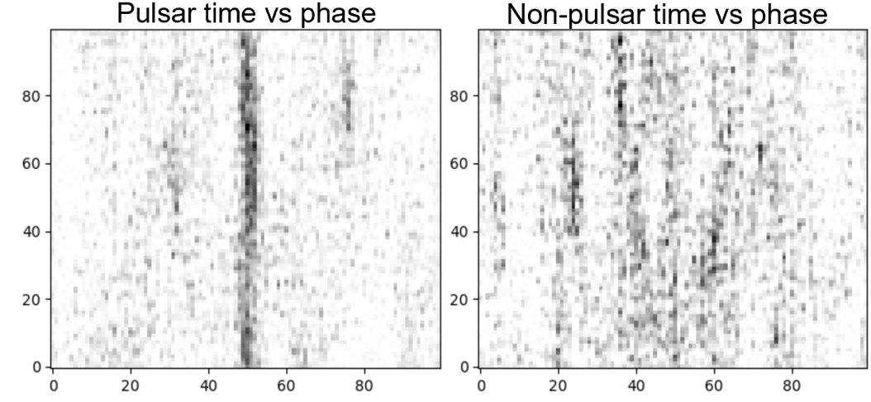
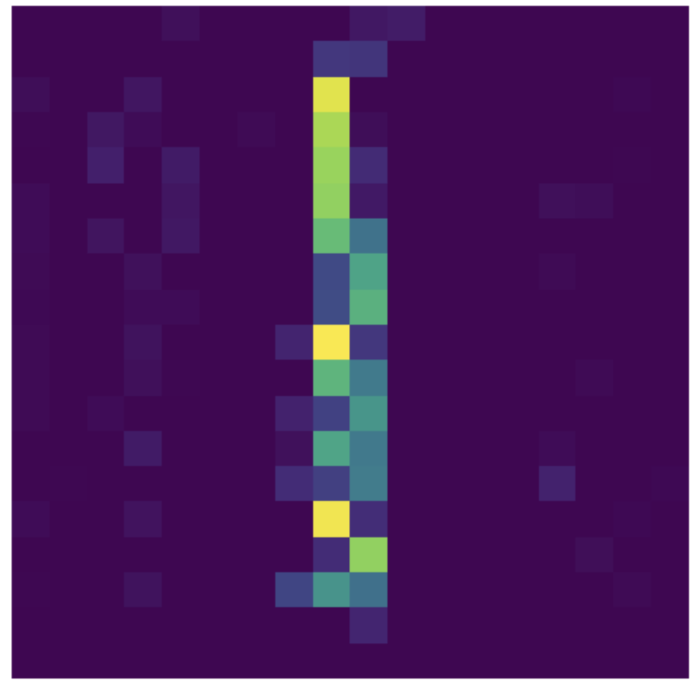
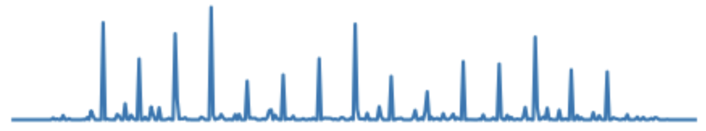
Fine-tuning
Feature extraction
Fine-tuning
x Channel Dimension
W₁
x₁
a₁
W_{ALL}
W₁
x_{n}
W₂
True
W_{m-1}
False
x_{n+1}
x Channel Dimension
W_{m}
a_{k}
x_{2n}
W_{j}
Linear Classifier
09/16

Slide 12
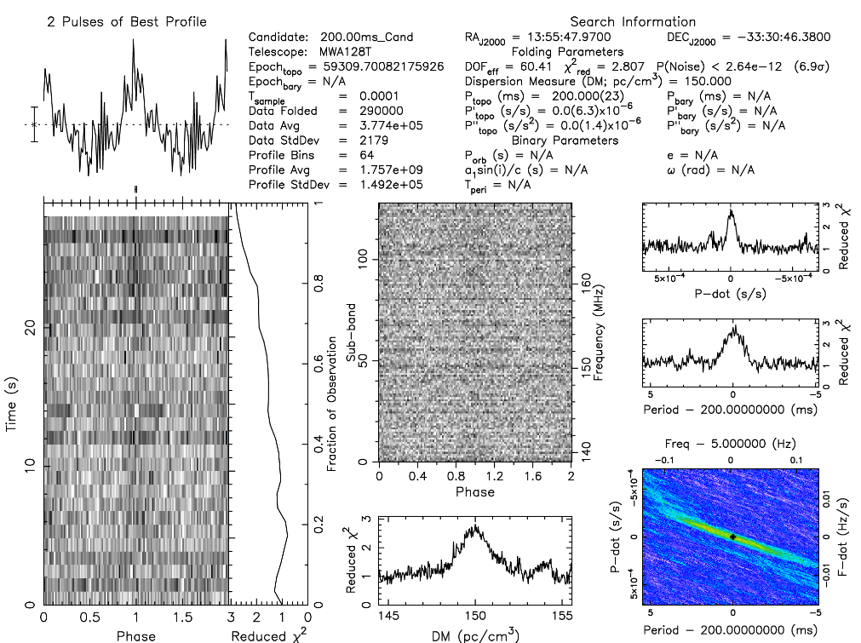
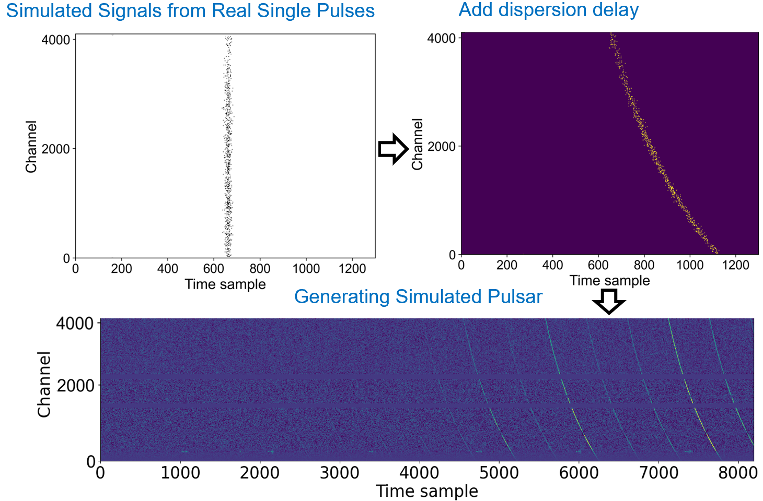
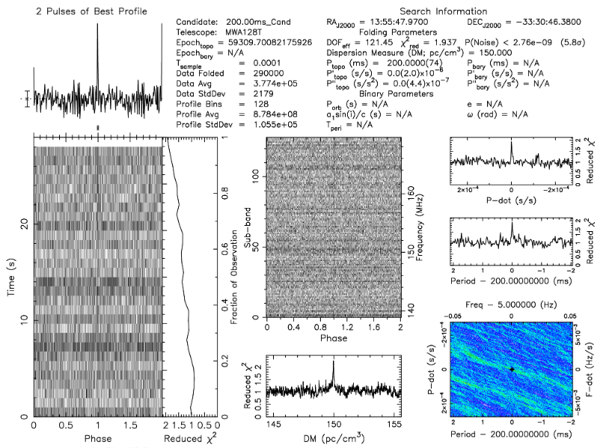
Simulation
Pulsar Simulation Program
Example:
Injecting periodic simulated signals into observational data
10/16

Slide 13
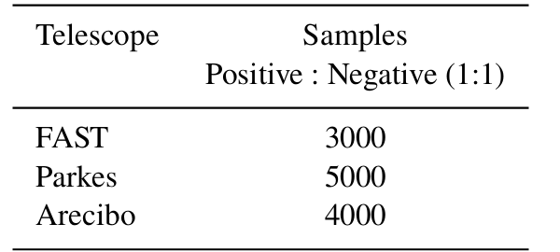
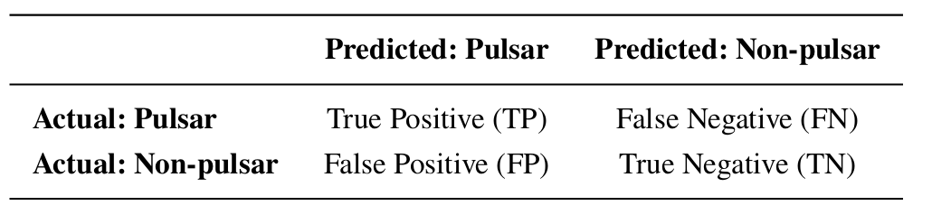
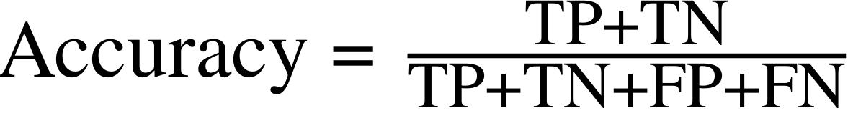
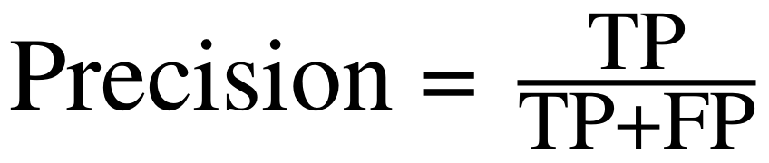
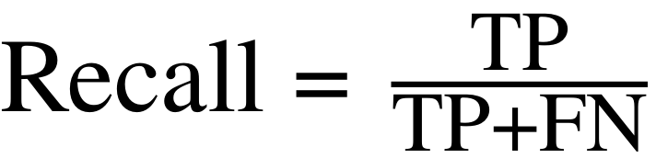
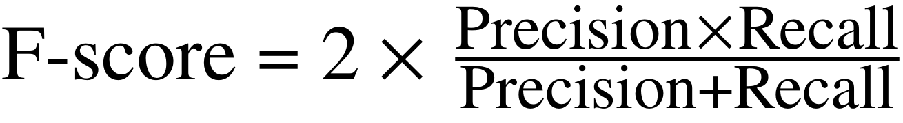
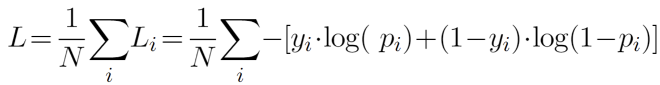
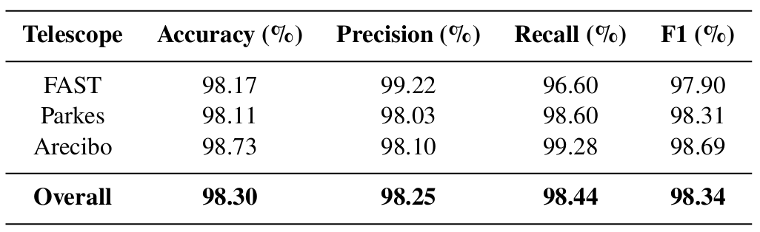

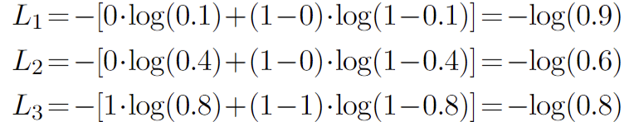

Performance (Classification)
Confusion matrix
Training (75%) and validation (25%) subsets of the datasets (12,000 samples) from FAST/Arecibo/Parkes.
Pulsars : 1
Non-pulsars : 0
Minimize the
Cross Entropy Loss Function (L)
Validation set (3000 samples)
denotes the label of sample
is the predicted probability of sample being positive
Assume
11/16

Slide 14
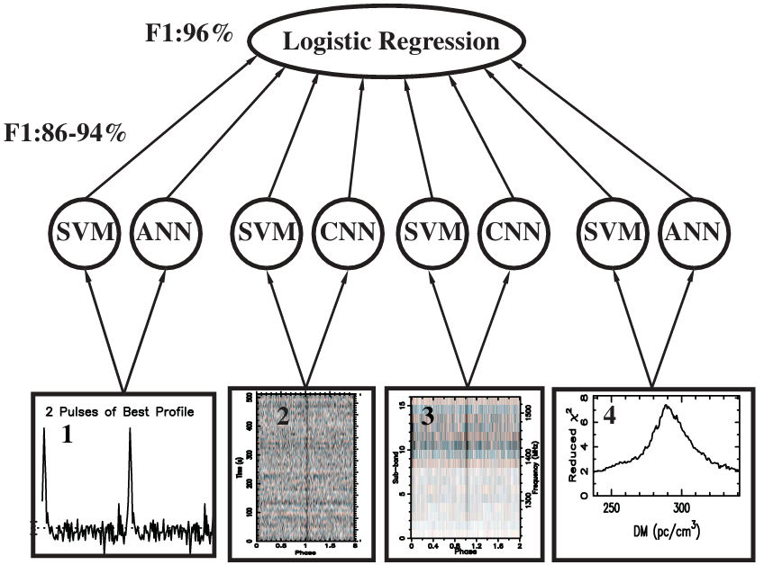
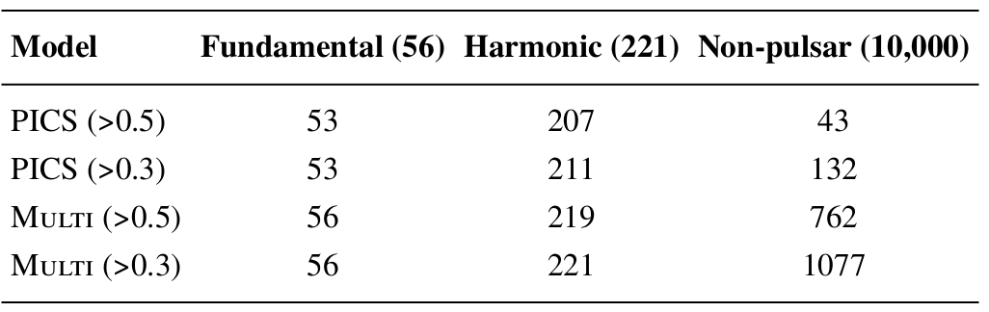
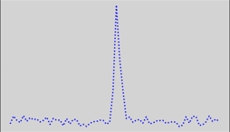

Performance (Classification)
GBNCC results
ANN: profile
CNN: time vs phase
Time-domain score:
(ANN + CNN) / 2
PICS Architecture
Credit: Zhu W. W., et al., 2014
The PICS AI considers both time and frequency features, while MULTI focuses only on time-domain features.
Fundamental
Harmonic
phase
phase
MULTI Architecture
12/16

Slide 15

Performance (Classification)
GBNCC results
ANN: profile
CNN: time vs phase
Time-domain score:
(ANN + CNN) / 2
PICS Architecture
Credit: Zhu W. W., et al., 2014
narrow-band RFIs
MULTI Architecture
12/16

Slide 16



Performance (Classification)
Fine-tuning dataset:
- 200 real pulsars (SMART survey)
- 500 non-pulsars (SMART survey)
- 300 simulated pulsars (based on MWA data)
→ Total: 1,000 samples (1 : 1)
SMART results (4000 positives; 6000 negatives)
4,000 positives from 86 known pulsars
via MWA's strong sidelobes
Finetuned MULTI
Both models use time-domain features for classification.
The numbers indicate the counts of correctly classified positive samples and misclassified negative samples.
Excellent radio environment of MWA
Minimal RFI
13/16

Slide 17

Performance (Fold Acceleration ratio)
The time required to fold the de-dispersed time series data (T₀) is much shorter than the time required to fold the full data (T₁).
N₀ is the number of candidates generated by PRESTO
N₁ is the number of candidates that require folding after AI model filtering
DATA: FAST M5 (NGC 5904) includes seven known pulsars
~ 30 mins = 545GB
T0 : 1h10min35s
Time series data ：
545GB/4096/4=34MB
T1 : 6.45s
Restricted parameter space
(DM range from 29.31 to 30.05 pc cm−3)
29.05 to 30.25 pc cm⁻³ in steps of 0.15 pc cm⁻³
-zmax 500 and -wmax 500
Search Parameters
ACCEL_sift.py (remove candidates)
The remaining 1,006 candidates include five known pulsars.
0.5 Threshold → 113 candidates (including five known pulsars )
Acceleration ratio: 113 / 1006
By using AI, the parameters requiring folding were reduced by a factor of 10, resulting in a tenfold acceleration of the folding process.
14/16

Slide 18
Performance (Fold Acceleration ratio)
Large-scale parameter space
G13 (Obs. ID 1267459328)
(including 43 detectable known pulsars)
Search Parameters
DM range of 0-500 pc cm⁻³ with a total of 6,624 trials
"-zmax 100,-numharm 16 and-sigma 2.0"
ACCEL_sift.py (remove candidates)
Beamformed data of 43 known pulsars:
25,691 potential DM-period combinations
0.5 Threshold → 436 candidates for further folding with the full data
(including the fundamental candidates of all 43 known pulsars,
as well as some harmonic candidates)
Acceleration ratio: 436 / 25,691 = 1.69 %
SMART Survey
≈ 60× faster
Blind search of 960 pointings:
569,869 potential DM-period combinations
0.5 Threshold → 6,478 candidates for further folding with the full data
Acceleration ratio: 6,478 / 569,869 = 1.14 %
15/16

Slide 19
SUMMARY
AI-Accelerated Pulsar Search for next-gen pulsar surveys
MWA-SMART Survey: large FoV → faster surveys
Challenge: Longer observations → larger data → folding step dominates
Key Innovations:
Pre-fold snapshot candidates → Folding step efficiency ×60 on SMART-scale parameter space
Simulation and Fine-tuning → Addresses sample scarcity and fine-tunes the model for new telescopes
Hybrid network → Robust and generalizable across telescopes and input sizes, >98.44% recall, >98% accuracy
The methodology establishes a reliable path-way for deploying an AI model in pulsar surveys of next-generation telescopes such as the SKA.
16/16

Slide 20
Thanks
This paper has been submitted to MNRAS.
Code: https://github.com/ifuqy/Multi
Email: fuqy@bao.ac.cn

